Slide 1


Hospitality Performance Analysis – Power BI Dashboard
A data-driven approach to optimizing hotel operations and revenue

Slide 2
Project Objective
Build an interactive Power BI dashboard for hospitality domain
Enable stakeholders to monitor key metrics: Occupancy, ADR, RevPAR, Realization
Visualize booking behavior, revenue trends, and guest flow

Slide 3
Data Used
Dim_Date
Dim_Hotels
Dim_Rooms
Fact_Aggregated_Bookings
Fact_Bookings

Slide 4
Dashboard Views
• Executive View: Key metrics and summary KPIs
• Booking Analysis: Trends by channel and lead time
• Revenue Analysis: ADR, RevPAR, Realization insights

Slide 5
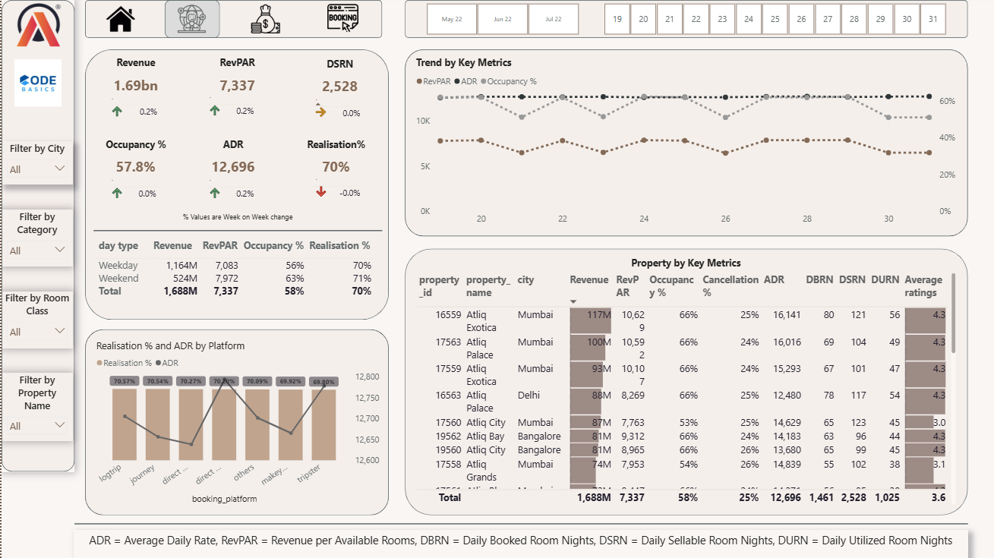
Executive View

Slide 6
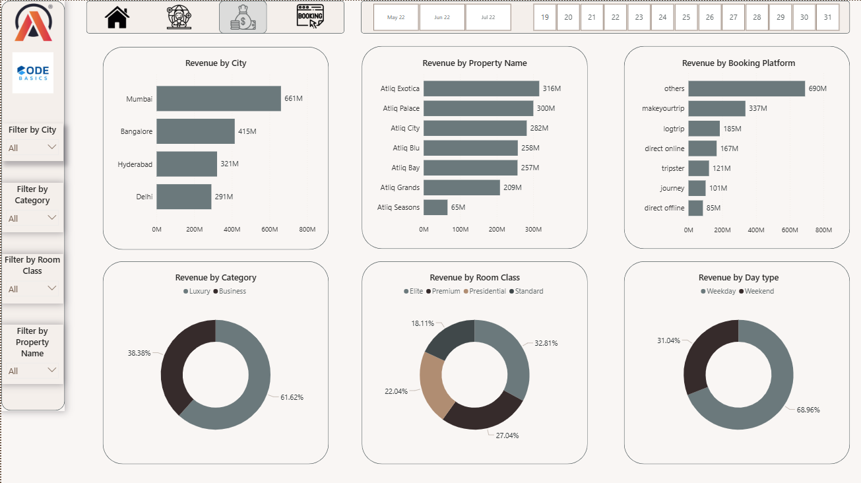
Revenue Analysis

Slide 7
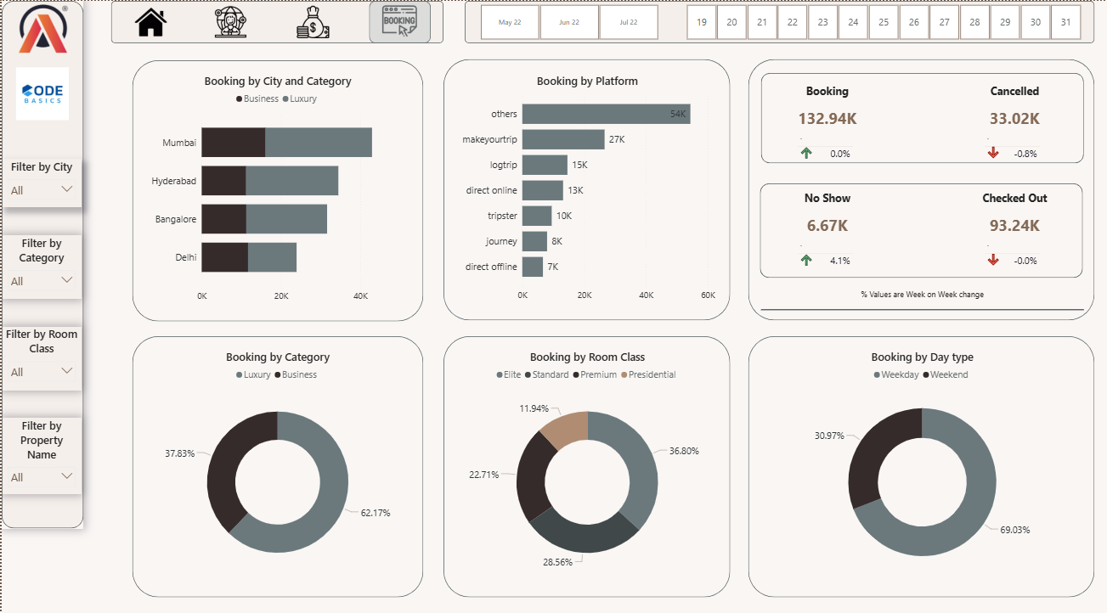
Booking Analysis

Slide 8
Key Business Insights
🛏️ Avg Occupancy Rate: 58%
💰 Revenue Realization: 70% — affected by 25% cancellation, 5% no-shows
📈 ADR – Nearly 13000 & RevPAR – 7500
📉 On weekends bookings are less compared to weekdays

Slide 9
Tools & Techniques
Power BI (DAX, tooltips, KPI cards)
Data Cleaning & Modeling
Custom Visuals & Conditional Formatting
Report Page Tooltips & Filters

Slide 10
📚 What I Learned
Translating business needs into BI visuals
Creating executive-level summaries
Using DAX for dynamic KPIs and tooltips
Designing intuitive navigation & user experience

Slide 11
🌐 Let’s Connect
Open to feedback, collaboration, and data analytics opportunities
🔗 LinkedIn: linkedin profile
🔗 GitHub: github profile

