Slide 1
Introduction to API’s
HackHERS, Spring 2016
Rutgers University

Slide 2
What is an API?
Application Programming Interface

Slide 3
Why API’s?
Hackathon Idea: An app that takes in two zip codes from a user, returns a list of restaurants between those zip codes.
Input: Two zip codes, user inputs.
Output: A list of restaurants near the midpoint.
Question: How can we find a midpoint? How can we find restaurants near that midpoint?

Slide 4
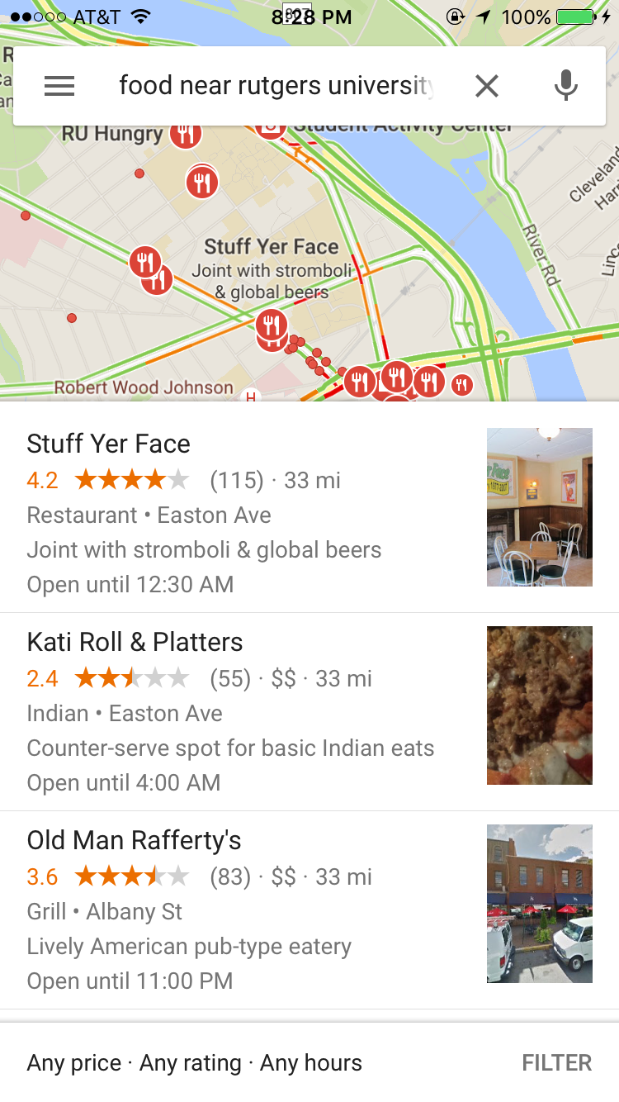
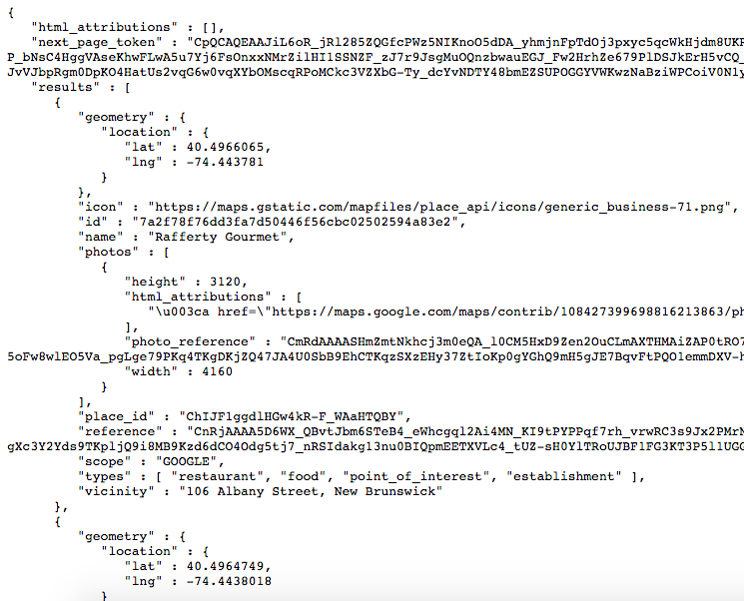
Google Developers
https://goo.gl/1FiD6A

Slide 5
REST API
RESTful or Representative State Transfer
Requests over HTTP/HTTPS
Responses are in JSON
JavaScript Object Notation

Slide 6
REST API Demo
Language-specific examples
PHP App

Slide 7
SDK’s
Software Development Kit
An SDK is an API, an API is not always an SDK!
Examples:
UIKit for iOS
Twilio and Clarifai for Python

Slide 8
Twilio
Text anything you’d (keep it clean!) like to:
+1 (973) 321-4779

Slide 9



/jayrav13

