Slide 1
Boundary Trees

Slide 2
How?
Features, as you all know, are the attributes of an input, or example. With the MNIST data set, each example is composed of 784 pixels, each one of which are considered the features.
The Boundary Tree is trained by querying the existing tree using the example as an input, looking for the closest node (using a Euclidean distance as the distance function). When it finds the closest node, if the example is not the same as the closest node, it will add a new node to the tree containing the example.
Testing the Boundary Tree involves simply querying the existing tree using an example from the test set. The Boundary Tree determines the class of the example by the class associated with the closest node.

Slide 3
Observations (MNIST)
In testing the Boundary Trees with the MNIST data set, we noticed a few things.
Changing the maximum branching factor, k, played a large role in both accuracy as well as the speed of training and querying. As the branching factor grows, it takes longer to train and query, although the accuracy is higher, so it may be worth it depending on the use case.
While accuracy and testing time plateaued, the time it took to train grew linearly with more examples.

Slide 4
Observations (MNIST)
Setting the branching factor to 5-10 seemed to be the best if both time and accuracy is a concern, as anything less than 5 will result in lower accuracy while taking about the same amount of time to train and test.
With larger branching factors, the training time varies by quite a bit, ranging from 140.47 seconds to 223.79 seconds, whereas tests ran with a lower branching factor resulted in fairly consistent training times.
k | Training Time (s) | Testing Time (s) | Accuracy (%)
2 | 75.96443768 | 14.89228232 | 79.248
3 | 76.26015964 | 14.11042054 | 82.253
5 | 72.54322867 | 14.19308667 | 84.988
10 | 93.82171679 | 18.15971713 | 87.397
20 | 128.2968537 | 25.59608793 | 88.211
50 | 165.1073234 | 34.94613609 | 88.036
100 | 164.9357249 | 35.71075509 | 87.952
infinity | 167.4871073 | 36.10234139 | 87.952

Slide 5
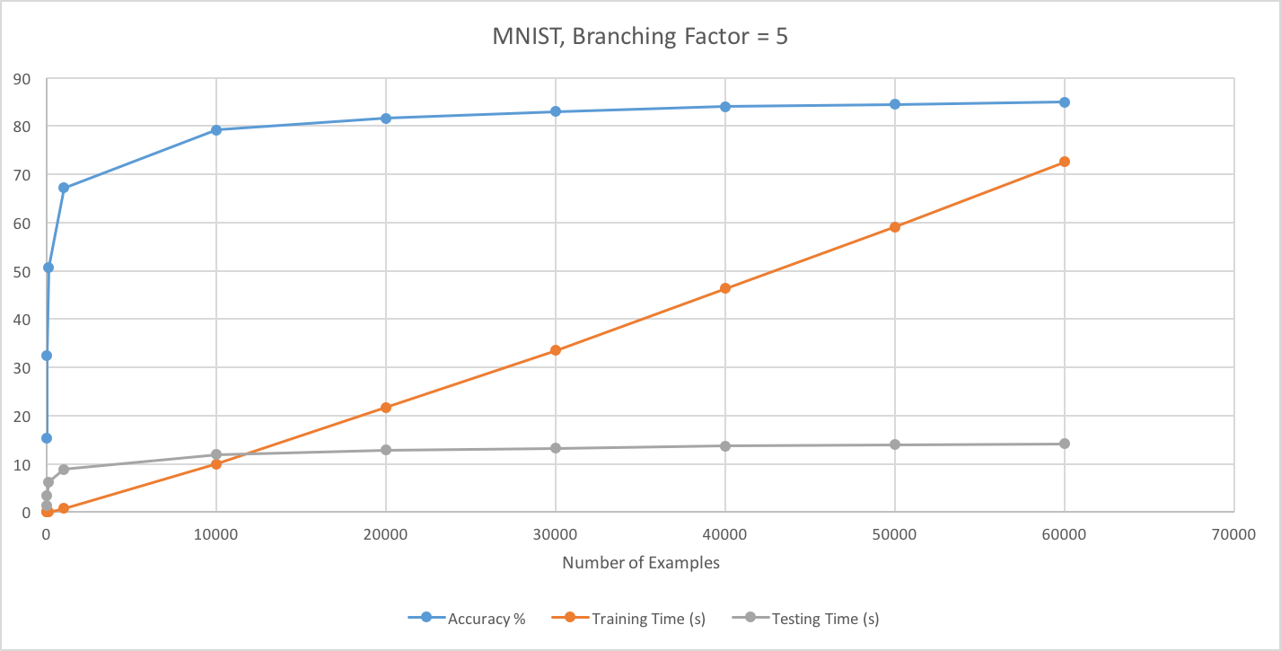
Observations (MNIST)

Slide 6
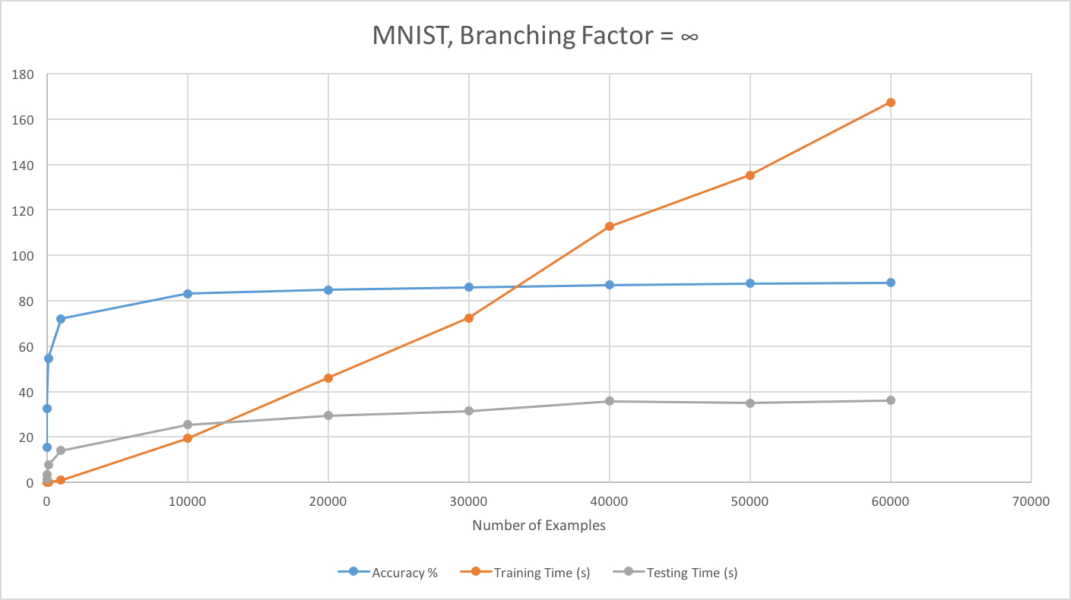
Observations (MNIST)

Slide 7
Observations (CIFAR10)
We saw similar results with the CIFAR10 dataset, although accuracy was never above 27.3% on average.

Slide 8
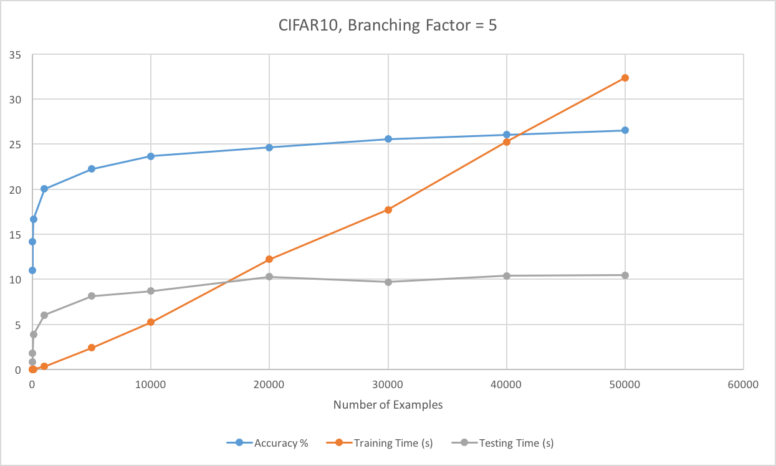
Observations (CIFAR10)

Slide 9
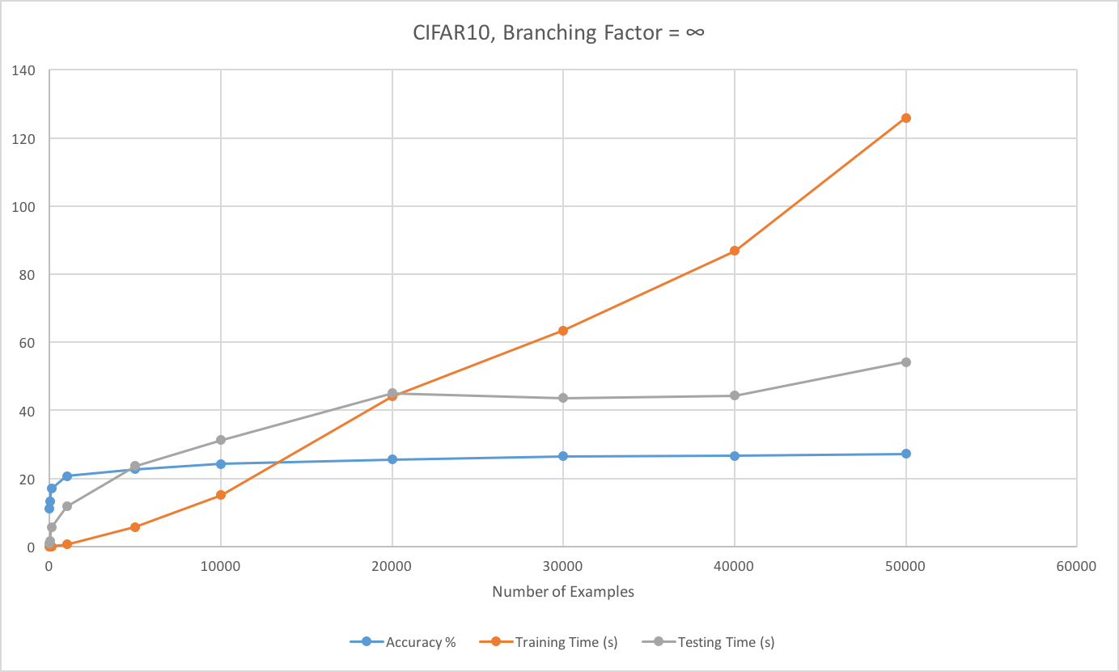
Observations (CIFAR10)

