Slide 1
Project Motivation
The motivation for this project comes from trying to understand, implement, and test datasets on a machine learning technique presented in the paper “Learning Deep Nearest Neighbor Representations Using Differentiable Boundary Trees” (Zoran et. al.), which builds upon work presented in “The Boundary Forest Algorithm for Online Supervised and Unsupervised Learning”. (Derbinsky, et. al.)
To understand Differentiable Boundary Trees, we first have to understand Boundary Trees themselves.

Slide 2
Boundary Trees

Slide 3
Introduction
Features are the individual attributes that make up a single example, or instance.
The goal is to learn from a training set, and then be able to classify each example correctly from the testing set into different classes.
With the MNIST dataset, there are 10 classes: each digit from 0-9.
With the CIFAR10 dataset, there are also 10 classes: airplane, automobile, bird, cat, deer, dog, frog, horse, ship, and truck.

Slide 4
How?
To train the Boundary:
Query the existing tree using the examples from the training set as an input, looking for the closest node (using a Euclidean distance as the distance function).
When it finds the closest node, if the example is not the same as the closest node, it will add a new node to the tree containing the example, along with its classification.
To test the Boundary Tree:
Query the existing tree using examples from the test set. The Boundary Tree determines the class of the example by the class associated with the closest node.

Slide 5
Observations
In testing the Boundary Trees with the MNIST and CIFAR10 data set, we noticed a few things.
Changing the maximum branching factor, k, played a large role in both accuracy as well as the speed of training and querying.
While accuracy and testing time plateaued, the time it took to train grew linearly with more examples.
This implementation works far better with the MNIST dataset compared to the CIFAR10 dataset in terms of accuracy.

Slide 6
Observations (MNIST)
Generally, as the branching factor grows, it takes longer to train and query, although the accuracy is higher, so it may be worth it depending on the use case.
k | Training Time (s) | Testing Time (s) | Accuracy (%)
2 | 75.96443768 | 14.89228232 | 79.248
3 | 76.26015964 | 14.11042054 | 82.253
5 | 72.54322867 | 14.19308667 | 84.988
10 | 93.82171679 | 18.15971713 | 87.397
20 | 128.2968537 | 25.59608793 | 88.211
50 | 165.1073234 | 34.94613609 | 88.036
100 | 164.9357249 | 35.71075509 | 87.952
infinity | 167.4871073 | 36.10234139 | 87.952
MNIST Dataset, varying the branching factor, k, averaged over 10 runs each

Slide 7
Observations (MNIST)
Setting the branching factor to between 5 and 10 seemed to be the best if both time and accuracy is a concern
k < 5 will result in lower accuracy while taking about the same amount of time to train and test as k = 5
With larger branching factors, the training time varies by quite a bit
With k = infinity, times ranged from 140 seconds to 223 seconds
With k = 5, times ranged from 70 seconds to 76 seconds.
Notes:
140.47 seconds to 223.79 seconds
70.31 seconds to 76.09 seconds.

Slide 8
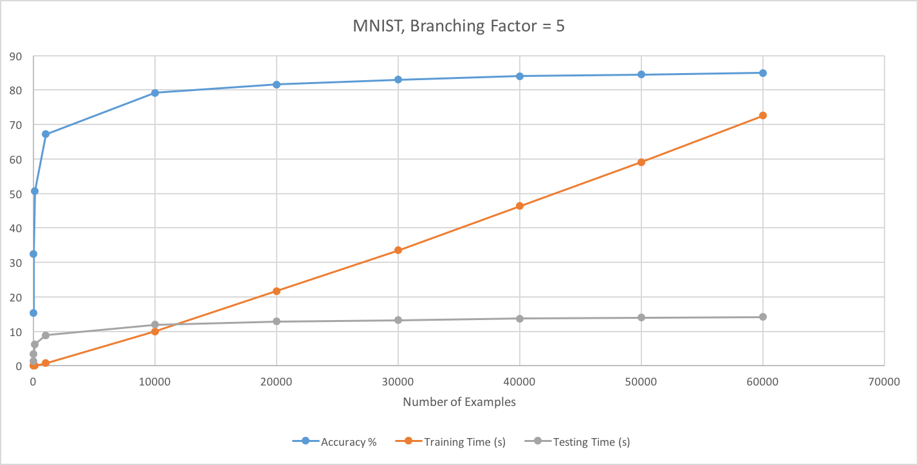
Observations (MNIST)
While accuracy and testing time plateaued, the time it took to train grew linearly with more examples.

Slide 9
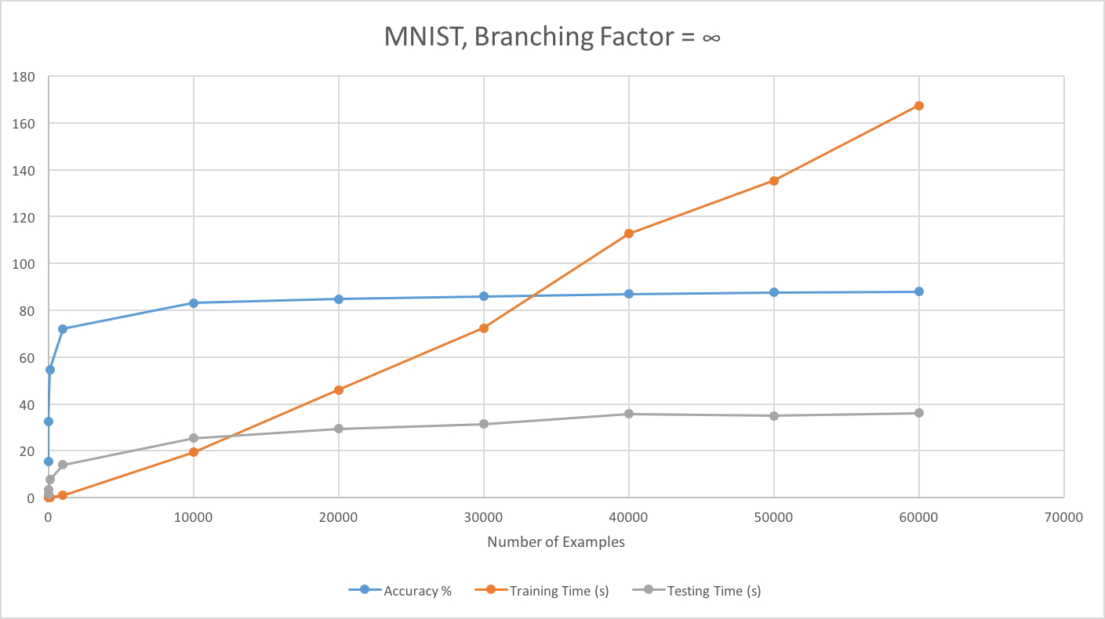
Observations (MNIST)
While accuracy and testing time plateaued, the time it took to train grew linearly with more examples.

Slide 10
Observations (CIFAR10)
We saw similar results with the CIFAR10 dataset, although accuracy was never above 27.7% on average.
k | Training Time (s) | Testing Time (s) | Accuracy (%)
2 | 31.6216013 | 10.17820182 | 23.928
3 | 28.85782518 | 9.416226149 | 25.422
5 | 32.36283786 | 10.46060543 | 26.509
10 | 36.72829039 | 12.98402145 | 27.169
20 | 51.99976389 | 18.62228603 | 27.708
50 | 79.45825586 | 29.97079742 | 27.453
100 | 98.72666419 | 38.09738462 | 27.629
infinity | 125.9124599 | 54.22032864 | 27.283

Slide 11
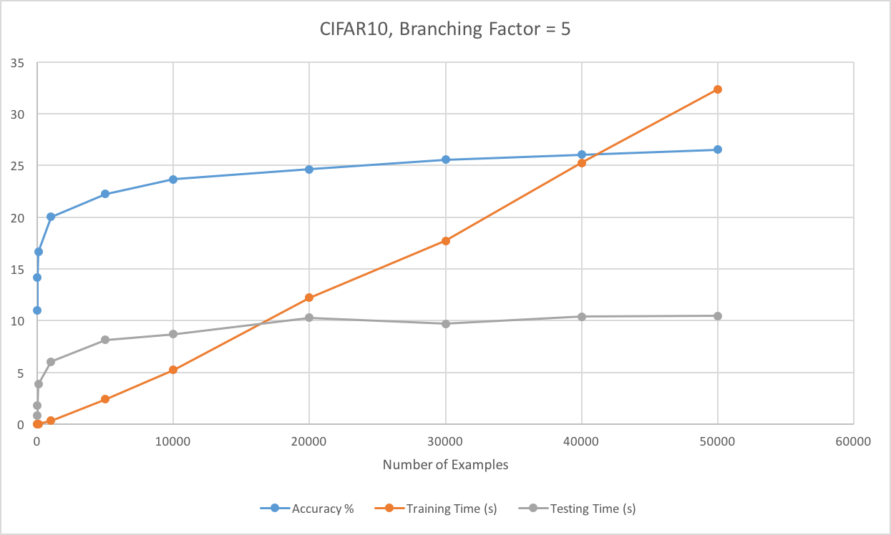
Observations (CIFAR10)
Graphs are similar to the MNIST graphs, with the accuracy and testing time plateauing, and training time continuing to grow

Slide 12
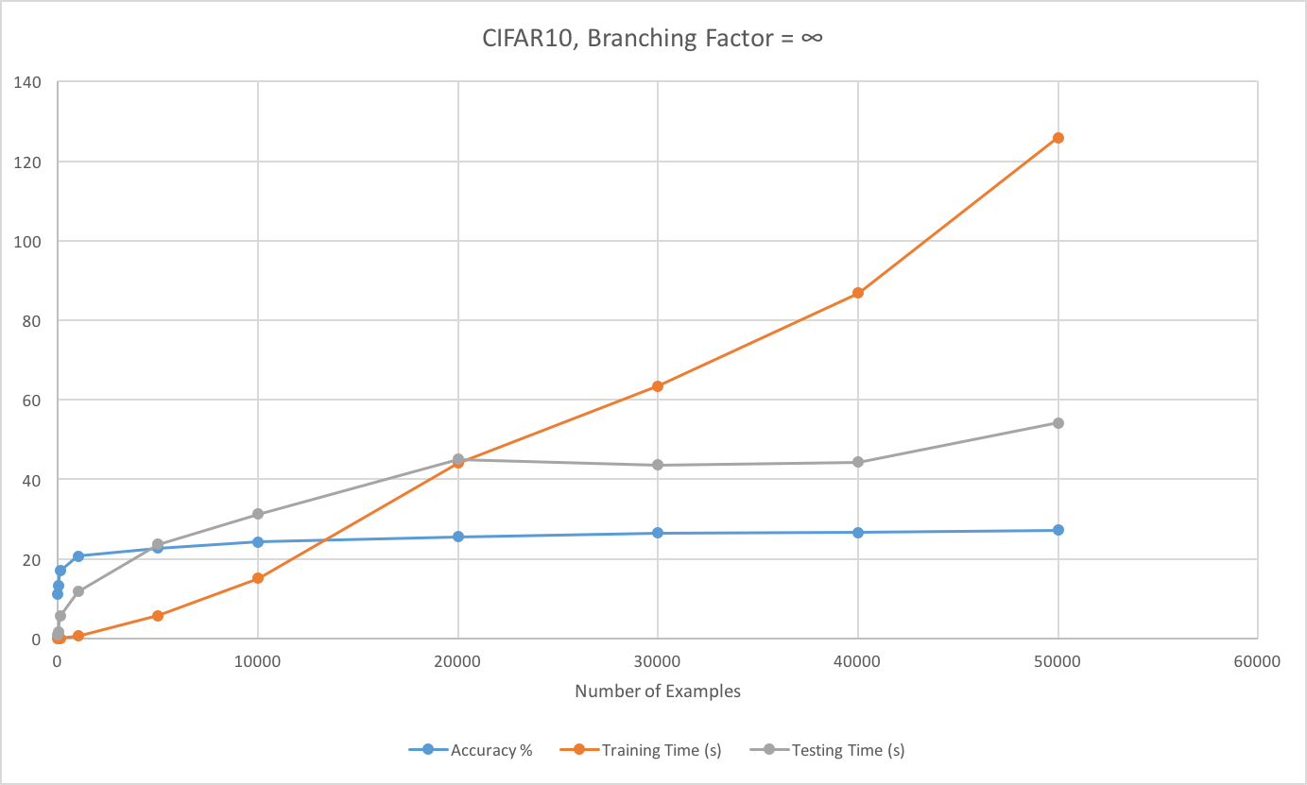
Observations (CIFAR10)

