Slide 1
Breastfeeding Promotion Through Home Visits
NYSPA 28th Annual Perinatal Conference
June 5-6, 2014
Albany, NY

Slide 2





Slide 3

Bernadette Johnson
Healthy Families New York Program Coordinator
Office of Children and Family Services
Sandra McGinnis, Ph.D.
Research Professor
Center for Human Services Research
Peggy Sheehan, BSN, IBCLC
Program Manager
Healthy Schenectady Families

Slide 4

Bernadette Johnson, Sandra McGinnis, and Peggy Sheehan have documented that they have no relevant financial relationships to disclose or COIs to resolve.
NYSPA Annual Meeting- Albany, NY

Slide 5
Agenda
Introduction to Healthy Families New York
  Bernadette Johnson, OCFS
Summary of breastfeeding literature
Research findings from HFNY evaluation
  Sandra McGinnis, CHSR
Practice Implications
  Peggy Sheehan, Healthy Schenectady Families

Slide 6

HEALTHY FAMILIES NEW YORK (HFNY)
Healthy Families New York (HFNY) is a voluntary home visiting program for expectant and new parents.
Families who participate are offered long-term in-home supportive services until the child is in school or Head Start.

Slide 7
HFNY GOALS
Promote positive parenting skills and parent-child bonding and interaction
Prevent child abuse and neglect
Promote optimal prenatal care and child health and development
Enhance family self-sufficiency

Slide 8

Measure Program’s Success on Family Outcome:
3 Domains
Health and Development
Parent Child Interaction
Family Life Course

Slide 9
HFNY: DISTINGUISHING COMPONENTS
Approach
  Long term services (prenatal through 5yrs)
  Reaches out to isolated families
  Strength-based
  Responsive to family and community values
  Limits duplication of services
Staff
  Specially trained paraprofessionals from the community
  Supervision provided by trained professionals & clinicians
  Staff represent the language and culture of families served
  Provide support, education, and linkages to community services

Slide 10
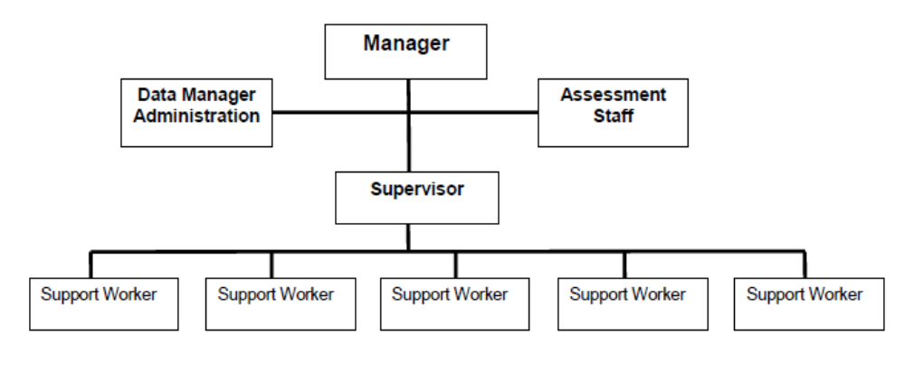
Staffing

Slide 11
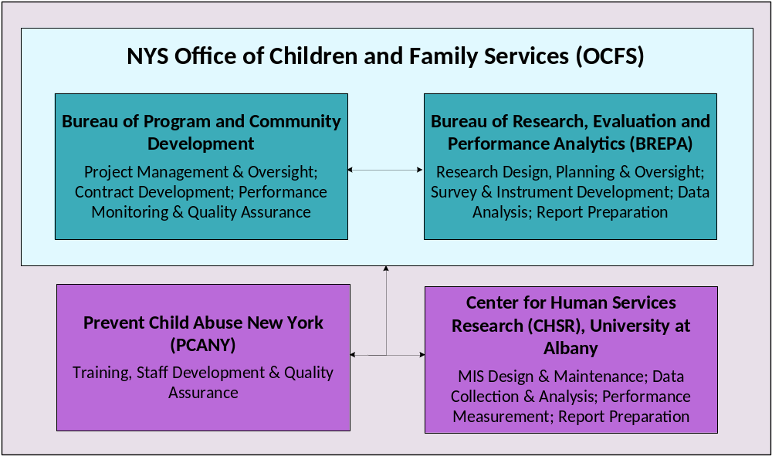

Slide 12
REFERRAL PROCESS
HFNY targets high need communities that have low birth weights, high teen pregnancy rates, and little or no prenatal care.
Families are referred to HFNY through community health and social service agencies and hospitals.
HFNY programs screen parents for risk factors, such as substance abuse, poor education and other stressors that may be predictive of child abuse and neglect.
Parents who screen positive are offered an assessment. The assessment provides the program with information, and leads to referrals to assist the family, and may include a referral to home visiting.

Slide 13
STRENGTH-BASED SERVICE DELIVERY
  Direct service staff are trained to become highly skilled in identifying what is going well with the family.
  Home visitors are trained to support the development of self-sufficiency by exploring competencies and resources with the participant rather than “rescuing” program participants.
  Home visitors and supervisors are trained to distinguish unacceptable situations from disagreeable ones and to use this as a model for service planning.
  Services for families are done from a basis of shared expertise: families are experts on their children, their own preferences, knowledge, culture and history; workers have expertise in child health and development and local services.

Slide 14
Evidence Based
HFA designated by HOMVEE & selected by HRSA
Designated by RAND as a Proven Program

Slide 15
Benefits of breastfeeding
Protects infants against:
  obesity -- diabetes
  SIDS -- asthma
  eczema -- colitis
Benefits mothers by:
  faster post-pregnancy weight loss
  reduced risk of some reproductive cancers
Longer duration of breastfeeding is associated with greater benefits.
Notes:
AAP recommends BF 1 year
Nationally, 76.5% of newborns are ever BF; 49.0% are BF 6 months
Lower rates among lower educ, lower income, younger, African-American
Higher rates among Hispanic and immigrants

Slide 16
Breastfeeding Study Sample
Study sample:
  1,490 families receiving services through HFNY who:
    had their first prenatal home visit in 2010 or 2011
    had 6-month follow-up data
Notes:
Limited to prenatal intake because initiation of BF starts immediately at birth
Limited to 6 mo FU because using 6 mo indicator
Note that women least likely to BF based on demographics may also be least likely to be in the program from pregnancy to 6 mo – a potential limitation of the analysis

Slide 17
Sample Characteristics
39% non-Hispanic white; 25% non-Hispanic black, 31% Latina
57% high school graduates
16% under 18
29% live in New York City; 52% in other metropolitan areas; 19% in non-metro areas
Average Kempe score = 39 (25 or higher is considered “high risk”)
Notes:
Characteristics are at intake
Kempe IDs “high risk” for child maltreatment or neglect

Slide 18
Outcome Variables
  Breastfeeding initiation
    Did mothers ever breastfeed the target child (exclusively or with other feeding)?
  Breastfeeding continuation
    For the cases where breastfeeding was initiated:
      Did breastfeeding continue for at least the first 6 months of the child’s life?

Slide 19
Outcome variables
1,033 mothers (69.3%) initiated breastfeeding
Of these, 439 mothers (29% of the total sample) breastfed for at least 6 months
Notes:
42% of BFrs continue

Slide 20
Home visiting variables
Home visiting intensity
  Average 6.7 prenatal visits/29.3 visits to nursing mothers
Breastfeeding discussions
  Occur on average in 35% of prenatal home visits and 22.8% of home visits to nursing mothers
Breastfeeding support referrals
  Made to 10.7% of pregnant women/6.8% of nursing mothers
Notes:
Taken from HV log
Of the subsample who initiated BF at birth, they averaged 29.3 visits in 6 months post-partum
Discussions measured as a percentage of visits, taken from a checklist of home visiting activities (“Provide BF information and support”)
Referrals were measured yes/no (although it was possible to have more than 1 referral either pre- or post-partum we were only interested in if they had any)
Referrals were typically to WIC, LLL, or community network
Postnatal referrals probably made to women who were having difficulty anyway

Slide 21
Control variables
Demographics
  Race/ethnicity
  Maternal age
  Maternal education
  Geographic location
    New York City, upstate metropolitan area, upstate non-metropolitan area
Other biological parent in home at intake
Maternal Kempe score
Notes:
Control means to statistically hold constant, allows us to ask “If all these factors were equal, what would effects of intervention be on outcomes?” – isolates the effect
Race – NH white-NH black-Hispanic-Other/Multiracial
Maternal age – under 18 (yes/no)
Maternal education – HS grad (yes/no)

Slide 22
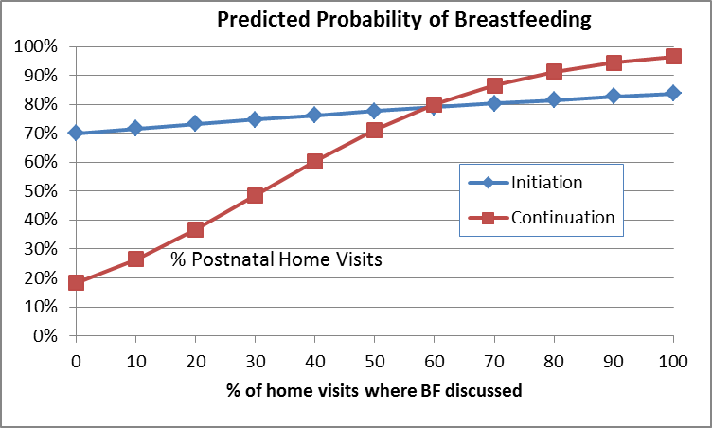
Results: Breastfeeding Discussions
% Prenatal Home Visits
% Prenatal Home Visits
Notes:
# of prenatal visits had no effect on BF initiation when controlling for the content of those visits
The likelihood that a nursing mom would continue to 6 mo increased by 2.5% for each postnatal visit she had
Would expect initiation to be right around 70% in absence of any discussions, 50% discussions = 78%, 100% discussions = 84%
In absence of postnatal discussions, continuation to 6 mo would be only about 18%; 50% discussions = 71%; 100% discussions = 96%
In practice this wouldn’t happen because this is holding constant for other characteristics that influence BF
(for an adult NH white woman living in NYC who never finished HS and did not have the baby’s father living in the home, and who had average Kempe scores for the sample and average # of home visits)

Slide 23
Results: Breastfeeding Referrals
A prenatal referral for breastfeeding support is related to an 88% increase in the probability that a client will initiate breastfeeding at birth (p<.000)
Postnatal referrals for breastfeeding support are not related to the probability that a client will continue breastfeeding for at least 6 months
Notes:
Again, the postnatal lack of finding may be because women who receive referrals are disproportionately ready to drop BF
Referrals seems to have the biggest impact on initiation
# of visits and percent of visits where BF discussed are key to continuation among those who already initiated
*None of these program effects varied between different groups; these practices were equally effective in promoting BF for women regardless of race, education, etc.

Slide 24
Study Limitations
Study sample includes only those families who began the program prenatally and who remained in the program until the child was at least 6 months old
The highest-risk families served by the program are less likely to begin prenatally and less likely to be retained until the child is 6 months, so this is a select sample
Notes:
Obviously selection factors are at play
Next Steps:
What predicts discussions and referrals?
Does type of referral make a difference?
Does referrals follow-through make a difference?

Slide 25

Healthy Schenectady Families
Schenectady County Public Health Services
Established 1998
Serves county residents: prenatal or newly parenting
Capacity: 120 families

Slide 26
Family Support Workers
College degree
Breastfeeding Experience:
Personal/observational
Attitude exploration
Breastfeeding Training:
  Basic: within first month of hire
  Ongoing: Quarterly “BF Roundtables”
  Certified Lactation Counselor
    www.healthychildren.cc

Slide 27

Parent Child Interaction

Slide 28

Reflective Strategies
Builds trust between parents & FSWs
Promotes voluntary behavior change
Builds on parents strengths
  Wondering curiosity
  Accentuating the positive
  Normalizing
Notes:
Reflective strategies

Slide 29
Prenatal Education & Support
Home Visit Frequency
  Two-four times/month
Includes woman’s “sphere of influence”
Individualized teaching strategies
Anticipatory guidance
Referrals as needed
Program expectation of ongoing BF discussions
  During home visits
  During FSW’s supervision sessions

Slide 30
Postpartum Education & Support
Contact during hospitalization
Home Visit frequency
  1-2x/week for first several weeks as needed
  Weekly for 9-12 months
Positive Affirmations
Anticipatory guidance
Referrals as needed
Program expectation of ongoing BF support

Slide 31

Social Marketing within HSF
Curriculum and support materials
Incentives
  Infant carriers/slings
  Pillows (boppy)
  Pumps

Slide 32
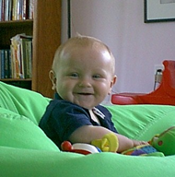
Consistent Community Message
WIC Peer Educators
Parsons Early Head Start Home Visitors
Breastfeeding Roundtables—Quarterly
  IBCLC
  CLCs
  FSWs

Slide 33
Contact Information
Bernadette Johnson
Office of Child and Family Services
Bernadette.Johnson@ocfs.ny.gov
Sandra McGinnis
Center for Human Services Research
smcginnis@albany.edu
Peggy Sheehan
Healthy Schenectady Families
Peggy.sheehan@schenectadycounty.com

