Slide 1





Promoting Father Engagement
New York State Office of Children and Family Services

Slide 2

Tom Dwyer
Program Contract Manager
Office of Children and Family Services
New York State Office of Children and Family Services

Slide 3
Agenda
Fatherhood Initiative of Healthy Families New York
  Tom Dwyer, OCFS
Research Findings on Father Involvement
  Matt Vogel, Center for Human Services Research
Is Your Organization Father Friendly?
  Audience Participation
Engaging Fathers in Program
  Corina Allen & Matt Scott,
  Healthy Families Broome

Slide 4
About HFNY
Healthy Families New York (HFNY) is a voluntary home visiting program for expectant and new parents.
36 Programs in Upstate New York and in NYC serve 5700 families annually
Paraprofessionals provide home visits

Slide 5

Partners with Healthy Families New York
NYS Office of Children and Family Services
Center for Human Services Research
Prevent Child Abuse New York

Slide 6
Goals of our program
  Support positive parent-child bonding and relationships
  Promote optimal child health and development
  Enhance parental self sufficiency
  Prevent child abuse and neglect

Slide 7
HFNY Fatherhood Initiative
The mission of the HFNY Fatherhood initiative is to engage fathers and support them in their parenting role to enhance child developmental outcomes and long-term family success.

Slide 8
HFNY Fatherhood Initiative Services
Modes of Service Delivery
  Tandem home visits where FSW and FA work with mother and father together.
  One-on-one sessions where FA works with just the father and child.
  Fathers’ groups where the FA works with a group of fathers together.
  Individual FSW works with entire family

Slide 9
HFNY Fatherhood Initiative Services
Services Provided
  Provide information on parenting skills, child development and PCI.
  Focus on relationship with parent(s) of child.
  Teach importance of fathers to families.
  Set specific goals.

Slide 10
Matt Vogel
Research Scientist
Center for Human Services Research

Slide 11
Importance of Father Involvement
A considerable body of research has accumulated on the importance of fathers in healthy child development (Rosenberg & Wilcox, 2006).
  Cognitive Development
  School Readiness
  Emotional Well-Being
  Social Development
Notes:
Father’s positive and emotionally appropriate interactions have positive effect on cognitive development at twenty-four months (Shannon, Tamis-LeMonda, London & Cabrera, 2002).
Toddlers with more involved fathers have greater academic readiness before starting school (Rosenberg & Wilcox, 2006).
Father involvement has tangible benefits for children’s emotional well-being and social development (Saracho & Spodek, 2008)

Slide 12
CHSR Fatherhood Study
Purpose
  What does father involvement mean?
  What types of families have actively involved fathers?
  What are the outcomes of father involvement?
    Retention
    Number of Visits
  Does having an active Fatherhood component increase father participation?
Sample
  2,433 families enrolled in HFNY during 2009 and followed through 2011.

Slide 13
Measuring Father Involvement in Program
Four Types of Father Involvement in Program
  Residential and Involved
  Residential and Non-Involved
  Non-Residential and Involved
  Non-Residential and Non-Involved
Notes:
Four Types of Father Involvement
Residential and Engaged
These fathers live in the same house as the child and have participated in at least one home visit
Residential and non-Engaged
These fathers live in the same house as the child but have not participated in any home visits
Non-Residential and Engaged
These fathers do not live in the same house as their child, but they have participated in at least one home-visit
Non-Residential and Non-Engaged
These fathers live in the same house as the child but have not participated in any home visits

Slide 14
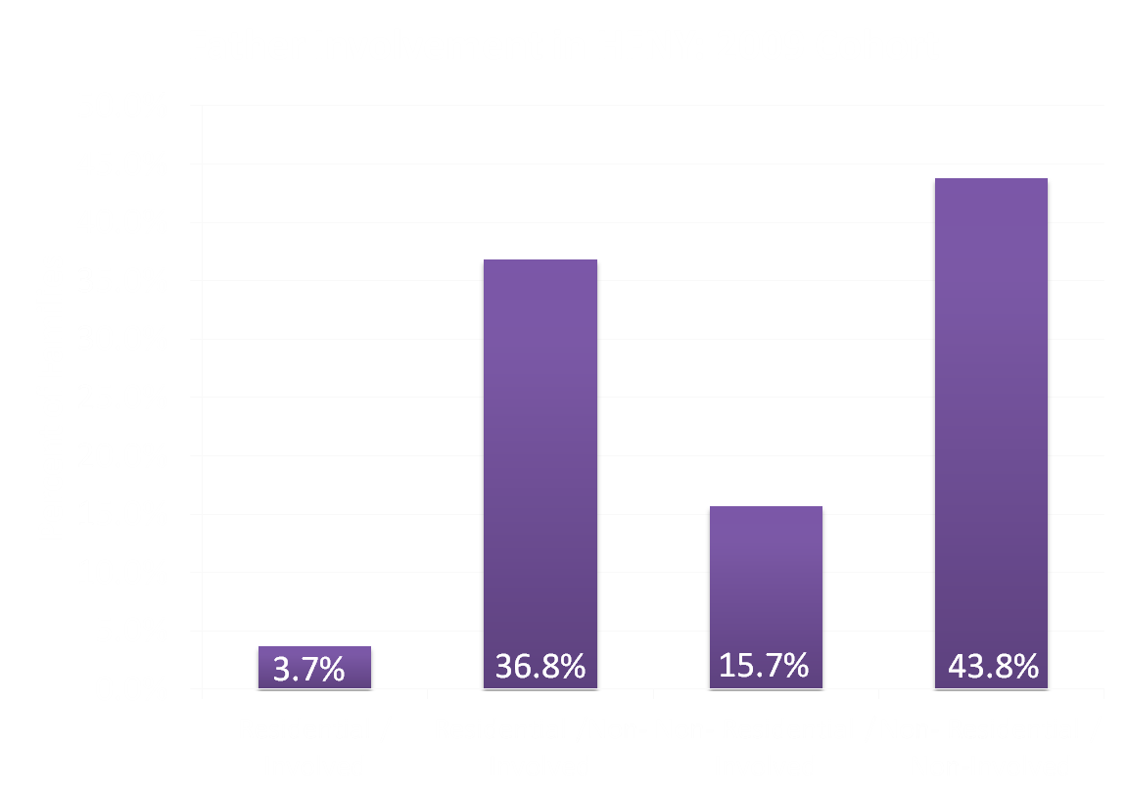
Measuring Father Involvement

Slide 15
Characteristics of Families with Involved Fathers
  Relative to all other HFNY families...
    Mothers with Residential and Involved fathers are more likely to be married and to have graduated high school.
    Mothers with Residential and Non-Involved fathers are more likely to be married, white, hold a HS diploma or higher, and are typically older and present with lower risk scores.
    Mothers with Non-Residential and Involved father are less likely to be married.
    Mothers with Non-Residential and Non-Involved father are more likely to be black, non-married, have dropped out of high school, and are typically younger and present with the highest risk scores.
Notes:
There is also clear variation by region. Families in NYC are significantly more likely to have non-residential and non-engaged fathers.

Slide 16
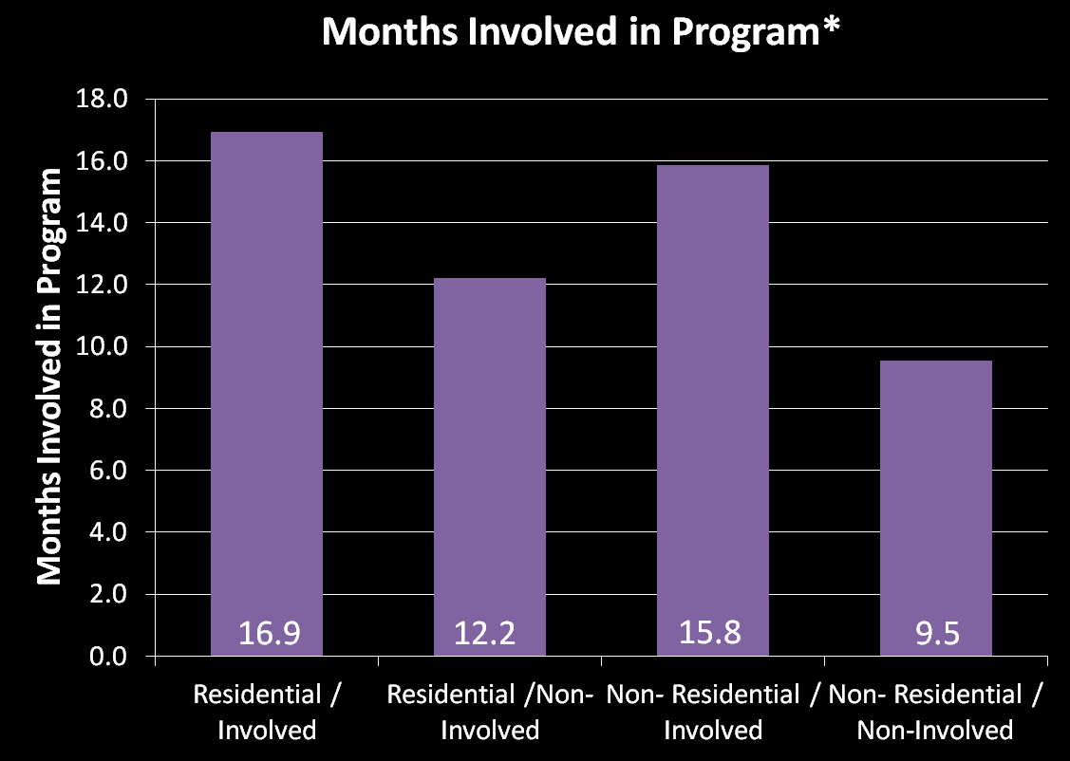
Effects of Father Involvement
*Holding constant Mother’s age, race, education, marital status, Kempe Score, and flag for NYC. Estimates adjusted for program effects.

Slide 17
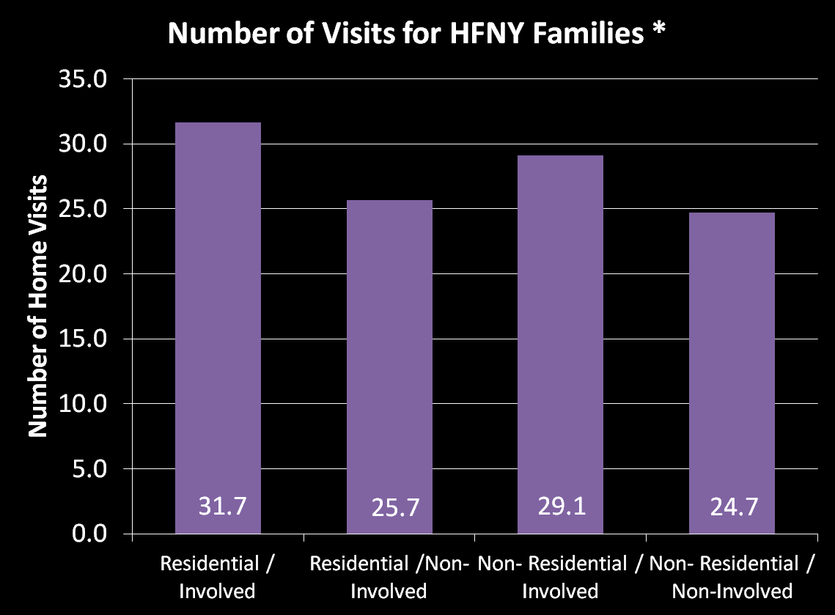
Effects of Father Involvement
*Holding constant Mother’s age, race, education, marital status, Kempe Score, and flag for NYC. Estimates adjusted for program effects.

Slide 18
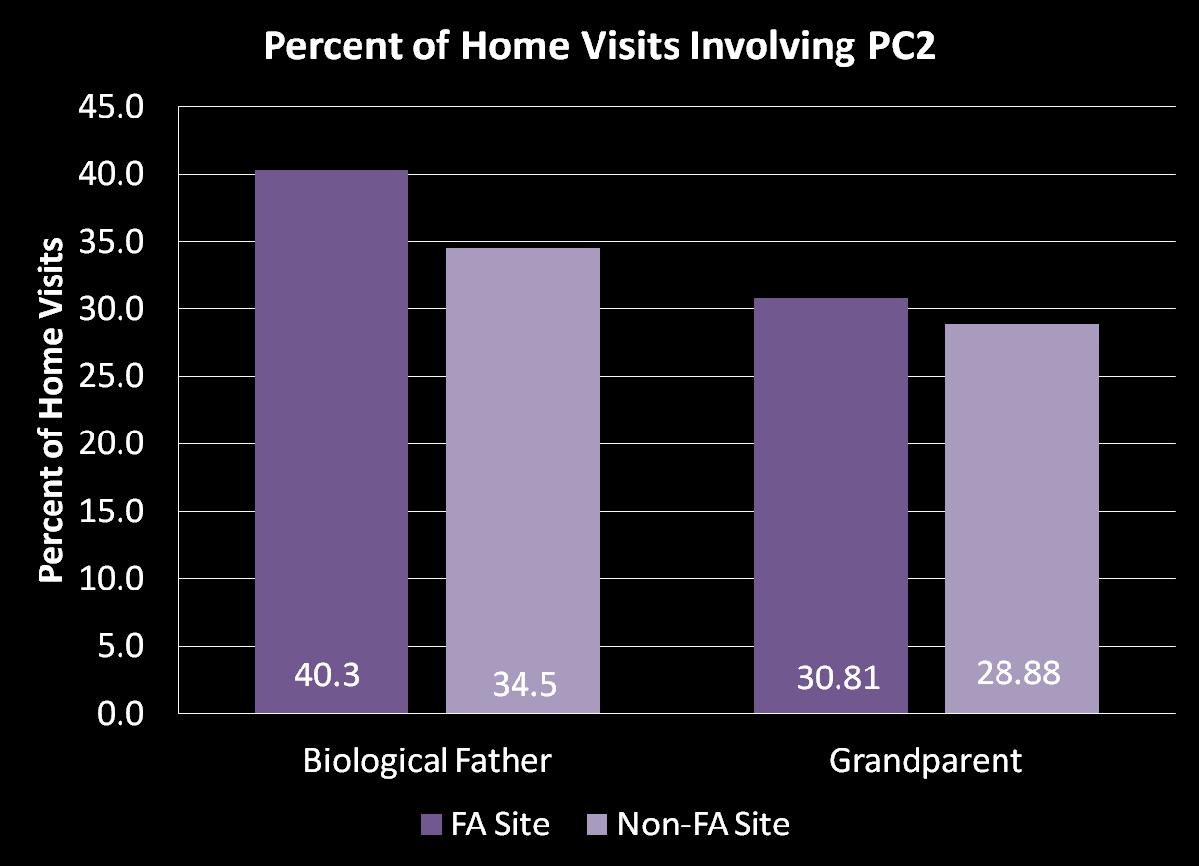
Effects of Father Advocate Component

Slide 19
Key Findings
There are clear differences in the level of father involvement among HFNY families
  These differences are linked to socio-economic, demographic, and regional differences between families.
Families with active father involvement:
  Involved with HFNY for longer.
  Have more home visits.
Sites with a Fatherhood Component:
  Involve fathers in roughly 6% more home-visits than non-FA sites.

Slide 20
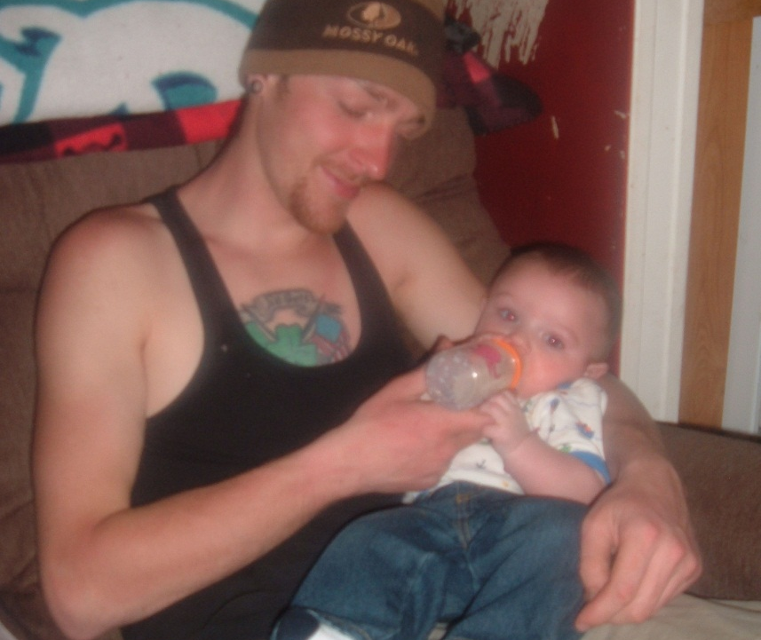

Slide 21
Activity Discussion Questions
What are the strengths of your program in involving fathers?
  How does your program involve fathers?
    What types of services do you provide?
    What kinds of activities do you engage in?
What are the barriers your program encounters in involving fathers?
  What are the challenges you face?
  How do you try to overcome those challenges?
What did you learn from this activity after discussing fatherhood involvement with your neighbor?

Slide 22

Corina Allen
Family Service Worker and
Senior Parent Educator
Healthy Families Broome
Matt Scott
Family Service Worker
Healthy Families Broome

Slide 23
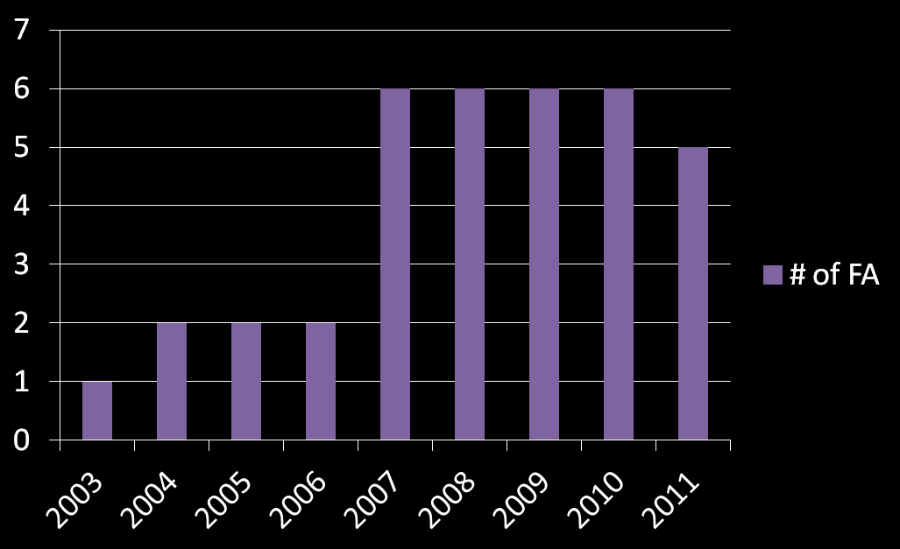
Fatherhood Initiative Timeline

Slide 24
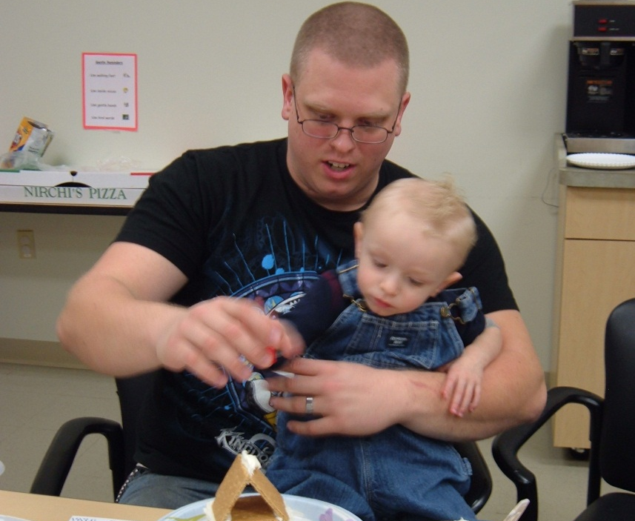
Assessment/Outreach
Include male figure on assessment .
First impressions.
Notes:
Matt involved from enrollment- harder to get dad involved after

Slide 25
Establishing Initial Relationships
Expectation to have Dad at enrollment and visits.
  More fathers say they are influenced by the way they were raised than mothers (59% vs. 50%) (Hart Research Associates, 2010).
Gather information for both parents.
  PSI, survey, ASQ.
Notes:
Changes in the field – having more males involved in visits, less of a mom’s program than a family program
Role model dad getting involved

Slide 26
Family as a whole unit
Fathers are 3X more likely than mothers to turn to their spouse for parenting information (Hart Research Associates, 2010).
Research shows that when there is a father-figure involved children do better in school and with relationships of their own in the future (Pruett, 2000).

Slide 27
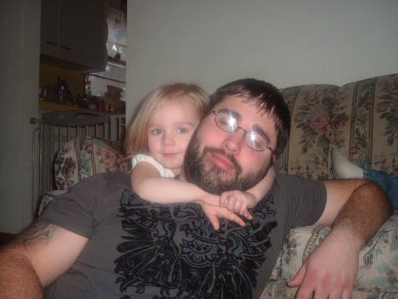
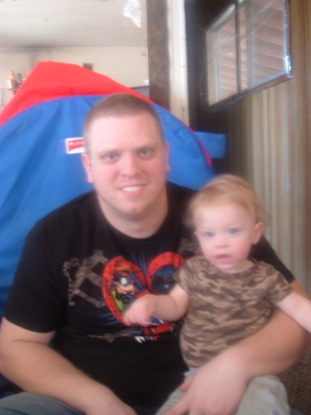
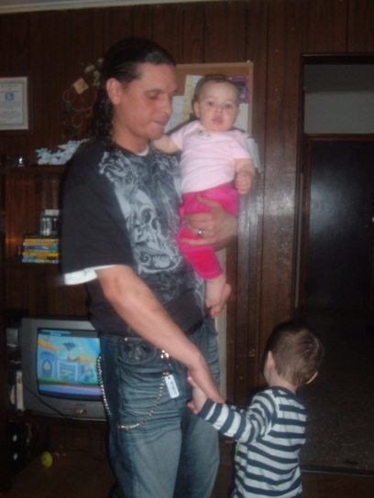
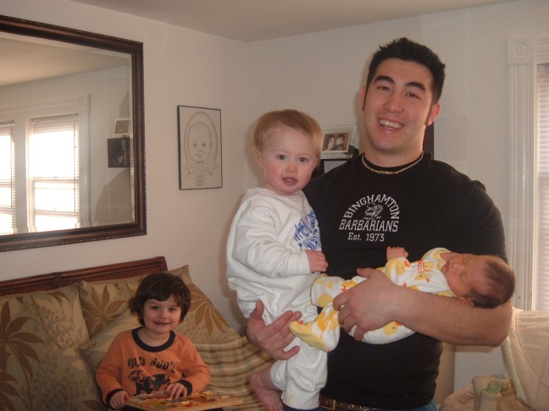
Tandem visits
How we do tandem visits
Who we work with
Notes:
Same gender parents, grandparents, uncles, friends, biodads
Grandparents have a strong influence on child rearing and are a key target audience for early childhood professionals (Hart Research Associates, 2010)

Slide 28
Communication styles
Multiple conversations going on during visits
Alternate use of electronic media to communicate with dads
Using curriculum that is father friendly

Slide 29
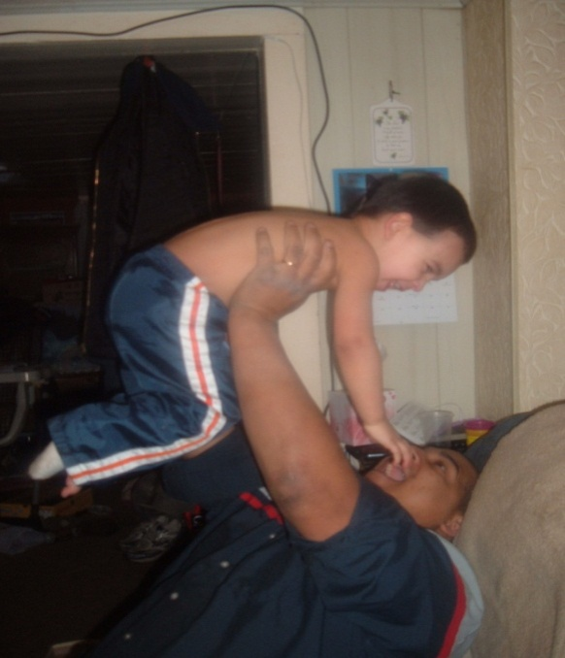
Dads play differently with children (dads are physical, moms nurturing)
FAs relate on a different level with dads than FSWs could

Slide 30
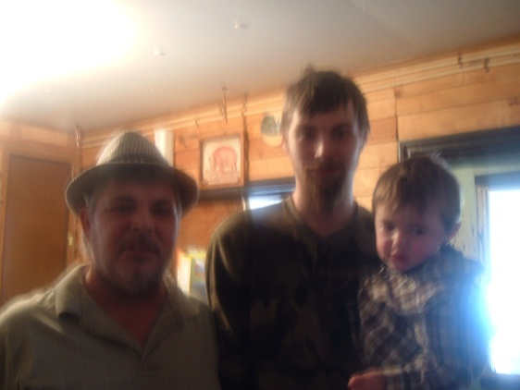
Child abuse prevention
Boyfriends are the highest perpetrators for child abuse.
We include any male figure in the home on the visits.
Notes:
Example of recent visit where grandmother told about another grandchild who had been abused by the mother’s boyfriend.

Slide 31
Challenges
Worker Safety
  For FSWs
  For FAs
  Liability
Scheduling
  With the Family
  With other Family Support Workers
Father involvement
  Initial Visit
  Program for FAMILY not just Mom
Curriculum
  Dad friendly
  Family oriented
Notes:
If family works, we have extended hours to accommodate their schedules
How we work out schedules between 5 FSWs and one FA
Cerise emphasizes when scheduling assessment that Dad’s are expected at assessment
When Dad sits in another room while we are doing the visit, we try to draw them in and include them in visits
Curriculum – Florida Curriculum is designed for women – touchy feely – and has some Dad related info, but little
24/7 Dads is a good resource, Parents as Teachers updated curriculum is better and has more info for Dads
Open discussion for other curriculum that incorporates Dads or excludes them

Slide 32
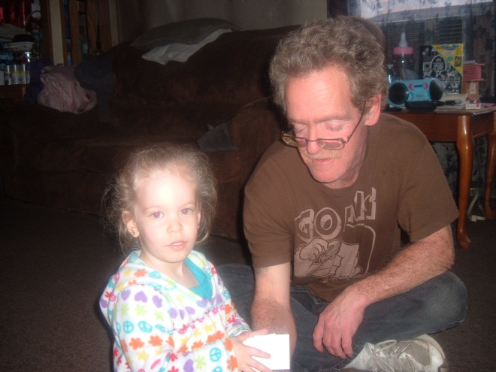
Retention rates
Extended leave of absence of FSW.
FSW resigning – retain families with FA more than those without being transferred to new FSW.
Seamless transfer of families to FA.
Families who split up – we continue
to serve both Mom and Dad.
Built rapport with the families.
Notes:
Matt’s dad who stuck with the program when mom could no longer see children.
Examples of FSW absence – Kim (flood), Jessica (Maternity)
Examples of FSW resigning – Jessica, Jessica, Theresa
Transfer families to FA to make more room for FSW to take another family
Families who split up – we may also split up services – Matt with Dad, me with Mom- if they cannot meet together

Slide 33
Resources
The National Fatherhood Initiative
http://www.fatherhood.org/
OCFS Fatherhood Initiative
http://www.ocfs.state.ny.us/main/fatherhood
Healthy Families New York
http://www.healthyfamiliesnewyork.org/
HFNY Newsletter on Father Involvement
http://www.healthyfamiliesnewyork.org/Media/newsletters/link-winter_%202012_final.pdf

Slide 34
Contact Information
Tom Dwyer
Office of Child and Family Services
Thomas.Dwyer@ocfs.state.ny.us
Matt Vogel
Center for Human Services Research
mvogel@albany.edu
Corina Allen
Healthy Families Broome County
caallen@lourdes.com
Matt Scott
Healthy Families Broome County
mscott@lourdes.com

