Slide 1
MedCare
Hospital Management System
Project - I

Slide 2

Hello!
The Team
Harshal Doshi | 140950107024
Jay Shah | 140950107082
Tarang Desai | 140950107100
Kapil Pandya | 140950107110

Slide 3
Problem Statement
Purpose and Scope
1

Slide 4
Problem Statment
As The Indian, government declared a rule in medical domain specifying that each practicing doctor will have to prescribe generic medicines to their patients and in prescription, there should be elements/contents of each particular medicine.
Therefore, we found this rule headache for everyone practicing in medical domain. To solve this problem is the main goal to achieve, also including the management modules for the hospital.
Therefore, we are going to create an application, which will help patients, doctors, and hospital staff to manage whole treatment cycle of a patient. By using this application, the doctor will not have to remember the contents of the medicine. Doctors even do not have to prepare a prescription; with use of OCR, we are going to solve this problem. Patients’ medical history will be there in the database including every prescription. Hospital staff can prepare patient’s file as required by using his/her history.

Slide 5

Purpose/Scope
The main purpose of this application is to ease up the ecosystem of a hospital, so they can serve more patients with more focus and reliability.
It will ease-up the work of doctor by auto-completing the name of medicines and symptoms.

Slide 6
Users
Administrator
Doctor
Patient
Nurse
Receptionist
Other Hospital Staff

Slide 7
Software and Hardware Requirement
Problems and Weaknesses of current System
Features of our System
Feasibility Study
Architecture Diagram
2

Slide 8
Software Requirement (Technology)
Java:
Spring Boot
Hibernate
JSP
Front-End
Bootstrap
Angular-JS
HTML
Android
Hardware Requirement
Server
Smartphone Tablet
Personal Computer

Slide 9
Problems and Weaknesses of current System
The current system does not provide synchronization for all hospitals.
In current system, the option to generate prescription with medicine’s contents is also not available.
Offline Execution is not available in current systems.
Alternate generic medicine listing is also not available in current systems.

Slide 10
Features of our System
Disconnected Architecture
Generic Medicine Listing
Medicine Content Auto fill-up
Synchronization between all sub-systems
This is a patient oriented system, so all patients’ history will be synced across all hospitals.

Slide 11
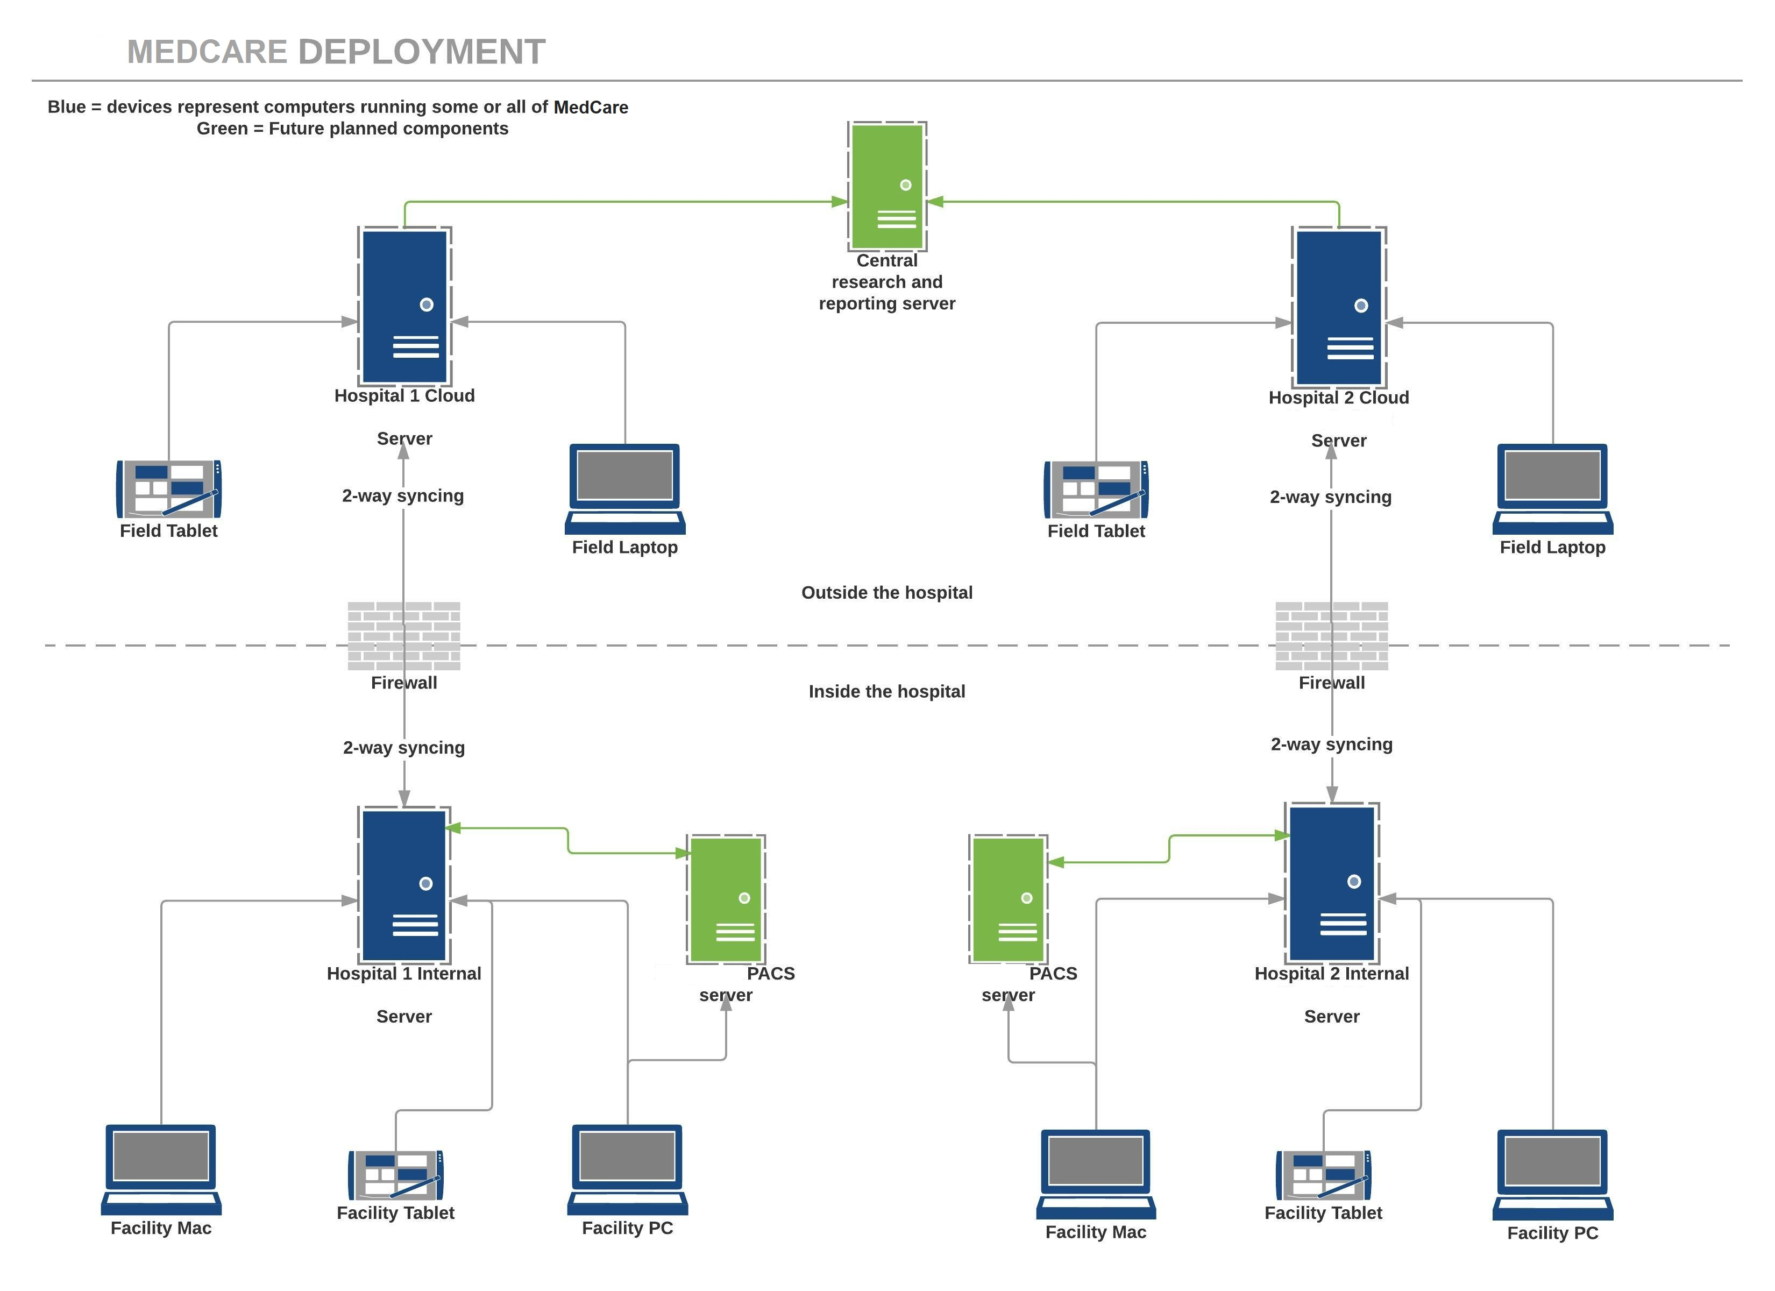
Architecture
Diagram

Slide 12
It must have a graphical user interface that assists employees that are not from IT background.
Scalability and extensibility.
Flexibility.
Robustness.
According to the organization requirement and the culture.
Must provide excellent reporting features with good printing support.
Platform independent.
Easy to debug and maintain.
We choose some of popular front-end tools like angular JS, Bootstrap, JSP to provide better performance and scalability.
Feasibility Study:
Front-End Selection

Slide 13
We opt to implement backend in MySQL as of its popularity and advantages like
Data Security
On-demand Scalability
High performance
Comprehensive Transactional support
Complete Workflow Control
The flexibility of Open Source
Robust
Integrity
Incredibly Inexpensive
In this system, we are using spring boot, hibernate, jsp to provide better performance in MVC pattern
Feasibility Study:
Back-End Selection

Slide 14
Main Modules of the System
Login:
a. patient
b. doctor
c. staff
Signup:
a. patient
b. doctor
c. staff
Staff Login – Receptionist
a. Patient Registration
b. Money Collection
c. Bill Generation
d. Assign Nurse
Staff Login – Nurse
a. Notification of work
b. Vital Measurement
Doctor Login
a. Admitted patient record on home page
b. Prescription
c. Generation
Patient Login
a. History will be seen

Slide 15
Functions of the Systems:
Usecase Diagram
Data Modelling:
Activity Diagram,
ER Diagram
Main Modules of the System
3

Slide 16
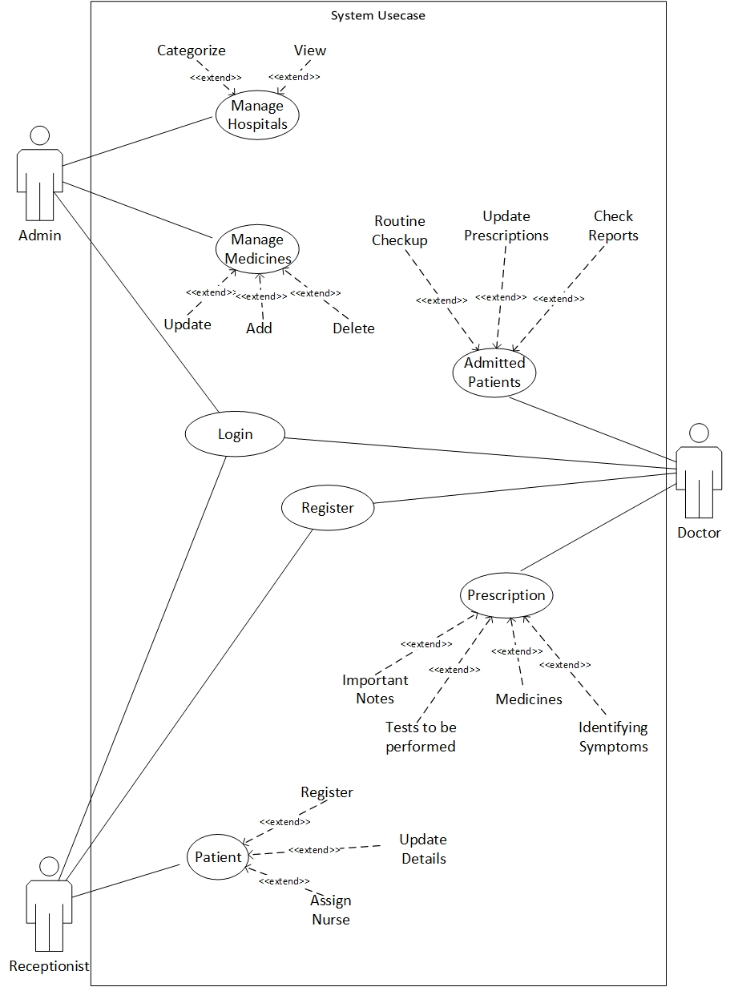
Usecase Diagram

Slide 17
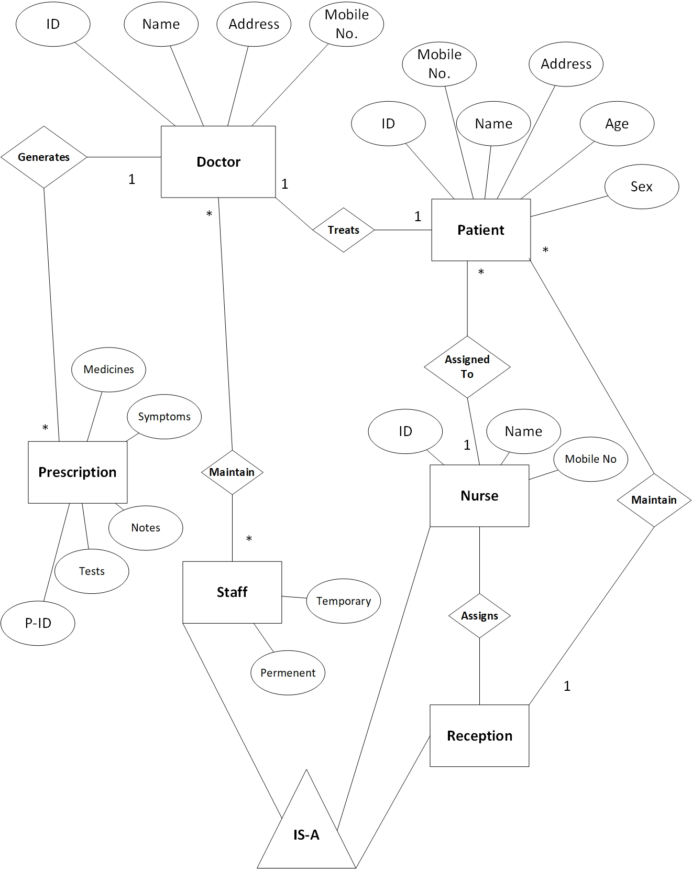
ER Diagram

Slide 18
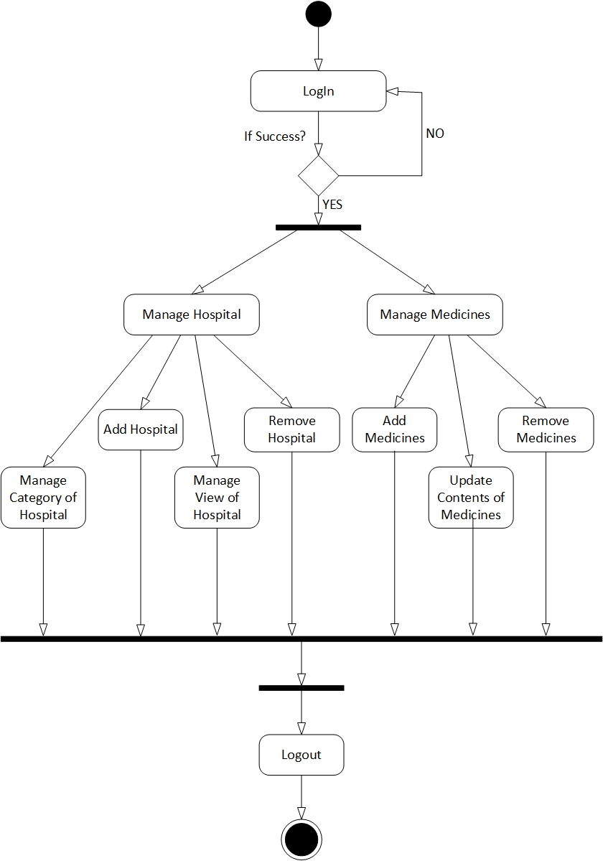
Activity Diagram
ADMIN

Slide 19
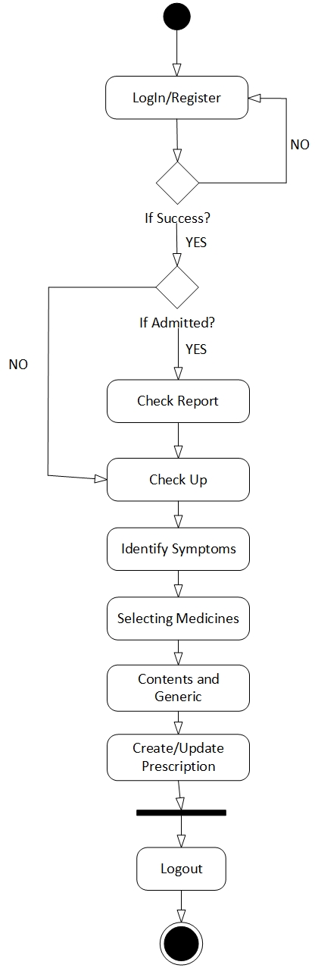
Activity Diagram:
Prescription Generation & OPD

Slide 20
Thank You!!

