Slide 1



Receipts & Payments

Slide 2
How to Do Receipts Entries

Slide 3
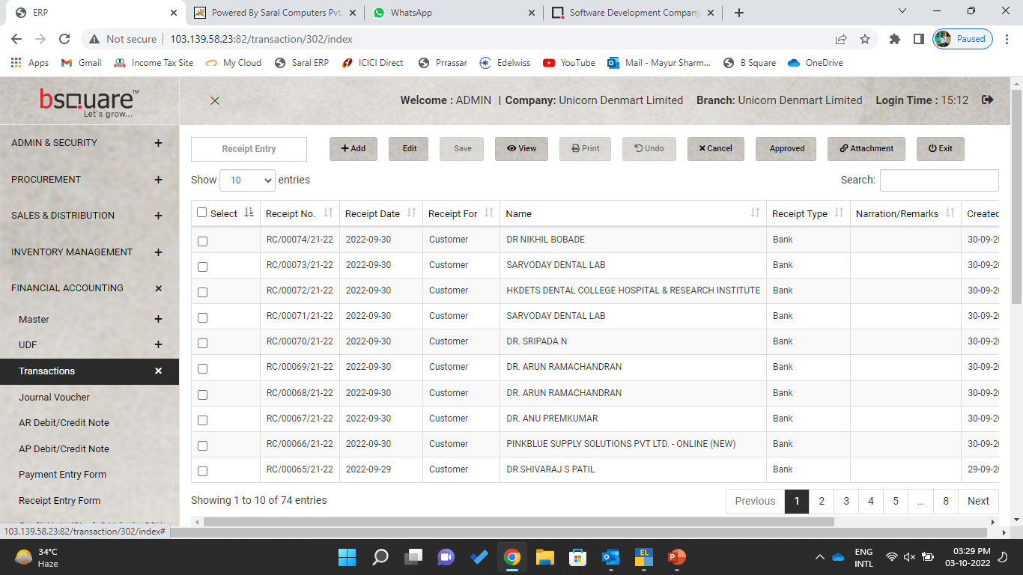

Bank/Cash/Contra Receipt – We need to use the Receipt Entry form
Go to Financial Accounting – Transections-Receipt Entry form

Slide 4
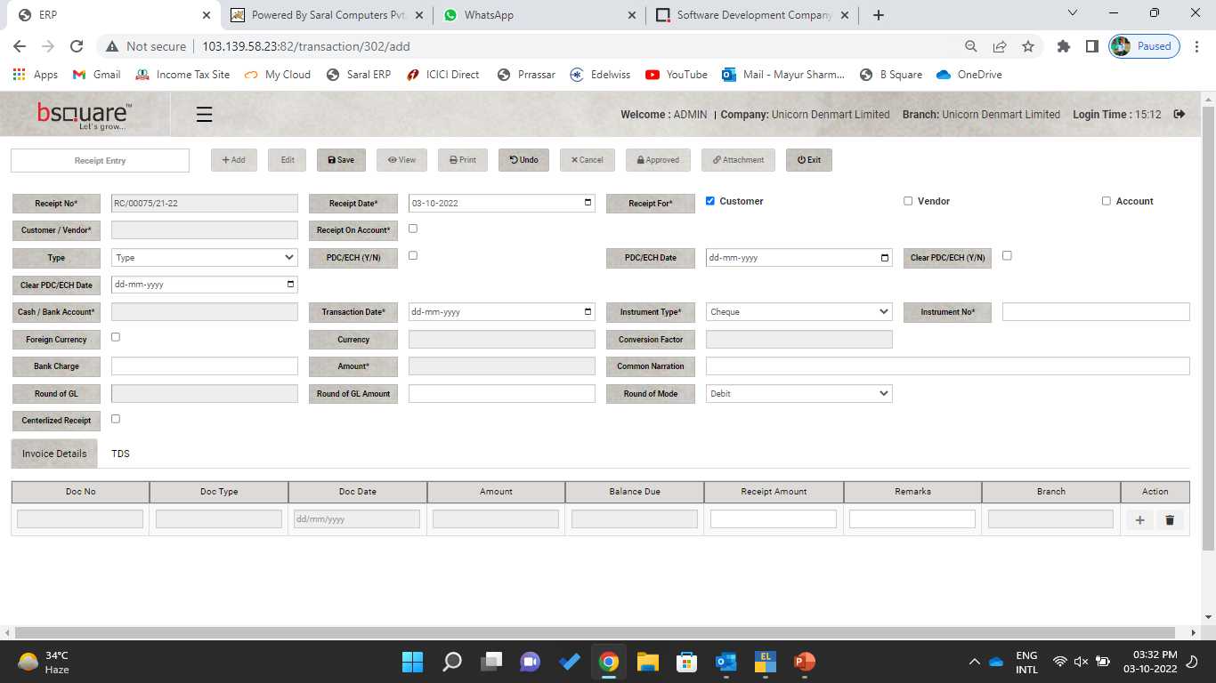

Slide 5
Choose payment receipt from Customer/Vendor/Employee (on Account), Default Option is Customer.
If Payment is not received against Invoice, Choose Receipt on Account
PDCs/ACH Entries to be done by Selecting the Type, if Normal Receipt than leave it blank
Choose Bank Account in which payment received or Cash
Transection Date , Instrument Type & Number
If the Payment receipt against Invoice, Choose the Doc (Invoice Number & Amount)
Save it, Post Save, this Voucher needs to be Approved before reflecting in financials.

Slide 6
How to Do Payments Entries

Slide 7
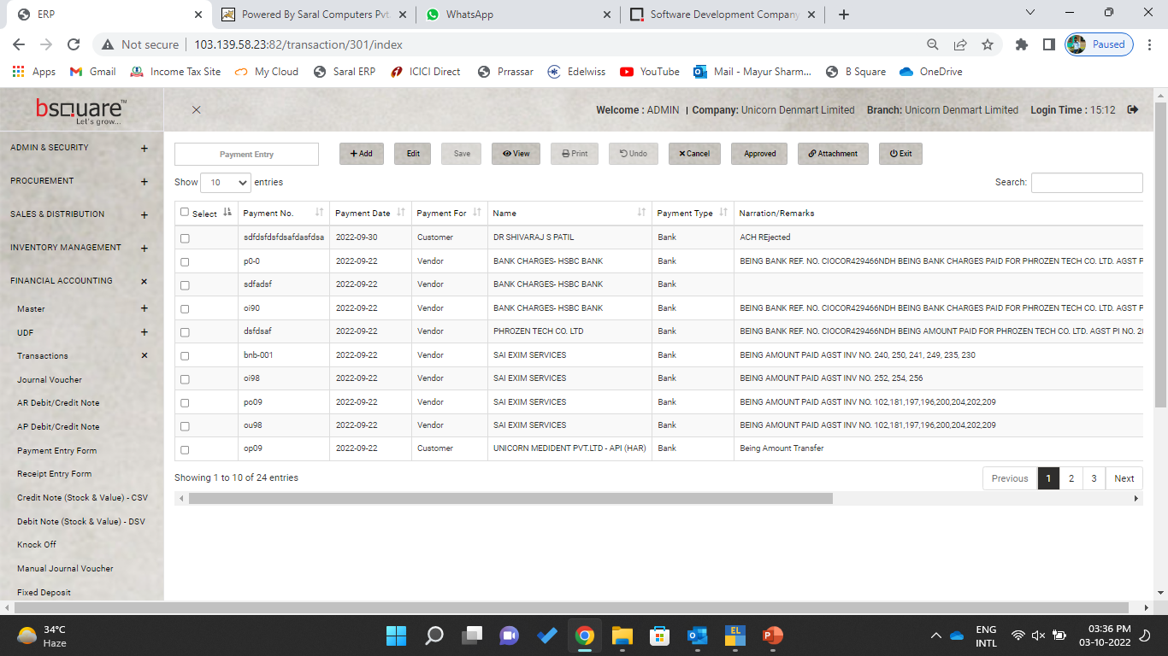
Bank/Cash Payment – We need to use the Payment Entry form
Go to Financial Accounting – Transections-Payment Entry form

Slide 8
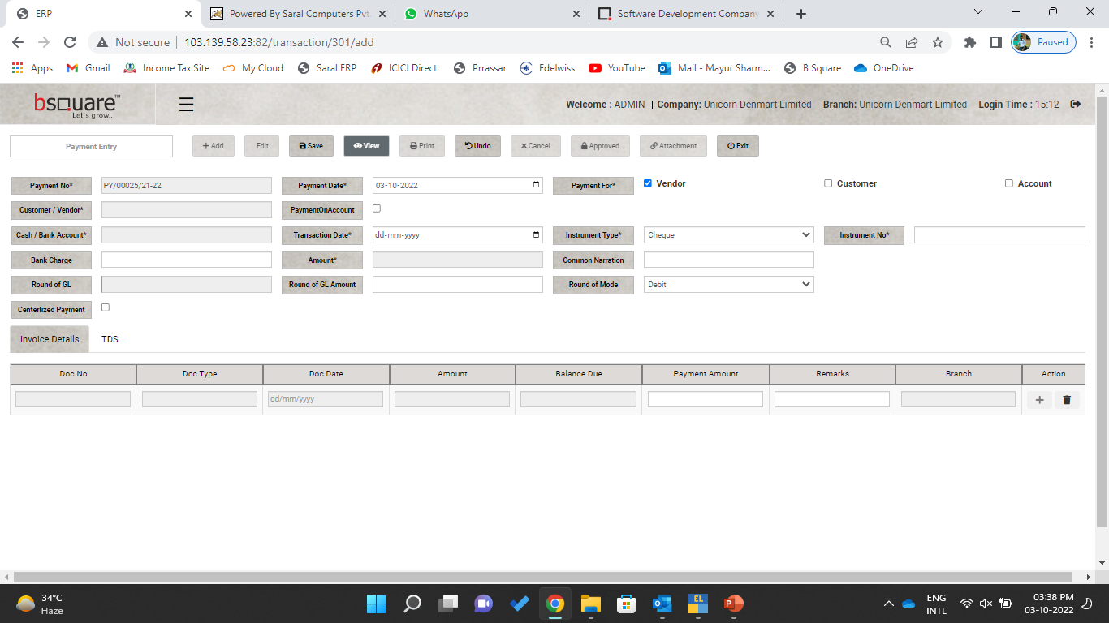

Slide 9
Choose payment receipt from Customer/Vendor/Employee (on Account), Default Option is Vendor.
If Payment is not done against Invoice, Choose payment on Account
Choose Bank Account from Payment to be made or Cash
Transection Date , Instrument Type & Number & Amount
Provide the Proper narrations in Common Narrations
If the payment done against invoice, choose the Doc Number & payment amount.
If TDS needs to be deduct Choose TDS type & Click on Applicable.

