Slide 1
SWAD
(Slide With Acronym Definitions)
CPU – Central Processing Unit
  General multiprocessor: Intel Core i7, etc.
GPU – Graphics Processing Unit
  Graphics cards: Nvidia GeForce, AMD Radeon, etc.
OpenGL – Open Graphics Language
  API specification that GPU vendors attempt to implement
  OpenGL ES is API for embedded systems
GLSL – GL Shading Language
  Specialized, C-like programming language for GPUs

Slide 2
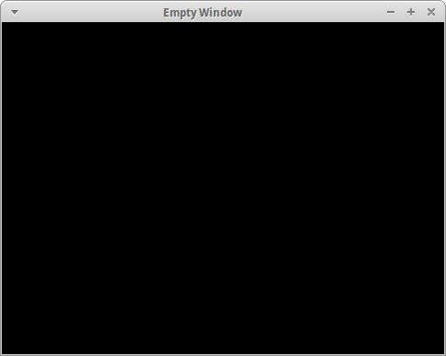
Example 0: Empty Window

Slide 3
GLFW Library
Handles hairy multi-platform details:
  OpenGL context creation
  Window management
  Input (keyboard, mouse, joystick) management
http://www.glfw.org/
Similar libraries:
  SDL (http://www.libsdl.org/)
  GLUT (http://freeglut.sourceforge.net/)

Slide 4
Basic GLFW Functions
glfwInit()
  Initialize library (must be called first)
glfwOpenWindowHint()
  Add some constraints to window/context creation
glfwOpenWindow()
  Create window and OpenGL context
glfwGetWindowParam()
  Query window state (opened, focused, etc.)
glfwSwapBuffers()
  Draw frame buffer to screen
Example: see shared_main.c

Slide 5
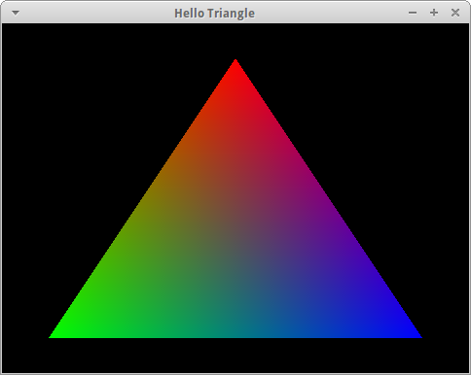
Example 1: Hello Triangle

Slide 6
Basic Primitives
3D objects are built from triangles
Triangles are defined by three vertices
Vertex is a point (set of coordinates) in 3D space
  (x, y, z): (0, 0, 0), (1, -3, 2), etc.

Slide 7
Overview
Create window and OpenGL context
Compile and link GLSL shader program
  Shader program outputs pixel colors to frame buffer
Upload vertex data into GPU buffer
  Coordinates, color, normal (direction), anything...
  Data has no meaning to buffer; it's just a bunch of bytes
Upload index data into GPU buffer
  Elements are an index into the vertex buffer
  Three indices is a triangle
Specify how shader program input maps to bytes in buffers
Draw pixels (dots on screen) using shader program

Slide 8
Shader Programs
Shader programs are GPU executable programs that output pixel color
Linked together from multiple shader types
  C analogy: Individual shader is like a compiled .o
  Shader program is like a fully-linked executable
Common shader types:
  Vertex (code executed per-vertex)
  Fragment (code executed per-pixel)

Slide 9
Vertex Shaders
Executed once per vertex
Inputs:
  Attributes – data specific to each vertex
  Uniforms – constant data
Outputs:
  gl_Position – vertex position
    (x,y,z,w) – w defines “clip space” for vertex
  “varying” variables – inputs to fragment shader
Example: see 1_triangle.c.vert.glsl

Slide 10
Fragment Shaders
Executed once per fragment (pixel)
Inputs:
  “varying” variables – linearly interpolated from vertex output
  Uniforms – constant data
Outputs:
  Fragment (pixel) color
Example: see 1_triangle.c.frag.glsl

Slide 11
Attributes and Interpolation
(x, y, z), (r, g, b)
v1: (0, 0.8, 0), (1, 0, 0)
frag: (0.4, 0, 0)
(0.5, 0, 0.5)
(0.8, -0.8, 0), (0, 0, 1) ← v2

Slide 12
Shader Functions
glCreateShader(type)
  Returns shader object handle of given type (vertex, fragment, etc.)
glShaderSource(handle, string(s))
  Set shader source code
glCompileShader(handle)
glGetShader(handle, parameter, value_ptr)
  Outputs value of parameter via pointer
  Check compile status, log string length, etc.
Example: see shared_utils.c: loadshader()

Slide 13
Program Functions
glCreateProgram()
  Returns program object handle
glAttachShader(prog_handle, shader_handle)
  Specifies shader to be linked into program
glLinkProgram(handle)
glGetProgram(handle, param, value_ptr)
  Outputs value of param via pointer
  Check link status, log string length, etc.
glUseProgram(handle)
  Use a program for drawing
Example: see shared_utils.c: loadprogram()

Slide 14
Buffer Functions
glGenBuffers(n, handle_array)
  Creates n GPU buffers and outputs their handles in handle_array
glBindBuffer(mount_point, handle)
  Bind buffer to “mount point” (file system analogy)
glBufferData(mount_point, buf_ptr)
  Writes data from buf_ptr into the mounted buffer
Reminder: data means nothing to buffer object

Slide 15
Attribute Functions
glGetAttributeLocation(prog, name_string)
  Returns location / handle of attribute in program
glVertexAttribPointer(location, components, type, stride, offset)
  Specifies how attribute gets data from buffer mounted at GL_ARRAY_BUFFER
glEnableVertexAttribArray(location)
  Enables the attribute

Slide 16
Vertex Array Objects
Remembers state when setting up attributes
  “Vertex Array” is a stupid, misleading name
glGenVertexArrays(n, handle_array)
glBindVertexArray(handle)
Be sure to have one bound when setting up attributes
Bind again later to restore state

Slide 17
Drawing
Setup reminder:
  Build shader program
  Upload vertex data to buffer
  Setup attributes
  Upload vertex indices to buffer
  Bind indices buffer to GL_ELEMENT_ARRAY_BUFFER
glDrawElements(mode)
  Draws mode (e.g. triangles) using the vertices referenced by the indices

Slide 18
Clear as mud.
(Questions?)

Slide 19
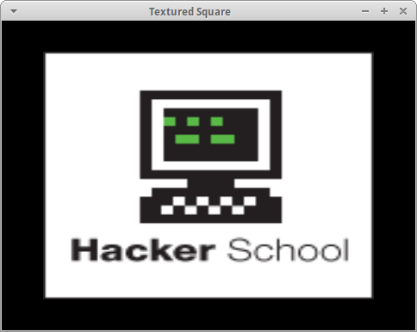
Example 2: Textured Square

Slide 20
Overview
Square from two triangles
  Yes, I know it looks like a rectangle. Coordinate-wise, it's a square. (More on this later.)
Color attribute replaced with texture coordinate attribute
Image is uploaded into GPU for texture
Uniforms introduced
Fragment color is sampled from texture

Slide 21
Texture Coordinate Attribute
(0, 0)
(1, 0)
(0, 1)
(1, 1)

Slide 22
Texture Upload Functions
glGenTextures(n, handle_array)
glBindTexture(mount_point, handle)
glTexImage(mount_point, format, dimensions, buf_ptr)
  Writes image data in buf_ptr to texture bound to mount_point
  Unlike generic buffer, data does have meaning (specified by format and dimensions)
  Image data is typically RGB[A] bytes, left to right, top to bottom
glTexParameter(mount_point, parameter, value)
  Set parameter to value for texture at mount_point
  Wrapping properties, min and magnification filters

Slide 23
Using a Texture
Fragment shaders contain a special “sampler” type for reading colors from textures
32 texture units (active slots) available
Bind texture to mount point on specific texture unit
Tell sampler uniform which texture unit to read from
In fragment shader, use texture(sampler, coordinates) to read a color from the texture

Slide 24
Uniform Functions
glGetUniformLocation(prog, name_string)
  Returns location / handle of uniform in program
glUniform(location, value)
  Writes value to uniform at location in active program
  Many variants for different types (int, vec3, mat4, etc.) and arrays
  Beware calling it with wrong active program

Slide 25
Questions?

Slide 26
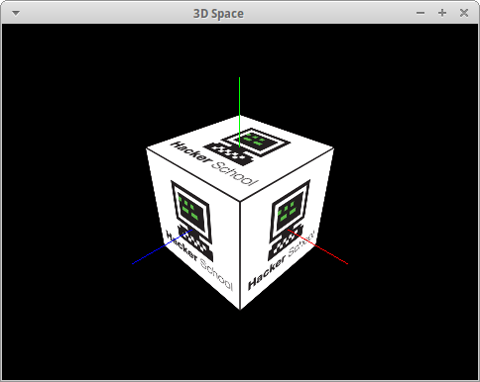
Example 3: 3D Space

Slide 27
Overview
Six squares form a cube
Camera added
  Introduces concept of spaces
    Model
    World
    View
Perspective
  Objects in distance look smaller
  Takes aspect ratio into account

Slide 28
Spaces
Model
  Each mesh has its own origin, regardless of where it's placed in the world
World
  Single space that contains all models
Eye
  OpenGL has no concept of “world”
  World must be transformed as if the view (screen) were the origin

Slide 29
Transformation Matrices
Linear algebra is useful for converting coordinates and vectors to different spaces
4D coordinates / vectors can be easily transformed in one operation
4th component starts at 1
Transformation matrix is product of more specific matrices:
  Translation (movement)
  Scaling
  Rotation
  Tr = S * R * T (order matters)

Slide 30
Translation
Given model position as (x, y, z)
Translation matrix =
[ 1 0 0 x
0 1 0 y
0 0 1 z
0 0 0 1 ]

Slide 31
Scaling
Given scalar s
Scaling matrix =
[ s 0 0 0
0 s 0 0
0 0 s 0
0 0 0 1 ]

Slide 32
Rotation
Given 3D vectors eye (out), up, right
Rotation matrix =
[ : : : 0
right, up, eye, 0
: , : , : , 0
0 , 0 , 0 , 1 ]

Slide 33
Model to World Space
Given position and direction of a model, a transformation matrix can be built
Vectors for rotation (out, up, right) can be calculated given just out (direction):
  right = cross(hard-coded up, out)
  up = cross(out, right)
Cross product of two unit vectors (length = 1) is an orthogonal unit vector
Scale first, then rotate, then translate

Slide 34
World to View Space
Similar to “model to world” transform, except inverted
Translate first, then rotate

Slide 35
View to Projection
Adds perspective
  Makes things farther away look smaller
  Takes aspect ratio into account
Still “magical” to me
Example: see 3_cube.c: resize()

Slide 36
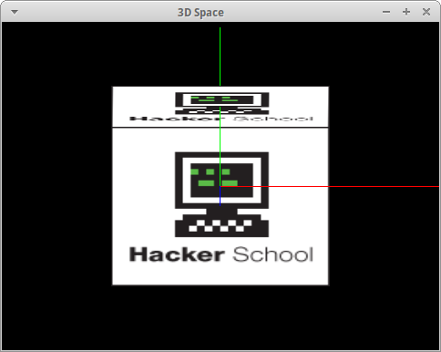
Without Perspective

Slide 37
Questions?

Slide 38
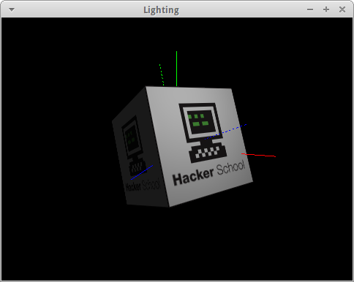
Example 4: Light

Slide 39
Overview
Diffuse map (texture) is color of surface
Lighting is applied by multiplying diffuse color with amount of light
  0 (no light) * color = black
  1 (full light) * color = color
Light = ambient + diffuse + specular
  Ambient is minimum amount to avoid pitch black
  Diffuse is light from source that scatters
  Specular is light from source that mirrors
Surface normal attribute added

Slide 40
Overview
Light from source
  Gets dimmer the further away you are
  Gets dimmer the more a surface is angled away from the light

Slide 41
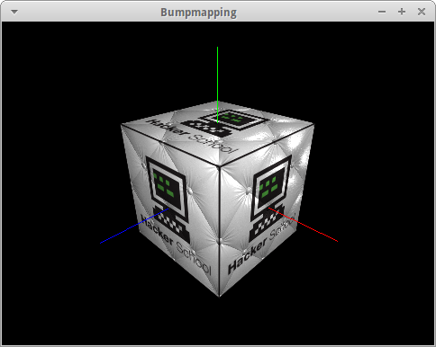
Example 5: Bump mapping

Slide 42
Overview
Same idea as previous example, except normals are read from a texture and not uniform across a triangle
Red = X, Green = Y, Blue = Z
Normals are in tangent space (on the same plane as the triangle)

Slide 43
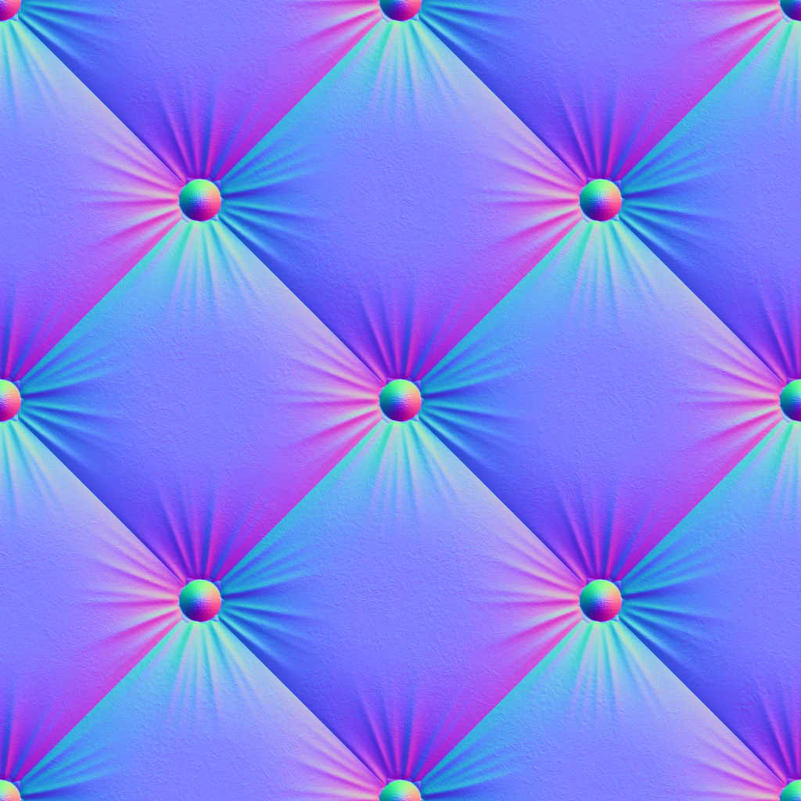
Normal map

