Slide 1




SmartGlow Lighting System
The Internet of Things
Group Members:
Jay Shah
Sudeep Mande
Chaitali Dandale
Confidential. For registered class user only. Not for external distribution.

Slide 2
SmartGlow Lighting System
Concept
- What is SmartGlow Lighting System?
- Need of Automated Street Lighting.
Current technology being implemented
-What is the traditional Street Lighting?
- Why is SmartGlow Lighting different??
Advantages
Confidential. For registered class user only. Not for external distribution.

Slide 3
Hardware/Software used
Hardware:
- Arch Pro Microcontroller
- Presence Sensor
- Sound Sensor
- Light Sensor
- LED
Web Application:
- Programmed in Python
Confidential. For registered class user only. Not for external distribution.

Slide 4
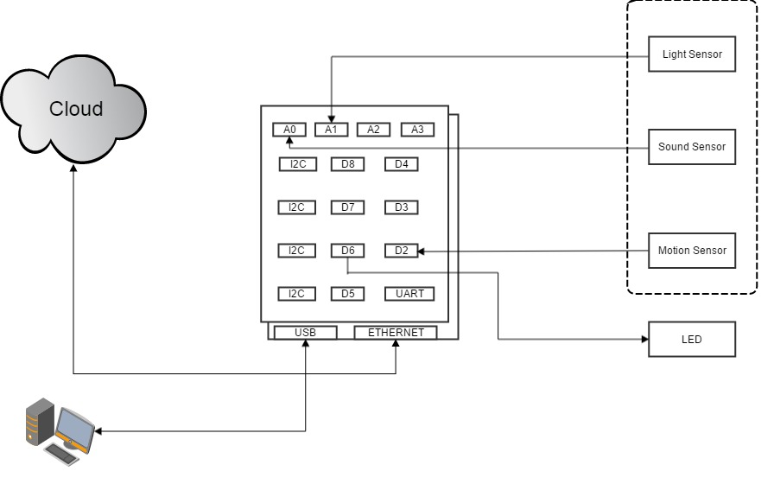
Block Diagram
Confidential. For registered class user only. Not for external distribution.

Slide 5
Questions?
Confidential. For registered class user only. Not for external distribution.

