Slide 1
Post Quantum {
presentation.html
[Zero Knowledge Proofs]
}
/**
* Authors:
* Sam Benoist
* Alexa Krempa
* Bryan Richez
* Preston Sergent
* Jay Shah
*/

Slide 2
Table Of ‘Contents’ {
01
02
03
presentation.html
Introduction
< Explanation of ZKP and post-quantum algorithms >
Background and Significance
< Introduce our core research problem and importance of this research >
Related Work
< Give examples of previous research done on this topic >
}

Slide 3
Table Of ‘Contents’ {
04
05
Research and Design Methods
< Show how we conducted research to gather our findings >
Conclusion
< Findings and implications for further research >
}

Slide 4
01 {
[Introduction]
<Explanation of Zero Knowledge Proof and post-quantum algorithms>
}

Slide 5
Introduction {
< Our core research problem is whether Zero-Knowledge proofs (ZKP) have quantum resilient implementations >
< We also aim to determine: >
What is the importance of this research
What is the goal of this research
What are the topics involved in this research
}
Notes:
Jay
Quantum computers will pose a significant threat for cyber security. When large fault-tolerant quantum computers are constructed the most commonly used cryptosystems will break. Therefore dealing with this threat is crucial and timely.
We aim to find if zero knowledge proof is efficient in post quantum era and what would be the possible solution for encryption and digital signature in post quantum era.
In order to understand the standing of Zero knowledge proofs in quantum era, first we need to understand how ZKP works in classical cryptosystem. Also, we need to understand current state of quantum cryptography.

Slide 6
Introduction - ZKP {
< Our core research problem is whether Zero-Knowledge proofs (ZKP) have quantum resilient implementations >
< We also aim to determine: >
Framework of ZKP
ZKP models
ZKP applications in different sector
}
Notes:
Jay
ZKP work in three phase.
Witness phase - The prover computes a proof that contains its statement.
Challenge phase - The verifier asks the prover several questions as challenge.
Response phase - The prover answers and verifier accepts it or rejects it.
There are several zkp models and each is used in different applications.
Example of ZKP use in classical application are Anonymous verifiable voting, Secure exchange of digital assets, secure auction.

Slide 7
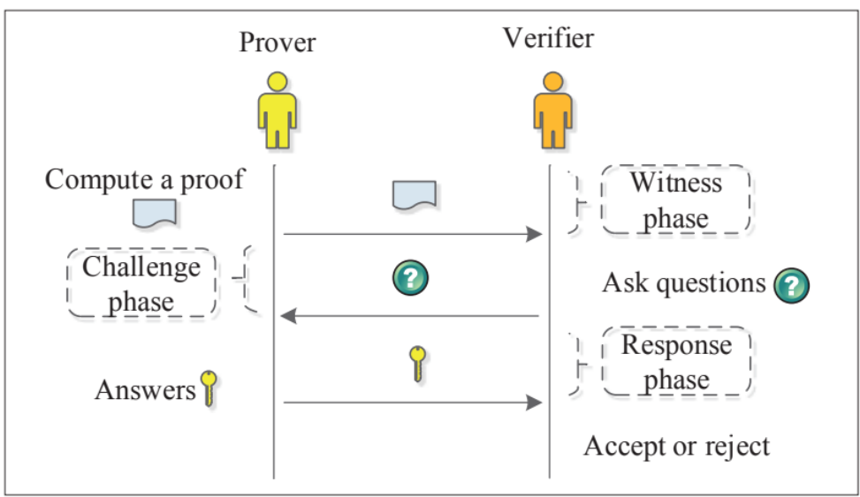
Introduction - ZKP {
< Framework of Zero Knowledge Proofs>
}
Notes:
Jay
ZKP work in three phase.
Witness phase - The prover computes a proof that contains its statement.
Challenge phase - The verifier asks the prover several questions as challenge.
Response phase - The prover answers and verifier accepts it or rejects it.

Slide 8
Introduction - Post Quantum {
General purpose quantum computers are coming
Quantum algorithms (Shors & Grovers) are not to be taken lightly
NIST Quantum Standardization
}
Notes:
The rapid explosion towards quantum computers has put many of the classical systems we rely on at risk. Something that many used to believe was impossible is now a threat that must be taken seriously. While quantum computers are not yet generally available, nor do they have the qubits necessary for many tasks, Algorithms like Shors and Grovers threaten the encryption systems used across the world.
Because of this, NIST has begun a process to evaluate and standardize a quantum resistant public key cryptographic algorithm. This process has been ongoing since 2017 and is currently analyzing candidates in the third round of evaluations. In round 3 remains 4 public key encryption algorithms and 3 digital signature algorithms.

Slide 9

What is ‘Post-Quantum Encryption’
Notes:
Post quantum encryption deals with cryptographic algorithms that are thought to be secure against attacks by quantum computers.
We can break this down to asymmetric and symmetric encryption.
Most asymmetric classical encryption algorithms rely the hard mathematical problems like integer factorizatieon, the discrete log problem, or the elliptic curve discrete log problem. These algorithms can be easily solved with a sufficiently powerful quantum computer. Asymmetric quantum resistant cryptography that aims to stop this has a few main approaches. These include lattice-based cryptography, hash-based cryptography, code based cryptography, and multivariate cryptography,
In regard to symmetric algorithms and hash functions,most are considered relatively secure against quantum threats. Grovers algorithm does speed up attacks on these, but adaptions like doubling block size can effectively block this. Some security researchers even recommend the use of symmetric key management, like Kerberos, as a way of resistance to post quantum attacks.

Slide 10
02 {
[Background and Significance]
<Introduce our core research problem and importance of this research >
}
Notes:
Alexa

Slide 11
Background & Significance {
< Our core research problem is whether Zero-Knowledge proofs (ZKP) have quantum resilient implementations >
< We also aim to determine: >
Whether the CRYSTALS algorithms comprehensively satisfies the objectives of ZKP
Any possible improvements that can be made to make ZKP quantum resilient
The efficiency of ZKP and post-quantum algorithms
}
Notes:
Alexa
As stated before, our

Slide 12
Background & Significance {
< Boundaries of our research: >
We focus specifically on the lattice-based CRYSTALS algorithms from NIST’s 3rd round of post-quantum cryptography (PQC)
We chose CRYSTALS because it provides both a public-key encryption algorithm (CRYSTALS-KYBER) and a digital signature algorithm (CRYSTALS-DILITHIUM)
}
Notes:
Alexa
So we are bounded by only looking at one PQC algorithm

Slide 13
Background & Significance {
< Importance of our research: >
Given the impending creation of commercial quantum computers, it’s vital that the quantum resilience of protocols be determined
It may increase CRYSTALS’ likelihood of being chosen by NIST for Post-Quantum Cryptography Standardization
This could also lead to further research on NIST’s other final candidates related to ZKP
}
Notes:
Alexa
…be determined prior to the commercialization of these computers
The possible use of the CRYSTALS algorithms to show ZKP quantum resilience may i

Slide 14
03 {
[Related Work]
<What other work has been done?>
}
Notes:
Preston
Academia is large and all-encompassing. As such, it is highly unlikely that any good work is unrelated to another work. Let’s talk about what work is related to ours.

Slide 15
Related Works {
< What differentiates our core question? >
Other reviews have focused more-so on the impacts PQC will have with cryptocurrency
While popular right now, cryptocurrency is not the only application of PQC algorithms.
Our focus on one single family of algorithms also differentiates our research.
}
Notes:
PReston
Cryptocurrency is big right now. Some of you may have heard of it, others may have invested in it or mined it.
However, cryptocurrency is not the only implementation that these algorithms can be used for.
Whether you all can believe it or not, security is one of the biggest driving factors behind the development of these algorithms.

Slide 16
Related Works {
< What differentiates our methodologies? >
Other researchers have taken approaches such as data mining and snowball sampling to find relevant papers, and then from there did a basic review.
Only included papers from the last five years.
We manually used the search engines that google scholar and the RIT library system provide. We also manually reviewed each paper, and noted inconsistencies that may disqualify one piece of literature from being valid.
}
Notes:
PReston

Slide 17
04 {
[Research and Design Methods]
<How did we perform our research?>
}
Notes:
Hello, I will now be talking to you about our Research and Design Methods

Slide 18
Research & Design Methods {
< Limitations & Risks >
We were only able to obtain free public information or information made available to RIT students
Since CRYSTALS hasn’t been standardized by NIST yet, there is a limited amount of research on it
We had no previous knowledge of this topic other than the basis of cryptography
Only a semester to complete this paper
}
Notes:
Bryan
While conducting our research we ran into some limitations
since CRYSTALS has not yet been standardized by NIST there is a limited amount of research on it,
In addition to this we are only able to to obtain information from free public sources and what was available to us as RIT students

Slide 19
Research & Design Methods {
< Procedures >
Used google scholar and the RIT library journal search engine to find relevant papers
Reached out to professors knowledgeable on the subject to obtain more sources
First established a core set of knowledge to gain an understanding of ZKP and PQAs
}
Notes:
Our procedures for conducting research included using platforms such as google scholar and the RIT library to find relevant articles, reaching out to professors and peers more knowledgeable on the subject to obtain more sources, and establishing a good understanding of cryptography to gain a better understanding of Zero Knowledge Protocols and Post Quantum Algorithms

Slide 20
Research & Design Methods {
< Novel Techniques >
We used comments from industry professionals that were posted on the NIST competition site to guide our thought processes
We also used the NIST competition guidelines to enhance our understanding of the objectives such cryptosystem may have
}
Notes:
Lastly we also used comments from industry professionals that were posted on the NIST competition site, and we used NIST competition guidelines to enhance our understanding of the objectives these types of cryptosystems have

Slide 21
05 {
[Conclusion]
< There are more research needed to make a judgement if the ZKP is the solution for post quantum era >
}
Notes:
Bryan
In conclusion, more research is needed to make a final judgment on if zero knowledge protocols are the solution in the post quantum era

Slide 22
Questions?
Questions.o
thanks-for-watch.ng
Notes:
Questions?

Slide 23
Conclusion {
< Why should this research have been done? >
In a post-quantum world, many of our cryptosystems will be easily broken
CRYSTALS is an algorithm family that looks posed to be both effective and comparatively easily implementable
Knowing the effectiveness of this cryptosystem allows developers to make a decision on whether to implement the system in their products.
}

Slide 24
Conclusion {
< Findings and Implications >
Manually reviewing documents only allowed us to read so many, but was essential to ensuring accuracy
The CRYSTALS family of algorithms is well-posed to become a leader in the world of Post-Quantum Cryptography
Post-Quantum Cryptosystems need to be implemented well to be effective.
}

Slide 25
Conclusion {
< How does this interact with other research? >
TO OUR KNOWLEDGE
This literature review is the only formally-written review of a single PQC algorithm
Paper acts as a ‘launching point’ for those looking to understand the field
Free from dependencies that surround grant or corporate funding
}

