Slide 1
PRDA-01
STARTUP PROFIT
ANALYSIS
Multiple Linear Regression • Exploratory Data Analysis • Business Insights
Dataset: 50 Startups | New York, California and Florida
JAY SUTHAR 04-11-2026
Prepared by: ____________________ Date: ____________________

Slide 2
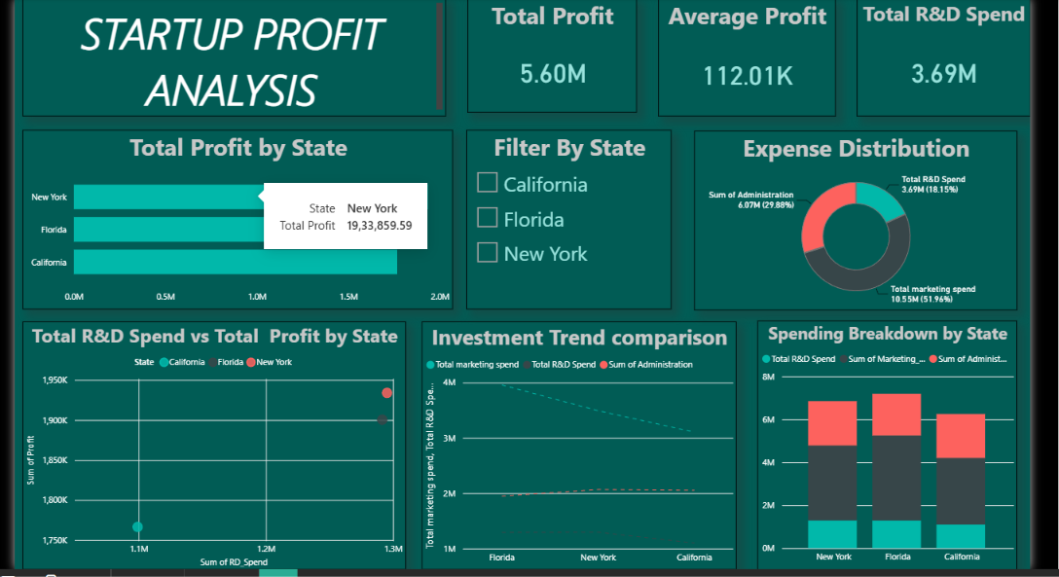
POWER BI DASHBOARD — STARTUP PROFIT ANALYSIS
Dashboard appearance supplied for the assignment
Includes KPI cards, state filter, profit by state, expense distribution, investment comparisons and spending breakdown.

Slide 3
1. Problem Understanding
What the assignment asks us to investigate
Understand how startup spending on Research & Development (R&D), Administration and Marketing relates to Profit.
Build a Multiple Linear Regression model using the three spending variables as predictors.
Predict Profit for the two input combinations provided in the assignment.
Visualise the dataset, compare the three states, interpret the results and recommend practical actions.
Important: the analysis identifies relationships in this historical dataset; it does not prove that spending alone causes profit.
PRDA-01 | Startup Profit Analysis Prepared for academic submission • 2

Slide 4
2. Dataset Overview
Dataset facts calculated from the supplied CSV
50
5
3
$5,600,632
$112,013
Startup records
Columns
States
Total recorded profit
Average profit
Column | Meaning | Role
RD_Spend | Amount invested in R&D | Predictor
Administration | Administrative expenditure | Predictor
Marketing_Spend | Marketing expenditure | Predictor
State | Startup location | Category
Profit | Recorded company profit | Target
PRDA-01 | Startup Profit Analysis Prepared for academic submission • 3

Slide 5
3. Data Preparation & Quality Checks
Preparing consistent data before modelling
Loaded the 50-startup dataset from the provided CSV export of the SQL data.
Checked the dataset shape: 50 rows and 5 columns.
Confirmed the expected fields: RD_Spend, Administration, Marketing_Spend, State and Profit.
Checked missing values and duplicate rows; the supplied dataset contains no missing values or duplicate records.
Kept State as a categorical field for group comparisons. Used the three numerical spending fields to predict Profit.
All monetary values are analysed in the units provided by the dataset; no currency conversion was applied.
PRDA-01 | Startup Profit Analysis Prepared for academic submission • 4

Slide 6
4. Exploratory Data Analysis
Summary statistics and what they tell us
Measure | R&D Spend | Administration | Marketing Spend | Profit
Mean | 73,721.62 | 121,344.64 | 211,025.10 | 112,012.64
Minimum | 0.00 | 51,283.14 | 0.00 | 14,681.40
Maximum | 165,349.20 | 182,645.56 | 471,784.10 | 192,261.83
Median | 73,051.08 | 122,699.79 | 212,716.24 | 107,978.19
R&D and Marketing spending vary widely across the 50 startups.
Profit ranges from approximately $14.7K to $192.3K, showing substantial differences in business outcomes.
Administration spending varies too, but its relationship with Profit appears weaker than R&D in this sample.
PRDA-01 | Startup Profit Analysis Prepared for academic submission • 5

Slide 7
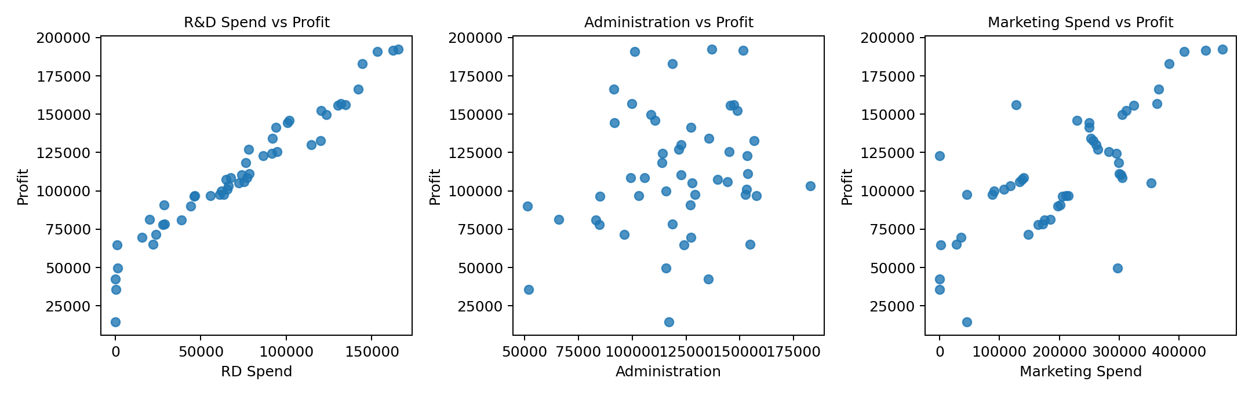
5. Spending Patterns and Profit
Scatter plots help reveal the direction and strength of relationships
Visual reading: the R&D plot shows the clearest upward pattern; Marketing also trends upward, while Administration shows a much weaker pattern.
PRDA-01 | Startup Profit Analysis Prepared for academic submission • 6

Slide 8
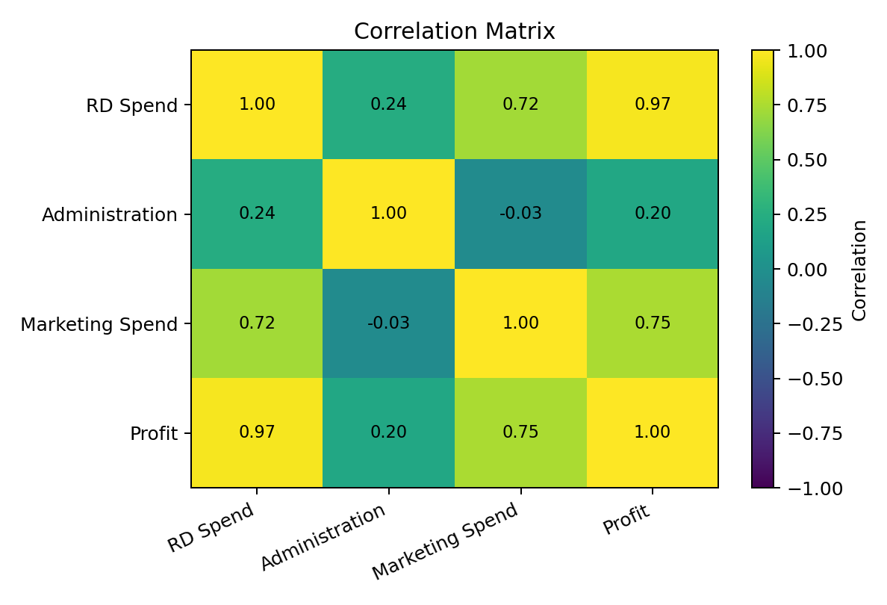
6. Correlation Analysis
Correlation measures the strength of a linear association (from -1 to +1)
R&D Spend and Profit: strong positive correlation (0.973).
Marketing Spend and Profit: positive correlation (0.748).
Administration and Profit: weak positive correlation (0.201).
Correlation is not proof of causation and can be affected by other business factors.
PRDA-01 | Startup Profit Analysis Prepared for academic submission • 7

Slide 9
7. Multiple Linear Regression
Model design and mathematical form
Target variable (Y)
Input variables (X)
Why Multiple Linear Regression?
Profit
R&D Spend
Administration
Marketing Spend
It estimates the relationship between one numerical outcome and several numerical predictors at the same time.
Profit = 50,122.19 + (0.805715 × R&D) + (-0.026816 × Administration) + (0.027228 × Marketing)
The coefficients are estimated from the 50 observed startups. They represent modelled changes in predicted Profit per one-unit increase in a predictor, holding the other predictors constant.
PRDA-01 | Startup Profit Analysis Prepared for academic submission • 8

Slide 10
8. Regression Results
Model fit on the full 50-row dataset
Model statistic | Result | Interpretation
R-squared | 0.9507 | 95.07% of variation explained in this fitted sample
RMSE | 8,855.34 | Typical scale of squared-error-based prediction error
MAE | 6,471.45 | Average absolute fitted error on this sample
Rows used | 50 | All 50 records used to fit the model
The fitted R-squared is high, indicating that the three predictors collectively explain much of the variation in the observed Profit values in this sample.
These are in-sample fit statistics, not an independent test-set score. With only 50 records, validation on new data is recommended before business use.
Administration has a small negative coefficient in the multivariable model; this does not mean reducing necessary administration will automatically increase profit.
PRDA-01 | Startup Profit Analysis Prepared for academic submission • 9

Slide 11
9. Prediction for Assignment Inputs
Predictions generated by the fitted regression model
Case | R&D Spend | Administration | Marketing Spend | Predicted Profit
Input 1 | 21,892.92 | 81,910.77 | 164,270.70 | 70,037.90
Input 2 | 23,940.93 | 96,489.63 | 137,001.10 | 70,554.57
Prediction 1
Prediction 2
$70,037.90
$70,554.57
These are model estimates for the supplied input combinations, not guaranteed future earnings. The inputs are within the broad ranges of the dataset, but prediction uncertainty remains.
PRDA-01 | Startup Profit Analysis Prepared for academic submission • 10

Slide 12
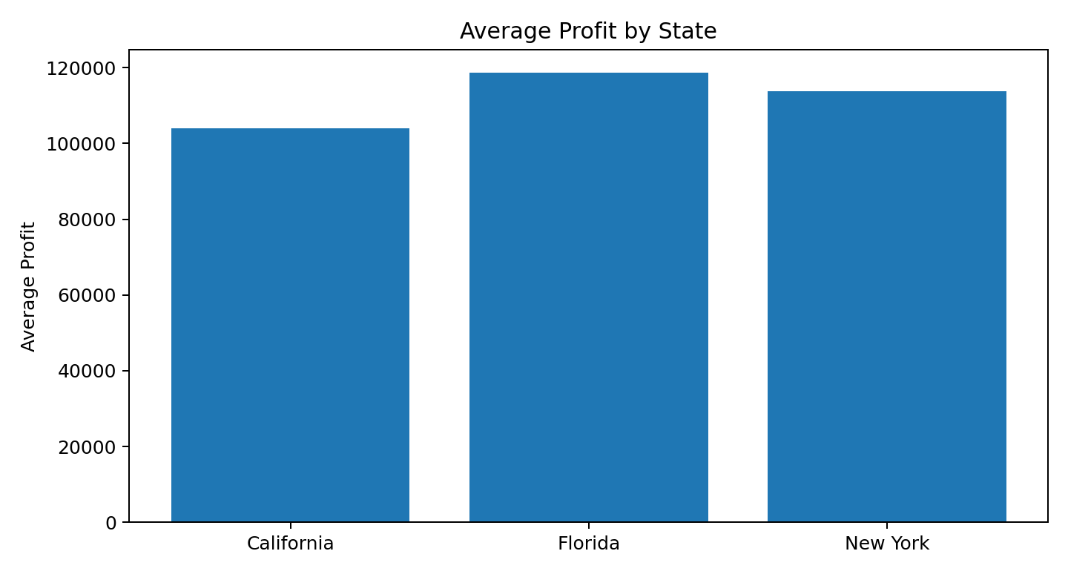
10. State-wise Profit Comparison
Comparing average profit across California, Florida and New York
California: 17 startups | average profit $103,905
Florida: 16 startups | average profit $118,774
New York: 17 startups | average profit $113,756
New York has the highest total profit in this dataset, while Florida has the highest average profit per startup.
State differences should be interpreted carefully because the number of records is small and other company-specific factors are not included.
PRDA-01 | Startup Profit Analysis Prepared for academic submission • 11

Slide 13
11. Key Findings
What the analysis suggests
R&D is the strongest single linear associate of Profit among the three spending variables in this dataset.
Marketing spending also has a positive relationship with Profit, though weaker than R&D.
Administration spending has a comparatively weak relationship with Profit and a small negative adjusted coefficient in the multivariable model.
The three predictors together produce a strong in-sample fit (R² ≈ 0.951).
State-level comparisons show variation, but State alone should not be treated as the explanation for profitability.
PRDA-01 | Startup Profit Analysis Prepared for academic submission • 12

Slide 14
12. Business Recommendations
Practical suggestions for startup management
Evaluate R&D projects using milestones, product-market fit, and measurable outcomes rather than increasing budgets automatically.
Track marketing ROI by channel: customer acquisition cost, conversion rate, revenue per customer and campaign payback.
Review administrative processes for efficiency, but protect essential compliance, finance, HR and operational controls.
Use monthly dashboards to compare spending, revenue and profit by startup, state and time period.
Run controlled experiments and collect more observations before making large budget reallocations.
Treat the regression model as a decision-support tool, not as a substitute for financial planning or management judgement.
PRDA-01 | Startup Profit Analysis Prepared for academic submission • 13

Slide 15
14. Conclusion
Summary of the analysis
The 50-startup dataset was prepared and analysed using exploratory analysis and Multiple Linear Regression.
R&D shows the strongest positive association with Profit in the observed data; Marketing is also positively associated.
The model predicts approximately $70,037.90 for Input 1 and $70,554.57 for Input 2.
The findings can help guide further investigation into investment priorities, marketing efficiency and operating costs.
More data and out-of-sample validation are required before using the model for high-impact financial decisions.
Thank you
PRDA-01 | Startup Profit Analysis Prepared for academic submission • 15

Slide 16
15. Appendix: Model Details and Limitations
Transparency for review and discussion
Intercept: 50,122.1930
R&D coefficient: 0.805715
Administration coefficient: -0.026816
Marketing coefficient: 0.027228
Model type: ordinary least-squares Multiple Linear Regression with three numeric predictors.
Limitations: small sample (n=50), no time dimension, omitted variables (industry, team, product, pricing, competition), and possible multicollinearity between spending variables.
Interpretation: coefficients are conditional associations, not causal effects. The model should be validated on additional data.
PRDA-01 | Startup Profit Analysis Prepared for academic submission • 16

Slide 17
Dashboard Design and Visual Interpretation
KPI CARDS
STATE FILTER
Total Profit, Average Profit and Total R&D Spend provide a quick summary of
business performance.
The slicer lets the viewer focus the dashboard on California, Florida
or New York.
PROFIT BY STATE
EXPENSE DISTRIBUTION
The horizontal bar chart compares total profit across the three states.
The donut chart compares the share of R&D, Administration
and Marketing expenditure.
INVESTMENT COMPARISON
SPENDING BREAKDOWN
The line visual compares the three spending categories across states.
The stacked column chart compares expense composition by state.

