Slide 1
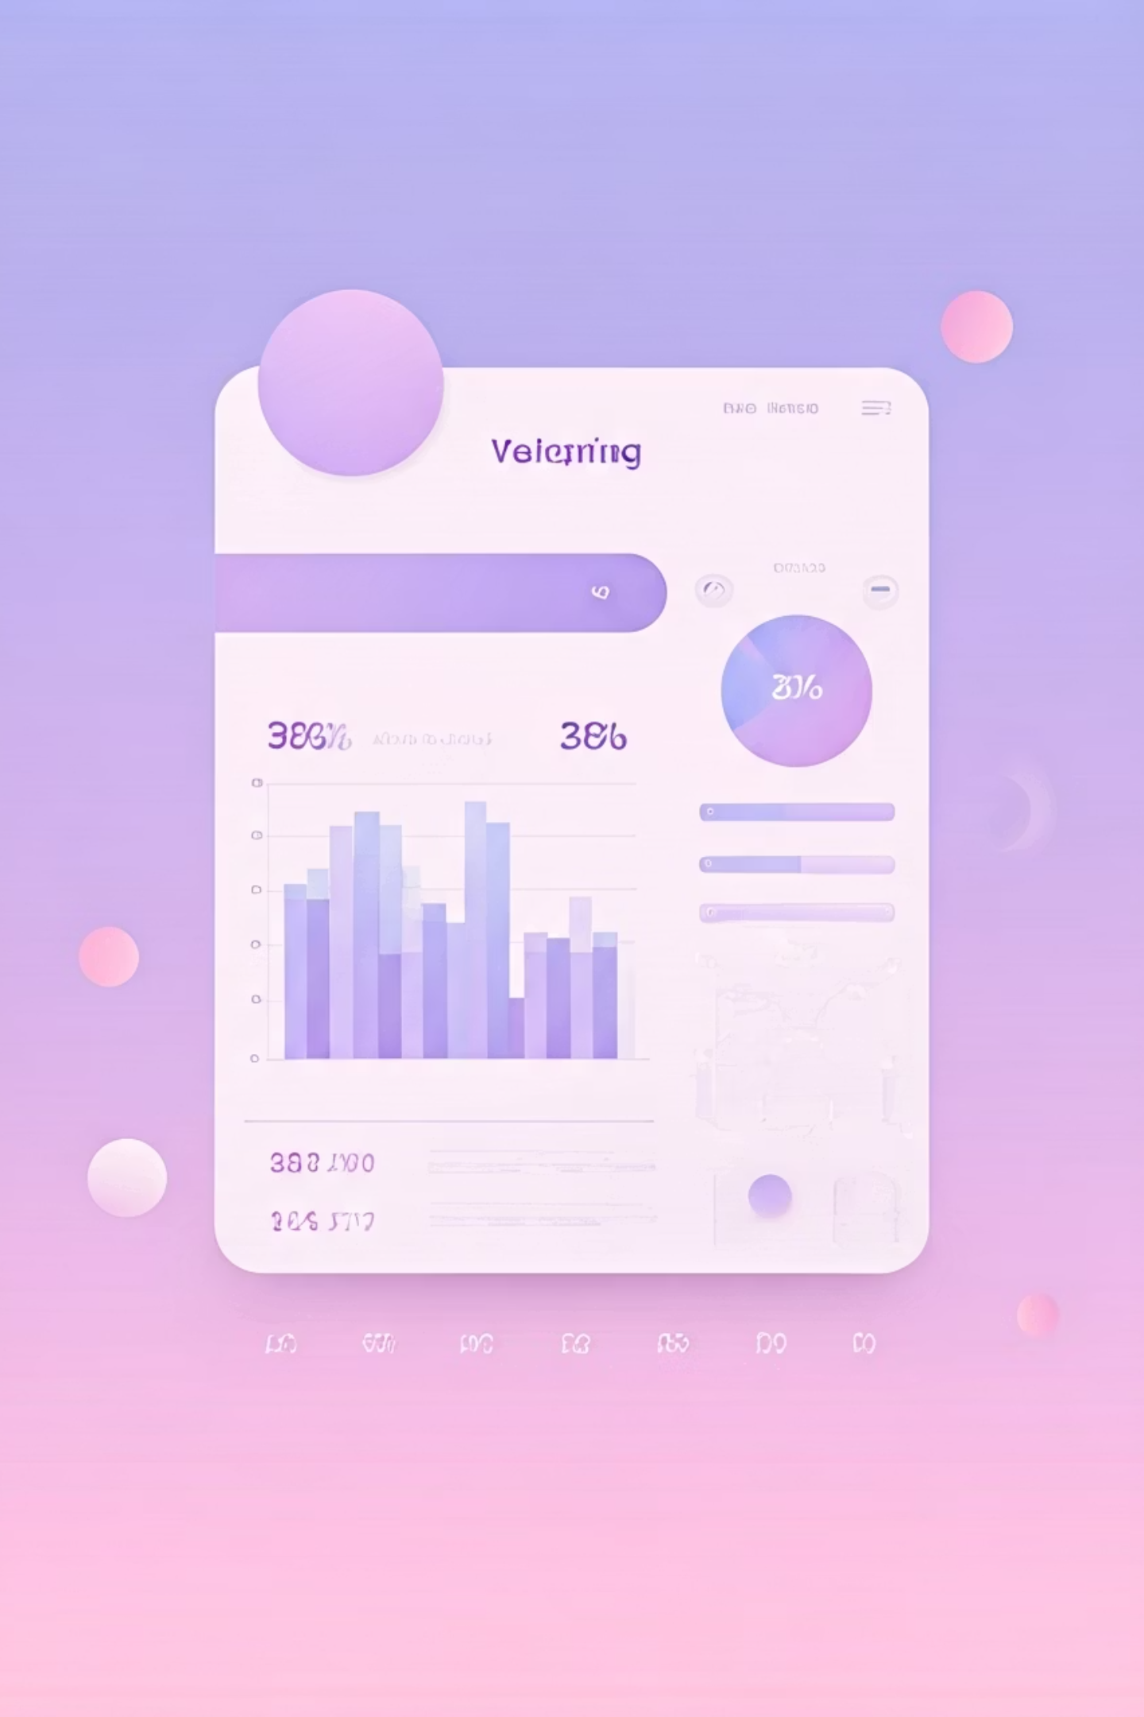
Customer Shopping Behavior Analysis
Analyzing 3,900 purchases to uncover insights into spending patterns, customer segments, and product preferences that drive strategic business decisions.

Slide 2

Dataset Overview
3,900
18
50
Total Purchases
Data Features
Locations
Comprehensive transactional data analyzed
Customer demographics and shopping behavior
Geographic diversity across customer base
25
Product Types
Diverse inventory across categories

Slide 3

Data Preparation & Python Analysis
Data Cleaning
Feature Engineering
Loaded dataset using pandas
Created age_group column by binning customer ages
Imputed 37 missing Review Rating values using median
Generated purchase_frequency_days from purchase data
Standardized columns to snake case
Verified data consistency
Dropped redundant promo_code_used column
Integrated with PostgreSQL database

Slide 4

Revenue Insights by Gender
$157,890
Male Customers
68% of total revenue generated
$75,191
Female Customers
32% of total revenue generated
Male customers drive significantly higher revenue, representing a key demographic for targeted marketing campaigns and product development strategies.

Slide 5

Discount Strategy Analysis
Smart Spenders
839 customers used discounts but still spent above the average purchase amount of $59.76. This segment represents savvy shoppers who seek value without compromising on quality.
Discount-Dependent Products
Hat (50% discount rate)
Sneakers (49.66%)
Coat (49.07%)
Sweater (48.17%)
Pants (47.37%)

Slide 6

Top-Rated Products
1
2
3
Gloves
Sandals
Boots
Average rating: 3.86
Average rating: 3.84
Average rating: 3.82
4
5
Hat
Skirt
Average rating: 3.80
Average rating: 3.78
These top-rated products should be prominently featured in marketing campaigns to leverage customer satisfaction and drive sales.

Slide 7



Customer Segmentation
New
1
83 customers
Returning
2
701 customers
Loyal
3
3,116 customers
The majority of customers (80%) fall into the Loyal segment, demonstrating strong customer retention. Focus on converting New and Returning customers into Loyal buyers through targeted engagement strategies.

Slide 8


Subscription Status Analysis
Revenue Comparison
Subscribers: $59.49 avg spend, $62,645 total revenue
Non-Subscribers: $59.87 avg spend, $170,436 total revenue
27%
While average spend is similar, non-subscribers generate more total revenue due to larger volume. Opportunity to convert more customers to subscriptions.
Subscribers
1,053 customers
73%
Non-Subscribers
2,847 customers

Slide 9
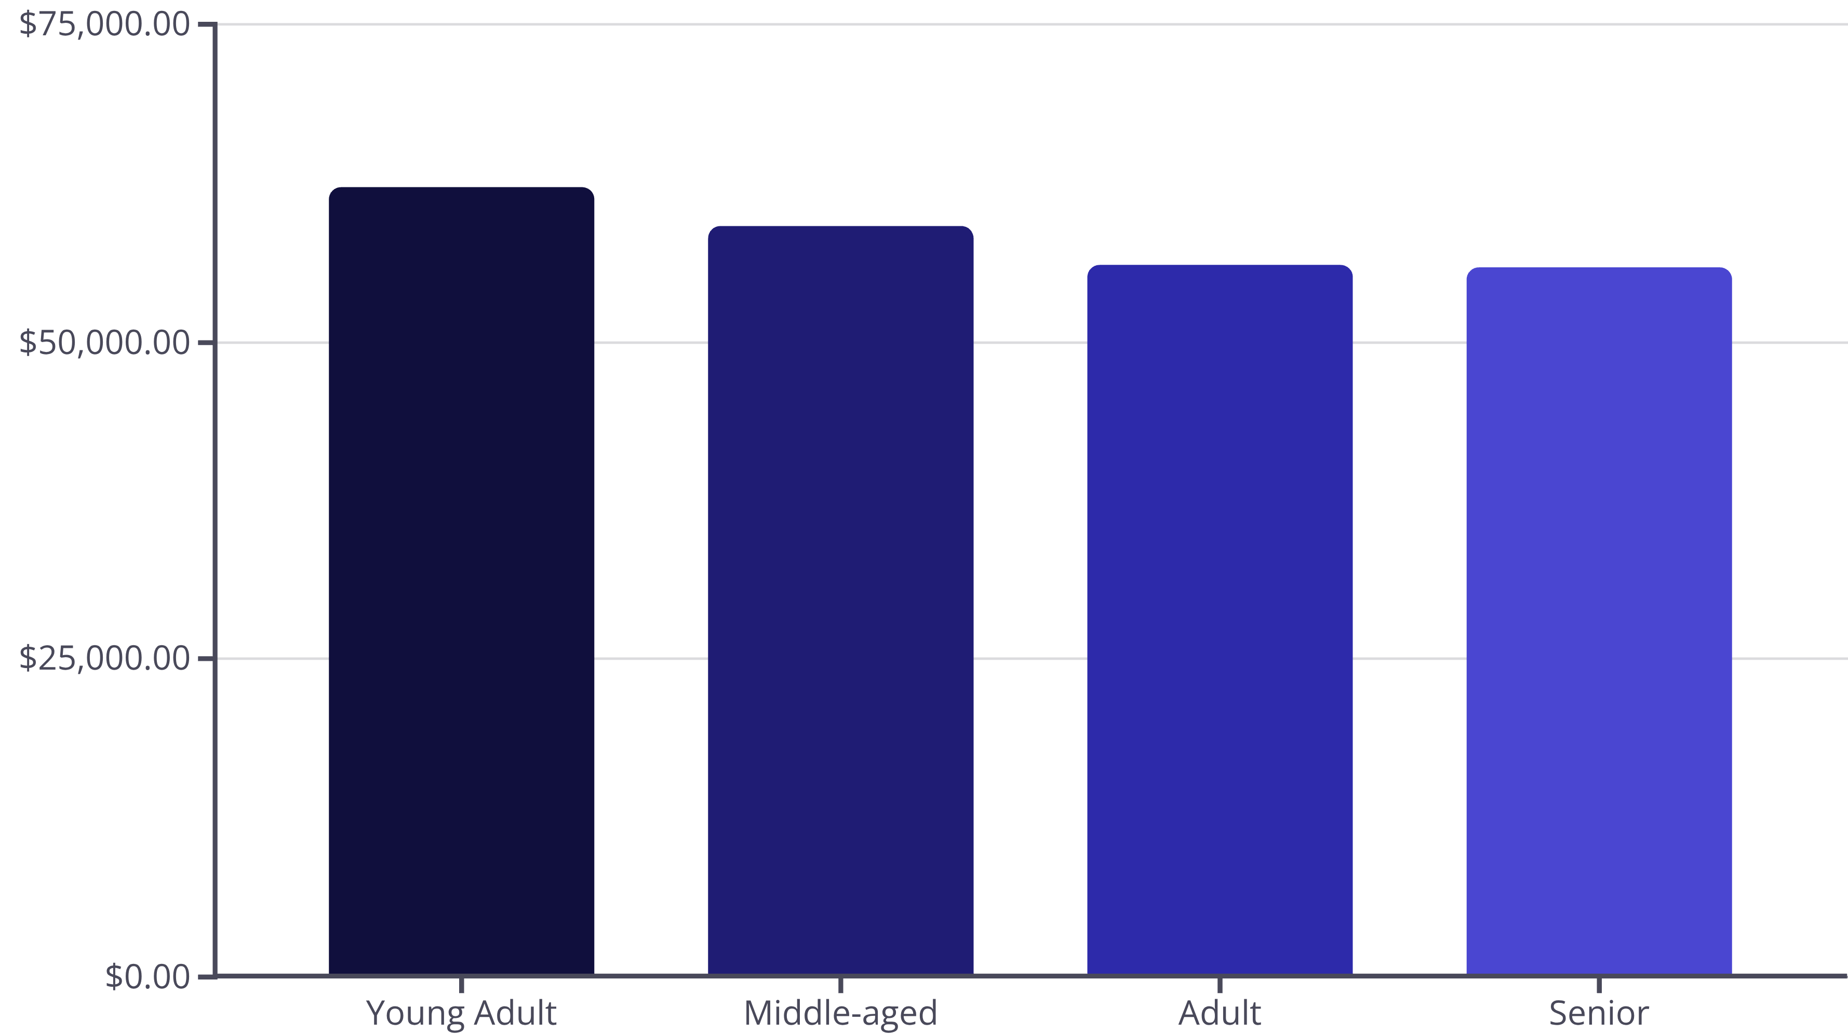
Revenue by Age Group
Young Adults lead revenue generation, followed closely by Middle-aged customers. Marketing efforts should prioritize these high-value segments while exploring growth opportunities in Adult and Senior demographics.

Slide 10


Strategic Recommendations
Boost Subscriptions
Promote exclusive benefits to convert the 73% non-subscriber base
Loyalty Programs
Reward repeat buyers to strengthen the Loyal segment
Optimize Discounts
Balance promotional sales with margin control strategies
Targeted Marketing
Focus on high-revenue age groups and express-shipping users

