Slide 1

https://www.jianshu.com/p/04d180d90a3f

Slide 2
大纲
数据分析师80%的时间用于数据准备：加载、清理、转换以及重塑
https://www.jianshu.com/p/ac7bec000dad
课程安排
7.1 处理缺失值
7.2 数据转换
7.3 字符串操作

Slide 3
7.1 处理缺失值
7.1.1 过滤缺失值
7.1.2 补全缺失值

Slide 4
7.1.1 过滤缺失值
pandas的目标之一就是尽量轻松地处理缺失数据。
对于数值数据，pandas使用浮点值NaN（Not a Number）表示缺失数据
In [10]: string_data = pd.Series(['aardvark', 'artichoke', np.nan, 'avocado'])
In [11]: string_data
Out[11]:
0 aardvark
1 artichoke
2 NaN
3 avocado
dtype: object
In [12]: string_data.isnull()
Out[12]:
0 False
1 False
2 True
3 False
dtype: bool

Slide 5
7.1.1 过滤缺失值
数据清洗时，应直接对缺失数据进行分析，以判断数据采集的问题或缺失数据可能导致的偏差
Python内置的None值在对象数组中也可以作为NA
pandas项目中还在不断优化内部细节以更好处理缺失数据
In [13]: string_data[0] = None
In [14]: string_data.isnull()
Out[14]:
0 True
1 False
2 True
3 False
dtype: bool

Slide 6
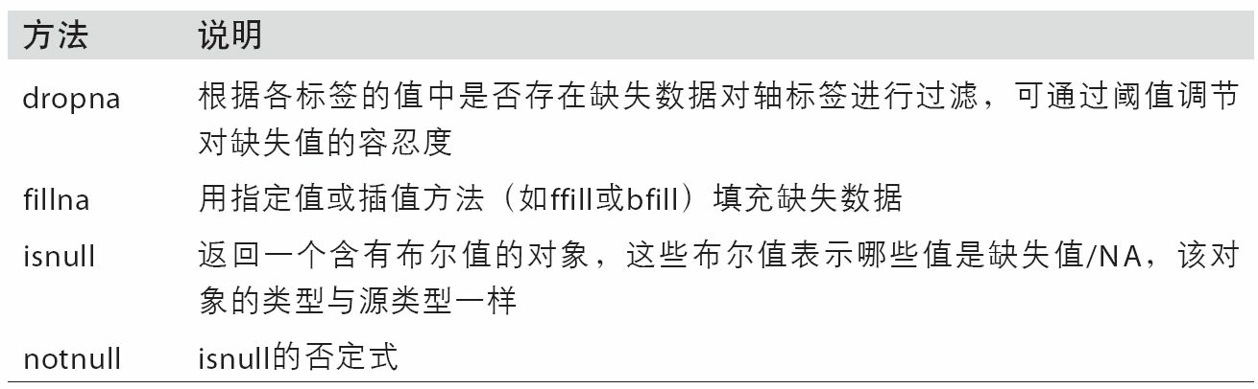
7.1.1 过滤缺失值
缺失数据处理的函数

Slide 7
7.1.1 过滤缺失值
过滤掉缺失数据的办法
通过pandas.isnull或布尔索引的手工方法
dropna可能会更实用一些
对于一个Series，dropna返回一个仅含非空数据和索引值的Series
In [15]: from numpy import nan as NA
In [16]: data = pd.Series([1, NA, 3.5, NA, 7])
In [17]: data.dropna()
Out[17]:
0 1.0
2 3.5
4 7.0
dtype: float64
In [18]: data[data.notnull()]
Out[18]:
0 1.0
2 3.5
4 7.0
dtype: float64

Slide 8
7.1.1 过滤缺失值
DataFrame过滤缺失值
默认丢弃任何含有缺失值的行
In [19]: data = pd.DataFrame([[1., 6.5, 3.], [1., NA, NA],
....: [NA, NA, NA], [NA, 6.5, 3.]])
In [20]: cleaned = data.dropna()
In [21]: data
Out[21]:
0 1 2
0 1.0 6.5 3.0
1 1.0 NaN NaN
2 NaN NaN NaN
3 NaN 6.5 3.0
In [22]: cleaned
Out[22]:
0 1 2
0 1.0 6.5 3.0

Slide 9
7.1.1 过滤缺失值
In [23]: data.dropna(how='all')
Out[23]:
0 1 2
0 1.0 6.5 3.0
1 1.0 NaN NaN
3 NaN 6.5 3.0
In [24]: data[4] = NA
In [25]: data
Out[25]:
0 1 2 4
0 1.0 6.5 3.0 NaN
1 1.0 NaN NaN NaN
2 NaN NaN NaN NaN
3 NaN 6.5 3.0 NaN
In [26]: data.dropna(axis=1, how='all')
Out[26]:
0 1 2
0 1.0 6.5 3.0
1 1.0 NaN NaN
2 NaN NaN NaN
3 NaN 6.5 3.0
DataFrame过滤缺失值
参数：
how='all'
axis=1

Slide 10
7.1.1 过滤缺失值
In [27]: df = pd.DataFrame(np.random.randn(7, 3))
In [28]: df.iloc[:4, 1] = NA
In [29]: df.iloc[:2, 2] = NA
In [30]: df
Out[30]:
0 1 2
0 -0.204708 NaN NaN
1 -0.555730 NaN NaN
2 0.092908 NaN 0.769023
3 1.246435 NaN -1.296221
4 0.274992 0.228913 1.352917
5 0.886429 -2.001637 -0.371843
6 1.669025 -0.438570 -0.539741
In [31]: df.dropna()
Out[31]:
0 1 2
4 0.274992 0.228913 1.352917
5 0.886429 -2.001637 -0.371843
6 1.669025 -0.438570 -0.539741
DataFrame过滤缺失值
参数：
how='all'
axis=1
thresh
In [32]: df.dropna(thresh=2)
Out[32]:
0 1 2
2 0.092908 NaN 0.769023
3 1.246435 NaN -1.296221
4 0.274992 0.228913 1.352917
5 0.886429 -2.001637 -0.371843
6 1.669025 -0.438570 -0.539741

Slide 11
7.1.2 填充缺失数据
fillna
常数：填充所有空值
字典：不同的列填充不同的值
inplace
In [33]: df.fillna(0)
Out[33]:
0 1 2
0 -0.204708 0.000000 0.000000
1 -0.555730 0.000000 0.000000
2 0.092908 0.000000 0.769023
3 1.246435 0.000000 -1.296221
4 0.274992 0.228913 1.352917
5 0.886429 -2.001637 -0.371843
6 1.669025 -0.438570 -0.539741
In [34]: df.fillna({1: 0.5, 2: 0})
Out[34]:
0 1 2
0 -0.204708 0.500000 0.000000
1 -0.555730 0.500000 0.000000
2 0.092908 0.500000 0.769023
3 1.246435 0.500000 -1.296221
4 0.274992 0.228913 1.352917
5 0.886429 -2.001637 -0.371843
6 1.669025 -0.438570 -0.539741
In [35]: _ = df.fillna(0, inplace=True)
In [36]: df
Out[36]:
0 1 2
0 -0.204708 0.000000 0.000000
1 -0.555730 0.000000 0.000000
2 0.092908 0.000000 0.769023
3 1.246435 0.000000 -1.296221
4 0.274992 0.228913 1.352917
5 0.886429 -2.001637 -0.371843
6 1.669025 -0.438570 -0.539741

Slide 12
7.1.2 填充缺失数据
fillna
插值方法
In [37]: df = pd.DataFrame(np.random.randn(6, 3))
In [38]: df.iloc[2:, 1] = NA
In [39]: df.iloc[4:, 2] = NA
In [40]: df
Out[40]:
0 1 2
0 0.476985 3.248944 -1.021228
1 -0.577087 0.124121 0.302614
2 0.523772 NaN 1.343810
3 -0.713544 NaN -2.370232
4 -1.860761 NaN NaN
5 -1.265934 NaN NaN
In [41]: df.fillna(method='ffill')
Out[41]:
0 1 2
0 0.476985 3.248944 -1.021228
1 -0.577087 0.124121 0.302614
2 0.523772 0.124121 1.343810
3 -0.713544 0.124121 -2.370232
4 -1.860761 0.124121 -2.370232
5 -1.265934 0.124121 -2.370232
In [42]: df.fillna(method='ffill', limit=2)
Out[42]:
0 1 2
0 0.476985 3.248944 -1.021228
1 -0.577087 0.124121 0.302614
2 0.523772 0.124121 1.343810
3 -0.713544 0.124121 -2.370232
4 -1.860761 NaN -2.370232
5 -1.265934 NaN -2.370232

Slide 13
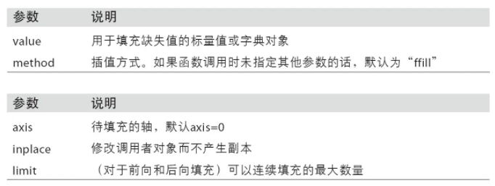
7.1.2 填充缺失数据
fillna
传入Series的平均值或中位数
参数说明
In [43]: data = pd.Series([1., NA, 3.5, NA, 7])
In [44]: data.fillna(data.mean())
Out[44]:
0 1.000000
1 3.833333
2 3.500000
3 3.833333
4 7.000000
dtype: float64

Slide 14
7.2 数据转换
7.2.1 删除重复值
7.2.2 利用函数或映射进行数据转换
7.2.3 替换值
7.2.4 重命名轴索引
7.2.5 离散化和分箱
7.2.6 检测和过滤异常值
7.2.7 排列和随机采样
7.2.8 计算指标/哑变量

Slide 15
7.2.1 删除重复值
In [45]: data = pd.DataFrame({'k1': ['one', 'two'] * 3 + ['two'],
....: 'k2': [1, 1, 2, 3, 3, 4, 4]})
In [46]: data
Out[46]:
k1 k2
0 one 1
1 two 1
2 one 2
3 two 3
4 one 3
5 two 4
6 two 4
In [47]: data.duplicated()
Out[47]:
0 False
1 False
2 False
3 False
4 False
5 False
6 True
dtype: bool
DataFrame中出现重复行有多种原因
duplicated方法返回一个布尔型Series
drop_duplicates
这两个方法默认会判断全部列
In [48]: data.drop_duplicates()
Out[48]:
k1 k2
0 one 1
1 two 1
2 one 2
3 two 3
4 one 3
5 two 4

Slide 16
7.2.1 删除重复值
指定部分列进行重复项判断
duplicated和drop_duplicates默认保留的是第一个出现的值组合
keep='last'则保留最后一个
In [49]: data['v1'] = range(7)
In [50]: data.drop_duplicates(['k1'])
Out[50]:
k1 k2 v1
0 one 1 0
1 two 1 1
In [51]: data.drop_duplicates(['k1', 'k2'], keep='last')
Out[51]:
k1 k2 v1
0 one 1 0
1 two 1 1
2 one 2 2
3 two 3 3
4 one 3 4
6 two 4 6

Slide 17
7.2.2 利用函数或映射进行数据转换
根据数组、Series或DataFrame列中的值来实现转换
示例：根据肉类映射到对应的动物
In [55]: lowercased = data['food'].str.lower()
In [56]: lowercased
Out[56]:
0 bacon
1 pulled pork
2 bacon
3 pastrami
4 corned beef
5 bacon
6 pastrami
7 honey ham
8 nova lox
Name: food, dtype: object
In [57]: data['animal'] = lowercased.map(meat_to_animal)
In [58]: data
Out[58]:
food ounces animal
0 bacon 4.0 pig
1 pulled pork 3.0 pig
2 bacon 12.0 pig
3 Pastrami 6.0 cow
4 corned beef 7.5 cow
5 Bacon 8.0 pig
6 pastrami 3.0 cow
In [52]: data = pd.DataFrame({'food': ['bacon', 'pulled pork', 'bacon',
....: 'Pastrami', 'corned beef', 'Bacon',
....: 'pastrami', 'honey ham', 'nova lox'],
....: 'ounces': [4, 3, 12, 6, 7.5, 8, 3, 5, 6]})
In [53]: data
Out[53]:
food ounces
0 bacon 4.0
1 pulled pork 3.0
2 bacon 12.0
3 Pastrami 6.0
4 corned beef 7.5
5 Bacon 8.0
6 pastrami 3.0
7 honey ham 5.0
8 nova lox 6.0
meat_to_animal = {
'bacon': 'pig',
'pulled pork': 'pig',
'pastrami': 'cow',
'corned beef': 'cow',
'honey ham': 'pig',
'nova lox': 'salmon'
}

Slide 18
7.2.2 利用函数或映射进行数据转换
根据数组、Series或DataFrame列中的值来实现转换
示例：根据肉类映射到对应的动物
使用匿名函数
map
实现元素级转换以及其他数据清理工作的便捷方式。
In [59]: data['food'].map(lambda x: meat_to_animal[x.lower()])
Out[59]:
0 pig
1 pig
2 pig
3 cow
4 cow
5 pig
6 cow
7 pig
8 salmon
Name: food, dtype: object

Slide 19
7.2.3 替换值
利用fillna方法填充缺失数据可以看做值替换的一种特殊情况
map可用于修改对象的数据子集
replace则提供了一种实现该功能的更简单、更灵活的方式
In [60]: data = pd.Series([1., -999., 2., -999., -1000., 3.])
In [61]: data
Out[61]:
0 1.0
1 -999.0
2 2.0
3 -999.0
4 -1000.0
5 3.0
In [62]: data.replace(-999, np.nan)
Out[62]:
0 1.0
1 NaN
2 2.0
3 NaN
4 -1000.0
5 3.0
dtype: float64

Slide 20
7.2.3 替换值
replace一次性替换多个值
In [63]: data.replace([-999, -1000], np.nan)
Out[63]:
0 1.0
1 NaN
2 2.0
3 NaN
4 NaN
5 3.0
dtype: float64
In [64]: data.replace([-999, -1000], [np.nan, 0])
Out[64]:
0 1.0
1 NaN
2 2.0
3 NaN
4 0.0
5 3.0
dtype: float64
In [65]: data.replace({-999: np.nan, -1000: 0})
Out[65]:
0 1.0
1 NaN
2 2.0
3 NaN
4 0.0
5 3.0
dtype: float64

Slide 21
7.2.4 重命名轴索引
rename
索引重新赋值
rename参数传递：函数或字典
In [71]: data.rename(index=str.title, columns=str.upper)
Out[71]:
ONE TWO THREE FOUR
Ohio 0 1 2 3
Colo 4 5 6 7
New 8 9 10 11
In [73]: data.rename(index={'OHIO': 'INDIANA'}, inplace=True)
In [74]: data
Out[74]:
one two three four
INDIANA 0 1 2 3
COLO 4 5 6 7
NEW 8 9 10 11
In [66]: data = pd.DataFrame(np.arange(12).reshape((3, 4)),
....: index=['Ohio', 'Colorado', 'New York'],
....: columns=['one', 'two', 'three', 'four'])
In [67]: transform = lambda x: x[:4].upper()
In [68]: data.index.map(transform)
Out[68]: Index(['OHIO', 'COLO', 'NEW '], dtype='object')
In [69]: data.index = data.index.map(transform)
In [70]: data
Out[70]:
one two three four
OHIO 0 1 2 3
COLO 4 5 6 7
NEW 8 9 10 11

Slide 22
7.2.5 离散化和分箱
为了便于分析，连续数据常常被离散化
示例：对一组人员数据，按年龄进行划分
“18到25”
“26到35”
“35到60”
“60以上”
pd.cut
In [75]: ages = [20, 22, 25, 27, 21, 23, 37, 31, 61, 45, 41, 32]
In [76]: bins = [18, 25, 35, 60, 100]
In [77]: cats = pd.cut(ages, bins)
In [78]: cats
Out[78]:
[(18, 25], (18, 25], (18, 25], (25, 35], (18, 25], ..., (25, 35], (60, 100], (35,60], (35, 60], (25, 35]]
Length: 12
Categories (4, interval[int64]): [(18, 25] < (25, 35] < (35, 60] < (60, 100]]
In [79]: cats.codes
Out[79]: array([0, 0, 0, 1, 0, 0, 2, 1, 3, 2, 2, 1], dtype=int8)
In [80]: cats.categories
Out[80]:
IntervalIndex([(18, 25], (25, 35], (35, 60], (60, 100]]
closed='right',
dtype='interval[int64]')
In [81]: pd.value_counts(cats)
Out[81]:
(18, 25] 5
(35, 60] 3
(25, 35] 3
(60, 100] 1
dtype: int64

Slide 23
7.2.5 离散化和分箱
为了便于分析，连续数据常常被离散化
pd.cut参数
right=False：右端为开端
labels：赋予分箱标签
precision：分箱精度
In [82]: pd.cut(ages, [18, 26, 36, 61, 100], right=False)
Out[82]:
[[18, 26), [18, 26), [18, 26), [26, 36), [18, 26), ..., [26, 36), [61, 100), [36,
61), [36, 61), [26, 36)]
Length: 12
Categories (4, interval[int64]): [[18, 26) < [26, 36) < [36, 61) < [61, 100)]
In [83]: group_names = ['Youth', 'YoungAdult', 'MiddleAged', 'Senior']
In [84]: pd.cut(ages, bins, labels=group_names)
Out[84]:
[Youth, Youth, Youth, YoungAdult, Youth, ..., YoungAdult, Senior, MiddleAged, MiddleAged, YoungAdult]
Length: 12
Categories (4, object): [Youth < YoungAdult < MiddleAged < Senior]
In [85]: data = np.random.rand(20)
In [86]: pd.cut(data, 4, precision=2)
Out[86]:
[(0.34, 0.55], (0.34, 0.55], (0.76, 0.97], (0.76, 0.97], (0.34, 0.55], ..., (0.34, 0.55], (0.34, 0.55], (0.55, 0.76], (0.34, 0.55], (0.12, 0.34]]
Length: 20
Categories (4, interval[float64]): [(0.12, 0.34] < (0.34, 0.55] < (0.55, 0.76] <(0.76, 0.97]]

Slide 24
7.2.5 离散化和分箱
pd.qcut
根据样本分位数对数据进行分箱
与cut区别：
cut：根据极差进行均分
qcut：根据数据的分布情况进行均分
In [87]: data = np.random.randn(1000) # Normally distributed
In [88]: cats = pd.qcut(data, 4) # Cut into quartiles
In [89]: cats
Out[89]:
[(-0.0265, 0.62], (0.62, 3.928], (-0.68, -0.0265], (0.62, 3.928], (-0.0265, 0.62]
, ..., (-0.68, -0.0265], (-0.68, -0.0265], (-2.95, -0.68], (0.62, 3.928], (-0.68, -0.0265]]
Length: 1000
Categories (4, interval[float64]): [(-2.95, -0.68] < (-0.68, -0.0265] < (-0.0265, 0.62] <(0.62, 3.928]]
In [90]: pd.value_counts(cats)
Out[90]:
(0.62, 3.928] 250
(-0.0265, 0.62] 250
(-0.68, -0.0265] 250
(-2.95, -0.68] 250
dtype: int64

Slide 25
7.2.5 离散化和分箱
pd.qcut
自定义的分位数
0到1之间的数值，包含端点
In [91]: pd.qcut(data, [0, 0.1, 0.5, 0.9, 1.])
Out[91]:
[(-0.0265, 1.286], (-0.0265, 1.286], (-1.187, -0.0265], (-0.0265, 1.286], (-0.0265, 1.286], ..., (-1.187, -0.0265], (-1.187, -0.0265], (-2.95, -1.187], (-0.0265,1.286], (-1.187, -0.0265]]
Length: 1000
Categories (4, interval[float64]): [(-2.95, -1.187] < (-1.187, -0.0265] < (-0.0265, 1.286] < (1.286, 3.928]]

Slide 26
7.2.6 检测和过滤异常值
过滤或变换异常值（outlier）在很大程度上就是运用数组运算
示例
找出某列中绝对值大小超过3的值
找出绝对值超过3的值所在的行数据
In [92]: data = pd.DataFrame(np.random.randn(1000, 4))
In [93]: data.describe()
Out[93]:
0 1 2 3
count 1000.000000 1000.000000 1000.000000 1000.000000
mean 0.049091 0.026112 -0.002544 -0.051827
std 0.996947 1.007458 0.995232 0.998311
min -3.645860 -3.184377 -3.745356 -3.428254
25% -0.599807 -0.612162 -0.687373 -0.747478
50% 0.047101 -0.013609 -0.022158 -0.088274
75% 0.756646 0.695298 0.699046 0.623331
max 2.653656 3.525865 2.735527 3.366626
In [94]: col = data[2]
In [95]: col[np.abs(col) > 3]
Out[95]:
41 -3.399312
136 -3.745356
Name: 2, dtype: float64
In [96]: data[(np.abs(data) > 3).any(1)]
Out[96]:
0 1 2 3
41 0.457246 -0.025907 -3.399312 -0.974657
60 1.951312 3.260383 0.963301 1.201206
136 0.508391 -0.196713 -3.745356 -1.520113
235 -0.242459 -3.056990 1.918403 -0.578828
258 0.682841 0.326045 0.425384 -3.428254
322 1.179227 -3.184377 1.369891 -1.074833
544 -3.548824 1.553205 -2.186301 1.277104
635 -0.578093 0.193299 1.397822 3.366626
782 -0.207434 3.525865 0.283070 0.544635
803 -3.645860 0.255475 -0.549574 -1.907459

Slide 27
7.2.6 检测和过滤异常值
过滤或变换异常值（outlier）在很大程度上就是运用数组运算
示例
将数据限制在【-3， 3】
np.sign(data)可以生成1、0或-1
In [97]: data[np.abs(data) > 3] = np.sign(data) * 3
In [98]: data.describe()
Out[98]:
0 1 2 3
count 1000.000000 1000.000000 1000.000000 1000.000000
mean 0.050286 0.025567 -0.001399 -0.051765
std 0.992920 1.004214 0.991414 0.995761
min -3.000000 -3.000000 -3.000000 -3.000000
25% -0.599807 -0.612162 -0.687373 -0.747478
50% 0.047101 -0.013609 -0.022158 -0.088274
75% 0.756646 0.695298 0.699046 0.623331
max 2.653656 3.000000 2.735527 3.000000
In [99]: np.sign(data).head()
Out[99]:
0 1 2 3
0 -1.0 1.0 -1.0 1.0
1 1.0 -1.0 1.0 -1.0
2 1.0 1.0 1.0 -1.0
3 -1.0 -1.0 1.0 -1.0
4 -1.0 1.0 -1.0 -1.0

Slide 28
7.2.7 排列和随机采样
随机重排序permutation
传递轴长，返回随机顺序的整数数组
In [100]: df = pd.DataFrame(np.arange(5 * 4).reshape((5, 4)))
In [101]: sampler = np.random.permutation(5)
In [102]: sampler
Out[102]: array([3, 1, 4, 2, 0])
In [103]: df
Out[103]:
0 1 2 3
0 0 1 2 3
1 4 5 6 7
2 8 9 10 11
3 12 13 14 15
4 16 17 18 19
In [104]: df.take(sampler)
Out[104]:
0 1 2 3
3 12 13 14 15
1 4 5 6 7
4 16 17 18 19
2 8 9 10 11
0 0 1 2 3

Slide 29
7.2.7 排列和随机采样
抽样sample
In [105]: df.sample(n=3)
Out[105]:
0 1 2 3
3 12 13 14 15
4 16 17 18 19
2 8 9 10 11
In [106]: choices = pd.Series([5, 7, -1, 6, 4])
In [107]: draws = choices.sample(n=10, replace=True)
In [108]: draws
Out[108]:
4 4
1 7
4 4
2 -1
0 5
3 6
1 7
4 4
0 5
4 4
dtype: int64

Slide 30
7.2.8 计算指标/虚拟变量
分类变量转换为“指标”矩阵常用于统计建模或机器学习的转换操作get_dummies
例如：分类结果变量有k个取值，可衍生一个k列的值为1或0的矩阵
In [109]: df = pd.DataFrame({'key': ['b', 'b', 'a', 'c', 'a', 'b'],
.....: 'data1': range(6)})
In [110]: pd.get_dummies(df['key'])
Out[110]:
a b c
0 0 1 0
1 0 1 0
2 1 0 0
3 0 0 1
4 1 0 0
5 0 1 0

Slide 31
7.2.8 计算指标/虚拟变量
get_dummies
prefix参数：设置列名前缀
复杂情况
DataFrame中的某行同属于多个分类
In [111]: dummies = pd.get_dummies(df['key'], prefix='key')
In [112]: df_with_dummy = df[['data1']].join(dummies)
In [113]: df_with_dummy
Out[113]:
data1 key_a key_b key_c
0 0 0 1 0
1 1 0 1 0
2 2 1 0 0
3 3 0 0 1
4 4 1 0 0
5 5 0 1 0

Slide 32
7.2.8 计算指标/虚拟变量
数据规整
从数据集中抽取出不同的genre值
构造虚拟变量
添加到原始DF
In [114]: mnames = ['movie_id', 'title', 'genres']
In [115]: movies = pd.read_table('datasets/movielens/movies.dat', sep='::',
.....: header=None, names=mnames)
In [116]: movies[:10]
Out[116]:
movie_id title genres
0 1 Toy Story (1995) Animation|Children's|Comedy
1 2 Jumanji (1995) Adventure|Children's|Fantasy
2 3 Grumpier Old Men (1995) Comedy|Romance
3 4 Waiting to Exhale (1995) Comedy|Drama
4 5 Father of the Bride Part II (1995) Comedy
5 6 Heat (1995) Action|Crime|Thriller
6 7 Sabrina (1995) Comedy|Romance
7 8 Tom and Huck (1995) Adventure|Children's
8 9 Sudden Death (1995)
Action
9 10 GoldenEye (1995) Action|Adventure|Thriller

Slide 33
7.2.8 计算指标/虚拟变量
数据规整
从数据集中抽取出不同的genre值
In [117]: all_genres = []
In [118]: for x in movies.genres:
.....: all_genres.extend(x.split('|'))
In [119]: genres = pd.unique(all_genres)
In [120]: genres
Out[120]:
array(['Animation', "Children's", 'Comedy', 'Adventure', 'Fantasy',
'Romance', 'Drama', 'Action', 'Crime', 'Thriller','Horror',
'Sci-Fi', 'Documentary', 'War', 'Musical', 'Mystery', 'Film-Noir',
'Western'], dtype=object)

Slide 34
7.2.8 计算指标/虚拟变量
数据规整
构造虚拟变量
In [121]: zero_matrix = np.zeros((len(movies), len(genres)))
In [122]: dummies = pd.DataFrame(zero_matrix, columns=genres)
In [123]: gen = movies.genres[0]
In [124]: gen.split('|')
Out[124]: ['Animation', "Children's", 'Comedy']
In [125]: dummies.columns.get_indexer(gen.split('|'))
Out[125]: array([0, 1, 2])
In [126]: for i, gen in enumerate(movies.genres):
.....: indices = dummies.columns.get_indexer(gen.split('|'))
.....: dummies.iloc[i, indices] = 1
.....:

Slide 35
7.2.8 计算指标/虚拟变量
数据规整
添加到原始DF
提示：
对于很大的数据，用这种方式构建多成员指标变量就会变得非常慢。
最好使用更低级的函数，将其写入NumPy数组，然后结果包装在DataFrame中。
In [127]: movies_windic = movies.join(dummies.add_prefix('Genre_'))
In [128]: movies_windic.iloc[0]
Out[128]:
movie_id 1
title Toy Story (1995)
genres Animation|Children's|Comedy
Genre_Animation 1
Genre_Children's 1
Genre_Comedy 1
Genre_Adventure 0
Genre_Fantasy 0
Genre_Romance 0
Genre_Drama 0
...
Genre_Documentary 0
Genre_War 0
Genre_Musical 0
Genre_Mystery 0
Genre_Film-Noir 0
Genre_Western 0
Name: 0, Length: 21, dtype: object

Slide 36
7.2.8 计算指标/虚拟变量
统计应用
生成随机虚拟变量
In [129]: np.random.seed(12345)
In [130]: values = np.random.rand(10)
In [131]: values
Out[131]:
array([ 0.9296, 0.3164, 0.1839, 0.2046, 0.5677, 0.5955, 0.9645,
0.6532, 0.7489, 0.6536])
In [132]: bins = [0, 0.2, 0.4, 0.6, 0.8, 1]
In [133]: pd.get_dummies(pd.cut(values, bins))
Out[133]:
(0.0, 0.2] (0.2, 0.4] (0.4, 0.6] (0.6, 0.8] (0.8, 1.0]
0 0 0 0 0 1
1 0 1 0 0 0
2 1 0 0 0 0
3 0 1 0 0 0
4 0 0 1 0 0
5 0 0 1 0 0
6 0 0 0 0 1
7 0 0 0 1 0
8 0 0 0 1 0
9 0 0 0 1 0

Slide 37
7.3 字符串操作
字符串对象方法
正则表达式
pandas的向量化字符串函数

Slide 38
7.3.1 字符串对象方法
内置的字符串方法
split
strip
+
join
in
find
index
count
replace
In [144]: val.index(':')
---------------------------------------------------------------------------
ValueError Traceback (most recent call last)
<ipython-input-144-280f8b2856ce> in <module>()
----> 1 val.index(':')
ValueError: substring not found
In [145]: val.count(',')
Out[145]: 2
In [146]: val.replace(',', '::')
Out[146]: 'a::b:: guido'
In [147]: val.replace(',', '')
Out[147]: 'ab guido'
In [134]: val = 'a,b, guido'
In [135]: val.split(',')
Out[135]: ['a', 'b', ' guido']
In [136]: pieces = [x.strip() for x in val.split(',')]
In [137]: pieces
Out[137]: ['a', 'b', 'guido']
In [138]: first, second, third = pieces
In [139]: first + '::' + second + '::' + third
Out[139]: 'a::b::guido'
In [140]: '::'.join(pieces)
Out[140]: 'a::b::guido'
In [141]: 'guido' in val
Out[141]: True
In [142]: val.index(',')
Out[142]: 1
In [143]: val.find(':')
Out[143]: -1

Slide 39
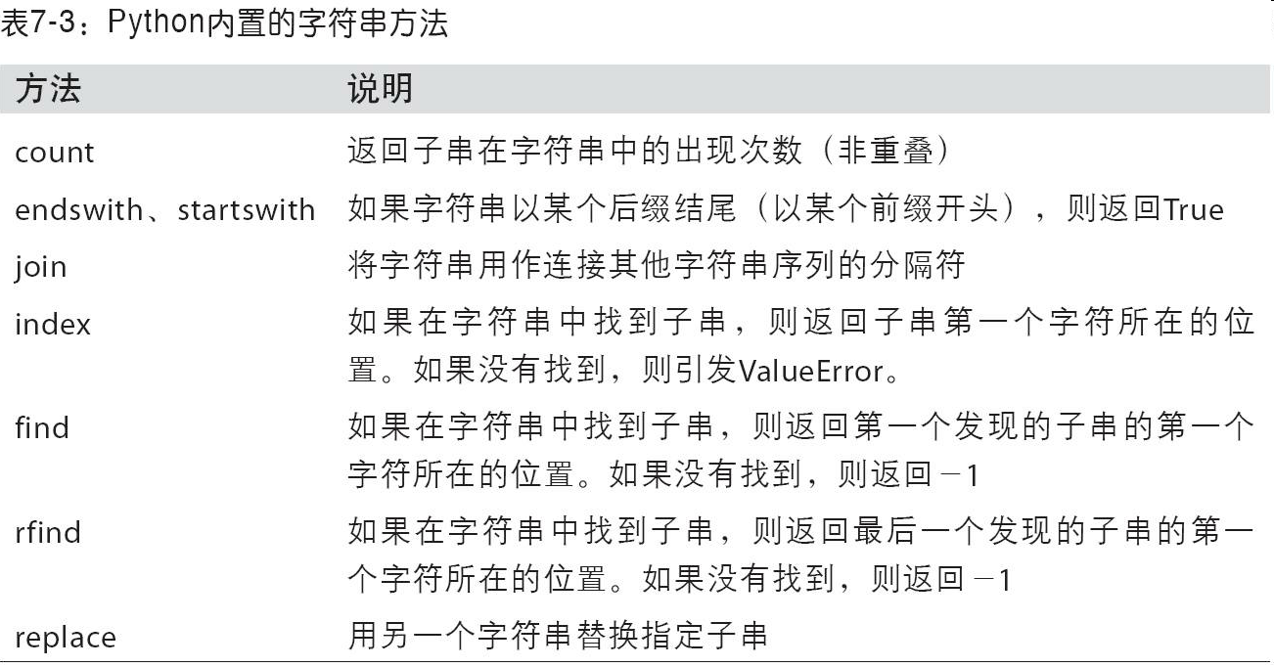
7.3.1 字符串对象方法
内置的字符串方法

Slide 40
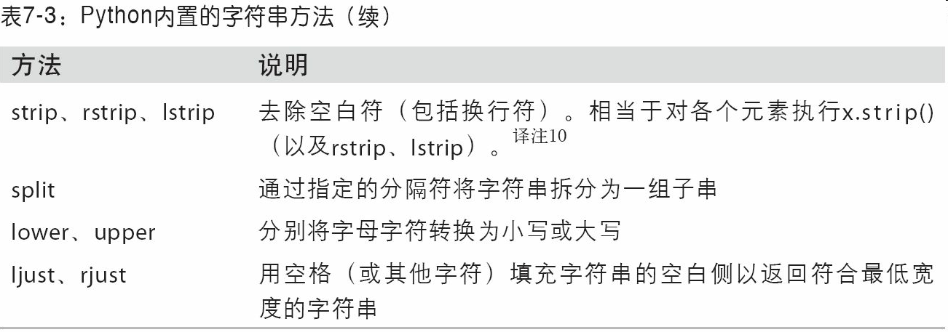
7.3.1 字符串对象方法
内置的字符串方法

Slide 41
7.3.2 正则表达式
正则表达式提供了一种灵活的在文本中搜索或匹配（通常比前者复杂）字符串模式的方式
Python内置的re模块负责对字符串应用正则表达式。
re模块的函数可以分为三个大类：模式匹配、替换以及拆分。
先编译再执行
re.compile自己编译regex以得到一个可重用的regex对象
re.split：根据正则表达式切分
re.findall：找到所有匹配的模式
示例：要拆分一个字符串，分隔符为数量不定的一组空白符。
In [148]: import re
In [149]: text = "foo bar\t baz \tqux"
In [150]: re.split('\s+', text)
Out[150]: ['foo', 'bar', 'baz', 'qux']
In [151]: regex = re.compile('\s+')
In [152]: regex.split(text)
Out[152]: ['foo', 'bar', 'baz', 'qux']
In [153]: regex.findall(text)
Out[153]: [' ', '\t ', ' \t']

Slide 42
7.3.2 正则表达式
findall返回的是字符串中所有的匹配项
search则只返回第一个匹配项
match只匹配字符串的首部
sub可以将匹配到的模式替换为指定字符串
示例：电子邮箱识别
text = """Dave dave@google.com
Steve steve@gmail.com
Rob rob@gmail.com
Ryan ryan@yahoo.com
"""
pattern = r'[A-Z0-9._%+-]+@[A-Z0-9.-]+\.[A-Z]{2,4}'
# re.IGNORECASE makes the regex case-insensitive
regex = re.compile(pattern, flags=re.IGNORECASE)
In [155]: regex.findall(text)
Out[155]:
['dave@google.com',
'steve@gmail.com',
'rob@gmail.com',
'ryan@yahoo.com']
In [156]: m = regex.search(text)
In [157]: m
Out[157]: <_sre.SRE_Match object; span=(5, 20), match='dave@google.com'>
In [158]: text[m.start():m.end()]
Out[158]: 'dave@google.com'
In [159]: print(regex.match(text))
None
In [160]: print(regex.sub('REDACTED', text))
Dave REDACTED
Steve REDACTED
Rob REDACTED
Ryan REDACTED

Slide 43
7.3.2 正则表达式
不仅想要找出电子邮件地址，还想将各个地址分成3个部分：用户名、域名以及域后缀
分组：小括号
sub访问各匹配项中的分组
符号\1对应第一个匹配的组
In [161]: pattern = r'([A-Z0-9._%+-]+)@([A-Z0-9.-]+)\.([A-Z]{2,4})'
In [162]: regex = re.compile(pattern, flags=re.IGNORECASE)
In [163]: m = regex.match('wesm@bright.net')
In [164]: m.groups()
Out[164]: ('wesm', 'bright', 'net')
In [165]: regex.findall(text)
Out[165]:
[('dave', 'google', 'com'),
('steve', 'gmail', 'com'),
('rob', 'gmail', 'com'),
('ryan', 'yahoo', 'com')]
In [166]: print(regex.sub(r'Username: \1, Domain: \2, Suffix: \3', text))
Dave Username: dave, Domain: google, Suffix: com
Steve Username: steve, Domain: gmail, Suffix: com
Rob Username: rob, Domain: gmail, Suffix: com
Ryan Username: ryan, Domain: yahoo, Suffix: com

Slide 44
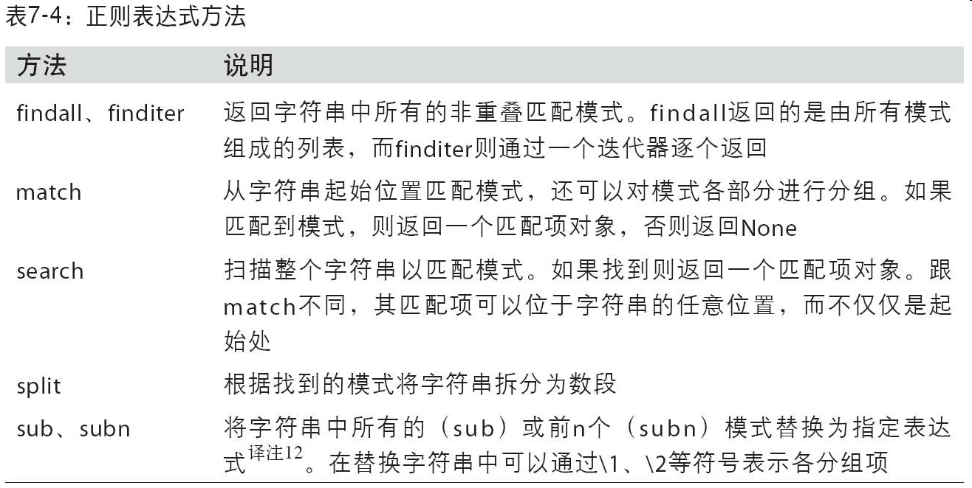
7.3.2 正则表达式
正则表达式方法

Slide 45
7.3.3 pandas的矢量化字符串函数
字符串规整化工作：清理待分析的散乱数据
字符串和正则表达式方法元素级应用
空值：data.map报错
解决方案
通过str属性访问字符串方法
In [167]: data = {'Dave': 'dave@google.com', 'Steve': 'steve@gmail.com',
.....: 'Rob': 'rob@gmail.com', 'Wes': np.nan}
In [168]: data = pd.Series(data)
In [169]: data
Out[169]:
Dave dave@google.com
Rob rob@gmail.com
Steve steve@gmail.com
Wes NaN
dtype: object
In [170]: data.isnull()
Out[170]:
Dave False
Rob False
Steve False
Wes True
dtype: bool
In [171]: data.str.contains('gmail')
Out[171]:
Dave False
Rob True
Steve True
Wes NaN
dtype: object

Slide 46
7.3.3 pandas的矢量化字符串函数
正则表达式
矢量化的元素获取操作
str.get，str属性
In [172]: pattern
Out[172]: '([A-Z0-9._%+-]+)@([A-Z0-9.-]+)\\.([A-Z]{2,4})'
In [173]: data.str.findall(pattern, flags=re.IGNORECASE)
Out[173]:
Dave [(dave, google, com)]
Rob [(rob, gmail, com)]
Steve [(steve, gmail, com)]
Wes NaN
dtype: object
In [174]: matches = data.str.match(pattern, flags=re.IGNORECASE)
In [175]: matches
Out[175]:
Dave True
Rob True
Steve True
Wes NaN
dtype: object
In [176]: matches.str.get(1)
Out[176]:
Dave NaN
Rob NaN
Steve NaN
Wes NaN
dtype: float64
In [177]: matches.str[0]
Out[177]:
Dave NaN
Rob NaN
Steve NaN
Wes NaN
dtype: float64
In [178]: data.str[:5]
Out[178]:
Dave dave@
Rob rob@g
Steve steve
Wes NaN
dtype: object

Slide 47
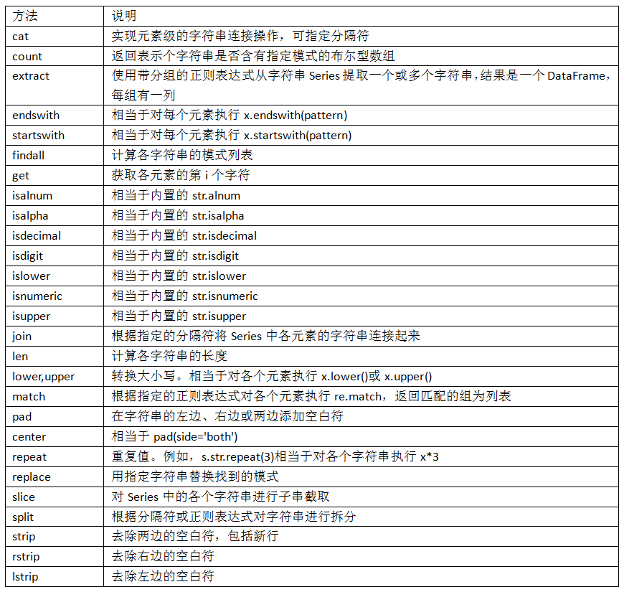
7.3.3 pandas的矢量化字符串函数
pandas字符串方法

