Slide 1

Real Estate Property
Listing and Searching

Slide 2
Company Details
Company Name: Jay Estate(Non-Technical Firm)
External Guide : Bipinbhai Sheth
Internal Guide: Prof. Munindra Lunagaria
Prepared By: Jay Sheth(090570107064)
Smit Vasha(090570107011)

Slide 3
Introduction
Real Estate System is all about purchasing and selling of Land, Houses,Shops, etc..
It also includes additional tools related to Real Estate ,Such as Mortgage Calculator, Loan Calculator, Recently Sold or bought , Browse Listing etc...
As it is website based portal anyone can access it globally and through mobile phones as well.
It is both the seller as well as buyer based portal.

Slide 4
Scope and Objective of Product
This web-site will basically perform two tasks that is Searching and Listing. In Searching basically three kinds of searching techniques are provided in which the first is the normal search and the second is the advance search and the third one is the searching on the map.
The main objective of the system is to make the work of finding appropriate properties and maintain the direct relationship between Seller of the property and Buyer of the Property and to make a system which reduce the work of industry as well as time.

Slide 5
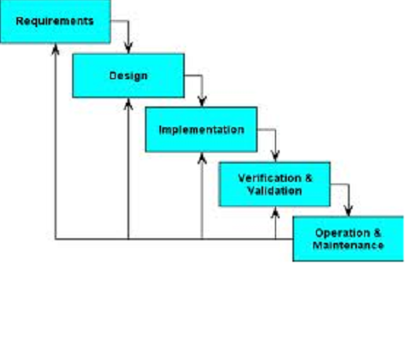
Process Models
We are following Waterfall Model for our project.

Slide 6
Users of the System
In this system there are mainly three types of users
Admin of the System.
System main users-Seller of the Property.
Buyer of the Property.

Slide 7
What does a Buyer look for..!
Location
Ambience
Pricing
Mortgage analysis
Type of Property.
Source
Neighborhood
Legal document and paperwork

Slide 8
What will Seller Provide..!
Price of the property
Neighbourhood of the property
Area of the property
Available facilities inside the property
Various photos of the property
Year in which it was built
Whether the builder of that property is new or experienced
Annual taxes on that property, etc.
Expected price-range

Slide 9
Main Features
Buying Or Selling
Mortgage Calculator
Loan Calculator
Featured
Foreclosures
Recently Sold/Bought
Integrated Google Maps Location
Subscription Through SMS/Newsletter.

Slide 10
User Interfaces
Home Page
Browse Listing
Password Security and Retrieval
Contact Us
Add Listings
Searching
Administrator’s Domain

Slide 11
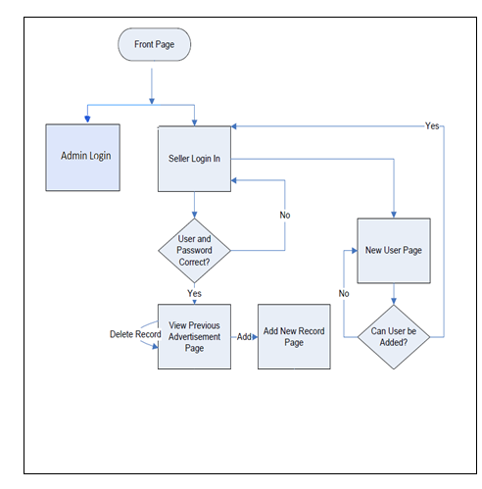
Flow Control

Slide 12
Use Case of the System
Search property
View Property Details
User/Customer
View Client
Property Details
Match Property
Moderator
Update Property
Manage Transaction
Generate Updates
Vendor Details
Manage Users
Administrator

Slide 13
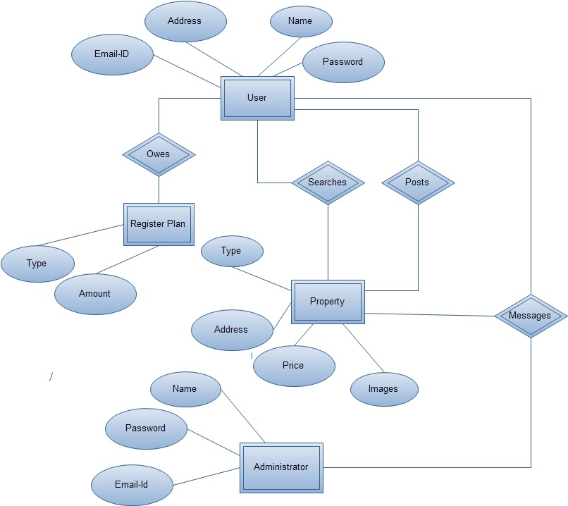
ER diagram of the System

Slide 14
Searching
  Expected price-range
  Number of bathrooms and bedrooms
  Type of property such as residential, commercial, open land, etc.
  Expected city and province or state

Slide 15
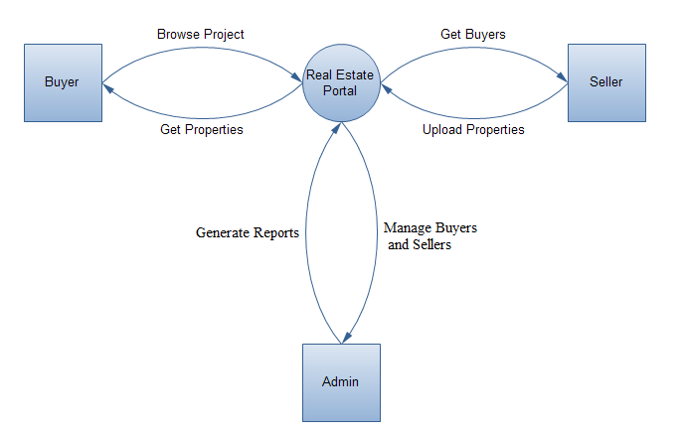
Context Diagram

Slide 16
Content Management Tools
Content Editor
  Edit each page HTML/Graphical
  Create Links
  Add New Pages
  Add Photos

Slide 17
Content Management Tools
Navigation Editor
  Add links to your navigation menu
  Edit existing links
  Change link order

Slide 18
Content Management Tools
Affiliate Manager
  Organize Affiliated Advertiser Program on your website
  Include Banner Ads

Slide 19
Content Management Tools
Listing Manager
  Listing search
  Listing stats
  1 click link to Listing Flyer
  Listing Editor
  Add photos
  Add remarks
  Input open house information

Slide 20
Administrative Tools
Edit User Privileges
Reset Passwords
Qualifying Information
Website Logs
  Website Traffic Statistics(Google analytic)
Add/Remove Information
Add/Remove Users

Slide 21
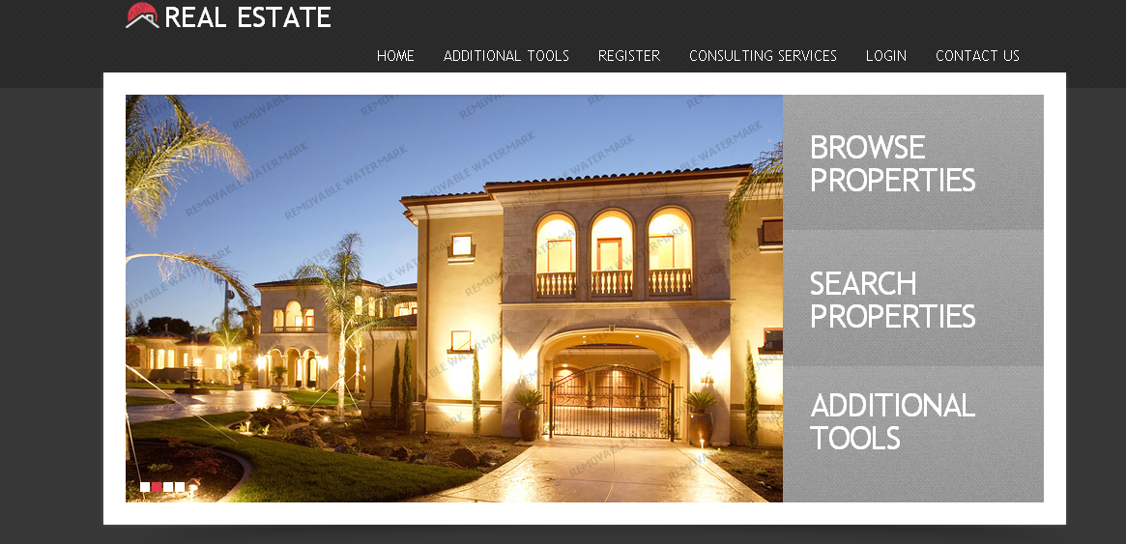
Home Page

Slide 22
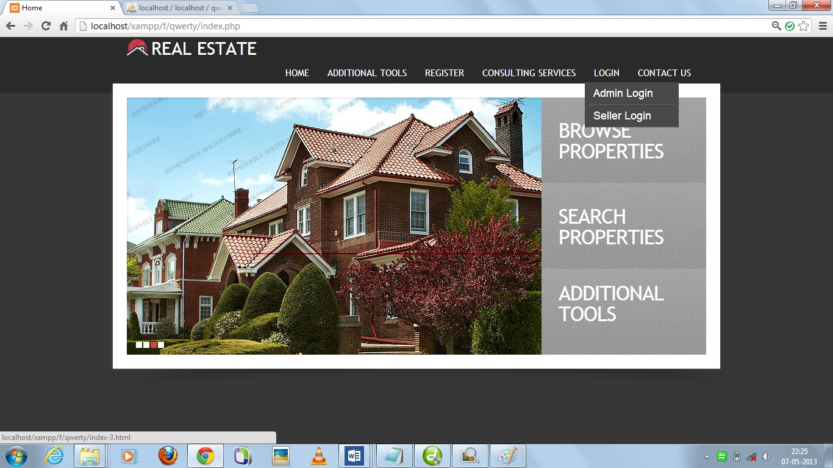
Login Panel

Slide 23
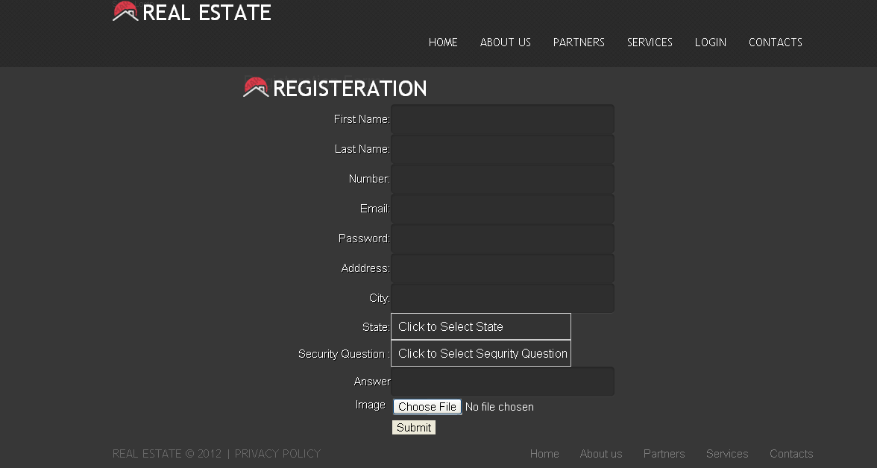
Registration Form

Slide 24
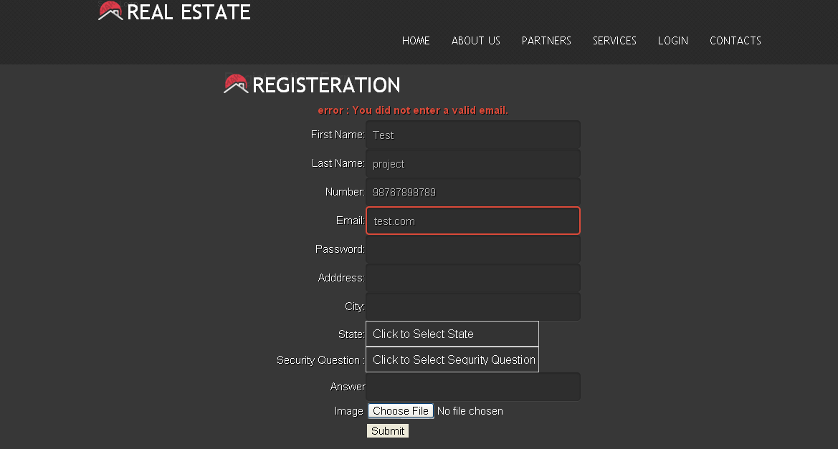
Registration Form Validation

Slide 25
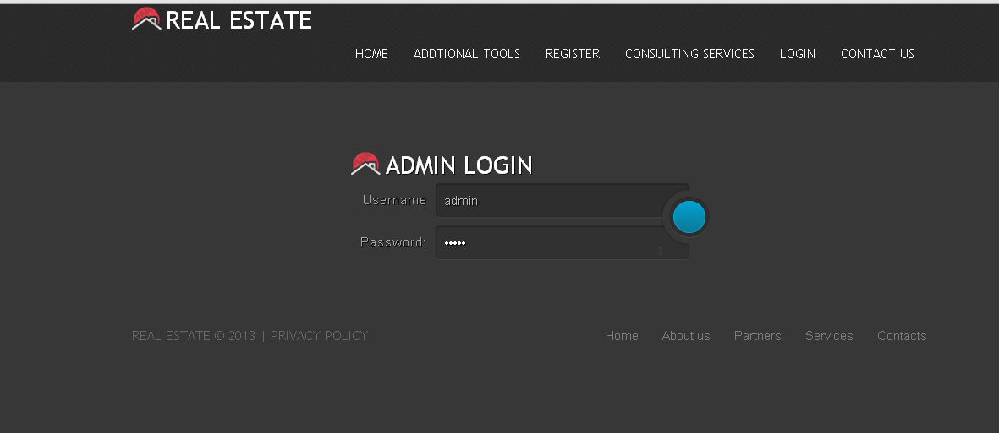
Admin Login

Slide 26
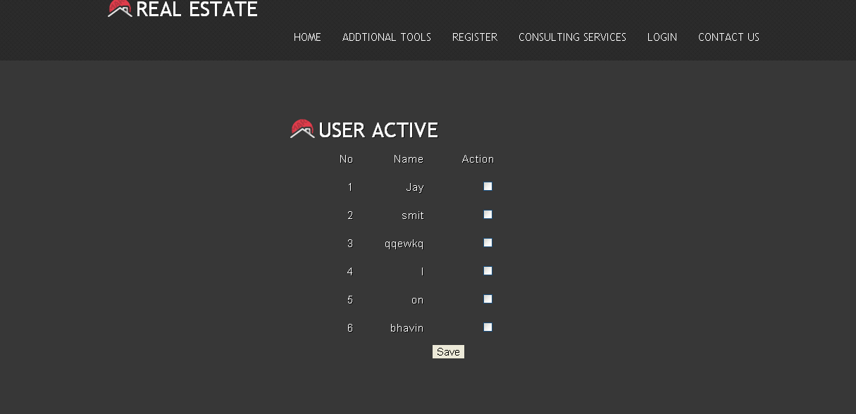
Admin Validates User

Slide 27
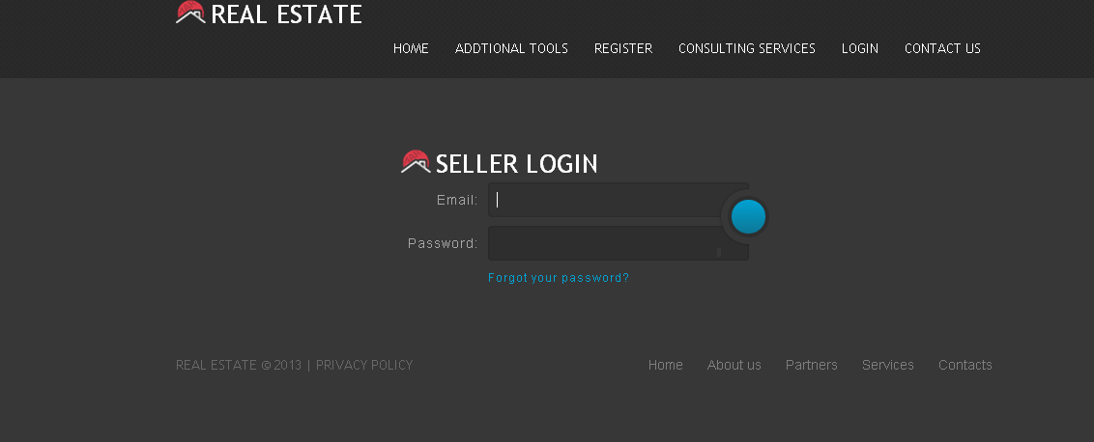
Seller Login

Slide 28
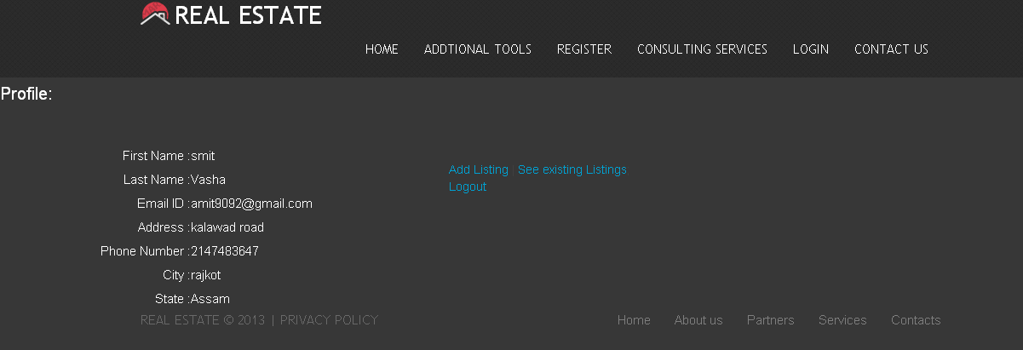
User Profile

Slide 29
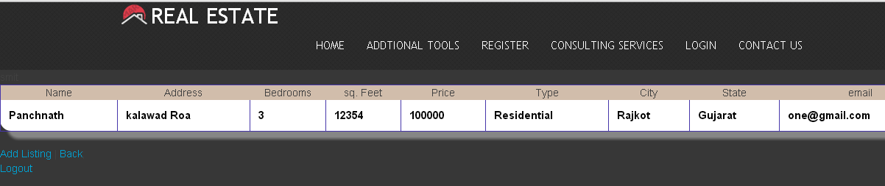
Watch Existing Listing

Slide 30
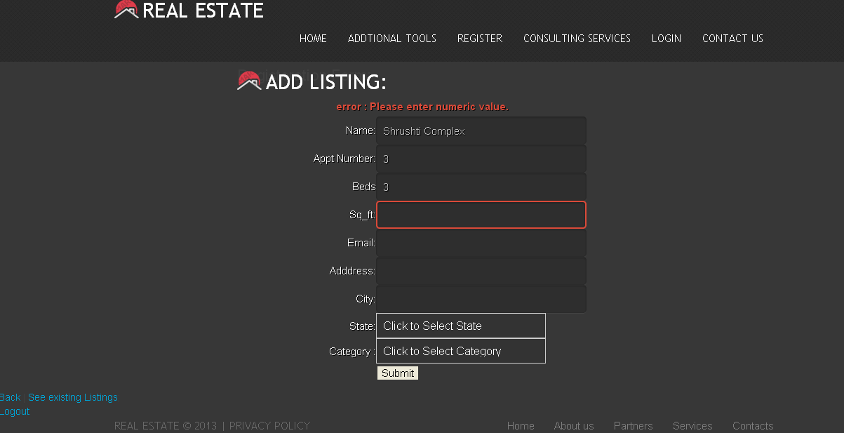
Add Listing(Validation)

Slide 31
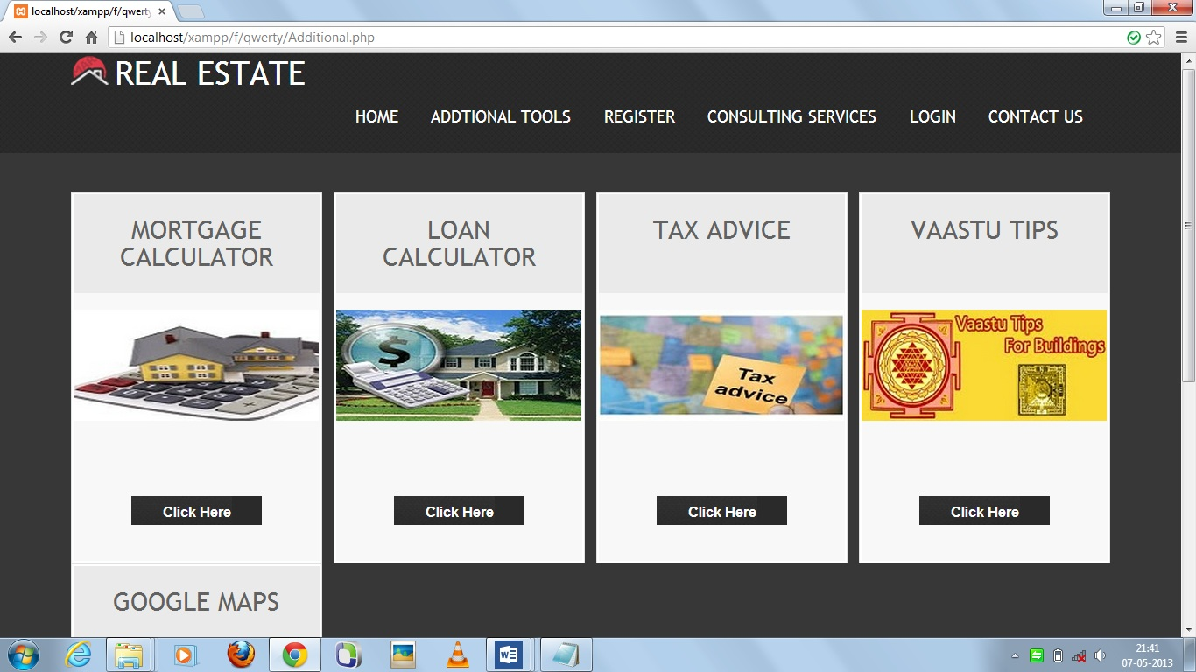
Additional Tools

Slide 32
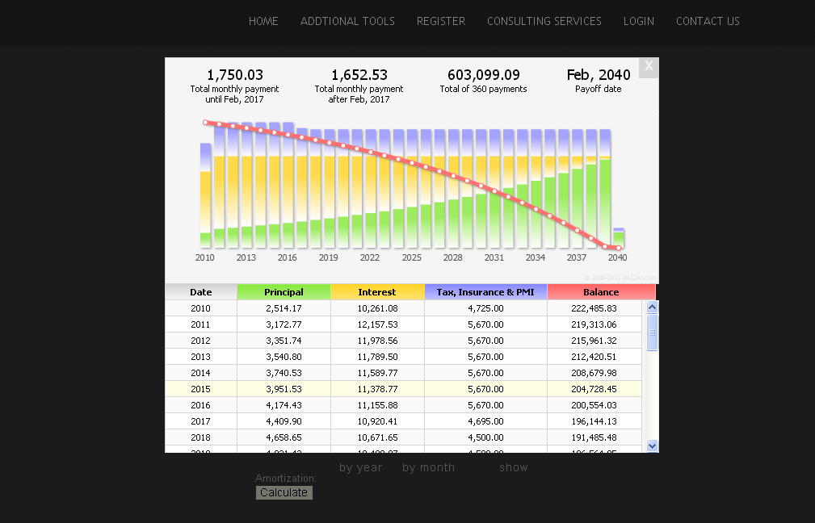
Mortgage Calculator Results

Slide 33
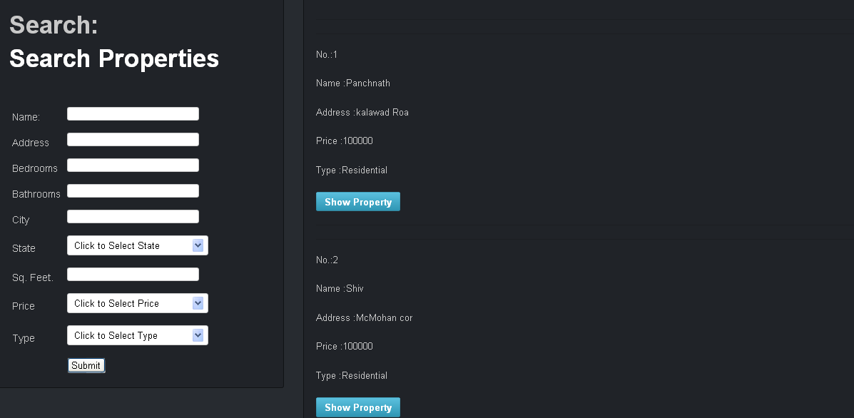
Searching Module

Slide 34
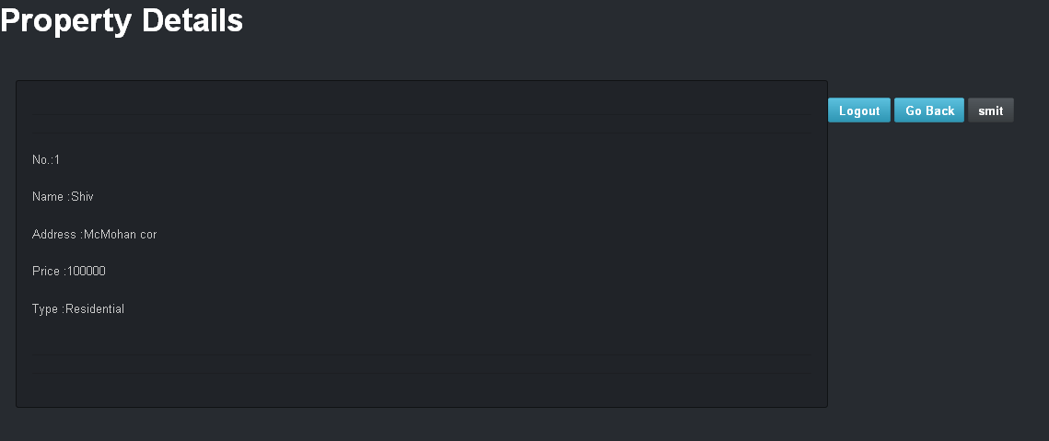
Property Information

Slide 35
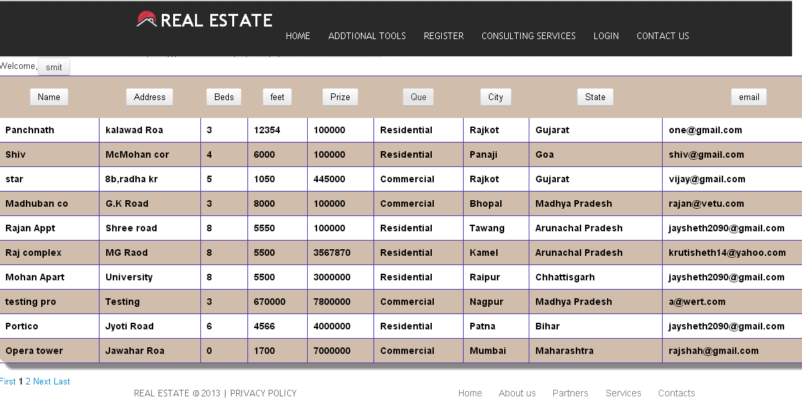
Browse Listing

Slide 36
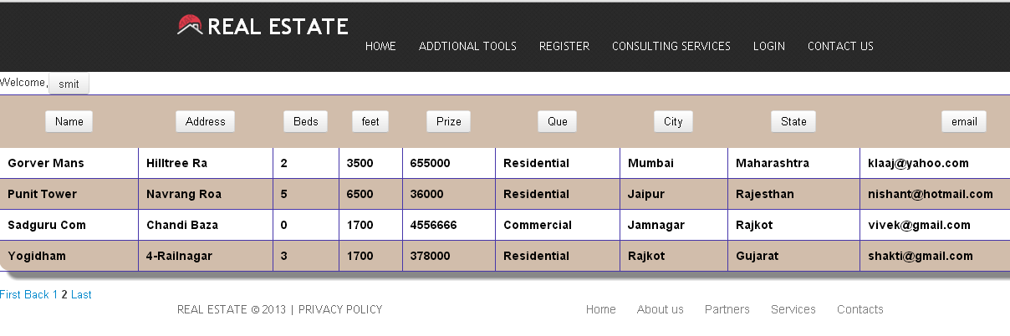
Listing with Pagination

Slide 37
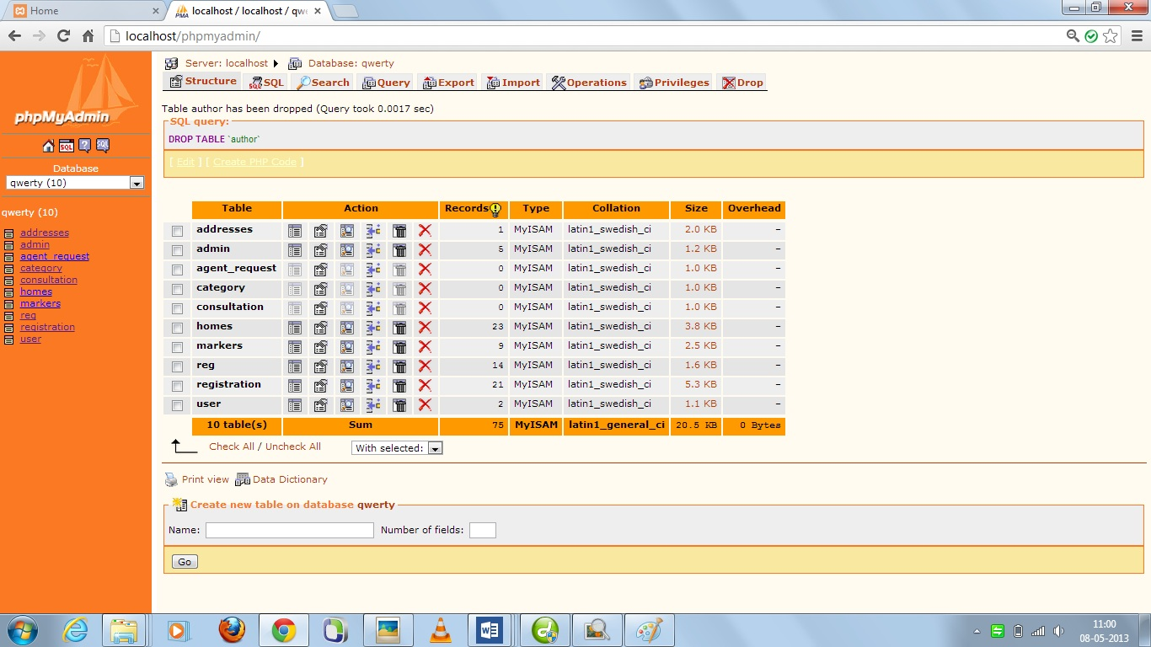
Tables(database)

Slide 38
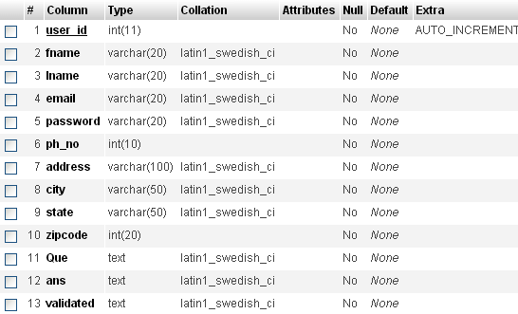
Registration Table

Slide 39

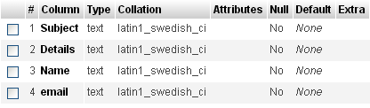
Login and Contact Us Table
Admin Table
Contact Us

Slide 40
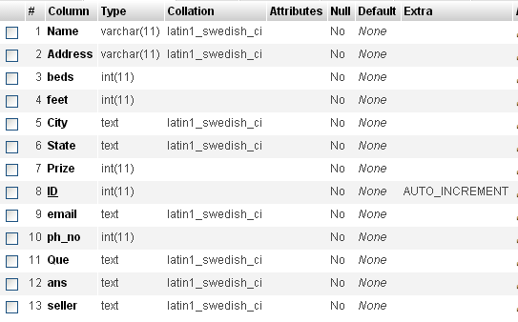
Homes Table

Slide 41
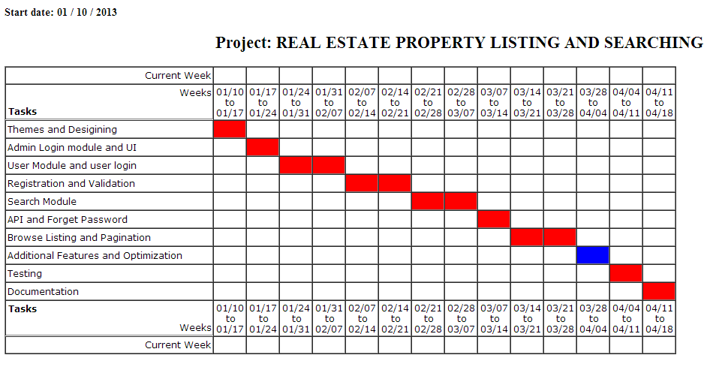
Time Line Chart

Slide 42


