Slide 1
Chapter 6:
Introduction to SQL
Modern Database Management
10th Edition
Jeffrey A. Hoffer, V. Ramesh,
Heikki Topi
© 2011 Pearson Education, Inc. Publishing as Prentice Hall

Slide 2
Objectives
Define terms
Interpret history and role of SQL
Define a database using SQL data definition language
Write single table queries using SQL
Establish referential integrity using SQL
Discuss SQL:1999 and SQL:200n standards

Slide 3
SQL Overview
Structured Query Language
The standard for relational database management systems (RDBMS)
RDBMS: A database management system that manages data as a collection of tables in which all relationships are represented by common values in related tables

Slide 4
History of SQL
1970–E. Codd develops relational database concept
1974-1979–System R with Sequel (later SQL) created at IBM Research Lab
1979–Oracle markets first relational DB with SQL
1986–ANSI SQL standard released
1989, 1992, 1999, 2003–Major ANSI standard updates
Current–SQL is supported by most major database vendors

Slide 5
Purpose of SQL Standard
Specify syntax/semantics for data definition and manipulation
Define data structures and basic operations
Enable portability of database definition and application modules
Specify minimal (level 1) and complete (level 2) standards
Allow for later growth/enhancement to standard

Slide 6
Benefits of a Standardized Relational Language
Reduced training costs
Productivity
Application portability
Application longevity
Reduced dependence on a single vendor
Cross-system communication

Slide 7
SQL Environment
Catalog
  A set of schemas that constitute the description of a database
Schema
  The structure that contains descriptions of objects created by a user (base tables, views, constraints)
Data Definition Language (DDL)
  Commands that define a database, including creating, altering, and dropping tables and establishing constraints
Data Manipulation Language (DML)
  Commands that maintain and query a database
Data Control Language (DCL)
  Commands that control a database, including administering privileges and committing data

Slide 8
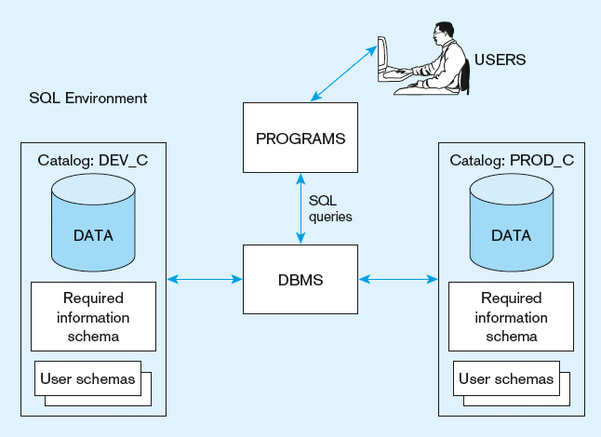
Figure 6-1
A simplified schematic of a typical SQL environment, as described by the SQL: 200n standard

Slide 9
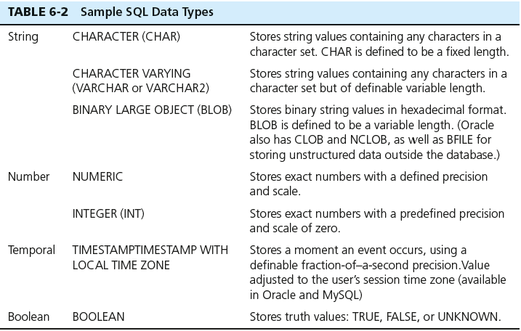
SQL Data Types

Slide 10
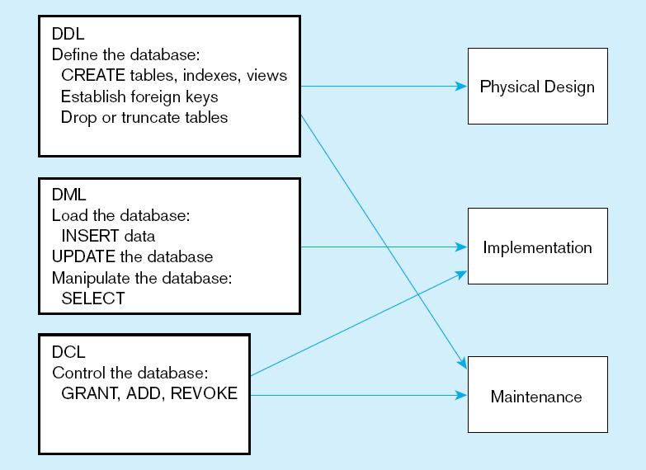
Figure 6-4
DDL, DML, DCL, and the database development process

Slide 11
SQL Database Definition
Data Definition Language (DDL)
Major CREATE statements:
  CREATE SCHEMA–defines a portion of the database owned by a particular user
  CREATE TABLE–defines a new table and its columns
  CREATE VIEW–defines a logical table from one or more tables or views
Other CREATE statements: CHARACTER SET, COLLATION, TRANSLATION, ASSERTION, DOMAIN

Slide 12
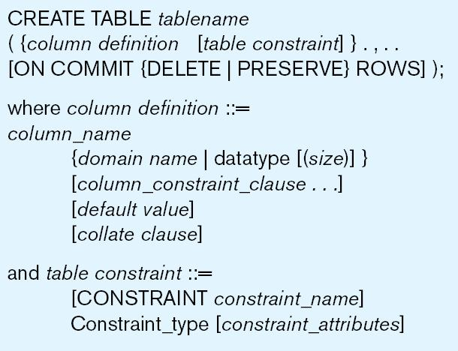
Table Creation
Steps in table creation:
Identify data types for attributes
Identify columns that can and cannot be null
Identify columns that must be unique (candidate keys)
Identify primary key–foreign key mates
Determine default values
Identify constraints on columns (domain specifications)
Create the table and associated indexes
Figure 6-5 General syntax for CREATE TABLE statement used in data definition language

Slide 13
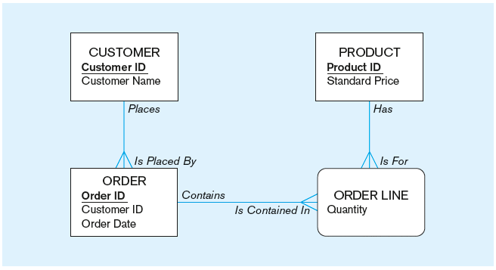
The following slides create tables for this enterprise data model
(from Chapter 1, Figure 1-3)

Slide 14
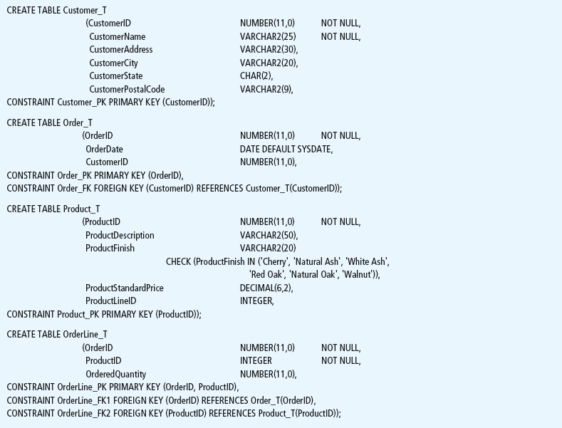
Figure 6-6 SQL database definition commands for Pine Valley Furniture Company (Oracle 11g)
Overall table definitions

Slide 15
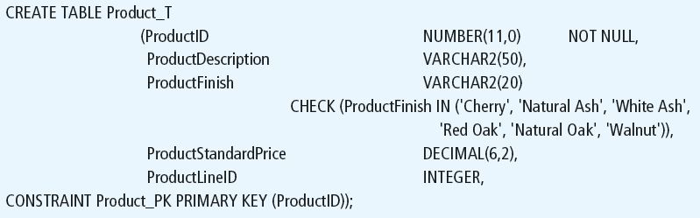
Defining attributes and their data types

Slide 16
Non-nullable specification
Primary keys can never have NULL values
Identifying primary key

Slide 17
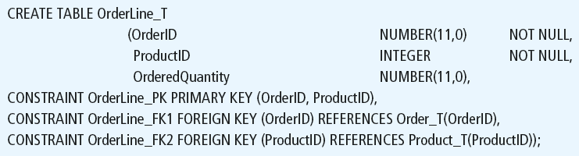
Non-nullable specifications
Primary key
Some primary keys are composite– composed of multiple attributes

Slide 18
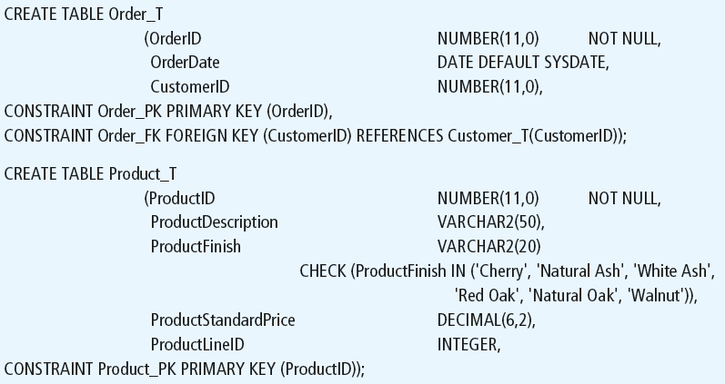
Controlling the values in attributes
Default value
Domain constraint

Slide 19
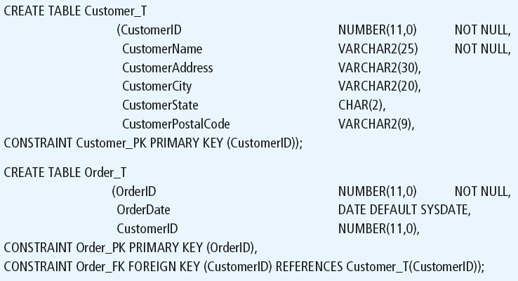
Identifying foreign keys and establishing relationships
Primary key of parent table
Foreign key of dependent table

Slide 20
Data Integrity Controls
Referential integrity–constraint that ensures that foreign key values of a table must match primary key values of a related table in 1:M relationships
Restricting:
  Deletes of primary records
  Updates of primary records
  Inserts of dependent records

Slide 21
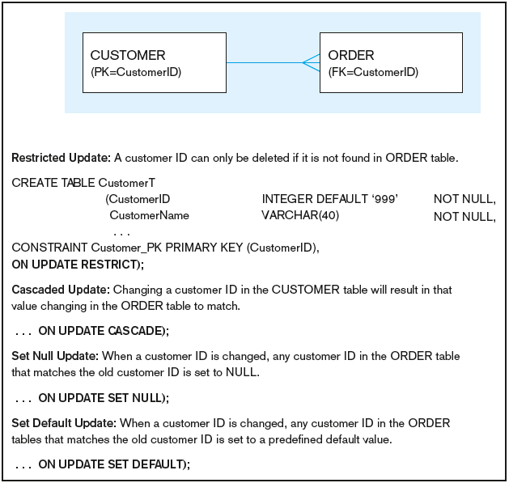
Figure 6-7 Ensuring data integrity through updates
Relational integrity is enforced via the primary-key to foreign-key match

Slide 22

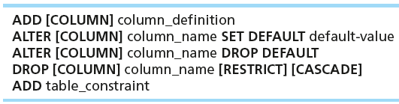

Changing Tables
ALTER TABLE statement allows you to change column specifications:
Table Actions:
Example (adding a new column with a default value):

Slide 23
Removing Tables
DROP TABLE statement allows you to remove tables from your schema:
  DROP TABLE CUSTOMER_T

Slide 24



Insert Statement
Adds one or more rows to a table
Inserting into a table
Inserting a record that has some null attributes requires identifying the fields that actually get data
Inserting from another table

Slide 25
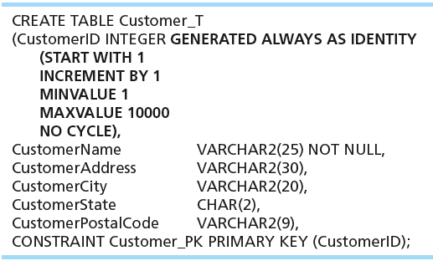
Creating Tables with Identity Columns
Introduced with SQL:200n
Inserting into a table does not require explicit customer ID entry or field list
  INSERT INTO CUSTOMER_T VALUES ( ‘Contemporary Casuals’, ‘1355 S. Himes Blvd.’, ‘Gainesville’, ‘FL’, 32601);

Slide 26
Delete Statement
Removes rows from a table
Delete certain rows
  DELETE FROM CUSTOMER_T WHERE CUSTOMERSTATE = ‘HI’;
Delete all rows
  DELETE FROM CUSTOMER_T;

Slide 27

Update Statement
Modifies data in existing rows

Slide 28
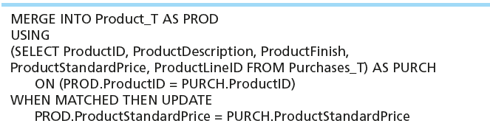
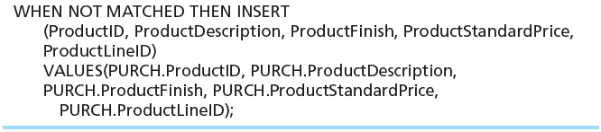
Merge Statement
Makes it easier to update a table…allows combination of Insert and Update in one statement
Useful for updating master tables with new data

Slide 29
Schema Definition
Control processing/storage efficiency:
  Choice of indexes
  File organizations for base tables
  File organizations for indexes
  Data clustering
  Statistics maintenance
Creating indexes
  Speed up random/sequential access to base table data
  Example
    CREATE INDEX NAME_IDX ON CUSTOMER_T(CUSTOMERNAME)
    This makes an index for the CUSTOMERNAME field of the CUSTOMER_T table

Slide 30
SELECT Statement
Used for queries on single or multiple tables
Clauses of the SELECT statement:
  SELECT
    List the columns (and expressions) that should be returned from the query
  FROM
    Indicate the table(s) or view(s) from which data will be obtained
  WHERE
    Indicate the conditions under which a row will be included in the result
  GROUP BY
    Indicate categorization of results
  HAVING
    Indicate the conditions under which a category (group) will be included
  ORDER BY
    Sorts the result according to specified criteria

Slide 31
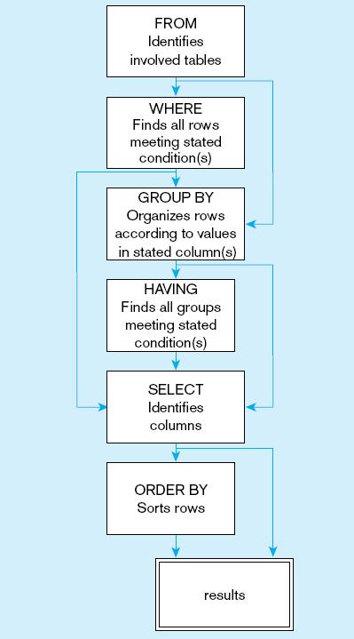
Figure 6-10
  SQL statement processing order (adapted from van der Lans, 2006 p.100)

Slide 32
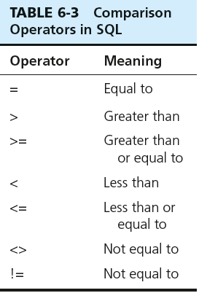

SELECT Example
Find products with standard price less than $275
Table 6-3: Comparison Operators in SQL

Slide 33
SELECT Example Using Alias
Alias is an alternative column or table name
    SELECT CUST.CUSTOMERNAME AS NAME, CUST.CUSTOMERADDRESS
    FROM CUSTOMER_V CUST
    WHERE NAME = ‘Home Furnishings’;

Slide 34
SELECT Example
Using a Function
Using the COUNT aggregate function to find totals
  SELECT COUNT(*) FROM ORDERLINE_T
  WHERE ORDERID = 1004;
  Note: with aggregate functions you can’t have single-valued columns included in the SELECT clause, unless they are included in the GROUP BY clause

Slide 35
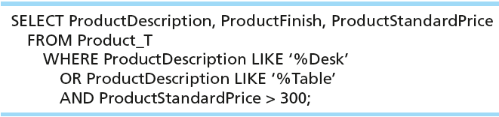
SELECT Example–Boolean Operators
AND, OR, and NOT Operators for customizing conditions in WHERE clause
Note: the LIKE operator allows you to compare strings using wildcards. For example, the % wildcard in ‘%Desk’ indicates that all strings that have any number of characters preceding the word “Desk” will be allowed.

Slide 36
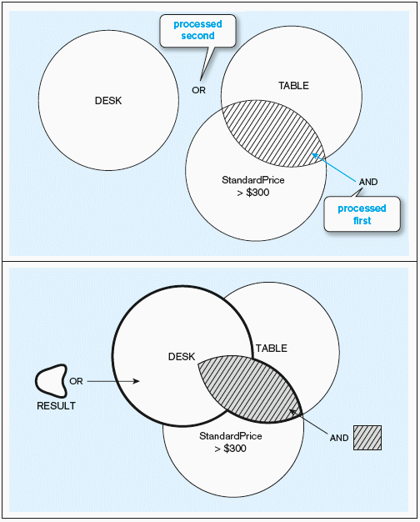
Figure 6-9 Boolean query without use of parentheses

Slide 37
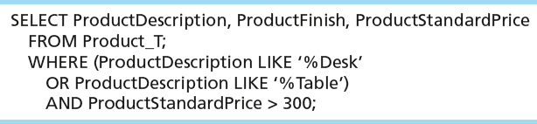
SELECT Example–Boolean Operators
With parentheses…these override the normal precedence of Boolean operators
Note: by default, the AND operator takes precedence over the OR operator. With parentheses, you can make the OR take place before the AND.

Slide 38
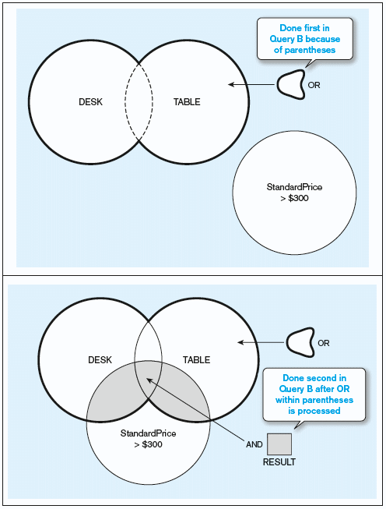
Figure 6-9 Boolean query with use of parentheses

Slide 39
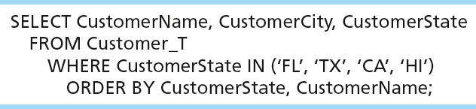
SELECT Example –
Sorting Results with the ORDER BY Clause
Sort the results first by STATE, and within a state by the CUSTOMER NAME
Note: the IN operator in this example allows you to include rows whose CustomerState value is either FL, TX, CA, or HI. It is more efficient than separate OR conditions.

Slide 40

SELECT Example–
Categorizing Results Using the GROUP BY Clause
For use with aggregate functions
  Scalar aggregate: single value returned from SQL query with aggregate function
  Vector aggregate: multiple values returned from SQL query with aggregate function (via GROUP BY)
  Note: you can use single-value fields with aggregate functions if they are included in the GROUP BY clause

Slide 41
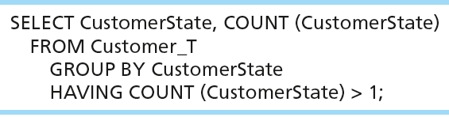
SELECT Example–
Qualifying Results by Categories
Using the HAVING Clause
For use with GROUP BY
  Like a WHERE clause, but it operates on groups (categories), not on individual rows. Here, only those groups with total numbers greater than 1 will be included in final result.

Slide 42
Using and Defining Views
Views provide users controlled access to tables
Base Table–table containing the raw data
Dynamic View
  A “virtual table” created dynamically upon request by a user
  No data actually stored; instead data from base table made available to user
  Based on SQL SELECT statement on base tables or other views
Materialized View
  Copy or replication of data
  Data actually stored
  Must be refreshed periodically to match the corresponding base tables

Slide 43
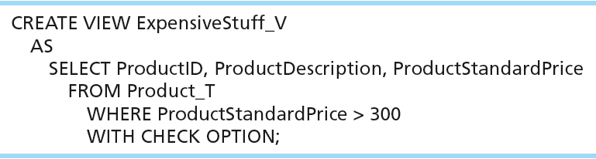
Sample CREATE VIEW
View has a name
View is based on a SELECT statement
CHECK_OPTION works only for updateable views and prevents updates that would create rows not included in the view

Slide 44
Advantages of Views
Simplify query commands
Assist with data security (but don't rely on views for security, there are more important security measures)
Enhance programming productivity
Contain most current base table data
Use little storage space
Provide customized view for user
Establish physical data independence

Slide 45
Disadvantages of Views
Use processing time each time view is referenced
May or may not be directly updateable

Slide 46

All rights reserved. No part of this publication may be reproduced, stored in a retrieval system, or transmitted, in any form or by any means, electronic, mechanical, photocopying, recording, or otherwise, without the prior written permission of the publisher. Printed in the United States of America.
Copyright © 2011 Pearson Education, Inc. Publishing as Prentice Hall

