Slide 1
Chapter 10:
Data Quality and Integration
Modern Database Management
10th Edition
Jeffrey A. Hoffer, V. Ramesh,
Heikki Topi
© 2011 Pearson Education, Inc. Publishing as Prentice Hall

Slide 2
Objectives
Define terms
Describe importance and goals of data governance
Describe importance and measures of data quality
Define characteristics of quality data
Describe reasons for poor data quality in organizations
Describe a program for improving data quality
Describe three types of data integration approaches
Describe the purpose and role of master data management
Describe four steps and activities of ETL for data integration for a data warehouse
Explain various forms of data transformation for data warehouses

Slide 3
Data Governance
Data governance
  High-level organizational groups and processes overseeing data stewardship across the organization
Data steward
  A person responsible for ensuring that organizational applications properly support the organization’s data quality goals

Slide 4
Requirements for Data Governance
Sponsorship from both senior management and business units
A data steward manager to coordinate data stewards
Data stewards for different business units, subjects, and/or source systems
A governance committee to provide data management guidelines and standards

Slide 5
Importance of Data Quality
Minimize IT project risk
Make timely business decisions
Ensure regulatory compliance
Expand customer base

Slide 6
Characteristics of Quality Data
Uniqueness
Accuracy
Consistency
Completeness
Timeliness
Currency
Conformance
Referential integrity

Slide 7
Causes of poor data quality
External data sources
  Lack of control over data quality
Redundant data storage and inconsistent metadata
  Proliferation of databases with uncontrolled redundancy and metadata
Data entry
  Poor data capture controls
Lack of organizational commitment
  Not recognizing poor data quality as an organizational issue

Slide 8
Data quality improvement
Get business buy-in
Perform data quality audit
Establish data stewardship program
Improve data capture processes
Apply modern data management principles and technology
Apply total quality management (TQM) practices

Slide 9
Business Buy-in
Executive sponsorship
Building a business case
Prove a return on investment (ROI)
Avoidance of cost
Avoidance of opportunity loss

Slide 10
Data Quality Audit
Statistically profile all data files
Document the set of values for all fields
Analyze data patterns (distribution, outliers, frequencies)
Verify whether controls and business rules are enforced
Use specialized data profiling tools

Slide 11
Data Stewardship Program
Roles:
  Oversight of data stewardship program
  Manage data subject area
  Oversee data definitions
  Oversee production of data
  Oversee use of data
Report to: business unit vs. IT organization?

Slide 12
Improving Data Capture Processes
Automate data entry as much as possible
Manual data entry should be selected from preset options
Use trained operators when possible
Follow good user interface design principles
Immediate data validation for entered data

Slide 13
TQM Principles and Practices
TQM – Total Quality Management
TQM Principles:
  Defect prevention
  Continuous improvement
  Use of enterprise data standards
Balanced focus
  Customer
  Product/Service

Slide 14
Master Data Management (MDM)
The disciplines, technologies, and methods to ensure the currency, meaning, and quality of reference data within and across various subject areas
Three main architectures
  Identity registry
  Integration hub
  Persistent

Slide 15
Data Integration
Data integration creates a unified view of business data
Other possibilities:
  Application integration
  Business process integration
  User interaction integration
Any approach requires changed data capture (CDC)
  Indicates which data have changed since previous data integration activity

Slide 16
Techniques for Data Integration
Consolidation (ETL)
  Consolidating all data into a centralized database (like a data warehouse)
Data federation (EII)
  Provides a virtual view of data without actually creating one centralized database
Data propagation (EAI and ERD)
  Duplicate data across databases, with near real-time delay

Slide 17
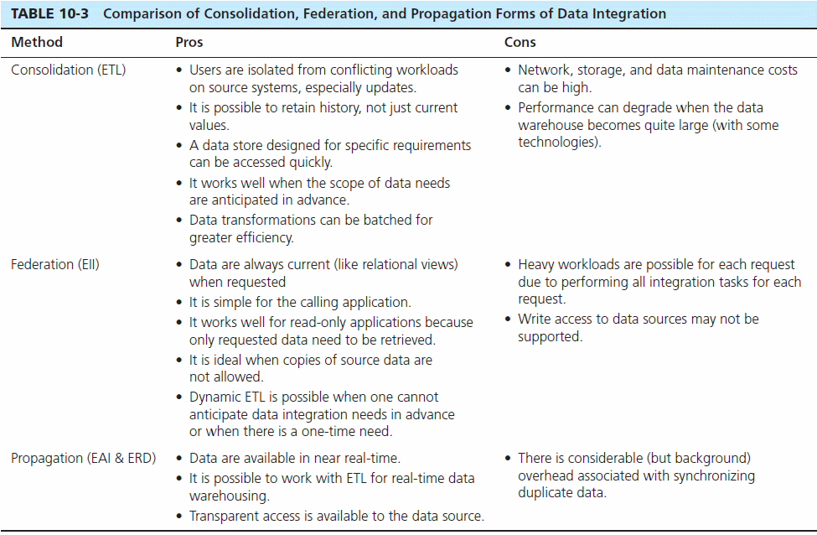

Slide 18
The Reconciled Data Layer
Typical operational data is:
  Transient–not historical
  Not normalized (perhaps due to denormalization for performance)
  Restricted in scope–not comprehensive
  Sometimes poor quality–inconsistencies and errors
After ETL, data should be:
  Detailed–not summarized yet
  Historical–periodic
  Normalized–3rd normal form or higher
  Comprehensive–enterprise-wide perspective
  Timely–data should be current enough to assist decision-making
  Quality controlled–accurate with full integrity

Slide 19
The ETL Process
Capture/Extract
Scrub or data cleansing
Transform
Load and Index
ETL = Extract, transform, and load

Slide 20
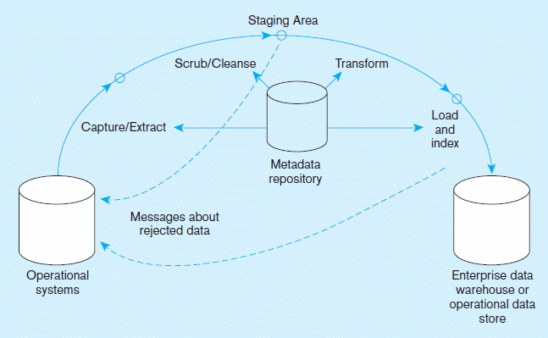
Capture/Extract…obtaining a snapshot of a chosen subset of the source data for loading into the data warehouse
Figure 10-1 Steps in data reconciliation
Static extract = capturing a snapshot of the source data at a point in time
Incremental extract = capturing changes that have occurred since the last static extract

Slide 21
Scrub/Cleanse…uses pattern recognition and AI techniques to upgrade data quality
Figure 10-1 Steps in data reconciliation
(cont.)
Fixing errors: misspellings, erroneous dates, incorrect field usage, mismatched addresses, missing data, duplicate data, inconsistencies
Also: decoding, reformatting, time stamping, conversion, key generation, merging, error detection/logging, locating missing data

Slide 22
Transform = convert data from format of operational system to format of data warehouse
Figure 10-1 Steps in data reconciliation
(cont.)
Record-level:
Selection–data partitioning
Joining–data combining
Aggregation–data summarization
Field-level:
single-field–from one field to one field
multi-field–from many fields to one, or one field to many

Slide 23
Load/Index= place transformed data into the warehouse and create indexes
Figure 10-1 Steps in data reconciliation
(cont.)
Refresh mode: bulk rewriting of target data at periodic intervals
Update mode: only changes in source data are written to data warehouse

Slide 24
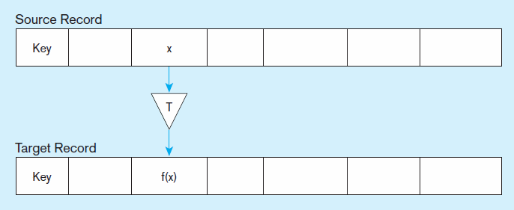
Figure 10-2 Single-field transformation
a) Basic Representation
In general–some transformation function translates data from old form to new form

Slide 25
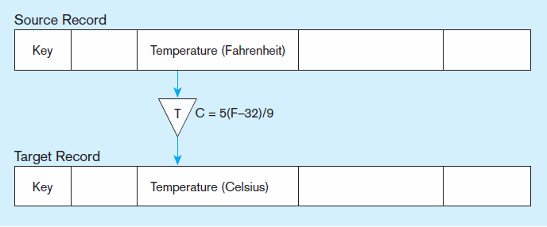
Figure 10-2 Single-field transformation (cont.)
b) Algorithmic
Algorithmic transformation uses a formula or logical expression

Slide 26
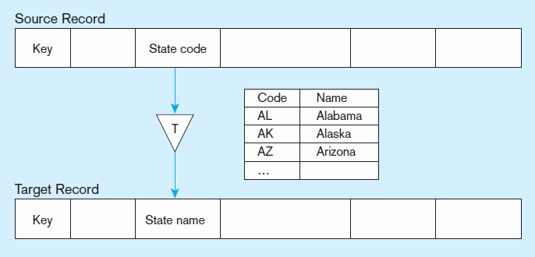
Figure 10-2 Single-field transformation (cont.)
c) Table lookup
Table lookup–another approach, uses a separate table keyed by source record code

Slide 27
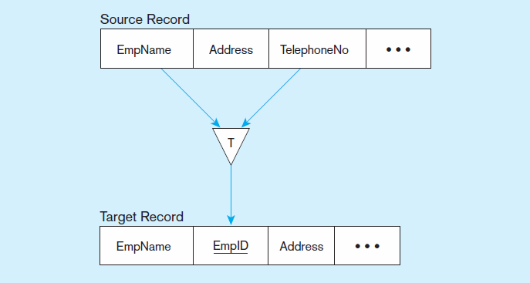
Figure 10-3 Multi-field transformation
a) Many sources to one target

Slide 28
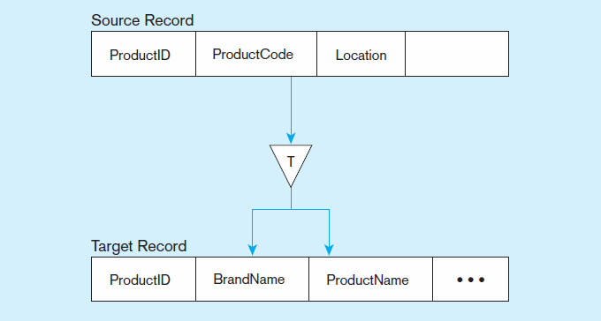
Figure 10-3 Multi-field transformation (cont.)
b) One source to many targets

Slide 29

All rights reserved. No part of this publication may be reproduced, stored in a retrieval system, or transmitted, in any form or by any means, electronic, mechanical, photocopying, recording, or otherwise, without the prior written permission of the publisher. Printed in the United States of America.
Copyright © 2011 Pearson Education, Inc. Publishing as Prentice Hall

