Slide 1
Chapter 12 (Online):
Distributed Databases
Modern Database Management
10th Edition
Jeffrey A. Hoffer, V. Ramesh,
Heikki Topi
© 2011 Pearson Education, Inc. Publishing as Prentice Hall

Slide 2
Objectives
Define terms
Explain business conditions driving distributed databases
Describe salient characteristics of distributed database environments
Explain advantages and risks of distributed databases
Explain strategies and options for distributed database design
Discuss synchronous and asynchronous data replication and partitioning
Discuss optimized query processing in distributed databases
Explain salient features of several distributed database management systems

Slide 3
Definitions
Distributed Database: A single logical database spread physically across computers in multiple locations that are connected by a data communications link
Decentralized Database: A collection of independent databases on non-networked computers
They are NOT the same thing!

Slide 4
Reasons for
Distributed Database
Business unit autonomy and distribution
Data sharing
Data communication reliability and costs
Multiple application vendors
Database recovery
Transaction and analytic processing

Slide 5
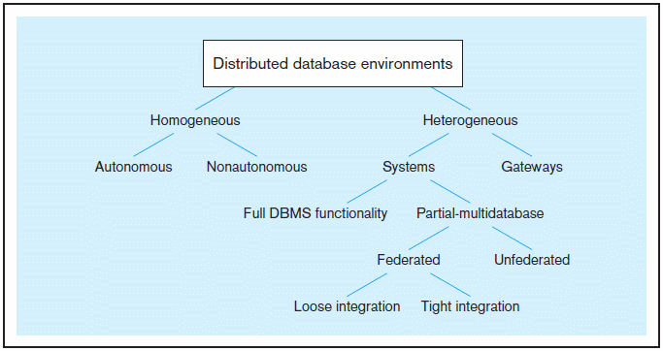
Figure 12-1 Distributed database environments (adapted from Bell and Grimson, 1992)

Slide 6
Distributed Database Options
Homogeneous–same DBMS at each node
  Autonomous–independent DBMSs
  Non-autonomous–central, coordinating DBMS
  Easy to manage, difficult to enforce
Heterogeneous–different DBMSs at different nodes
  Systems–with full or partial DBMS functionality
  Gateways–simple paths are created to other databases without the benefits of one logical database
  Difficult to manage, preferred by independent organizations

Slide 7
Distributed Database Options (cont.)
Systems (Heterogeneous)–supports some or all functionality of one logical database
  Full DBMS Functionality–all distributed DB functions
  Partial-Multi database–some distributed DB functions
    Federated–supports local databases for unique data requests
      Loose Integration–local database have their own schemas
      Tight Integration–local database use common schema
    Unfederated–requires all access to go through a central, coordinating module

Slide 8
Homogeneous, Non-Autonomous Database
Data is distributed across all the nodes
Same DBMS at each node
All data is managed by the distributed DBMS (no exclusively local data)
All access is through one, global schema
The global schema is the union of all the local schema

Slide 9
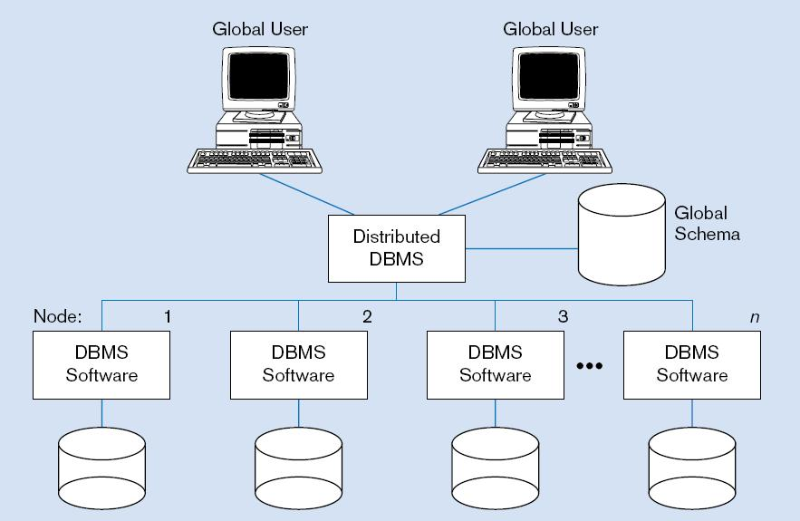
Figure 12-2 Homogeneous Distributed Database Environment
Identical DBMSs
Source: Based on Bell and Grimson, 1992.

Slide 10
Typical Heterogeneous Environment
Data distributed across all the nodes
Different DBMSs may be used at each node
Local access is done using the local DBMS and schema
Remote access is done using the global schema

Slide 11
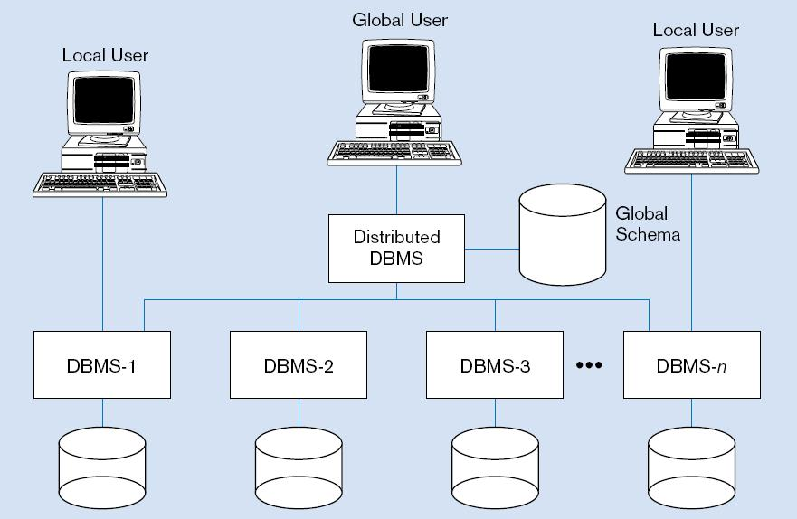
Figure 12-3 Heterogeneous Distributed Database Environment
Non-identical DBMSs
Source: Based on Bell and Grimson, 1992.

Slide 12
Major Objectives
Location Transparency
  User does not have to know the location of the data
  Data requests automatically forwarded to appropriate sites
Local Autonomy
  Local site can operate with its database when network connections fail
  Each site controls its own data, security, logging, recovery

Slide 13
Significant Trade-Offs
Synchronous Distributed Database
  All copies of the same data are always identical
  Data updates are immediately applied to all copies throughout network
  Good for data integrity
  High overhead ➔ slow response times
Asynchronous Distributed Database
  Some data inconsistency is tolerated
  Data update propagation is delayed
  Lower data integrity
  Less overhead ➔ faster response time
NOTE: all this assumes replicated data (to be discussed later)

Slide 14
Advantages of
Distributed Database over Centralized Databases
Increased reliability/availability
Local control over data
Modular growth
Lower communication costs
Faster response for certain queries

Slide 15
Disadvantages of
Distributed Database Compared to
Centralized Databases
Software cost and complexity
Processing overhead
Data integrity exposure
Slower response for certain queries

Slide 16
Options for
Distributing a Database
Data replication
  Copies of data distributed to different sites
Horizontal partitioning
  Different rows of a table distributed to different sites
Vertical partitioning
  Different columns of a table distributed to different sites
Combinations of the above

Slide 17
Data Replication
Advantages:
  Reliability
  Fast response
  May avoid complicated distributed transaction integrity routines (if replicated data is refreshed at scheduled intervals)
  Decouples nodes (transactions proceed even if some nodes are down)
  Reduced network traffic at prime time (if updates can be delayed)

Slide 18
Data Replication (cont.)
Disadvantages:
  Additional requirements for storage space
  Additional time for update operations
  Complexity and cost of updating
  Integrity exposure of getting incorrect data if replicated data is not updated simultaneously
Therefore, better when used for non-volatile
(read-only) data

Slide 19
Types of Data Replication
Push Replication–
  updating site sends changes to other sites
Pull Replication–
  receiving sites control when update messages will be processed

Slide 20
Types of Push Replication
Snapshot Replication–
  Changes periodically sent to master site
  Master collects updates in log
  Full or differential (incremental) snapshots
  Dynamic vs. shared update ownership
Near Real-Time Replication–
  Broadcast update orders without requiring confirmation
  Done through use of triggers
  Update messages stored in message queue until processed by receiving site

Slide 21
Issues for Data Replication
Data timeliness–high tolerance for out-of-date data may be required
DBMS capabilities–if DBMS cannot support multi-node queries, replication may be necessary
Performance implications–refreshing may cause performance problems for busy nodes
Network heterogeneity–complicates replication
Network communication capabilities–complete refreshes place heavy demand on telecommunications

Slide 22
Horizontal Partitioning
Different rows of a table at different sites
Advantages
  Data stored close to where it is used ➔ efficiency
  Local access optimization ➔ better performance
  Only relevant data is available ➔ security
  Unions across partitions ➔ ease of query
Disadvantages
  Accessing data across partitions ➔ inconsistent access speed
  No data replication ➔ backup vulnerability

Slide 23
Vertical Partitioning
Different columns of a table at different sites
Advantages and disadvantages are the same as for horizontal partitioning except that combining data across partitions is more difficult because it requires joins (instead of unions)

Slide 24
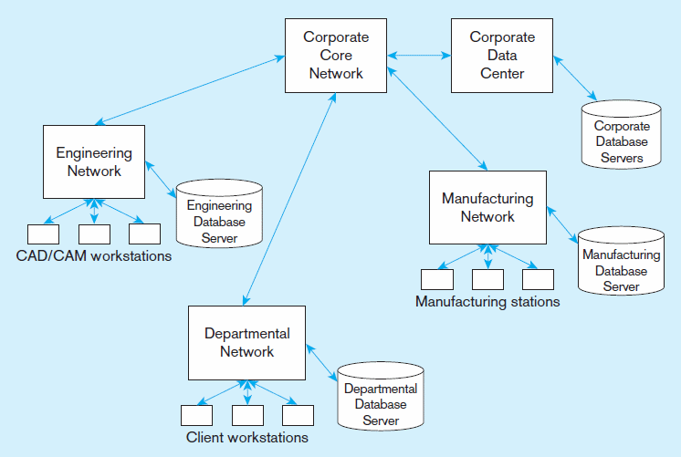
Figure 12-6
Distributed processing system for a manufacturing company

Slide 25
Five Distributed Database Strategies
Centralized database, distributed access
Replication with periodic snapshot update
Replication with near real-time synchronization of updates
Partitioned, one logical database
Partitioned, independent, nonintegrated segments

Slide 26
Factors in Choice of
Distributed Strategy
Organizational forces – funding, autonomy, security
Frequency and locality or clustering of reference to data
Growth and expansion needs
Technological capabilities
Costs of managing complex technologies
Need for reliable service

Slide 27
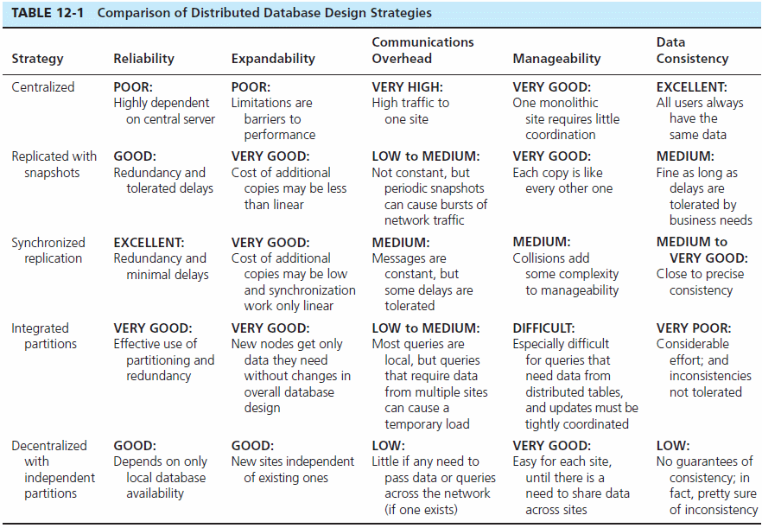

Slide 28
Functions of a Distributed DBMS
  Locate data with a distributed data dictionary
  Determine location from which to retrieve data and process query components
  Translate between nodes with different local DBMSs
  Provide data management functions: security, concurrency, deadlock control, query optimization, failure recovery
  Provide data consistency (via multiphase commit protocols)

Slide 29
Functions of a Distributed DBMS (cont.)
  Provide a single logical database, physically distributed → Global primary key control
  Be scalable
  Replicate data and stored procedure
  Transparently use residual computing power to improve database processing performance
  Permit different nodes to run different DBMSs
  Allow different versions of application code to reside on different nodes

Slide 30
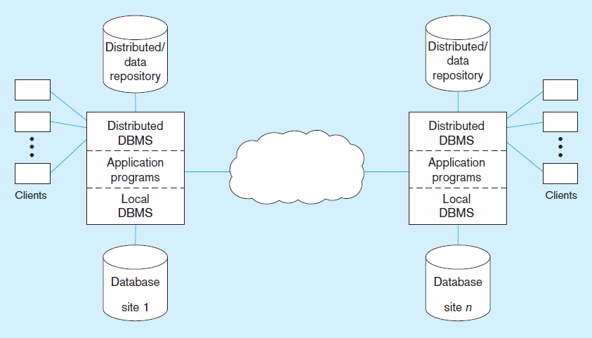
Figure 12-10 Distributed DBMS architecture

Slide 31
Local Transaction Steps
Application makes request to distributed DBMS.
Distributed DBMS checks distributed data repository for location of data. Finds that it is local.
Distributed DBMS sends request to local DBMS.
Local DBMS processes request.
Local DBMS sends results to application.

Slide 32
Figure 12-10 Distributed DBMS Architecture (showing local transaction steps)
2
1
3
5
4
Local transaction–all data stored locally

Slide 33
Global Transaction Steps
Application makes request to distributed DBMS.
Distributed DBMS checks distributed data repository for location of data. Finds that it is remote.
Distributed DBMS routes request to remote site.
Distributed DBMS at remote site translates request for its local DBMS if necessary, and sends request to local DBMS.
Local DBMS at remote site processes request.
Local DBMS at remote site sends results to distributed DBMS at remote site.
Remote distributed DBMS sends results back to originating site.
Distributed DBMS at originating site sends results to application.

Slide 34
Figure 12-10 Distributed DBMS architecture (showing global transaction steps)
2
3
1
6
7
8
4
5
Global transaction–some data is at remote site(s)

Slide 35
Distributed DBMS
Transparency Objectives
Location Transparency
  User/application does not need to know where data resides
Replication Transparency
  User/application does not need to know about duplication
Failure Transparency
  Either all or none of the actions of a transaction are committed
  Each site has a transaction manager
    Logs transactions and before and after images
    Concurrency control scheme to ensure data integrity
  Requires special commit protocol

Slide 36
Two-Phase Commit
Prepare Phase
  A message is broadcast to every participating site, asking whether that site is willing to commit its portion of the transaction at that site. Each site returns an “OK” or “not OK” message.
  An “OK” says that the remote site promises to allow the initiating request to govern the transaction at the remote database.

Slide 37
Two-Phase Commit (cont.)
Commit Phase
  The originating site collects the messages from all sites.
  If all are “OK,” it broadcasts a message to all sites to commit the portion of the transaction handled at each site.
  If one or more responses are “not OK,” it broadcasts a message to all sites to abort the transaction.
  If the transaction fails during the commit phase it is in limbo.
  A limbo transaction can be identified by a timeout or polling.

Slide 38
Concurrency Control
Concurrency Transparency
  Design goal for distributed database
  Appearance of serial transactions, even though simultaneous transactions are occurring
Time stamping
  Concurrency control mechanism
  Assign globally unique timestamp to each transaction
  Alternative to locks in distributed databases

Slide 39
Query Optimization
For a multi-site join the distributed DBMS must decide where to access the data and how to proceed with the join. Three step process:
  Query decomposition
  Data localization
  Global optimization
Semijoin operation: only the joining attribute of the query is sent from one site to the other, rather than all selected attributes

Slide 40
Evolution of Distributed DBMS
“Unit of Work”–All of a transaction’s steps
Remote Unit of Work
  SQL statements originated at one location can be executed as a single unit of work on a single remote DBMS

Slide 41
Evolution of Distributed DBMS (cont.)
Distributed Unit of Work
  Different statements in a unit of work may refer to different remote sites
  All databases in a single SQL statement must be at a single site
Distributed Request
  A single SQL statement may refer to tables in more than one remote site
  May not support replication transparency or failure transparency

Slide 42
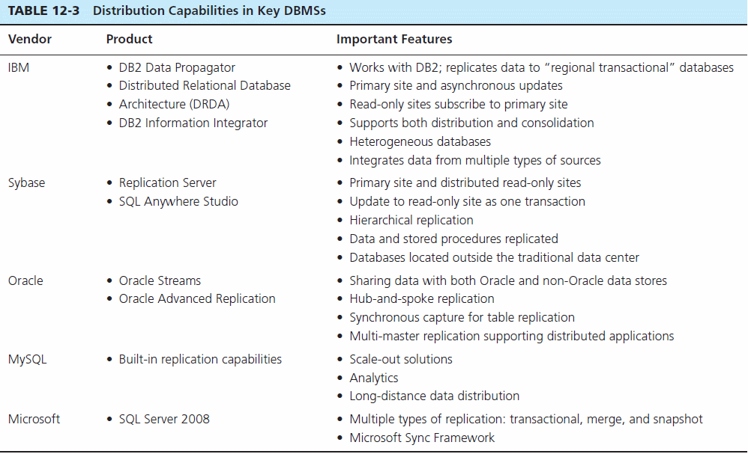

Slide 43

All rights reserved. No part of this publication may be reproduced, stored in a retrieval system, or transmitted, in any form or by any means, electronic, mechanical, photocopying, recording, or otherwise, without the prior written permission of the publisher. Printed in the United States of America.
Copyright © 2011 Pearson Education, Inc. Publishing as Prentice Hall

