Slide 1
Chapter 13:
Object-Oriented Data Modeling (Overview)
Modern Database Management
10^{h} Edition
Jeffrey A. Hoffer, V. Ramesh,
Heikki Topi
© 2011 Pearson Education, Inc. Publishing as Prentice Hall

Slide 2
Objectives
Define terms
Describe phases of object-oriented development life cycle
State advantages of object-oriented modeling
Compare object-oriented model with E-R and EER models
Model real-world application using UML class diagram
Provide UML snapshot of a system state
Recognize when to use generalization, aggregation, and composition
Specify types of business rules in a class diagram

Slide 3
The Unified Modeling Language (UML)
A set of graphical notations for business modeling and for specifying, designing, and implementing the software system artifacts
Class diagram is the most relevant UML diagram for database modeling

Slide 4
Classes and Objects
Class: An entity that has a well-defined role in the application domain, as well as state, behavior, and identity
  Tangible: person, place or thing
  Concept or Event: department, performance, marriage, registration
  Artifact of the Design Process: user interface, controller, scheduler
Object: a particular instance of a class
Objects exhibit BEHAVIOR as well as attributes
➔ Different from entities

Slide 5
State, Behavior, Identity
State: attribute types and values
Behavior: how an object acts and reacts
  Behavior is expressed through operations that can be performed on it
Identity: every object has a unique identity, even if all of its attribute values are identical to another object’s

Slide 6
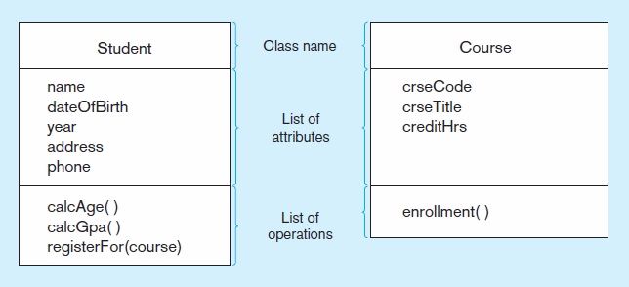
Figure 13-2 UML class and object diagram
a) Class diagram showing two classes
Class diagram shows the static structure of an object-oriented model: object classes, internal structure, relationships

Slide 7
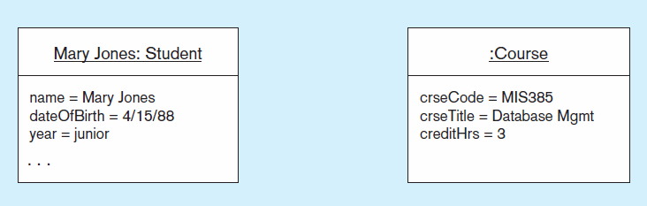
Figure 13-2 UML class and object diagram (cont.)
b) Object diagram with two instances
Object diagram shows instances that are compatible with a given class diagram

Slide 8
Operation
A function or service that is provided by all instances of a class
Encapsulation–hiding internal implementation details
Types of operations:
  Constructor: creates a new instance of a class
  Query: accesses the state of an object but does not alter its state
  Update: alters the state of an object
  Scope: operation applying to the class instead of an instance
Operations implement the object’s behavior

Slide 9
Associations
Association:
  Named relationship among object classes
Association Role:
  Role of an object in an association
  The end of an association where it connects to a class
Multiplicity:
  How many objects participate in an association. Lower-bound…Upper-bound (cardinality)

Slide 10
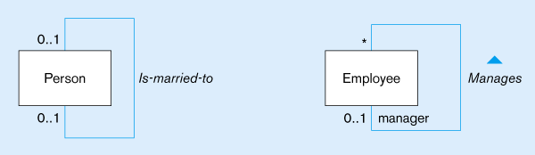
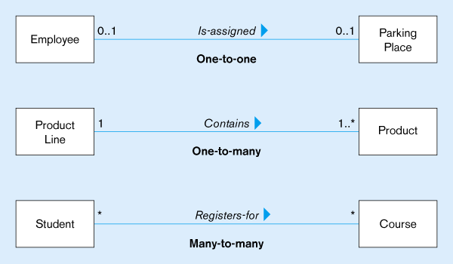
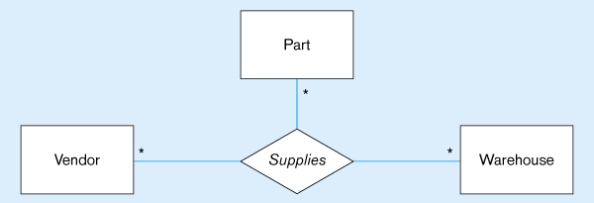
Figure 13-3
Examples of association relationships of different degrees
Unary
Lower-bound – upper-bound
Represented as:
0..1, 0..*, 1..1, 1..*
Similar to minimum/maximum cardinality rules in EER
Binary
Ternary

Slide 11
Association Class
An association that has attributes or operations of its own or that participates in relationships with other classes
Like an associative entity in E-R model

Slide 12
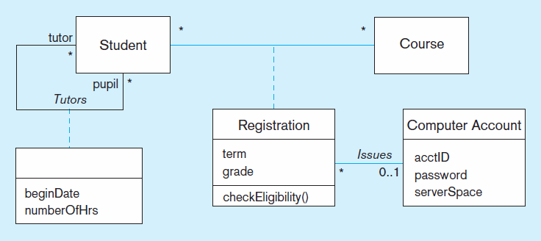
Figure 13-6 Association class and link object
a) Class diagram showing association classes
Binary association class with behavior
Unary association with only attributes and no behavior

Slide 13
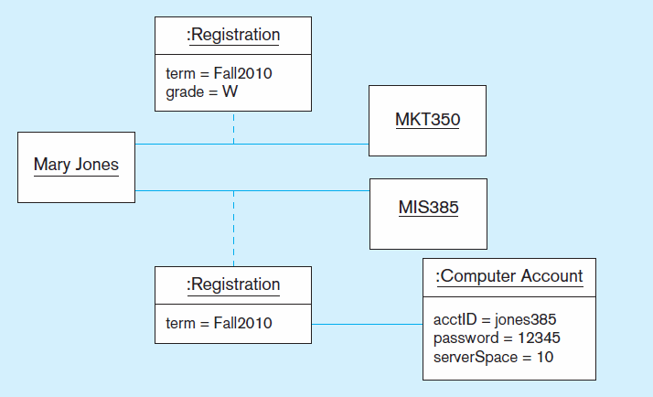
Figure 13-6 Association class and link object (cont.)
b) Object diagram showing link objects
Association class
instances

Slide 14
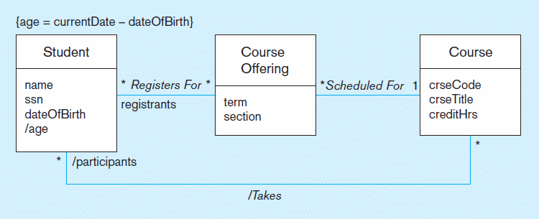
Figure 13-8 Derived attribute, association, and role
Constraint expression for derived attribute
Derived attribute
Derived relationship (from Registers-for and Scheduled-for)
Derived attributes and relationships shown with / in front of the name

Slide 15
Generalization/Specialization
Subclass, superclass
  similar to subtype/supertype in EER
Common attributes, relationships, and operations
Disjoint vs. Overlapping
Complete (total specialization) vs. incomplete (partial specialization)
Abstract Class: no direct instances possible, but subclasses may have direct instances
Concrete Class: direct instances possible

Slide 16
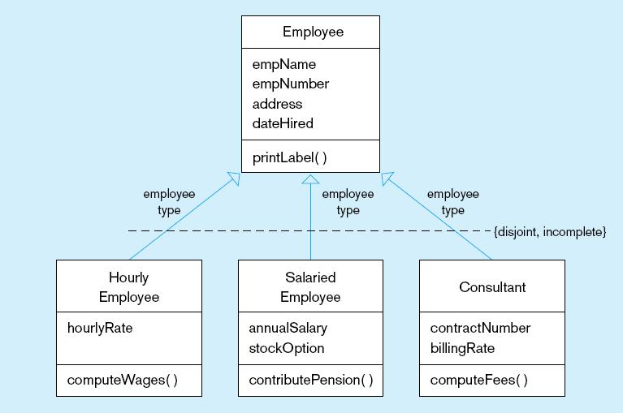
Figure 13-9 Examples of generalization, inheritance, and constraints
a) Employee superclass with three subclasses
An employee can only be one of these subclasses
Shared attributes and operations
An employee may be none of them
Specialized attributes and operations

Slide 17
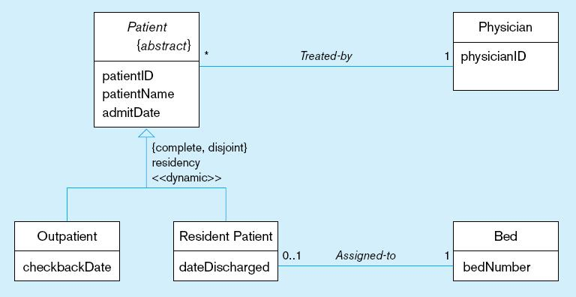
Figure 13-9 Examples of generalization, inheritance, and constraints (cont.)
b) Abstract Patient class with two concrete subclasses
Abstract indicated by italics
A patient MUST be EXACTLY one of the subtypes
Dynamic means a
patient can change from one subclass to another over time

Slide 18
Class-Scope Attribute
Specifies a value common to an entire class, rather than a specific value for an instance.
Represented by underlining
“=“ is initial, default value

Slide 19
Polymorphism
Abstract Operation: Defines the form or protocol of the operation, but not its implementation
Method: The implementation of an operation
Polymorphism: The same operation may apply to two or more different classes in different ways

Slide 20
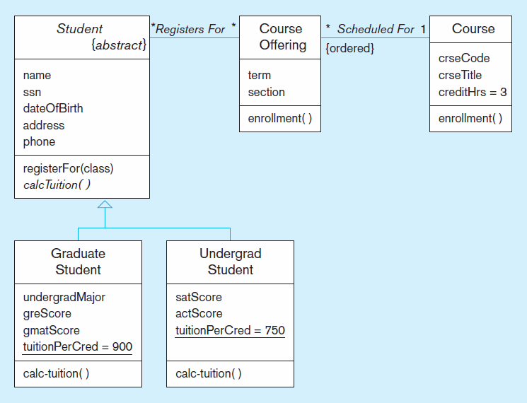
Figure 13-11 Polymorphism, abstract operation, class-scope attribute, and ordering
This operation is abstract…it has no method at Student level
Class-scope attributes–only one value common to all instances of these classes (includes default values)
Methods are defined at subclass level

Slide 21
Aggregation
Aggregation: A part-of relationship between a component object and an aggregate object
Composition: A stronger form of aggregation in which a part object belongs to only one whole object and exists only as part of the whole object
Recursive Aggregation: Composition where component object is an instance of the same class as the aggregate object

Slide 22
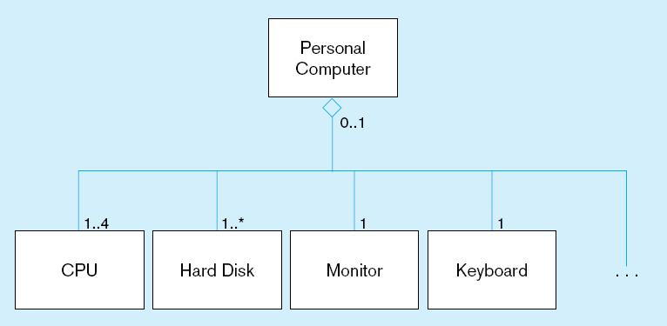
Figure 13-14 Example of aggregation
A Personal Computer includes CPU, Hard Disk, Monitor, and Keyboard as parts. But, these parts can exist without being installed into a computer. The open diamond indicates aggregation, but not composition.

Slide 23

All rights reserved. No part of this publication may be reproduced, stored in a retrieval system, or transmitted, in any form or by any means, electronic, mechanical, photocopying, recording, or otherwise, without the prior written permission of the publisher. Printed in the United States of America.
Copyright © 2011 Pearson Education, Inc. Publishing as Prentice Hall

