Slide 1
Chapter 14
Using Relational Databases to Provide Object Persistence (Online)
Modern Database Management
10th Edition
Jeffrey A. Hoffer, V. Ramesh,
Heikki Topi
© 2011 Pearson Education, Inc. Publishing as Prentice Hall

Slide 2
Objectives
Define terms
Understand mismatch between object-oriented and relational paradigms and the consequences of mismatch
Understand similarities and differences between approaches used to address object-relational mismatch
Create mapping between OO structures and relational structures using Hibernate
Identify primary contexts for the different approaches of addressing the object-relational mismatch
Understand performance, concurrency, and security effects of object-relational mapping
Use HQL to formulate queries

Slide 3
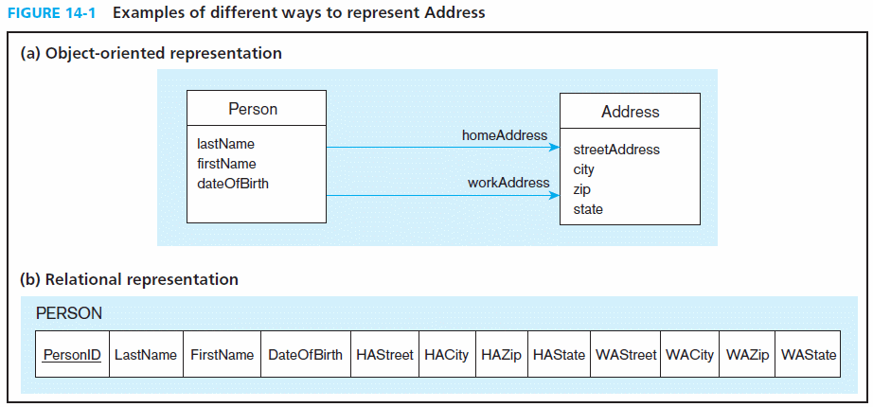

Slide 4
Storage in OO systems
Persistence
  An object’s capacity to maintain its state between application execution sessions
Serialization
  Writing an object onto a storage medium or a communication channel as a data stream
Object-relational mapping (ORM)
  Defining structural relationships between object-oriented and relational representations of data, typically to enable the use of a relational database to provide persistence for objects

Slide 5
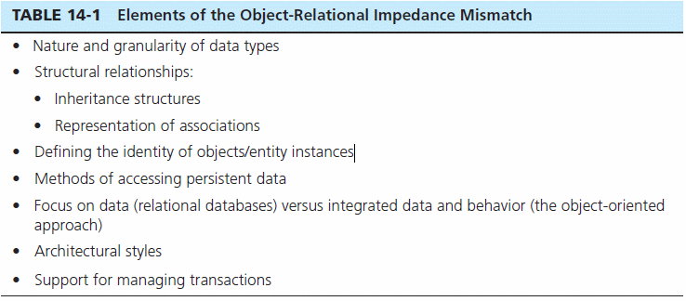
Object-Relational Impedance Mismatch
Conceptual differences between the object-oriented approach to application design and the relational model for database design/implementation

Slide 6
Object Identity and Access
Object identity
  Property of an object separating it from other objects based on its existence
Accessor method
  A method that provides other objects with access to the state of an object

Slide 7
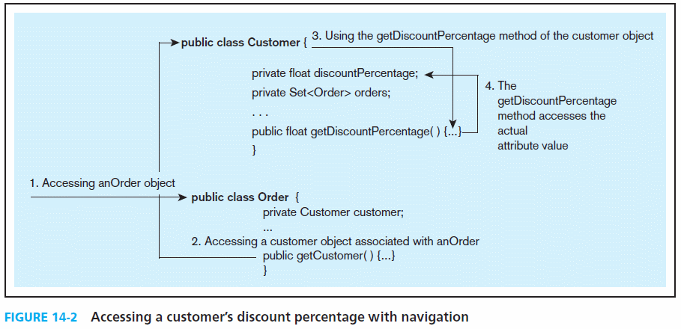
Object-oriented navigation is done via accessor methods on attributes, whereas with relational databases it is typically done via a single join query

Slide 8
Providing Object Persistence Using Relational Databases
Call-level Application Program Interface (API)
SQL Mapping Frameworks
Object-Relational Mapping Frameworks
Proprietary Approaches

Slide 9
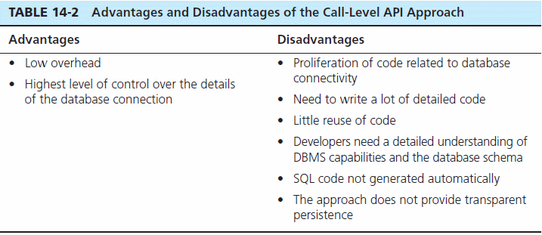
Call-Level APIs
SQL query hand-coded by programmer passed as parameter to driver
Examples: Java Database Connectivity (JDBC), ADO .NET, Open Database Connectivity (ODBC)

Slide 10
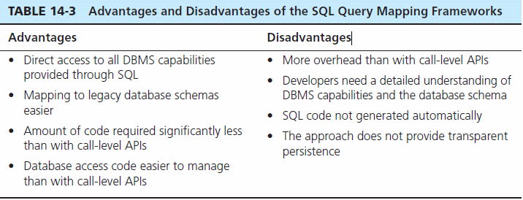
SQL Query Mapping Frameworks
Allow developers to operate at a higher level of abstraction
Examples: iBATIS and iBATIS .NET

Slide 11
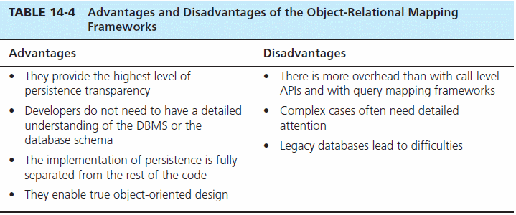
ORM Mapping Frameworks
Transparent persistence: Hides underlying storage technology
Declarative Mapping Schema: Defines relationship between OO classes and database relations/tables
Examples: Hibernate, JDO, Java Persistence API (JPA), Cayenne, TJDO, Prevayler, Speedo, and XORM

Slide 12
Proprietary Frameworks
Example:
  Microsoft’s Language Integrated Query (LINQ)
Goal:
  very closely integrate data access queries into programming languages, not limiting the access to relational databases or XML but any type of data store

Slide 13
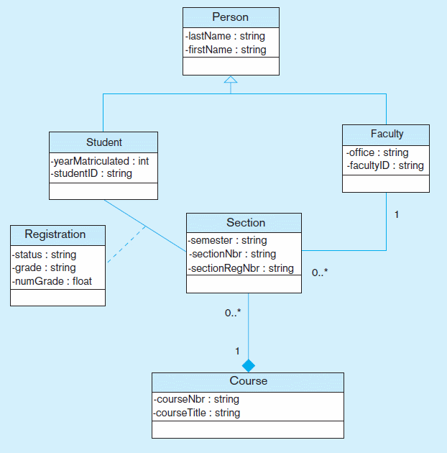
Example Hibernate Mapping
Figure 14-3 Object-oriented domain model

Slide 14
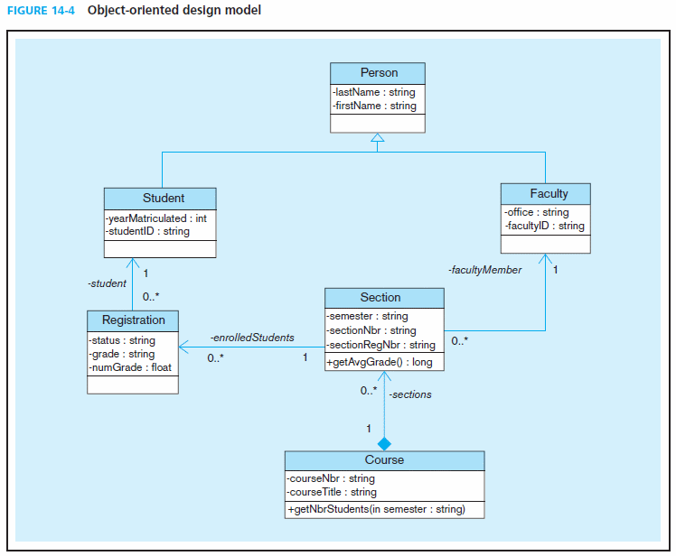

Slide 15
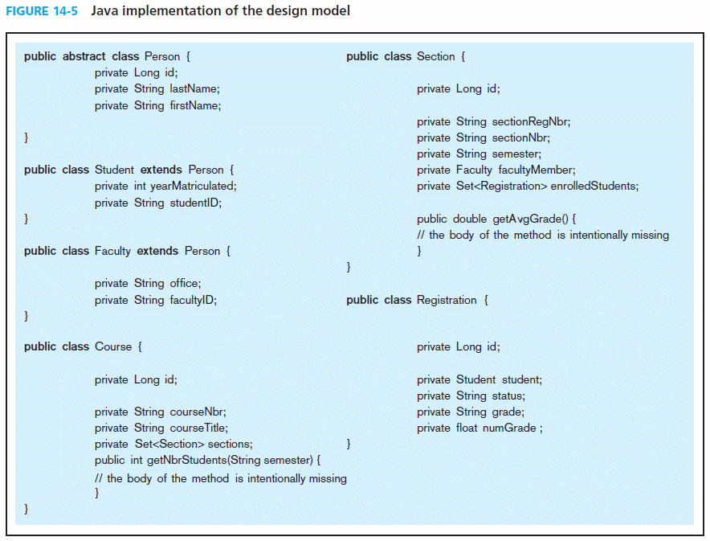
Example Hibernate Mapping

Slide 16

Example Hibernate Mapping
Figure 14-6 Relational database implementation

Slide 17

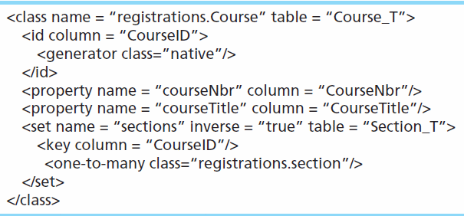
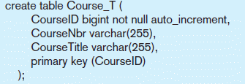
Example Hibernate Mapping
An ORM mapping

Slide 18
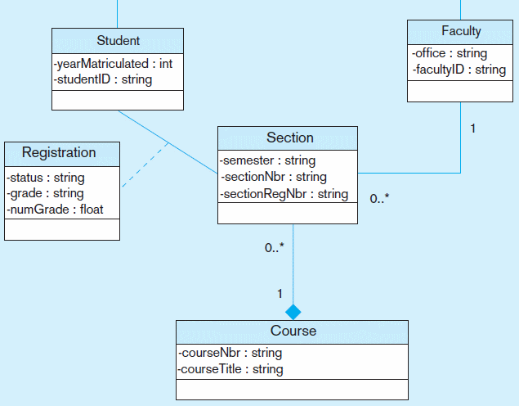
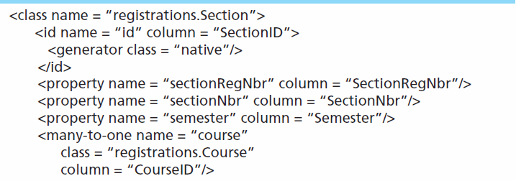
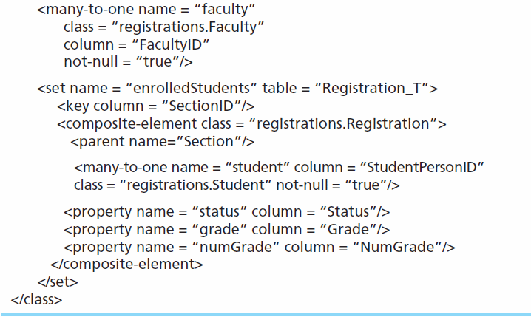
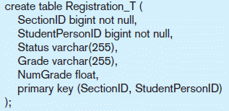
Example Hibernate Mapping
Another ORM mapping

Slide 19
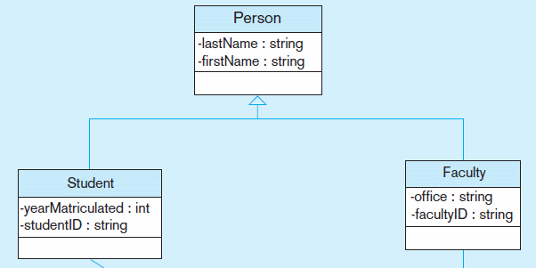
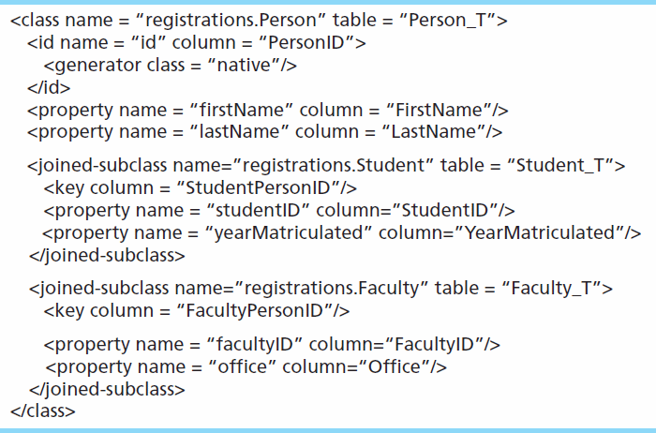

Example Hibernate Mapping
Another ORM mapping

Slide 20
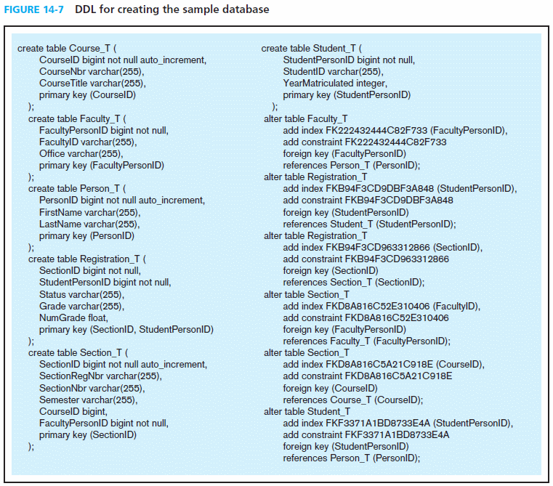
Example Hibernate Mapping
Hibernate’s SchemaExpert tool generates DDL from ORM mappings

Slide 21
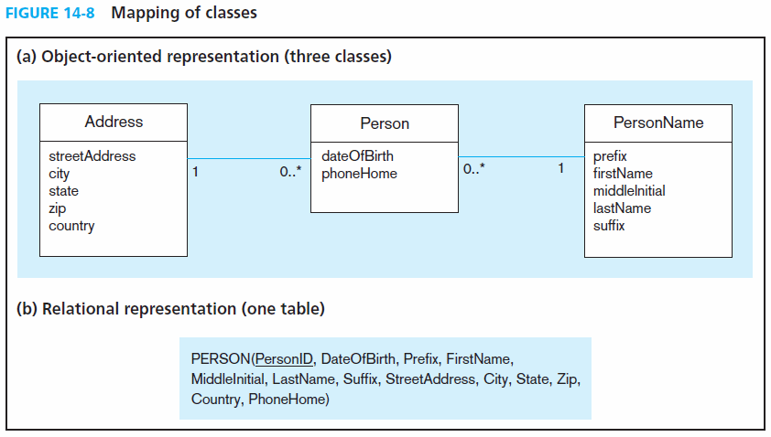
Mapping OO Structures to a Relational Database

Slide 22
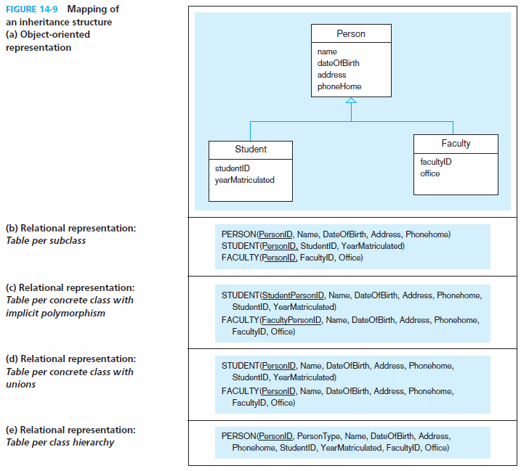

Slide 23
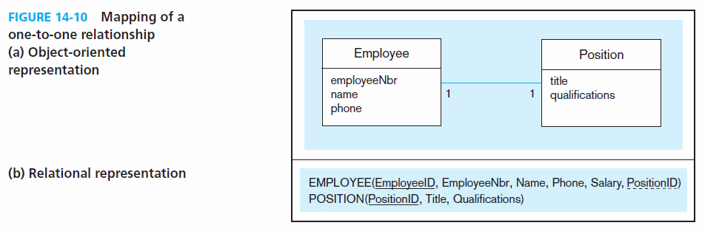
Mapping OO Structures to a Relational Database

Slide 24
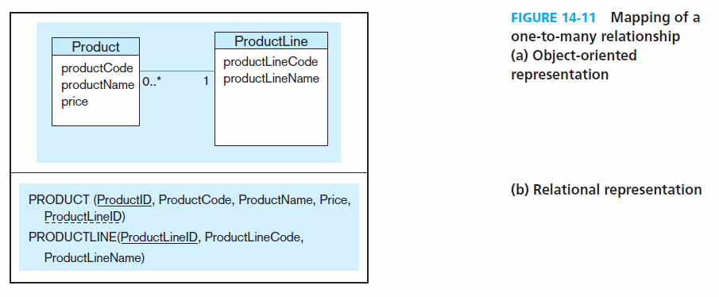
Mapping OO Structures to a Relational Database

Slide 25
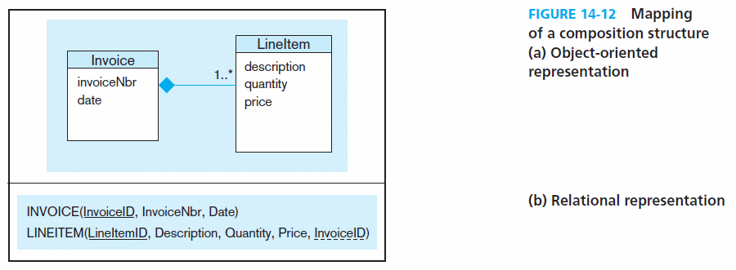
Mapping OO Structures to a Relational Database

Slide 26
Responsibilities of ORM Mapping Frameworks
Providing a layer of abstraction between OO applications and a database schema implemented with a DBMS ➝ transparent persistence
Generating SQL code for database access
Centralizing code related to database access
Support for transaction integrity and management
Services for concurrency control
Query language (e.g. Hibernate’s HQL)

Slide 27
ORM Database Performance Management
Fetching strategy – a model for specifying when and how an ORM framework retrieves persistent objects to the run-time memory during a navigation process
N+1 selects problem – a performance problem caused by too many SELECT statements generated by an ORM framework
Lazy vs. eager loading

Slide 28
Hibernate’s HQL Query Language
Similar to SQL
Different approaches to handling joins
  Implicit association join
  Ordinary join in FROM clause
  Fetch join in FROM clause
  Theta-style join in WHERE clause
From Bauer and King (2006, p645)

Slide 29

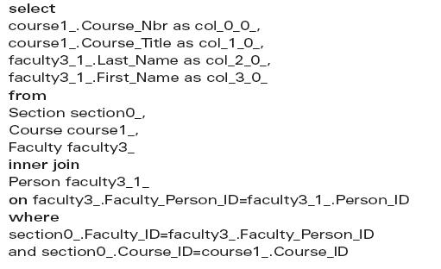
Sample HQL Query
Implicit join (simple many-to-one)
Equivalent SQL query

Slide 30

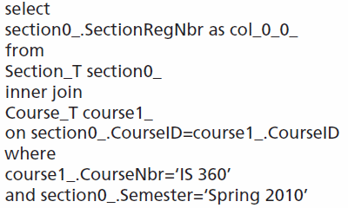
Sample HQL Query
Explicit join (complex one-to-many)
Equivalent SQL query

Slide 31
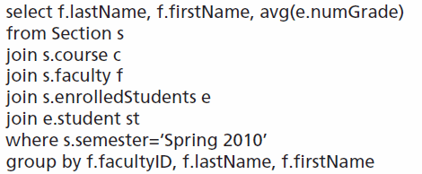
Sample HQL Query
Aggregate query with join

Slide 32

All rights reserved. No part of this publication may be reproduced, stored in a retrieval system, or transmitted, in any form or by any means, electronic, mechanical, photocopying, recording, or otherwise, without the prior written permission of the publisher. Printed in the United States of America.
Copyright © 2011 Pearson Education, Inc. Publishing as Prentice Hall

