Slide 1
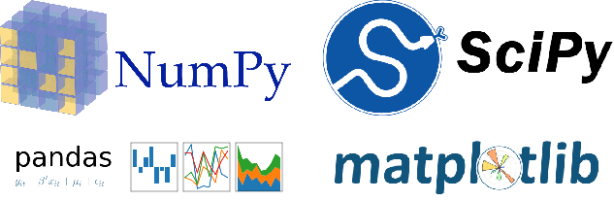
CEng 240 – Spring 2021 Week 13
Scientific and Engineering Libraries
Part 2: Pandas and Matplotlib
Sinan Kalkan

Slide 2
This Week
Scientific and Engineering Libraries
Pandas for data handling and analysis
Matplotlib for plotting

Slide 3


Slide 4

Outline
Overview
Installation
DataFrames
Accessing data in DataFrames
Modifying data in DataFrames
Analyzing data in DataFrames
Presenting data in DataFrames

Slide 5
Overview
A handy library for:
working with files of different formats
manipulating & analyzing data
Data types & structures for
tables, especially numerical tables,
time series
Name comes from “panel data”

Slide 6
Installation
On your Linux environment:
$ pip install pandas
or
$ conda install pandas
On Windows/Mac: install anaconda first
On Colab, it is already installed
import pandas as pd

Slide 7
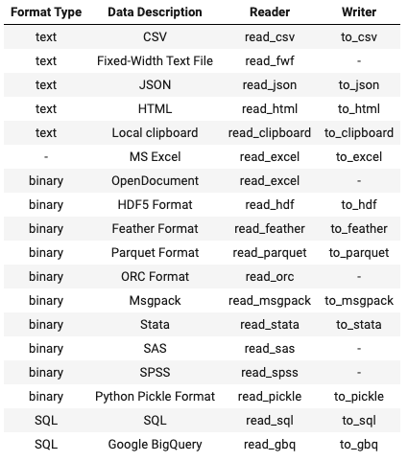
Supported Files
A wide collection of file formats
Each format has a reader and a writer
For an up-to-date list: https://pandas.pydata.org/pandas-docs/stable/user_guide/io.html

Slide 8
Data Frames
Similar to NumPy’s ndarray datatype, Pandas has a very fundamental data type called DataFrame
A DataFrame is created by
Data loaded from files (using a reader)
The constructor DataFrame()

Slide 9
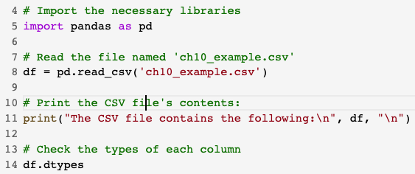
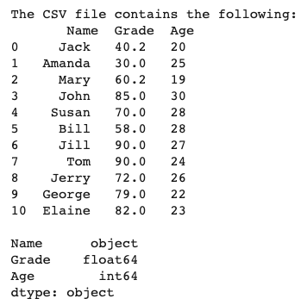
Data Frames
Loading data from files
This produces the following output:
For more information about the CSV file format, have a look at the File Handling chapter.
Sample file ‘ch10_example.csv’ at:
https://raw.githubusercontent.com/sinankalkan/CENG240/master/figures/ch10_example.csv

Slide 10
Data Frames
Loading data from files
More on pd.read_csv():
Automatically loads column headers
If your file does not have a header, use: pd.read_csv(filename, header=None)
If you want to read specific columns, use:
pd.read_csv(filename, usecols=[‘column name 1’, ...])
For more information & control, see help(pd.read_csv)

Slide 11
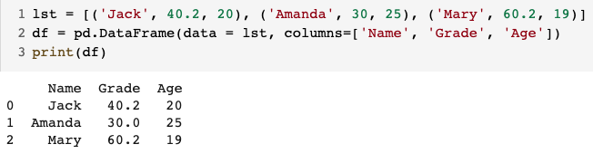
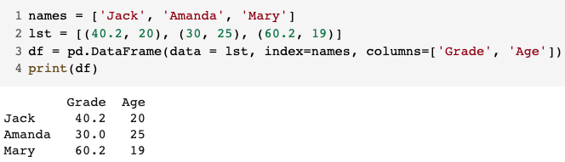
Data Frames
Create a DataFrame from Python data
Use the pd.DataFrame() function:
If you need keys/names for each row, then:

Slide 12
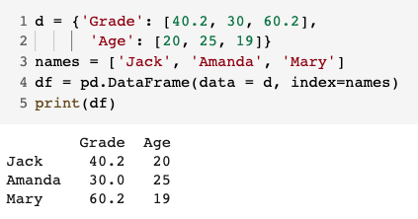
Data Frames
Create a DataFrame from Python data
It is also possible to create the columns of data in a dictionary and pass that to the pd.DataFrame() function:
Note that the column names were retrieved from the keys of the dictionary

Slide 13
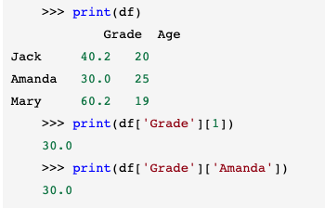
Accessing Data
Column-wise access
Use column names & row names like keys in a dictionary
df[‘Name’] returns the ‘Name’ column
Then you can use integer index or named index (key) in each row

Slide 14
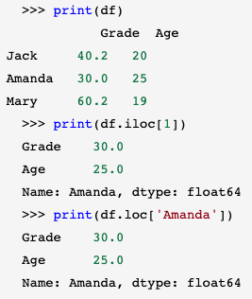
Accessing Data
Row-wise access
df.iloc[<row index>
for integer indexes
df.loc[<row name>]
for named indexes
Row & column indexing can be combined:
df.loc[‘Amanda’, ‘Grade’]
df.iloc[1, 1]
With integer indexes, Python’s slicing ([start:end:step]) can be used

Slide 15
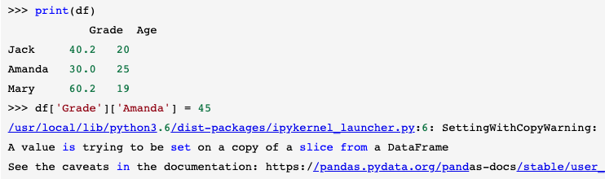
Modifying Data
Modifying data is very easy
Need to be careful about chained indexing
No guarantee on df[‘Grade’] being a copy or a direct access to the ‘Grade’ column

Slide 16
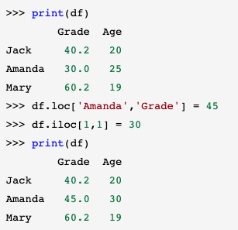
Modifying Data
Specify row & column in one step/go
Avoid chained indexing when modifying data

Slide 17
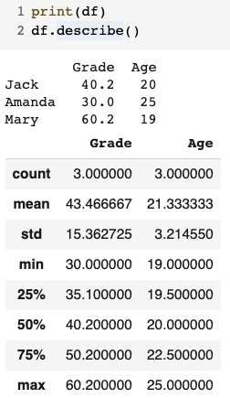
Analyzing Data
Pandas provides many facilities for analyzing your data in a DataFrame
df.describe()
df.value_counts()
df.max() or df.min()
df.sort_values(by=<col name>)
df.nlargest(<n>)

Slide 18
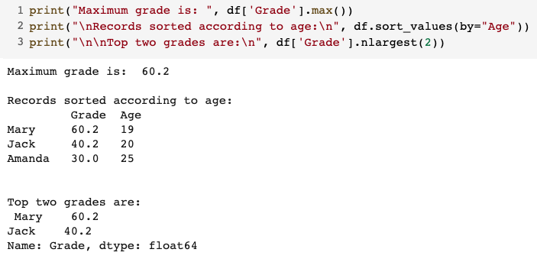
Analyzing Data
Pandas provides many facilities for analyzing your data in a DataFrame
df.describe()
df.value_counts()
df.max() or df.min()
df.sort_values(by=<column name>)
df.nlargest(<n>)

Slide 19
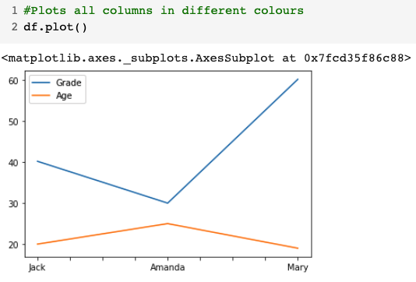
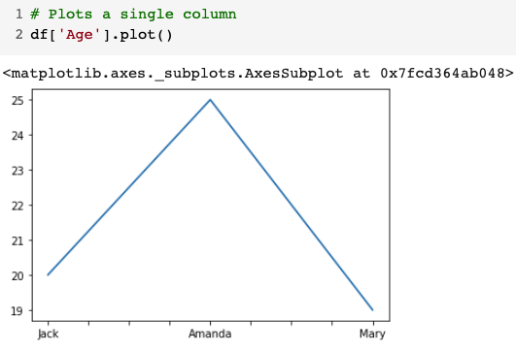
Presenting Data
plot() function

Slide 20


Slide 21
Outline
Overview
Installation
Anatomy of a figure/plot
Preparing your data
Drawing single plots
Drawing multiple plots
Changing elements of a plot

Slide 22
Overview
A drawing library for Python
A free and open source alternative to Matlab
Allows 2D & 3D plots

Slide 23
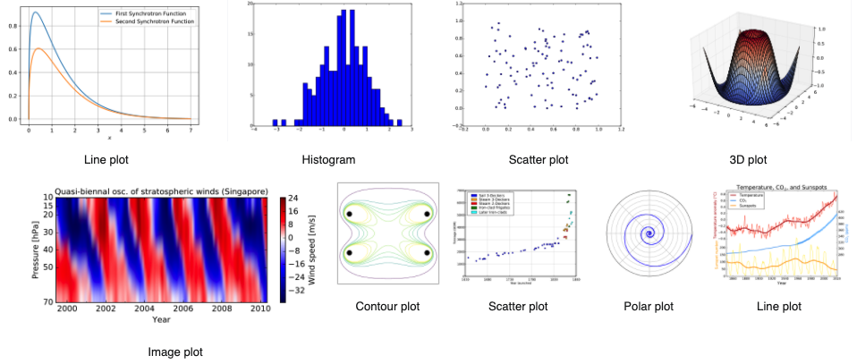
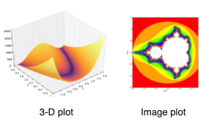
Overview

Slide 24
Installation
On your Linux environment:
$ pip install matplotlib
or
$ conda install matplotlib
On Windows/Mac: install anaconda first
On Colab, it is already installed
import matplotlib.pyplot as plt

Slide 25
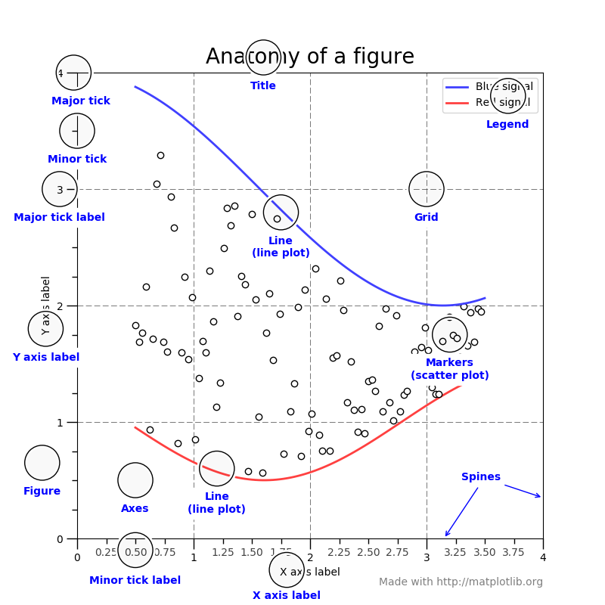
Anatomy of a plot
Canvas / drawing area
scatter plot, line plot, ...
Axes
ticks, tick labels, axis labels
figure title
legend
Figure from: https://matplotlib.org/tutorials/introductory/usage.html

Slide 26
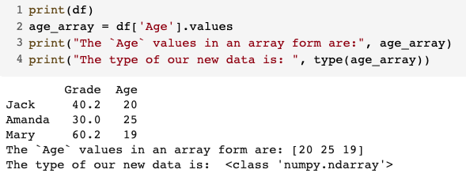
Preparing your data
Matplotlib expects NumPy arrays
Convert your data to NumPy
If your data is a Python data type, use array() function to do the conversion
If your data is a DataFrame, use df.values, e.g.:

Slide 27
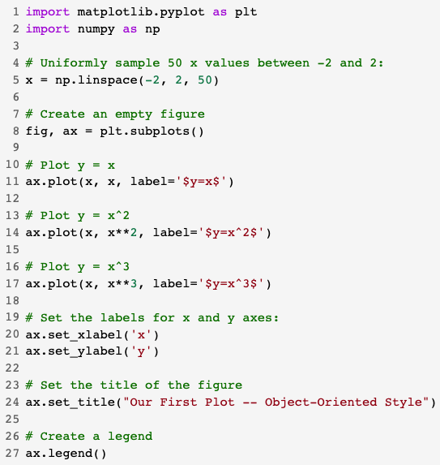
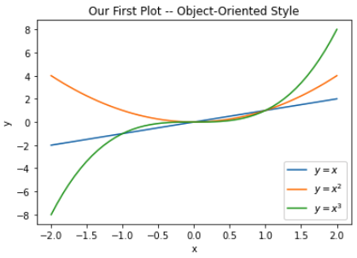
Drawing single plots
Drawing in an Object-Oriented Style
Create a figure object and axes object
Use their member functions & variables

Slide 28
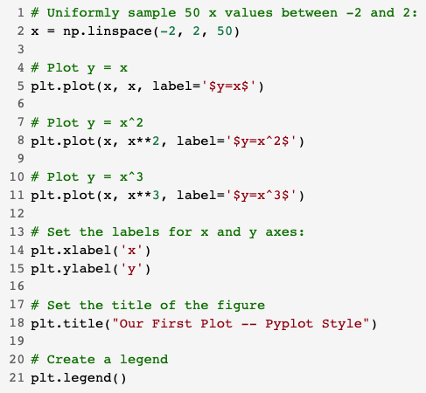
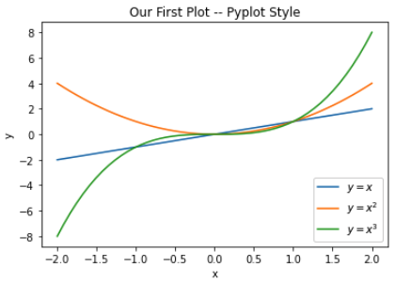
Drawing single plots
Drawing in an Pyplot Style
Use matplotlib.pylot directly

Slide 29
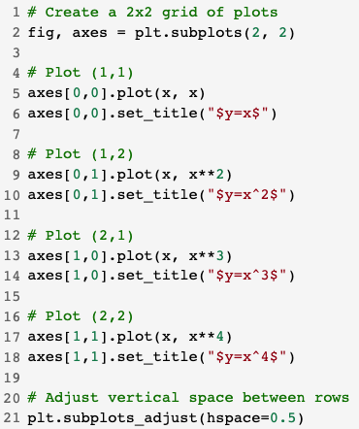
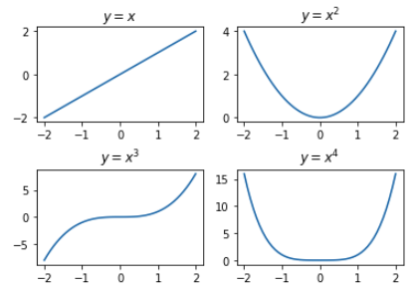
Drawing multiple plots
This example uses the object-oriented approach

Slide 30
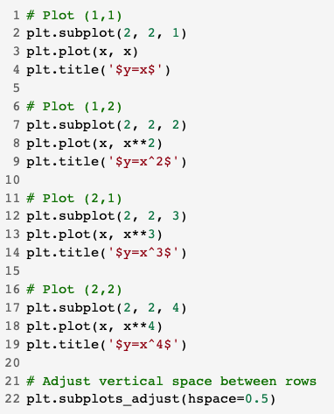
Drawing multiple plots
Multiple plots PyPlot style
Multiple plots OOP style

Slide 31
Changing plot elements
All elements of a plot are changeable
ticks, tick labels, ...
line/dot color, line/dot size, shape, ..
legends, titles, ...
font style, size, ...
Latex support
See
help(plt.plot)
https://matplotlib.org/2.1.1/contents.html

Slide 32
Examples (from the book)
Create a simple CSV file using your favorite spreadsheet editor (e.g. Microsoft Excel or Google Spreadsheets) and create a file with your exams and their grades as two separate columns. Save the file, upload it to the Colab notebook and do the following:
Load the file using Pandas.
Calculate the mean of your exam grades.
Calculate the standard deviation of your grades.
Using Matplotlib, generate the following plots with suitable names for the axes and the titles.
Draw the following four functions in separate single plots: sin(𝑥),cos(𝑥),tan(𝑥),cot(𝑥).
Draw these four functions in a single plot.
Draw a multiple 2x2 plot where each subplot is one of the four functions.

Slide 33
Final Words: Important Concepts
Pandas, DataFrame, loading files with Pandas.
Accessing and modifying content in DataFrames.
Analyzing and presenting data in DataFrames.
Matplotlib and different ways to make plots.
Drawing single and multiple plots. Changing elements of a plot.

Slide 34
that’s all folks! Stay healthy

