Slide 1
CEng 240 – Spring 2021 Week 14
Example Applications with Python
Sinan Kalkan

Slide 2
This Week
Example applications with Python
Approximation
Root Finding
Optimization
Linear and Non-linear Regression
Objectives:
Use Python for mathematical problems
Use some modules from the SciPy library

Slide 3
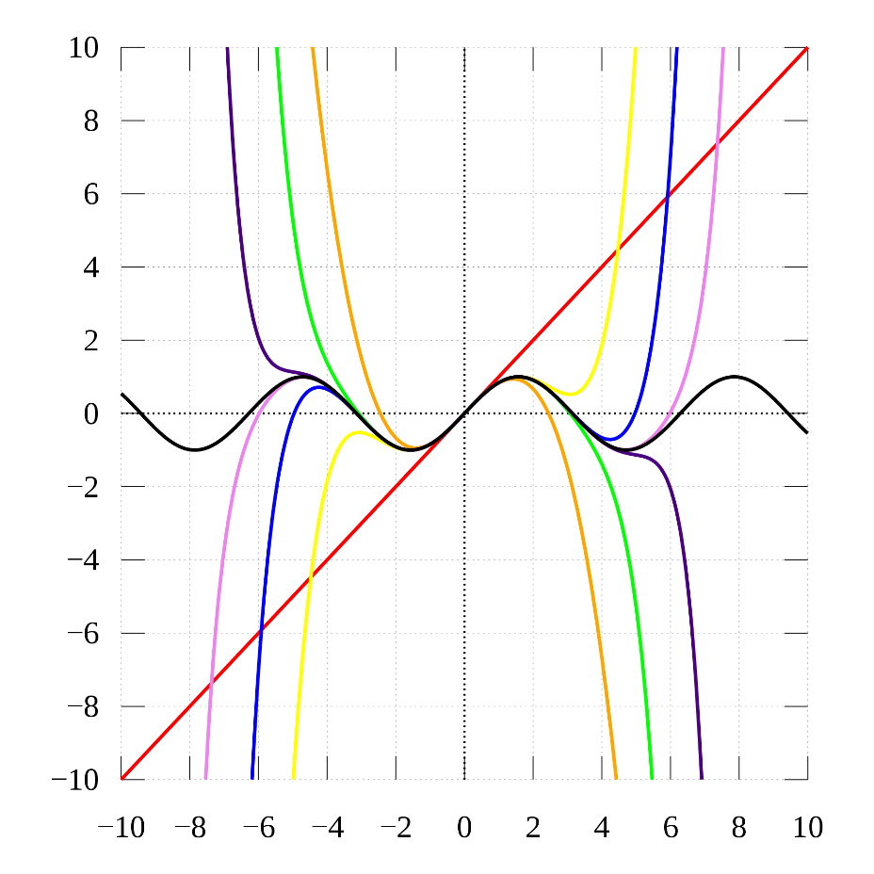
taylor series
Figure from Wikipedia

Slide 4
Taylor Series
$$?$$
$$f(a)$$
$$a$$
$$x_{0}$$

Slide 5
Taylor Series
Real f() function
$$f\left(a\right)+f^{′}\left(a\right)×(x_{0}−a)$$
tangent line
$$?$$
$$f^{′}\left(a\right)×(x_{0}−a)$$
$$f′(a)$$
$$f(a)$$
$$x_{0}−a$$
$$a$$
$$x_{0}$$
First order approximation: $f\left(x\right)≈f\left(a\right)+f^{′}\left(a\right)×(x−a)$

Slide 6
Taylor Series
First order approximation: $f\left(x\right)≈f\left(a\right)+f^{′}\left(a\right)×\left(x−a\right)$
General form:
$$f\left(x\right)=f\left(a\right)+\frac{f^{′}\left(a\right)}{1!}\left(x−a\right)+\frac{f^{′′}\left(a\right)}{2!}{\left(x−a\right)}^{2}…$$
or in more compact form:
$$f\left(x\right)=\sum_{n=0}^{∞}{\frac{f^{\left(n\right)}\left(a\right)}{n!}{\left(x−a\right)}^{n}}$$
$n^{th}$ derivative

Slide 7
Taylor Series
Approximation with first $m$ terms:
$$f\left(x\right)≈f\left(a\right)+\frac{f^{′}\left(a\right)}{1!}\left(x−a\right)+\frac{f^{′′}\left(a\right)}{2!}{\left(x−a\right)}^{2}+…+\frac{f^{(m)}\left(a\right)}{m!}{\left(x−a\right)}^{m}$$
or in more compact form:
$$f\left(x\right)≈\sum_{n=0}^{m}{\frac{f^{\left(n\right)}\left(a\right)}{n!}{\left(x−a\right)}^{n}}$$

Slide 8
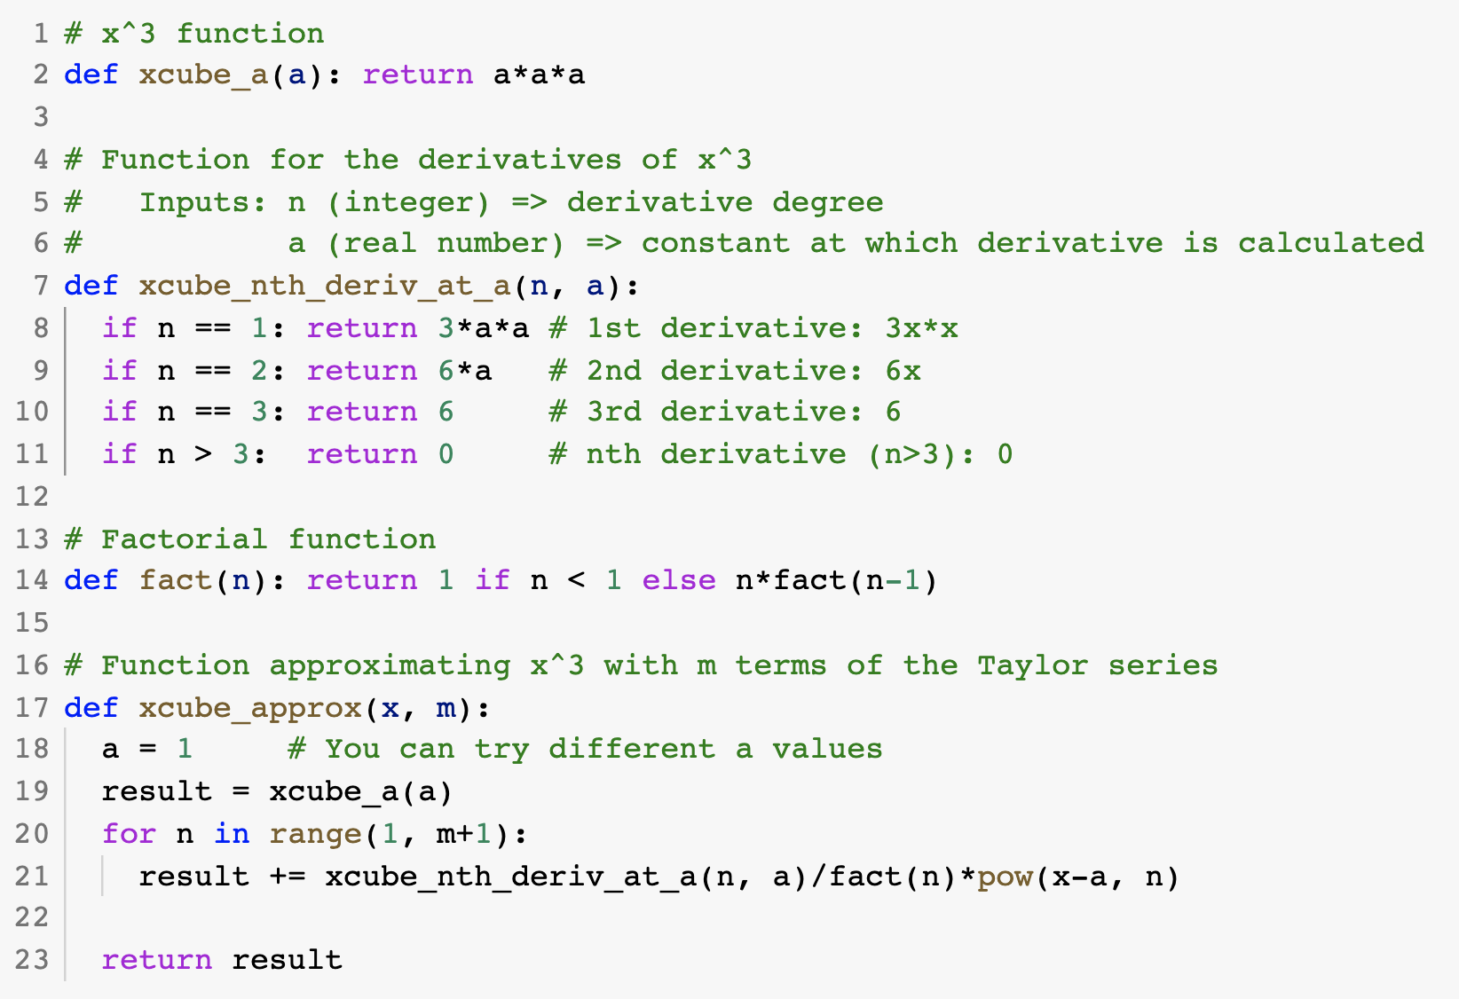
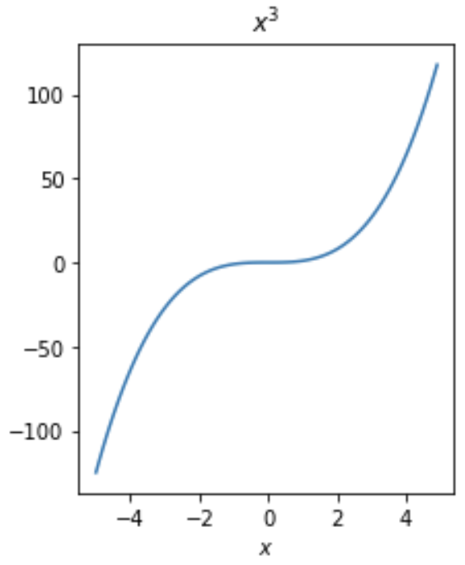
Taylor Series in Python
Approximate $f(x)=x^{3}$
$$f\left(x\right)≈\sum_{n=0}^{m}{\frac{f^{\left(n\right)}\left(a\right)}{n!}{\left(x−a\right)}^{n}}$$

Slide 9
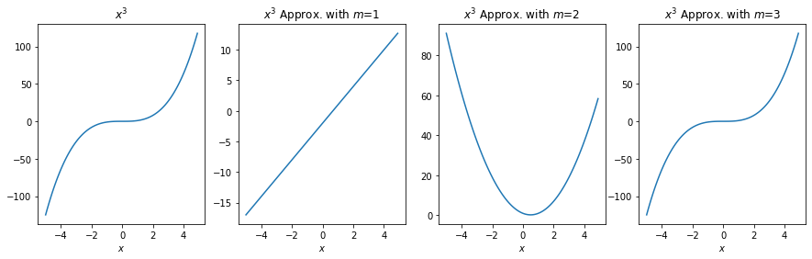
Taylor Series in Python
Approximate $f(x)=x^{3}$
$$f\left(x\right)≈\sum_{n=0}^{m}{\frac{f^{\left(n\right)}\left(a\right)}{n!}{\left(x−a\right)}^{n}}$$

Slide 10
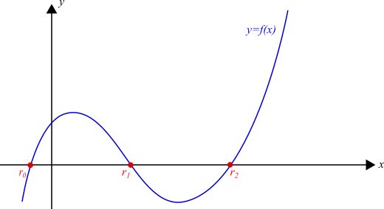
find the roots of a function

Slide 11
Problem Definition
Find $r_{0}, r_{1}, …, r_{n}$ that satisfies the following constraint:
$$f\left(r_{i}\right)=0$$
Many problems of the form $g\left(x\right)=h(x)$ can be solved using the roots of $g\left(x\right)−h\left(x\right)=0$

Slide 12
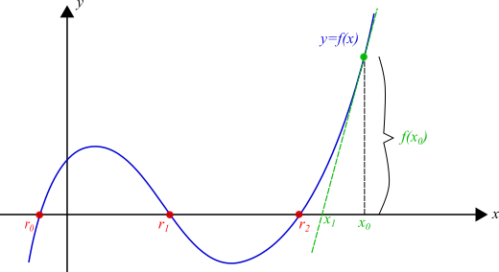
Newton’s Method

Slide 13
Newton’s Method
Step 1
$i←0$
$x_{i}←$ random value or a good guess
Step 2
Use tangent line at $x_{i}$ to calculate $x_{i+1}$
$$x_{i+1}=x_{i}−\frac{f\left(x_{i}\right)}{f′(x_{i})}$$
Step 3
$x_{i}←x_{i+1}$
Repeat Step 2 until “convergence”

Slide 14
Notes on Newton’s Method
Convergence
How can we be sure that the method converges to a solution?
If it converges, how can we know that we have converged?
Multiple roots
Try different values
Use prior knowledge about the function, e.g. the ranges where we expect the roots

Slide 15
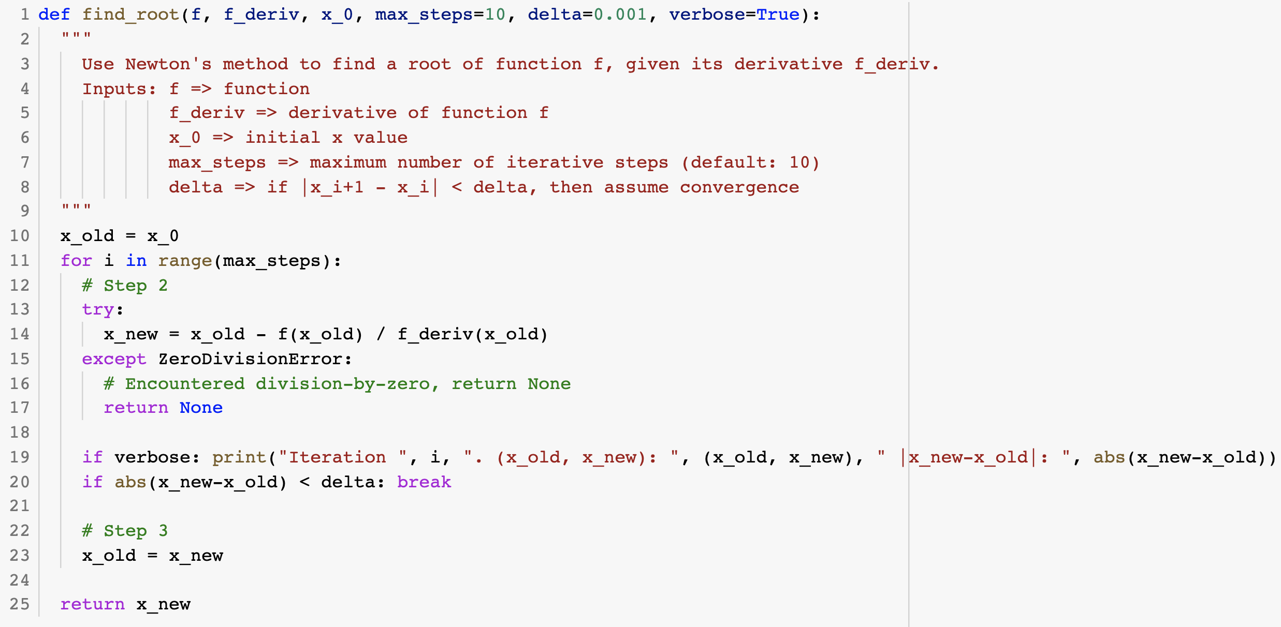
Newton’s Method in Python

Slide 16
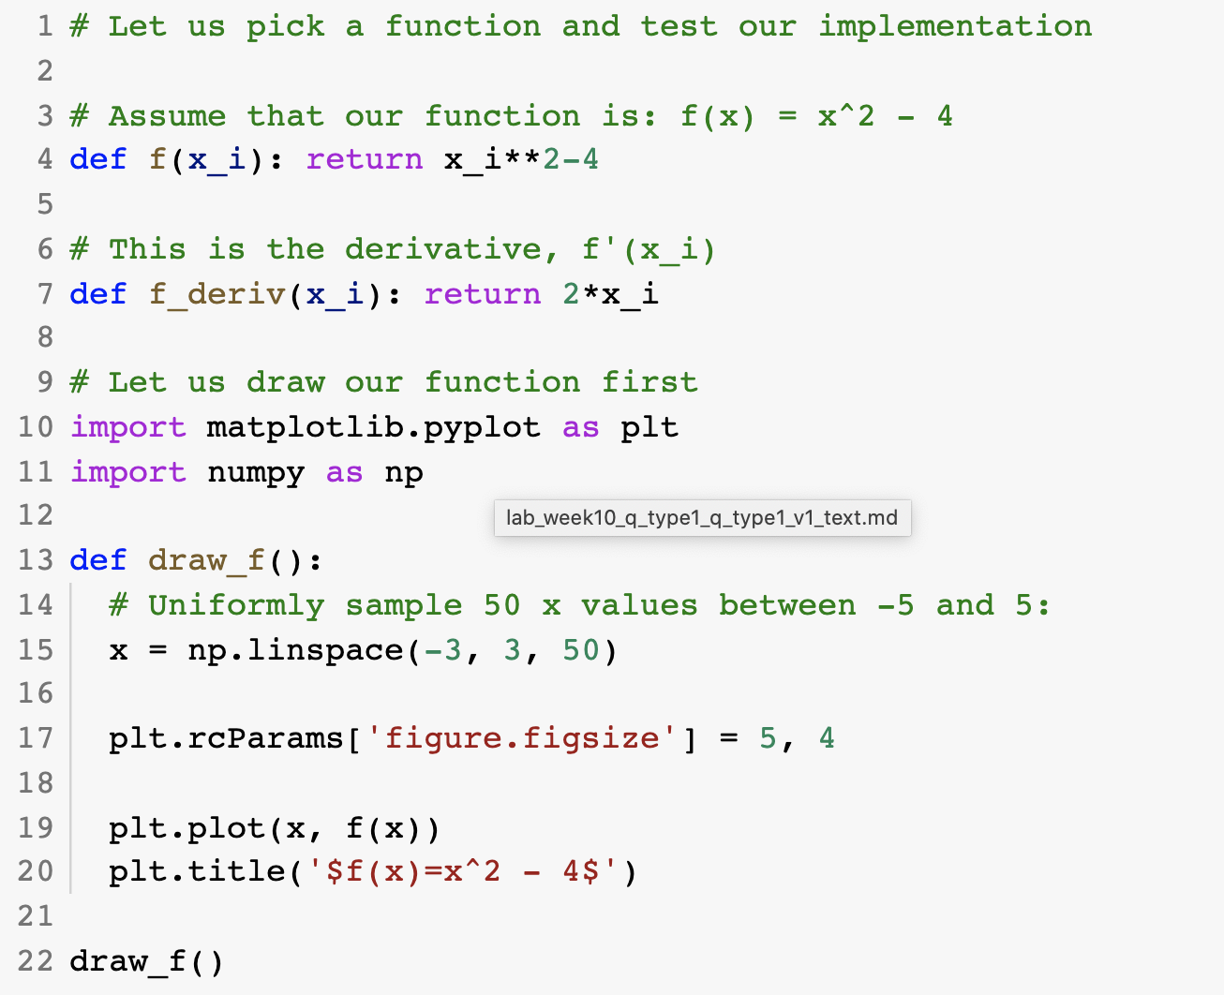
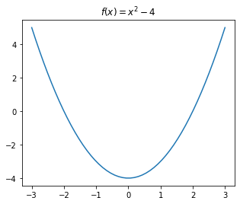
Newton’s Method in Python

Slide 17
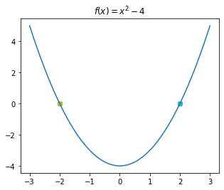
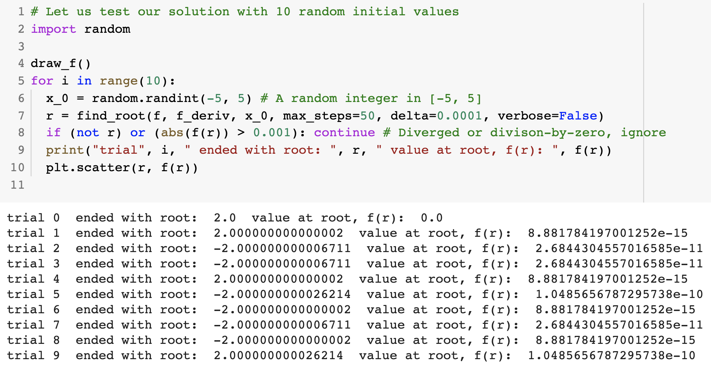
Newton’s Method in Python

Slide 18
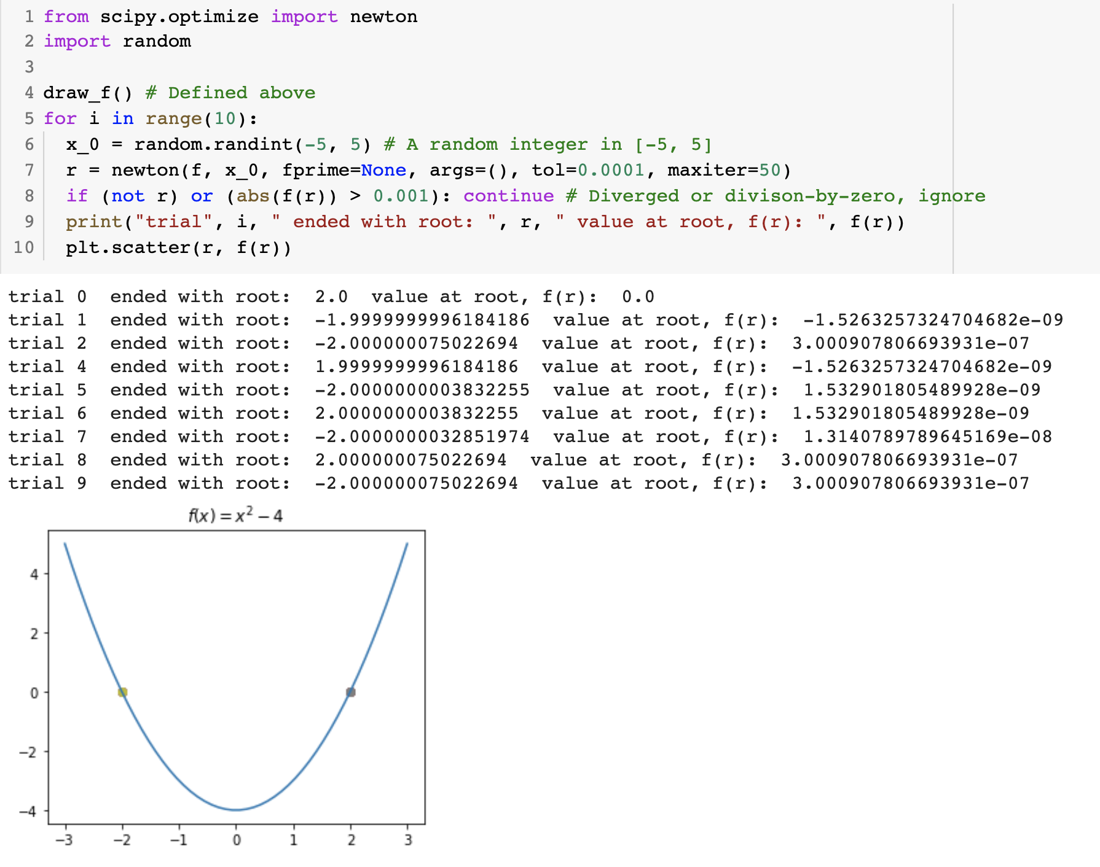
Newton’s Method in SciPy

Slide 19
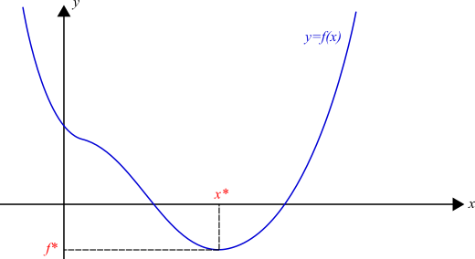
find the minima of a function

Slide 20
Problem Definition
Find $x^{∗}$ that minimizes function $f(x)$:
$$x^{∗}←\arg{\min_{x}{f(x)}}$$
Global minimum:
No $\hat{x}$ exist with $f\left(\hat{x}\right)<f(x^{∗})$
Local minimum:
No $\hat{x}$ exist in a neighborhood with $f\left(\hat{x}\right)<f(x^{∗})$
Two cues:
Derivative change
Derivative zero

Slide 21
Newton’s Method
Approximate the function with the first two orders:
$$f\left(x_{i+1}\right)≈f\left(x_{i}\right)+\frac{f^{′}\left(x_{i}\right)}{1!}\left(x_{i+1}−x_{i}\right)+\frac{f^{′′}\left(x_{i}\right)}{2!}{\left(x_{i+1}−x_{i}\right)}^{2}$$
Replace $x_{i+1}−x_{i}$ by $δ$:
$$f\left(x_{i}\right)+\frac{f^{′}\left(x_{i}\right)}{1!}δ+\frac{f^{′′}\left(x_{i}\right)}{2!}δ^{2}$$
Set the first derivative to zero:
$$\frac{d}{dδ}\left(f\left(x_{i}\right)+\frac{f^{′}\left(x_{i}\right)}{1!}δ+\frac{f^{′′}\left(x_{i}\right)}{2!}δ^{2}\right)=f^{′}\left(x_{i}\right)+f^{′′}\left(x_{i}\right)δ=0$$
Obtain $δ$:
$$δ=−\frac{f^{′}\left(x_{i}\right)}{f′′(x_{i})}$$
Plug this back into $x_{i+1}−x_{i}=δ$:
$$x_{i+1}=x_{i}−\frac{f^{′}\left(x_{i}\right)}{f′′(x_{i})}$$

Slide 22
Newton’s Method
Finding Minimum
Finding Root
$$x_{i+1}=x_{i}−\frac{f^{′}\left(x_{i}\right)}{f′′(x_{i})}$$
$$x_{i+1}=x_{i}−\frac{f\left(x_{i}\right)}{f′(x_{i})}$$

Slide 23
Notes
Convergence
When does it converge?
How do we understand it has converged?
Multiple Minima
Try multiple initial values
Use any prior knowledge available

Slide 24
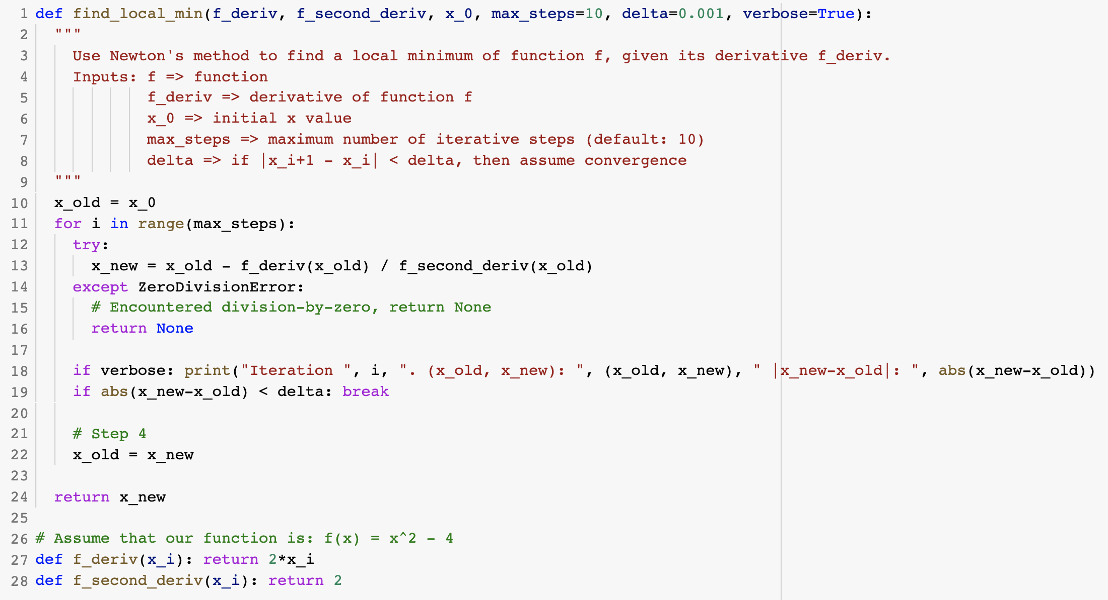
Newton’s Method in Python

Slide 25
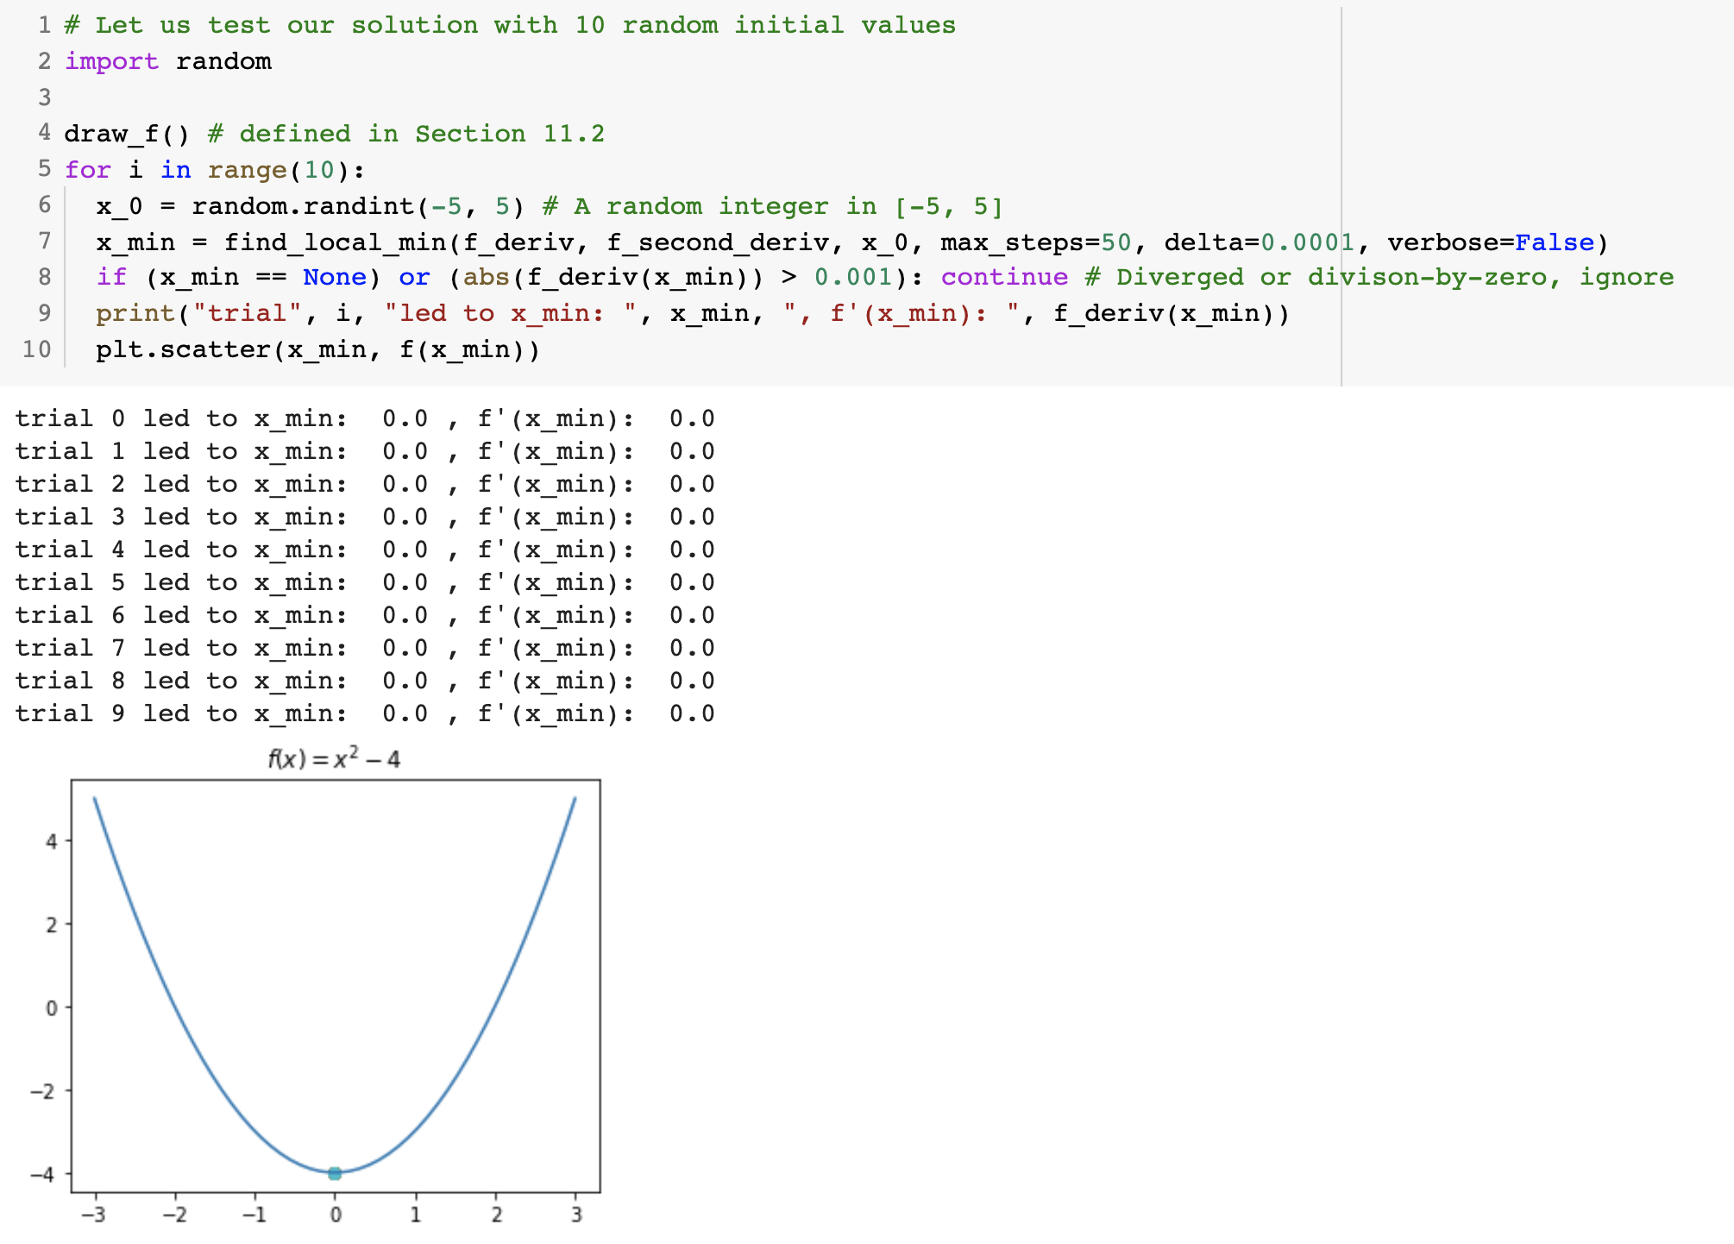
Newton’s Method in Python

Slide 26
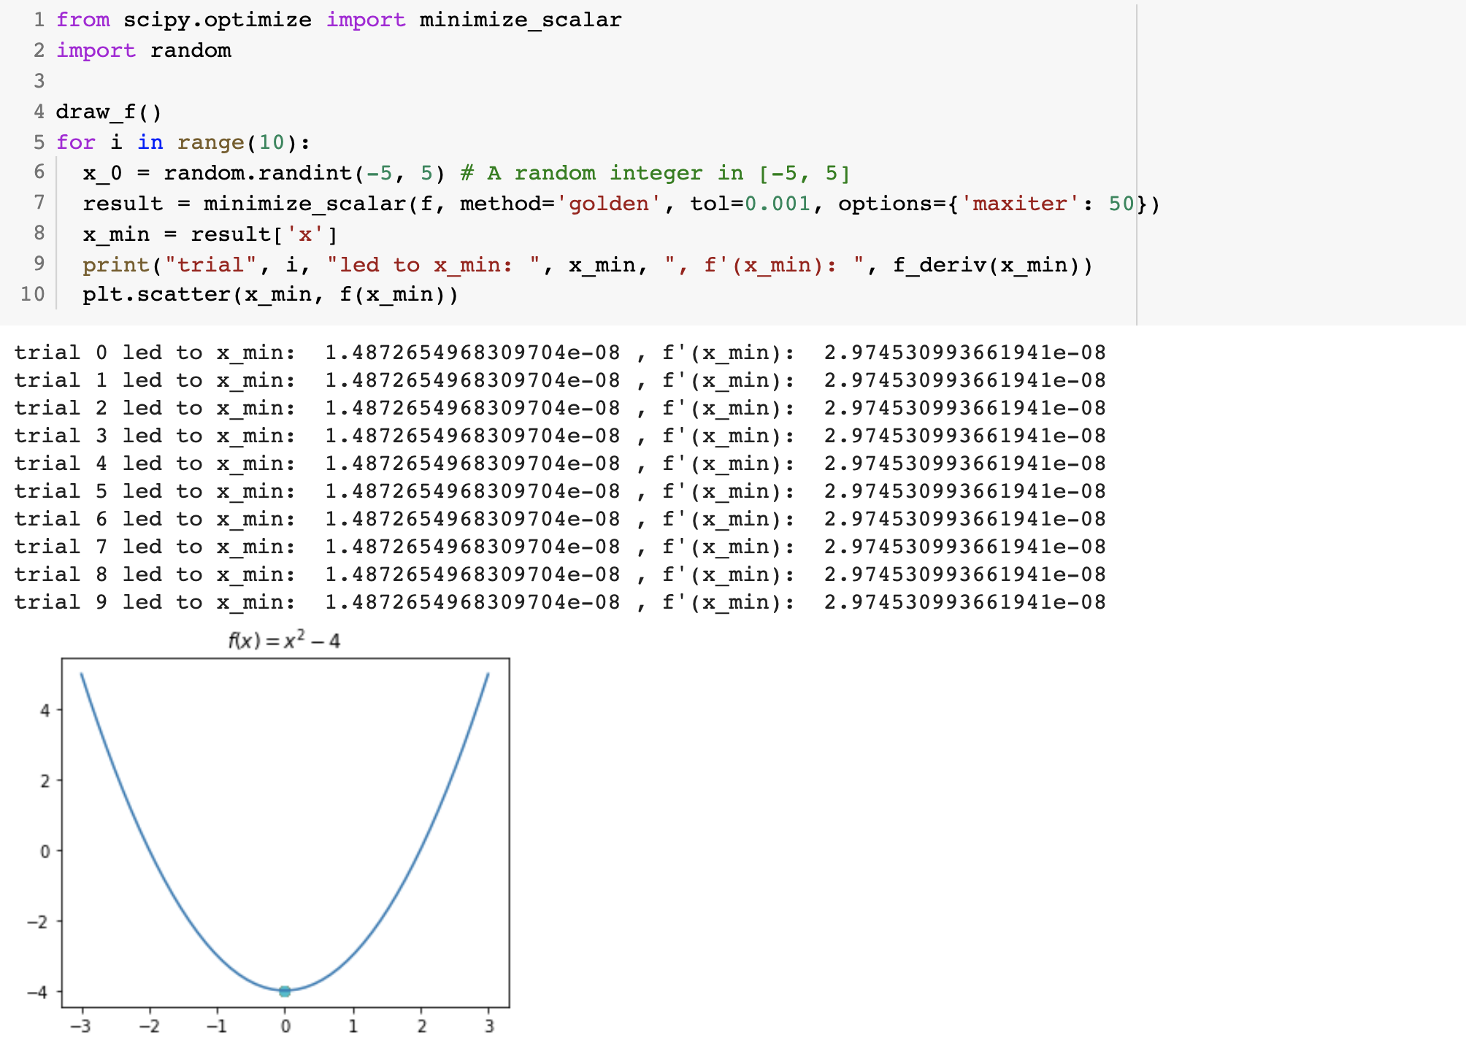
Newton’s Method in SciPy

Slide 27
Regression

Slide 28

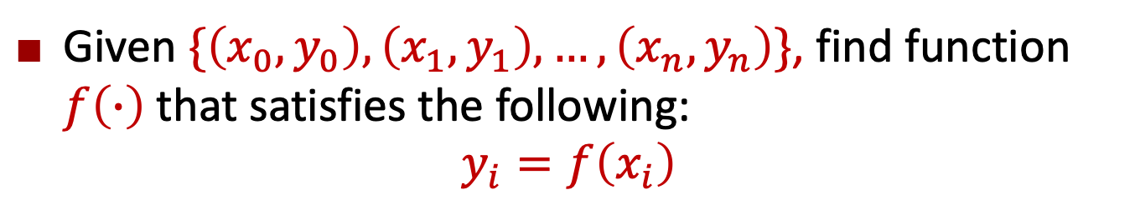



Problem Definition
Given $\{\left(x_{0},y_{0}\right),\left(x_{1},y_{1}\right),…,\left(x_{n},y_{n}\right)\}$, find function $f\left(∙\right)$that satisfies the following:
$$y_{i}=f\left(x_{i}\right)$$
$$y=f_{2}\left(x\right)$$
$$y=f_{1}\left(x\right)$$
$$y$$
$$x$$

Slide 29
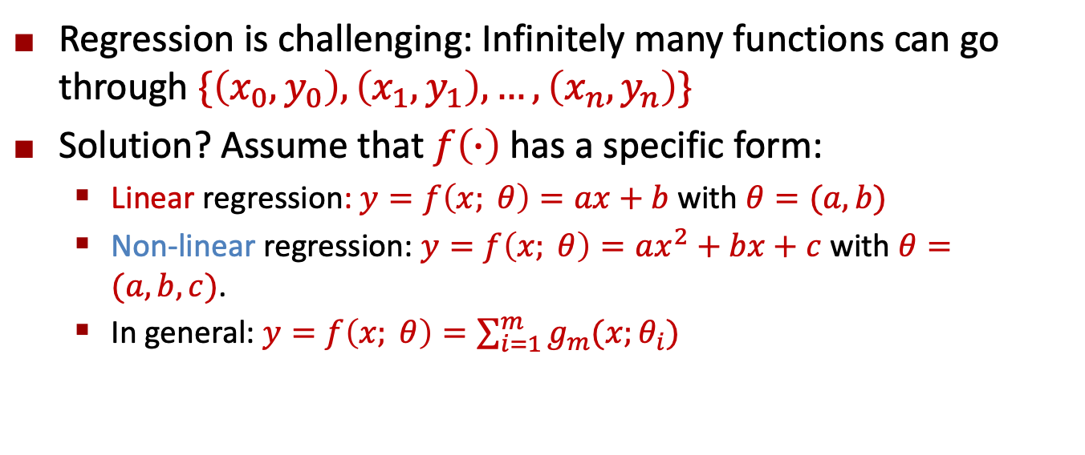
Problem Definition
Regression is challenging: Infinitely many functions can go through $\{\left(x_{0},y_{0}\right),\left(x_{1},y_{1}\right),…,\left(x_{n},y_{n}\right)\}$
Solution? Assume that $f\left(∙\right)$has a specific form:
Linear regression: $y=f\left(x; θ\right)=ax+b$ with $θ=(a,b)$
Non-linear regression: $y=f\left(x; θ\right)=ax^{2}+bx+c$ with $θ=(a,b,c)$.
In general: $y=f\left(x; θ\right)=\sum_{i=1}^{m}{g_{m}(x;θ_{i})}$

Slide 30
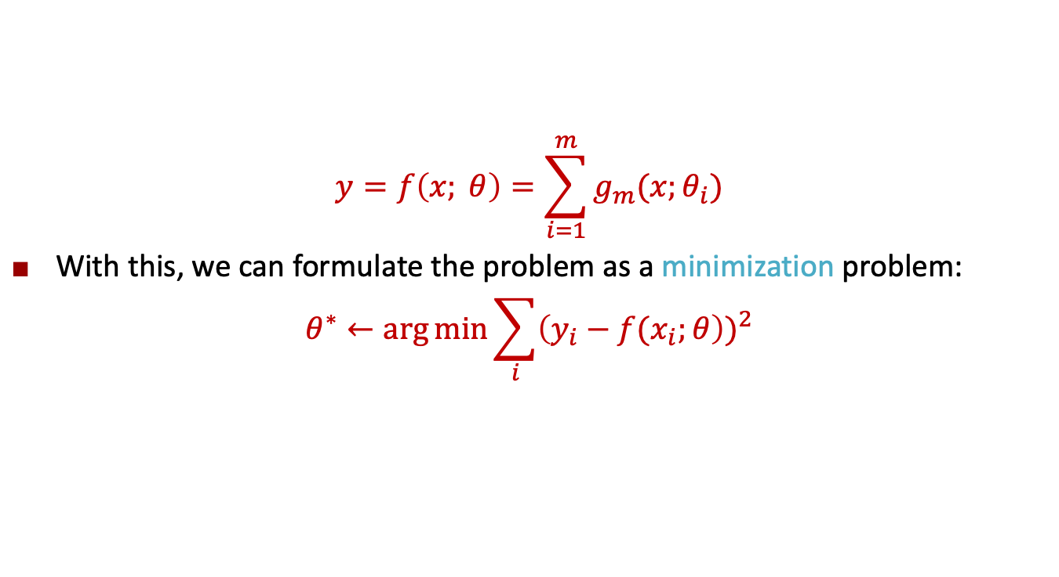
Problem Definition
$$y=f\left(x; θ\right)=\sum_{i=1}^{m}{g_{m}(x;θ_{i})}$$
With this, we can formulate the problem as a minimization problem:
$$θ^{∗}←\arg{\min{\sum_{i}{{\left(y_{i}−f(x_{i};θ\right))}^{2}}}}$$
Regression error

Slide 31
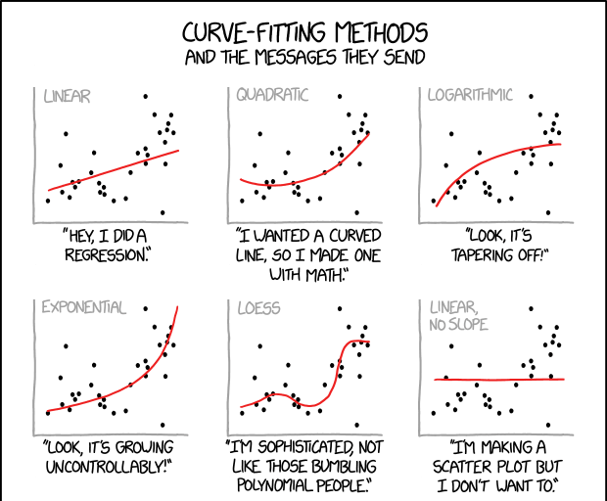
The form of the function
https://xkcd.com/2048/

Slide 32
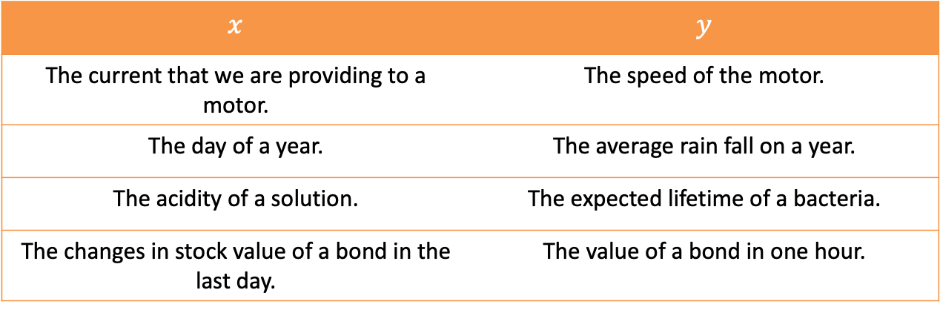

Why study regression?
Many disciplines give us $x,y$values and benefit from a function $f$ that goes through those values
$$x$$ | $$y$$
The current that we are providing to a motor. | The speed of the motor.
The day of a year. | The average rain fall on a year.
The acidity of a solution. | The expected lifetime of a bacteria.
The changes in stock value of a bond in the last day. | The value of a bond in one hour.

Slide 33
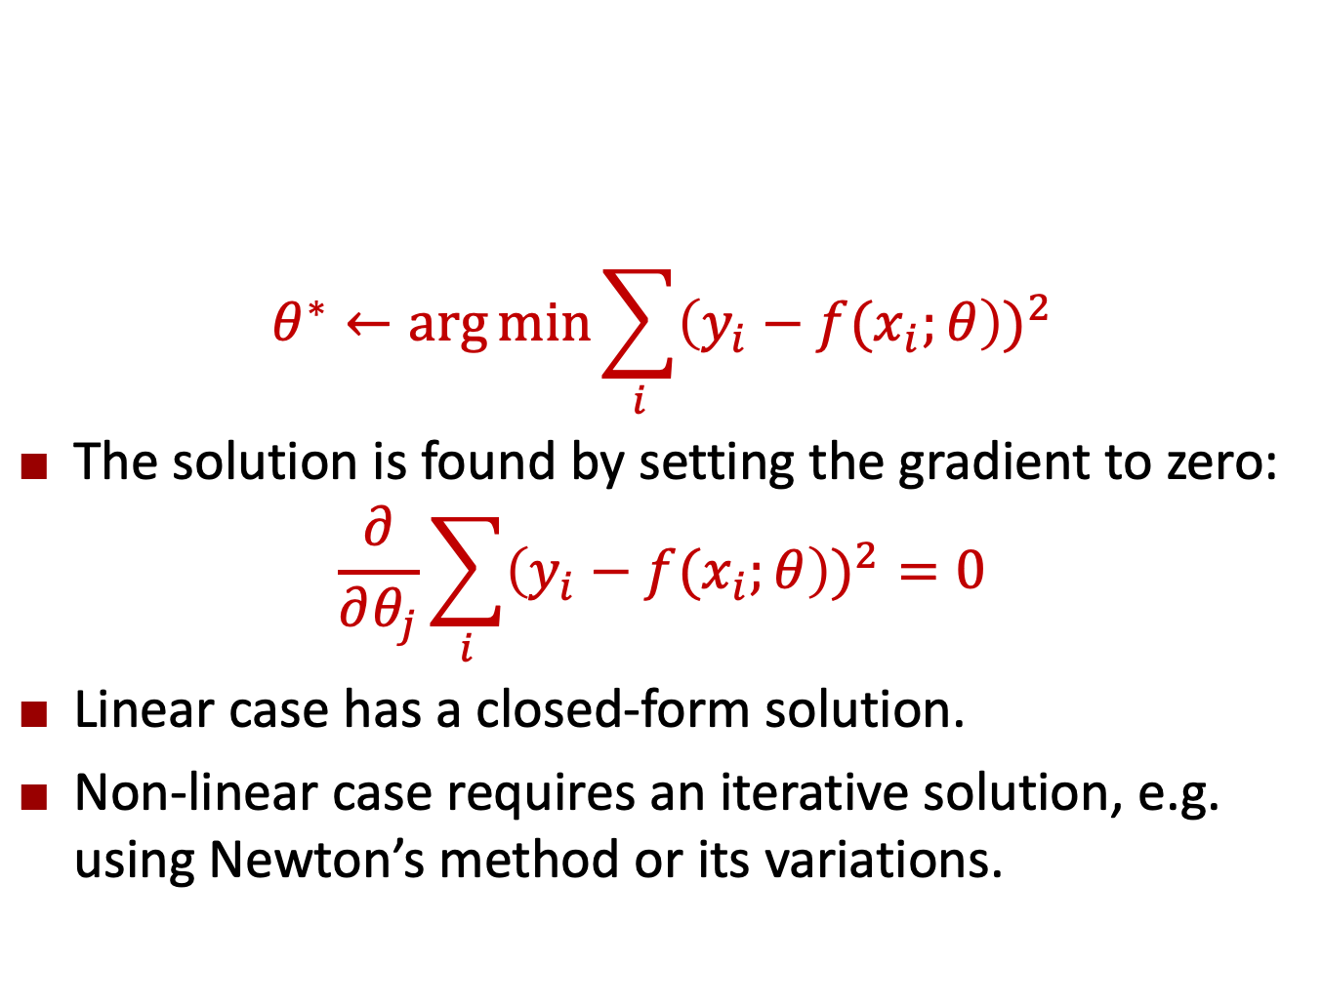
Least-Squares Regression
$$θ^{∗}←\arg{\min{\sum_{i}{{\left(y_{i}−f(x_{i};θ\right))}^{2}}}}$$
The solution is found by setting the gradient to zero:
$$\frac{∂}{∂θ_{j}}\sum_{i}{{\left(y_{i}−f(x_{i};θ\right))}^{2}}=0$$
Linear case has a closed-form solution.
Non-linear case requires an iterative solution, e.g. using Newton’s method or its variations.

Slide 34
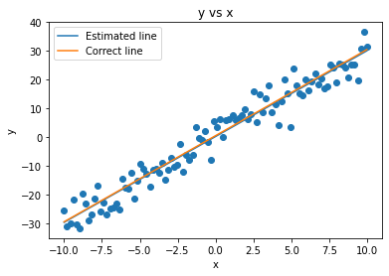
Evaluation: Qualitative
Analyze the found solution visually, by plotting it on the data:

Slide 35
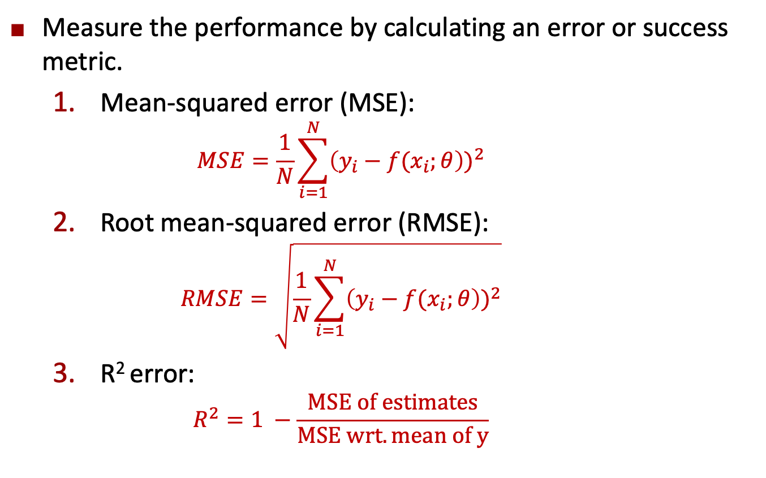
Evaluation: Quantitative
Measure the performance by calculating an error or success metric.
Mean-squared error (MSE):
$$MSE=\frac{1}{N}\sum_{i=1}^{N}{{\left(y_{i}−f(x_{i};θ\right))}^{2}}$$
Root mean-squared error (RMSE):
$$RMSE=\sqrt{\frac{1}{N}\sum_{i=1}^{N}{{\left(y_{i}−f(x_{i};θ\right))}^{2}}}$$
R² error:
$$R^{2}=1 −\frac{MSE of estimates}{MSE wrt. mean of y}$$

Slide 36
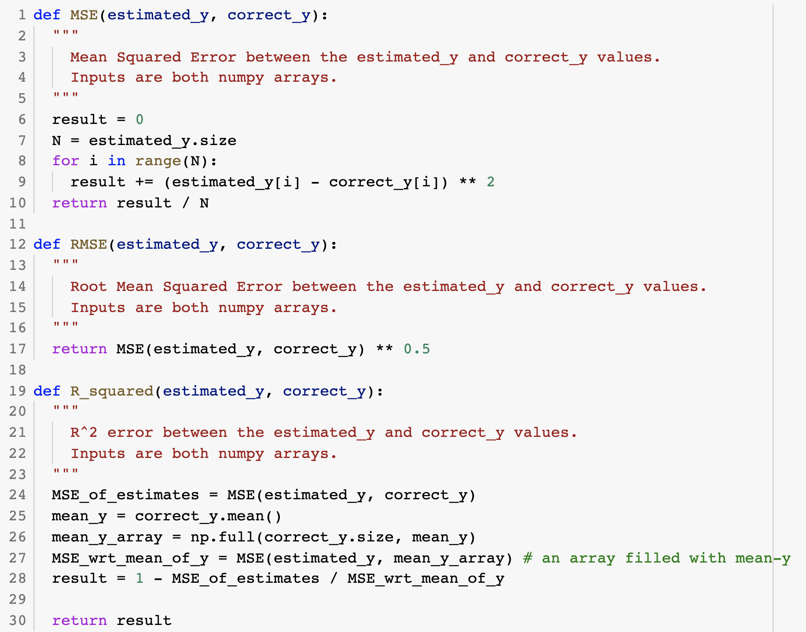
Evaluation: Quantitative

Slide 37
LINEAR Regression
With SciPy

Slide 38
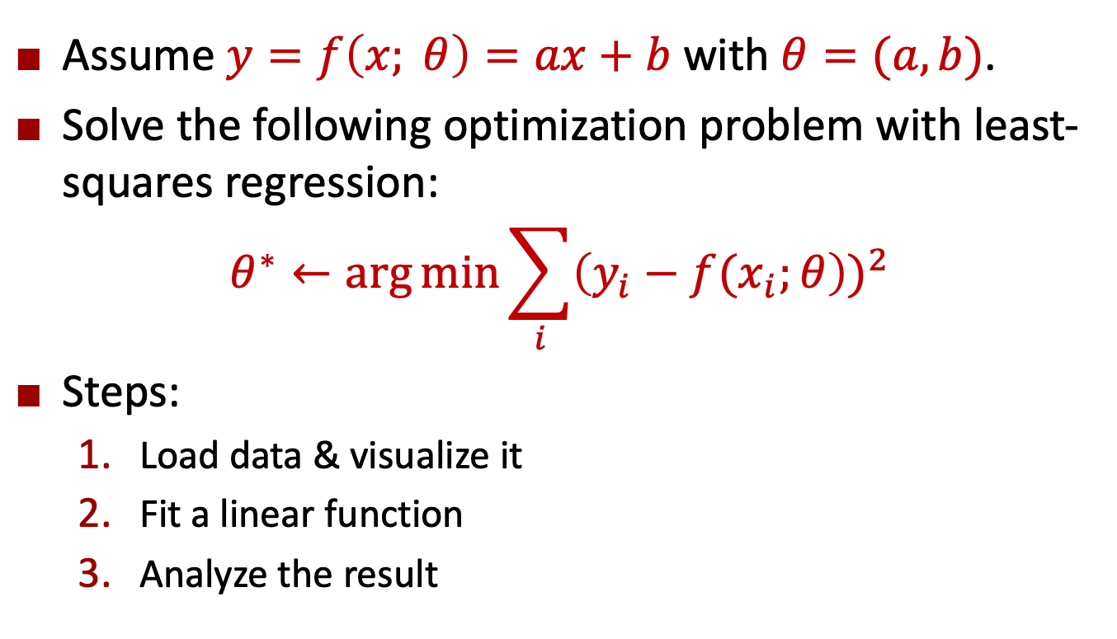
Problem Definition
Assume $y=f\left(x; θ\right)=ax+b$ with $θ=(a,b)$.
Solve the following optimization problem with least-squares regression:
$$θ^{∗}←\arg{\min{\sum_{i}{{\left(y_{i}−f(x_{i};θ\right))}^{2}}}}$$
Steps:
Load data & visualize it
Fit a linear function
Analyze the result

Slide 39
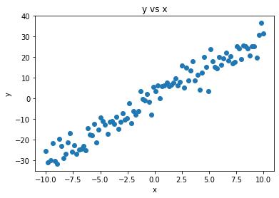
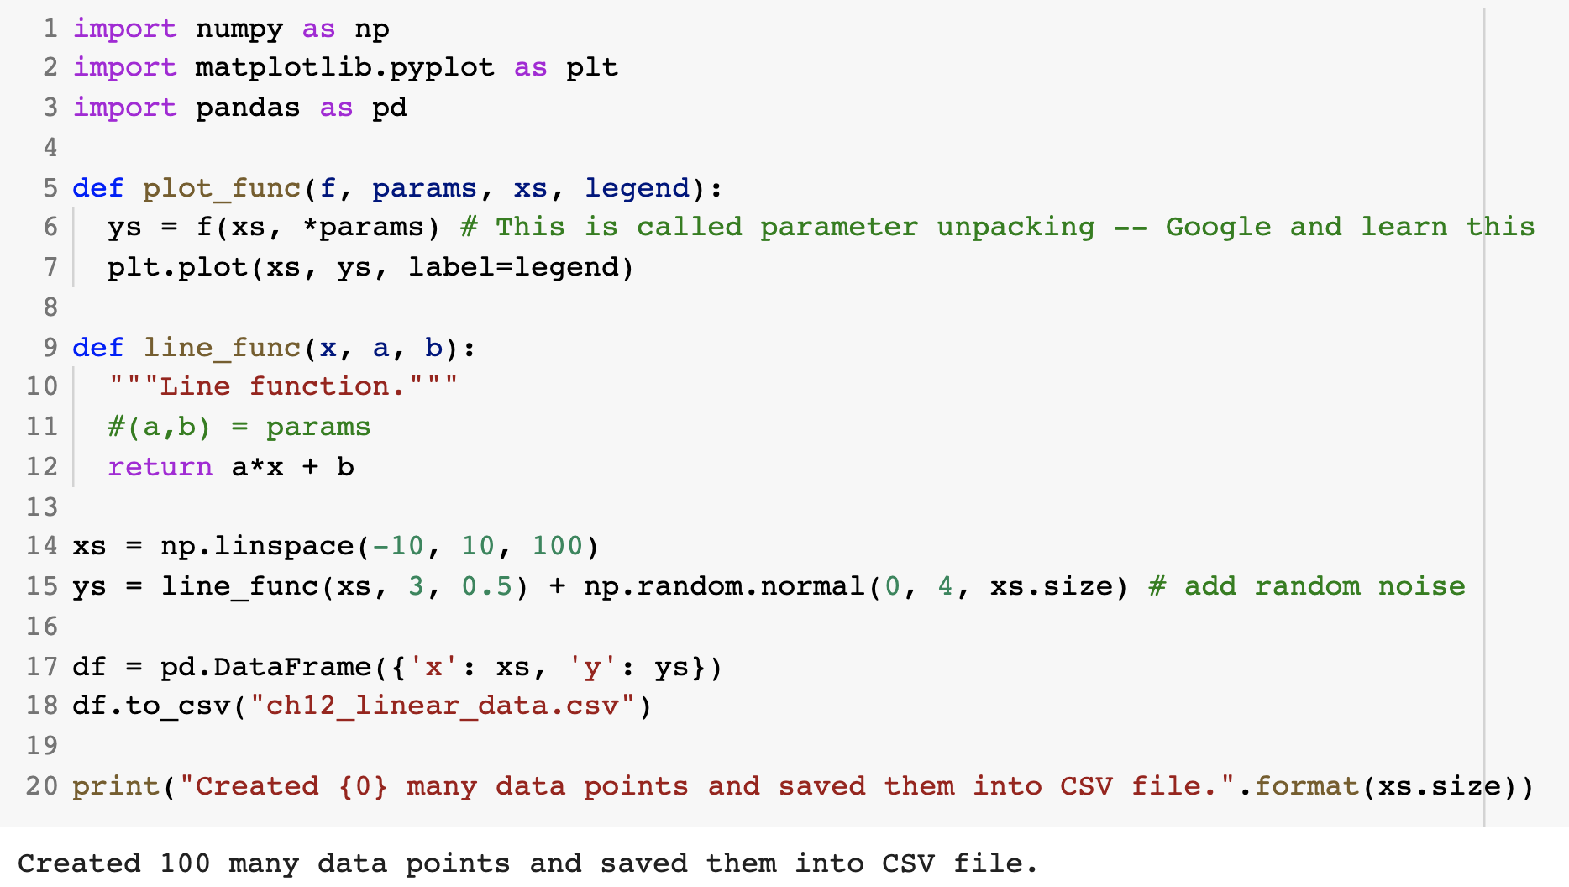
Step 0: Create Artificial Data

Slide 40
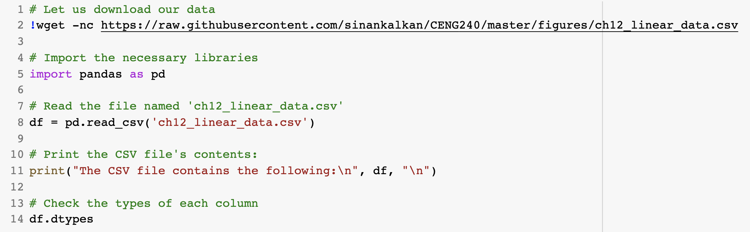
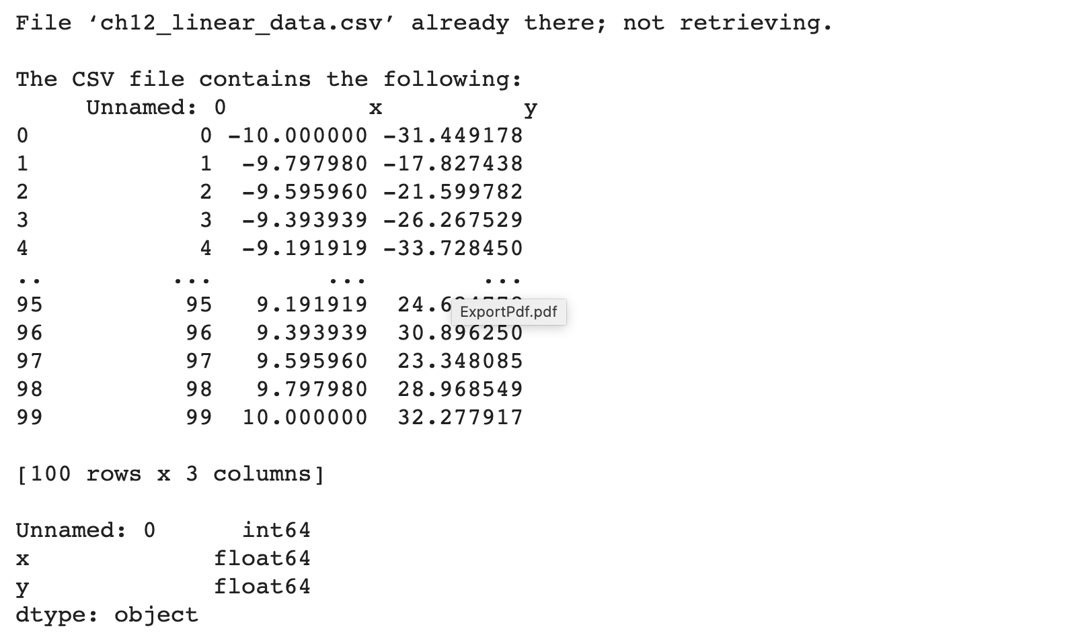
Step 1: (Down)load and Visualize Data

Slide 41
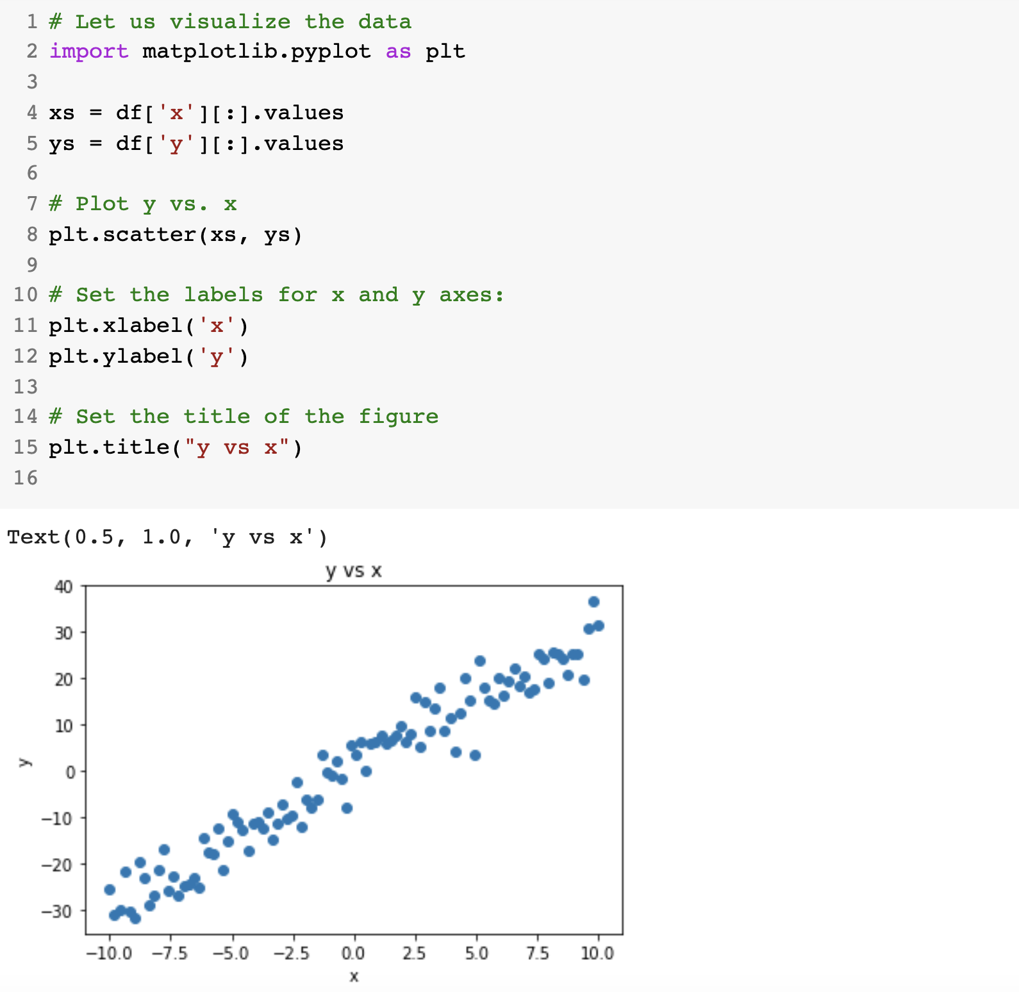
Step 1: (Down)load and Visualize Data

Slide 42
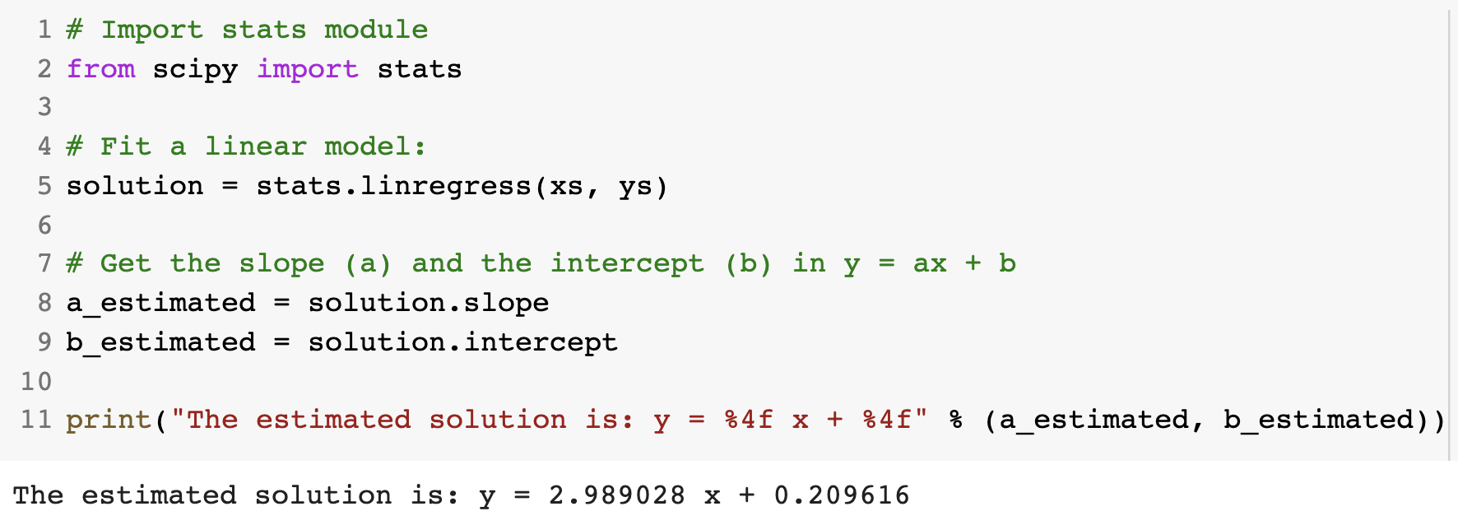
Step 2: Fit a linear function with SciPy
scipy.stats.linregress

Slide 43
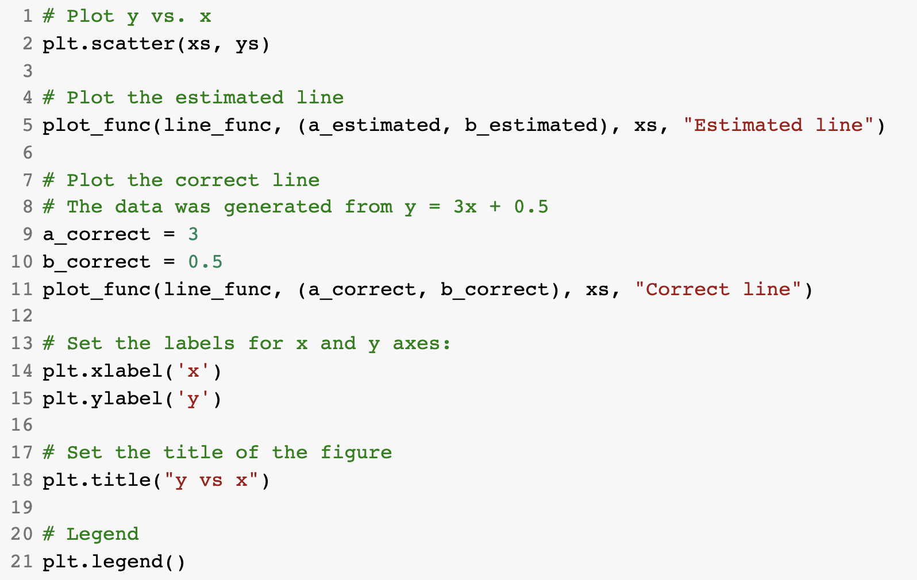
Step 3: Analyze the results (Qualitative Analysis)

Slide 44
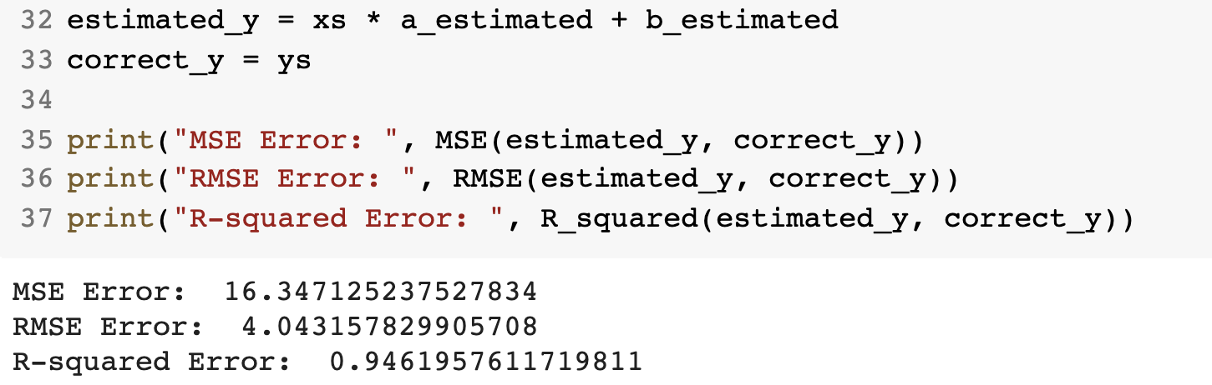
Step 3: Analyze the results (Quantitative Analysis)

Slide 45
Non-linear Regression
With SciPy

Slide 46
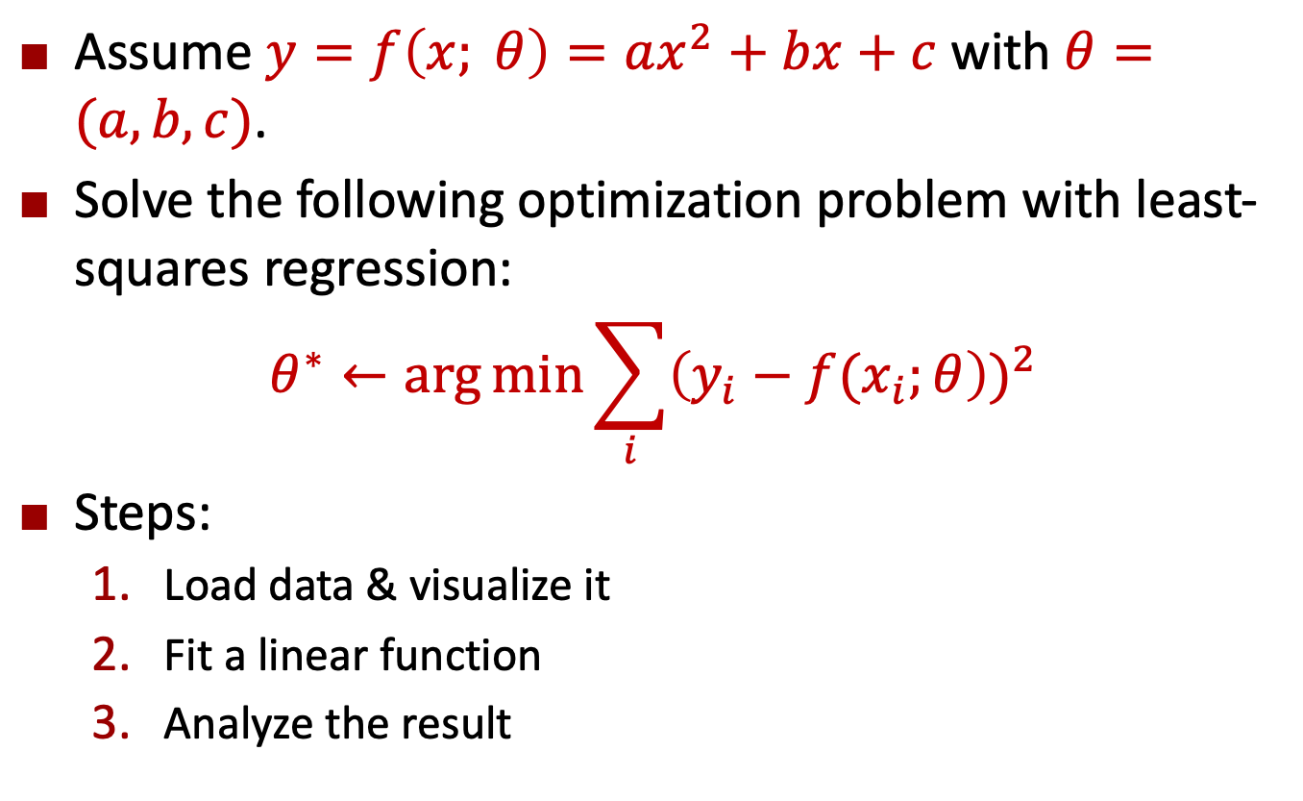
Problem Definition
Assume $y=f\left(x; θ\right)=ax^{2}+bx+c$ with $θ=(a,b,c)$.
Solve the following optimization problem with least-squares regression:
$$θ^{∗}←\arg{\min{\sum_{i}{{\left(y_{i}−f(x_{i};θ\right))}^{2}}}}$$
Steps:
Load data & visualize it
Fit a linear function
Analyze the result

Slide 47
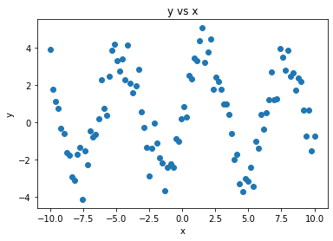
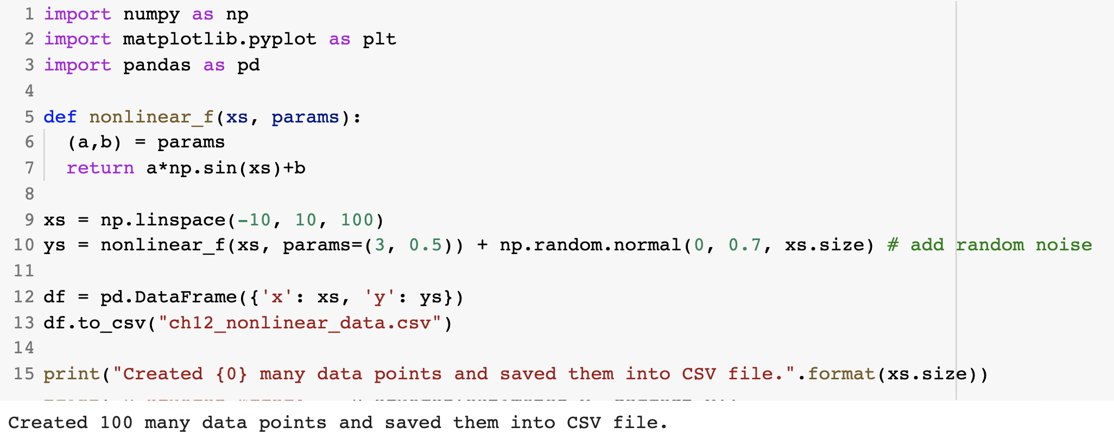
Step 0: Create Artificial Data

Slide 48
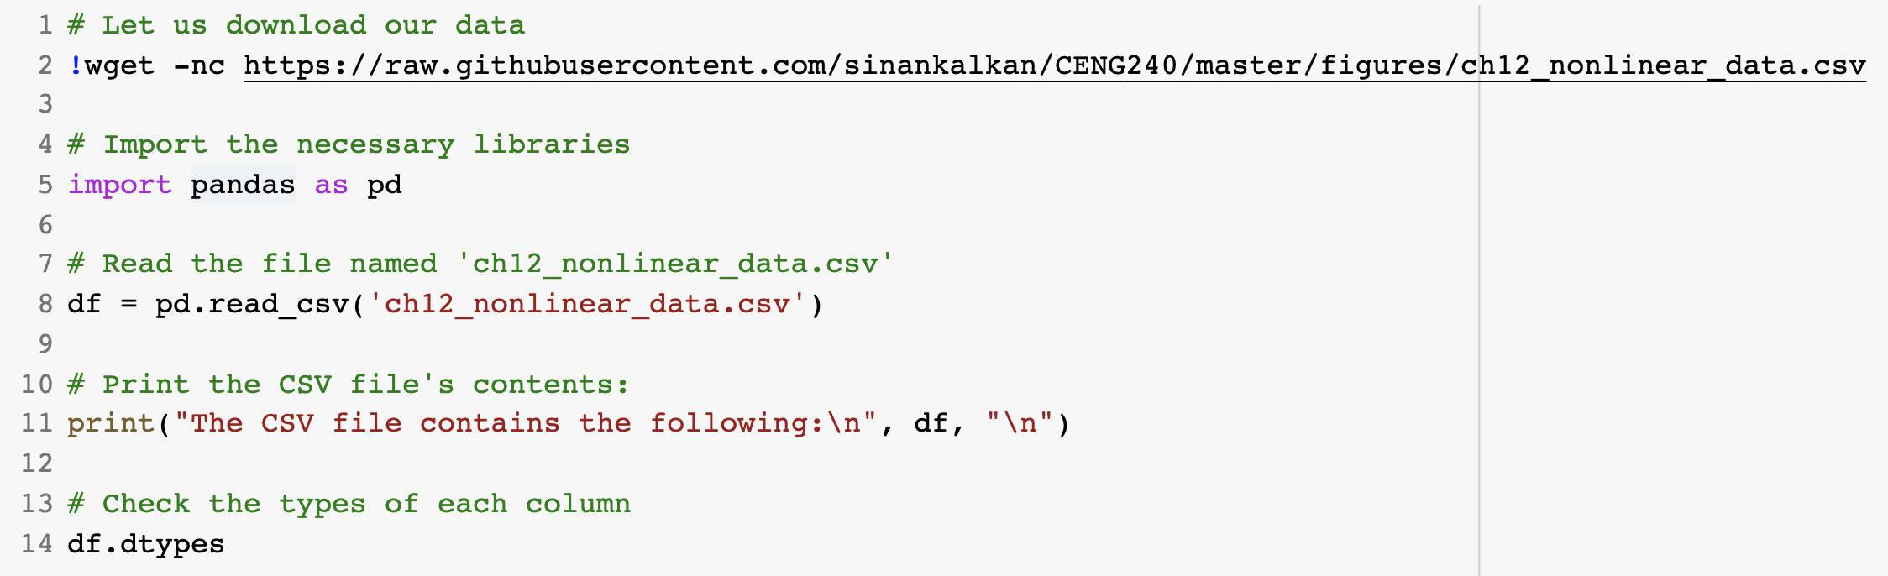
Step 1: (Down)load and Visualize Data

Slide 49
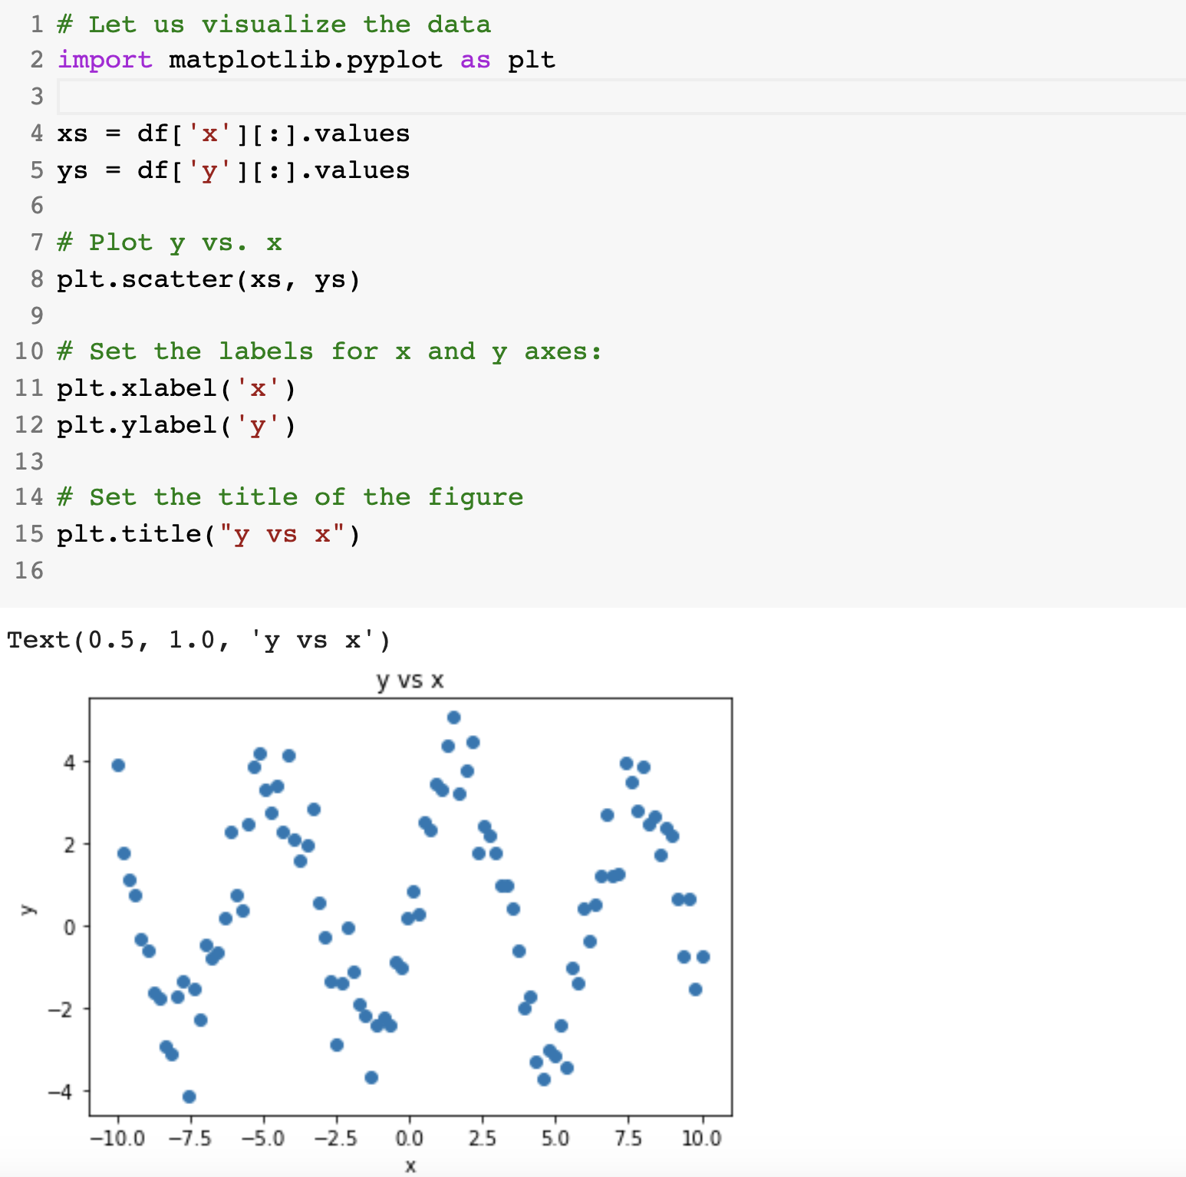
Step 1: (Down)load and Visualize Data

Slide 50
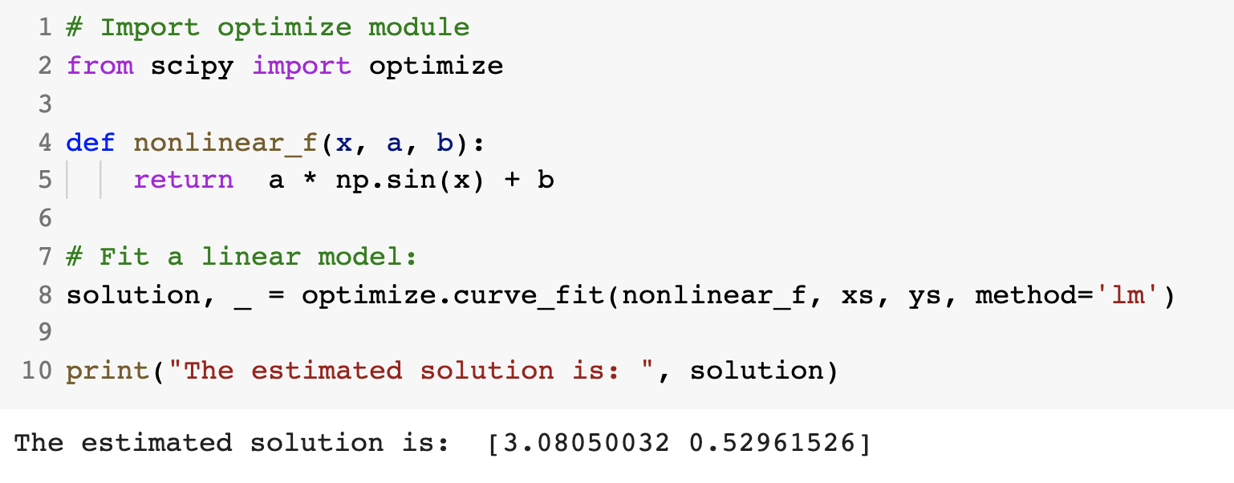
Step 2: Fit a non-linear function with SciPy
scipy.optimize.curve_fit

Slide 51
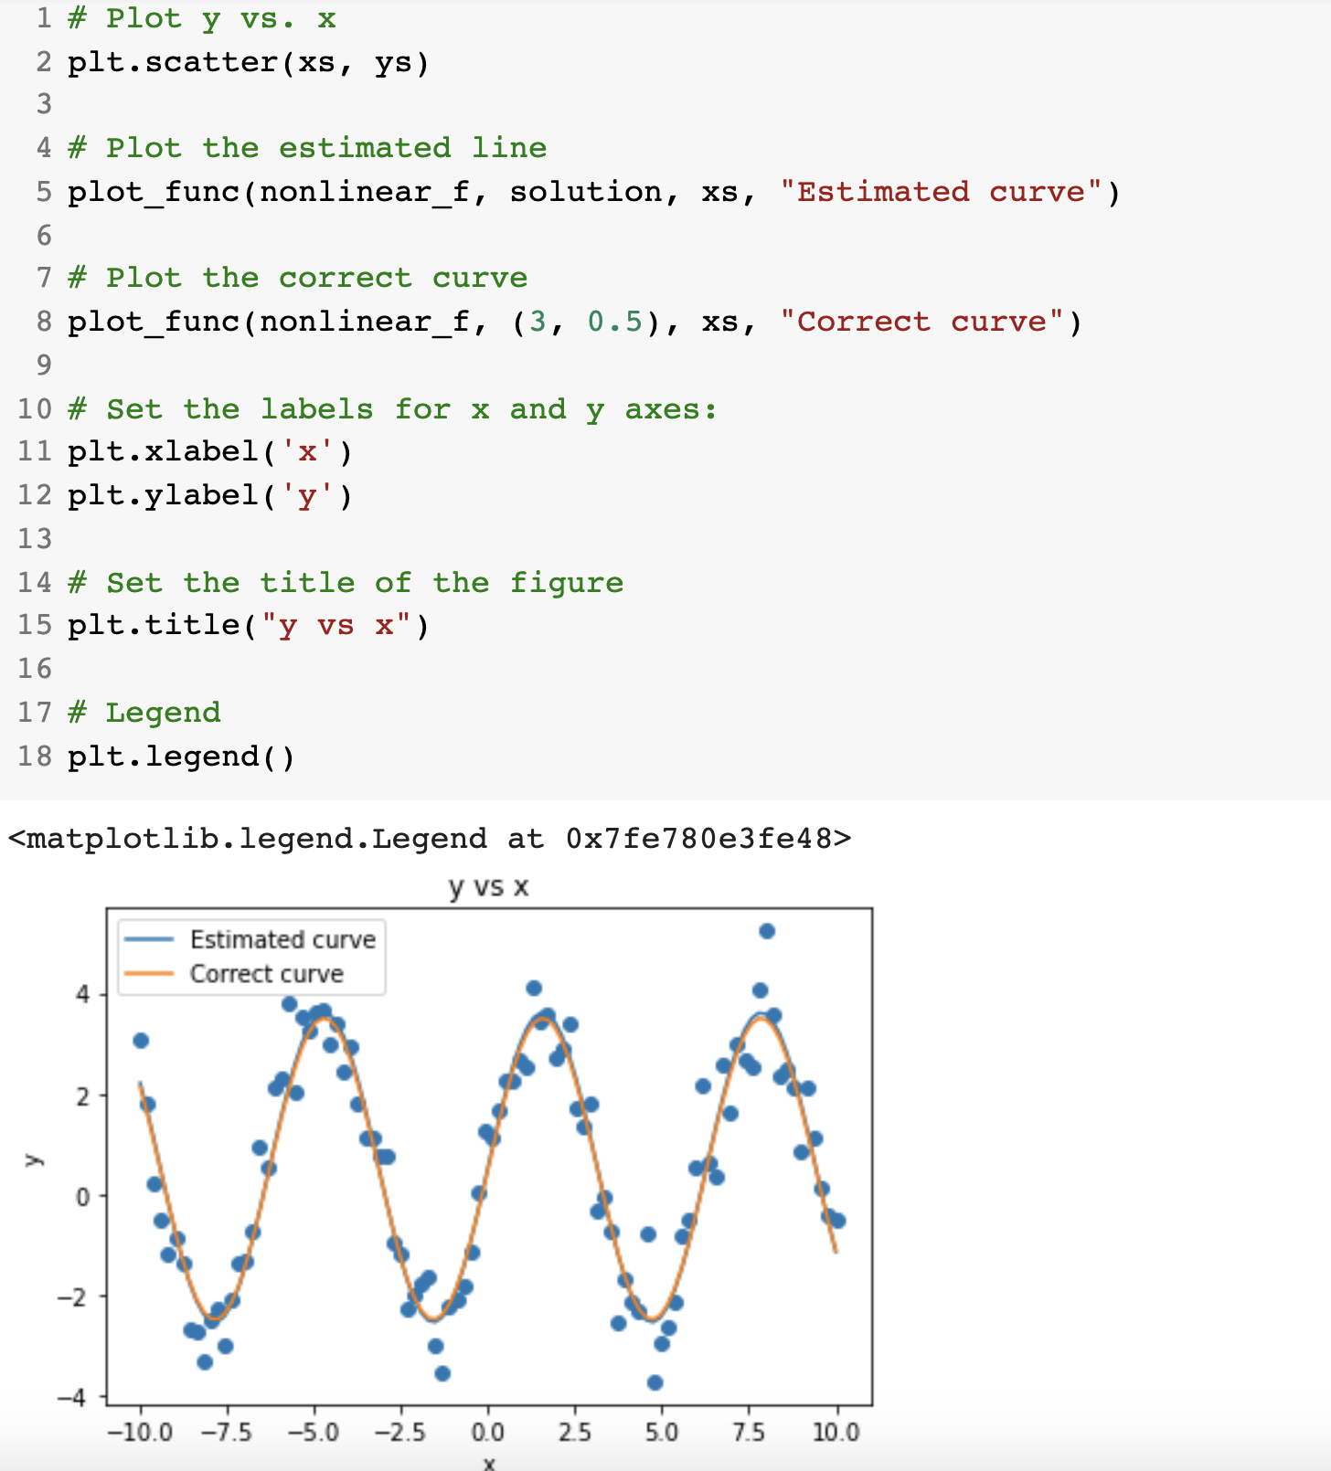
Step 3: Analyze the results (Qualitative analysis)

Slide 52
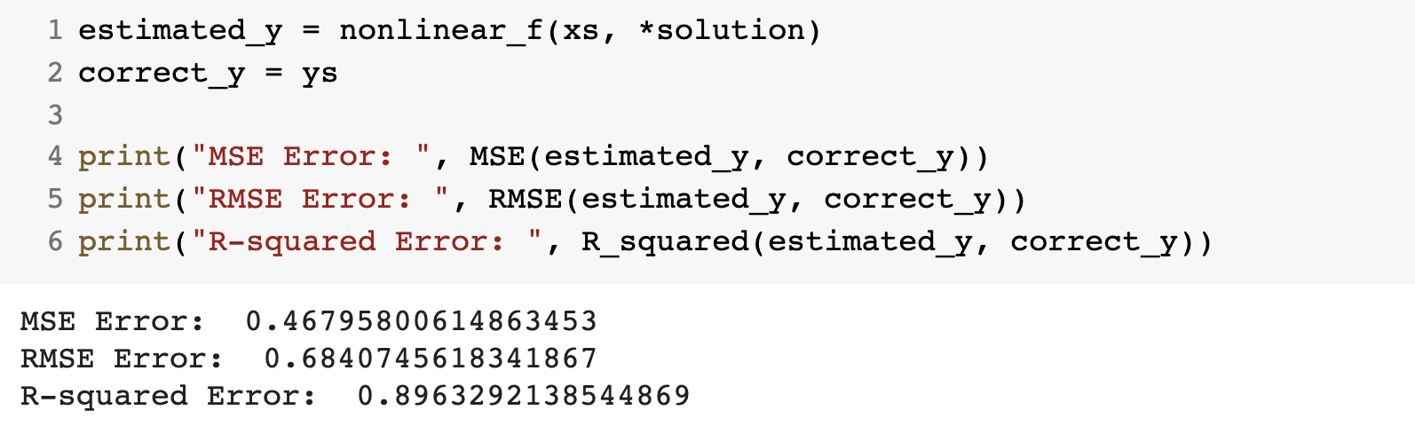
Step 3: Analyze the results (Quantitative analysis)

Slide 53
that’s all folks! Stay healthy

