Slide 1
CEng 240 – Spring 2021 Week 2
Sinan Kalkan
A Broad Look at Programming and PL,
Representation of data in computers
Disclaimer: Figures without reference are from either from “Introduction to programming concepts with case studies in Python” or “Programming with Python for Engineers”, which are both co-authored by me.

Slide 2
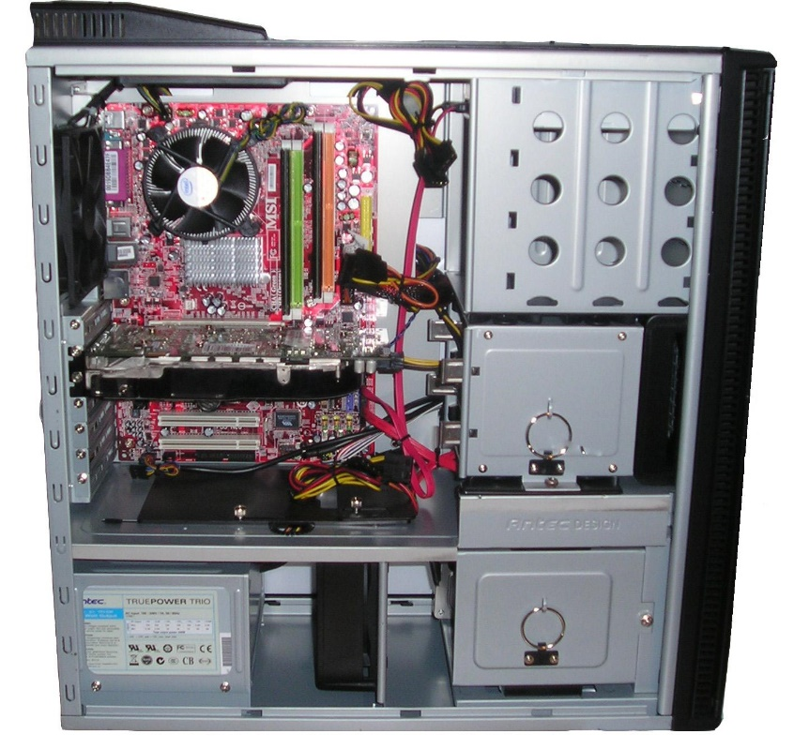
What is a computer?
Previously on CENG240!
The most common context: An electronic device that has a ‘microprocessor’ in it.
Binary
The broader context: Any physical entity that can do ‘computation’.
https://en.m.wikipedia.org/wiki/File:Computer_from_inside_018.jpg

Slide 3
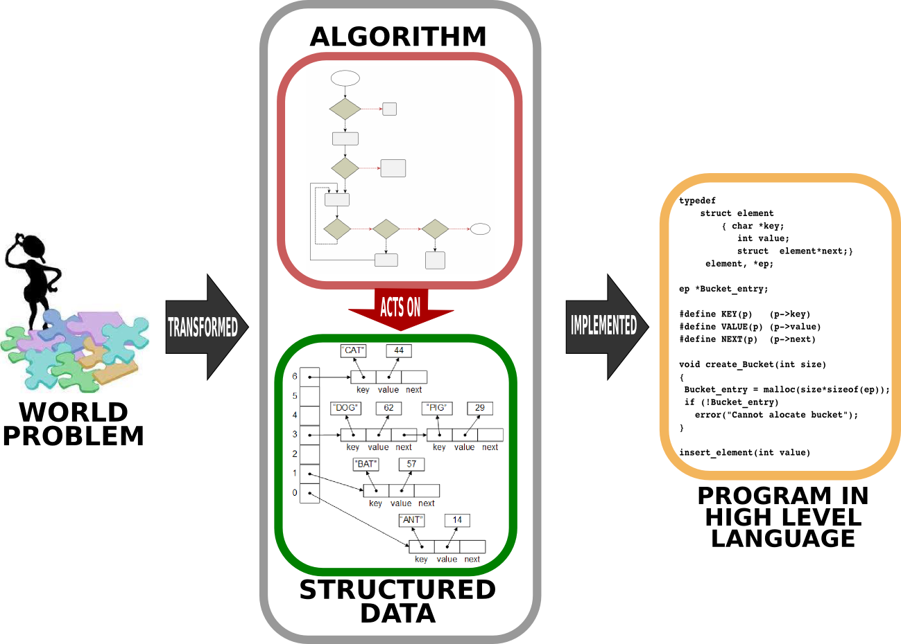
What is programming?
Previously on CENG240!

Slide 4
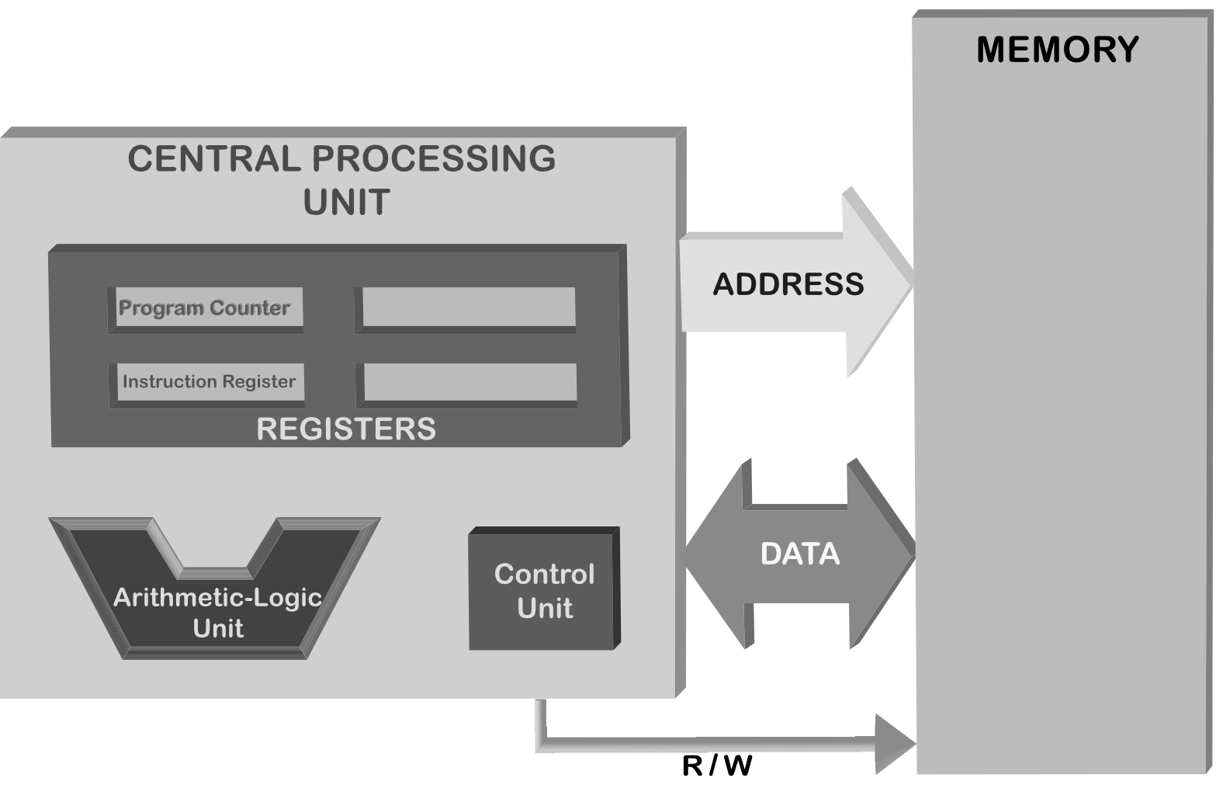
Von Neumann Architecture
Previously on CENG240!

Slide 5
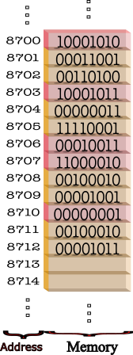
Memory
Previously on CENG240!
Random Access Memory (RAM)
Allows reading and writing operations
Each access requires an address

Slide 6
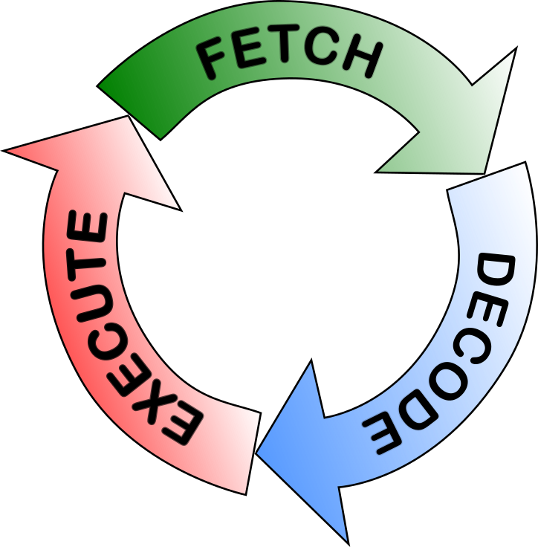
Fetch, decode, execute cycle
Previously on CENG240!
Fetch
Retrieve the next instruction from the memory
Decode
Look at the opcode of the instruction and decode what actions should be performed.
Execute
Execute the actions identified in the decode phase.

Slide 7
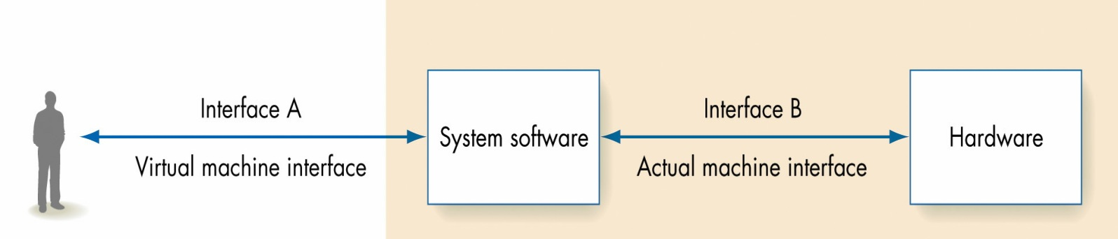
OS
Previously on CENG240!
From: “Invitation to Computer Science” book by G. M. Schneider, J. L. Gersting
Memory management
Process management
Device management
File management
Security
User interface

Slide 8
This Week
A Broad Look at Programming and PL (CH2)
Concept of Algorithm, Comparing algorithms, World of PLs, Low-High level PL, Interpreter vs Compiler, Programming Paradigms, Python as a PL
Representation of data in computers (CH3)
Two’s complement representation of integers, IEEE floating-point representation, Information loss with Floating Points, representation of characters, text and Boolean.

Slide 10
A Broad Look at Programming and PL (CH2)
Concept of Algorithm, Comparing algorithms, World of PLs, Low-High level PL, Interpreter vs Compiler, Programming Paradigms, Python as a PL

Slide 11
What does ‘algorithm’ mean?
“A procedure or formula for solving a problem”
“A set of instructions to be followed to solve a problem”
“an effective method expressed as a finite list of well-defined instructions for calculating a function”
“step-by-step procedure for calculations”

Slide 12
A formal definition of algorithm
“Starting from an initial state and initial input (perhaps empty), the instructions describe a computation that, when executed, will proceed through a finite number of well-defined successive states, eventually producing "output" and terminating at a final ending state.”

Slide 13
What is an algorithm?
An algorithm is a list that looks like
STEP 1: Do something
STEP 2: Do something
STEP 3: Do something
. .
. .
. .
STEP N: Stop, you are finished
From “Invitation to Computer Science”

Slide 14
Valid Operations in Algorithms
Sequential – simple well-defined task, usually declarative sentence.
Conditional- “ask a question and select the next operation on the basis of the answer to the question – usually an “if- then” or “if then else”
Iterative- “looping” instructions – repeat a set of instructions
From “Invitation to Computer Science”

Slide 15
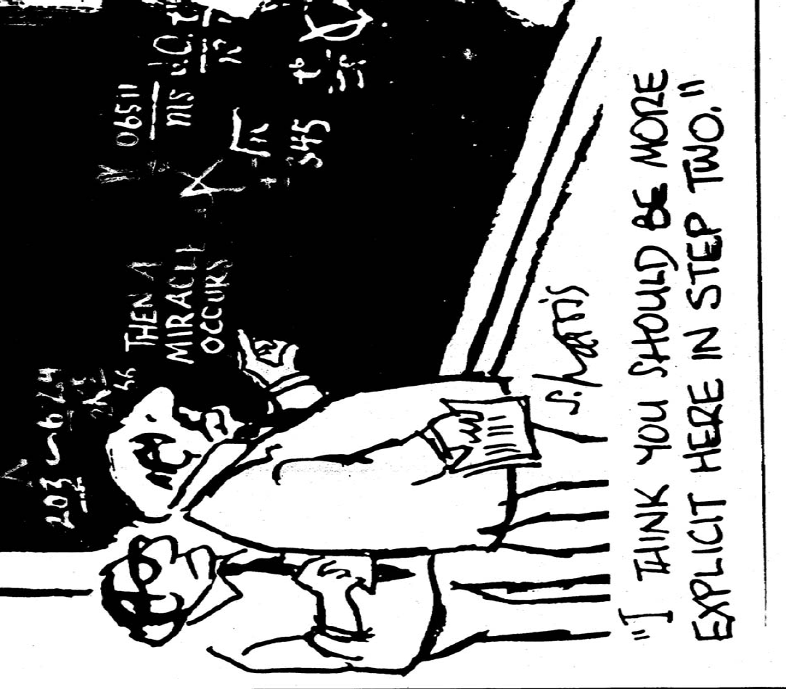
From “Invitation to Computer Science”

Slide 16
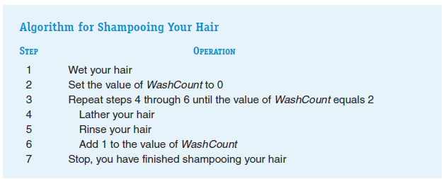
An example algorithm from our daily lives
From “Invitation to Computer Science”

Slide 17
Describing algorithms
Option 1: Use pseudo-code descriptions.
Algorithm. Calculate the average of numbers provided by the user.
Input: N -- the count of numbers
Output: The average of N numbers to be provided
Step 1: Get how many numbers will be provided and store that in N
Step 2: Create a variable named Result with initial value 0
Step 3: Execute the following step N times:
Step 4: Get the next number and add it to Result
Step 5: Divide Result by N to obtain the average

Slide 18
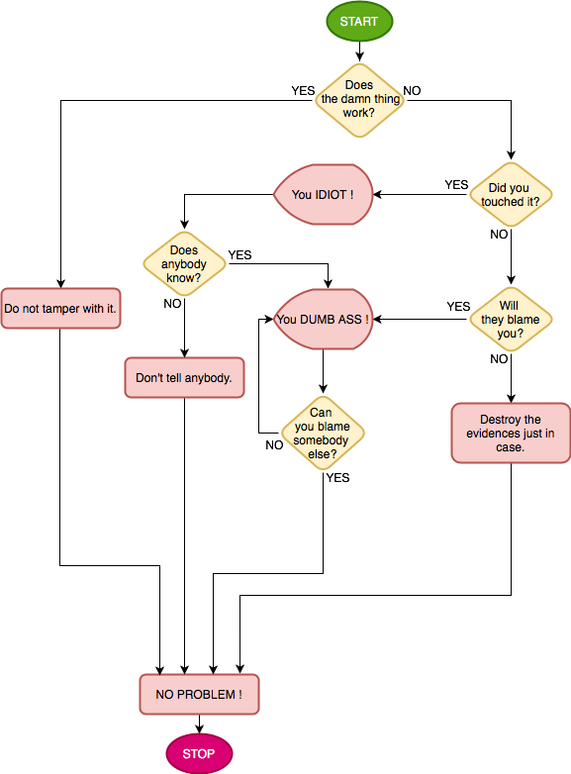
Describing algorithms
Option 2: Use flow-charts.

Slide 19
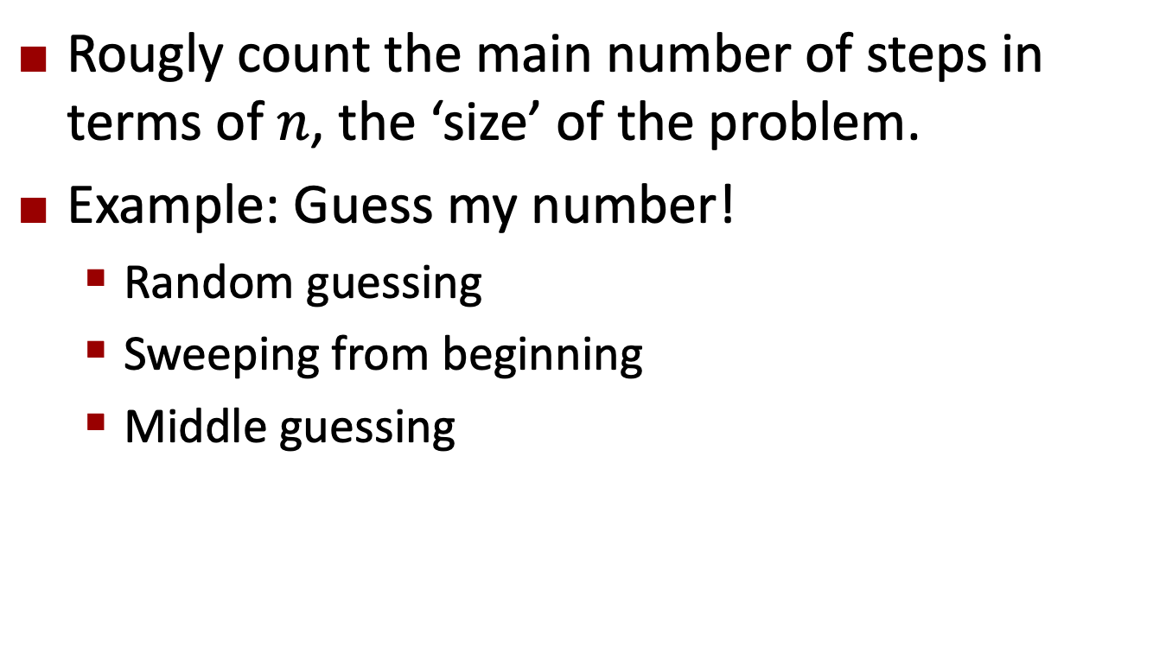
Comparing Algorithms
Rougly count the main number of steps in terms of $n$, the ‘size’ of the problem.
Example: Guess my number!
Random guessing
Sweeping from beginning
Middle guessing

Slide 20
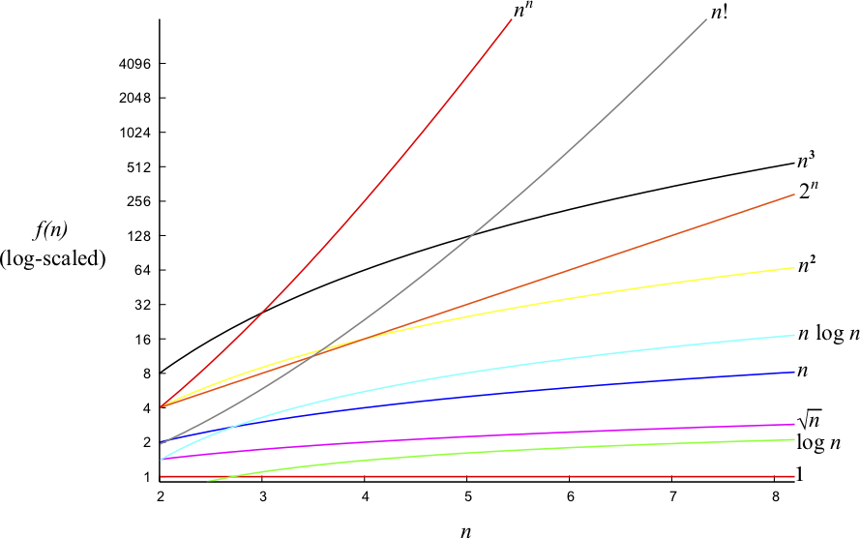
Comparing Algorithms

Slide 21
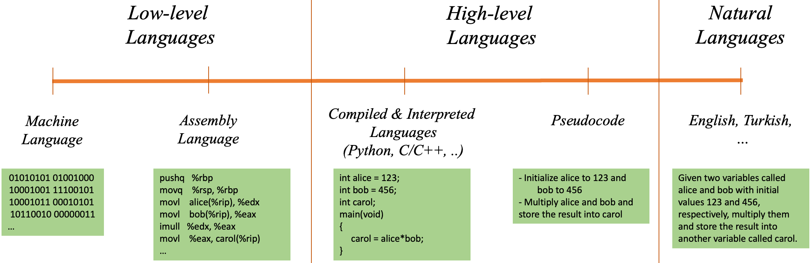
The World of Programming Languages

Slide 22
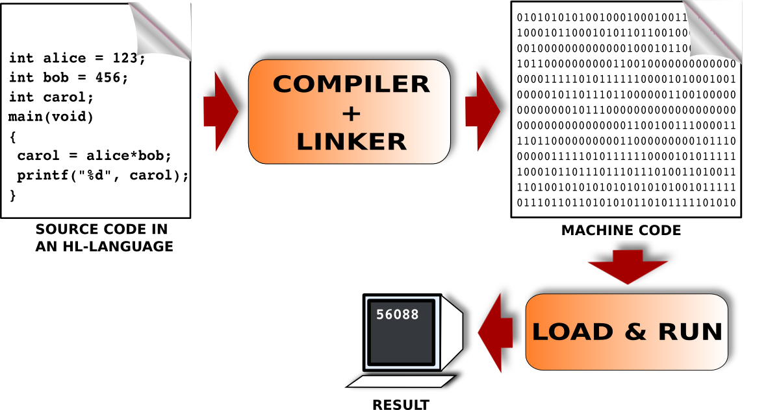
Interpreter vs. Compiler

Slide 23
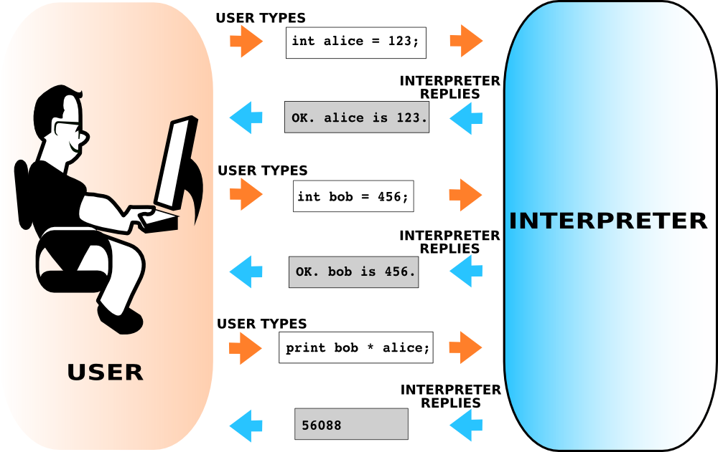
Interpreter vs. Compiler

Slide 24
PL Paradigms
Imperative
Functional
Object-oriented
Logical-declarative
Concurrent
Event-driven

Slide 25


Meet
Guido van Rossum (1956 - )

Slide 26
Zen of Python [https://en.wikipedia.org/wiki/Zen_of_Python]
Beautiful is better than ugly.
Explicit is better than implicit.
Simple is better than complex.
Complex is better than complicated.
Flat is better than nested.
Sparse is better than dense.
Readability counts.
…

Slide 27
An interpretive/scripting PL that:
Longs for code readability
Ease of use, clear syntax
Wide range of applications, libraries, tools
Multiple Paradigms:
Functional
Imperative
Object-oriented

Slide 28
Started at the end of 1980s.
V2.0 was released in 2000
With a big change in development perspective: Community-based
Major changes in the facilities.
V3.0 was released in 2008
Backward-incompatible
Some of its features are put into v2.6 and v2.7.

Slide 29
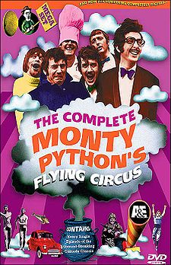
Where does the name come from?
While van Possum was developing Python, he read the scripts of Monty Python’s Flying Circus and thought ‘python’ was “short, unique and mysterious” for the new language [1]
One goal of Python: “fun to use”
The origin of the name is the comedy group “Monty Python”
This is reflected in sample codes that are written in Python by the original developers.
[1] https://docs.python.org/2/faq/general.html#why-is-it-called-python

Slide 30
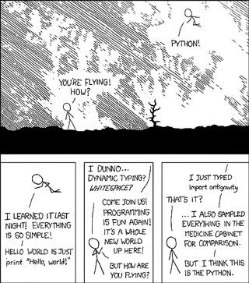

Slide 31
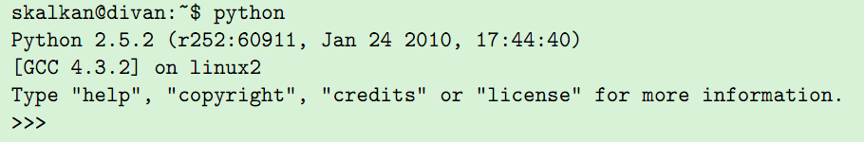

Slide 32
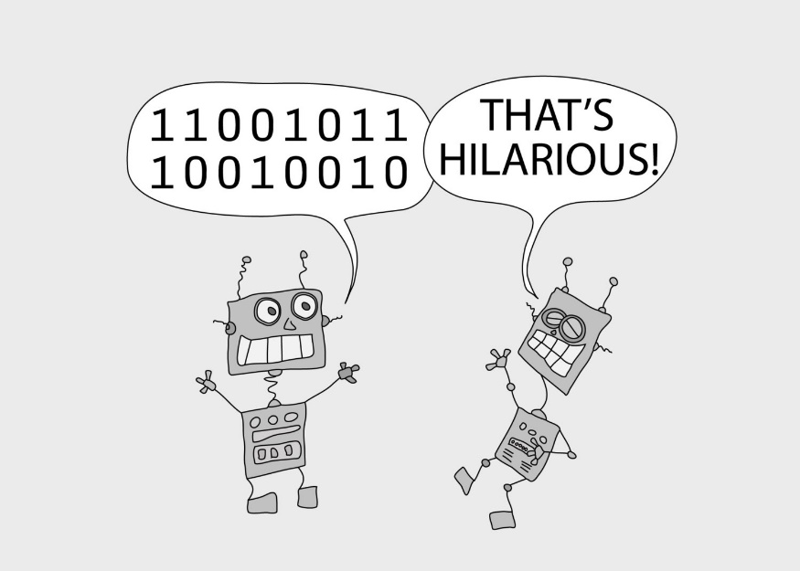
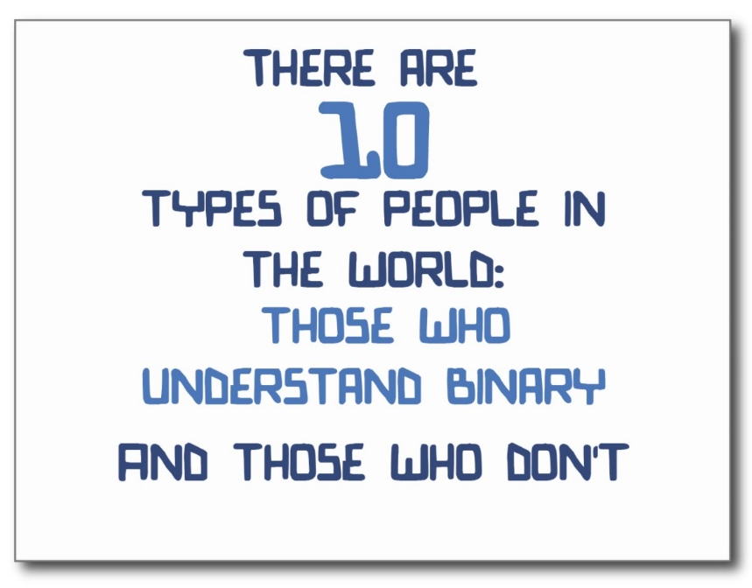
Representation of data in computers (CH3)
Two’s complement representation of integers, IEEE floating-point representation, Information loss with Floating Points, representation of characters, text and Boolean.

Slide 33
Data Representation
Based on 1s and 0s
So, everything is represented as a set of binary numbers
We will now see how we can represent:
Integers: 3, 1234435, -12945 etc.
Floating point numbers: 4.5, 124.3458, -1334.234 etc.
Characters: /, &, +, -, A, a, ^, 1, etc.
…

Slide 34
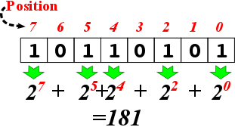
Binary Representation of Numeric Information
Decimal numbering system
Base-10
Each position is a power of 10
3052 = 3 x 10³ + 0 x 10² + 5 x 10¹ + 2 x 10⁰
Binary numbering system
Base-2
Uses ones and zeros
Each position is a power of 2
1101 = 1 x 2³ + 1 x 2² + 0 x 2¹ + 1 x 2⁰

Slide 35
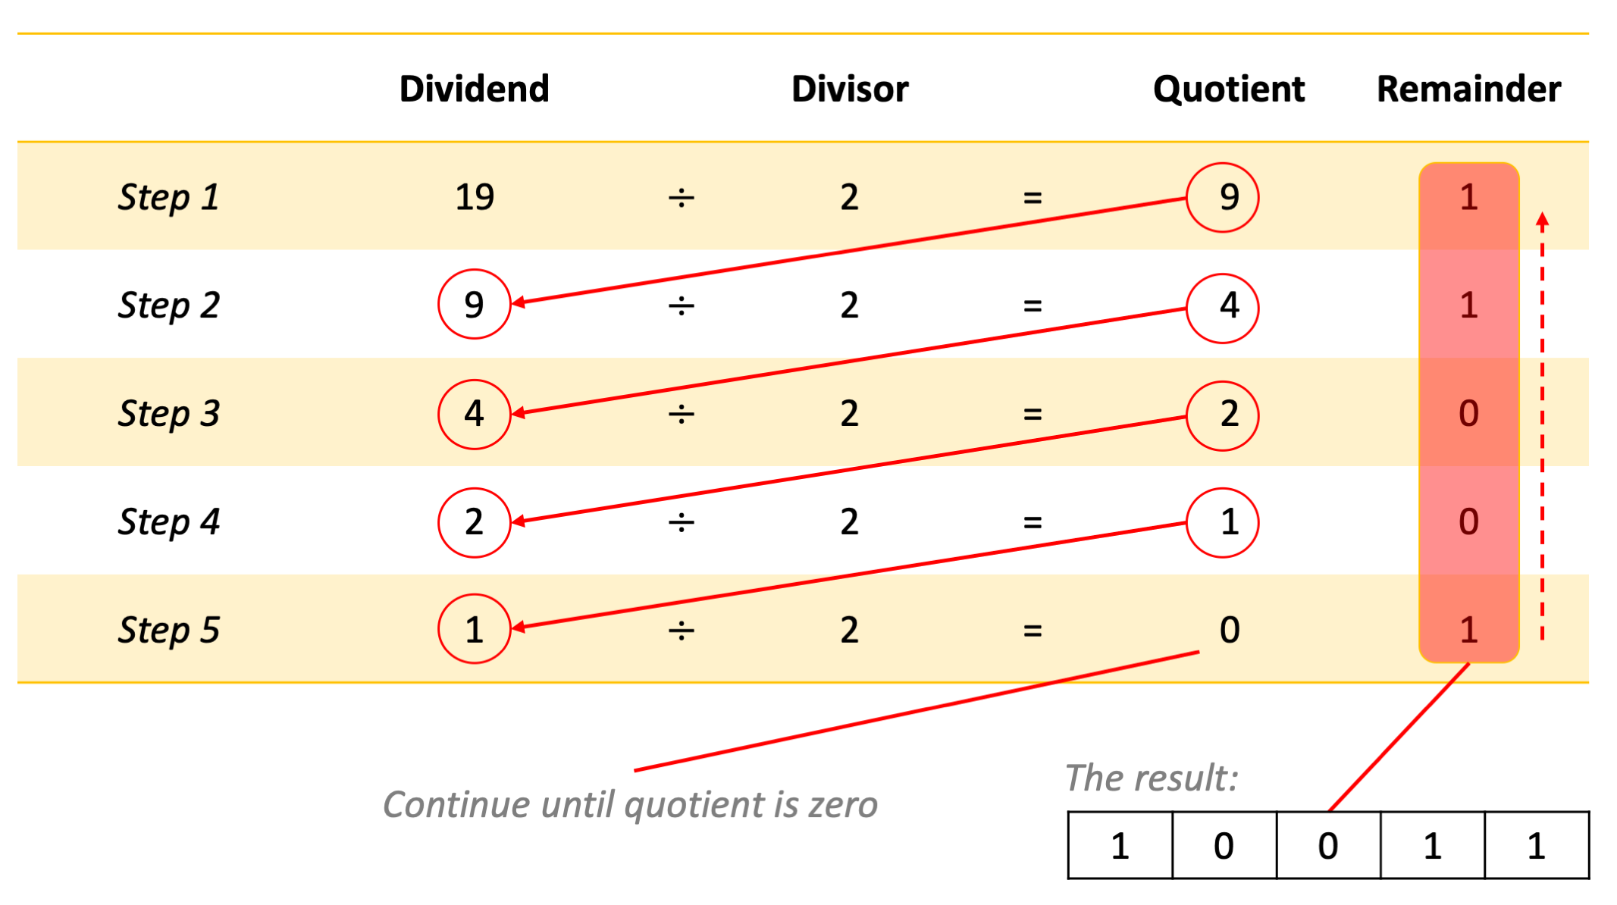
Decimal-to-binary Conversion
Divide the number until zero:
35 / 2 = 17x2 + 1
17 / 2 = 8x2 + 1
8 / 2 = 4x2 + 0
4 / 2 = 2x2 + 0
2 / 2 = 1x2 + 0
Therefore, 35 has the binary representation: 100011
Notes:
http://acc6.its.brooklyn.cuny.edu/~gurwitz/core5/nav2tool.html

Slide 36
Binary Representation of Numeric Information (continued)
Representing integers
Decimal integers are converted to binary integers
Question: given k bits, what is the value of the largest integer that can be represented?
2^{k} - 1
Ex: given 4 bits, the largest is 2⁴-1 = 15
Signed integers must also represent the sign (positive or negative) - Sign/Magnitude notation
Notes:
Given 16 bits, the largest value represented is 65,535
2^0 + 2^1 + …. + 2^14 + 2^15 =111111111111111
Arithmetic Overflow: # exceeds maxiumum allowable value

Slide 37
Binary Representation of Numeric Information (continued)
Sign/magnitude notation
1 101 = - 5
0 101 = + 5
Problems:
Two different representations for 0:
1 000 = -0
0 000 = +0
Addition & subtraction require a watch for the sign! Otherwise, you get wrong results:
0 010 (+2) + 1 010 (-2) = 1 100 (-4)
Notes:
Given 16 bits, the largest value represented is 65,535
2^0 + 2^1 + …. + 2^14 + 2^15 =111111111111111
Arithmetic Overflow: # exceeds maxiumum allowable value

Slide 38


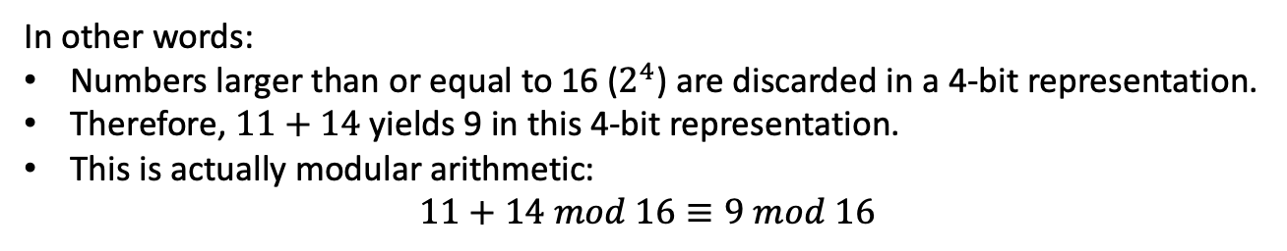

Arithmetic in Computers is Modular
Let’s add two numbers in binary
(Assume that there is no sign bit)
1 | 0 | 1 | 1
1 | 1 | 1 | 0
$${\left(11\right)}_{10}$$
+
+
$${\left(14\right)}_{10}$$
1
1 | 0 | 0 | 1
$${\left(9\right)}_{10}$$
In other words:
Numbers larger than or equal to 16 ($2^{4}$) are discarded in a 4-bit representation.
Therefore, $11+14$ yields 9 in this 4-bit representation.
This is actually modular arithmetic:
$$11+14 mod 16≡9 mod 16$$

Slide 39
Binary Representation of Numeric Information (continued)
Two’s complement instead of sign-magnitude representation
Positive numbers have a leading 0.
5 => 0101
The representation for negative numbers is found by subtracting the absolute value from 2^{N} for an N-bit system:
-5 => 2⁴ – 5 = 16 – 5 = (11)₁₀ => (1011)₂
Advantages:
0 has a single representation: +0 = 0000, -0 = 0000
Arithmetic works fine without checking the sign bit:
1011 (-5) + 0110 (6) = 0001 (1)
1011 (-5) + 0011 (3) = 1110 (-2)

Slide 40
Binary Representation of Numeric Information (continued)
Binary Number | Decimal Value | Value in Two’s Complement
0000 | 0 | 0
0001 | 1 | 1
0010 | 2 | 2
0011 | 3 | 3
0100 | 4 | 4
0101 | 5 | 5
0110 | 6 | 6
0111 | 7 | 7
1000 | 8 | -8
1001 | 9 | -7
1010 | 10 | -6
1011 | 11 | -5
1100 | 12 | -4
1101 | 13 | -3
1110 | 14 | -2
1111 | 15 | -1
Shortcut to convert from “two’s complement” :
If the leading bit is zero, no need to convert.
If the leading bit is one, invert the number and add 1.
What is our range?
With 2’s complement we can represent numbers from -2^{N-1} to 2^{N-1} - 1 using N bits.
8 bits: -128 to +127.
16 bits: -32,768 to +32,767.
32 bits: -2,147,483,648 to +2,147,483,647.

Slide 41
Binary Representation of Numeric Information (continued)
Example:
We want to compute: 12 – 6
12 => 01100
-6 => -(00110) => (11001)+1 => (11010)
12 – 6 =
01100
+ 11010
-----------
00110 => 6
So, addition and subtraction operations
are simpler in the Two’s Complement
representation
Notes:
http://fac-staff.seattleu.edu/quinnm/web/education/JavaApplets/applets/TwosComplement.html

Slide 42
Binary Representation of Numeric Information (continued)
Due to its advantages, two’s complement is the most common way to represent integers on computers.
Notes:
http://fac-staff.seattleu.edu/quinnm/web/education/JavaApplets/applets/TwosComplement.html

Slide 43
Why does Two’s Complement work?
Inversion and addition of a 1-bit correspond effectively to subtraction from 0 – i.e., negative of a number.
Negative of a binary number X: (00…00)₂ - (X)₂
Note that (00…00)₂ = (11…11)₂ + (1)₂
In other words:
(00…00)₂ - (X)₂ = (11…11)₂- (X)₂ + (1)₂.
(i.e., how we find two’s complement)
Inversion
Notes:
http://www.cs.cornell.edu/~tomf/notes/cps104/twoscomp.html#whyworks

Slide 44
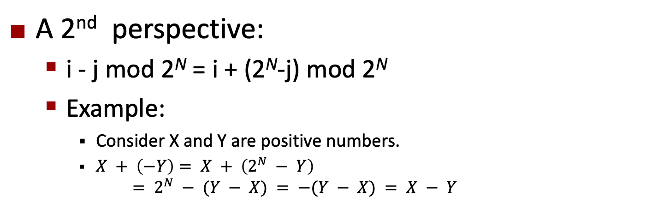
Why does Two’s Complement work?
A 2nd perspective:
i - j mod 2^{N} = i + (2^{N}-j) mod 2^{N}
Example:
Consider X and Y are positive numbers.
$X + \left(−Y\right)= X + \left(2^{N} − Y\right)$
$$= 2^{N} − (Y − X) = −(Y − X) = X − Y$$
Notes:
http://www.cs.cornell.edu/~tomf/notes/cps104/twoscomp.html#whyworks

Slide 45
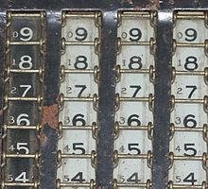
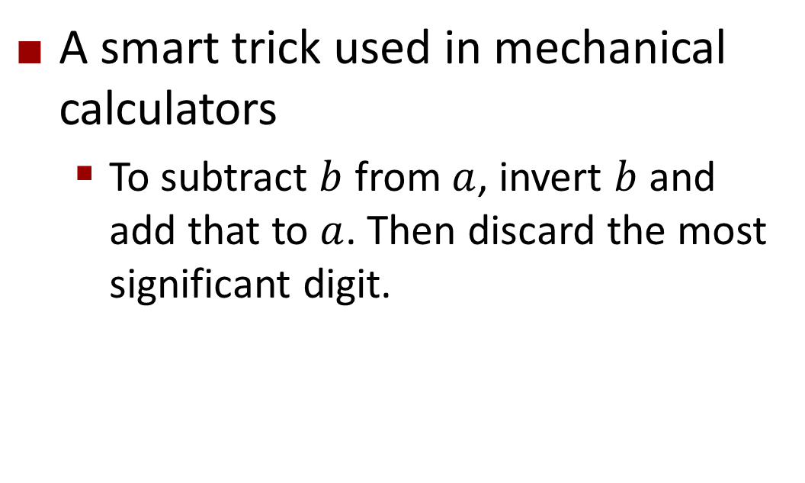
Why does Two’s Complement work?
A smart trick used in mechanical calculators
To subtract $b$ from $a$, invert $b$ and add that to $a$. Then discard the most significant digit.
http://en.wikipedia.org/wiki/Method_of_complements

Slide 46
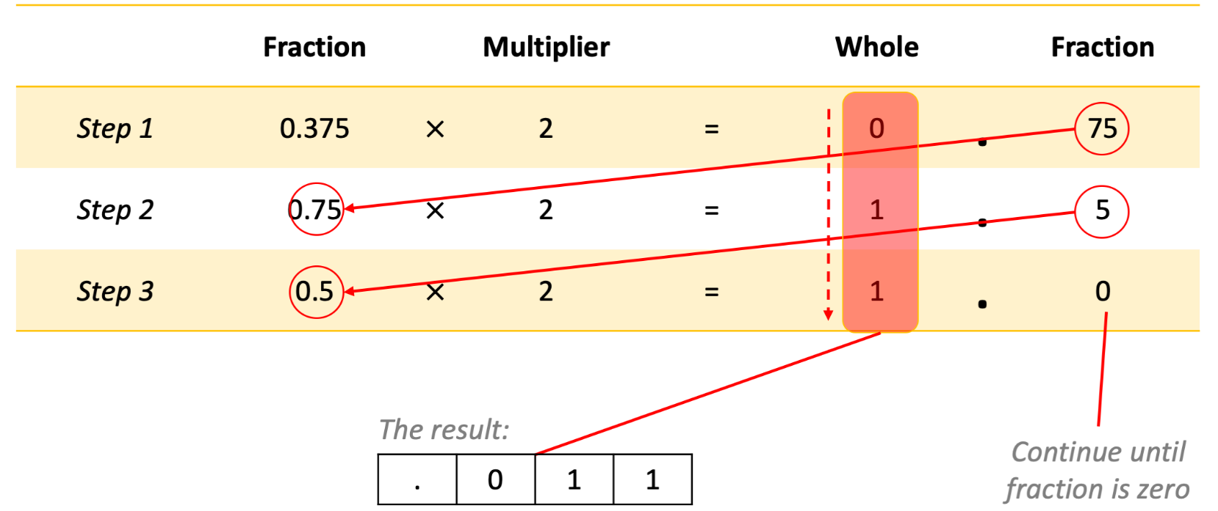
Binary Representation of Real Numbers
Conversion of the digits after the dot into binary:
1st Way:
0.375 → 0x½ + 1x¼ + 1x1/8 → 011
2nd Way:
Multiply by 2 and get the integer part until we get ‘0’ after the dot:
0.375 x 2 = 0.750 = 0 + 0.750
0.750 x 2 = 1.500 = 1 + 0.500
0.500 x 2 = 1.000 = 1 + 0.000

Slide 47
Binary Representation of Real Numbers
Approach 1: Use fixed-point
Similar to integers, except that there is a decimal point.
E.g.: using 8 bits:
1
1
1
1
1
1
1
1
= 1×2³ + 1×2² + 1×2¹ + 1×2⁰ + 1×2⁻¹ + 1×2⁻² + 1×2⁻³ + 1×2⁻⁴
= 15.9375
Assumed decimal point

Slide 48
Binary Representation of Real Numbers
Location of the decimal point changes the value of the number.
E.g.: using 8 bits:
1
1
1
1
1
1
1
1
= 1×2⁴ + 1×2³ + 1×2² + 1×2¹ + 1×2⁰
1×2⁻¹ + 1×2⁻² + 1×2⁻³ = 31.875
Assumed decimal point

Slide 49
Binary Representation of Real Numbers
Problems with fixed-point:
Limited in the maximum and minimum values that can be represented.
For instance, using 32-bits, reserving 1-bit for the sign and putting the decimal point after 16 bits from the right, the maximum positive value that can be stored is slightly less than 2¹⁵.
Allowing larger values gives away from the precision (the decimal part).

Slide 50
Binary Representation of Real Numbers
Solution: Use scientific notation: a x 2^{b} (or ±M x B^{±E})
Example: 5.75
5 → 101
0.75 → ½ + ¼ → 2⁻¹+2⁻² → (0.11)₂
5.75 → (101.11)₂ x 2⁰
Number is then normalized so that the first significant digit is immediately to the left of the binary point
Example: 1.0111 x 2²
We take and store the mantissa and the exponent.

Slide 51
Binary Representation of Real Numbers
This needs some standardization for:
where to put the decimal point
how to represent negative numbers
how to represent numbers less than 1

Slide 52
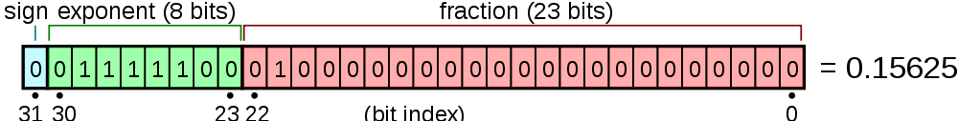

IEEE 32bit Floating-Point Number Representation
M x 2E
Exponent (E): 8 bits
Add 127 to the exponent value before storing it
E can be 0 to 255 with 127 representing the real zero.
Fraction (M - Mantissa): 23 bits
2¹²⁸ = 1.70141183 × 10³⁸
$$\left(2−2^{−23}\right)×2^{127}$$
Notes:
Why add 127 to the exponent?
This is the excess-K notation, which provides advantages of 2s complement. In addition to that, logical comparison of numbers is easier. In two’s complement, it is more difficult since once has to watch for the sign.

Slide 53
IEEE 32bit Floating-Point Number Representation
Example: 12.375
The digits before the dot:
(12)₁₀ → (1100)₂
The digits after the dot:
1st Way: 0.375 → 0x½ + 1x¼ + 1x1/8 → 011
2nd Way: Multiply by 2 and get the integer part until 0:
0.375 x 2 = 0.750 = 0 + 0.750
0.750 x 2 = 1.50 = 1 + 0.50
0.50 x 2 = 1.0 = 1 + 0.0
(12.375)₁₀ = (1100.011)₂
NORMALIZE (move the point): (1100.011)₂= (1.100011)₂x2³
Exponent: 3, adding 127 to it, we get 1000 0010
Fraction: 100011
Then our number is: 0 10000010 10001100000000000000000

Slide 54
Why add bias to the exponent?
Binary Number | Decimal Value | Value in Two’s Complement | Value with bias 7
0000 | 0 | 0 | -7
0001 | 1 | 1 | -6
0010 | 2 | 2 | -5
0011 | 3 | 3 | -4
0100 | 4 | 4 | -3
0101 | 5 | 5 | -2
0110 | 6 | 6 | -1
0111 | 7 | 7 | 0
1000 | 8 | -8 | 1
1001 | 9 | -7 | 2
1010 | 10 | -6 | 3
1011 | 11 | -5 | 4
1100 | 12 | -4 | 5
1101 | 13 | -3 | 6
1110 | 14 | -2 | 7
1111 | 15 | -1 | 8
It helps in comparing the exponents of the same-sign real-numbers without looking out for the sign of the exponent.
To read more on this:
https://blog.angularindepth.com/the-mechanics-behind-exponent-bias-in-floating-point-9b3185083528

Slide 55
IEEE 32bit Floating-Point Number Representation
Zero:
Exponent: All zeros
Fraction: All zeros
+0 and -0 are different numbers but they are equal!
Infinity:
Exponent: All ones
Fraction: All zeros
Not a number (NaN):
Exponent: All ones
Fraction: non-zero fraction.
http://steve.hollasch.net/cgindex/coding/ieeefloat.html

Slide 56
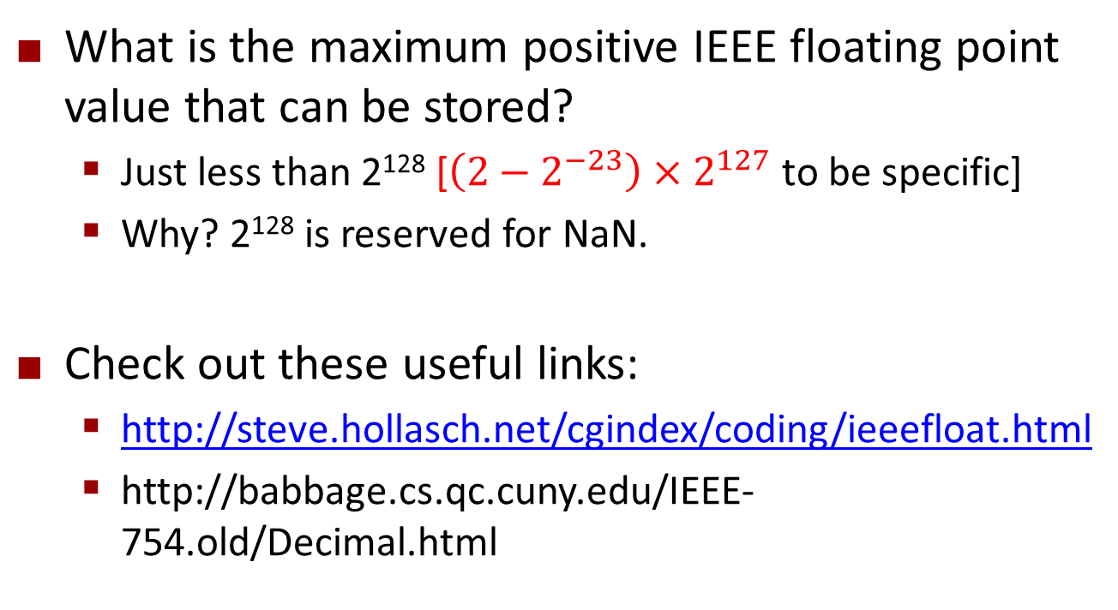
IEEE 32bit Floating-Point Number Representation
What is the maximum positive IEEE floating point value that can be stored?
Just less than 2¹²⁸ [$\left(2−2^{−23}\right)×2^{127}$ to be specific]
Why? 2¹²⁸ is reserved for NaN.
Check out these useful links:
http://steve.hollasch.net/cgindex/coding/ieeefloat.html
http://babbage.cs.qc.cuny.edu/IEEE-754.old/Decimal.html
Notes:
$\left(2−2^{−23}\right)×2^{127}$ cunku (i) 2^128 NaN icin reserve edilmis durumda, (ii) 1.0111’de ilk bir, gosterime store edilmiyor. O nedenle, 1-2^-23’un yaninda, bir bir daha var!

Slide 57
IEEE 32bit Floating-Point Number Representation
Now consider 4.1:
4 => (100)₂
0.1 =>
x 2 = 0.2 = 0 + 0.2
x 2 = 0.4 = 0 + 0.4
x 2 = 0.8 = 0 + 0.8
x 2 = 1.6 = 1 + 0.6
x 2 = 1.2 = 1 + 0.2
x 2 = 0.4 = 0 + 0.4
x 2 = 0.8 = 0 + 0.8
…….
So,
Representing a fraction which is a multiple of 1/2^{n} is lossless.
Representing a fraction which is not a multiple of 1/2^{n} leads to precision loss.

Slide 58

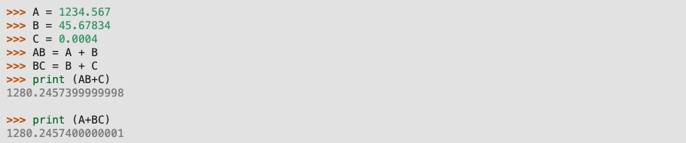
Representing Real Numbers: Information Loss

Slide 59
Representing Real Numbers: Information Loss
What can you do?
It is in your best interest to refrain from using floating points. If it is possible transform the problem to the integer domain.
Use the most precise type of floating point provided by your high-level language, some languages provide you with 64 bit or even 128 bit floats, use them.
Use less precision floating points only when you are in short of memory.
Subtracting two floating points close in value has a potential danger.
If you add or subtract two numbers which are magnitude-wise not comparable (one very big the other very small), it is likely that you will lose the proper contribution of the smaller one. Especially when you iterate the operation (repeat it many times), the error will accumulate.
You are strongly advised to use well-known, commonly used scientific computing libraries instead of coding floating point algorithms by yourself.

Slide 60
Numbers in Python
Integers
Floating point numbers
Complex numbers

Slide 61
Representing Boolean Values
The CPU often needs to compare numbers, or data:
3 >? 4
125 =? 1000/8
3 ≤? 12345.34545/12324356.0
We have the truth values for representing the answers to such comparisons:
If correct: TRUE, True, true, T, 1
If not correct: FALSE, False, false, F, 0

Slide 62
Binary Representation of Textual Information
ASCII (American Standard Code for Information Interchange) code set
Originally: 7 bits per character; 128 character codes
Unicode code set
16 bits per character
UTF-8 (Universal Character Set Transformation Format) code set.
Variable number of 8-bits.

Slide 63
Binary Representation of Textual Information (cont’d)
Decimal | Binary | Val.
48 | 00110000 | 0
49 | 00110001 | 1
50 | 00110010 | 2
51 | 00110011 | 3
52 | 00110100 | 4
53 | 00110101 | 5
54 | 00110110 | 6
55 | 00110111 | 7
56 | 00111000 | 8
57 | 00111001 | 9
58 | 00111010 | :
59 | 00111011 | ;
60 | 00111100 | <
61 | 00111101 | =
62 | 00111110 | >
63 | 00111111 | ?
64 | 01000000 | @
65 | 01000001 | A
66 | 01000010 | B
Hex. | Unicode | Charac.
0x30 | 0x0030 | 0
0x31 | 0x0031 | 1
0x32 | 0x0032 | 2
0x33 | 0x0033 | 3
0x34 | 0x0034 | 4
0x35 | 0x0035 | 5
0x36 | 0x0036 | 6
0x37 | 0x0037 | 7
0x38 | 0x0038 | 8
0x39 | 0x0039 | 9
0x3A | 0x003A | :
0x3B | 0x003B | ;
0x3C | 0x003C | <
0x3D | 0x003D | =
0x3E | 0x003E | >
0x3F | 0x003F | ?
0x40 | 0x0040 | @
0x41 | 0x0041 | A
0x42 | 0x0042 | B
ASCII
7 bits long
Unicode
16 bits long
Partial
listings
only!

Slide 64
UTF-8 Illustrated
Bits | Last code point | Byte 1 | Byte 2 | Byte 3 | Byte 4 | Byte 5 | Byte 6
7 | U+007F | 0xxxxxxx
11 | U+07FF | 110xxxxx | 10xxxxxx
16 | U+FFFF | 1110xxxx | 10xxxxxx | 10xxxxxx
21 | U+1FFFFF | 11110xxx | 10xxxxxx | 10xxxxxx | 10xxxxxx
26 | U+3FFFFFF | 111110xx | 10xxxxxx | 10xxxxxx | 10xxxxxx | 10xxxxxx
31 | U+7FFFFFFF | 1111110x | 10xxxxxx | 10xxxxxx | 10xxxxxx | 10xxxxxx | 10xxxxxx
Character |  | Binary code | Binary UTF-8
$ | U+0024 | 0100100 | 00100100
¢ | U+00A2 | 00010100010 | 11000010 10100010
€ | U+20AC | 0010000010101100 | 11100010 10000010 10101100
𤭢 | U+24B62 | 000100100101101100010 | 11110000 10100100 10101101 10100010

Slide 65
How about a text?
Text in a computer has two alternative representations:
A fixed-length number representing the length of the text followed by the binary values of the characters in the text.
Ex: “ABC” =>
00000011 01000001 01000001 01000001 (3 ‘A’ ‘B’ ‘C’)
Binary values of the characters in the text ended with a unique marker, like “00000000” which has no value in the ASCII table.
Ex: “ABC” =>
01000001 01000001 01000001 00000000 (‘A’ ‘B’ ‘C’ END)

Slide 66
Containers
Width =
4 bytes
If you have lots and lots of one type of data (for example, the ages of all the people in Turkey):
You can store them into memory consecutively (supported by most PLs)
This is called arrays.
Easy to access an element. Nth element:
<Starting-address>+ (N-1)*<Word Width>
Ex: 2nd element is at 128 + (2-1) * 4 = 132
Address
128
….
132
136
140

Slide 67
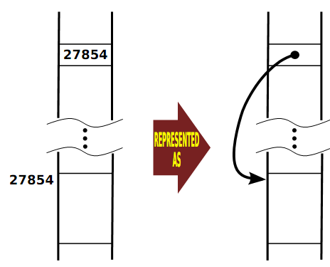
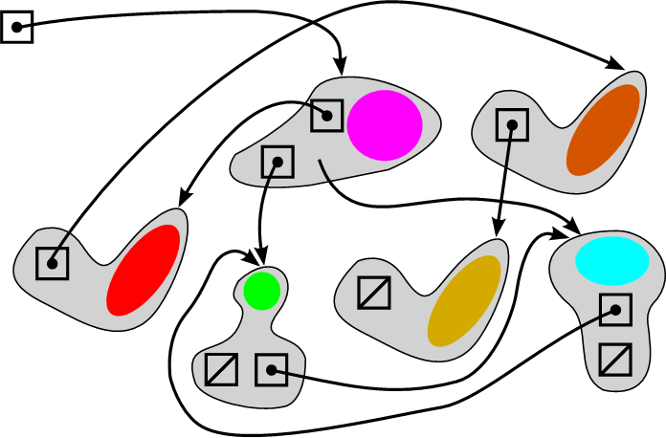
Containers
What if you have to make a lot of deletions and insertions in the middle of an array?
Then, you have to store your data in blocks/units such that each unit has the starting address of the next unit/block.
Blocks of Data

Slide 68
Final Words: Important Concepts
The world of programming
How we solve problems using computers.
Algorithms: What they are, how we write them and how we compare them.
The spectrum of programming languages.
Pros and cons of low-level and high-level languages.
Interpretive vs. compilative approach to programming.
Programming paradigms.
Representation of data
Sign-magnitude notation and two’s complement representation for representing integers.
The IEEE754 standard for representing real numbers.
Precision loss in representing floating point numbers.
Representing characters with the ASCII table.
Representing truth values.

Slide 69
Final Words: Reading
The material at the end of the first chapter.

Slide 70
that’s all folks! Stay healthy

