Slide 1
CEng 240 – Spring 2021 Week 3
Sinan Kalkan
Dive into Python [Part 1]
Disclaimer: Figures without reference are from either from “Introduction to programming concepts with case studies in Python” or “Programming with Python for Engineers”, which are both co-authored by me.

Slide 2
What does ‘algorithm’ mean?
Previously on CENG240!
“A procedure or formula for solving a problem”
“A set of instructions to be followed to solve a problem”
“an effective method expressed as a finite list of well-defined instructions for calculating a function”
“step-by-step procedure for calculations”

Slide 3
Describing algorithms
Previously on CENG240!
Option 1: Use pseudo-code descriptions.
Algorithm. Calculate the average of numbers provided by the user.
Input: N -- the count of numbers
Output: The average of N numbers to be provided
Step 1: Get how many numbers will be provided and store that in N
Step 2: Create a variable named Result with initial value 0
Step 3: Execute the following step N times:
Step 4: Get the next number and add it to Result
Step 5: Divide Result by N to obtain the average

Slide 4
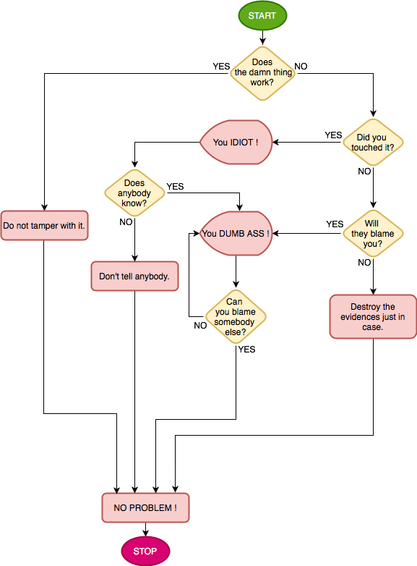
Describing algorithms
Previously on CENG240!
Option 2: Use flow-charts.

Slide 5
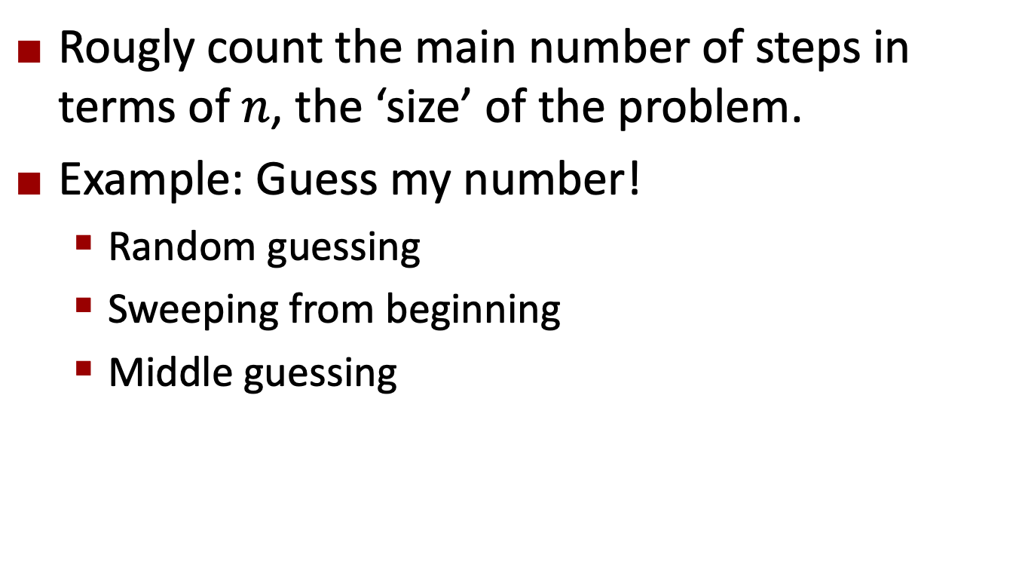
Comparing Algorithms
Previously on CENG240!
Rougly count the main number of steps in terms of $n$, the ‘size’ of the problem.
Example: Guess my number!
Random guessing
Sweeping from beginning
Middle guessing

Slide 6
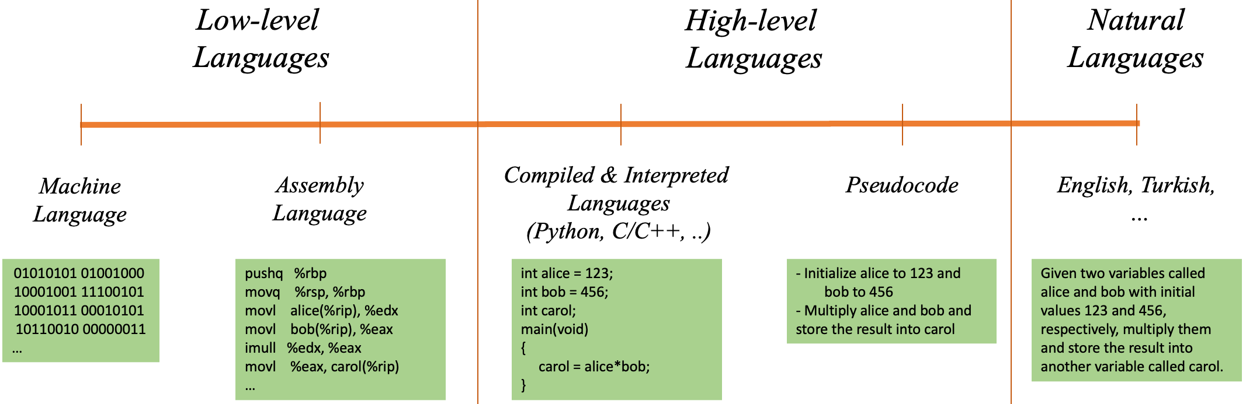
The World of Programming Languages
Previously on CENG240!

Slide 7
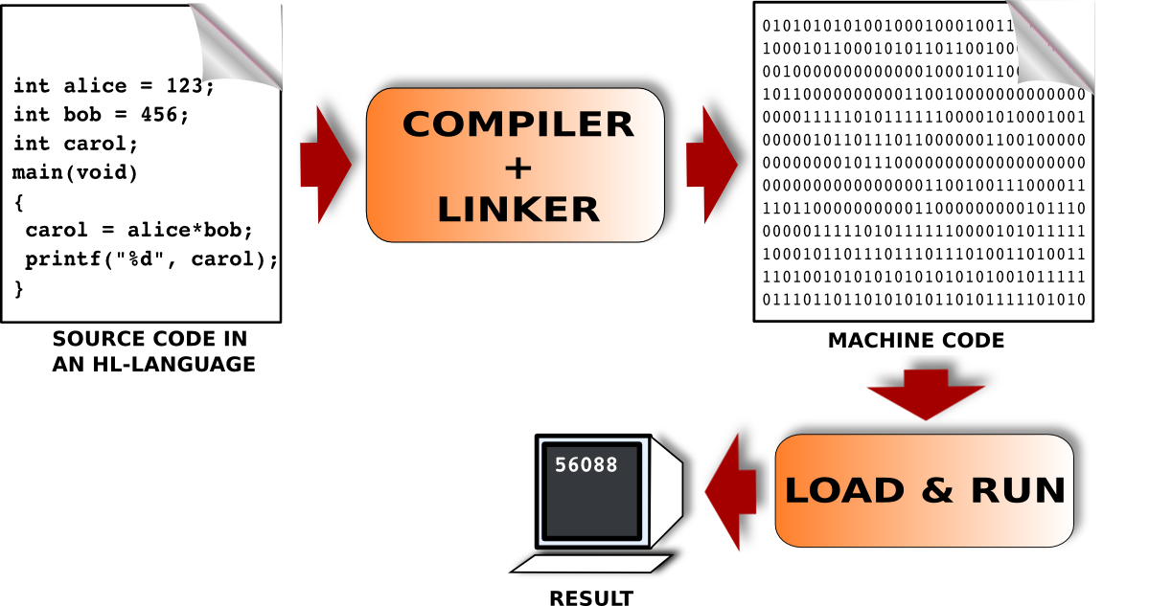
Interpreter vs. Compiler
Previously on CENG240!

Slide 8
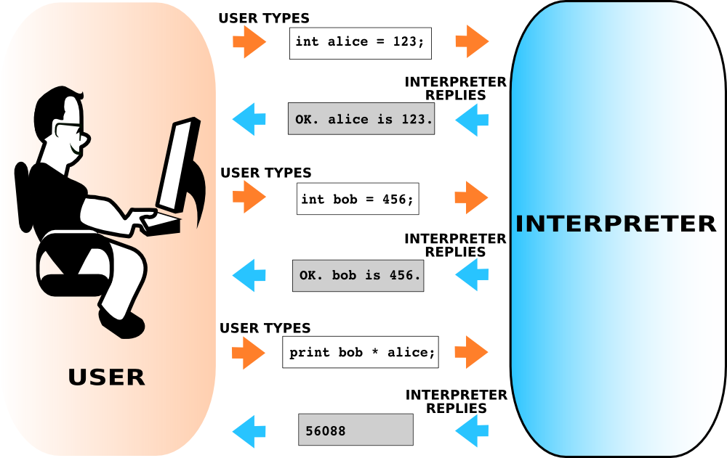
Interpreter vs. Compiler
Previously on CENG240!

Slide 9
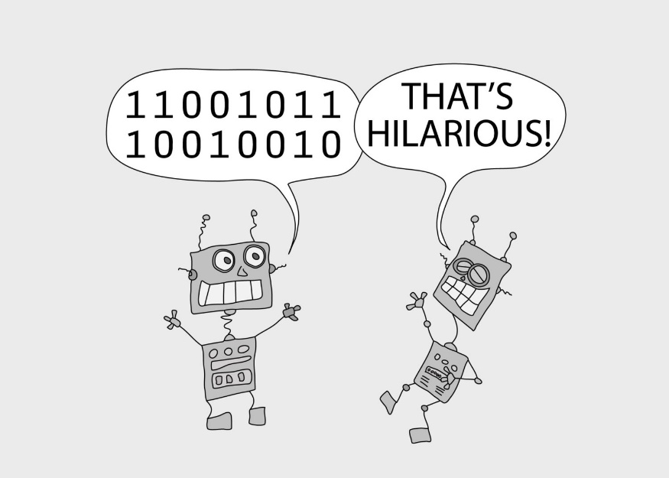
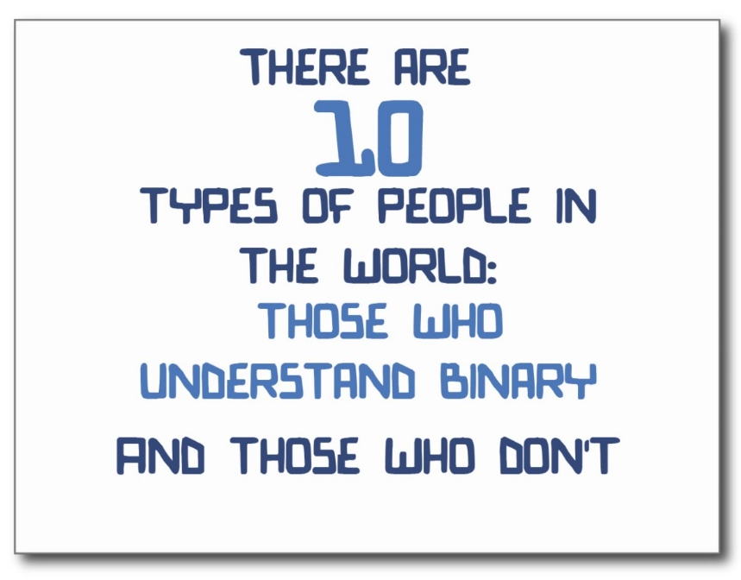
Representation of data in computers (CH3)
Previously on CENG240!
Two’s complement representation of integers, IEEE floating-point representation, Information loss with Floating Points, representation of characters, text and Boolean.

Slide 10
Binary Representation of Numeric Information (continued)
Previously on CENG240!
Two’s complement instead of sign-magnitude representation
Positive numbers have a leading 0.
5 => 0101
The representation for negative numbers is found by subtracting the absolute value from 2^{N} for an N-bit system:
-5 => 2⁴ – 5 = 16 – 5 = (11)₁₀ => (1011)₂
Advantages:
0 has a single representation: +0 = 0000, -0 = 0000
Arithmetic works fine without checking the sign bit:
1011 (-5) + 0110 (6) = 0001 (1)
1011 (-5) + 0011 (3) = 1110 (-2)

Slide 11
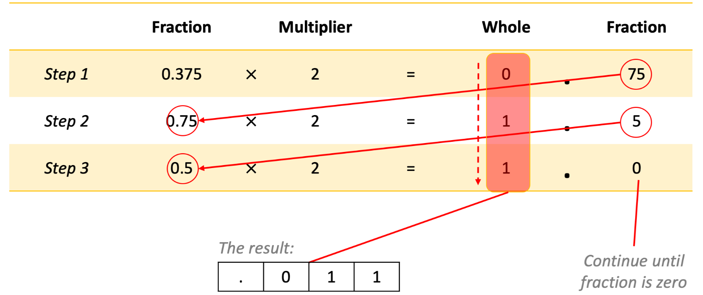
Binary Representation of Real Numbers
Previously on CENG240!
Conversion of the digits after the dot into binary:
1st Way:
0.375 → 0x½ + 1x¼ + 1x1/8 → 011
2nd Way:
Multiply by 2 and get the integer part until we get ‘0’ after the dot:
0.375 x 2 = 0.750 = 0 + 0.750
0.750 x 2 = 1.500 = 1 + 0.500
0.500 x 2 = 1.000 = 1 + 0.000

Slide 12
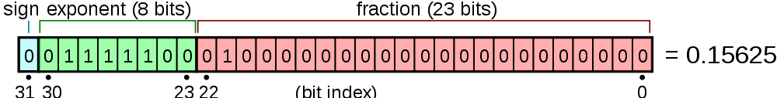

IEEE 32bit Floating-Point Number Representation
Previously on CENG240!
M x 2E
Exponent (E): 8 bits
Add 127 to the exponent value before storing it
E can be 0 to 255 with 127 representing the real zero.
Fraction (M - Mantissa): 23 bits
2¹²⁸ = 1.70141183 × 10³⁸
$$\left(2−2^{−23}\right)×2^{127}$$
Notes:
Why add 127 to the exponent?
This is the excess-K notation, which provides advantages of 2s complement. In addition to that, logical comparison of numbers is easier. In two’s complement, it is more difficult since once has to watch for the sign.

Slide 13
IEEE 32bit Floating-Point Number Representation
Previously on CENG240!
Now consider 4.1:
4 => (100)₂
0.1 =>
x 2 = 0.2 = 0 + 0.2
x 2 = 0.4 = 0 + 0.4
x 2 = 0.8 = 0 + 0.8
x 2 = 1.6 = 1 + 0.6
x 2 = 1.2 = 1 + 0.2
x 2 = 0.4 = 0 + 0.4
x 2 = 0.8 = 0 + 0.8
…….
So,
Representing a fraction which is a multiple of 1/2^{n} is lossless.
Representing a fraction which is not a multiple of 1/2^{n} leads to precision loss.

Slide 14

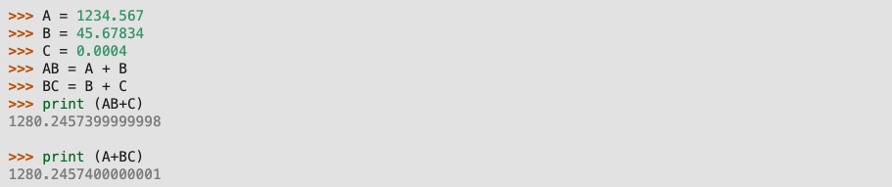
Representing Real Numbers: Information Loss
Previously on CENG240!

Slide 15
Binary Representation of Textual Information (cont’d)
Decimal | Binary | Val.
48 | 00110000 | 0
49 | 00110001 | 1
50 | 00110010 | 2
51 | 00110011 | 3
52 | 00110100 | 4
53 | 00110101 | 5
54 | 00110110 | 6
55 | 00110111 | 7
56 | 00111000 | 8
57 | 00111001 | 9
58 | 00111010 | :
59 | 00111011 | ;
60 | 00111100 | <
61 | 00111101 | =
62 | 00111110 | >
63 | 00111111 | ?
64 | 01000000 | @
65 | 01000001 | A
66 | 01000010 | B
Hex. | Unicode | Charac.
0x30 | 0x0030 | 0
0x31 | 0x0031 | 1
0x32 | 0x0032 | 2
0x33 | 0x0033 | 3
0x34 | 0x0034 | 4
0x35 | 0x0035 | 5
0x36 | 0x0036 | 6
0x37 | 0x0037 | 7
0x38 | 0x0038 | 8
0x39 | 0x0039 | 9
0x3A | 0x003A | :
0x3B | 0x003B | ;
0x3C | 0x003C | <
0x3D | 0x003D | =
0x3E | 0x003E | >
0x3F | 0x003F | ?
0x40 | 0x0040 | @
0x41 | 0x0041 | A
0x42 | 0x0042 | B
Previously on CENG240!
ASCII
7 bits long
Unicode
16 bits long
Partial
listings
only!

Slide 16
This Week
Dive into Python [Part 1/2]
Basic and Container Data in Python:
int, float, complex, bool
string, list, tuple, dict, set
Operators and Expressions: Arithmetic operators, Expression, Comparison operators, Logic connectives

Slide 17
basic and container data
int, float, complex, bool
string, list, tuple, dict, set

Slide 18
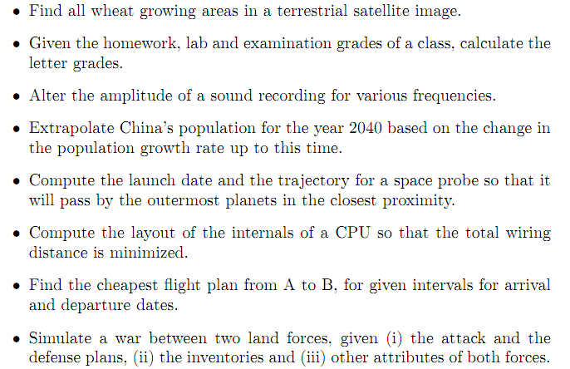
What is data?
Data: Information to be processed to solve a problem.
Identify the data for the following example problems:

Slide 19
What is data?
CPU can only understand two types of data:
Integers,
Floating points.
The following are not directly understandable by a CPU:
Characters (‘a’, ‘A’, ‘2’, …)
Strings (“apple”, “banana”, …)
Complex Numbers
Matrices
Vectors
But, programming languages can implement these data types.

Slide 20
Basic Data in Python Numerical Types
Integers:
int
Unlimited size
Floating point numbers:
float
IEEE754 standard (32bit, 64bit)
Complex numbers
complex
3+4j

Slide 21
Basic Data in Python Numerical Types
Useful operations with numerical types
type(<data>) function
abs(<number>)
pow(<number1>, <number2>)
round(<float-number>)
sin(), cos(), log() from math library

Slide 22
Basic Data in Python Boolean Type
bool type
Can take True or False
Useful operations with bool type
and, or, not

Slide 23
Container Data in Python
str
list
tuple
dict
set
frozenset
Mutability vs. immutability
Mutable
Immutable

Slide 24

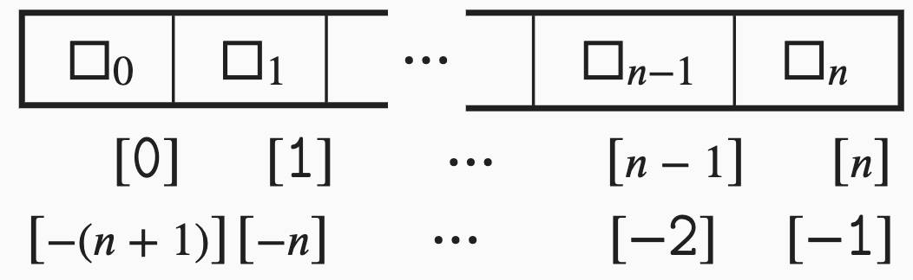
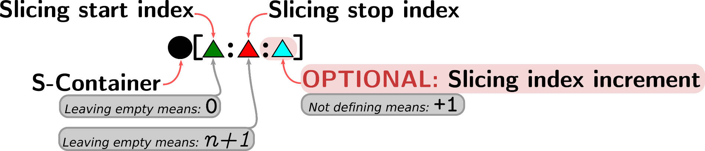
Container Data in Python Accessing Elements of Sequences
Positive indexing
Negative indexing
Slicing

Slide 25

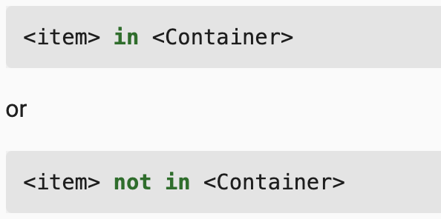


Container Data in Python Useful Operations
len()
Concatenation (+)
Repetition
Membership

Slide 26
Container Data in Python String
Writing strings
single quote
double quote
triple quote
Special characters
Unicode support in v3

Slide 27
Container Data in Python String
Examples with strings
Strings are immutable

Slide 28
Container Data in Python String: Useful Operations
str()
len()
Concatenation, repetition, membership
Evaluate a string: eval() function
Deletion from / insertion into a string
Not possible

Slide 29
Container Data in Python List and Tuple
Lists: mutable
[10, 20, 30]
[“ali”, 20, “veli”, 30]
[10, [20, [30]], 40]
Tuples: immutable
(10, 20, 30)
(“ali”, 20, “veli”, 30)
(10, (20, (30)), 40)

Slide 30
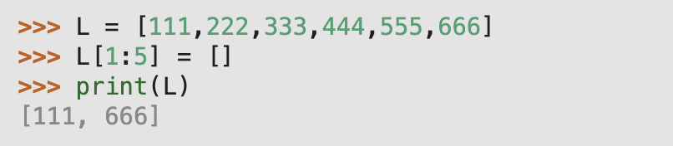
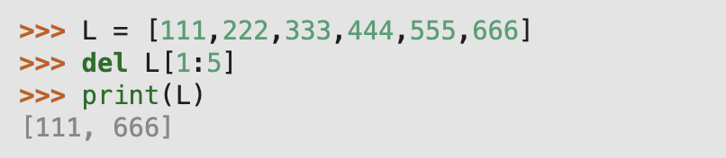
Container Data in Python List: Useful Operations
Deletion

Slide 31
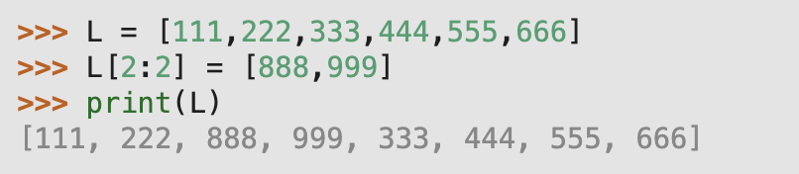
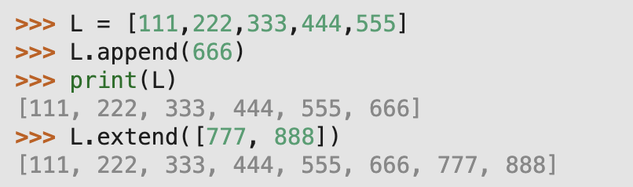
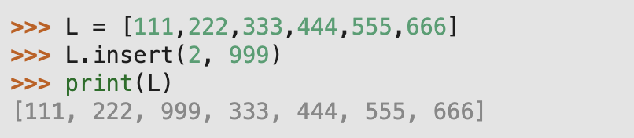
Container Data in Python List: Useful Operations
Insertion

Slide 32
Container Data in Python List: Useful Operations
list() and tuple() functions
Concatenation, repetition
Membership

Slide 33
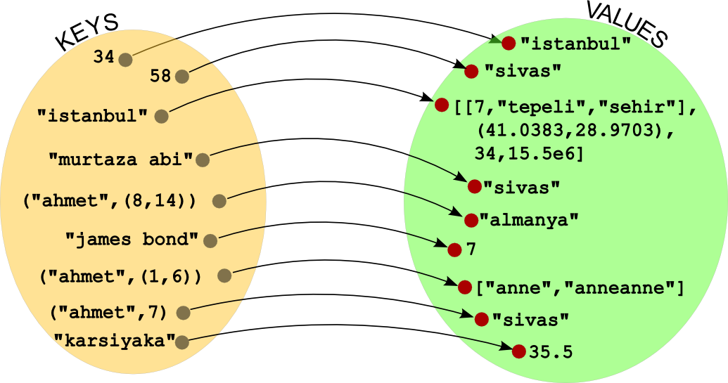
Container Data in Python Dictionary
dict: mutable
Add/delete elements
KeyError

Slide 34
Container Data in Python Dictionary: Useful Operations
len()
Membership
values()
keys()

Slide 35
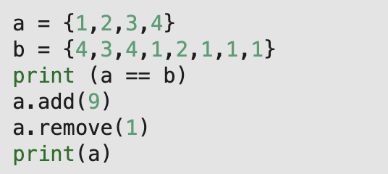
Container Data in Python Set
set: mutable

Slide 36
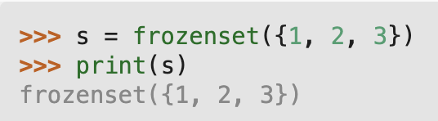
Container Data in Python Frozen Set
frozenset: immutable

Slide 37
Container Data in Python Set: Useful Operations
len(<set>)
Membership
Set operations:
Subset: S1 <= S2
Superset: S1 >= S2
Union: S1 | S2
Intersection: S1 & S2
Set difference: S1-S2
Only with the ‘set’ type:
S.add(element)
S.remove(element)
S.pop()

Slide 38
Action
Operators and Expressions

Slide 39
Action
Purposes of actions
Creating/modifying data
Interaction with the environment
Types of actions
Expressions
Statements

Slide 40
Expressions
Expression: A mathematical operation that has a resulting value
a = 10 + 20 * 3
Operators can be unary or binary

Slide 41
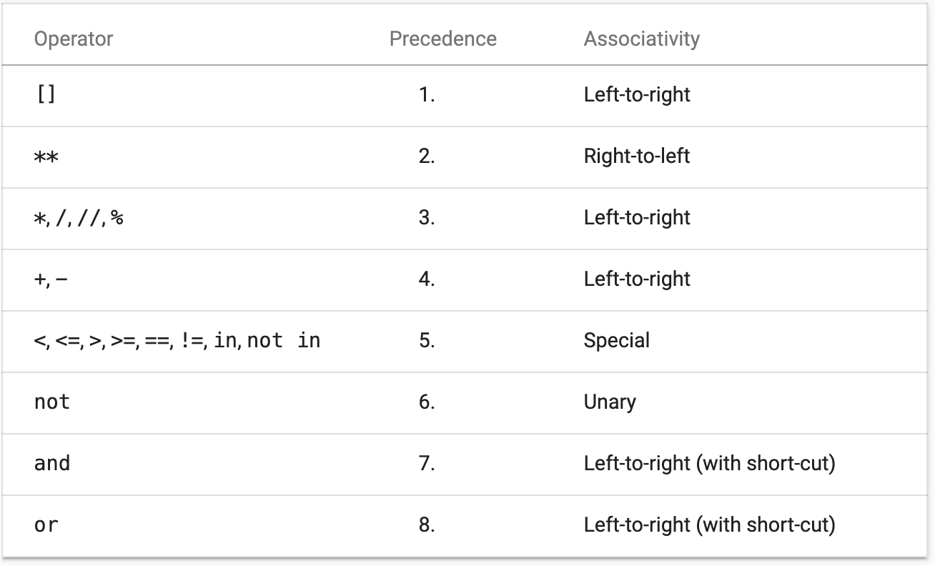
Expression Evaluation Precedence and Associativity

Slide 42
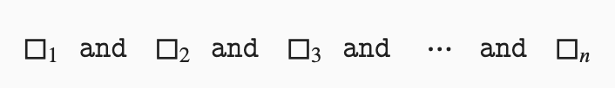
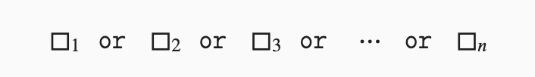
Expression Evaluation and, or evaluation
A shortcut is taken if possible

Slide 43
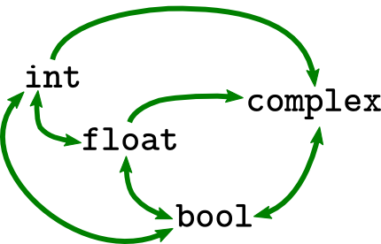
Expression Evaluation Type Conversion
Implicit
3 + 4.5
3 + True
Explicit
int(), float(), bool()
str(), ...

Slide 44
Statements
Basic statements
del L[3]
a = 20
pass, del, return, yield, raise, break, continue, import, future, global, nonlocal.
Compound statements
Conditional statement
Repetition statements

Slide 45
Statements: Assignment
Simple assignment
a = 10
Multiple assignment
a = b = c = 10
a, b = 10, 20
Compound assignment
a += 10
a *= 20
Swapping values
a, b = b, a
id() function

Slide 46
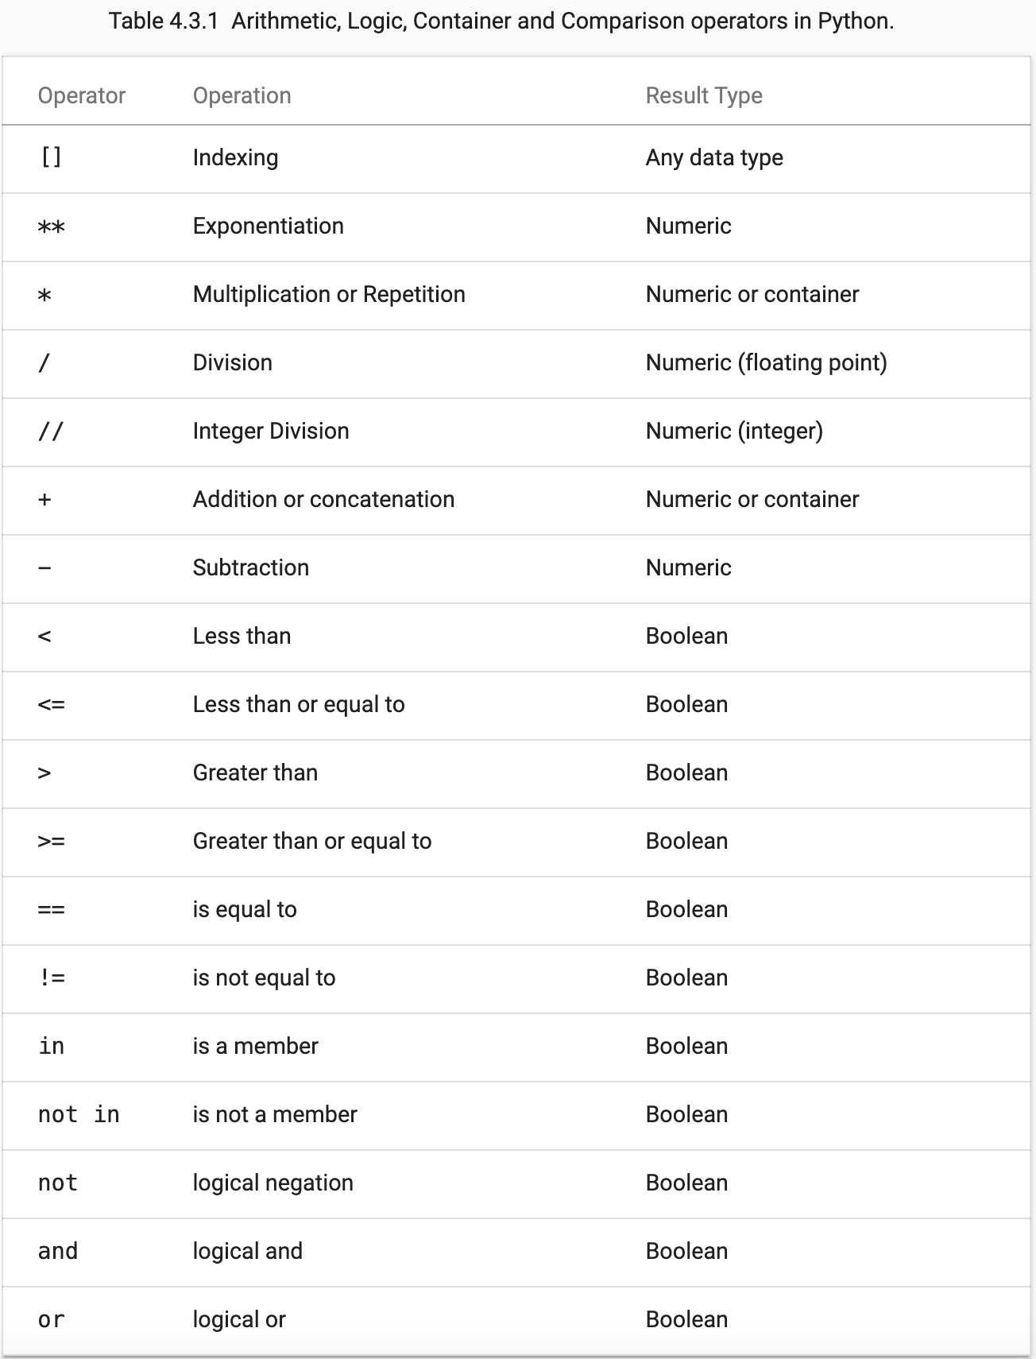
Operators in Python
Arithmetic operators
Logic operators
Container operators
Comparison operators

Slide 47
Final Words: Important Concepts
Data
Basic Data Types
Container Types
Accessing elements of a container type (indexing, negative indexing, slicing).
Mutable vs. immutable types
Actions
Expressions, statements
Expression evaluation: Operators, precedence, associativity
Basic statements
Assignment

Slide 48
that’s all folks! Stay healthy

