Slide 1
CEng 240 – Spring 2021 Week 4
Sinan Kalkan
Dive into Python [Part 2]
Disclaimer: Figures without reference are from either from “Introduction to programming concepts with case studies in Python” or “Programming with Python for Engineers”, which are both co-authored by me.

Slide 2
Basic Data in Python Numerical Types
Previously on CENG240!
Integers:
int
Unlimited size
Floating point numbers:
float
IEEE754 standard (32bit, 64bit)
Complex numbers
complex
3+4j

Slide 3
Basic Data in Python Boolean Type
Previously on CENG240!
bool type
Can take True or False
Useful operations with bool type
and, or, not

Slide 4
Container Data in Python
Previously on CENG240!
str
list
tuple
dict
set
frozenset
Mutability vs. immutability
Mutable
Immutable

Slide 5

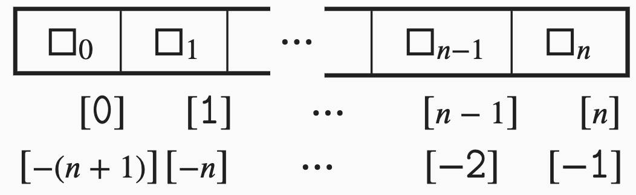
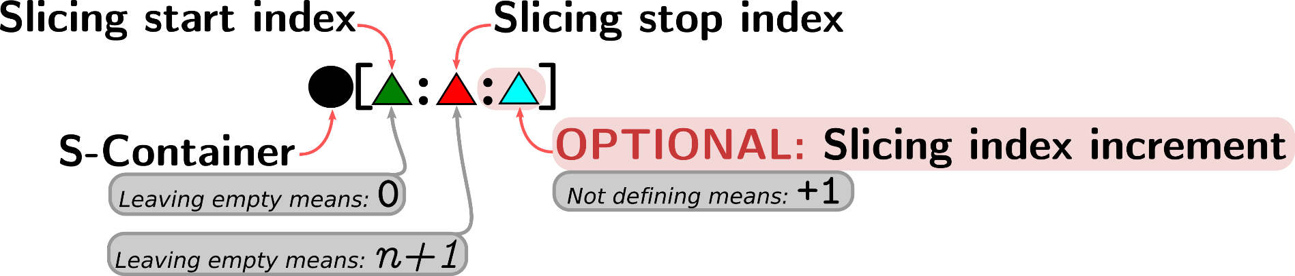
Container Data in Python Accessing Elements of Sequences
Previously on CENG240!
Positive indexing
Negative indexing
Slicing

Slide 6
Action
Previously on CENG240!
Purposes of actions
Creating/modifying data
Interaction with the environment
Types of actions
Expressions
Statements

Slide 7
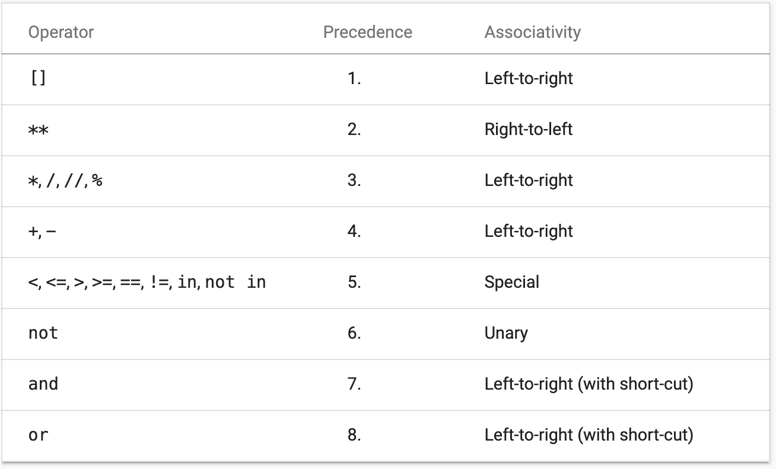
Expression Evaluation Precedence and Associativity
Previously on CENG240!

Slide 8
Statements
Previously on CENG240!
Basic statements
del L[3]
a = 20
pass, del, return, yield, raise, break, continue, import, future, global, nonlocal.
Compound statements
Conditional statement
Repetition statements

Slide 9
Statements: Assignment
Previously on CENG240!
Simple assignment
a = 10
Multiple assignment
a = b = c = 10
a, b = 10, 20
Compound assignment
a += 10
a *= 20
Swapping values
a, b = b, a
id() function

Slide 10
This Week
Dive into Python [Part 2/2]
Variables; Aliasing problem; Naming Variables
Actions for interacting with the environment
Actions that are ignored (comments, pass statements)
Actions in packages (libraries)
Writing your actions (interpreter vs. script/modules)

Slide 11
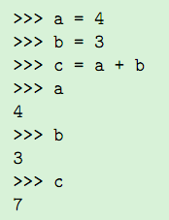
Variables in Python
We don’t need to define a variable before using it.
We don’t need to specify the type of a variable.
‘=‘ means “Change the content of the variable with the value at the right-hand side”.
Assignment!
The left-side of the assignment should be a valid variable name:
Ex: a+2 = 5 → NOT VALID!

Slide 12
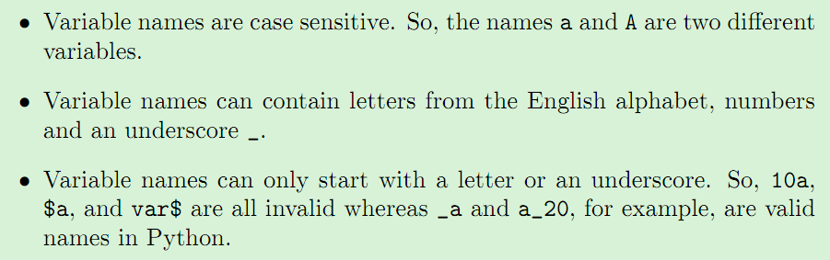
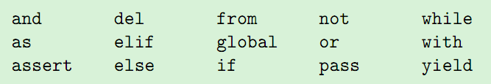
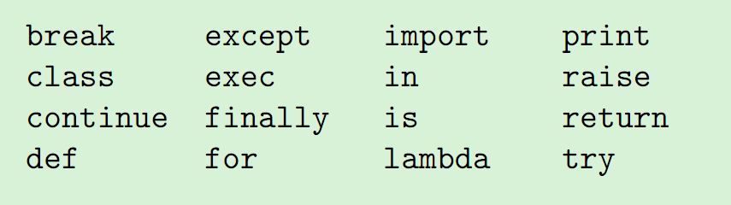
Variable Naming in Python
Variable names cannot be one of the keywords in Python:

Slide 13
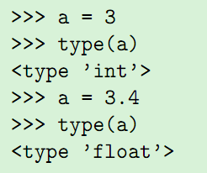
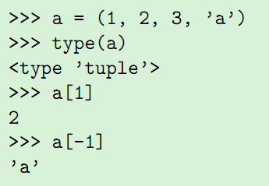
More on Variables in Python
Typing of variables:
Python is dynamically typed:
Using variables:

Slide 14
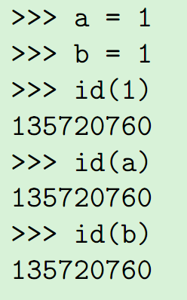
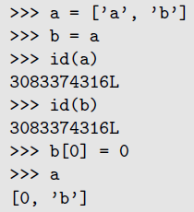
Variables, Values and Aliasing in Python
Every data (whether constant or not) has an identifier (an integer) in Python:
If the type of the data is mutable, there is a problem!!!
This is called
Aliasing.

Slide 15
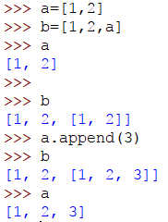

Slide 16

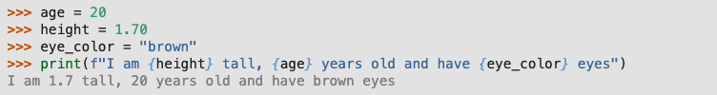
Actions for I/O

Slide 17
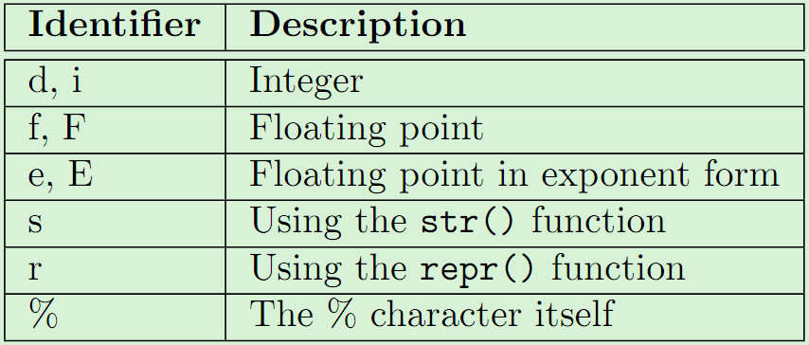
Actions for I/O
>>> print("I am %f tall, %d years old and have %s eyes" % (1.7569, 20, "blue"))
I am 1.756900 tall, 20 years old and have blue eyes
>>> print("I am %.2f tall, %d years old and have %s eyes" % (1.7569, 20, "blue"))
I am 1.76 tall, 20 years old and have blue eyes
%f → Data identifier
We have the following identifiers in Python:

Slide 18

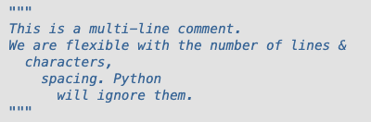
Actions that are ignored: Comments

Slide 19
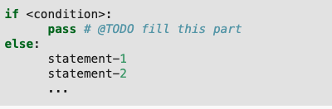
Actions that are ignored: pass statement

Slide 20
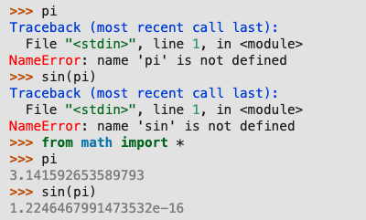
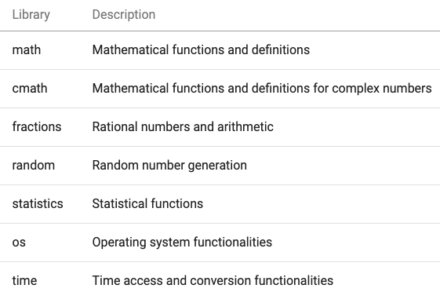
Actions in packages

Slide 21


Actions in packages

Slide 22
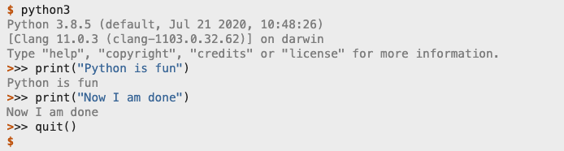
Writing your actions: (1) Interact with the interpreter

Slide 23
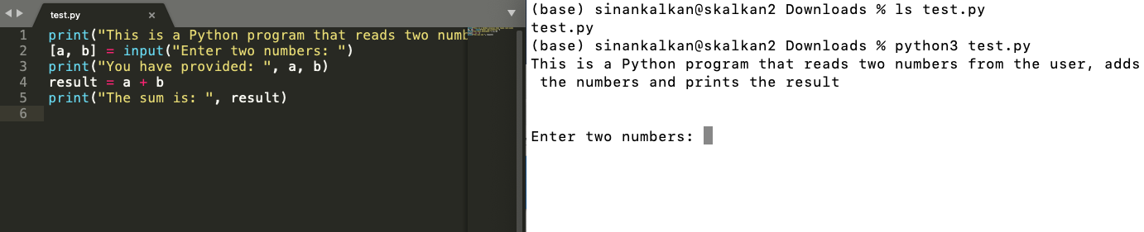
Writing your actions: (2) Putting your actions into a script file

Slide 24
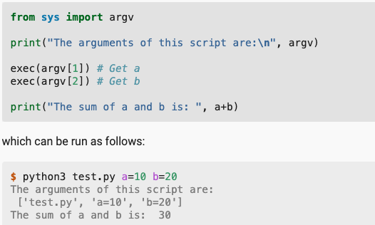
Writing your actions: (2) Putting your actions into a script file

Slide 25
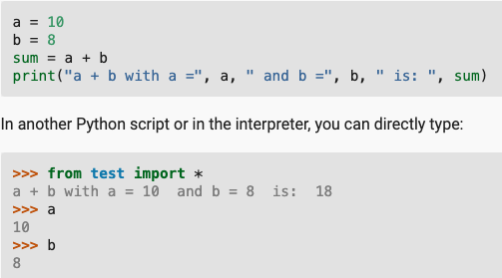
Writing your actions: (3) Your actions in a module
To reload:
>>> from importlib import reload
>>> reload(test)

Slide 26
Final Words: Important Concepts
Variables; Aliasing problem; Naming Variables
Actions for interacting with the environment
Comments, pass statements
Actions in packages (libraries)
Writing your actions (interpreter vs. script/modules)

Slide 27
Exercises from the book
https://pp4e-workbook.github.io/

Slide 28
that’s all folks! Stay healthy

