Slide 1
CEng 240 – Spring 2021 Week 5
Sinan Kalkan
Conditional and Repetitive Execution
Disclaimer: Figures without reference are from either from “Introduction to programming concepts with case studies in Python” or “Programming with Python for Engineers”, which are both co-authored by me.

Slide 2
This Week
Conditional Execution
if statement
Conditional expression
Repetitive Execution
while/for statement
break/continue statements
Set/list comprehension

Slide 3
Conditional execution

Slide 4
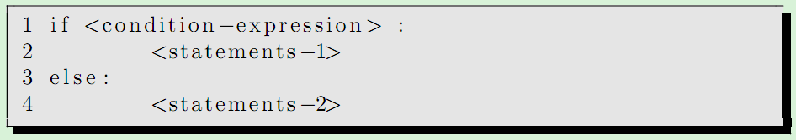
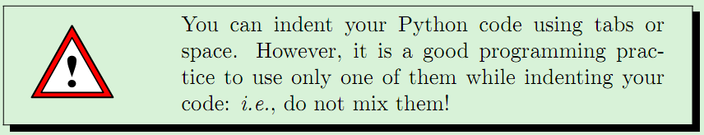
Conditional Statements in Python
the syntax is important!
indentation is extremely important!
“else”-part can be omitted!

Slide 5
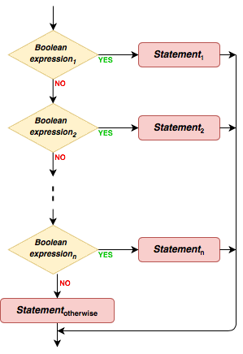
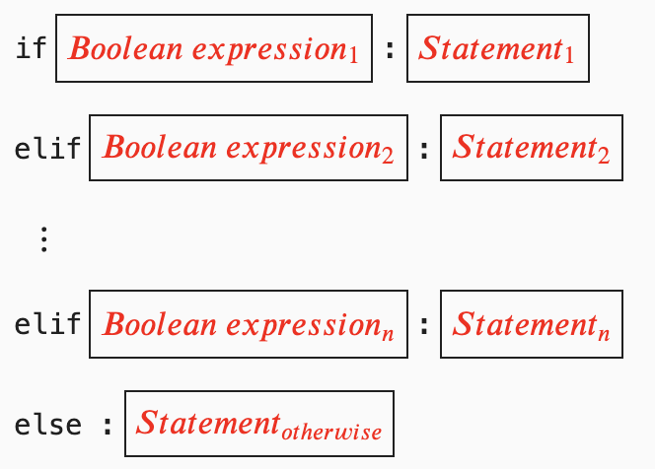
Multiple If Statements in Python

Slide 6
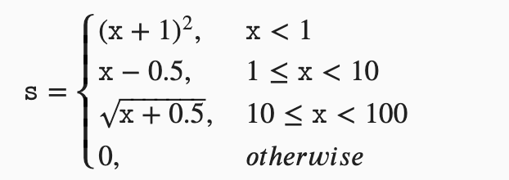
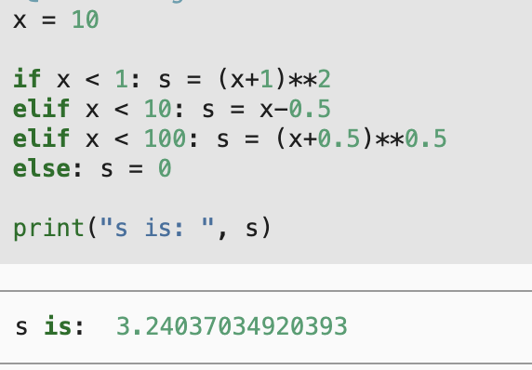
Example

Slide 7
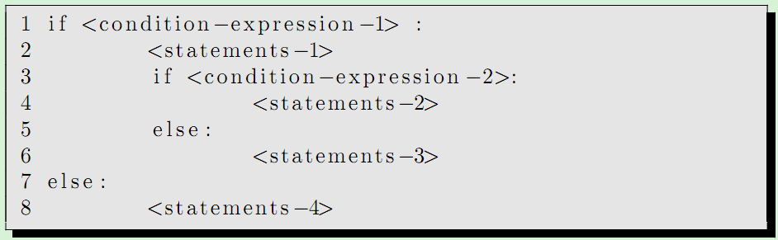
Multiple Nested If Statements in Python

Slide 8
Example
Finding the maximum of two numbers
Finding the maximum of three numbers

Slide 9
Conditional Expression in Python
<exp-1> if <cond-exp> else <exp-2>
Note that this is an expression not a statement!!

Slide 10
Repetitive execution

Slide 11
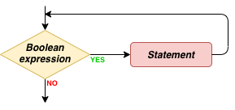

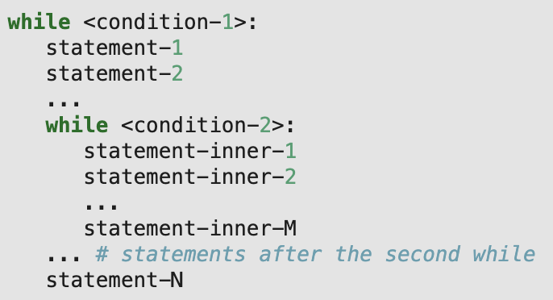
while statement

Slide 12

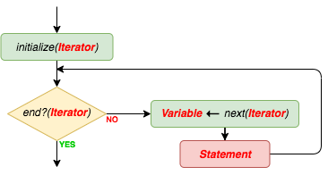
for statement

Slide 13
Example
Count the occurrences of characters in a string, e.g. "aaaaaaxxxxmyyyaaaassssssssstttuivvvv”

Slide 14
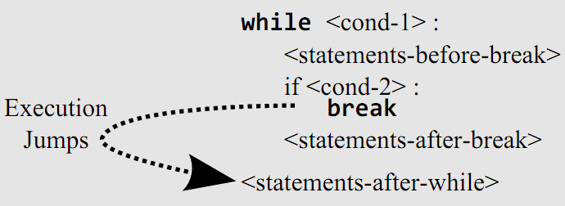
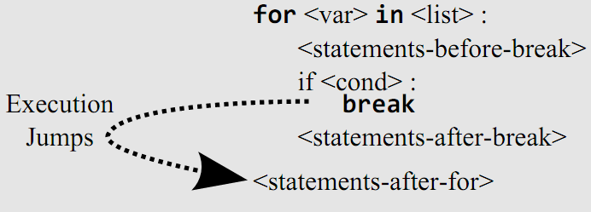
Break statements

Slide 15
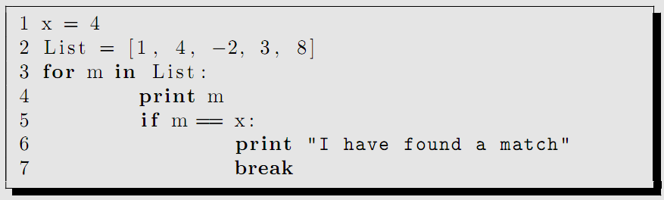
“break” example

Slide 16
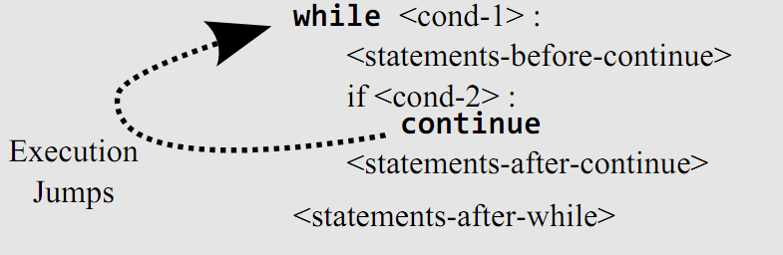
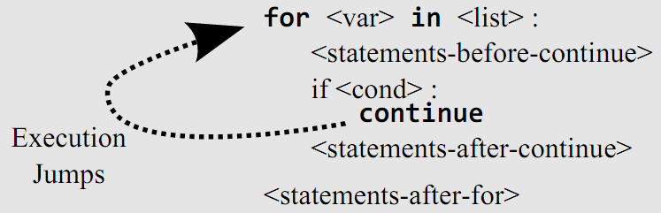
Continue statements
<var> will point to the next item in the list.

Slide 17
Set and list comprehension
[x**3 for x in range(8)]
{x**3 for x in range(8)}

Slide 18
Exercises from the book
https://pp4e-workbook.github.io/

Slide 19
Final Words: Important Concepts
Variables; Aliasing problem; Naming Variables
Actions for interacting with the environment
Comments, pass statements
Actions in packages (libraries)
Writing your actions (interpreter vs. script/modules)

Slide 20
that’s all folks! Stay healthy

