Slide 1
CEng 240 – Spring 2021 Week 6
Sinan Kalkan
Conditional and Repetitive Execution
Disclaimer: Figures without reference are from either from “Introduction to programming concepts with case studies in Python” or “Programming with Python for Engineers”, which are both co-authored by me.

Slide 2
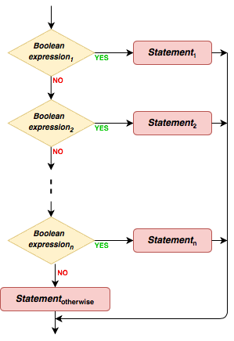
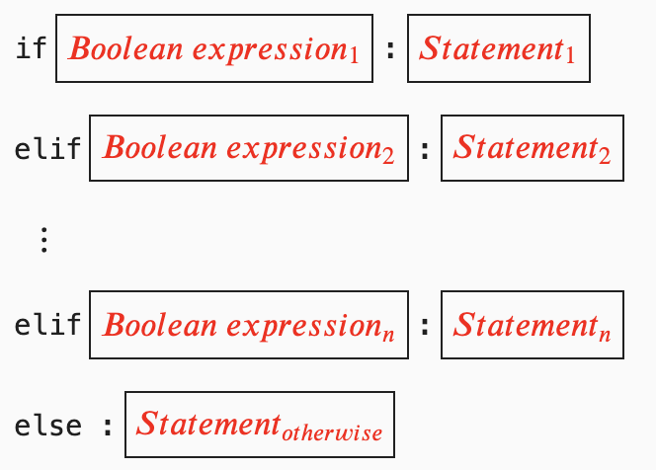
Multiple If Statements in Python
Previously on CENG240!

Slide 3
Conditional Expression in Python
Previously on CENG240!
<exp-1> if <cond-exp> else <exp-2>
Note that this is an expression not a statement!!

Slide 4
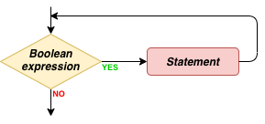

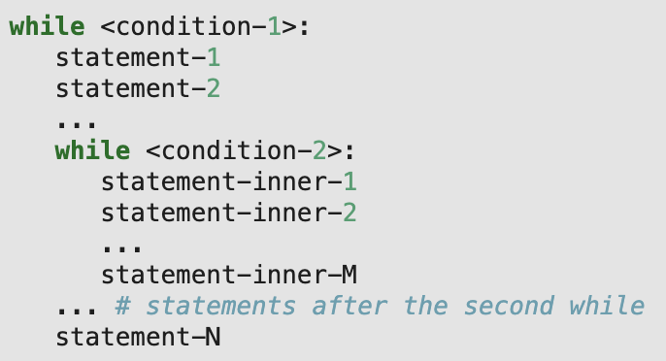
while statement
Previously on CENG240!

Slide 5

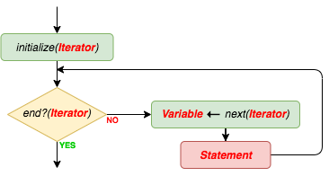
for statement
Previously on CENG240!

Slide 6
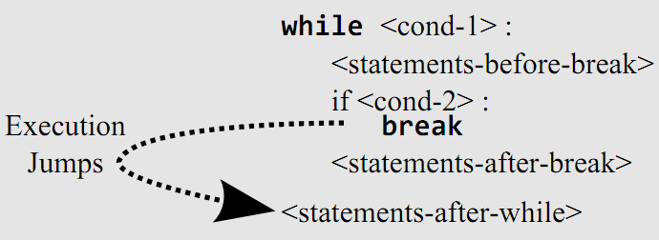
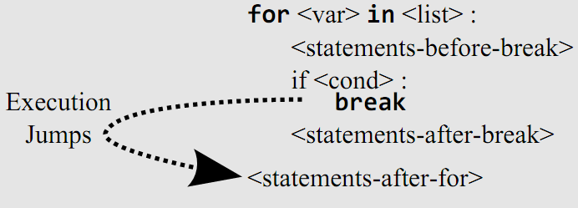
Break statements
Previously on CENG240!

Slide 7
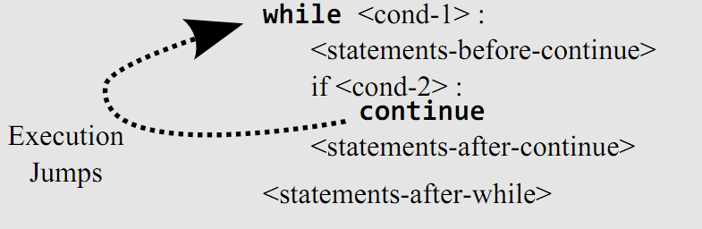
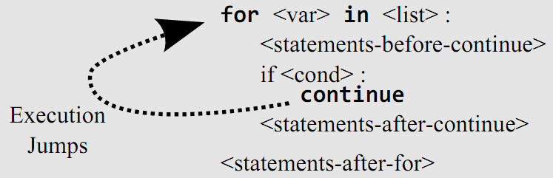
Continue statements
Previously on CENG240!
<var> will point to the next item in the list.

Slide 8
Set and list comprehension
Previously on CENG240!
[x**3 for x in range(8)]
{x**3 for x in range(8)}

Slide 9
This Week
More examples with conditional and iterative execution

Slide 10
Problems
Sequential search: Find whether a number is in a list of numbers or not.
Example input/output:
5 is in [100, 4, 48, 5] => True
5 is in [38, 45, 20, 3] => False

Slide 11
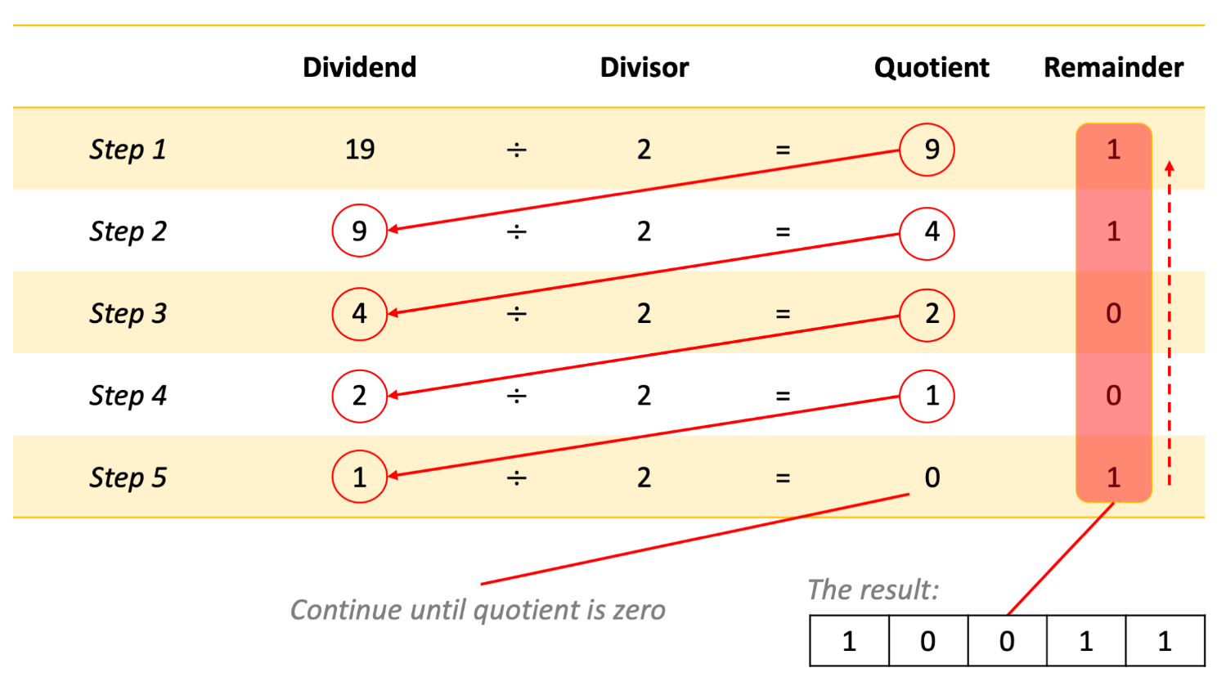
Problems
Decimal number to binary conversion
Example input/output:
5=> “101”.
9 => “1001”

Slide 12
Problems
Calculate AND operation on two binary strings.
Example input/output:
“1011” AND “1001” => “1001”.
“1010” AND “0101” => “0000”.

Slide 13
Problems
Binary string to decimal conversion
Example input/output:
“101” => 5.
“1001” => 9.

Slide 14
Problems
In a list, if you encounter another list of numbers, replace that nested list of numbers with the average of the numbers.
Example input/output:
[[1, 3], [4, 5, 6], 7, [10, 20]] => [2, 5, 7, 15].
[20, 30, [4, 8]] => [20, 30, 6]

Slide 15
Problems
Bubble sort: Sort numbers in increasing order
Example input/output:
[5, 1, 3, 6] => [1, 3, 5, 6]
[10, -4, 8, 20] => [-4, 8, 10, 20]

Slide 16
Final Words: Important Concepts
The same as last week.

Slide 17
that’s all folks! Stay healthy

