Slide 1
CEng 240 – Spring 2021 Week 7
Sinan Kalkan
Functions
Disclaimer: Figures without reference are from either from “Introduction to programming concepts with case studies in Python” or “Programming with Python for Engineers”, which are both co-authored by me.

Slide 2
This Week
Functions
Why define functions?
Defining functions
Parameter passing
Default parameters
Scope of variables
Examples
Next week:
Recursion, higher-order functions
Examples

Slide 3
Why define functions?
Reusability
Maintenance
Structure

Slide 4
Functions in programming vs. Mathematics
Functions in programming are similar to functions in Mathematics but there are differences.
Difference to mathematical functions:
A function in programming may not return a value.
A function in mathematics only depends on its arguments unlike the functions in programming.
A mathematical function does not have the problem of side effects.

Slide 5
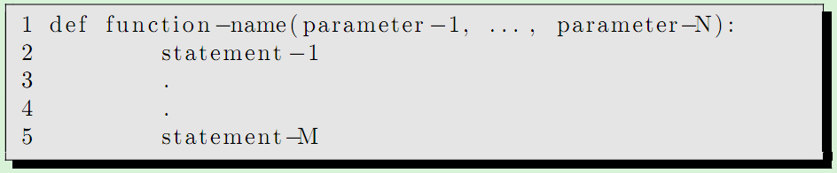
Functions in Python
Syntax is important!
Indentation is extremely important!

Slide 6
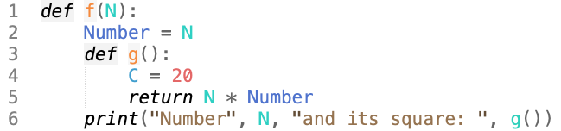
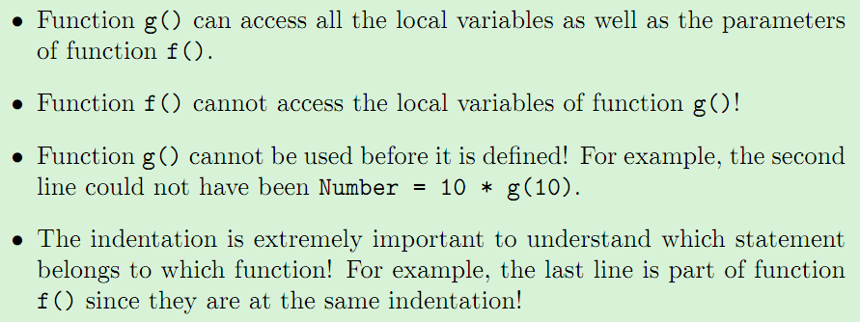
Nested Functions in Python

Slide 7
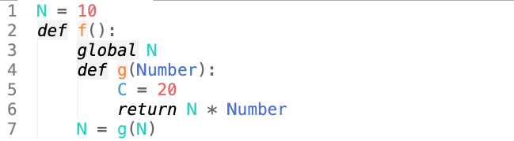
Global Variables in Python
To access variables in the global workspace, you should use “global <varname>”

Slide 8
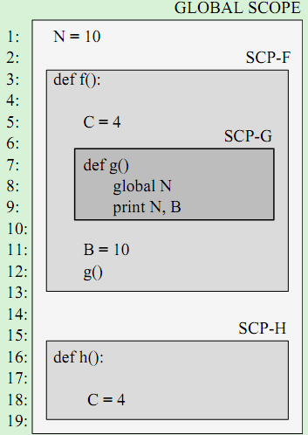
Scope in Python
Since you can nest functions in Python, understanding scope is important
LEGB rule:
Local < Enclosing < Global < Built-in

Slide 9
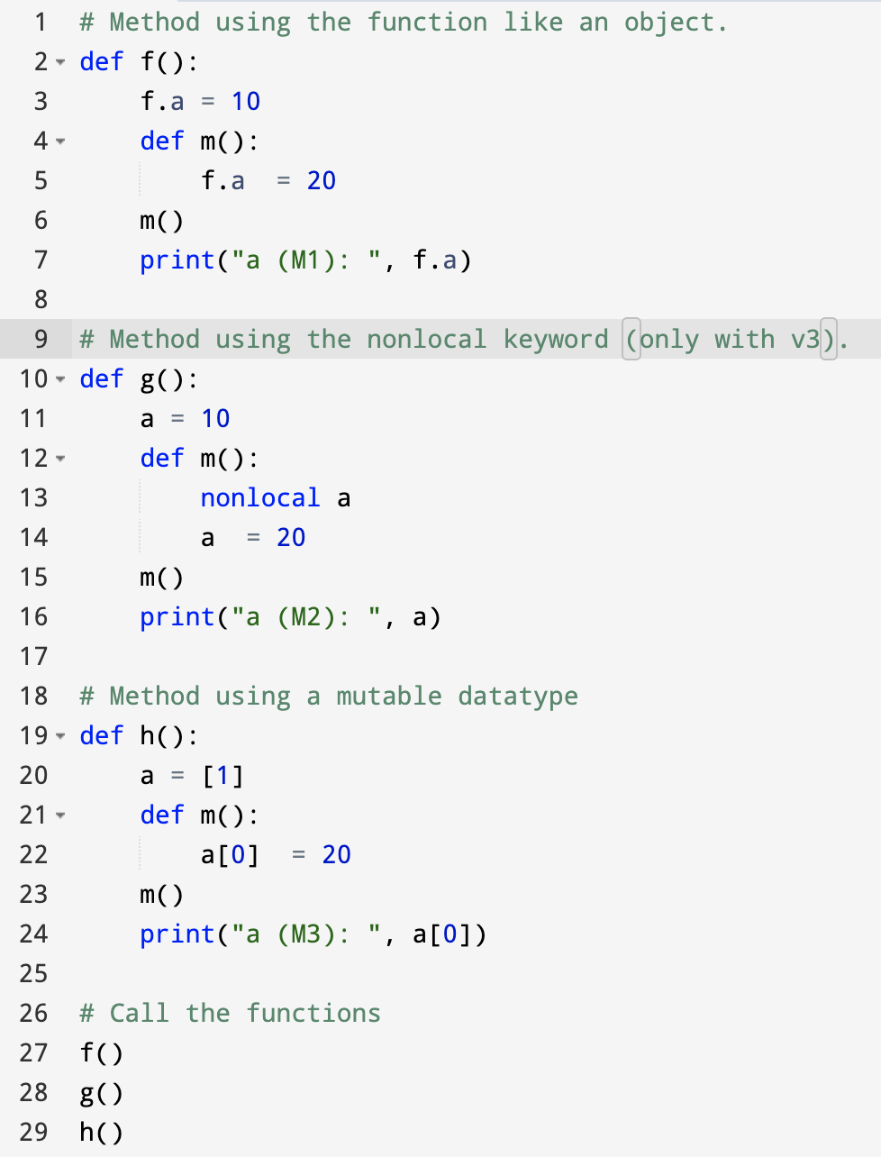
Updating variables of an outer function
Notes:
# Method using the function like an object.
def f():
f.a = 10
def m():
f.a = 20
m()
print("a (M1): ", f.a)
# Method using the nonlocal keyword (only with v3).
def g():
a = 10
def m():
nonlocal a
a = 20
m()
print("a (M2): ", a)
# Method using a mutable datatype
def h():
a = [1]
def m():
a[0] = 20
m()
print("a (M3): ", a[0])
# Call the functions
f()
g()
h()

Slide 10
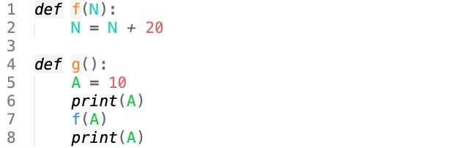

Parameter passing in functions in Python

Slide 11
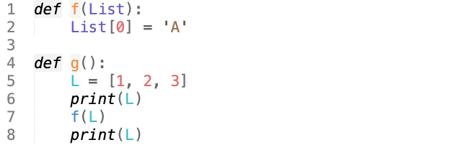

Parameter passing in functions in Python

Slide 12
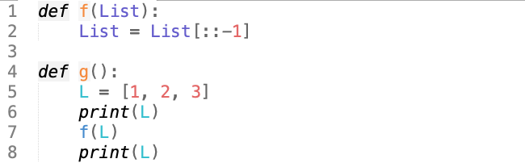

Parameter passing in functions in Python

Slide 13
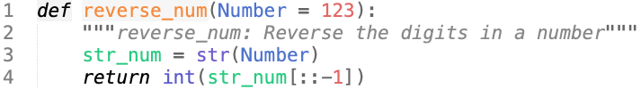
Default Parameters in Python
We can now call this function with reverse_num() in which case Number is assumed to be 123.
If we supply a value for Number, that value is used instead.

Slide 14
Function Examples
Finding max of numbers
Sequential search
Write a Python function named only_numbers() that removes items in a list that are not numbers.
E.g. only_numbers([10, "ali", [20], True, 4]) should return [10, 4].
Insertion sort
Notes:
def insertion_sort(L):
result = []
for x in L:
insert(result, x)
return result
def insert(L, x):
i = 0
while i < len(L):
if x < L[i]: break
i += 1
L.insert(i, x)
print(f"{insertion_sort([10, -4, 3, -10])}")

Slide 15
Final Words: Important Concepts
Benefits of defining functions
How to define functions
Default parameters
Scopes of variables

Slide 16
that’s all folks! Stay healthy

