Slide 1
CEng 240 – Spring 2021 Week 8
Sinan Kalkan
Functions [continued]
Disclaimer: Figures without reference are from either from “Introduction to programming concepts with case studies in Python” or “Programming with Python for Engineers”, which are both co-authored by me.

Slide 2
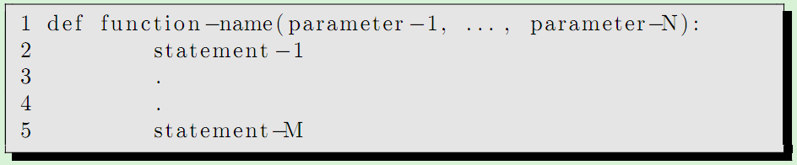
Functions in Python
Previously on CENG240!
Syntax is important!
Indentation is extremely important!

Slide 3
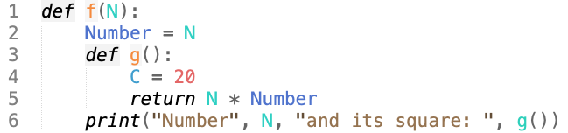
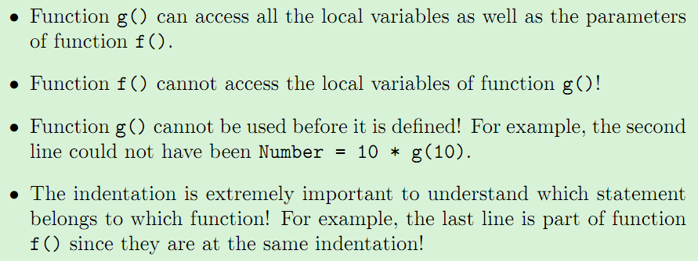
Nested Functions in Python
Previously on CENG240!

Slide 4
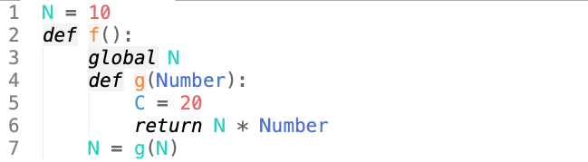
Global Variables in Python
Previously on CENG240!
To access variables in the global workspace, you should use “global <varname>”

Slide 5
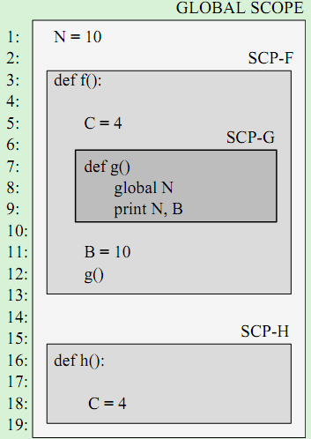
Scope in Python
Previously on CENG240!
Since you can nest functions in Python, understanding scope is important
LEGB rule:
Local < Enclosing < Global < Built-in

Slide 6
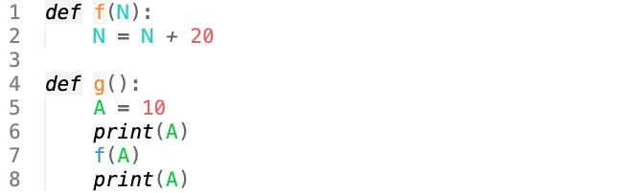

Parameter passing in functions in Python
Previously on CENG240!

Slide 7
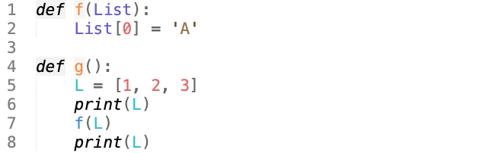

Parameter passing in functions in Python
Previously on CENG240!

Slide 8
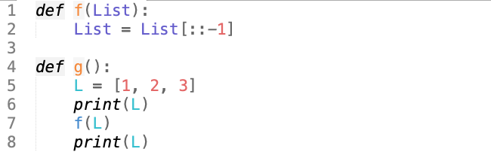

Parameter passing in functions in Python
Previously on CENG240!

Slide 9
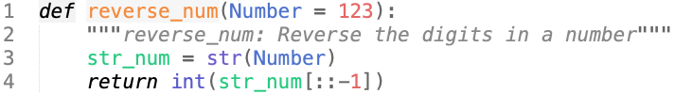
Default Parameters in Python
Previously on CENG240!
We can now call this function with reverse_num() in which case Number is assumed to be 123.
If we supply a value for Number, that value is used instead.

Slide 10
This Week
Previous week was:
Why define functions?
Defining functions
Parameter passing
Default parameters
Scope of variables
Examples
This week:
Recursion, higher-order functions
Examples

Slide 11
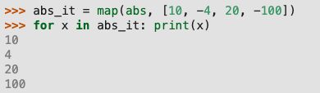

Higher-order functions
map(function, Iterator)
filter(predicate, Iterator)

Slide 12
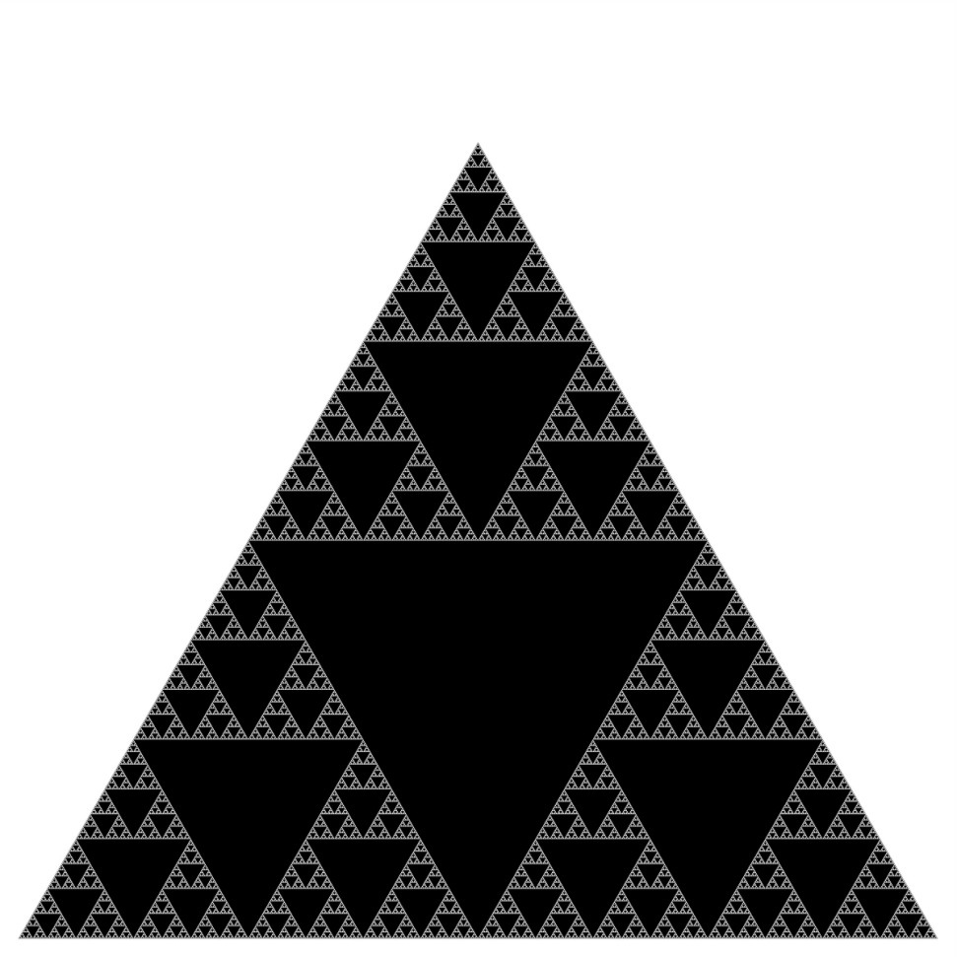

Recursion: An action wizard
What is recursion?

Slide 13
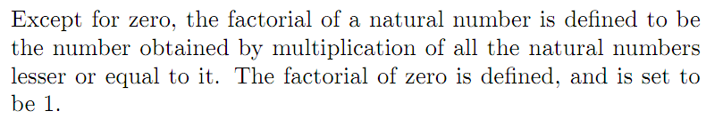

Recursion: An example
Definition of factorial:
More formally:

Slide 14
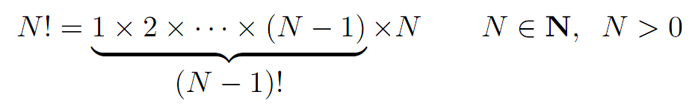
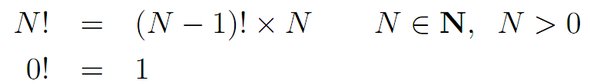
Recursion: an example (cont’d)
A careful look at the formal definition:
Factorial uses
its own definition!

Slide 15
Recurrence & Recursion
This is called recurrence relation/rule.
Algorithms which make use of recurrence relations are called recursive.

Slide 16
Recursion: an example (cont’d)
Let us look at the pseudo-code:
def factorial(N):
if N == 0: return 1
else: return N * factorial(N-1)

Slide 17
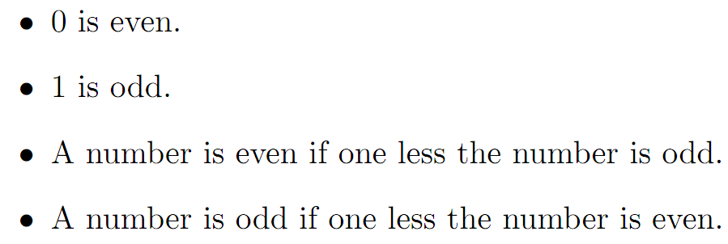
Recursion: another example
Recursive definition of even or odd (a mutually recursive example):

Slide 18
Another example for recursion
Reversing a list / string
[a, b, c] → [c, b, a]
reverse([a, b, c]) = reverse([b, c]) + [a].

Slide 19
Function Examples
What is printed by the following code piece?
N = 1
M = 2
def f():
global M
N = 3
M = 4
print(N, M)
f()
print(N,M)

Slide 20
Function Examples
Finding the median
https://pp4e-workbook.github.io/chapters/functions/finding_median.html
Bankruptcy Countdown:
https://pp4e-workbook.github.io/chapters/functions/bankruptcy_countdown.html
Perfect Number:
https://pp4e-workbook.github.io/chapters/functions/perfect_number.html

Slide 21
Final Words: Important Concepts
Benefits of defining functions
How to define functions
Default parameters
Scopes of variables

Slide 22
that’s all folks! Stay healthy

