Slide 1
CEng 240 – Spring 2021 Week 9
Sinan Kalkan
Object-Oriented Programming
Disclaimer: Figures without reference are from either from “Introduction to programming concepts with case studies in Python” or “Programming with Python for Engineers”, which are both co-authored by me.

Slide 2
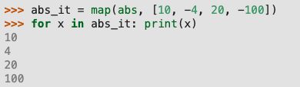

Higher-order functions
Previously on CENG240!
map(function, Iterator)
filter(predicate, Iterator)

Slide 3
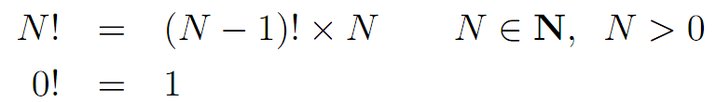
Recursion: an example (cont’d)
Previously on CENG240!
Let us look at the pseudo-code:
def factorial(N):
if N == 0: return 1
else: return N * factorial(N-1)

Slide 4
This Week
Object-oriented Programming (OOP)
What is it? What are the benefits?
Properties of OOP: Encapsulation, Inheritance, Polymorphism
Class definition
Member functions and variables
The concept of message passing
Basics of OOP in Python

Slide 5
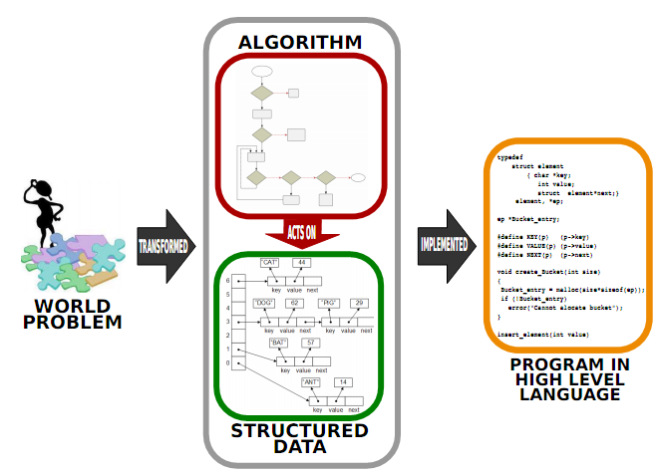

Slide 6

What is an object?
An object is an entity which has a state and a set of behaviors that, when executed, change the state of the entity or the environment.
A car object:
State:
Position, Speed, Gear State, Brake State, Wheel State
Behaviors:
Rotate, Accelerate, Brake

Slide 7
Why do we need/have OOP?
Consider a problem of drawing/manipulating geometric objects:
Points in 2D Cartesian space
Lines: Made from two points
Triangle: Made from three lines or three points
Square/rectangle: Made from four lines or two points
Circle: A point and a radius
Polygon: A collection of lines / points.

Slide 8
Why do we need/have OOP? (cont’d)
When we have to draw in 3D:
Points in 3D Cartesian space
3D Lines: Made from two 3D points
3D Triangle: Made from three 3D lines or three 3D points
3D Square/3D rectangle: Made from four 3D lines or two 3D points
3D Circle: A 3D point and a radius
Prism: A collection of 3D triangles & rectangles & parallelograms.

Slide 9
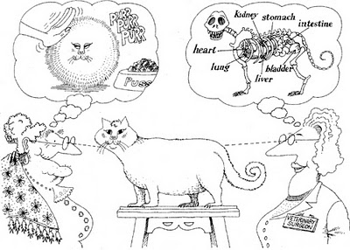
What does OOP provide?
Encapsulation: Hiding implementation/representation details
Figure: G. Booch, R. A. Maksimchuk, M. W. Engel, B. J. Young, J. Conallen, K. A. Houston,
Object-Oriented Analysis and Design with Applications (3rd Edition), 2007.

Slide 10
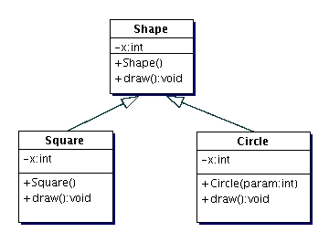
What does OOP provide?
Inheritance:
A class inherits some variables and functions from another one.
Square class inherits x and draw() from the Shape class.
Shape: Parent class
Square: Child class

Slide 11
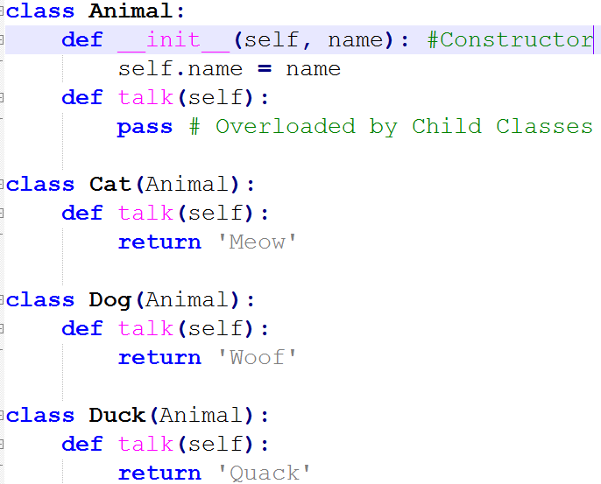
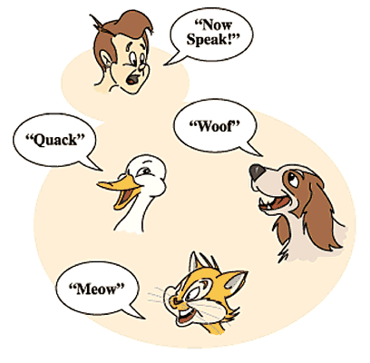
What does OOP provide?
Polymorphism:
The ability of a child class to behave and appear like its parent.

Slide 12
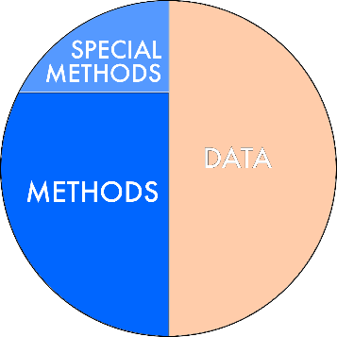
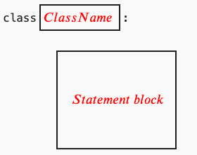
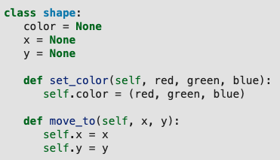
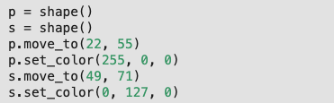
Class Definition

Slide 13
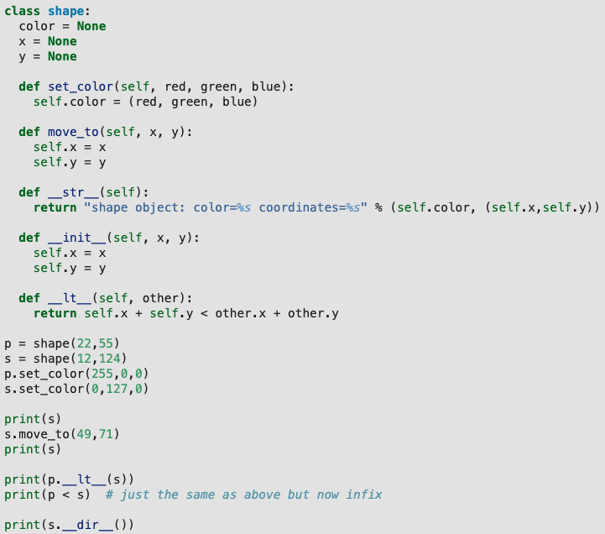
Class Definition

Slide 14

Special Methods
x<y calls x.__lt__(y)
x<=y calls x.__le__(y)
x==y calls x.__eq__(y)
x!=y calls x.__ne__(y)
x>y calls x.__gt__(y)
x>=y calls x.__ge__(y)

Slide 15
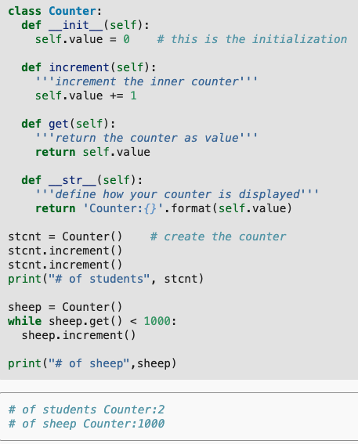
Counter Example

Slide 16
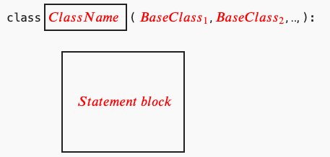
Inheritance in Python

Slide 17
Some Remarks
If a member variable and a member function has the same name, the member variable override the member function.
In Python, you cannot enforce data hiding.
The users of a class should be careful about using member variables since they can be deleted or altered easily.
To arrange proper deletion of an object, you can define a “__del__(self)” function ➔ also called, the destructor.
The word self can be replaced by any other name. However, since “self” is the convention and some code browsers rely on the keyword “self”, it is ideal to use “self” all the time.

Slide 18
Examples
Person, Student, Instructor
From the workbook
Database Recovery
https://pp4e-workbook.github.io/chapters/a_gentle_introduction_to_object_oriented_programming/database_recovery.html
Notes:
class Person:
def __init__(self, name, age):
self.age = age
self.name = name
class Student(Person):
def __init__(self, name, age, ID, year, department):
super().__init__(name, age)
self.ID = ID
class Instructor(Person):
def __init__(self, name, age, title, department):

Slide 19
Final Words: Important Concepts
Encapsulation, inheritance and polymorphism.
Benefits of the Object-Oriented Paradigm.
Concepts such as class, instance, object, member, method, message passing.
Concepts such as base class, ancestor, descendant.

Slide 20
that’s all folks! Stay healthy

