Slide 1
CEng 240 – Spring 2021 Week 10
Sinan Kalkan
File Handling
Disclaimer: Figures without reference are from either from “Introduction to programming concepts with case studies in Python” or “Programming with Python for Engineers”, which are both co-authored by me.

Slide 2
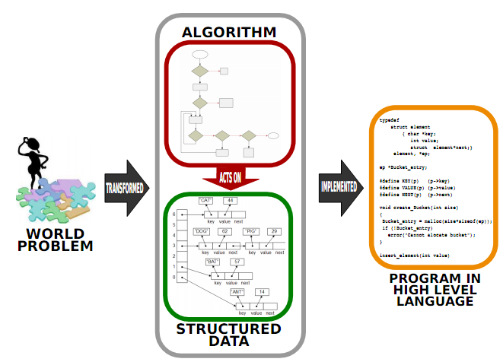
Previously on CENG240!

Slide 3
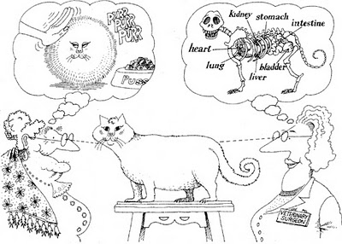
What does OOP provide?
Previously on CENG240!
Encapsulation: Hiding implementation/representation details
Figure: G. Booch, R. A. Maksimchuk, M. W. Engel, B. J. Young, J. Conallen, K. A. Houston,
Object-Oriented Analysis and Design with Applications (3rd Edition), 2007.

Slide 4
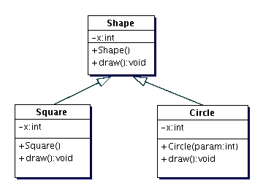
What does OOP provide?
Previously on CENG240!
Inheritance:
A class inherits some variables and functions from another one.
Square class inherits x and draw() from the Shape class.
Shape: Parent class
Square: Child class

Slide 5
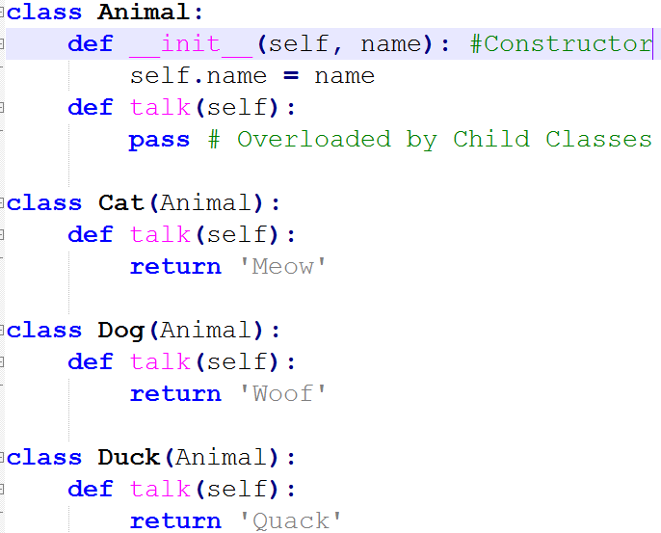
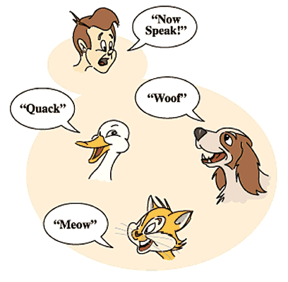
What does OOP provide?
Previously on CENG240!
Polymorphism:
The ability of a child class to behave and appear like its parent.

Slide 6
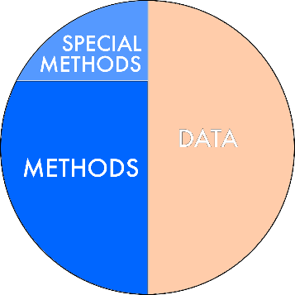
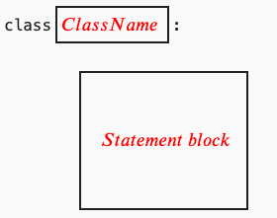
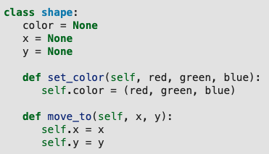
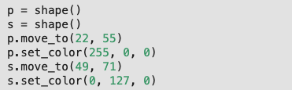
Class Definition
Previously on CENG240!

Slide 7
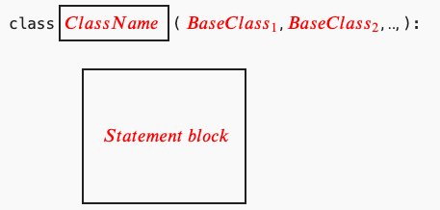
Inheritance in Python
Previously on CENG240!

Slide 8
This Week
File Handling
Files and sequential access
Parsing
Termination of input
Formatting files
Binary files

Slide 9
First Example
fpointer = open('firstexample.txt', "w")
fpointer.write("hello\n")
fpointer.write("how are\n") fpointer.write("you?\n")
fpointer.close()

Slide 10
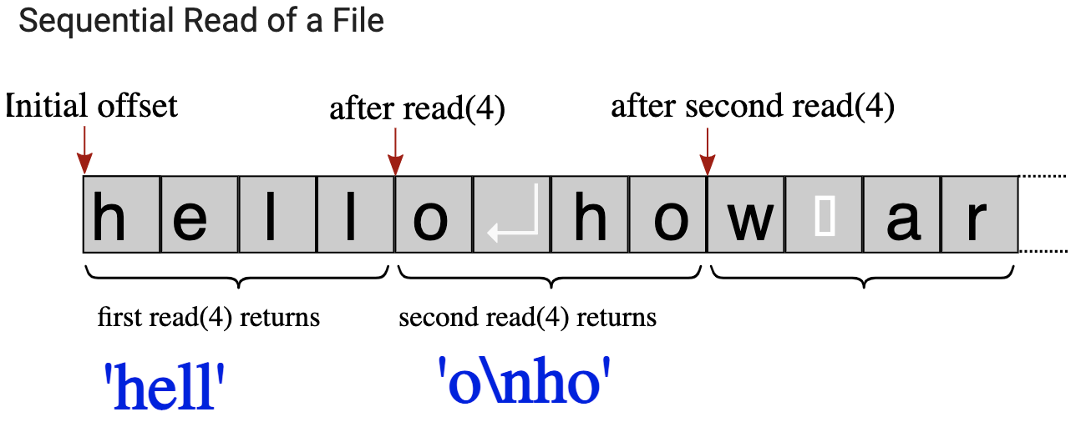
Files and Sequential Access
fp = open("firstexample.txt","r") # the example file we created above
for i in range(3): # repeat 3 times
content = fp.read(4) # read 4 bytes in each step
print("> ", content) # output 4 bytes preceded by >
fp.close()

Slide 11
Parsing
instr = '10.0 5.0 5.0’
outlst = []
# Go over each substring
for substr in instr.split(' ‘):
outlst += [float(substr)]
# Convert each element to float and append it to the list
OR:
outlst = [ float(substr) for substr in instr.split(' ')]

Slide 12
Opening/closing files
Opening files:
open(filename, “r”) => open file for reading
open(filename, “w”) => open file for writing
open(filename, “a”) => open file for appending
Closing file:
fileobject.close()

Slide 13

Accessing Files Line by Line
pointlist = [(0,0), (10,0), (10,10), (0,10)]
fp = open("pointlist.txt", "w") # open file for writing fp.write(str(len(pointlist))) # write list length fp.write('\n’)
# Go over each point in the list
for (x,y) in pointlist: # for each x,y value in the list fp.write(str(x)) # write x
fp.write(' ') # space as number separator
fp.write(str(y)) # write y
fp.write('\n') # \n as line separator
fp.close()
Produces file
with content:

Slide 14
Accessing Files Line by Line
Read file with content:
fp = open("pointlist.txt") # open file for reading
nextline = fp.readline() # read the first line
while nextline != '': # while read is successful
print(nextline) # output the line
nextline = fp.readline() # read the nextline
fp.close() # when nextline == '' loop terminates

Slide 15
Termination of input
There are two ways to stop reading input:
By reading a definite number of items.
Call read() or readline() functions for a fixed number of times.
By the end of the file.
Continue to read() or readline() until they return empty string ‘’.
fp = open("pointlist.txt") # open file for reading
nextline = fp.readline() # read the first line
while nextline != '': # until end of file
... # Do something with the read line
nextline = fp.readline() # read the next line

Slide 16
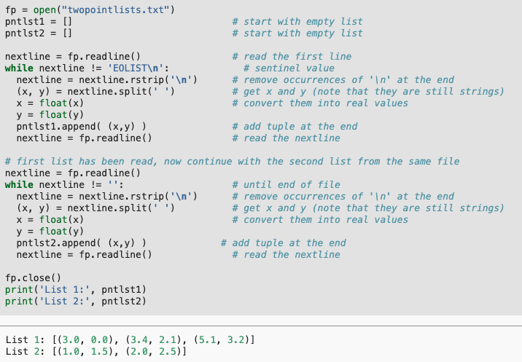
Termination of input
We can also use our own special “marker”
File contents:
3 0
3.4 2.1
5.1 3.2
EOLIST
1 1.5
2.0 2.5

Slide 17
Formatting Files
You can use the formatted strings to control the format of the strings you place in files:
<string>.format()
For example:
'{:10}, {:20}, {:3d}, {:f7.3}'.format('Han', 'Solo', 80, -0.2)'

Slide 18
Binary Files
A text file is human readable.
Each number is represented by the characters of the digits.
“3.1415926535897932384626433832795028” occupies 34 characters/bytes.
Content of a binary file is directly the binary representation of data
Number 3.1415926535897932384626433832795028 occupies 4 bytes on a 32-bit computer.
But the file is not human-readable.
Opening binary files: open(filename, ‘rb’) or open(filename, ‘wb’)
struct module should be used for creating and interpreting bytes

Slide 19
Examples
Read a CSV file
Dice game exercise:
https://pp4e-workbook.github.io/chapters/file_handling/dice_game.html

Slide 20
Final Words: Important Concepts
Sequential access. File access.
Text files. Reading and writing text files. Parsing a text file.
End of file, new line.
Formatting files.
Binary files and binary file access.

Slide 21
that’s all folks! Stay healthy

