Slide 1
CEng 240 – Spring 2021 Week 11
Sinan Kalkan
Error Handling & Debugging
Disclaimer: Figures without reference are from either from “Introduction to programming concepts with case studies in Python” or “Programming with Python for Engineers”, which are both co-authored by me.

Slide 2
Opening/closing files
Previously on CENG240!
Opening files:
open(filename, “r”) => open file for reading
open(filename, “w”) => open file for writing
open(filename, “a”) => open file for appending
Closing file:
fileobject.close()

Slide 3
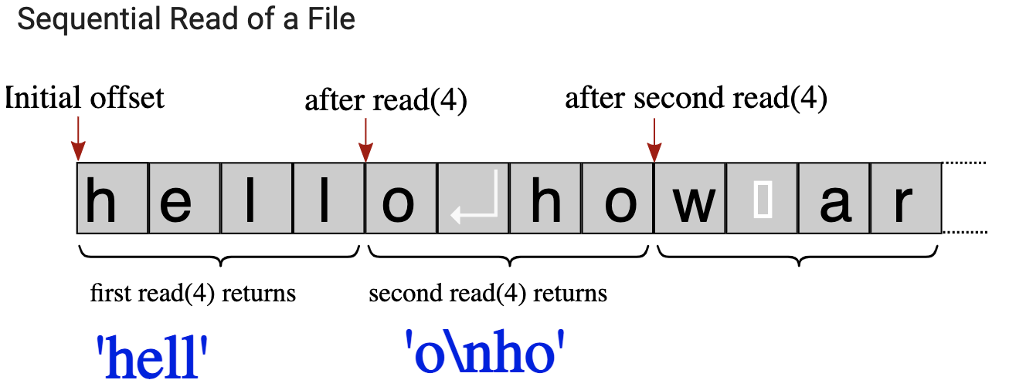
Files and Sequential Access
Previously on CENG240!
fp = open("firstexample.txt","r") # the example file we created above
for i in range(3): # repeat 3 times
content = fp.read(4) # read 4 bytes in each step
print("> ", content) # output 4 bytes preceded by >
fp.close()

Slide 4

Accessing Files Line by Line
Previously on CENG240!
pointlist = [(0,0), (10,0), (10,10), (0,10)]
fp = open("pointlist.txt", "w") # open file for writing fp.write(str(len(pointlist))) # write list length fp.write('\n’)
# Go over each point in the list
for (x,y) in pointlist: # for each x,y value in the list fp.write(str(x)) # write x
fp.write(' ') # space as number separator
fp.write(str(y)) # write y
fp.write('\n') # \n as line separator
fp.close()
Produces file
with content:

Slide 5
Accessing Files Line by Line
Previously on CENG240!
Read file with content:
fp = open("pointlist.txt") # open file for reading
nextline = fp.readline() # read the first line
while nextline != '': # while read is successful
print(nextline) # output the line
nextline = fp.readline() # read the nextline
fp.close() # when nextline == '' loop terminates

Slide 6
Termination of input
Previously on CENG240!
There are two ways to stop reading input:
By reading a definite number of items.
Call read() or readline() functions for a fixed number of times.
By the end of the file.
Continue to read() or readline() until they return empty string ‘’.
fp = open("pointlist.txt") # open file for reading
nextline = fp.readline() # read the first line
while nextline != '': # until end of file
... # Do something with the read line
nextline = fp.readline() # read the next line

Slide 7
This Week
Error handling and Debugging:
Kinds of errors
Exceptions
Debugging techniques

Slide 8
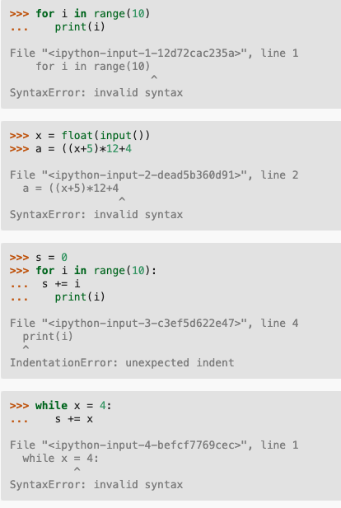
Error Types
Syntax errors
Type errors
Run-time errors
Logical errors

Slide 9
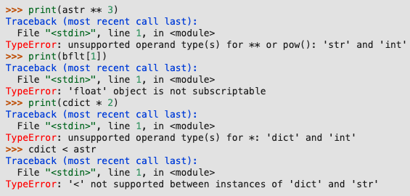
Error Types
Syntax errors
Type errors
Run-time errors
Logical errors

Slide 10
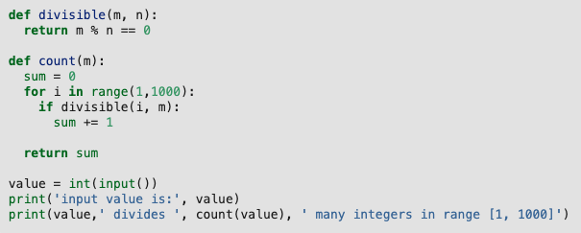
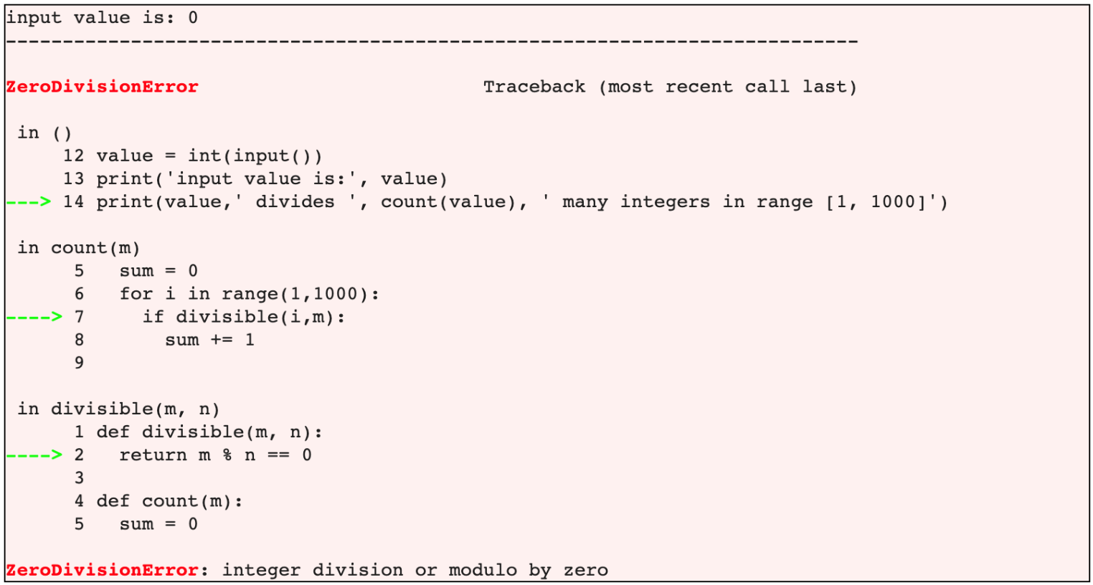
Error Types
Syntax errors
Type errors
Run-time errors
Logical errors

Slide 11
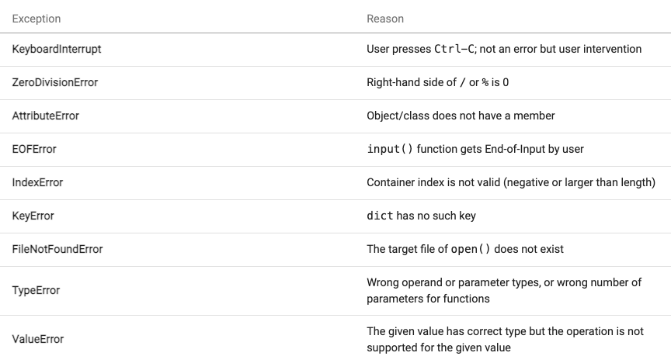
Exceptions

Slide 12
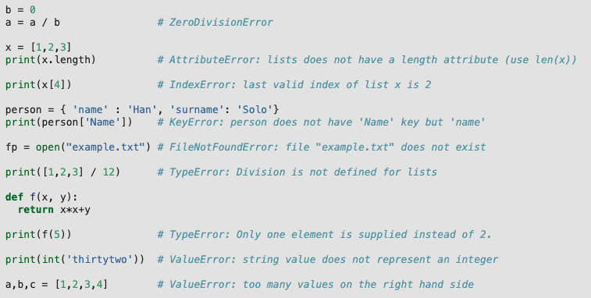
Exception Examples

Slide 13
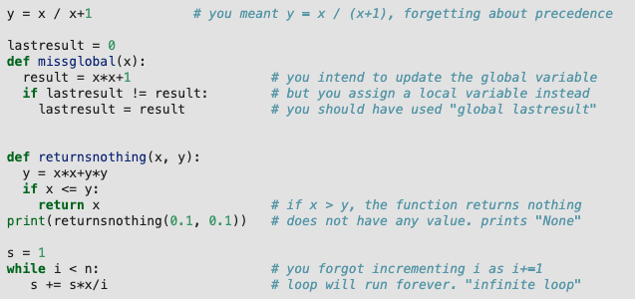
Error Types
Syntax errors
Type errors
Run-time errors
Logical errors

Slide 14
How to work with errors
Program with care
Place controls in your code
Handle exceptions
Write verification code & raise exceptions
Debug your code
Write test cases

Slide 15
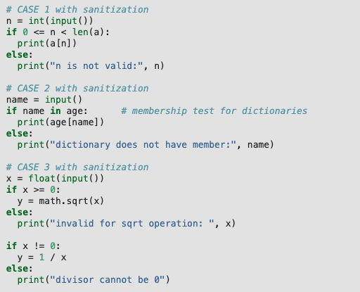
How to work with errors: (2) Place controls in your code

Slide 16
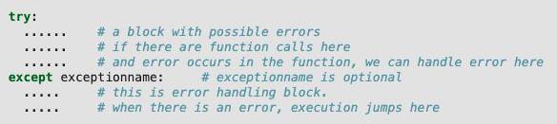
How to work with errors: (3) Handle Exceptions

Slide 17
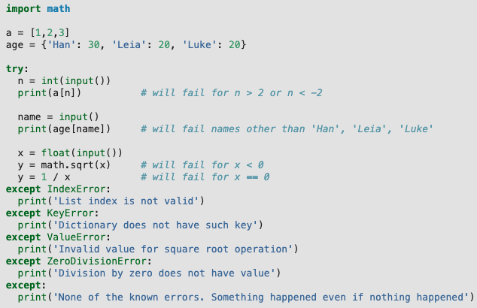
How to work with errors: (3) Handle Exceptions

Slide 18
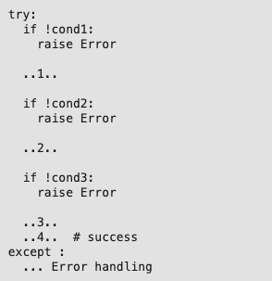
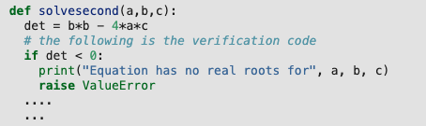
How to work with errors: (4) Write verification code and raise exception
You can raise exceptions
“raise Exception” => raise a generic exception

Slide 19

How to work with errors: (6) Write test cases

Slide 20
Debugging
Using debugging outputs
Handling exception and getting more info
Using debugger

Slide 21
Debugging: Using debugging outputs
The following code has a bug, how can we find it?
def sum_and_delete(L):
sum = 0
for i in range(len(L)):
sum += L[i]
del L[i]
return sum
sum_and_delete([1, 2, 3, 4, 5])

Slide 22
Debugging: Handling Exception to Get More Info
def sum_and_delete(L):
sum = 0
try:
for i in range(len(L)):
sum += L[i]
del L[i]
except:
print(f"i: {i} len(L): {len(L)}")
return sum
sum_and_delete([1, 2, 3, 4, 5])

Slide 23
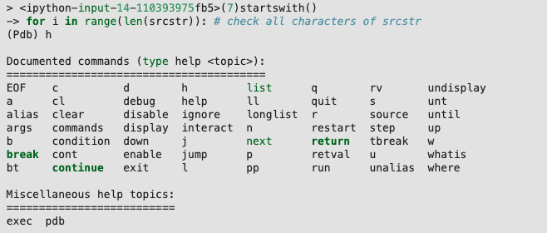
Debugging: Using debugger

Slide 24
Debugging: Using debugger
import pdb
def sum_and_delete(L):
sum = 0
pdb.set_trace()
for i in range(len(L)):
sum += L[i]
del L[i]
return sum
sum_and_delete([1, 2, 3, 4, 5])

Slide 25
Example
Calculate Discount Averages
https://pp4e-workbook.github.io/chapters/error_handling_and_debugging/calculate_discount_averages.html
Memento
https://pp4e-workbook.github.io/chapters/error_handling_and_debugging/memento.html

Slide 26
Final Words: Important Concepts
Different types of errors: Syntax, type, run-time and logical errors.
How to deal with errors.
Exceptions and exception handling.
Debugging by “printing” values, exception handling and a debugger.

Slide 27
that’s all folks! Stay healthy

