Slide 1
Accident Severity Prediction
Jayshree Rambhau Parate
Date: 6th April, 2025

Slide 2


INTRODUCTION
PROBLEM STATEMENT
STEPS INVOLVED
DATASET INFORMATION
EXPLOLATORY DATA ANALYSIS
MODEL BUILDING
CONCLUSION
Q&A
AGENDA

Slide 3
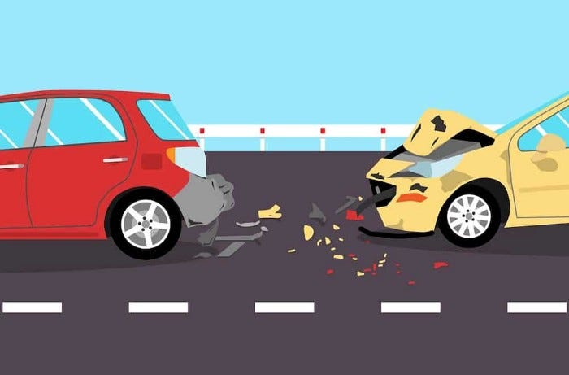
INTRODUCTION
Road accidents are a major public safety concern, leading to injuries and fatalities.
Predicting accident severity can help authorities take preventive measures.
Objective: Build a machine learning model to predict accident severity based on real-world data.

Slide 4
PROBLEM STATEMENT
Develop a robust Machine Learning model capable of accurately predicting Accident Severity, incorporating essential variables including Age, gender, Educational level, Driving experience, Type of vehicle', Service year of vehicle and many more.
This model will offer invaluable insights into the multifaceted factors influencing Accident Severity outcomes.
The objective is to construct a predictive framework that elucidates the interplay of diverse factors contributing to Severity, facilitating the maintenance of balanced Driving Experience, Age, gender, Type of Vehicle etc.

Slide 5







STEPS INVOLVED
Step 1: Importing all the necessary libraries
Step 1: Importing all the necessary libraries
Step 2: Importing the dataset
Step 3:
Data Preprocessing
Step 4: Exploratory Data Analysis
Step 5: Balancing imbalanced data using ‘SMOTE’
Step 6: Model Building
Step 7:
Model Deployment

Slide 6
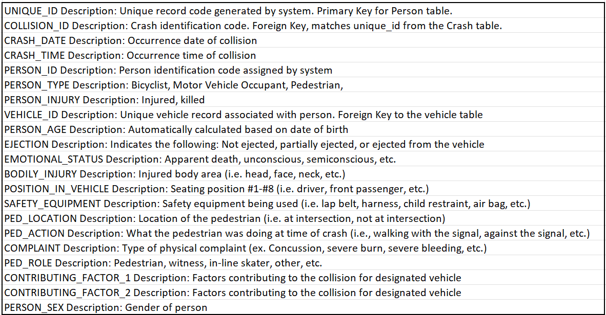
DATASET INFORMATION

Slide 7
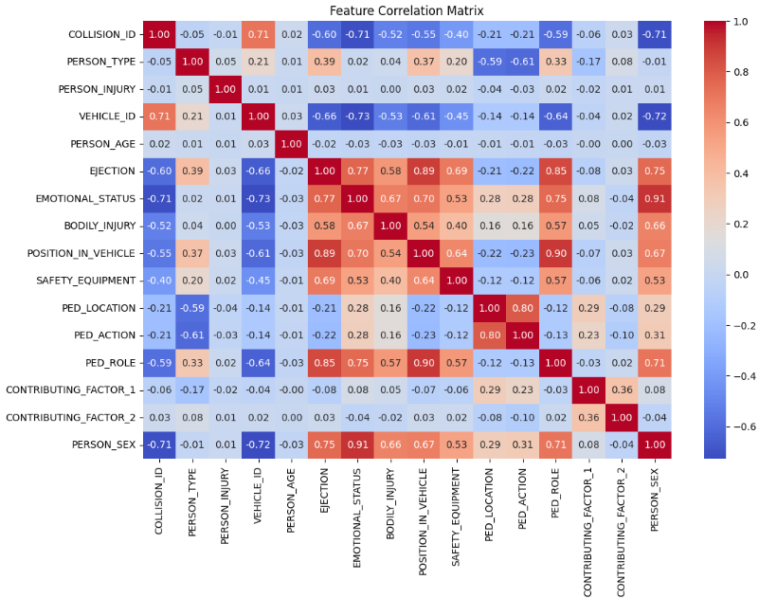
EXPLORATORY DATA ANALYSIS
Corelation
Heatmap

Slide 8
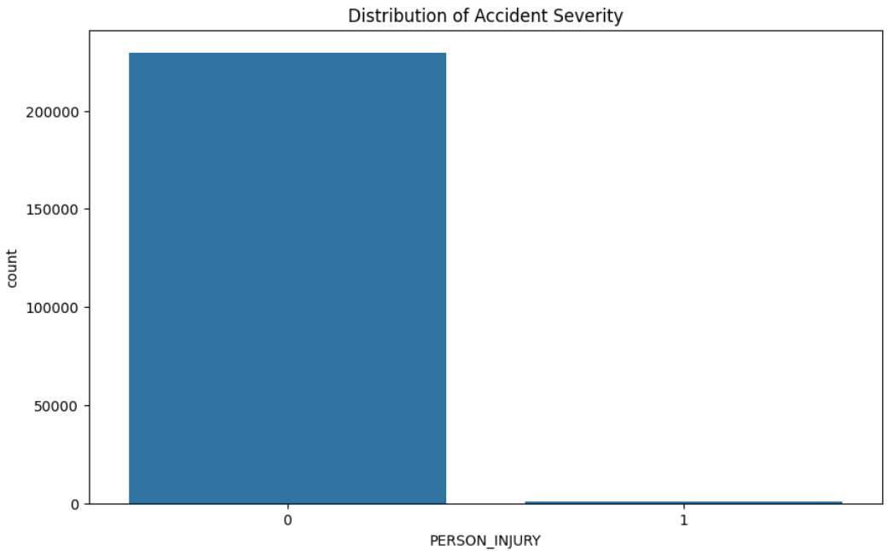
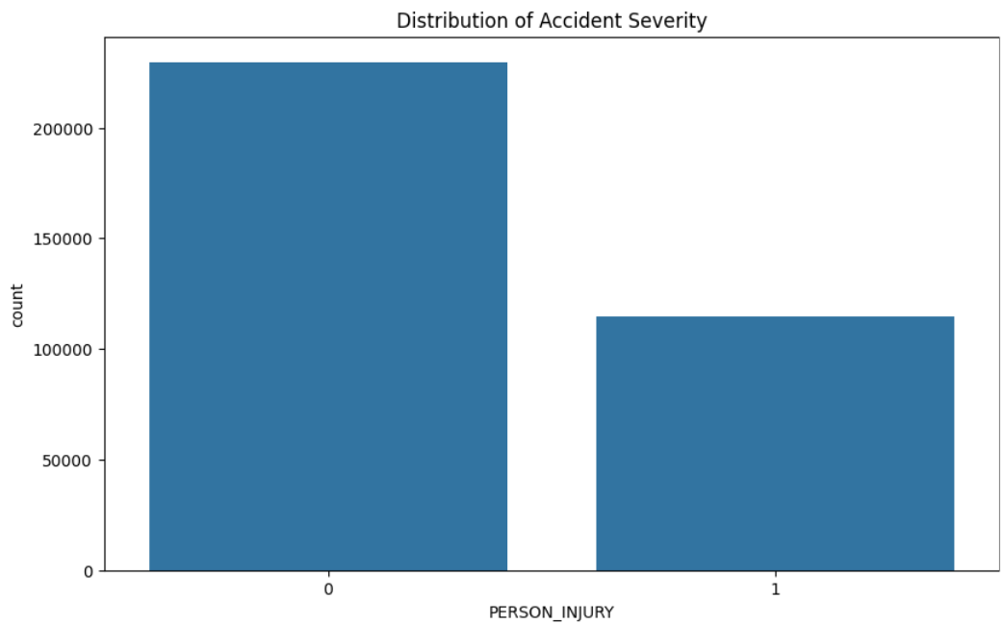
EXPLORATORY DATA ANALYSIS
Imbalanced Data before using ‘SMOTE’
Balanced Data after using ‘SMOTE’

Slide 9
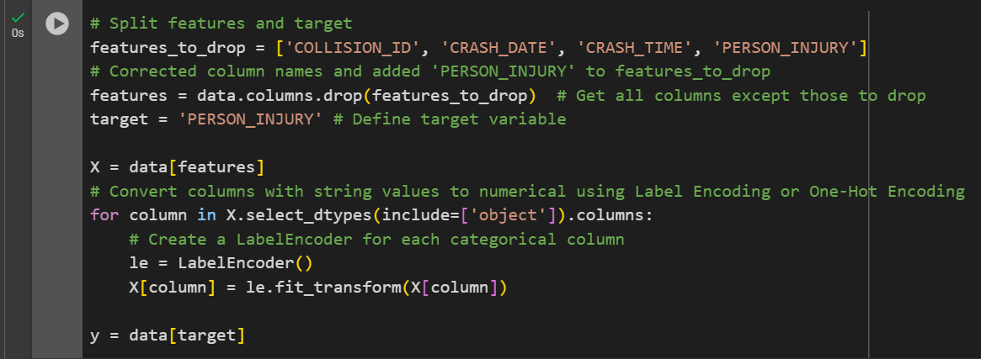
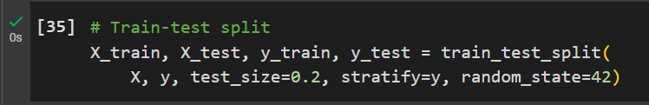
MODEL BUILDING
Splitting the data into X and y
Train-Test Split

Slide 10
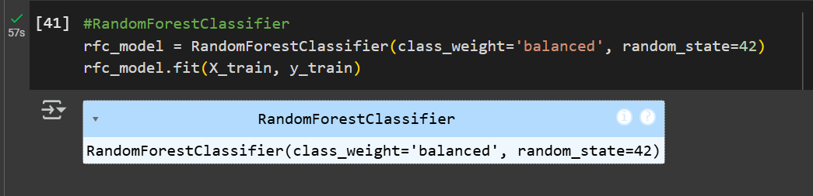
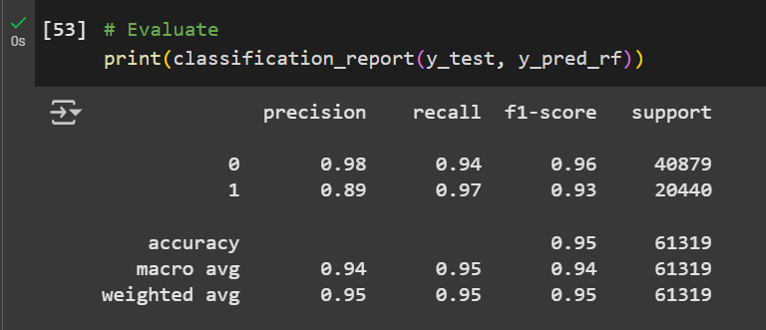
MODEL BUILDING
Random Forest Classifier
Classification Report

Slide 11
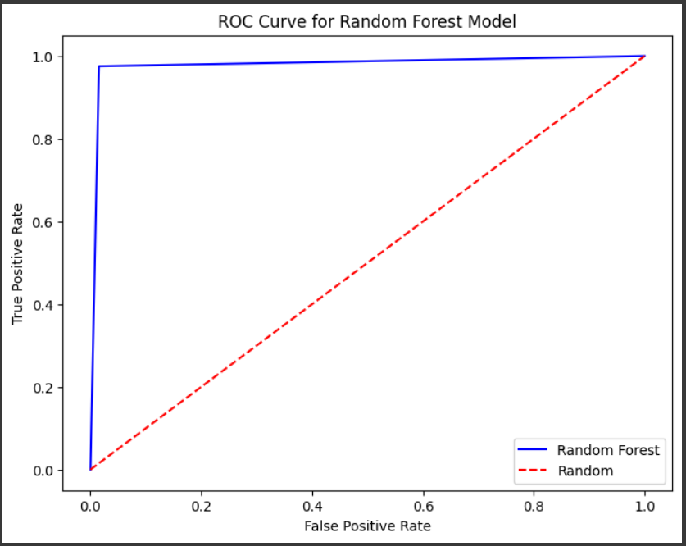
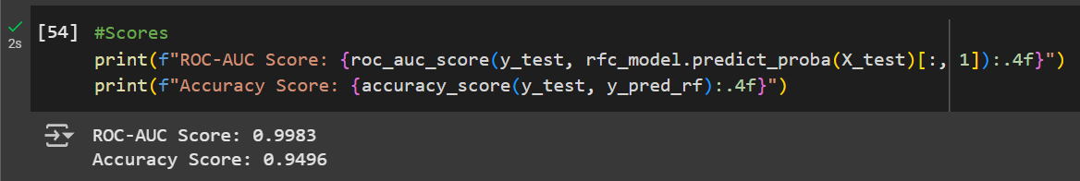
MODEL BUILDING
ROC Curve and AUC Score and Accuracy Score for Random Forest Classifier Model

Slide 12
CONCLUSION
Data Processing & Exploration: We identified correlations among various features and handled data imbalances using SMOTE to improve model performance.
Model Performance: The Random Forest classifier demonstrated strong predictive capabilities, achieving high accuracy and a well-balanced classification.
Practical Implications: The model provides valuable insights for policymakers and traffic authorities to implement preventive measures, such as improved road safety protocols and targeted driver awareness programs.

Slide 13
QUESTIONS?

Slide 14
Thank You!

