Slide 1
Predicting
Sleep Disorders
Jayshree Rambhau Parate
Date: 2nd May 2025

Slide 2


INTRODUCTION
PROBLEM STATEMENT
STEPS INVOLVED
DATASET OVERVIEW
EXPLOLATORY DATA ANALYSIS
MODEL BUILDING
FEATURE IMPORTANCE
CONCLUSION
Q&A
AGENDA

Slide 3

INTRODUCTION
Sleep is essential for physical and mental well-being.
Sleep disorders negatively affect productivity, health, and quality of life.
Early prediction can help prevent long-term health issues.
Goal: Use machine learning to predict whether a person suffers from Insomnia, Sleep Apnea, or None.

Slide 4






STEPS INVOLVED
Step 1: Importing all the necessary libraries
Step 1: Importing all the necessary libraries
Step 2: Importing the dataset
Step 3:
Data Preprocessing
Step 4: Exploratory Data Analysis
Step 5: Model Building
Step 6:
Model Deployment

Slide 5
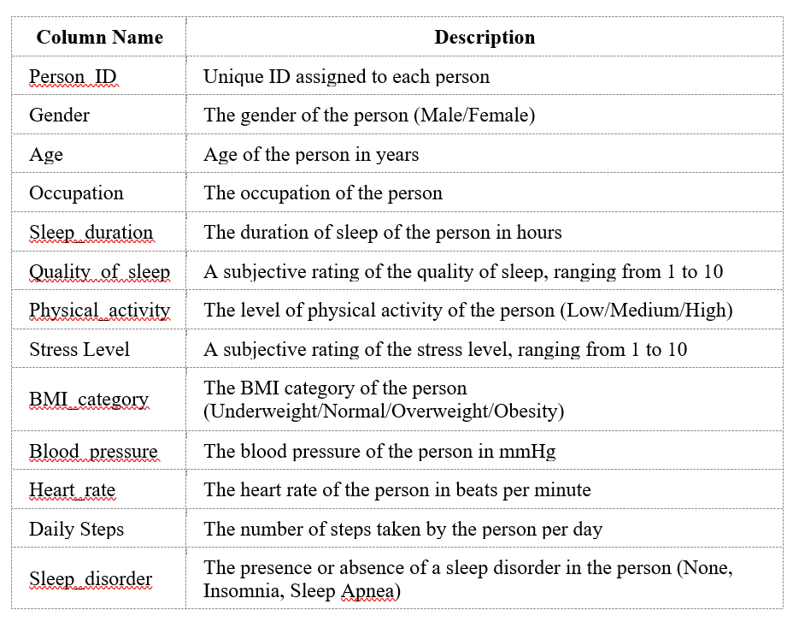
DATASET OVERVIEW

Slide 6
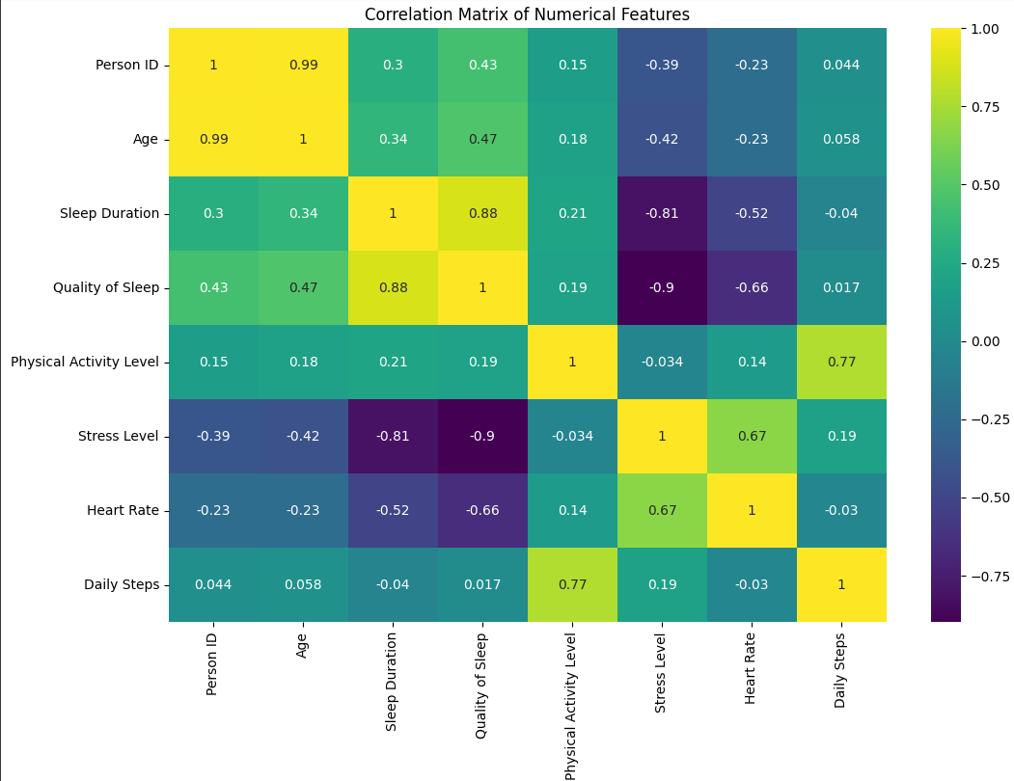
EXPLORATORY DATA ANALYSIS
Correlation Heatmap

Slide 7
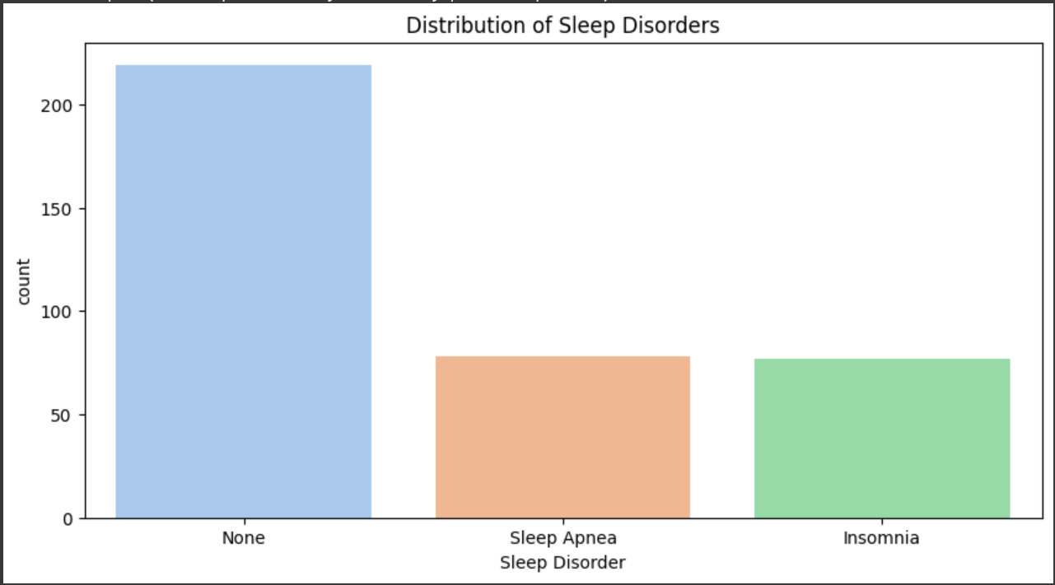
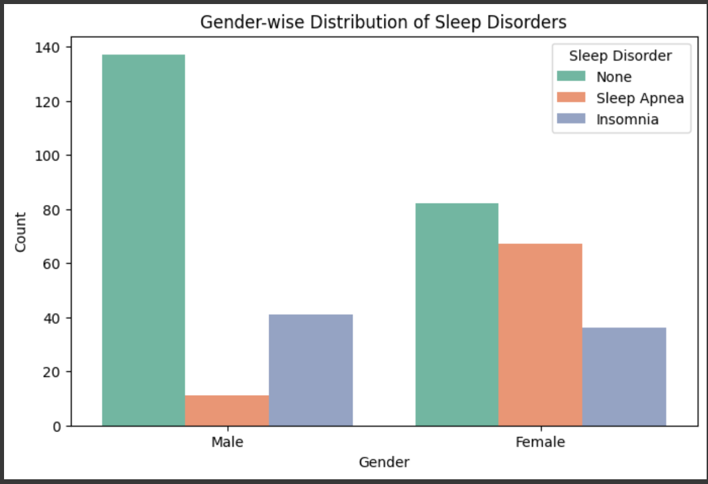
EXPLORATORY DATA ANALYSIS

Slide 8
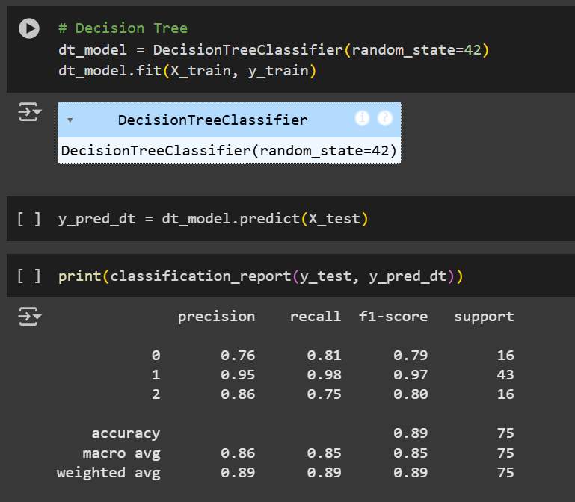
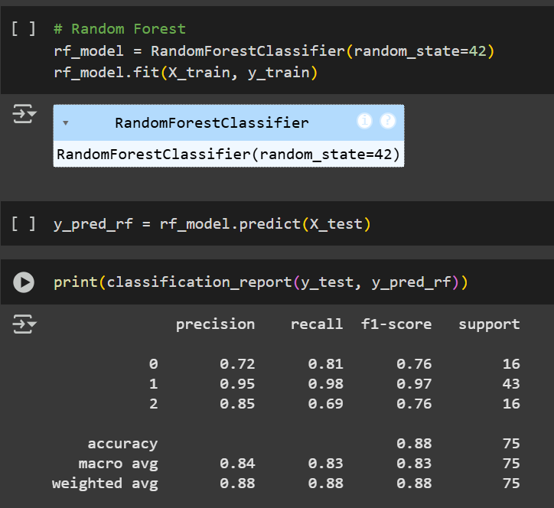
MODEL BUILDING
Random Forest Classifier
Decision Tree Classifier

Slide 9
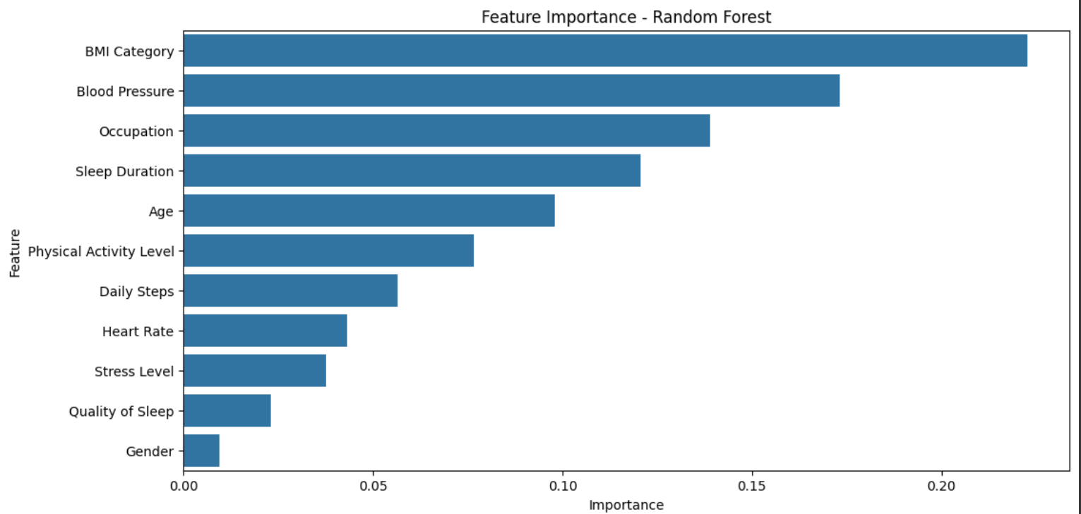
FEATURE IMPORTANCE

Slide 10
CONCLUSION
Developed a Machine Learning Model to Predict Sleep Disorders with ~88% Accuracy
Successfully implemented classification algorithms, with the Random Forest model achieving the best performance.
The model demonstrated high accuracy and reliability in distinguishing between Insomnia, Sleep Apnea, and None.
Evaluation metrics like precision, recall, and F1-score confirmed the model’s robustness for real-world application.
Feature importance analysis revealed that Stress Level, Sleep Duration, and BMI were the most significant predictors.
These factors showed strong relationships with the presence of sleep disorders, providing valuable insights into lifestyle and health influences.
Less influential features like Gender and Occupation contributed minimally to prediction, simplifying the focus for future models.

Slide 11
QUESTIONS?

Slide 12
Thank You!

