Slide 1
Prediction Product AD Campaign Performance
Jayshree Rambhau Parate
Date: 9th March, 2025

Slide 2


INTRODUCTION
STEPS INVOLVED
DATASET INFORMATION
EXPLOLATORY DATA ANALYSIS
VISUALIZATIONS
MODEL BUILDING
FEATURE IMPORTANCE
CONCLUSION
Q&A
AGENDA

Slide 3
INTRODUCTION
An advertising campaign is a set of advertisements that work together to promote a product or service. An ad campaign is designed around a specific and unique theme to create brand awareness about the company's product or service.
An advertising campaign can be a series of different individual ads or the same ad across mediums used to create awareness and interest in a product or service.
This is achieved through different forms of media, including radio, television, print advertising, direct mail, or the internet.
The intended objective of this project is to develop a robust supervised machine learning model designed to accurately forecasts key performance indicators (KPIs) for future product ad campaign. By achieving this goal, we aim to provide them with valuable insights that can inform strategic decision-making, optimize resource allocation, and enhance overall marketing effectiveness.

Slide 4






STEPS INVOLVED
Step 1: Importing all the necessary libraries
Step 1: Importing all the necessary libraries
Step 2: Importing the dataset
Step 3:
Data Preprocessing
Step 4: Exploratory Data Analysis
Step 6: Model Building
Step 7:
Model Deployment

Slide 5
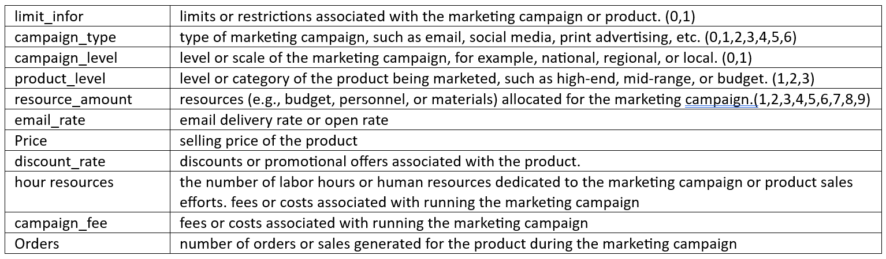
DATASET INFORMATION

Slide 6
EXPLORATORY DATA ANALYSIS
EDA is used to provides a provides a better understanding of data set variables and the relationships between them.
The dataset had no duplicates and 2 missing values in "price" which was 0.27% of total data. Hence, the rows with missing values were dropped.
While observing the relationship of numeric values with "orders", the campaign_fee had one outlier which was removed for a cleaner data.

Slide 7
EXPLORATORY DATA ANALYSIS
Correlation coefficient revealed that 'discount_rate' (0.232), email_rate' (0.628), 'hour_resouces' (0.664), and 'campaign_fee' (0.929) have positive correlations with 'orders'. 'price' (-0.103) has a weak negative correlation with 'orders'.
The ANOVA results provide insights into the relationship between each categorical variable and the numerical variable 'orders'. 'product_level' and 'resource_amount' appear to have a significant relationship with 'orders', while the other categorical variables do not.
To ensure consistent scales for numerical features, MinMax Scaler was employed during preprocessing.

Slide 8
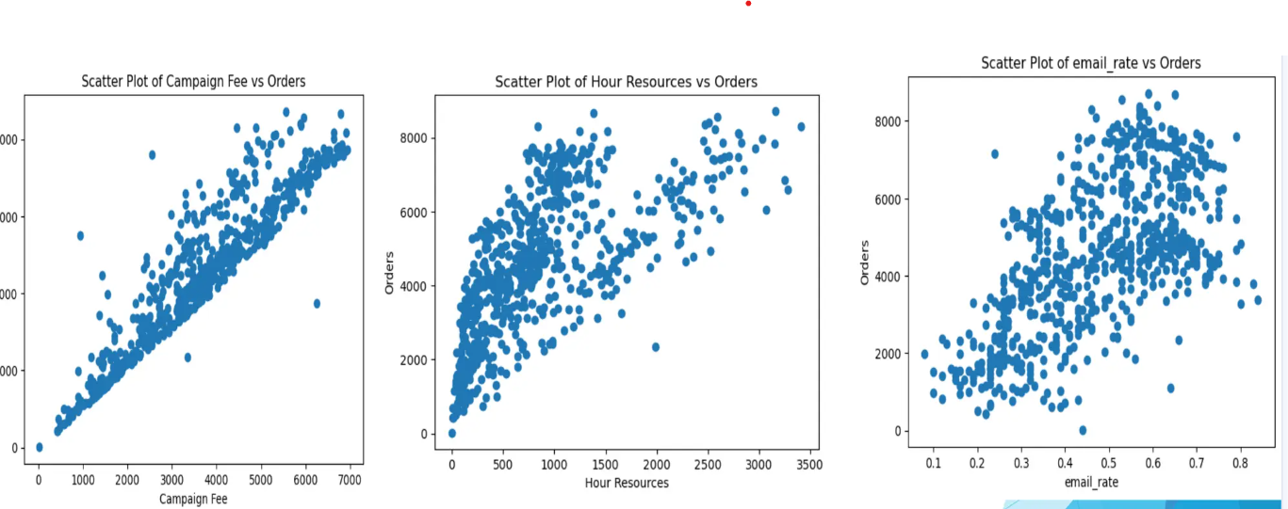
VISUALIZATIONS
The independent variables “campaing_fee” , “hour_resources” and “email_rate” have linear relationship with target variable “orders”

Slide 9
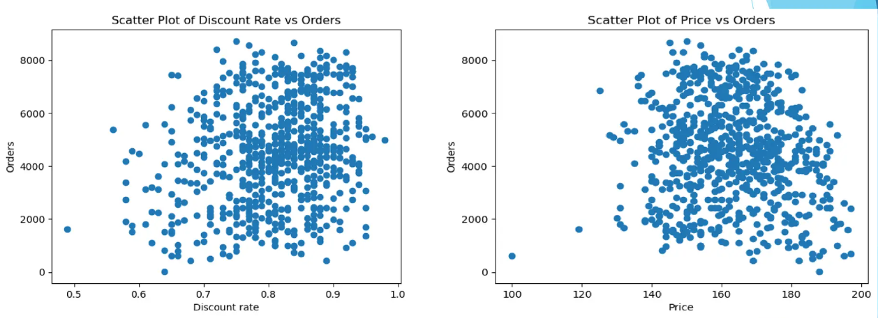
VISUALIZATIONS
The “discount_rate” have positive relationship with “orders”
There is a non-linear relationship between price and the number of orders

Slide 10
MODEL BUILDING
Splitting the data into X and y
In this step, we divided the dataset into two parts: X and y.
X contains all the independent variables, which are the features used to
make predictions.
Meanwhile, y represents the dependent variable or target variable, which is the outcome we want to predict.
Train-Test Split
The dataset was split into training and testing sets.
An 80:20 ratio was used, with 80% of the data allocated to training and 20% to testing, and the test size set to 0.2.
A random state of 42 was specified to ensure the reproducibility of results across different runs

Slide 11
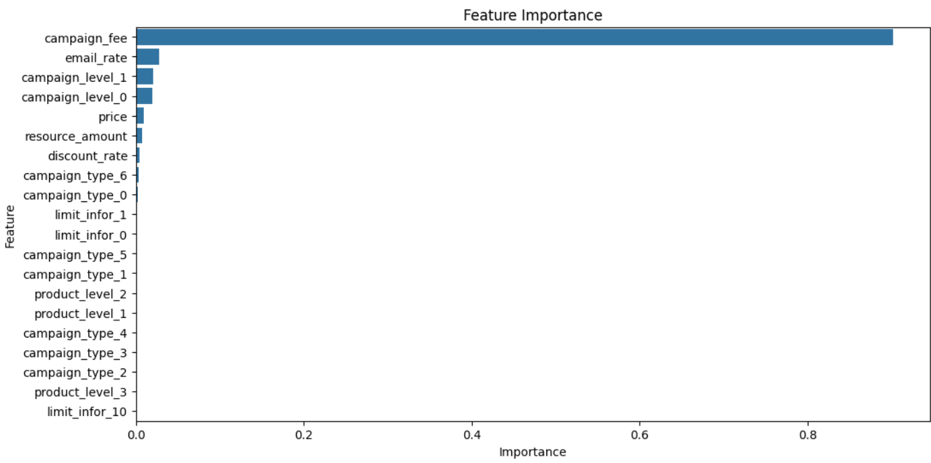
'campaign_fee' has the highest importance, 'hour_resources' have moderate importance and price have minimal importance compared to other two.
The remaining features (email_rate, discount_rate, campaign_type, resource_amount, product_level, campaign_level, limit_infor) have negligible importance in the model.
FEATURE IMPORTANCE

Slide 12
CONCLUSION
Campaign Fee and Hour Resources: Increasing campaign fees and allocating more resources positively influence the number of orders, suggesting that investments in these areas are likely to yield higher returns.
Pricing Strategy: Higher prices tend to reduce the number of orders. Therefore, maintaining competitive and minimal prices can attract more customers and boost sales.
Discount Rates: While higher discount rates can slightly increase the number of orders, their impact is minimal. This indicates that focusing primarily on pricing and resource allocation may be more effective than relying heavily on discounts.
Model Performance: Linear regression outperforms SVM and random forest regression due to the linear relationship between features and the target variable. This finding underscores the importance of using a simpler, well-suited model to avoid overfitting and ensure accurate predictions.
By leveraging these insights, the company can strategically allocate resources, optimize pricing, and fine-tune their ad campaigns to maximize effectiveness and improve the overall return on investment (ROI).

Slide 13
QUESTIONS?

Slide 14
Thank You!

