Slide 1
Website Traffic Forecasting
Jayshree Rambhau Parate
Date: 08th June 2025

Slide 2


INTRODUCTION
PROJECT OVERVIEW
STEPS INVOLVED
DATA OVERVIEW
DATA PREPROCESSING
DATA EXPLORATION
MODEL BUILDING
MODEL EVALUATION
CONCLUSION
Q&A
AGENDA

Slide 3

INTRODUCTION
Why Website Traffic Forecasting?
Crucial for content planning, server resource management, and marketing.
Helps businesses respond proactively to user behavior and demand.
Scope of the Project:
Develop a predictive model to forecast website page loads.
Utilize historical trends and behavioral features.

Slide 4
PROJECT OVERVIEW
Objective:
Accurately forecast daily website traffic using hybrid ML and time series techniques.
Client Goal:
Improve planning, optimize content strategy, and allocate resources more effectively.
Approach:
Combine SARIMA for seasonality and ML (Random Forest) for feature-rich forecasting.
Outcome:
Accurate traffic prediction and trend insights.

Slide 5






STEPS INVOLVED
Step 1: Importing all the necessary libraries
Step 1: Importing all the necessary libraries
Step 2: Importing the dataset
Step 3:
Data Preprocessing
Step 4: Exploratory Data Analysis
Step 5: Model Building
Step 6:
Model Evaluation

Slide 6
DATA OVERVIEW
Features:
Temporal: Date, Day, Day.Of.Week
Target: Page.Loads
Behavioral: Unique.Visits, First.Time.Visits, Returning.Visits
Row: Index of the data point
Day: Day of the month
Day.Of.Week: Day of the week
Date: Full date of the traffic data
Page.Loads: Number of page loads (target variable)
Unique.Visits: Number of unique visitors
First.Time.Visits: Number of first-time visitors
Returning.Visits: Number of returning visitors

Slide 7
DATA PREPROCESSING
Handled missing values and ensured datetime consistency
Created lag features (Page.Loads(t-1), Page.Loads(t-7))
Engineered rolling averages to smooh fluctuations
Split dataset: 70% training, 30% testing

Slide 8
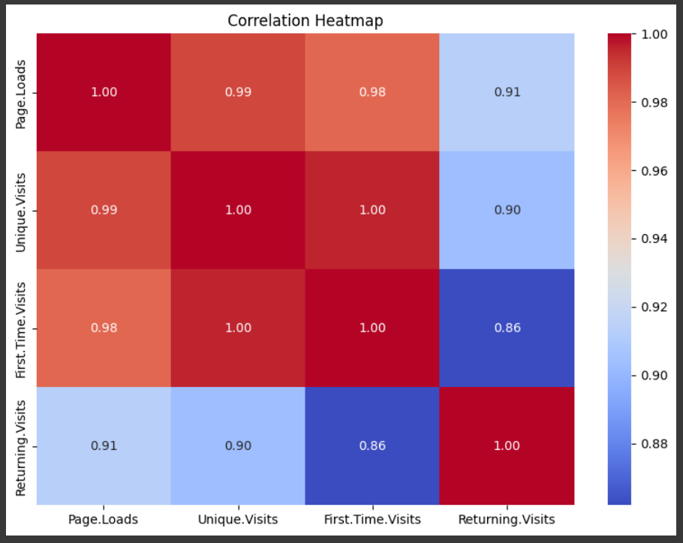
DATA EXPLORATION
Corelation
Heatmap

Slide 9
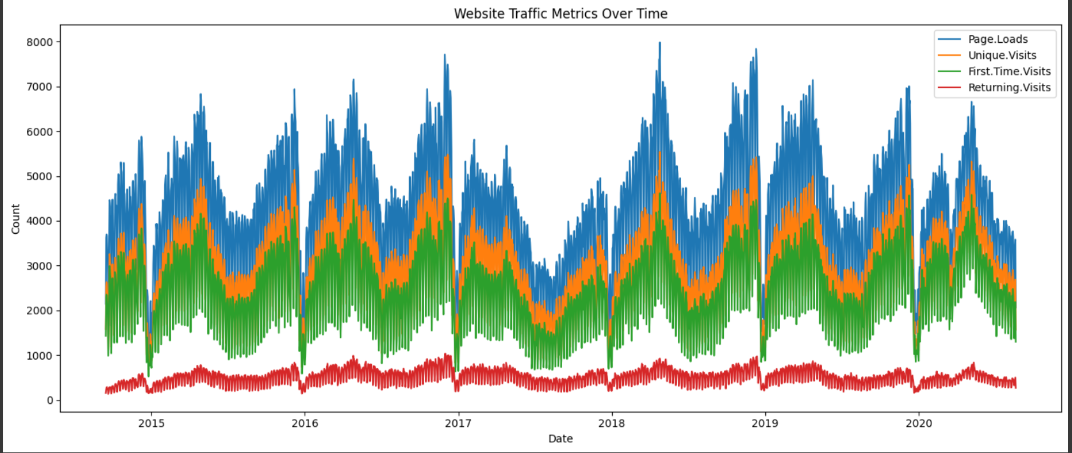
DATA EXPLORATION

Slide 10
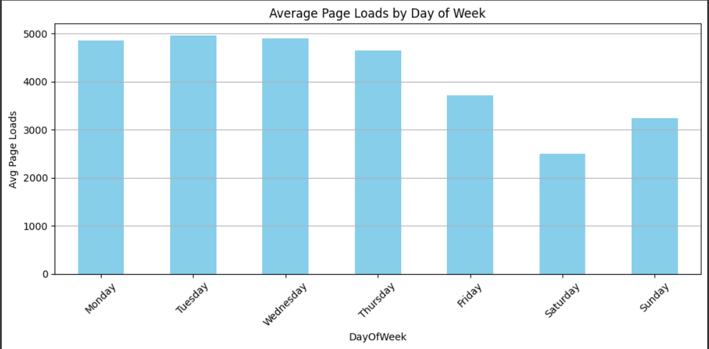
DATA EXPLORATION

Slide 11
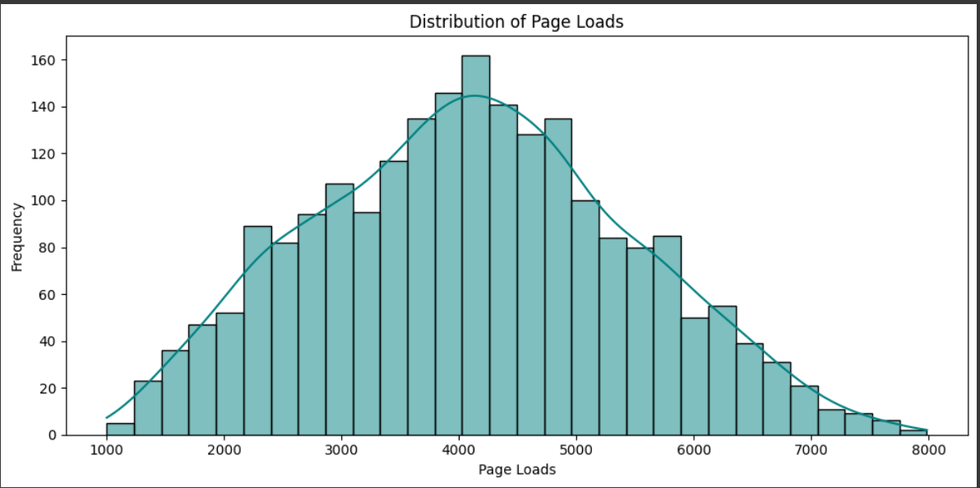
DATA EXPLORATION

Slide 12
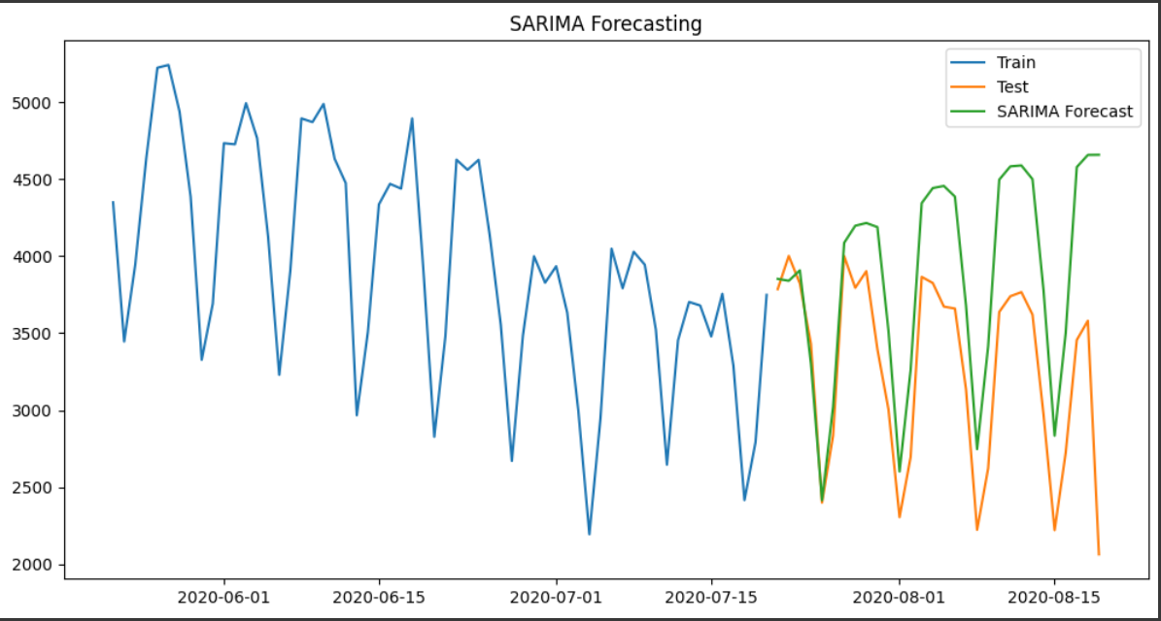
MODEL BUILDING
SARIMA Model
Captures trend, seasonality, and residuals
Order: (1,1,1), Seasonal: (1,1,1,7)

Slide 13
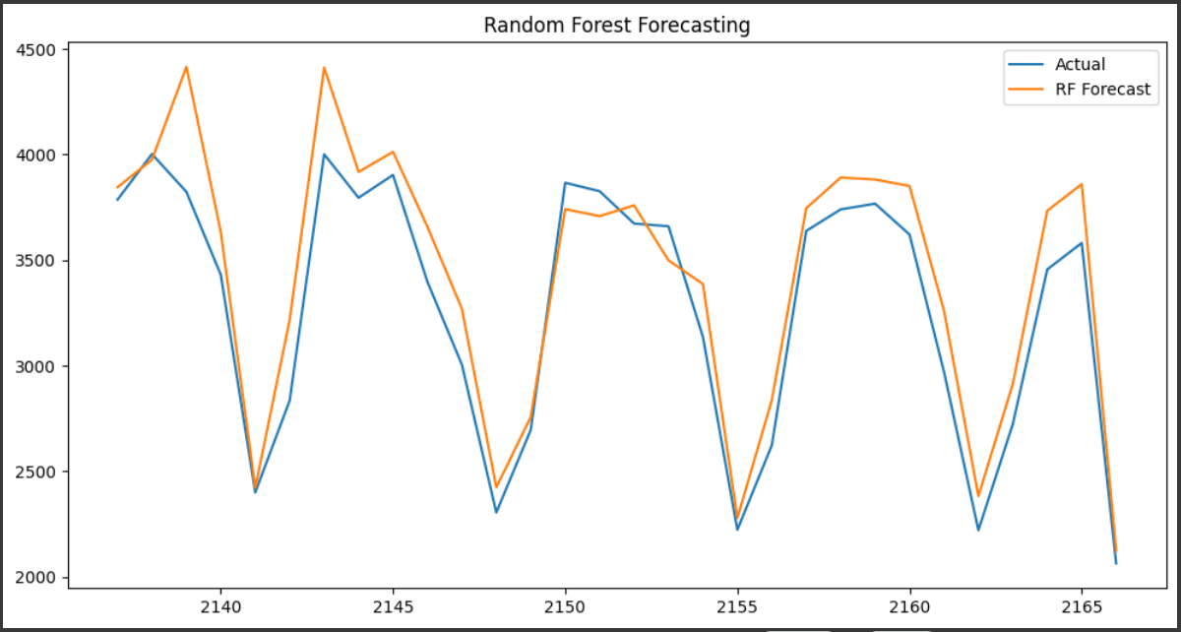
MODEL BUILDING
Random Forest Regressor
Trained with behavioral and lag features
Captures complex interactions not visible to SARIMA

Slide 14
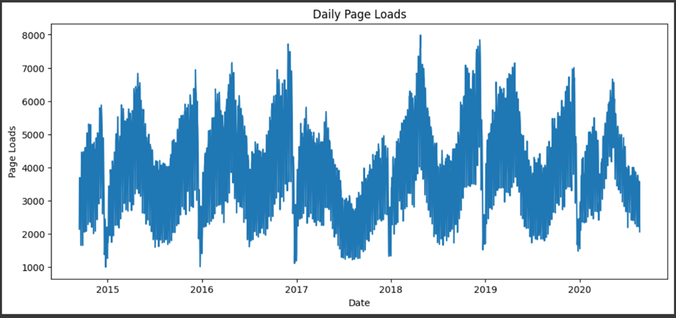
MODEL EVALUATION
Evaluation Metrics:
SARIMA:
RMSE: 780.74
MAPE: : 20.62%
Random Forest:
RMSE: 221.46
MAPE: 5.63%

Slide 15
CONCLUSION
The hybrid approach using SARIMA (for time-dependent trends & seasonality) and Random Forest Regressor (for behavioral patterns) delivered robust and accurate website traffic forecasts.
SARIMA efficiently modeled weekly and seasonal fluctuations in user activity.
Random Forest leveraged visitor metrics (Unique, Returning, First-Time Visits) to capture hidden, non-linear relationships.
This model helps in:
Content scheduling based on expected traffic.
Server load planning to ensure smooth user experience.
Marketing strategy optimization through traffic pattern awareness.
The combination outperformed single-model approaches by reducing RMSE and improving interpretability.

Slide 16
QUESTIONS?

Slide 17
Thank You!

