Slide 1
Smart Maintenance System for Industrial IoT
Jayshree Venkatesvaran

Slide 2
System Architecture
• Telemetry ingestion (IoT Hub or simulated events)
• Stateful Predictor Agent (Python)
• Azure AI Search (RAG evidence retrieval)
• Deterministic/SK-ready Planner
• Alerting module
• Azure AI Foundry (Model hosting + project runtime)

Slide 3
Agent Design
• Predictor Agent → Risk scoring, stateful history
• RAG Retriever → Queries Azure AI Search index
• Planner Agent → Generates workflow & procedures
• Alert Agent → Threshold-based alerting
• Orchestrator → Coordinates all tools & produces report

Slide 4
End-to-End Workflow
1. Telemetry event received
2. Predictor computes risk (stateful logic)
3. Risk ≥ threshold → RAG retrieval from AI Search
4. Planner generates steps, safety, ETA, rollback
5. Alert module triggers high-risk alerts
6. Orchestrator compiles final maintenance report

Slide 5
Responsible AI & Compliance
• Transparent, risk based logic
• Source-traceable evidence from Azure Search
• Deterministic plan = auditable and reproducible
• Human-in-loop alert escalation possible

Slide 6
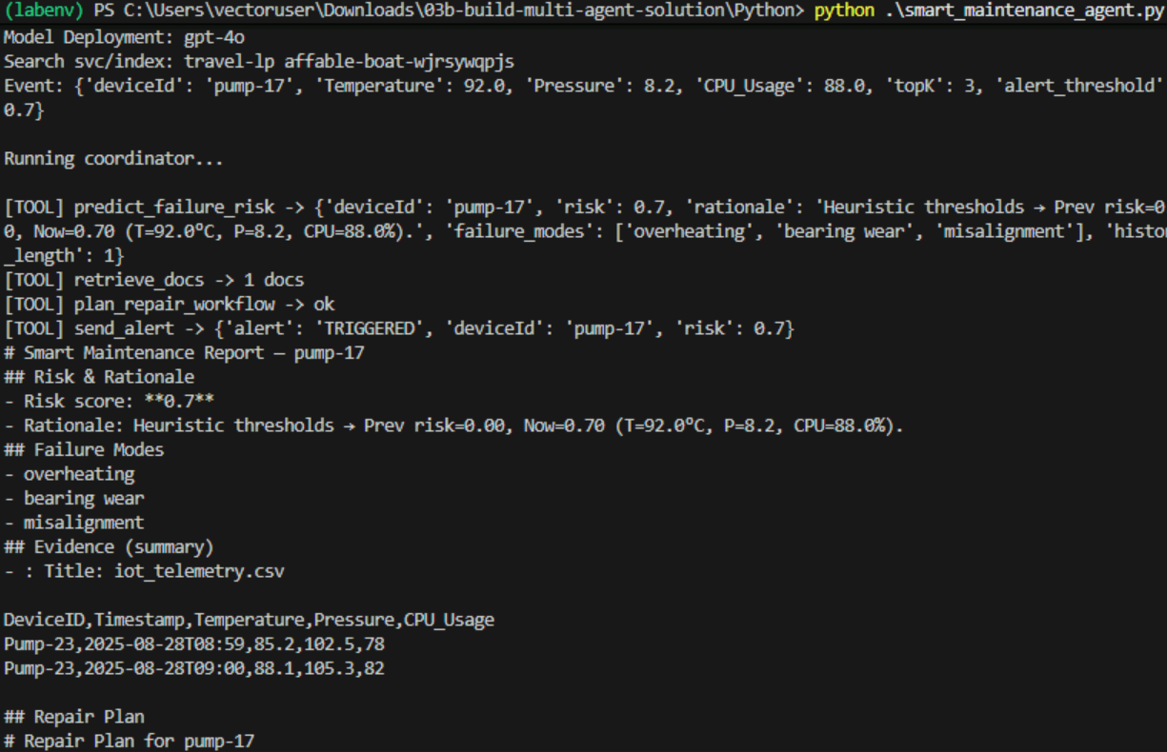
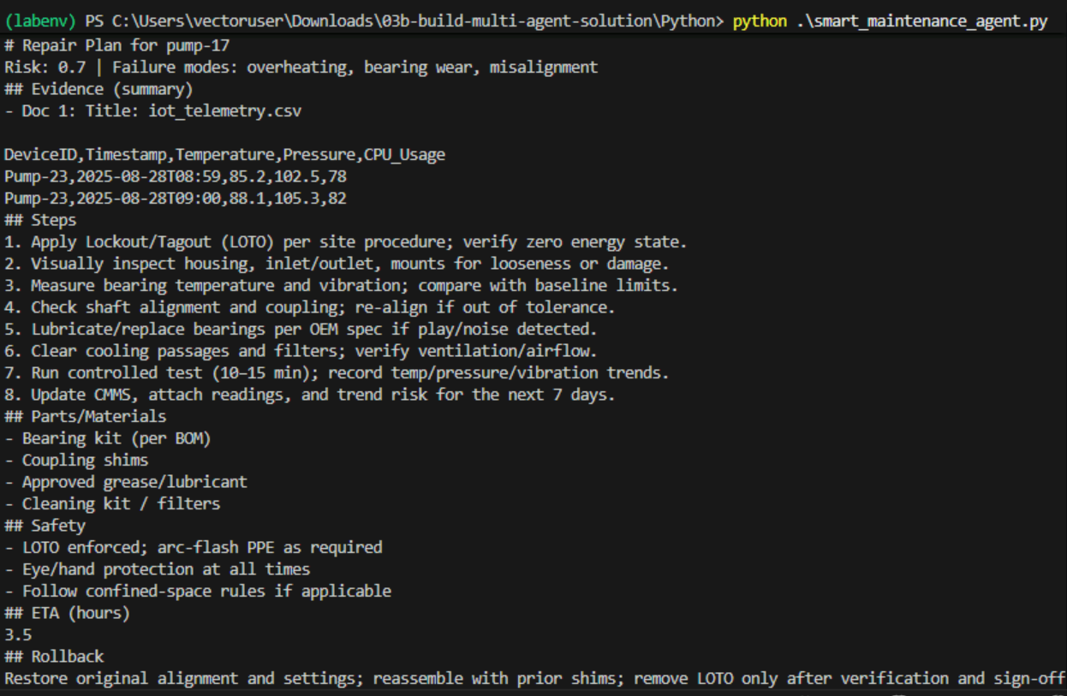
Screenshot evidence
Output screenshot

Slide 7
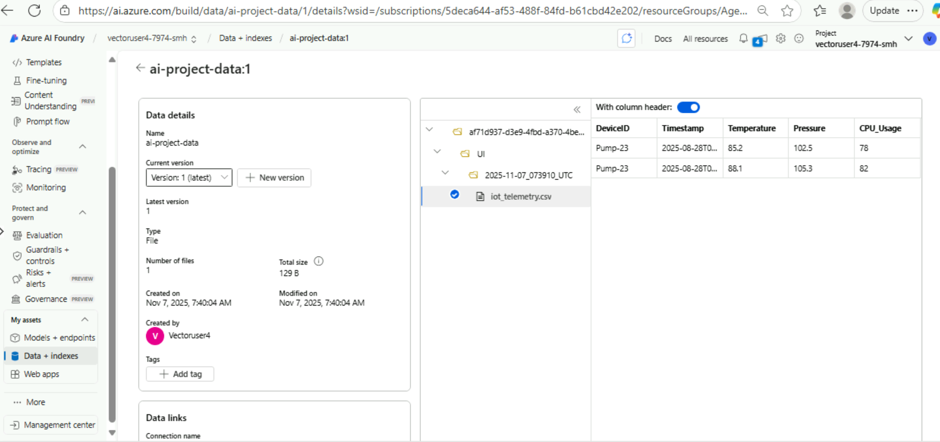
Screenshot evidence
Index screenshot

