Slide 1
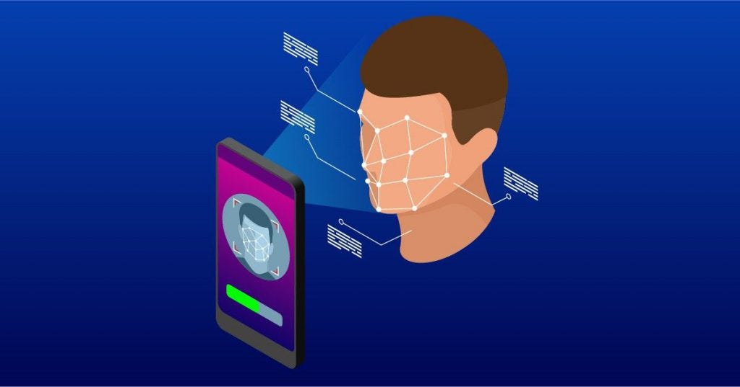
ATTENDANCE SYSTEM USING FACE RECOGNITION

Slide 2
TEAM MEMBERS:
VEDANT UPADHYAY(220002081)
JAY SOLANKI(220001033)
LALIT(220001042)

Slide 3




MODEL WE USE
FEATURE COLLECTION
Image collection
Feature Extraction
Database
INFERENCE
PERSON NAME
New Image
Feature Extraction
Machine Learning Algorithm

Slide 4
ADVANTAGES OF THIS MODEL
Less Samples Required
No Model retrain for new person
Good Accuracy
Low processing Time

Slide 5
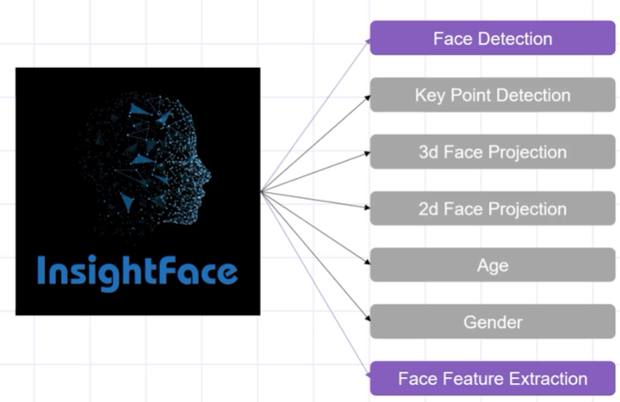
Note:
We use buffalo_l model of Insightface for Face Detection in this project
Why Insightface?
Used in project

Slide 6
FLOW CHART OF OUR PROJECT
Step-III:
Build The Web APP
Step-II:
Step-I:
Integrate to DataBase
Feature Extraction And ML Search Algorithm

Slide 7
Step-I:
Feature Extraction And ML Search Algorithm
We get the images of students from the drive.
2. Get the facial features using Insightface Model.
3. Use the machine learning cosine similarity method to test the results.

Slide 8

COSINE SIMILARITY METHOD OF COMPARING FACES
Cosine similarity is a metric used to measure the similarity of two vectors. Specifically, it measures the similarity in the direction or orientation of the vectors ignoring differences in their magnitude or scale. Both vectors need to be part of the same inner product space, meaning they must produce a scalar through inner product multiplication. The similarity of two vectors is measured by the cosine of the angle between them.

Slide 9
Step-II:
Integrate To Database
Get mean of all the facial features of different images of the student.
2. Convert the facial features in form of bytes.
We use redis database in our project.
3. Store the facial features in the database.
In the database we store the facial features using HASHMAP Data Structure

Slide 10
WHY WE USE HASHMAP?
We found the Hashes best store our data because “WE WOULD BE ABLE TO STORE THE PERSON NAME AND FACIAL FEATURES IN THE SAME HASHES. ALSO, WE CAN RETREIVE THE VALUES ACCORDING TO THE KEY IN O(1) TIME COMPLEXITY.”

Slide 11
OTHER IMPORTANT LIBRARIES USED
OPENCV-PYTHON
1. Used for detecting face in the images.
2. Filtering images in the given photo.
3. Helps us to bound faces in photo, write text in image etc.

Slide 12
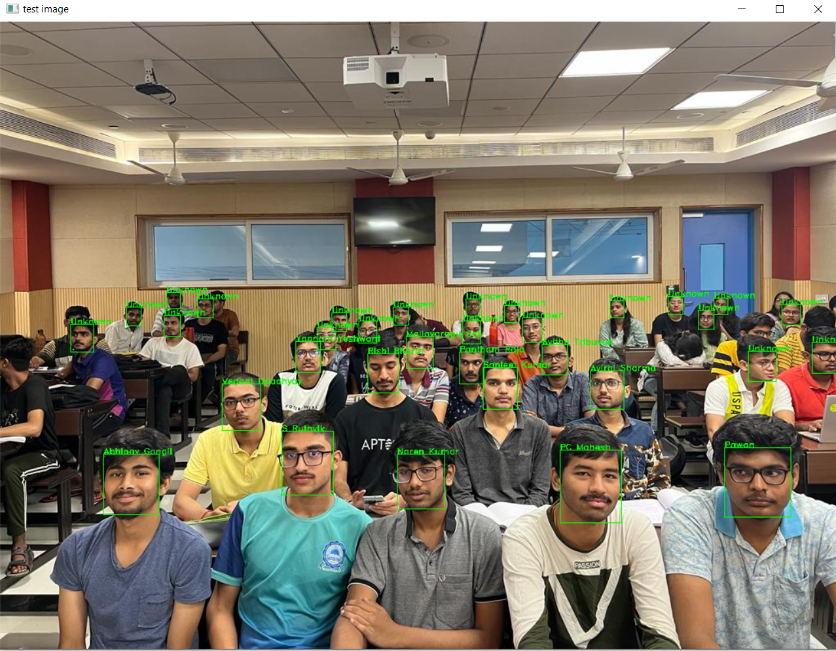
SAMPLE OUTPUT

Slide 13
This is where we left last time

Slide 14
Now comes the third step
Building our Web App
“We use Stremalit for building our web app”
Advantages of using streamlit
1. It embraces Python scripting.
2. Less code is needed to create a beautiful application.
3. No callbacks are needed since widgets are treated as variable.
4. Data caching simplifies and speeds up computation pipelines

Slide 15
Our Web App comes up with three pages:
Real Time Face Detection
Reports
Home
We come to know if all the modules are loaded properly or not
We get the attendance report of all the students on this page.
We can see the results of the photo on this page.

Slide 16
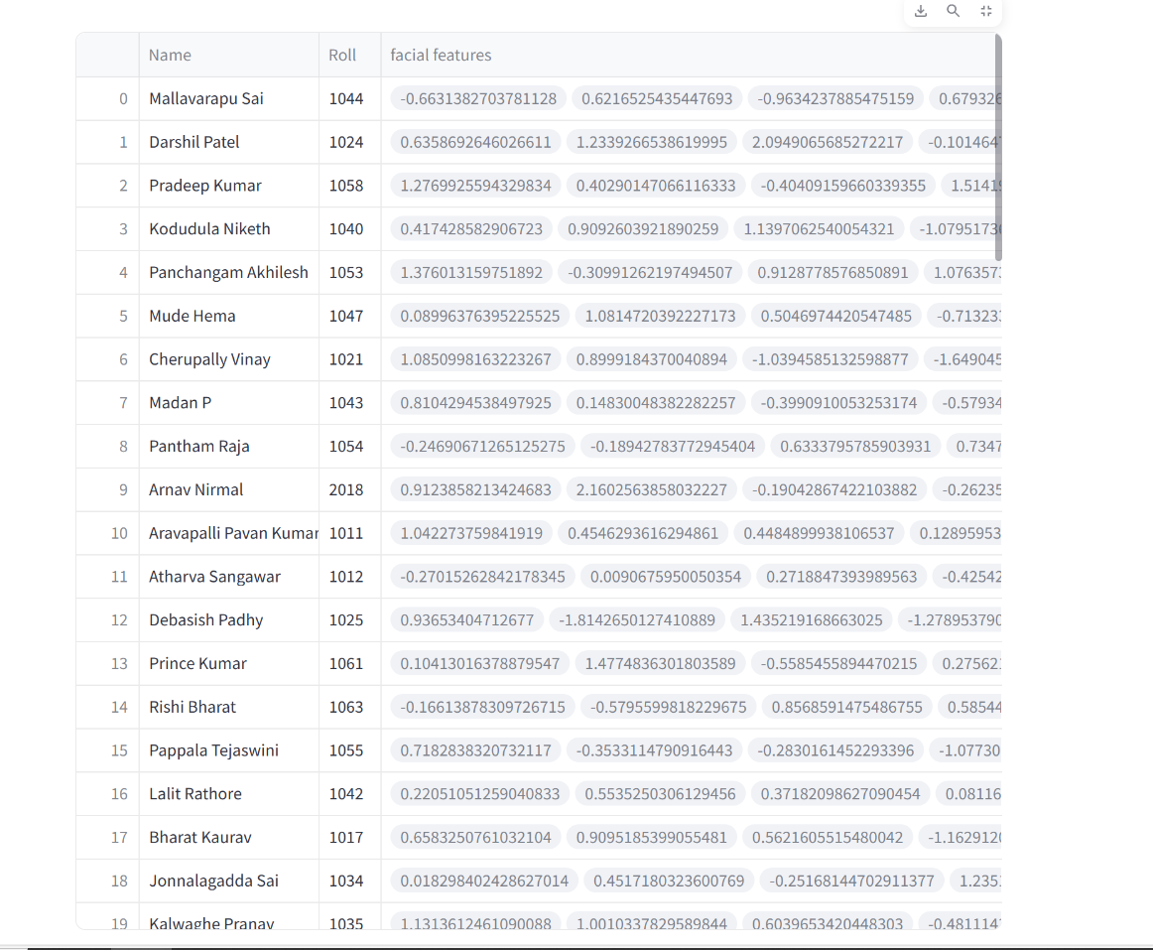
Our database
You can clearly see after retriving the information
from our
database the entries are in random order , which proves that we have used hashmap data structure in our database

Slide 17
Improvements we did after mid-evaluation
“In order to improve the accuracy we shifted from buffalo_sc model which provides 73% accuracy for South-Asian people to buffalo_l model which provides 93% accuracy for the South-Asian people.”
“We extended our model to video also. Yet not implemented we would show running our video camera and detecting the faces.”

Slide 18
Key Challenges Faced
1. Choosing appropriate model, maintaining proper balance in “accuracy” and “time and size of the model”.
2. Choosing a data structure for storing data in the database.

Slide 19
Further Improvements
1. Integrate a web camera to the app. To improve the scope of this app. We have build a rough design for it.
2. We can also integrate in-time and out-time in the app. Which would give us a proper information when the student is coming or not.
3. In the near future we also plan to integrate a registration form in the app , which can add details in case a new student comes to the class

Slide 20
THANK YOU!

