Slide 1

PEOPLE | SAFETY | QUALITY | PROGRESS

Slide 2
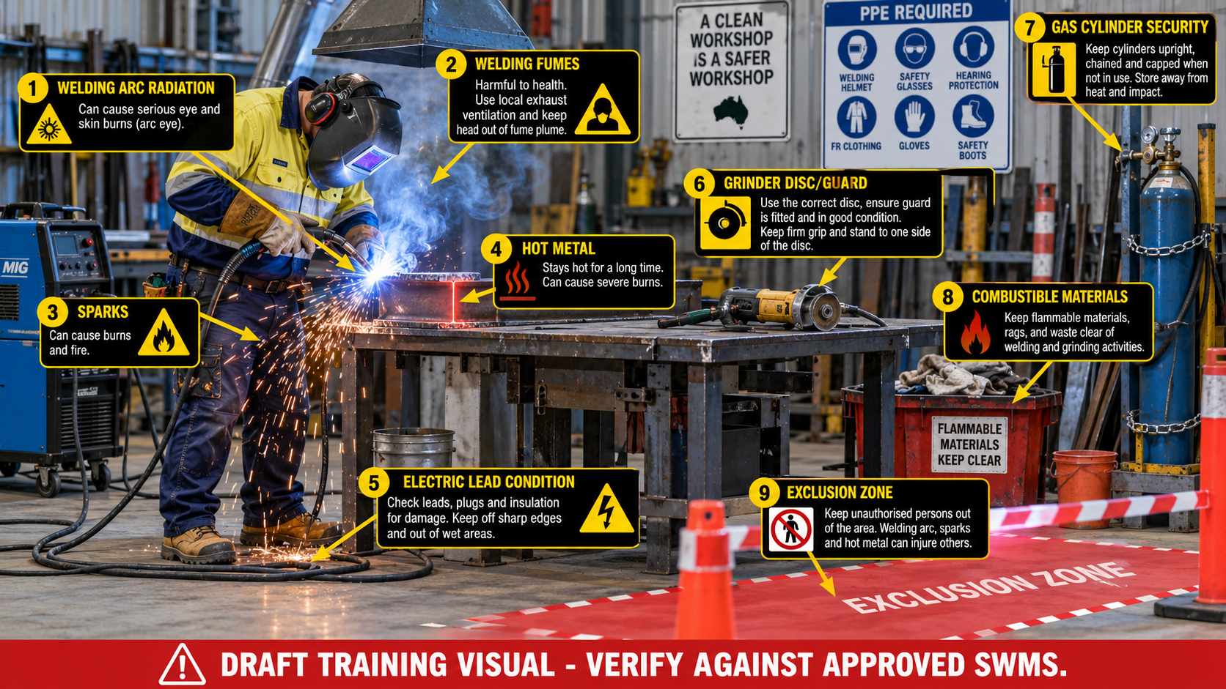
Why hot work control matters
Hot work can injure people, damage property and create non-conformance if controls are missed
HOT WORK CREATES MULTIPLE RISKS AT ONCE
• Arc radiation can injure eyes and skin and affect nearby workers.
• Welding fumes and airborne contaminants must be controlled at source where practicable.
• Sparks, slag and hot metal can ignite combustible material or cause burns.
• Defective leads, grinders, discs or gas systems can cause serious incidents.
• Poor traceability, wrong WPS or missing records can affect quality and compliance.
Note: hot work must be planned, controlled, monitored and recorded — not treated as routine.
PP-TRN-WLD-001 | Hot Work: MIG Welding and Grinding Safety | Draft Rev 1 | VERIFY BEFORE CONTROLLED ISSUE
2/20

Slide 3
Learning objectives
At the end of training, the employee should be able to...
• Identify key hot-work hazards for MIG welding, grinding and hot metal handling.
• Explain when SWMS, JSA, permit, fire watch, ventilation and exclusion controls are required.
• Inspect PPE, welding equipment, electrical leads, gas cylinders and grinders before use.
• Apply stop-work authority when conditions change or controls cannot be maintained.
• Understand the online knowledge check and onsite competency verification process.
Competency requires knowledge, correct behaviour and supervisor verification.
PP-TRN-WLD-001 | Hot Work: MIG Welding and Grinding Safety | Draft Rev 1 | VERIFY BEFORE CONTROLLED ISSUE
3/20

Slide 4
What counts as hot work?
Panalo Pipes activities that can create ignition sources, fumes or heat-related hazards
WELDING
MIG/GMAW, SMAW/MMAW, TIG/GTAW, tack welding
GRINDING
Angle grinding, cutting discs, surface preparation
THERMAL CUTTING
Oxy-fuel cutting, heating, gouging, plasma cutting where used
HOT METAL HANDLING
Newly welded/grinded parts, slag, hot workpieces
SPARK-PRODUCING TASKS
Any activity that can ignite combustibles or expose nearby people
Treat the task as hot work whenever heat, sparks, flames, molten metal, arc radiation or ignition sources may be produced.
PP-TRN-WLD-001 | Hot Work: MIG Welding and Grinding Safety | Draft Rev 1 | VERIFY BEFORE CONTROLLED ISSUE
4/20

Slide 5
Panalo Pipes requirements for hot work
The training must link safety, quality, environment and document control
CONTROLLED DOCUMENTS
COMPETENCY
CONSULTATION
RECORDS
✓ Current SWMS/JSA
✓ Procedure or client method
✓ Latest revision only
✓ Worker sign-on recorded
✓ Induction completed
✓ Task training completed
✓ Licences/tickets checked
✓ Onsite observation where required
✓ Toolbox talk before work
✓ Hazards discussed
✓ Changes reported
✓ Workers can stop work
✓ Training result
✓ Permit / SWMS sign-on
✓ Inspection checks
✓ Incident, NCR or corrective action
If the activity is not documented, communicated and verified, it is not controlled under the IMS.
PP-TRN-WLD-001 | Hot Work: MIG Welding and Grinding Safety | Draft Rev 1 | VERIFY BEFORE CONTROLLED ISSUE
5/20

Slide 6
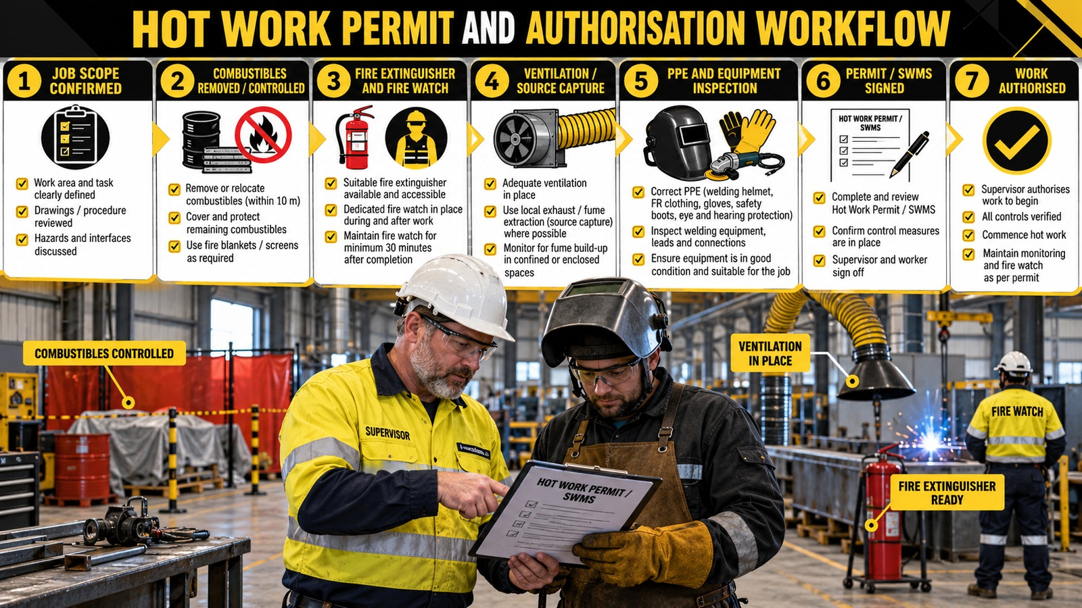
Hot work permit and authorisation workflow
Use this as the visual walkthrough before starting work
PP-TRN-WLD-001 | Hot Work: MIG Welding and Grinding Safety | Draft Rev 1 | VERIFY BEFORE CONTROLLED ISSUE
6/20

Slide 7
SWMS / JSA control focus
A SWMS supports higher-order controls and confirms how critical controls will be monitored
Work step
Critical hazard
Control required
Verify before start
Prepare area
Fire / nearby workers
Remove or protect combustibles; set screens and exclusion zone
Combustibles clear; barrier visible
Set up welding
Fumes / arc / electrical
LEV or ventilation; welding screen; inspect leads and earth return
Extractor positioned; leads undamaged
Grind / cut
Disc failure / sparks
Correct disc, guard, handle, PPE, spark direction controlled
Disc rating OK; guard fitted
Gas use
Cylinder fall / leak / fire
Secure upright; check hoses, regulators and segregation
No leak or damage; cylinders chained
Change in work
Uncontrolled new risk
Stop, make safe, notify, reassess and update SWMS/JSA
Supervisor authorises restart
A SWMS is not just a form — workers must understand, apply and monitor the controls.
PP-TRN-WLD-001 | Hot Work: MIG Welding and Grinding Safety | Draft Rev 1 | VERIFY BEFORE CONTROLLED ISSUE
7/20

Slide 8
Hazard hotspot review
PP-TRN-WLD-001 | Hot Work: MIG Welding and Grinding Safety | Draft Rev 1 | VERIFY BEFORE CONTROLLED ISSUE
8/20

Slide 9
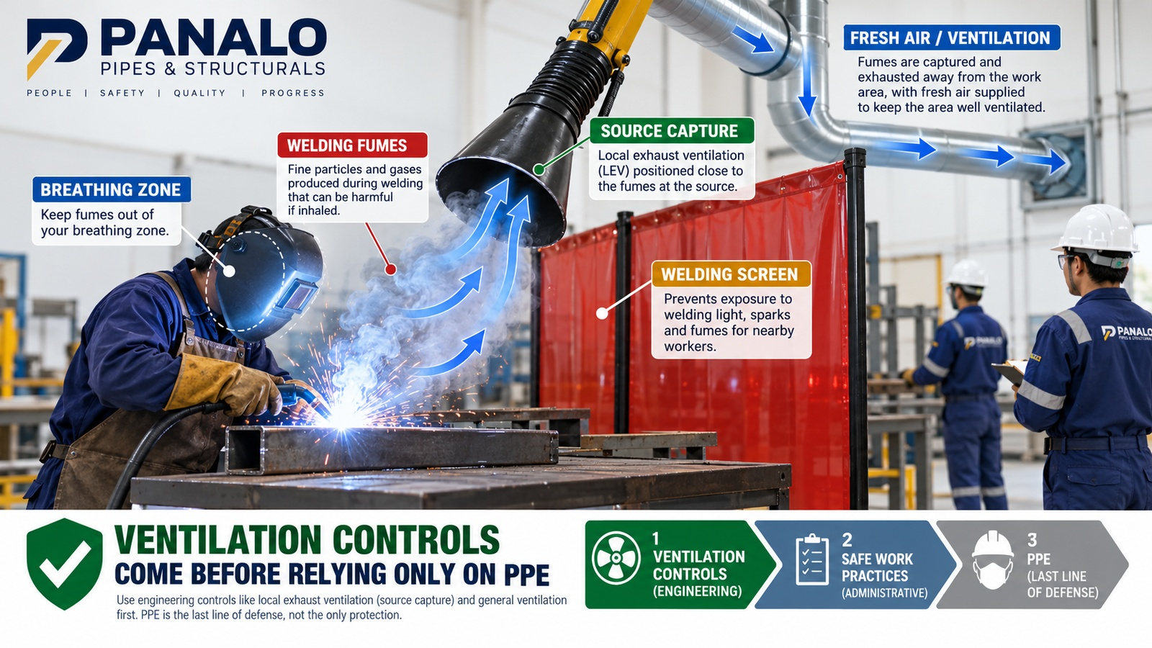

Welding fumes and ventilation controls
Control exposure at source before relying on respiratory PPE alone
PP-TRN-WLD-001 | Hot Work: MIG Welding and Grinding Safety | Draft Rev 1 | VERIFY BEFORE CONTROLLED ISSUE
9/20

Slide 10
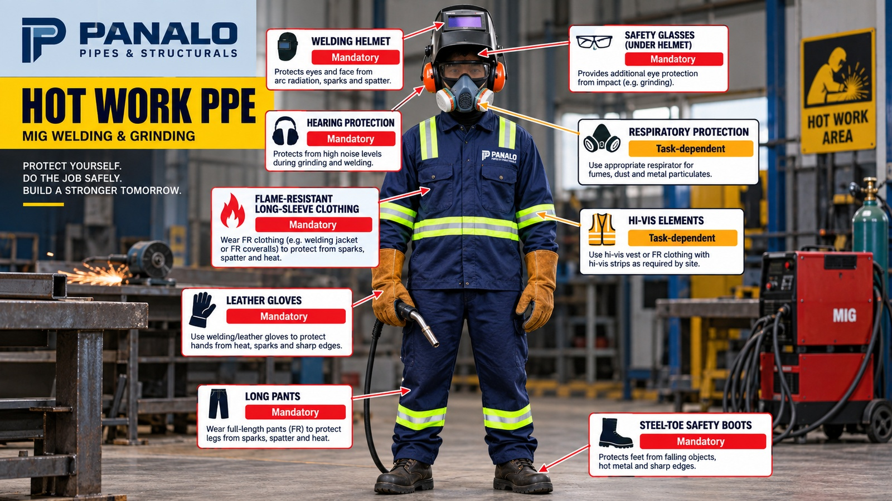
Hot work PPE requirements
PPE is the final barrier — it must be selected, fitted, inspected and worn correctly
PP-TRN-WLD-001 | Hot Work: MIG Welding and Grinding Safety | Draft Rev 1 | VERIFY BEFORE CONTROLLED ISSUE
10/20

Slide 11
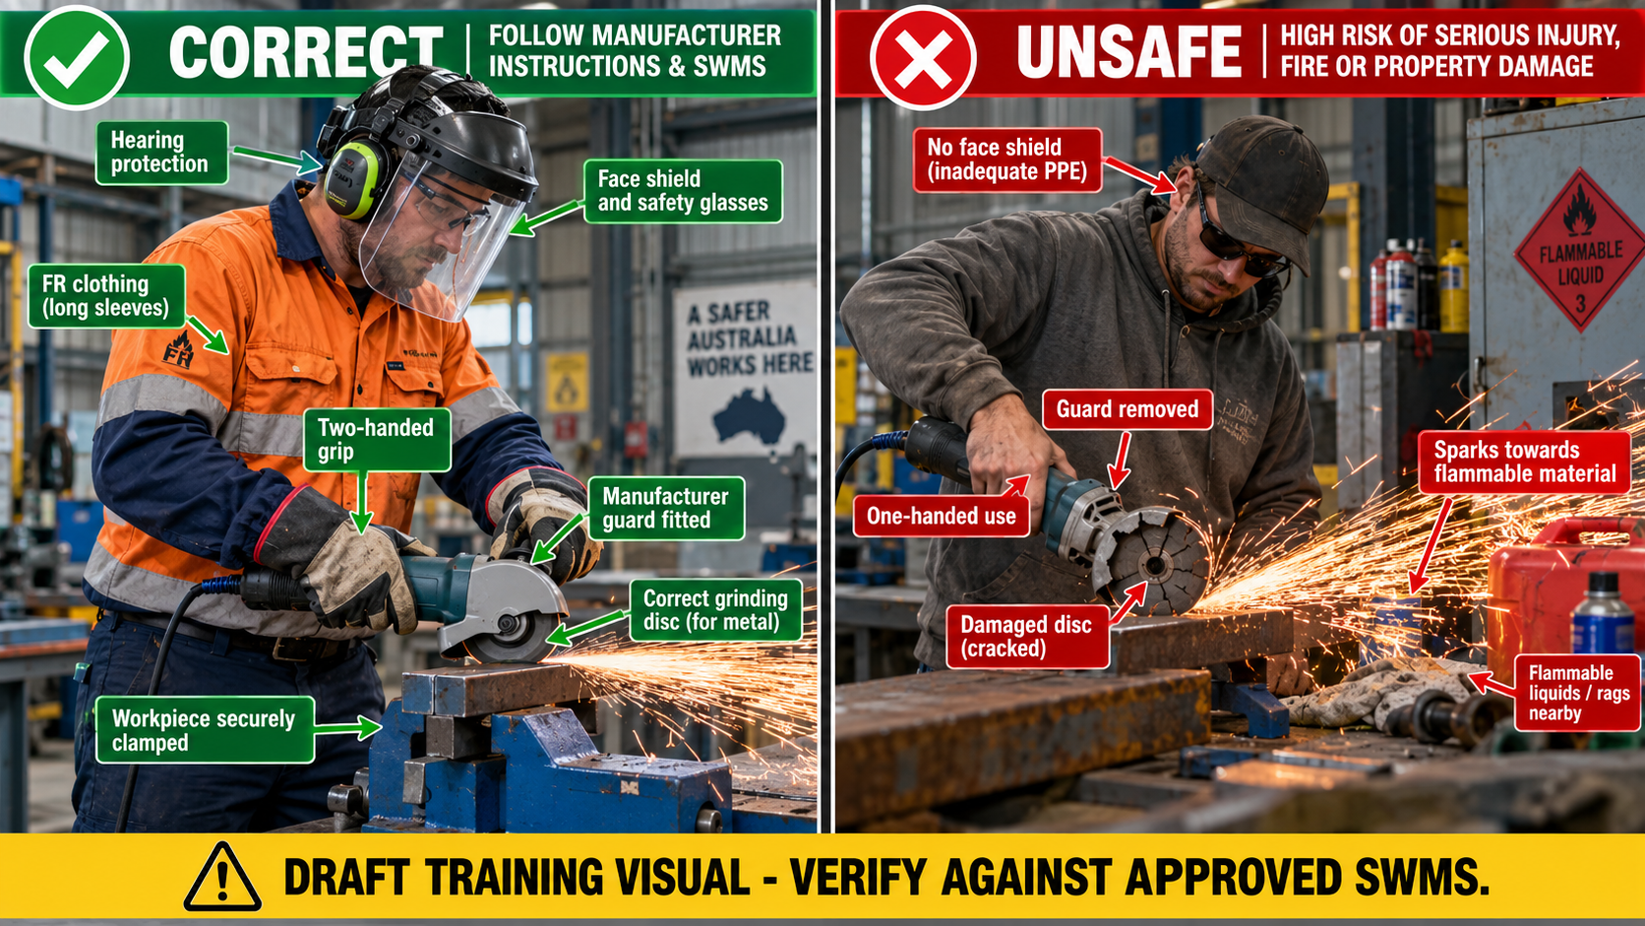
Grinding safety: correct vs unsafe practice
Critical visual: grinder guard, correct disc, two-handed control and spark direction
PP-TRN-WLD-001 | Hot Work: MIG Welding and Grinding Safety | Draft Rev 1 | VERIFY BEFORE CONTROLLED ISSUE
11/20

Slide 12
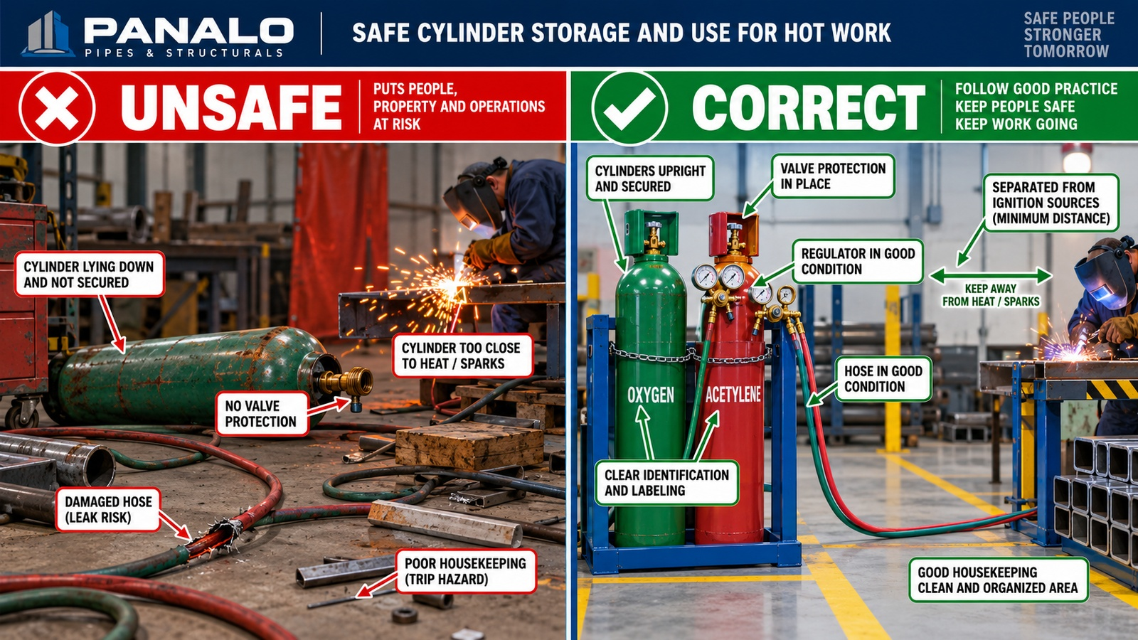
Gas cylinder storage and use
Critical visual: secure upright, protect valves, check hoses and keep away from ignition sources
PP-TRN-WLD-001 | Hot Work: MIG Welding and Grinding Safety | Draft Rev 1 | VERIFY BEFORE CONTROLLED ISSUE
12/20

Slide 13
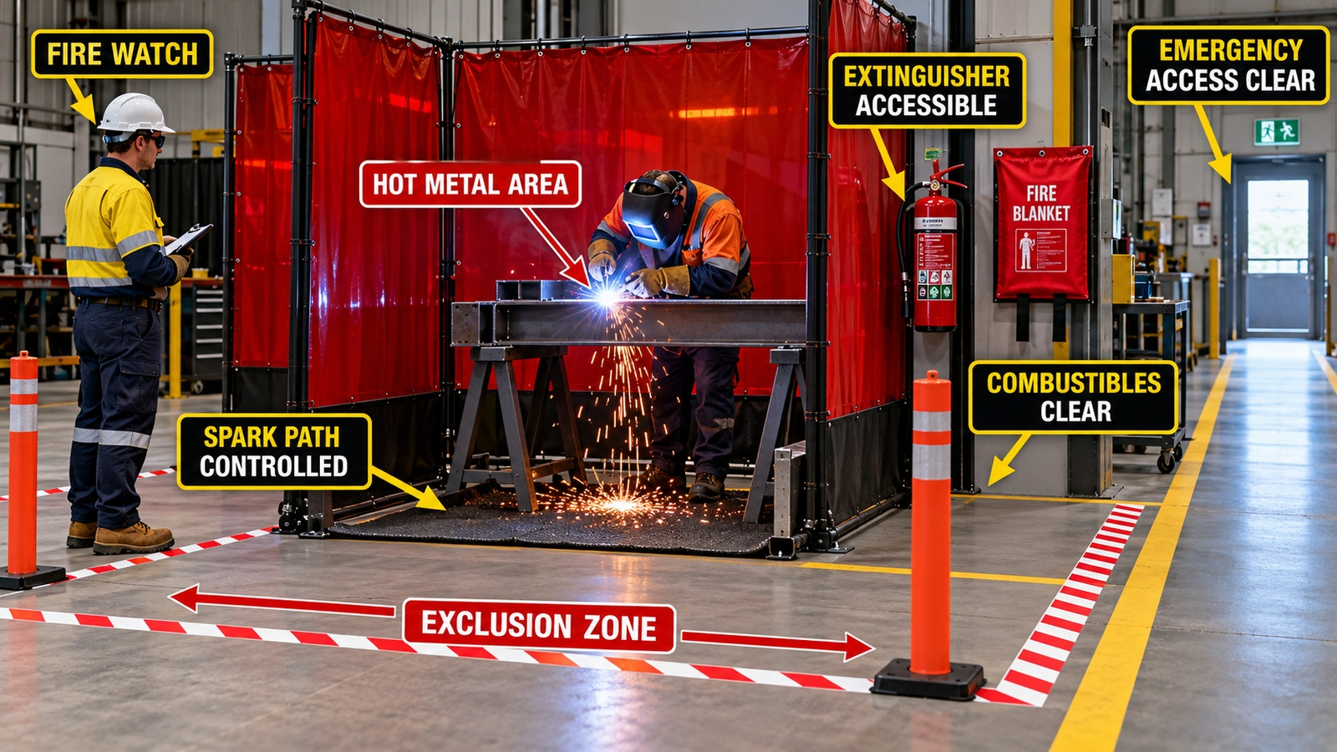
Fire prevention and fire watch
Fire controls must be ready before hot work starts and maintained after completion
PP-TRN-WLD-001 | Hot Work: MIG Welding and Grinding Safety | Draft Rev 1 | VERIFY BEFORE CONTROLLED ISSUE
13/20

Slide 14
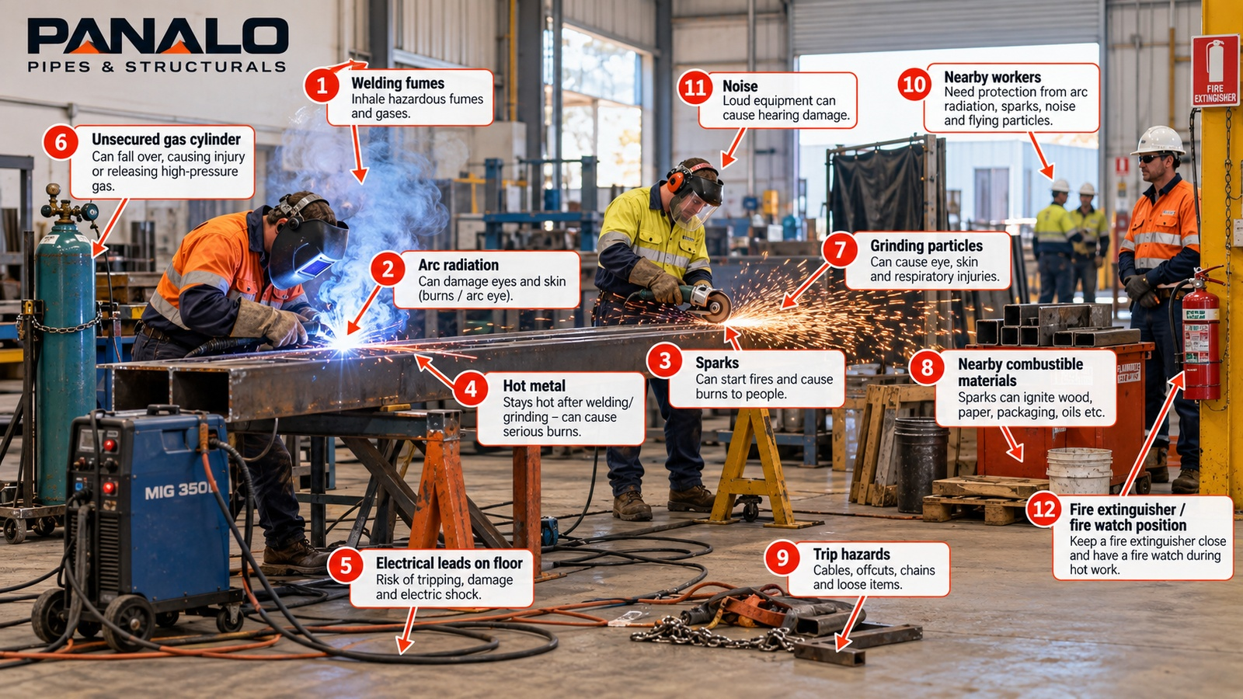
Exclusion zones and nearby workers
Protect people not doing the work from arc flash, sparks, noise and flying particles
• Use screens or barriers to isolate arc radiation and grinding particles.
• Keep unauthorised people out of the spark path and hot-metal zone.
• Communicate with nearby trades before starting hot work.
• Control hoses, leads and offcuts to reduce trip hazards.
• Stop work when the exclusion zone cannot be maintained.
Hot work controls must protect the welder, the helper, nearby workers and the workplace.
PP-TRN-WLD-001 | Hot Work: MIG Welding and Grinding Safety | Draft Rev 1 | VERIFY BEFORE CONTROLLED ISSUE
14/20

Slide 15
Equipment pre-start inspection
Do not energise damaged or unsuitable equipment
WELDER / MIG LEADS
GRINDER
□ No exposed wires
□ Secure connections
□ Torch in good condition
□ Return clamp contact clean
□ Correct disc for material
□ Disc intact and in-date where applicable
□ Guard fitted
□ Side handle installed
GAS SYSTEM
FIRE CONTROL
□ Cylinder secured upright
□ Regulator and hose undamaged
□ Correct gas and labels
□ Leak check where required
□ Extinguisher accessible
□ Combustibles removed/protected
□ Fire watch assigned where required
□ Emergency access clear
Tag out, remove from service and report defects — do not “try it and see.”
PP-TRN-WLD-001 | Hot Work: MIG Welding and Grinding Safety | Draft Rev 1 | VERIFY BEFORE CONTROLLED ISSUE
15/20

Slide 16
Safe work sequence
Use this sequence for workshop or site hot work
1
2
3
4
5
6
PLAN
Scope, drawings, WPS, SWMS/JSA, site rules
PREPARE
Area, combustibles, ventilation, screens, exclusion zone
INSPECT
PPE, equipment, leads, cylinders, grinder, fire gear
WORK
Maintain controls; keep fumes out of breathing zone; control sparks
MONITOR
Changing conditions, nearby people, heat, fire risk
CLOSE OUT
Cool/label hot metal, clean area, complete records
Sequence prevents missed controls — do not skip steps because the job looks simple.
PP-TRN-WLD-001 | Hot Work: MIG Welding and Grinding Safety | Draft Rev 1 | VERIFY BEFORE CONTROLLED ISSUE
16/20

Slide 17
Stop work and change management
Use stop-work authority whenever a critical control is missing, failed or uncertain
STOP: SWMS/JSA does not match the work
STOP: Permit missing or expired
STOP: Ventilation unavailable or ineffective
STOP: Grinder guard/disc/lead defective
STOP: Combustibles cannot be removed or protected
STOP: Cylinder, regulator or hose damage found
STOP: Unauthorised person enters the exclusion zone
STOP: Worker is unsure how to continue safely
STOP → MAKE SAFE → NOTIFY SUPERVISOR → REASSESS → UPDATE SWMS/JSA/PERMIT IF REQUIRED → AUTHORISE RESTART
No disciplinary action should arise from a genuine stop-work action raised for safety.
PP-TRN-WLD-001 | Hot Work: MIG Welding and Grinding Safety | Draft Rev 1 | VERIFY BEFORE CONTROLLED ISSUE
17/20

Slide 18
Emergency and incident response
Respond early, report accurately and preserve evidence where safe
• Raise the alarm and stop work immediately.
• Make the area safe only if you are trained and it is safe to do so.
• Use fire equipment only if competent, exit route is clear and fire is small.
• Treat burns, arc-eye, electric shock, fume symptoms and near misses as reportable.
• Notify supervisor and complete incident/near-miss records under IMS requirements.
Early reporting protects people and gives Panalo the evidence needed for corrective action.
PP-TRN-WLD-001 | Hot Work: MIG Welding and Grinding Safety | Draft Rev 1 | VERIFY BEFORE CONTROLLED ISSUE
18/20

Slide 19
Quality and Integrated Management System controls during hot work
Safety and quality controls must work together
BEFORE WELDING
DURING WORK
AFTER WORK
✓ Correct drawing/specification available
✓ Approved WPS selected
✓ Welder qualification/WPQ checked
✓ Material and heat number verified
✓ Weld ID / welder ID maintained
✓ Fit-up and tacks checked
✓ Parameters controlled as required
✓ Non-conforming conditions stopped
✓ Inspection completed per ITP
✓ NDT request raised where required
✓ NCR raised for defects
✓ Records filed under document control
Wrong WPS, lost traceability or missed inspection is an IMS failure — not only a production issue.
PP-TRN-WLD-001 | Hot Work: MIG Welding and Grinding Safety | Draft Rev 1 | VERIFY BEFORE CONTROLLED ISSUE
19/20

Slide 20

Five critical hot-work rules
Worker memory anchors
1
Read and follow the current SWMS/JSA before starting.
2
Control fumes, fire, sparks and hot metal at source.
3
Inspect PPE, welder, grinder, leads and gas systems before use.
4
Keep cylinders secured and exclusion zones controlled.
5
Stop work if conditions are unsafe, unclear or changed.
No job is urgent enough to skip a critical control.
PP-TRN-WLD-001 | Hot Work: MIG Welding and Grinding Safety | Draft Rev 1 | VERIFY BEFORE CONTROLLED ISSUE
20/20

