Slide 1

Customer
Engagement
Analysis
Excel portfolio project: confidence intervals, hypothesis testing, and business recommendations.
Start interactive story →
Prepared by Jayson Sugpatan

Slide 2
Interactive Portfolio Map
Choose a section to review the business question, statistical evidence, and decision story.
01 Business Problem What decision does the analysis support?
02 Data & Distribution Why descriptive statistics mattered first.
03 Confidence Intervals Which cohorts changed between Q4 2021 and Q4 2022?
04 Hypothesis Tests What the t-tests say about the feature impact.
05 Business Decision How management should interpret the findings.
06 Portfolio Skills How to explain this project in interviews.
Use these buttons during Slide Show mode. The Home button appears on every section slide.
Customer Engagement Analysis • Portfolio Case Study • 2/8
Interactive PPT: use section buttons in Slide Show mode

Slide 3
Business Problem
⌂ Menu
The platform needs evidence before deciding whether new features increased customer engagement.
Question to answer
Paid students
Free students
Did student engagement improve in Q4 2022 compared with Q4 2021 — and did the effect differ by plan type?
2021 vs 2022
US vs India
I treated this as a practical customer-engagement decision: not only “what changed,” but “what should management do next?”
Analysis path
Describe mean, median, skewness
Estimate 95% confidence intervals
Test Welch two-sample t-tests
Decide business recommendation
Jump to results
Jump to decision
Customer Engagement Analysis • Portfolio Case Study • 3/8
Interactive PPT: use section buttons in Slide Show mode

Slide 4
Descriptive Statistics: Distribution Check
⌂ Menu
The first warning: minutes watched were not normally distributed, especially in 2022.
7.07
paid-plan skewness, 2022
right-skewed usage
15.06
free-plan skewness, 2022
more extreme right tail
315.76
free-plan kurtosis, 2022
very heavy tail/outliers
Option 2
best answer
paid 2022 skew < free 2022 skew
Mean is not close to median in the 2022 groups. That signals a long right tail: a small number of students watched very high minutes while many watched little.
Portfolio takeaway: before presenting averages, check the distribution so the business does not overinterpret a mean driven by heavy users.
Not normal
Skewed users
Customer Engagement Analysis • Portfolio Case Study • 4/8
Interactive PPT: use section buttons in Slide Show mode

Slide 5
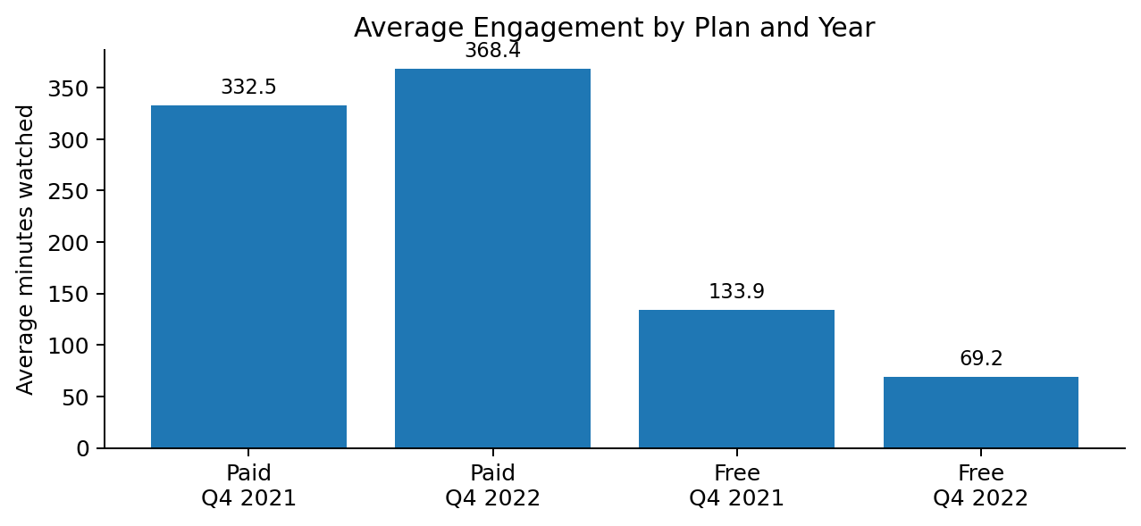
Confidence Intervals: What Changed?
⌂ Menu
95% confidence intervals show clear movement in opposite directions for paid vs free students.
316.25–348.76
paid Q4 2021 CI
mean = 332.50
351.99–384.72
paid Q4 2022 CI
mean = 368.35
129.92–137.95
free Q4 2021 CI
mean = 133.93
67.71–70.59
free Q4 2022 CI
mean = 69.15
Conclusion from intervals
Paid students: 2022 interval is entirely above 2021 → engagement increased.
Free students: 2022 interval is entirely below 2021 → engagement decreased.
The intervals do not overlap for either segment, so the direction of change is visually clear.
See hypothesis test →
Customer Engagement Analysis • Portfolio Case Study • 5/8
Interactive PPT: use section buttons in Slide Show mode

Slide 6
Hypothesis Testing: Evidence for the Decision
⌂ Menu
Welch two-sample t-tests were used because the F-tests supported unequal variances.
Null hypothesis tested separately by segment:
H₀: μ₂₀₂₁ ≥ μ₂₀₂₂ vs. H₁: μ₂₀₂₁ < μ₂₀₂₂
−3.05
paid-plan t-statistic
reject H₀ • significant increase
29.78
free-plan t-statistic
fail to reject H₀ • decline, not increase
−1.21
US vs India t-statistic
fail to reject H₀ • no valid conclusion
Critical-value logic
Type I vs Type II error
For the one-tailed tests, the critical value is about 1.65 in magnitude. Paid students cross the decision threshold; free-plan students move in the opposite direction; US vs India does not cross the threshold.
Type I may cost more if the company scales features that do not really improve engagement. Type II means missing a useful feature and lost opportunity.
Business decision →
Customer Engagement Analysis • Portfolio Case Study • 6/8
Interactive PPT: use section buttons in Slide Show mode

Slide 7

Business Decision: Segment the Product Story
⌂ Menu
The features may be working for paid students, but the free-plan experience needs investigation.
Management should not claim a platform-wide engagement win.
The evidence is segmented: paid-plan engagement increased, free-plan engagement fell sharply, and the US–India difference was not statistically conclusive.
+10.8%
paid subscribers
statistically significant increase
−48.4%
free users
substantial decline in engagement
no valid conclusion
geo test
US vs India at 5% significance
Recommended next step
Run a deeper feature-level analysis: compare which features paid students use, investigate free-plan friction, and avoid rolling out changes based only on aggregate averages.
How I explain this →
Customer Engagement Analysis • Portfolio Case Study • 7/8
Interactive PPT: use section buttons in Slide Show mode

Slide 8
Portfolio Skills Demonstrated
⌂ Menu
Use this slide as your interview talking track.
What this project proves
Simple interview script
Excel analytics COUNT, AVERAGE, STDEV.S, VAR.S, confidence intervals
Statistical thinking skewness, kurtosis, unequal variances, t-tests
“I analyzed customer engagement by cohort, tested whether 2022 usage improved, and found that paid subscribers increased significantly while free-plan users declined. My recommendation was to segment the product decision instead of claiming an overall engagement win.”
Business interpretation translated formulas into product decisions
Consulting mindset identified segment-level risk and next steps
Use as portfolio attachment
Attach this deck together with the Word case study. In applications, describe it as a customer engagement analytics project built in Excel.
Back to menu
Restart
Customer Engagement Analysis • Portfolio Case Study • 8/8
Interactive PPT: use section buttons in Slide Show mode

