Slide 1
VACUTECH · PHASE 2 · BUSINESS INTELLIGENCE & DATA MINING
From RMAs to Recommendations
Three CRM questions, three transparent data-mining models
Course module: DLMDSEBA02 • Composite presentation
W1 · Apriori
W2 · Decision Tree
W3 · DT classifier
306 rules from 7460 PM cases
R² = 0.93 on 2000 test cases
Threshold = 0.3, recall 49%
Pareto: 26 SKUs cover ≈80%
MAE ≈ 1.07 days at intake
Accuracy 85% on 2000 test cases
All KPIs are read live from exports/metrics_summary.json

Slide 2
CONTEXT
CRM tasks and the data-mining toolbox
Customer Relationship Management aims to identify, attract, retain and develop customers. Data mining supports each of these CRM tasks with a different family of algorithms¹⁾¹⁴. VacuTech's three W questions sit on the retention and development side: stock the right parts, make credible promises, and prevent rework before customers feel it.
Customer Identification
Customer Attraction
Segmentation, target selection
Direct marketing, lead scoring
DM family: Clustering, classification
DM family: Classification, association rules
Customer Retention
Customer Development
Service quality, churn, complaint triage
Cross-/up-sell, lifetime value, bundling
DM family: Classification (DT), regression
DM family: Association rules, regression
VacuTech mapping • W1 → Customer Development (parts bundling) • W2 → Customer Retention (credible ETAs) • W3 → Customer Retention (QA-failure prevention)
¹⁴ Ngai et al. 2009 ¹ Shearer 2000
VacuTech · DLMDSEBA02 · BI & Data Mining (Phase 2)
2 / 10

Slide 3
WORK PACKAGE 1 · INVENTORY OPTIMISATION
Which parts frequently co-occur and should be bundled together?
Business question
Apriori association rules + Pareto
Technicians often consume additional parts that break together. We want to find which parts frequently co-occur across all repairs completely independently of PM, so planners can pre-stock or bundle them and replace them in every repair where one is flagged.
● Apriori (mlxtend) discovers frequent co-occurring add-on parts
● Rules ranked by lift, retained when lift exceeds independence
● Pareto chart on part counts complements rules with a SKU shortlist
Data used
● 10,000 repair cases from repairs.csv (independent of PM flag)
● Add-on lines from parts_used.csv (kit_part_flag = 0)
● Pivoted into a boolean basket matrix: 10,000 cases x 36 add-on parts
● No scaling or imputation required — Apriori runs directly on baskets
Fixed hyperparameters
● min_support = 0.05 (≈ 25-50 baskets at this dataset size)
● min_lift = 1.2 (meaningfully stronger than chance)
● Outputs: w1_rules.csv, w1_metrics.json, two PNG charts
Frameworks
mlxtend.apriori · mlxtend.association_rules
³ Agrawal & Srikant 1994 ⁴ Brin et al. 1997
VacuTech · DLMDSEBA02 · BI & Data Mining (Phase 2)
3 / 10

Slide 4
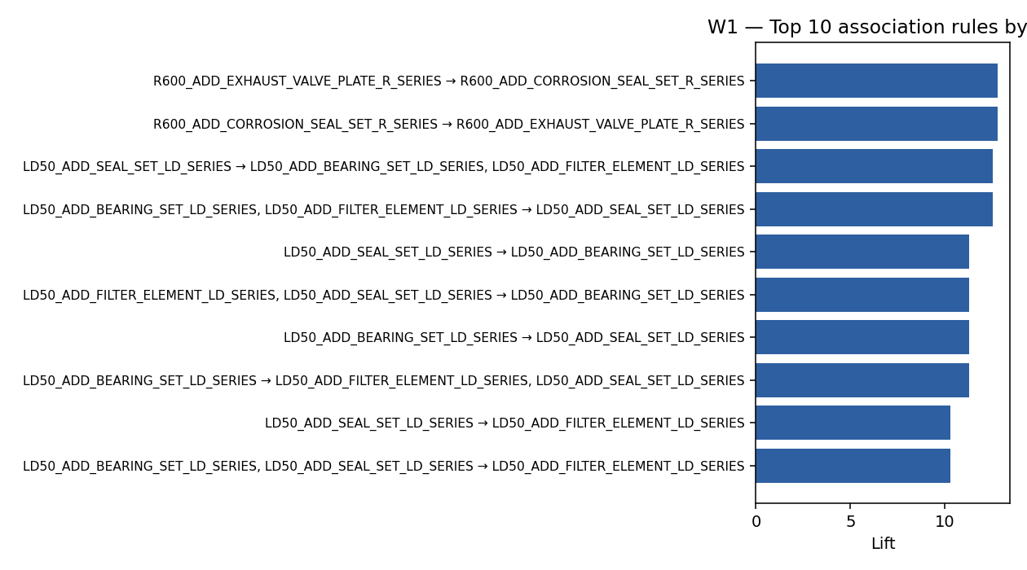
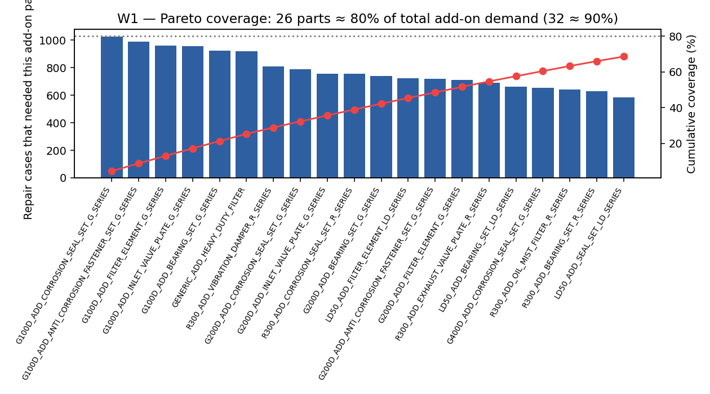
WORK PACKAGE 1 · RESULT
Predictive stocking shortlist + direct bundling rules
Bundle Rules Found
Rule Strength (Lift)
Bundling Confidence
80% / 90% SKU Headcount
306
12.8x
84%
26 / 32 SKUs
Management action
● Stock the top 20 high-demand add-on parts at every regional warehouse to satisfy 80% of extra demand.
● Bundle complementary wear-and-tear parts (e.g. O-rings + Seals) directly into standard PM kits.
● Verify first-visit completion rates before vs. after roll-out to measure customer satisfaction gains.
⁶ Wang et al. 2018 ⁷ Didriksen et al. 2026
VacuTech · DLMDSEBA02 · BI & Data Mining (Phase 2)
4 / 10

Slide 5
WORK PACKAGE 2 · REPAIR DURATION
At intake, how long will this repair take?
Business question
Decision Tree Regressor (Whitebox AI)
The service planner must commit to a reliable repair completion date. The prediction model must use only safe, intake-time features (no QA or completion fields) and stay fully explainable to a front-desk advisor.
● Fully transparent method — logic splits readable on a whiteboard
● Decision paths trace exactly how job drivers add up to the ETA
● Evaluated on a completely separate, held-out test dataset
Data used
● Target: Actual Repair Duration (in Days)
● Predictors: Pump age, technician experience, estimated parts cost
● Job Info: Specific pump model, failure category, complexity level, region
● Preparation: Clean incomplete records + format categorical groups
Fixed hyperparameters
● max_depth = 6 (captures age x complexity interactions without over-fitting)
● min_samples_leaf = 20 (≥ 20 historic cases per decision path)
● random_state = 7 (fully repeatable and auditable models)
Frameworks
scikit-learn DecisionTreeRegressor · CART (Breiman et al. 1984)
⁸ Breiman et al. 1984 ⁹ Rudin 2019
VacuTech · DLMDSEBA02 · BI & Data Mining (Phase 2)
5 / 10

Slide 6
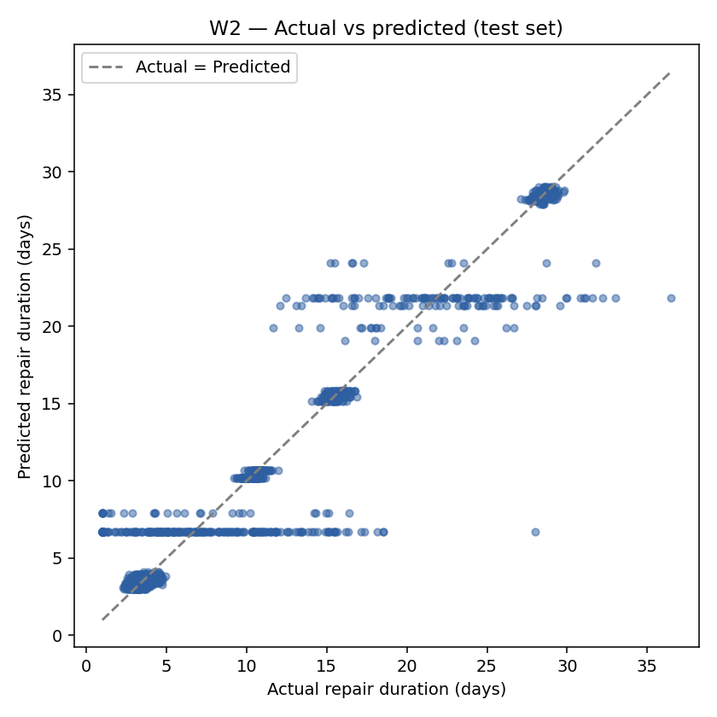
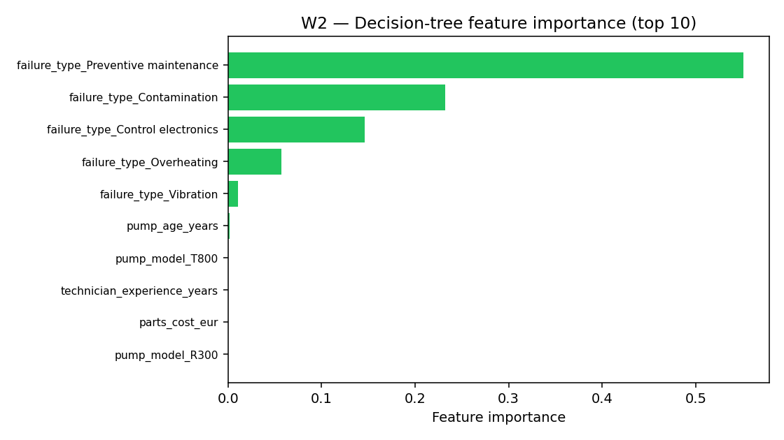
WORK PACKAGE 2 · RESULT
Usable intake-time ETAs — publish as a tailored range
Model Reliability (R²)
Avg. Prediction Error
Risk Buffer Margin (RMSE)
Repairs Analyzed
92.7%
1.1 Days
2.2 Days
10000 Cases
Management action
● Publish a standard ±1-day delivery window on the receipt for predictable repairs (e.g. Overheating).
● Route highly unpredictable repairs ('Control electronics' and 'Seal/Leak') to senior staff and quote a wider ±4-day window.
● Standardize repair procedures for high-variance failure categories to systematically reduce scheduling errors.
¹⁰ Jang et al. 2021 ¹¹ Ding et al. 2022 · Acela
VacuTech · DLMDSEBA02 · BI & Data Mining (Phase 2)
6 / 10

Slide 7
WORK PACKAGE 3 · QA-FAILURE RISK
Which repairs deserve a closer pre-QA look?
Business question
Decision Tree Classifier + fixed threshold
Before signing off a repair, operations needs an automated alert system. The model must calculate failure risk at intake and trigger a review flag, balancing QA team capacity against quality goals.
● Calculate failure risk probability -> trigger alert at 30% risk
● Clear trigger threshold = highly governable dashboard flag
● Evaluated by: failures successfully caught vs review workload
Data used
● Target: QA Inspection Failure Flag (historical rate ≈13%)
● Predictors: Pump age, technician experience, estimated parts cost
● Job Info: Specific pump model, complexity class, failure type
● Preparation: Stratified data split to keep failure rates fully representative
Fixed hyperparameters
● max_depth = 6 ; min_samples_leaf = 20 ; random_state = 7
● Alert Trigger Threshold = 30% (optimized for shop review capacity)
● Stratification active to preserve natural 13% failure rate in evaluation
Frameworks
scikit-learn DecisionTreeClassifier · Imbalanced classification metrics
⁸ Breiman et al. 1984 ⁹ Rudin 2019
VacuTech · DLMDSEBA02 · BI & Data Mining (Phase 2)
7 / 10

Slide 8
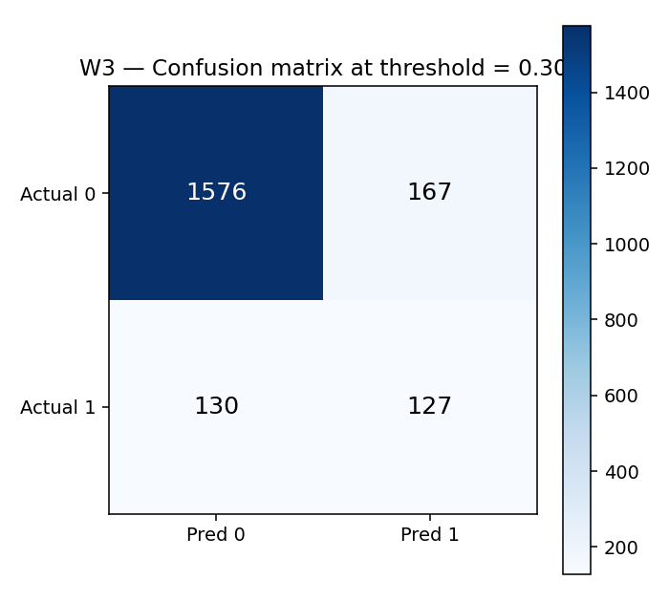
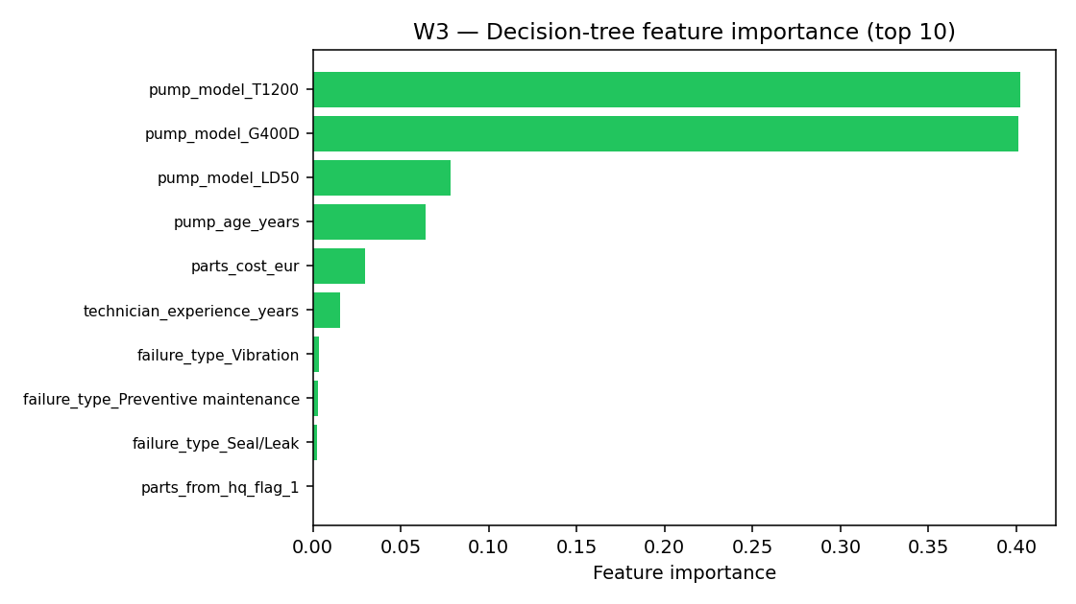
WORK PACKAGE 3 · RESULT
Triage high-risk pump models 'T1200' and 'G400D'
Failures Caught (Recall)
Alert Accuracy (Precision)
Overall Triage Accuracy
Risk Trigger Threshold
49%
43%
85%
30%
Management action
● Route flagged jobs and high-risk pump models 'T1200' and 'G400D' through a mandatory senior tech pre-QA check.
● Use the risk flag to intercept 49% of all pre-QA failures early, keeping extra review workload below 15%.
● Run low-risk pump models ('G200D', 'R300') on an automated fast-track QA queue to maximize throughput.
¹² Zhang et al. 2023 ¹³ Sonawani & Mukhopadhyay 2013
VacuTech · DLMDSEBA02 · BI & Data Mining (Phase 2)
8 / 10

Slide 9
CONCLUSION
Three concrete recommendations for VacuTech management
W1 · Parts Stocking
W2 · Smart Scheduling
W3 · Quality Triage
Optimize regional warehouse stocking by holding the top 26 critical add-on parts. Deploy the 306 high-confidence parts bundling rules to ensure technicians complete maintenance visits in a single trip.
Provide reliable repair windows based on our 93% reliable duration model. Quote a standard ±1-day window for predictable repairs, and route unpredictable categories ('Control electronics' and 'Seal/Leak') to senior staff with a wider ±4-day buffer.
Automatically flag high-risk jobs at intake, focusing on vulnerable pump models like 'T1200' and 'G400D'. This triage check will intercept 49% of all potential quality issues early with a quick, senior technician review.
CRM Value: Customer Development — Boost first-visit completion rates.
CRM Value: Customer Retention — Fewer status check calls.
CRM Value: Customer Loyalty — Prevent costly repeat-failure cycles.
Why interpretable models? Stakeholders (planners, advisors, QA supervisors) must act on the output. A shallow, auditable model that they can read and override is preferable to a high-accuracy black box they cannot challenge⁹⁻².
⁹ Rudin 2019 ² CRISP-DM Consortium 2000
VacuTech · DLMDSEBA02 · BI & Data Mining (Phase 2)
9 / 10

Slide 10
BIBLIOGRAPHY
Peer-reviewed sources and frameworks
[1] Shearer, C. (2000). The CRISP-DM model: The new blueprint for data mining. Journal of Data Warehousing, 5(4), 13-22. link
[2] CRISP-DM Consortium (2000). CRISP-DM 1.0: Step-by-step data mining guide. link
[3] Agrawal, R., & Srikant, R. (1994). Fast algorithms for mining association rules in large databases. Proc. VLDB '94, 487-499. link
[4] Brin, S., Motwani, R., Ullman, J. D., & Tsur, S. (1997). Dynamic itemset counting and implication rules for market basket data. Proc. ACM SIGMOD, 255-276. link
[5] Mundler, N. (2019). Association rule mining and itemset-correlation based variants. arXiv:1907.09535. link
[6] Wang, J., Pan, X., Wang, L., & Wei, W. (2018). Method of spare parts prediction models evaluation based on grey comprehensive correlation degree and association rules mining: A case study in aviation. Mathematical Problems in Engineering, 2018, 2643405. link
[7] Didriksen, S. K., Sigsgaard, K. W., Mortensen, N. H., & Jespersen, C. B. (2026). Assigning spare parts management decision-making strategies: A holistic portfolio classification methodology. Applied Sciences, 16(4), 1961. link
[8] Breiman, L., Friedman, J. H., Olshen, R. A., & Stone, C. J. (1984). Classification and Regression Trees. Chapman & Hall. link
[9] Rudin, C. (2019). Stop explaining black box machine learning models for high stakes decisions and use interpretable models instead. Nature Machine Intelligence, 1, 206-215. link
[10] Jang, J., Nana, D., Hochschild, J., & de Lorenzo, J. V. H. (2021). Predicting breakdown risk based on historical maintenance data for Air Force ground vehicles. arXiv:2112.13922. link
[11] Ding, Y., Gao, A., Ryden, T., et al. (2022). Acela: Predictable datacenter-level maintenance job scheduling. arXiv:2212.05155. link
[12] Zhang, Y., Gao, Z., Sun, J., & Liu, L. (2023). Machine-learning algorithms for process condition data-based inclusion prediction in continuous-casting process. Sensors, 23(15), 6719. link
[13] Sonawani, S., & Mukhopadhyay, D. (2013). A decision tree approach to classify web services using quality parameters. arXiv:1311.6240. link
[14] Ngai, E. W. T., Xiu, L., & Chau, D. C. K. (2009). Application of data mining techniques in customer relationship management: A literature review and classification. Expert Systems with Applications, 36(2), 2592-2602. link
Frameworks used
● scikit-learn (Decision Trees)
● mlxtend (Apriori, association rules)
● pandas (data manipulation)
● Jupyter (CRISP-DM notebooks)
● CRISP-DM 1.0 guide
See ACADEMIC_METHOD_JUSTIFICATION.md for full per-W argumentation.
VacuTech · DLMDSEBA02 · BI & Data Mining (Phase 2)
10 / 10

