Slide 1
We will have order
Software Engineering Community of Practice

Slide 2
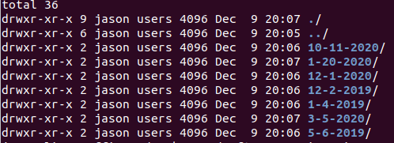
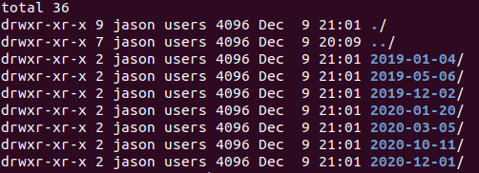
Write dates for alphabetic ordering
When someone creates a folder like "12-1-20" you beat them over the head with ISO8601 until they convert. Ain't no one got time for bass-ackwards date formats – William Wall

Slide 3
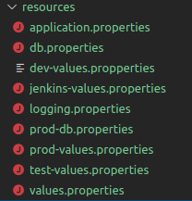
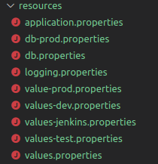
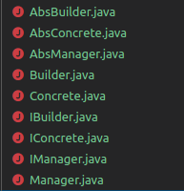
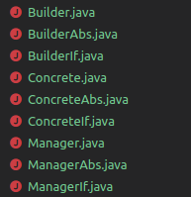
Postfixes are better than Prefixes
Look at that typo jump out!
I hate searching. Searching is for losers – Jason Stiles

Slide 4
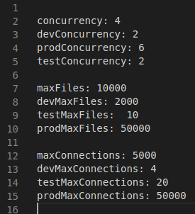
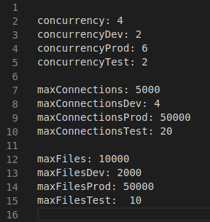
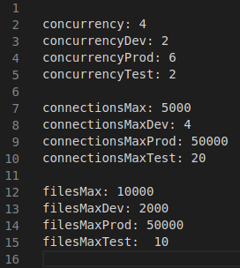
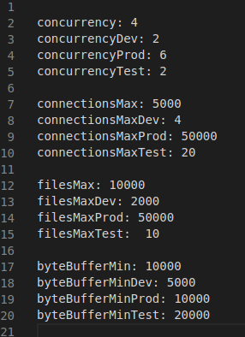
Sort file contents
Is sorting on max helpful?
What is wrong with this addition?
Many submissions I see are not sorted. It's not that important in this small program, but in larger programs it can be helpful to have many use elements sorted. – bobahop, exercism.io mentor

Slide 5

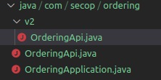
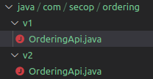
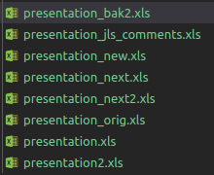
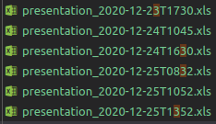
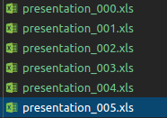
Multiple Versions
Making breaking API changes
Version the package, keep names the same
If you knew you were creating an api, probably should’ve started with a version number
Or… you know… use version control
That's not just bad, it's rude. Like you aren't just bad at your job,
you're also an asshole – William Wall

Slide 6
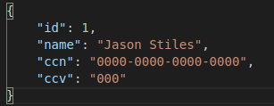
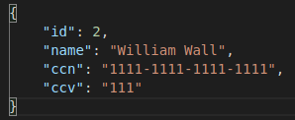
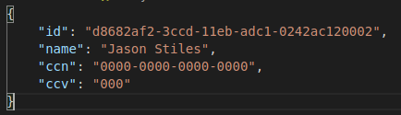
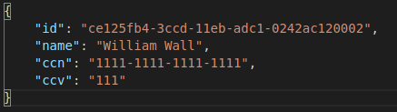
Sometimes ordering is really really bad
https://mybadsecurity.io/users/{sequence_id}
https://mylessbadsecurity.io/users/{uuid}

