Slide 1

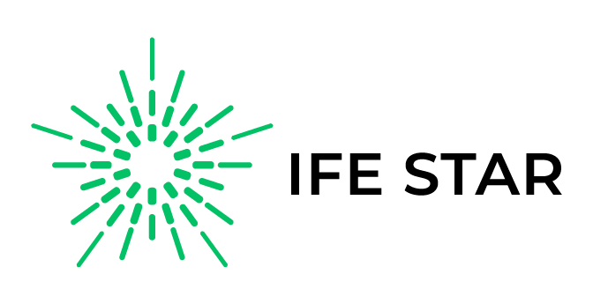


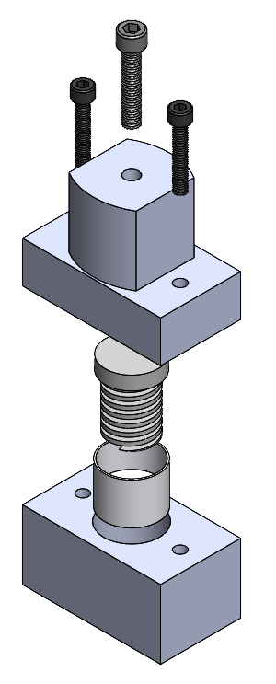
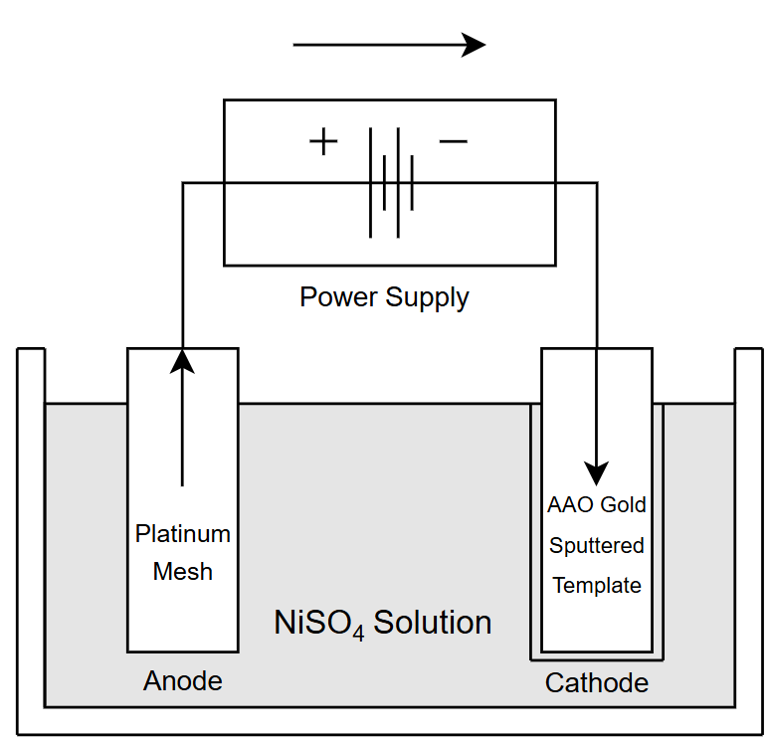
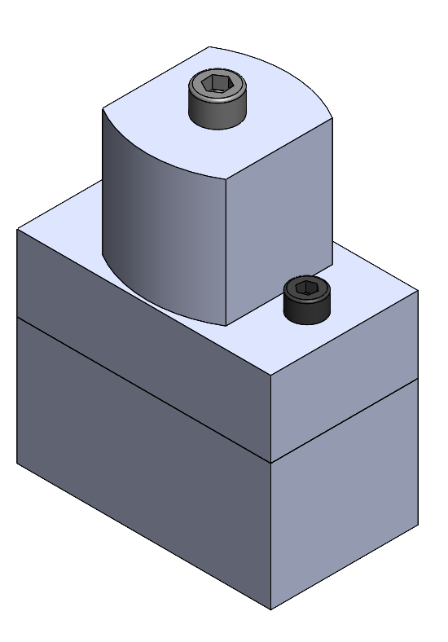
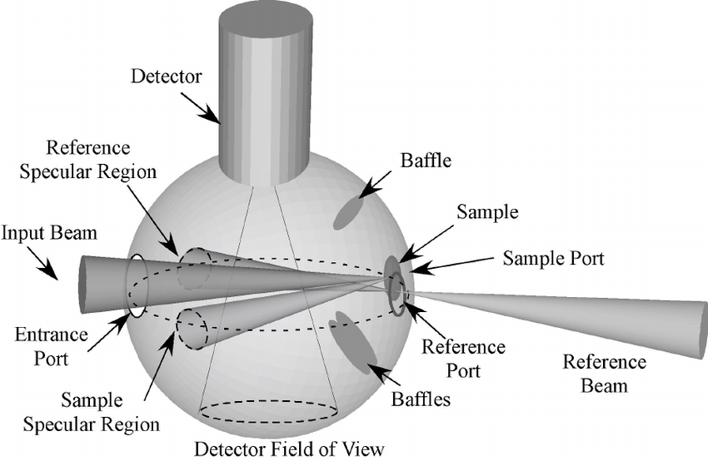
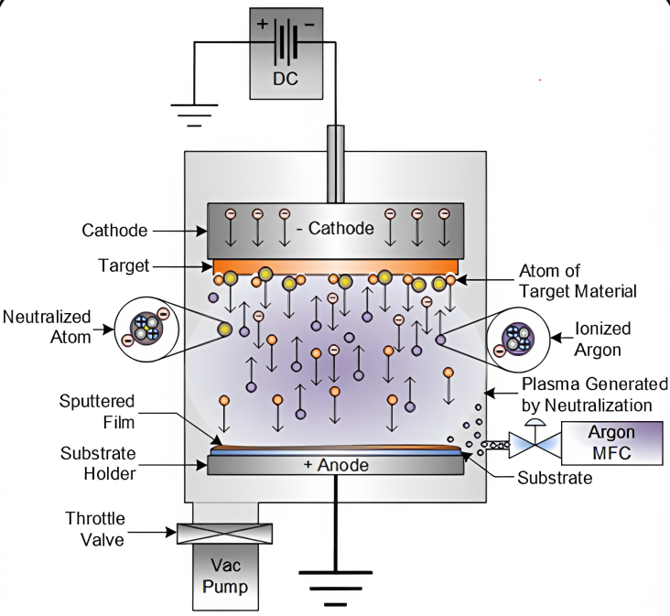
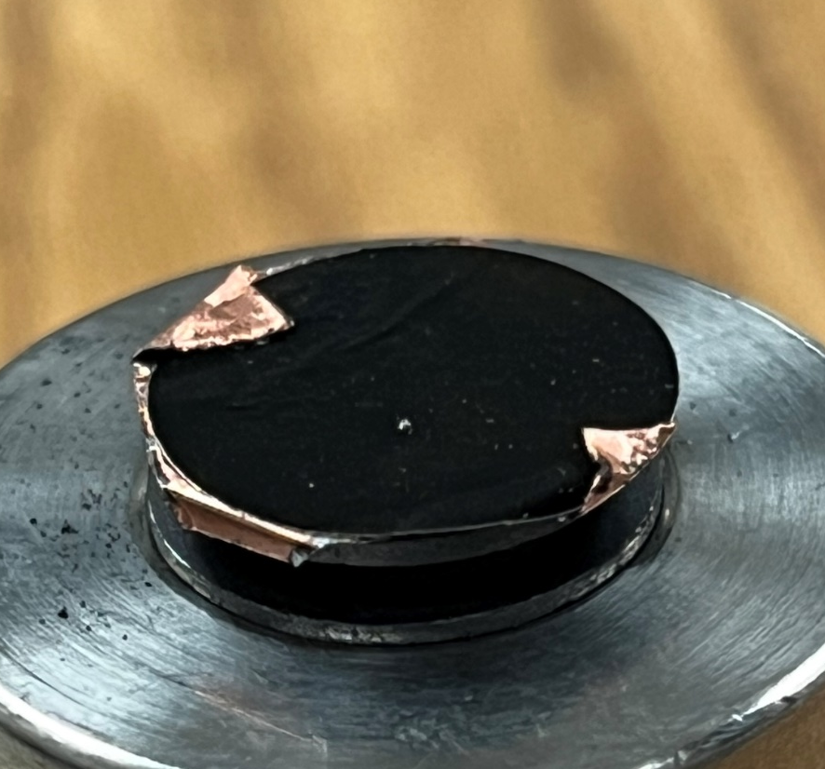
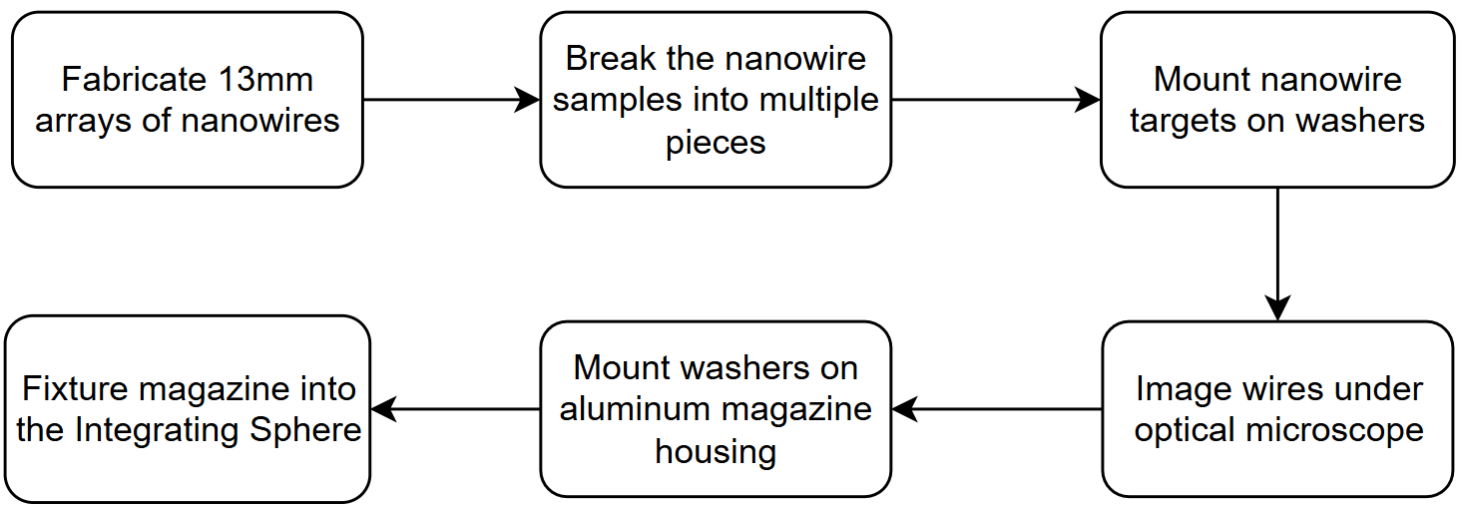
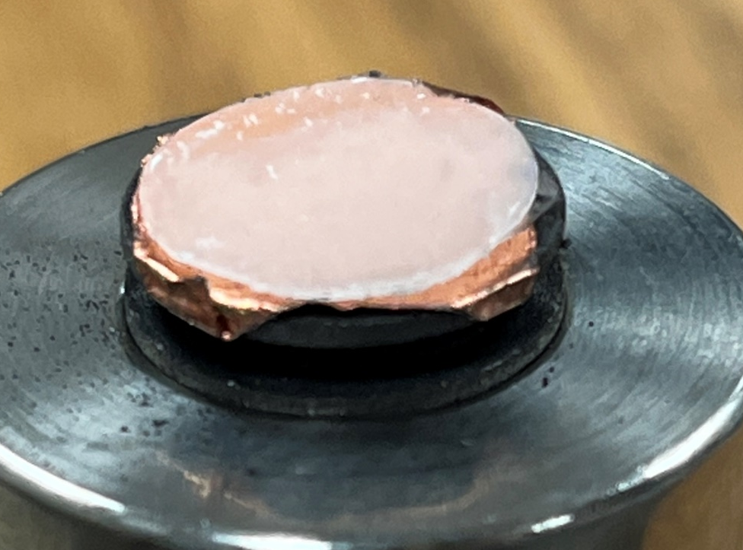
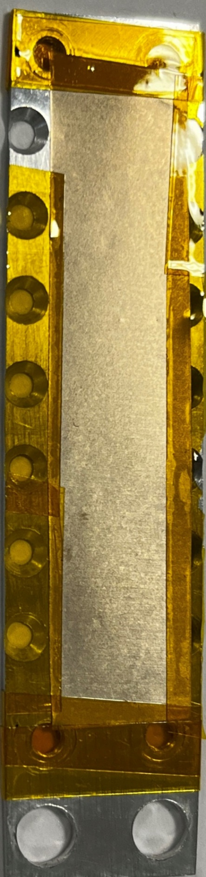
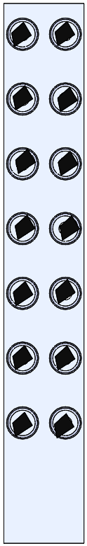
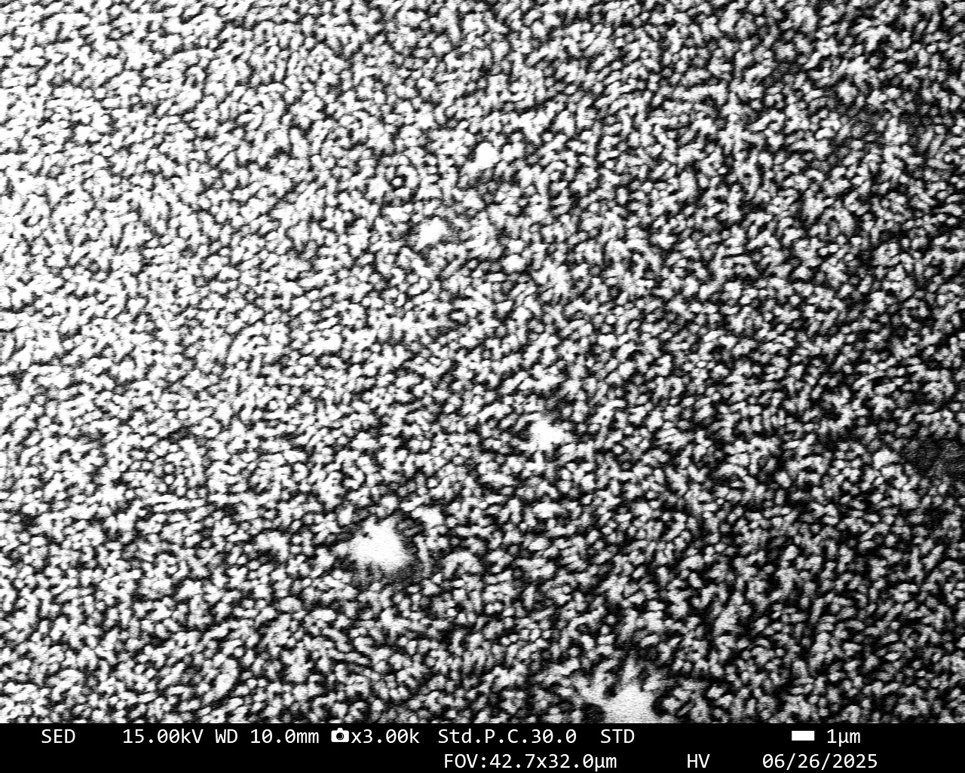
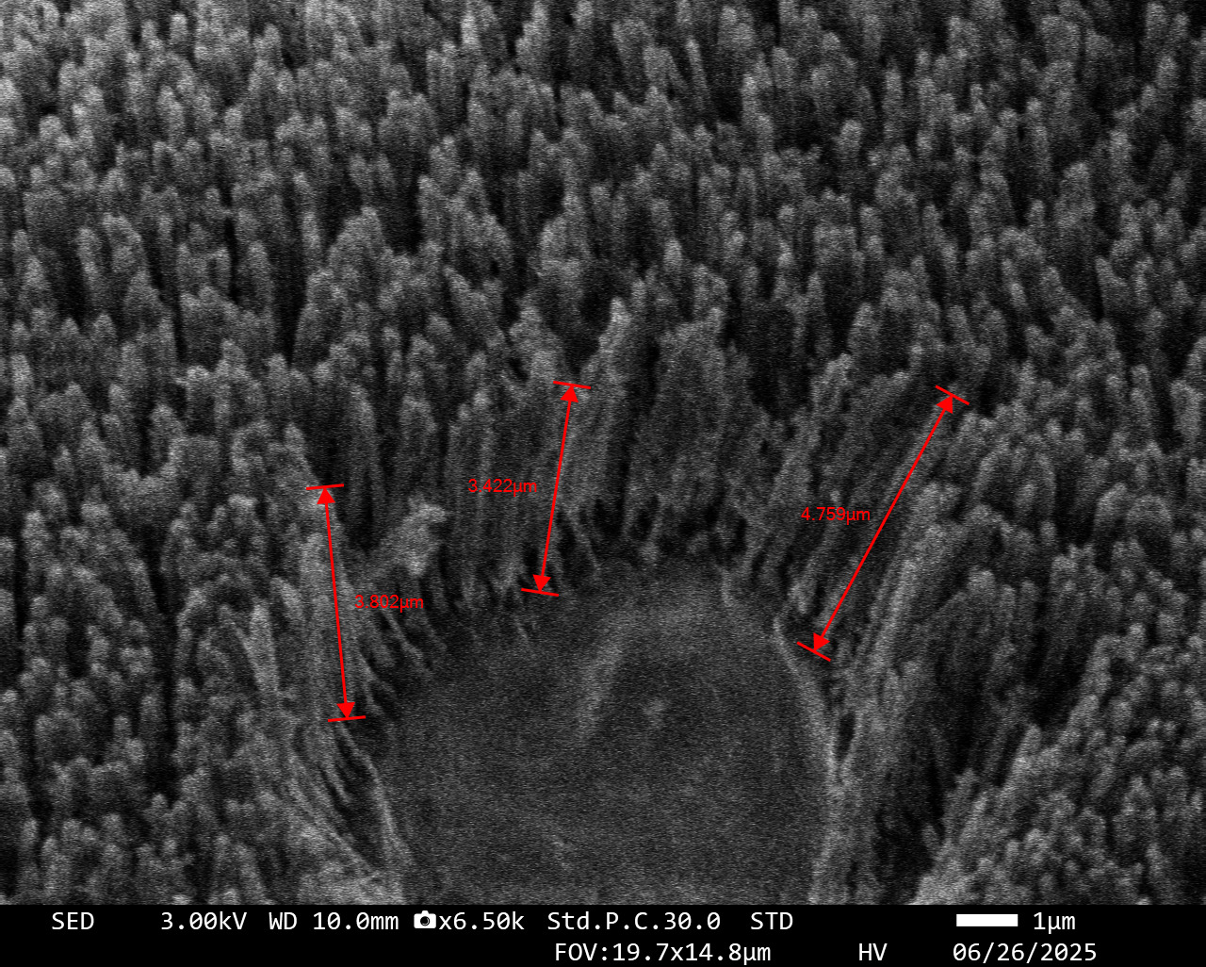
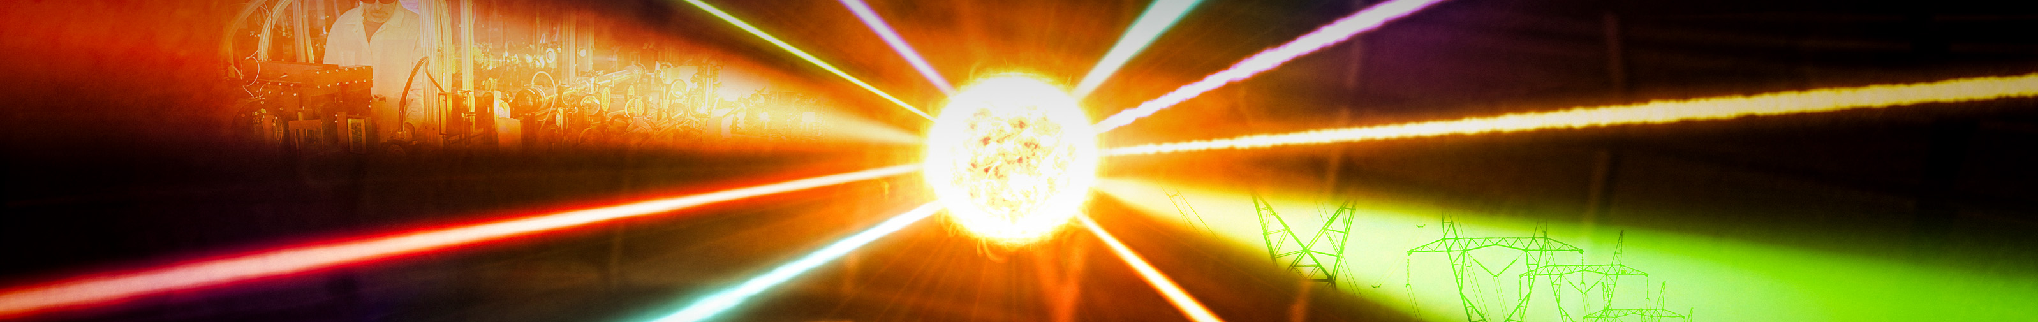
Creating nanostructured targets to increase laser absorption and ion acceleration for inertial fusion applications
Jay Suthar¹, Natalie Ingegneri¹, Houston Davis⁴, Thaddeus Hendrickson⁴, Jaden Hoeschtstetter², Nashad Rahman², M. Gabriela Capeluto³ and Jorge Rocca^{1,2}
¹Department of Electrical Engineering, Colorado State University, Fort Collins, CO, 80523, USA; ²Department of Physics, Colorado State University, Fort Collins, CO, 80523, USA; 3Departamento de Física, Universidad de Buenos Aires-IFIBA, 1428 Buenos Aires, Argentina 1428
ABSTRACT
NICKEL NANOWIRES
POLYETHYLENE NANOWIRES
Inertial fusion is of great interest as a sustainable energy source, with efficient laser light absorption by the target being a critical factor in optimizing inertial fusion processes. This study focuses on the fabrication and analysis of polyethylene and nickel nanowires, which enhance laser-matter interactions relevant to fusion applications. The research aims to improve nanowire fabrication process such that nanowire arrays can reliably be made more uniformly with thin substrates. Uniform and thin substrate arrays of nanowires will be crucial in experiments which seek to understand the interaction between laser and nanowires.
Empty AAO Template placed on Teflon insert
Machined press to melt polyethylene films
Empty AAO Template
Sputter Gold
Polyethylene Film
Spring to apply force
MOTIVATION
Teflon holder
Measuring the absorption of 10²⁰ W/cm² pulse
Comparing the light absorption of nanowire targets against flat foil targets of the same base material
Using an Integrating Sphere to measure scattering of incident light.
Electroplate Nickel
Plastic stub to apply force
Dissolve Template, Critically Dry
Machined enclosure to extrude wires
Oven casing enclosure
Heat Insulation
EXPERIMENT DETAILS
Heat in oven while applying force
PID Controller/
On-screen temperature display
Nanowires are irradiated with a relativistic femtosecond laser pulse, and light absorption values are compared to flat targets
The process of shooting nanowires and flat targets is shown below
Remove from insert; dissolve template.
Aluminum housing with iodine bath
Parameters
CH2 wires are extruded through a lattice in an AAO Template
Extrusion occurs in a 200°C oven
Wire lengths are limited to 5µm or 10 µm.
Cleaning is similar to nickel nanowires but excludes nitric acid.
A thermocouple monitors the press until it reaches 140°C.
Wires are dissolved in NaOH at 50°C.
Parameters
Nanowire characteristics depend on several parameters.
Diameter, pore density, and length affect laser interaction data.
Wires are dried in a critical point dryer using CO₂.
Higher pore density allows more wires per micron of template.
High-density wires require constant pipetting.
Aluminum magazine
Cut-out samples are placed on washers due to the central hole/opening, which ensures effective transmittance of photons on the back reflection detectors, subsequently ensuring consistent, and reliable results.
Imaging the wires under an optical microscope serves as a preliminary validation step to assess whether the wires are uniformly spaced or bunched together.
Target holders need to be a certain distance away from each other ensuring the heat from irradiation doesn’t affect adjacent samples.
RESULTS OF NANOWIRE FABRICATION
Metal washers to house nanowire templates
Top View
Side View
Top View
Side View
ACKNOWLEDGEMENT
U.S. Department of Energy (DOE), Office of Science, Fusion Energy Sciences, Award No. DE-SC0024882: IFE-STAR, using facilities supported by LaserNet US, DOE grant US DE- SC0021246
J.J. Rocca, M.G. Capeluto, R.C. Hollinger, S. Wang, Y. Wang, G.R. Kumar, A.D. Lad, A. Pukhov, and V.N. Shylyaptsev, Ultra-intense femtosecond laser interactions with aligned nanostructures, OPTICA, 11: 510542, (2024)

