Slide 1
Long Short Term Memory(LSTM)
-Sajjan Adhikari

Slide 2
Limitations of RNN
Short-term memory
Lack ability to learn and remember over long sequences of input data
Vanishing gradient
In the vanishing gradient problem, gradient shrinks as it back propagates through time
Exploding gradient
occurs when the network assigns unreasonably high importance to the weights

Slide 3
LSTM to the rescue
type of Recurrent Neural Networks(RNNs)
Capable of learning long term dependencies
The clouds are in the sky.
I grew up in China. I studied Chinese from my school level. I even completed masters in Chinese literature. So, I am very much fluent in Chinese.

Slide 4
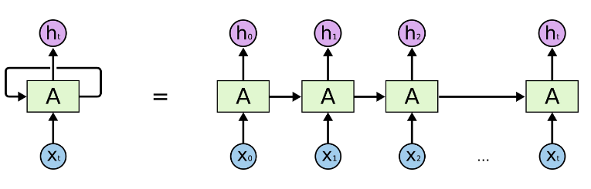
RNN

Slide 5
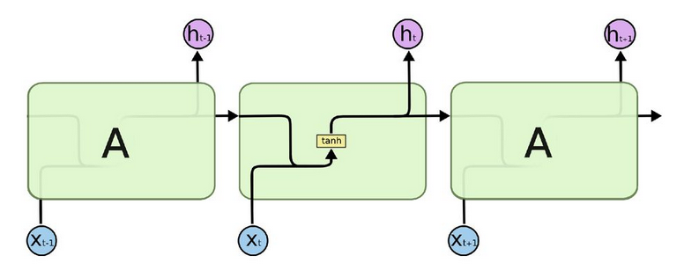
Internal structure of RNN

Slide 6
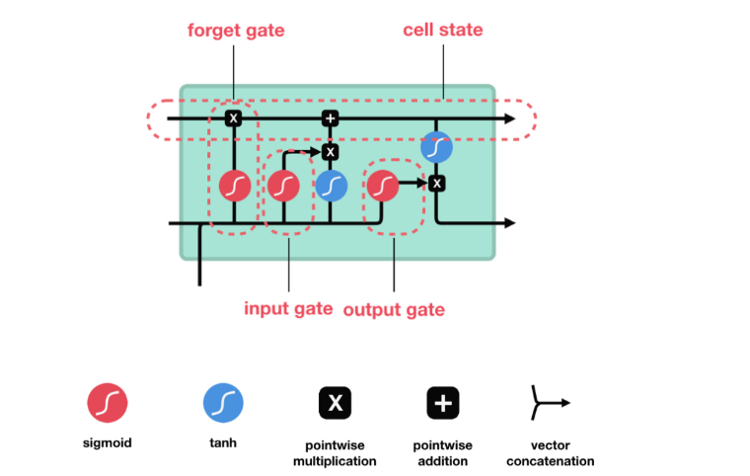
Internal structure of RNN

Slide 7
Components of LSTM
An LSTM cell consists of following functions:
Forget gate
Input gate
Output gate
Cell state
Activation function
Sigmoid
TanH

Slide 8
Components of LSTM
Forget gate
Decides which information should be kept and which should be discarded
Input gate
Updates the cell state.
Output gate
Decides what the next hidden state(contains information on previous inputs) should be.

Slide 9
Components of LSTM
Cell state
Acts as a highway that transports relative information along the sequence chain.
Activation function
Sigmoid - squishes values between 0 and 1.
TanH - squishes values between -1 and 1.

Slide 10
Working mechanism of LSTM

Slide 11
Working mechanism of LSTM
Step 1
Step 2
Step 3
Step 4

Slide 12
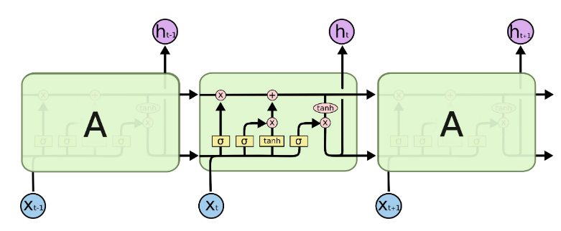
Interacting LSTM

Slide 13
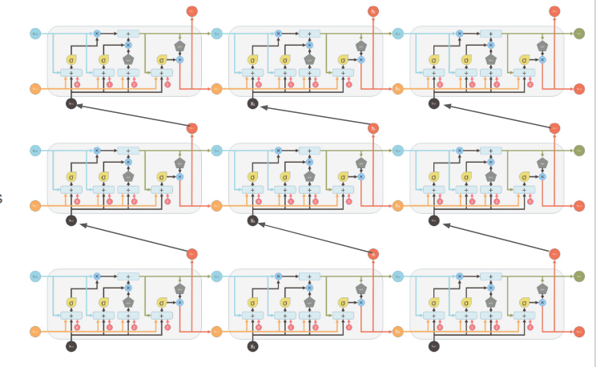

Slide 14
Applications
Language Modelling
Machine Translation
Speech Recognition
Image Captioning
Video Tagging

Slide 15
Materials
https://www.youtube.com/watch?v=LHXXI4-IEns&list=RDLV8HyCNIVRbSU&index=2
https://www.youtube.com/watch?v=8HyCNIVRbSU
https://towardsdatascience.com/illustrated-guide-to-lstms-and-gru-s-a-step-by-step-explanation-44e9eb85bf21
https://medium.datadriveninvestor.com/a-high-level-introduction-to-lstms-34f81bfa262d
https://medium.com/@kangeugine/long-short-term-memory-lstm-concept-cb3283934359
https://pages.cs.wisc.edu/~shavlik/cs638/lectureNotes/Long%20Short-Term%20Memory%20Networks.pdf

