Slide 1
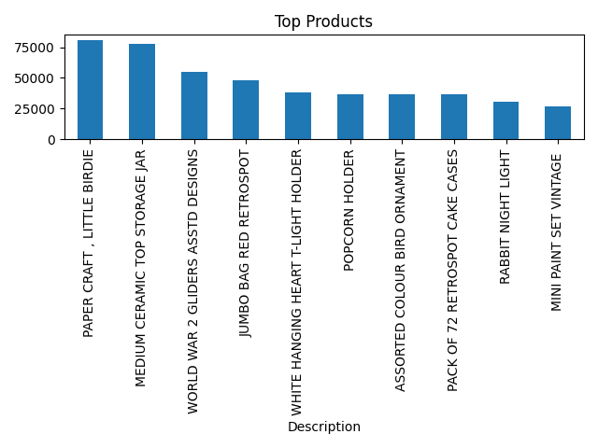
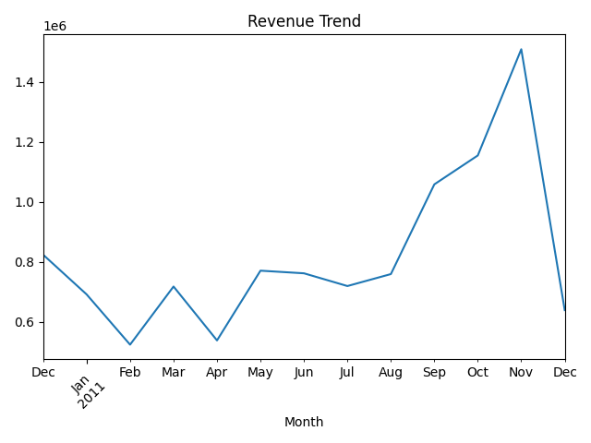
Dashboard Prototype
Total Revenue
Total Invoices
Top Country
Active Customers

Slide 2
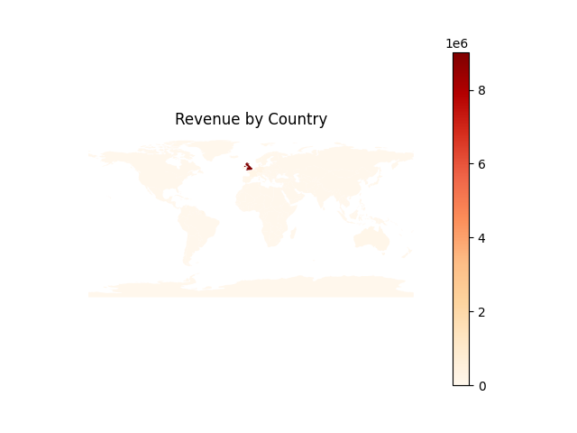
Dashboard Prototype

