Slide 1
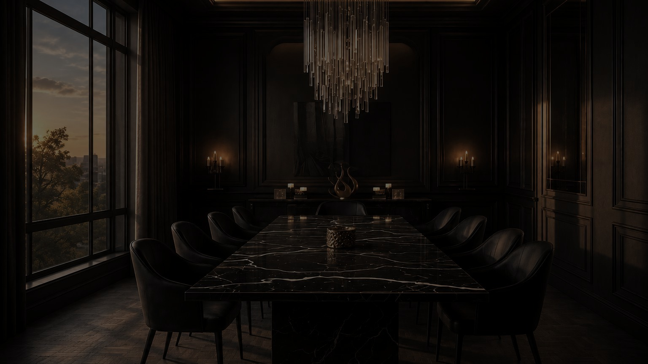
ORKAY TILES INTERNATIONAL
CRAFTED IN MORBI.
DESIGNED FOR THE WORLD.
A global-first digital experience showcasing ORKAY as an internationally trusted
manufacturer with Indian roots and world-class standards.
WEBSITE CONCEPT 01 · DESIGN RATIONALE
IDEA → VISUAL LANGUAGE → COLOUR → TYPE → IMAGERY → UX → MOTION → RATIONALE

Slide 2
00
THE STORYLINE
HOW THIS DECK READS
01
02
03
04
THE CORE IDEA
VISUAL CONCEPT
COLOUR SYSTEM
TYPOGRAPHY & HIERARCHY
From Morbi. To the World.
A gallery, not a catalogue.
Colour as a material environment.
Typography creates the voice.
05
06
07
08
IMAGE & ART DIRECTION
UX & USER JOURNEY
INTERACTION & MOTION
WHY THIS CONCEPT WORKS
Making surfaces the hero.
From inspiration to enquiry.
Movement with purpose.
Measured, not asserted.
ORKAY TILES INTERNATIONAL · WEBSITE CONCEPT 01
01

Slide 3
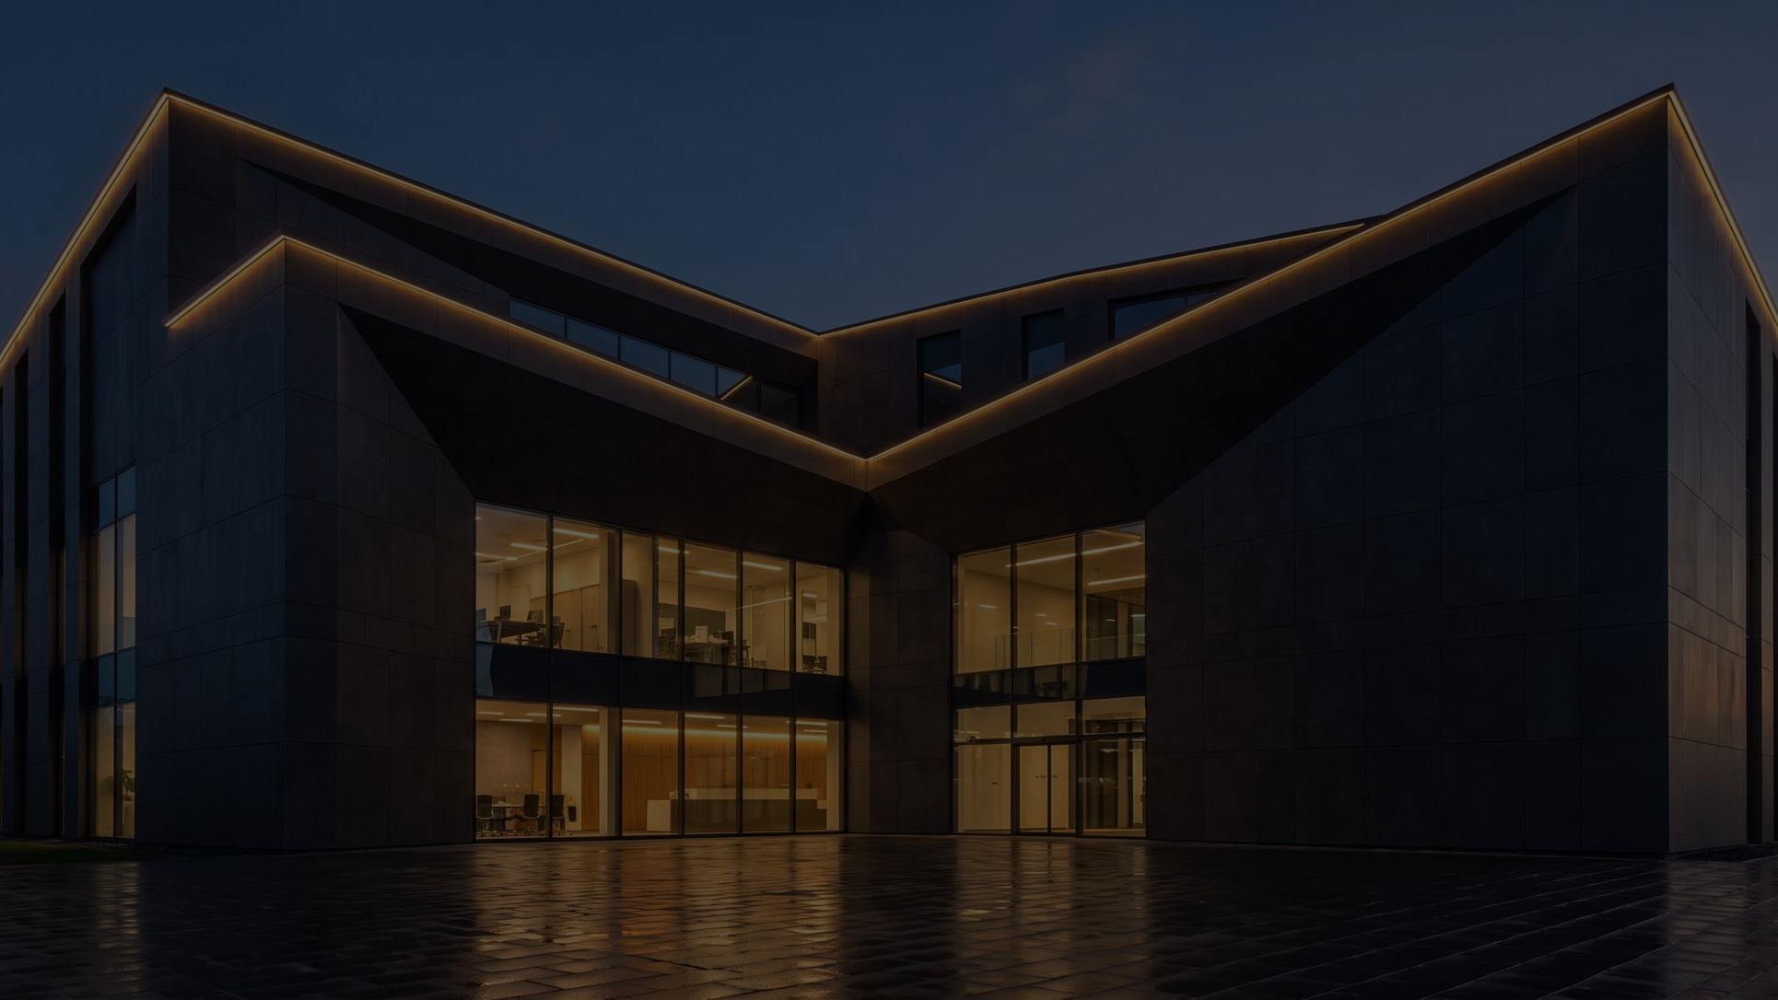
01
THE CORE IDEA
FROM MORBI.
TO THE WORLD.
Morbi fires most of India's porcelain — and almost nobody outside the trade knows its name. The concept turns that anonymity into the story: name the town, then prove the reach.
The site opens on a black panel and a lit interior, holds a single Indian face against a marble wall, then spends twenty-two full-bleed screens walking a buyer from a Gujarat kiln to a lobby in forty countries.
It is built to make an importer in Dubai, Nairobi or Warsaw feel they are dealing with a house, not a supplier — and to make an Indian origin read as provenance, not as a discount.
ONE-LINE PHILOSOPHY
Indian origin, stated proudly. Global standard, demonstrated quietly.
ORKAY TILES INTERNATIONAL · WEBSITE CONCEPT 01
02

Slide 4
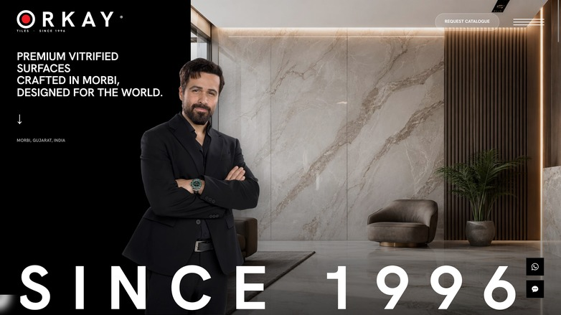
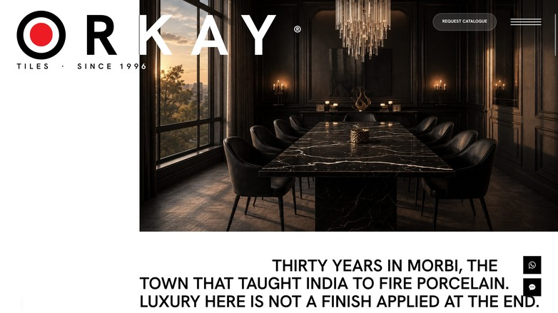
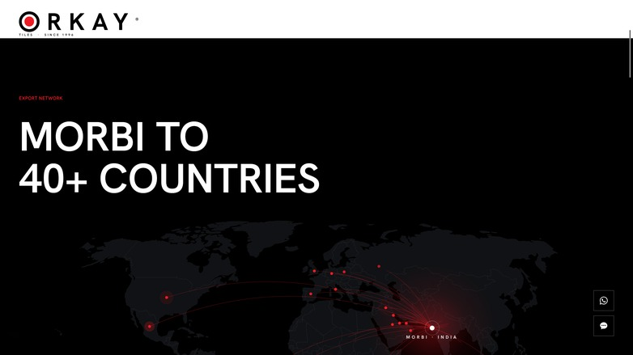
01
THE CORE IDEA · ON SCREEN
THREE SCREENS CARRY THE WHOLE THESIS
ORIGIN
PLACE
REACH
A single Indian figure, a marble wall, and SINCE 1996 set across the full width. Person first, material second, brand third — the order a surfaces manufacturer needs.
The wordmark scales to 2.7× over one word — MORBI. The town is given the same typographic weight as the brand, because the concept says it earned it.
Every red arc leaves one gate in Gujarat. The map is the proof asset: 40+ countries, one origin, and it owns its screen entirely.
ORKAY TILES INTERNATIONAL · WEBSITE CONCEPT 01
03

Slide 5
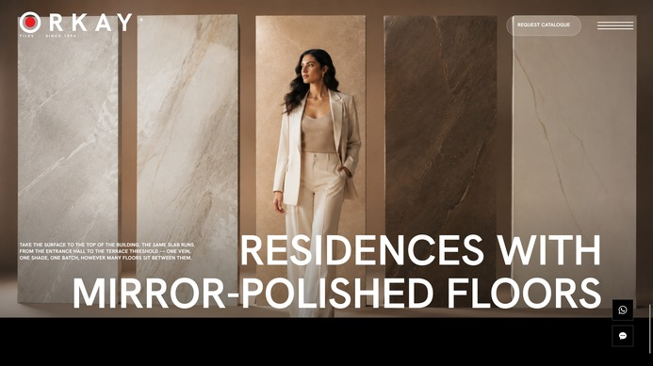
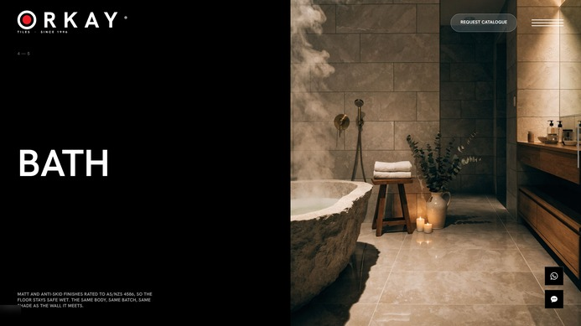
02
VISUAL CONCEPT & DESIGN LANGUAGE
A GALLERY, NOT A CATALOGUE.
AESTHETIC
Editorial full-bleed. Twenty-two screens, one subject each — no product grid anywhere on the page.
VISUAL PERSONALITY
Composed and unhurried. Confident enough to leave a third of the first screen completely unlit.
LAYOUT PHILOSOPHY
Copy anchored left, imagery right. A predictable axis the eye learns by the third screen.
GEOMETRY & ASYMMETRY
34/66 splits, staggered pairs, matched frames — and one levitating collage as the deliberate exception.
WHITESPACE
Calm fields are load-bearing. They remove alternatives so the subject has nothing to compete with.
MINIMAL, NOT EMPTY
Zero border-radius, zero shadows, one easing curve. Dense with photography, thin on interface.
Two consecutive plates: a full-bleed image with one title, then a panel that holds still while the photograph behind it steps through five rooms. Same language, different tempo.
ORKAY TILES INTERNATIONAL · WEBSITE CONCEPT 01
04

Slide 6
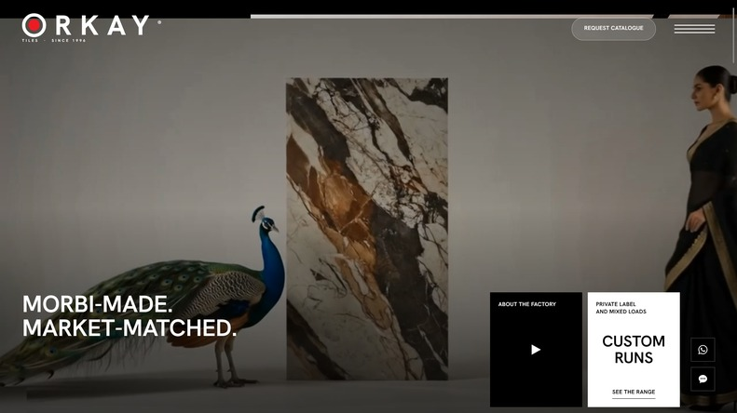
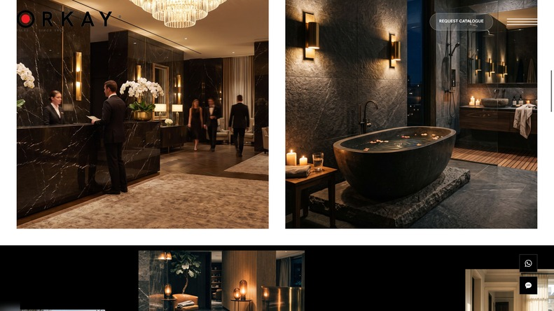
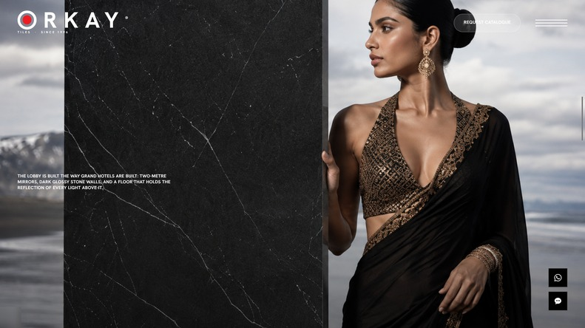

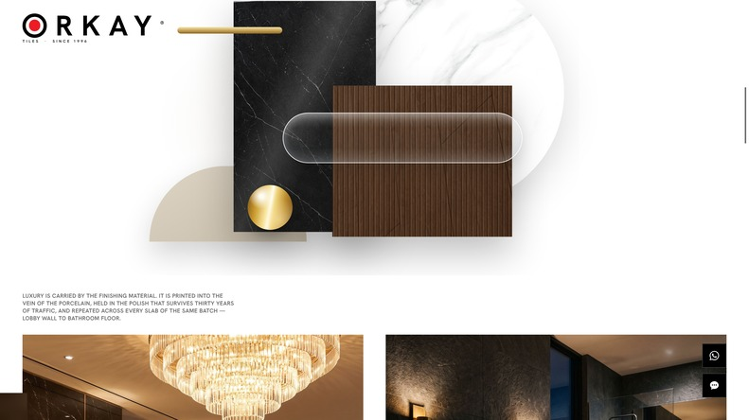
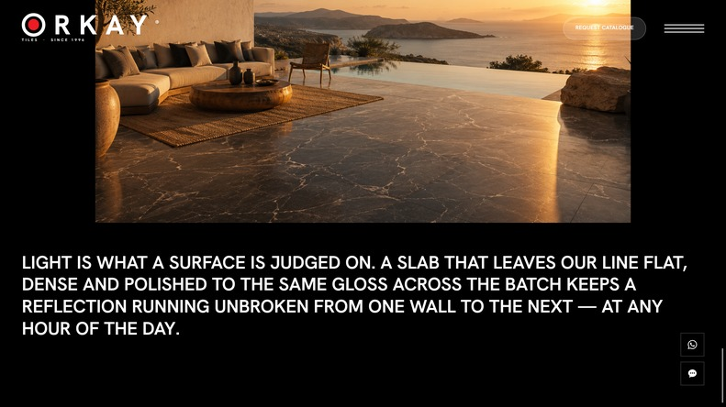
02
VISUAL CONCEPT · MOODBOARD
THE PAGE AS A SEQUENCE OF PLATES
Dark plate, light plate, dark plate. Fourteen black screens and seven white ones alternate eight times down the scroll, so the page reads with a gallery cadence instead of a flat catalogue rhythm.
ORKAY TILES INTERNATIONAL · WEBSITE CONCEPT 01
05

Slide 7
03
COLOUR SYSTEM
COLOUR AS A MATERIAL ENVIRONMENT
WHY THIS PALETTE
Tile is sold on colour. Any brand colour on the page competes with the product, so the interface keeps none: it is black, white and one red hairline.
Every colour a visitor sees is a surface ORKAY actually manufactures. The palette is the material.
BLACK
WHITE
ORKAY RED
LIGHT GREY
MID GREY
#000000
#FFFFFF
#ED1C24
#AAAAAA
#666666
PRIMARY
PRIMARY
ACCENT
SUPPORT
SUPPORT
CONTRAST STRATEGY
COLOUR PSYCHOLOGY
RED, HELD BACK
Polarity, not shading. Every section is declared ui-dark or ui-light and never a mid-grey. Pure #000 against pure #FFF gives 21:1, so type never needs a shadow or a scrim to survive.
Black is the gallery wall: it makes stone look expensive and removes every distraction around it. White is the specification sheet — where technical copy, formats and packing data live.
#ED1C24 is sampled from the ORKAY bullseye. In the UI it appears only as a 1px rule, a section label, a map arc, a hover and a focused form field — never as a fill. Scarcity is what makes it read as brand.
ORKAY TILES INTERNATIONAL · WEBSITE CONCEPT 01
06

Slide 8
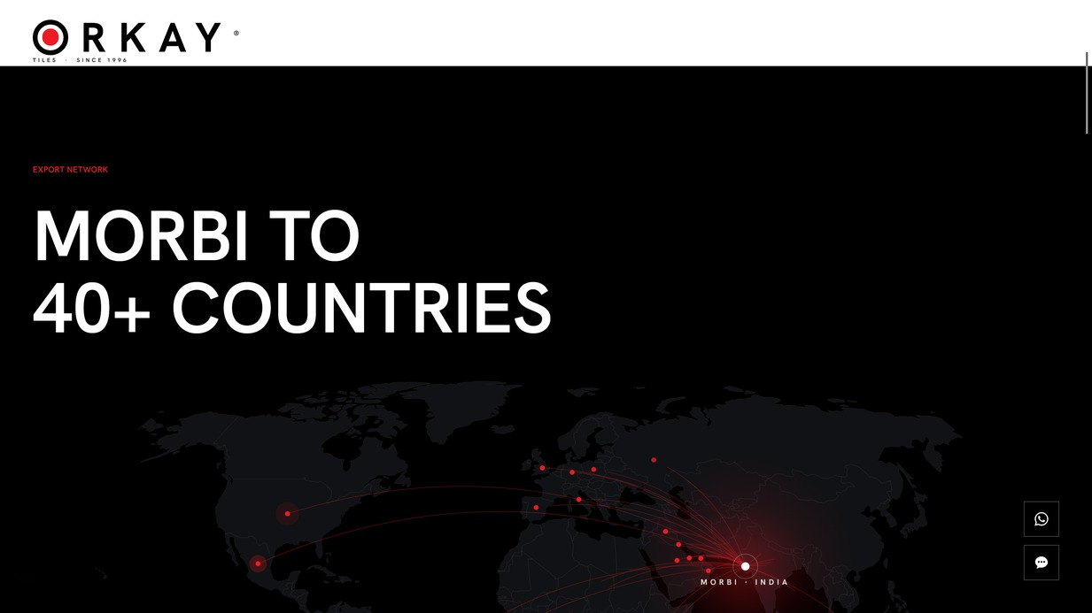
03
COLOUR SYSTEM · THE ACCENT
ONE RED, SPENT LIKE CURRENCY
THE BULLSEYE
The only literal brand red that never inverts. The fixed wordmark runs a white layer plus a black ink clone whose clip-path is recomputed every frame — the red dot stays red through both.
SECTION LABELS
Export Network. Infrastructure. Our Products. Contact. Eight words on the entire page, each one red, each one 12px.
THE MAP
Arcs, pulse rings and the Morbi origin marker. Red is the export network made visible.
INTERACTION ONLY
The export map is the one screen where red is allowed to multiply — and it is still only a 0.5px arc and a 2.4px dot. Forty-plus markers read as a constellation rather than as decoration, because nothing else on the black plate is coloured.
Menu hover, product rule wipe, footer heads, form focus border. Red never appears until the visitor does something.
ORKAY TILES INTERNATIONAL · WEBSITE CONCEPT 01
07

Slide 9
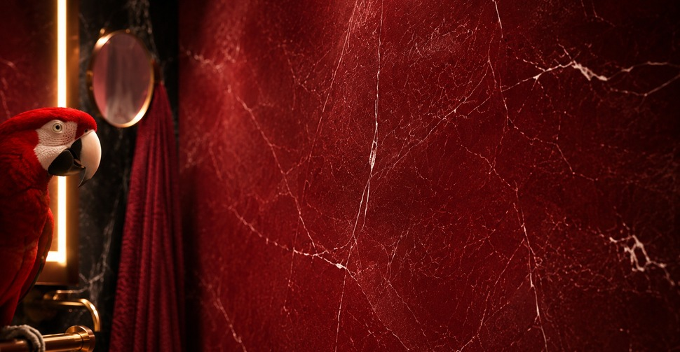
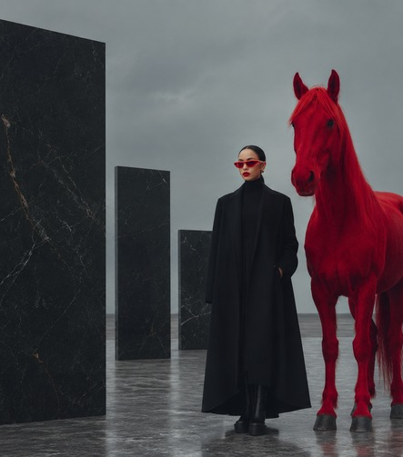
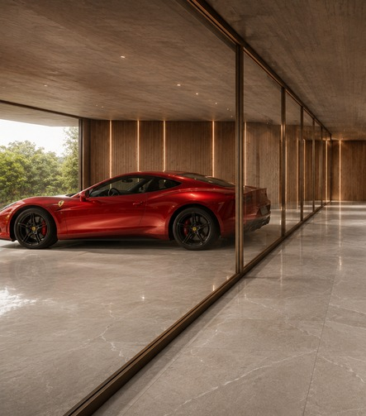
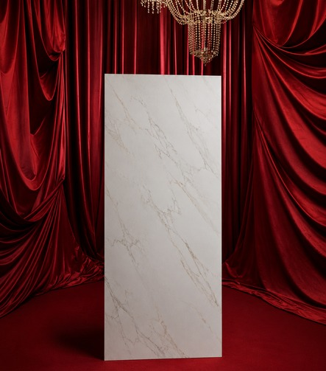
03
COLOUR SYSTEM · THE BRAVE MOVE
RED IS NOT ON THE INTERFACE. IT IS IN THE ROOM.
The bravest colour decision on the site is that brand recognition is carried by the photography, not by the chrome. Four screens are art-directed around ORKAY red — and each one is a surface, an object or a set, never a graphic.
ROSSO MARBLE BATH
THE RED HORSE
THE RED CAR
RED VELVET, 2016
A full wall of deep red marble-look porcelain, veined white and lit low. The brand colour arrives as the product itself — and a scarlet macaw holds the left edge, so the eye lands on red before it reads the room.
Black slabs stood in an open yard, a figure in black, and one saturated red horse. Fashion-campaign nerve on a tile site: the only colour in the frame is the brand's.
Behind glass, on polished ORKAY floor. Red as aspiration rather than as branding — it signals the buyer's world and reflects into the surface being sold.
A statuario slab on a red velvet stage under a chandelier. The milestone that put ORKAY at 65,000 sq.m a day is staged like a couture reveal.
Result: a visitor who never reads the logo still leaves with the colour. Recognition is built into the art direction, so it survives a screenshot, a Pinterest crop and a printed catalogue page.
ORKAY TILES INTERNATIONAL · WEBSITE CONCEPT 01
08

Slide 10
04
TYPOGRAPHY & HIERARCHY
TYPOGRAPHY CREATES THE VOICE
HANKEN GROTESK · 600 SEMIBOLD / 700 BOLD · SET UPPERCASE THROUGHOUT
WHY THIS TYPEFACE BELONGS HERE
SINCE 1996
Three voices, no more. Display, mid, small — one page, one scale, zero exceptions. A serif or a decorative face would have decorated the product; a geometric grotesk stays out of the way of stone.
Uppercase everywhere. Caps give a wordmark rhythm to running copy and let type sit directly on photography without a box behind it — the discipline architecture and fashion houses use on signage.
Wide tracking on the small voice. 0.36px on 12px copy turns specification detail — sizes, kg per box, sq.m per container — into something that reads as an engraved plate rather than a datasheet.
One weight pair. 600 for everything, 700 for the wordmark and display line, so hierarchy comes from scale and space rather than from six competing weights.
DISPLAY · CLAMP(44 – 110PX) · LINE-HEIGHT 1.02
Crafted in Morbi.
Designed for the World.
MID · CLAMP(28 – 48PX) · LINE-HEIGHT 1.07
VITRIFIED · PORCELAIN · CERAMIC · SLABS · COUNTERTOPS · OUTDOOR
SMALL · 12PX / 16PX · LETTER-SPACING 0.36PX
ORKAY TILES INTERNATIONAL · WEBSITE CONCEPT 01
09

Slide 11
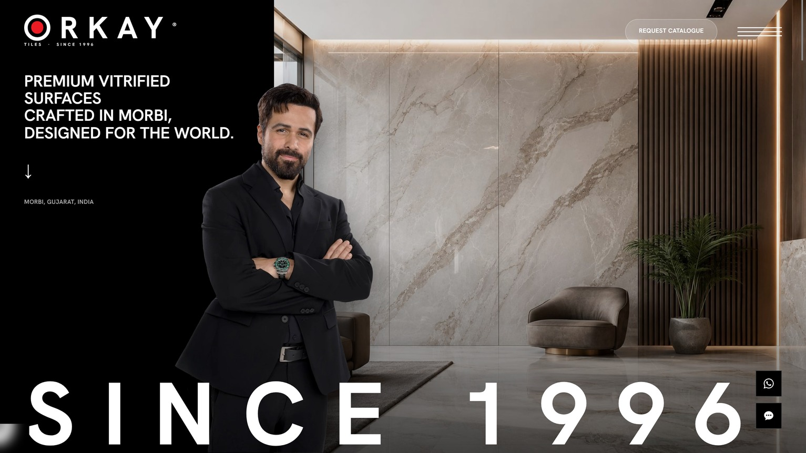
04
TYPOGRAPHY & HIERARCHY · THE LADDER
ONE DECISION PER SCREEN
1
THE SUBJECT
A human figure on the seam between the black panel and the lit interior — maximum tonal separation, maximum pull.
2
THE MATERIAL
The marble wall behind him. The product registers inside the first second without being sold to anyone.
3
THE SIGNATURE
SINCE 1996 spans the full viewport width, flex space-between, so the glyphs land exactly on both margins.
4
THE ONE ACTION
A single glass pill in the top-right quadrant. Isolation beats size — there is exactly one thing to click.
The desktop fold: four elements, one of them a face, and 34% of the width left deliberately unlit.
ORKAY TILES INTERNATIONAL · WEBSITE CONCEPT 01
The same ladder is rebuilt 21 more times down the scroll.
10

Slide 12

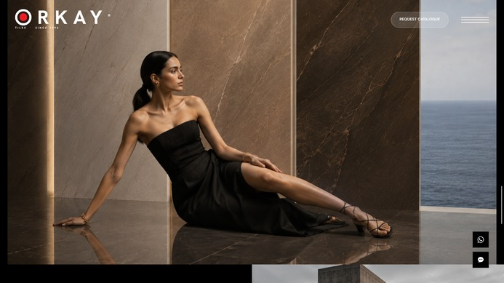
05
IMAGE & ART DIRECTION
MAKING SURFACES THE HERO.
PHOTOGRAPHY DIRECTION
Set-built, not catalogue. Every frame is lit for one material and stripped of any prop that would compete with it.
SCALE & CROPPING
Full-bleed by default. Slabs are shot standing, at human height, so a 1200×2400 panel reads as architecture rather than as a sample.
HUMAN PRESENCE
Used sparingly, always for scale or aspiration. A figure beside a slab tells an importer the size faster than a dimension line does.
LIGHTING & MOOD
Low-key, directional, specular. Gloss is the product claim, so every hero frame carries a reflection running across the floor.
IMAGE ↔ TYPOGRAPHY
Type sits on the photograph, never inside a box. Caps and a single scrim gradient do the work a panel would otherwise do.
WHY THESE IMAGES BELONG
Each one answers a buyer's question — how big, how it reflects, how it ages, how it looks in my light. None is mood for its own sake.
A slab on a black-sand shore and a dining room at sunset. Both are product photographs; neither looks like one.
ORKAY TILES INTERNATIONAL · WEBSITE CONCEPT 01
11

Slide 13
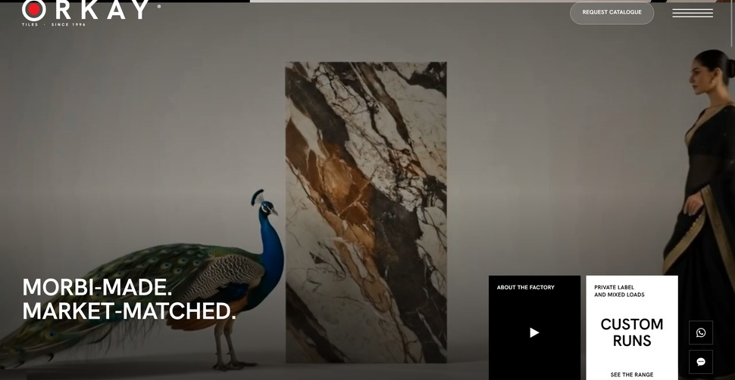
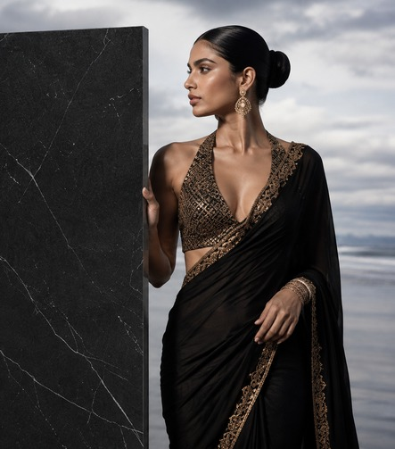
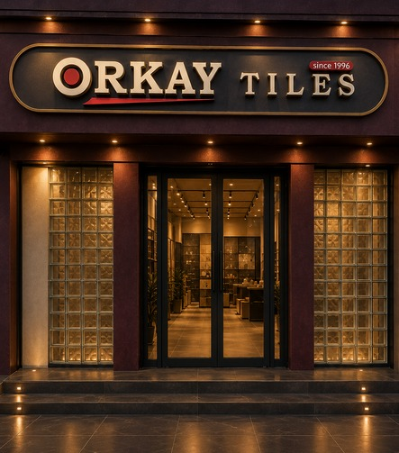

05
IMAGE & ART DIRECTION · MORBI
THE INDIAN THREAD, SHOWN AS LUXURY
Indian-ness is never signalled with a flag, a pattern or a colour cliché. It arrives through casting, craft and place — the same way a European house signals its own origin.
THE PEACOCK & THE SARI
GOLD ZARI ON BLACK
THE FIRST SHOWROOM
MUNDRA PORT
A peacock beside a book-matched slab, a woman in a black-and-gold sari holding the right edge. India stated at couture register, not at souvenir register — and it is the second screen on the site.
Nero slab, black sari, gold embroidery and jhumka earrings against an Icelandic shore. Indian craft placed on a world stage, literally.
1996: gold letters, glass block, and the ORKAY bullseye with its red underline lit above the door. The brand's own history becomes the imagery.
Crated slabs on the quay at sunrise. Morbi is never presented as remote — it is presented as three hours from a deep-water port.
And a national brand ambassador standing in the fold: an Indian face is the first fixation on the entire site, by design.
ORKAY TILES INTERNATIONAL · WEBSITE CONCEPT 01
12

Slide 14
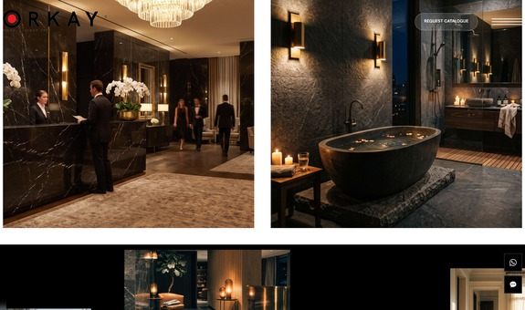
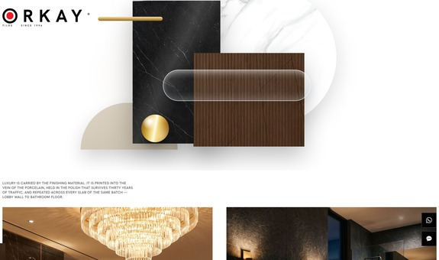
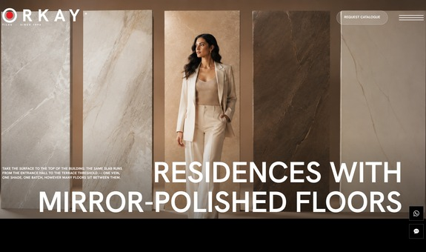
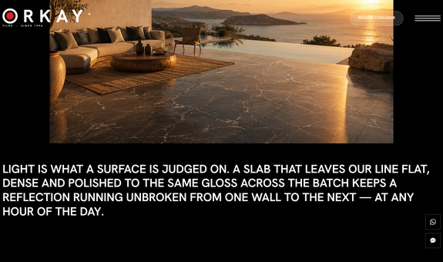
05
IMAGE & ART DIRECTION · LUXURY
LUXURY IS PROVED BY THE ROOM, NOT BY THE WORD
No badges, no gold gradients, no 'premium' label anywhere in the copy. Luxury is established the way it is established in print: restraint, scale, light, and one expensive-looking object per frame.
MATCHED PAIR
THE LEVITATING PLATE
MIRROR-POLISHED
GOLDEN HOUR
A hotel lobby and a dark bathroom, identical frame width and height, one caption between them. The symmetry is the argument: same slab, two rooms, one batch.
Statuario disc, veined nero, fluted walnut, travertine dome, brass rod, glass capsule — the collage drifts away from the cursor. The only maximal screen on the site.
Full-bleed image, one title, nothing else. The claim — one vein, one shade, one batch — is carried entirely by the reflection.
A clifftop terrace above an infinity pool. Light is what a surface is judged on, so the closing plate is a lighting test disguised as a lifestyle shot.
Every one of these frames is also a product shot. Nothing on the page is decorative-only — the mood board and the catalogue are the same asset.
ORKAY TILES INTERNATIONAL · WEBSITE CONCEPT 01
13

Slide 15
06
UX & USER JOURNEY
DESIGNING THE JOURNEY FROM INSPIRATION TO ENQUIRY
01
02
03
04
05
DISCOVER
→
EXPLORE
→
UNDERSTAND
→
SELECT
→
ENQUIRE
HERO → MORBI → EXPORT MAP
MATERIALS → GALLERY → SPACES
RANGES → APPLICATIONS → FORMATS
1,000 DESIGNS → TECHNOLOGIES
FLOATING CONTACT → FOOTER
Who made this, where, and how far it already ships. Three screens, no navigation required.
Browse surfaces the way a designer does — by room and by mood, never by SKU.
Seven ranges, three environments, four sizes. The tool screens live here, deliberately mid-scroll.
Range depth and capacity, so a buyer can size the order before they size the relationship.
A 52px WhatsApp and chat pair pinned to the thumb arc at every breakpoint, plus the full contact block.
NAVIGATION PHILOSOPHY
INFORMATION HIERARCHY
PRODUCT DISCOVERY & CTA
Scroll is the primary navigation. The burger menu holds four links only — Home, About, Products, Contact — because the page already is the sitemap.
Emotional proof first, technical proof second. Packing tables and container loads exist, but they sit below the point where a visitor has already been convinced.
Gallery lightboxes, a format stepper and an arrow-driven applications rail. One action above the fold, one persistent affordance in the thumb zone, one contact block at the end. No pop-ups.
ORKAY TILES INTERNATIONAL · WEBSITE CONCEPT 01
14

Slide 16
07
INTERACTION, MOTION & DIGITAL EXPERIENCE
MOVEMENT WITH PURPOSE
Every behaviour below exists to answer a question a buyer would otherwise have to ask. None of it loops in the periphery competing with the subject.
SMOOTH SCROLL
Makes a 22-screen page feel like turning pages instead of dragging a document.
PINNED SEQUENCES
Four sections hold the viewport while their content steps. A scroll-past becomes measured dwell time on product content.
LENIS-DRIVEN INERTIA
SPACES · RANGES · APPLICATIONS · FORMATS
LINE REVEALS
The positioning statement arrives as a sentence being spoken, not as a block appearing.
IMAGE WIPES
A slab uncovers the way a sample is drawn out of a rack — the motion mirrors the material.
HEADLINES SPLIT INTO MASKED LINES
CLIP-PATH REVEALS, LEFT AND RIGHT
THE ZEBRA WORDMARK
The fixed mark stays legible over black and white plates without ever changing colour. The red bullseye never inverts.
THE LEVITATION PLATE
Six collage pieces move at different depths. The one moment the site plays — and it sits on Premium Materials.
DUAL-LAYER CLIP INVERSION
CURSOR LERP + SCROLL DRIFT
THE DAY DIAL
One floor at 07:00, 13:00, 19:00 and 23:00. Answers 'how will it look in my light?' in four clicks.
FORMAT STEPPER
600×1200 down to 400×400 redraws with dimension lines — a spec sheet that behaves like a configurator.
CLOCK HANDS SWING TO EACH HOUR
TABS DRIVE A LIVE SVG PLAN
THUMB-ZONE CONTACT
WhatsApp and chat pinned bottom-right at every breakpoint — the highest tap-density zone on a phone.
REDUCED MOTION
Every reveal has a painted base state and autoplay is suppressed, so the page is complete without animation.
52 × 52PX, PERSISTENT
PREFERS-REDUCED-MOTION HONOURED
ORKAY TILES INTERNATIONAL · WEBSITE CONCEPT 01
15

Slide 17
08
VALIDATION · VISUAL ATTENTION HEAT-MAP
THE DESIGN, MEASURED
7.5
3.1
COMPETING FOCALS PER SCREEN
77%
SCREENS WITH 3 FOCALS OR FEWER
Category norm is 8–12
45% carry two or fewer
/10
4.2
FOCAL CLARITY INDEX, OUT OF 5
9/10
IMAGERY ATTENTION QUALITY
OVERALL HEAT-MAP SCORE
WELL ABOVE CATEGORY NORM
Across all 22 sections
The highest-scoring dimension
WHAT THE MODEL FOUND
Heat concentrates, it does not scatter
The fold lands in under 0.4 seconds
Two dense screens — both on purpose
Nearly every screen resolves to one dominant subject. Very few sites in this category hold a single focal per screen this consistently.
A face is the strongest saliency trigger in visual perception, and here it sits on the seam between the dark panel and the lit interior.
The materials collage and the gallery are browse surfaces where scanning, not fixation, is intended. No unintended competition was found anywhere.
ORKAY TILES INTERNATIONAL · WEBSITE CONCEPT 01
16

Slide 18
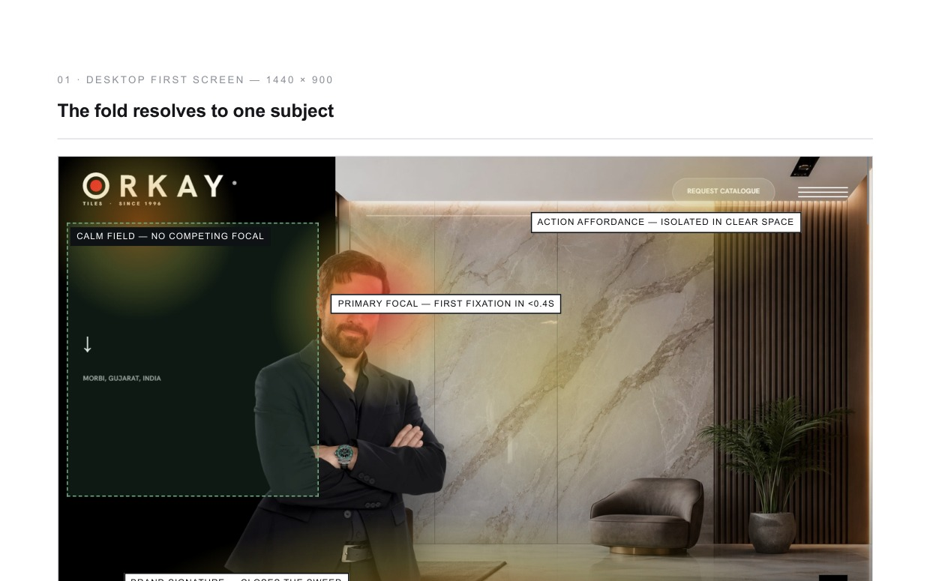
08
VALIDATION · WHERE THE EYE GOES
A MAGAZINE SIGNATURE, NOT A CATALOGUE SIGNATURE
EIGHT TONAL RESETS
The page alternates dark and light plates eight times. Each switch forces a pupil adjustment and re-engages attention — why long editorial scrolls hold a reader.
A PREDICTABLE READING AXIS
Copy left, imagery right, learned by roughly the third screen. Scanning cost drops sharply from there; the few reversals are used as accents.
TEN SINGLE-SUBJECT SCREENS
10 of 22 sections present two or fewer competing elements. On a heat map these render as one clean hotspot each — the strongest structural finding in the report.
ERGONOMICS AHEAD OF CATEGORY
The persistent 52px contact affordance sits inside the bottom-right thumb arc. Most manufacturer sites put contact behind a menu and a scroll.
The rendered desktop fold with the modelled attention overlay: a calm field on the left third, one primary fixation, one isolated action affordance, and the brand signature closing the sweep.
Projected 8.9 / 10 — every remaining point is one crop value, one copy block and three style rules.
ORKAY TILES INTERNATIONAL · WEBSITE CONCEPT 01
17

Slide 19
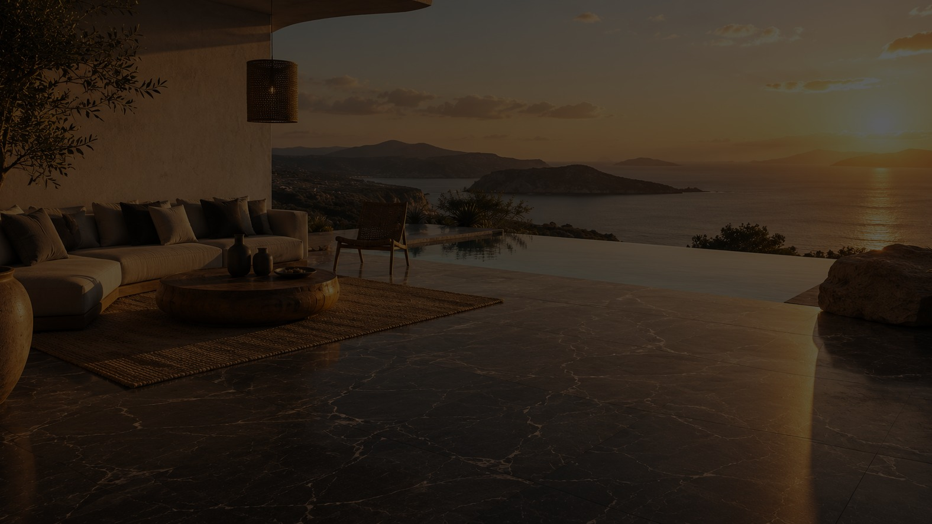
08
THE EXPERIENCE · DESIGN RATIONALE
WHY THIS CONCEPT WORKS
DISTINCTIVE
MEMORABLE
EASY TO USE
No competitor in this category opens on a face and a calm field. The page looks like a fashion house that happens to fire porcelain.
Recognition is built into the photography — a red marble wall, a red horse, a red car, red velvet. The colour survives without the logo.
Twenty-two screens, 3.1 competing elements each, one predictable reading axis, one persistent way to make contact.
IT SHOWCASES THE PRODUCT
IT CREATES THE RIGHT PERCEPTION
IT IS COHERENT
Every frame is simultaneously a mood image and a product shot. Nothing on the page is decoration-only.
Indian origin reads as provenance. Seven units and 16,000 sq.m a day read as capability. Neither is claimed loudly.
One accent, one easing curve, three type voices, zero radius, zero shadows. A system small enough to hold in the head — which is why it never breaks.
Crafted in Morbi. Designed for the World.
One town, named without apology. One standard, demonstrated without a single superlative.
ORKAY TILES INTERNATIONAL · WEBSITE CONCEPT 01
18

