Slide 1
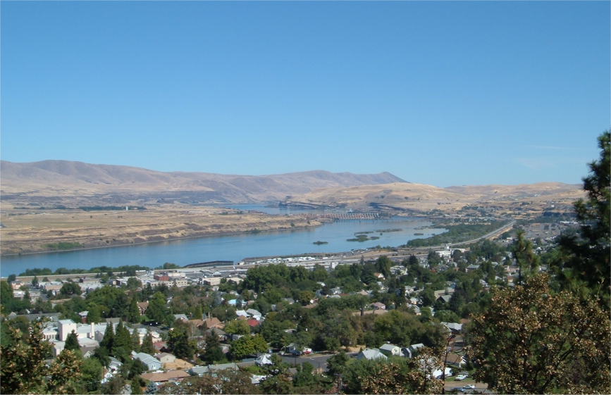
Map Reduce
CS4230
Jay Urbain, Ph.D.
Credits:
Jeffery Dean and Sanjay Chemawat. MapReduce
Barroso and Urs Hölzle (2009))
Jimmy Lin and Chris Dyer. Data Intensive Text Processing with MapReduce

Slide 2

The datacenter is the computer

Slide 3
Big Ideas
Scale out, not up
Limits of SMP (symmetric multi-processing) and large shared-memory machines
Move processing to the data
Cluster has limited bandwidth
Process data sequentially, avoid random access
Seeks are expensive, disk throughput is reasonable
Seamless scalability
Without synchronization issues, we move from the mythical man-month to the tradable machine-hour

Slide 4
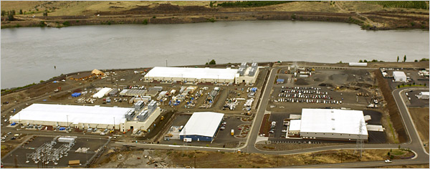
Source: NY Times (6/14/2006)

Slide 5
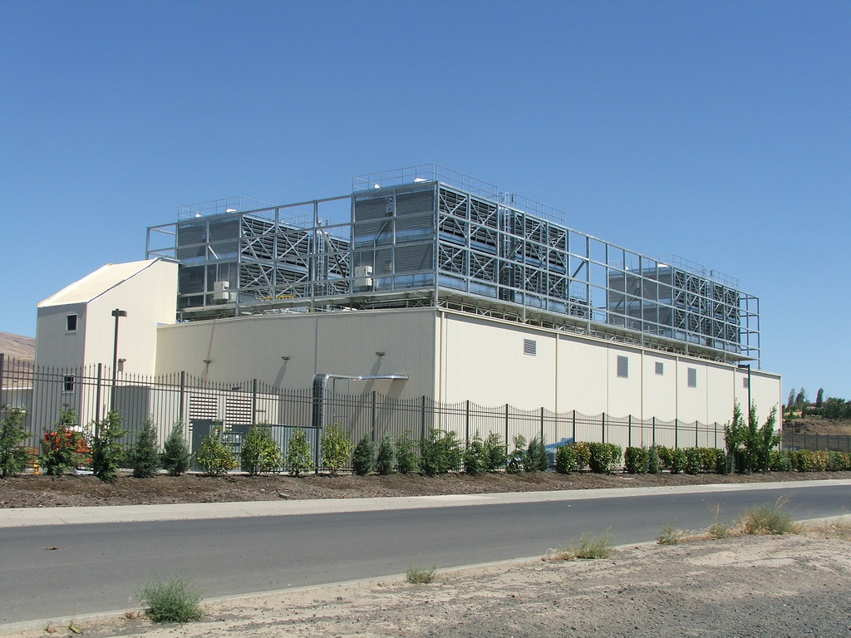
Source: www.robinmajumdar.com

Slide 6
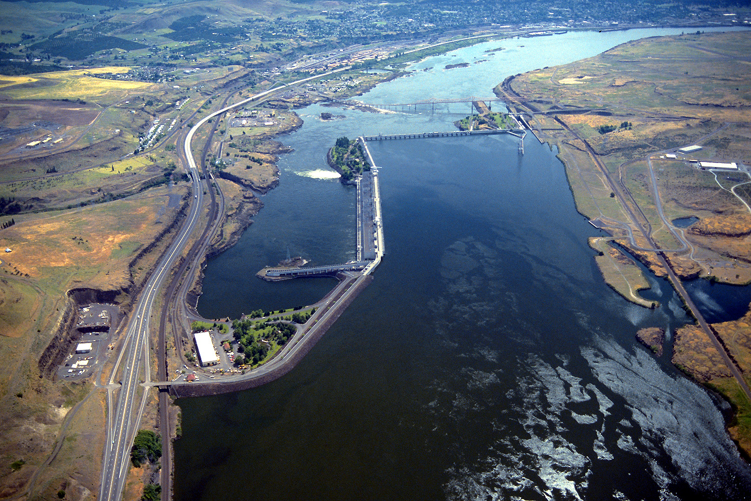
Source: Bonneville Power Administration

Slide 7
Typical Large-Data Problem
Iterate over a large number of records
Extract something of interest from each
Shuffle and sort intermediate results
Aggregate intermediate results
Generate final output
Map
Reduce
Key idea: provide a functional abstraction for these two operations.
(Dean and Ghemawat, OSDI 2004)

Slide 8
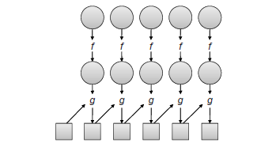
Roots in Functional Programming
Functional programming
Treats computation as the evaluation of mathematical functions.
Avoids state and mutable data.
Map and fold: map takes function f applies it to every element in a list, fold iteratively applies g to aggregate results.
Map
Fold

Slide 9
MapReduce – Map + Reduce
"Map" step:
The master node takes the input, partitions it up into smaller sub-problems, distributes to worker nodes.
The worker node applies a function to that smaller sub-problem
"Reduce" step:
The master node then takes the answers to all the sub-problems and aggregates them in some way to get the output — the answer to the problem it was originally trying to solve.

Slide 10
MapReduce - Programmatic
Programmers specify two functions:
map (k, v) → <k’, v’>*
reduce (k’, v’) → <k’, v’>*
Input data stored on underlying distributed file system (GFS, HDFS).
Mapper is applied to every input key-value pair (k, v) to generate an arbitrary number of intermediate key-value pairs <k’, v’>*.
Reducer is applied to all values associated with the same intermediate key (k’, v’) to generate output key-value pairs <k’, v’>*.
Implicit between the map and reduce phases is a distributed “group by” operation on intermediate keys.
Intermediate data arrive at each reducer in key sorted order.

Slide 11
MapReduce - Notes
Notes:
Output key-value pairs from each reducer are written persistently back onto the distributed file system.
Intermediate key-values pairs are transient and are not preserved.
The output ends up in r files on the distributed file system where r is the number of reducers.

Slide 12
k₁
v₁
k₂
v₂
k₃
v₃
k₄
v₄
k₅
v₅
k₆
v₆
map
map
map
map
a
1
b
2
c
3
c
6
a
5
c
2
b
7
c
8
Shuffle and Sort: aggregate values by keys
a
1
5
b
2
7
c
2
3
6
8
reduce
reduce
reduce
r₁
s₁
r₂
s₂
r₃
s₃

Slide 13
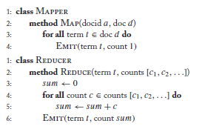
MapReduce Example
Word count algorithm

Slide 14
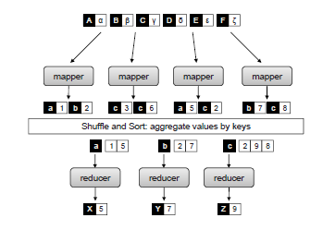
MapReduce Example
Simplified MapReduce view

Slide 15
MapReduce
Programmers specify two functions:
map (k, v) → <k’, v’>*
reduce (k’, v’) → <k’, v’>*
All values with the same key are sent to the same reducer
The execution framework handles everything else…
What’s “everything else”?

Slide 16
Execution Framework
One of the most important ideas behind MapReduce is separating the what of distributed processing from the how.
A MapReduce program (job) consists of:
Code for mappers and reducers (as well as combiners and partitioners … later)
Configuration parameters (e.g., where the input lies and where the output should be stored)
The developer submits the job to the submission node of a cluster (jobtracker).
The execution framework (runtime) takes care of everything else.

Slide 17
MapReduce Runtime
Handles scheduling
Assigns workers to map and reduce tasks
Handles “data/code distribution”
Moves processes to data
Handles synchronization
Gathers, sorts, and shuffles intermediate data
Handles errors and faults
Detects worker failures and restarts
Everything happens on top of a distributed file system (GFS!)

Slide 18
Runtime Scheduling Issues
Scheduling involves coordination among tasks belonging to different jobs.
Speculative execution optimization (dealing with Stragglers)
The map phase of a job is only as fast as the slowest map task.
Completion of a job is bounded by the running time of the slowest reduce tasks.
Speculative execution makes identical copy of the same task and executes on a different machine, use first task completed.
Shown to improve running times by 44%.

Slide 19
Runtime Data/code Distribution Issues
Need to somehow feed data to co-located code.
Dependent on scheduling and underlying distributed file system.
The scheduler starts tasks on the node that holds a particular block of data, i.e., local drive, needed by the task.
In effect moving the code to the data.
If this is not possible, it must stream data across the network.
An optimization here is to prefer nodes that are on the same rack in the datacenter – inter-rack BW is much slower.

Slide 20
Runtime Synchronization Issues
Synchronization accomplished by a barrier between the map and reduce phases of processing.
Intermediate key-value pairs must be grouped by key.
Accomplished by large distributed sort involving all the nodes that executed map tasks and all the nodes that will execute reduce tasks.
Involves copying intermediate data over the network - “shuffle and sort”.
m mappers and r reducers involves up to m x r distinct copy operations.
Reduce computation can not start until all mappers have finished emitting key-value pairs & all key-value pairs have been shuffled and sorted!

Slide 21
Runtime Error and Fault Handling
Disk failures are common
RAM failures
Planned and unplanned data center outages
Software bugs
Large data sets contain corrupted data
Rely heavily on distributed file system

Slide 22
Partitioners and Combiners
Two additional elements that complete the programming model: partitioners and combiners.
Partitioners – divide up intermediate key space and assign intermediate key-value pairs to reducers.
Within each reducer, keys are processed in sorted order
The simplest partitioner involves computing the hash value of the key and then taking the mod of that value with the number of reducers.

Slide 23
Partitioners and Combiners
Combiners – optimization that allows for local aggregation before the shuffle and sort phase.
Word count example:
Emits a key-value pair for each word in the collection!
Key-value pairs need to be copied across the network!
The amount of intermediate data will be larger than the input collection itself!!! – clearly not good.
E.g., perform local aggregation on the output of each mapper, i.e., perform local count for a word over all the documents processed by the mapper.
Number of words reduced to (at most) the number of unique words in the collection times the number of mappers – usually much smaller (Zipfian distribution of word occurrences).

Slide 24
MapReduce
Programmers specify two functions:
map (k, v) → <k’, v’>*
reduce (k’, v’) → <k’, v’>*
All values with the same key are reduced together
combine (k’, v’) → <k’, v’>*
Mini-reducers that run in memory after the map phase
Used as an optimization to reduce network traffic
partition (k’, number of partitions) → partition for k’
Often a simple hash of the key, e.g., hash(k’) mod n
Divides up key space for parallel reduce operations

Slide 25
k₁
v₁
k₂
v₂
k₃
v₃
k₄
v₄
k₅
v₅
k₆
v₆
map
map
map
map
a
1
b
2
c
3
c
6
a
5
c
2
b
7
c
8
combine
combine
combine
combine
a
1
b
2
c
9
a
5
c
2
b
7
c
8
partition
partition
partition
partition
Shuffle and Sort: aggregate values by keys
a
1
5
b
2
7
c
c
2
2
9
3
8
6
8
reduce
reduce
reduce
r₁
s₁
r₂
s₂
r₃
s₃

Slide 26

How do we get data to the workers?
NAS
SAN
Compute Nodes
What’s the problem here?

Slide 27
Distributed File System
Don’t move data to workers… move workers to the data!
Store data on the local disks of nodes in the cluster
Start up the workers on the node that has the data local
Why?
Not enough RAM to hold all the data in memory
Disk access is slow, but disk throughput is reasonable
A distributed file system is the answer
GFS (Google File System) for Google’s MapReduce
HDFS (Hadoop Distributed File System) for Hadoop

Slide 28
GFS: Design Decisions
Files stored as chunks
Fixed size (64MB)
Reliability through replication
Each chunk replicated across 3+ chunkservers
Single master to coordinate access, keep metadata
Simple centralized management
No data caching
Little benefit due to large datasets, streaming reads
Simplify the API
Push some of the issues onto the client (e.g., data layout)
HDFS = GFS clone (same basic ideas)

Slide 29
From GFS to HDFS
Terminology differences:
GFS master = Hadoop namenode
GFS chunkservers = Hadoop datanodes
Functional differences:
No file appends in HDFS (planned feature)
HDFS performance is (likely) slower

Slide 30
HDFS Architecture
HDFS namenode
Application
/foo/bar
(file name, block id)
File namespace
HDFS Client
block 3df2
(block id, block location)
instructions to datanode
(block id, byte range)
datanode state
HDFS datanode
HDFS datanode
block data
Linux file system
Linux file system
…
…
Adapted from (Ghemawat et al., SOSP 2003)

Slide 31
Namenode Responsibilities
Managing the file system namespace:
Holds file/directory structure, metadata, file-to-block mapping, access permissions, etc.
Coordinating file operations:
Directs clients to datanodes for reads and writes
No data is moved through the namenode
Maintaining overall health:
Periodic communication with the datanodes
Block re-replication and rebalancing
Garbage collection

Slide 32
Putting everything together…
namenode
job submission node
namenode daemon
jobtracker
tasktracker
tasktracker
tasktracker
datanode daemon
datanode daemon
datanode daemon
Linux file system
Linux file system
Linux file system
…
…
…
slave node
slave node
slave node

Slide 33
Cloud Resources
Hadoop on your local machine
Hadoop in a virtual machine on your local machine
Hadoop in the clouds with Amazon EC2
Hadoop on the Google/IBM cluster

Slide 34
MapReduce Implementations
Google has a proprietary implementation in C++
Bindings in Java, Python
Hadoop is an open-source implementation in Java
Development led by Yahoo, used in production
Now an Apache project top level project
Rapidly expanding software ecosystem
Lots of custom research implementations
For GPUs, cell processors, etc.

