Slide 1
Hive
Jay Urbain, PhD

Slide 2
Hive
SQL-like query language that generates MapReduce
Developed at Facebook
It uses H-SQL, not quite the same as ANSI SQL, ~70% overlap
Underlying execution much different than relational engine
MapReduce
Batch, not interactive.
Latency in results
Move to Spark, Impala
Often used with HBase wide column database
Create schema “on read”

Slide 3
HBase
Wide-column, NoSQL database
Use CREATE TABLE over HDFS
Once your table is created, query with Hive H-SQL
Hive libraries are integrated with HBase
Hive libraries include the H-SQL/HQL language
Commercial distributions include Hive

Slide 4
Basic Hive usage example:
CREATE TABLE table col1, col2
SELECT col1, col2 FROM table

Slide 5
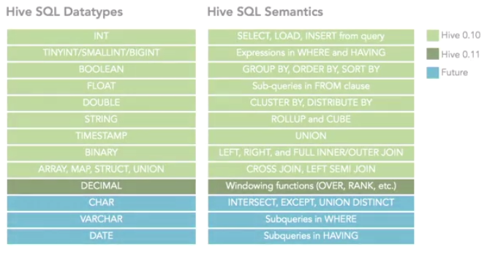
Hive
Note: JOINs can have substantial overhead

Slide 6
Working with Hive
Start the Hive service
Use admin tools to verify its started
Turned on by default with commercial distributions
Managing the metastore database
Stores the metadata for Hive tables in a database
Can be embedded, local, or remote
Schema tool: offline tool for defining schema

Slide 7
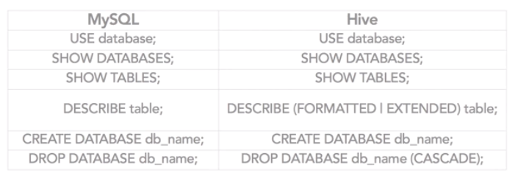
Metadata

Slide 8
Why use Hive?
You’re a analyst, use databases, spreadsheets
You know SQL
Want to ask analytical questions, the questions you ask with SQL
Not as useful for data preprocessing
Use MapReduce, scripting language, Pig
Gives convenience of SQL, but is really MapReduce.
JOINs function differently than on RDBMS
NoSQL has no need to be normalized, very expensive operation on big data

Slide 9
WordCount in Hive
Pseudo code:
Create HBase table for text input
Load your data into the table
Create a new destination table
Load the table with processed results

Slide 10
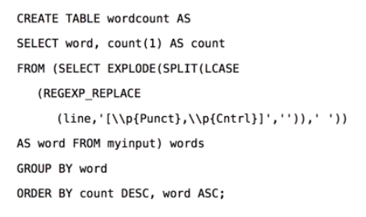
WordCount in Hive
Regex is ugly, best to use something else for preprocessing

Slide 11
Using Hive
HBase tables and Hive queries
Query optimization for Hive
Partitioning, bucketizing, or sampling (subsets)
Cost-based optimization (CBO)
Column based statistics

Slide 12
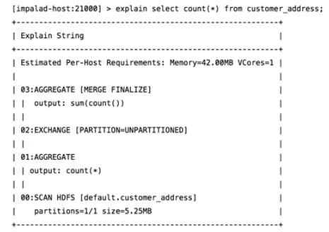
Reading HQL Query Plans
Read from bottom to top:

Slide 13
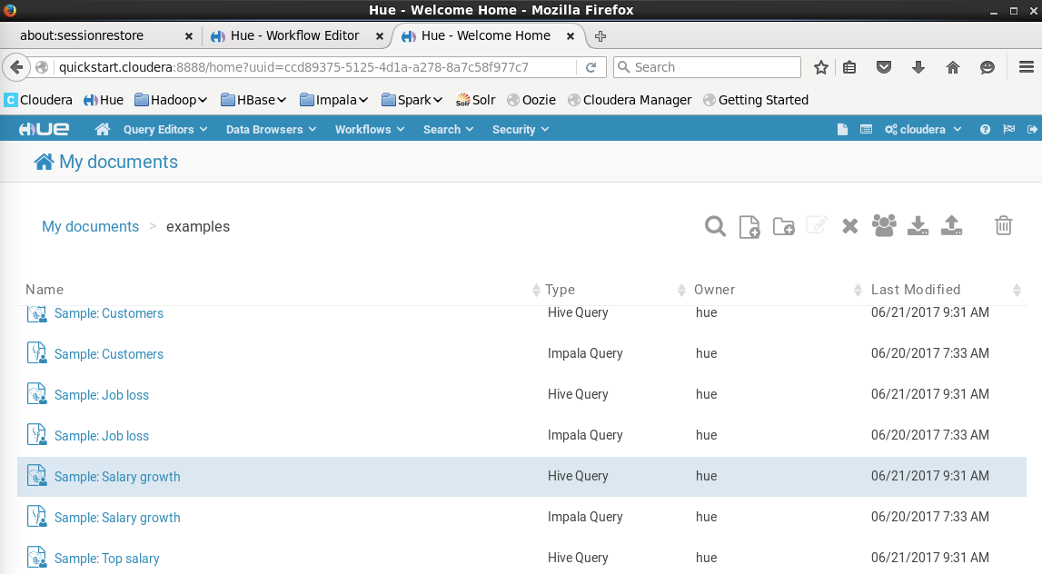
Hue Home -> examples -> Salary Growth (Hive Query)

Slide 14
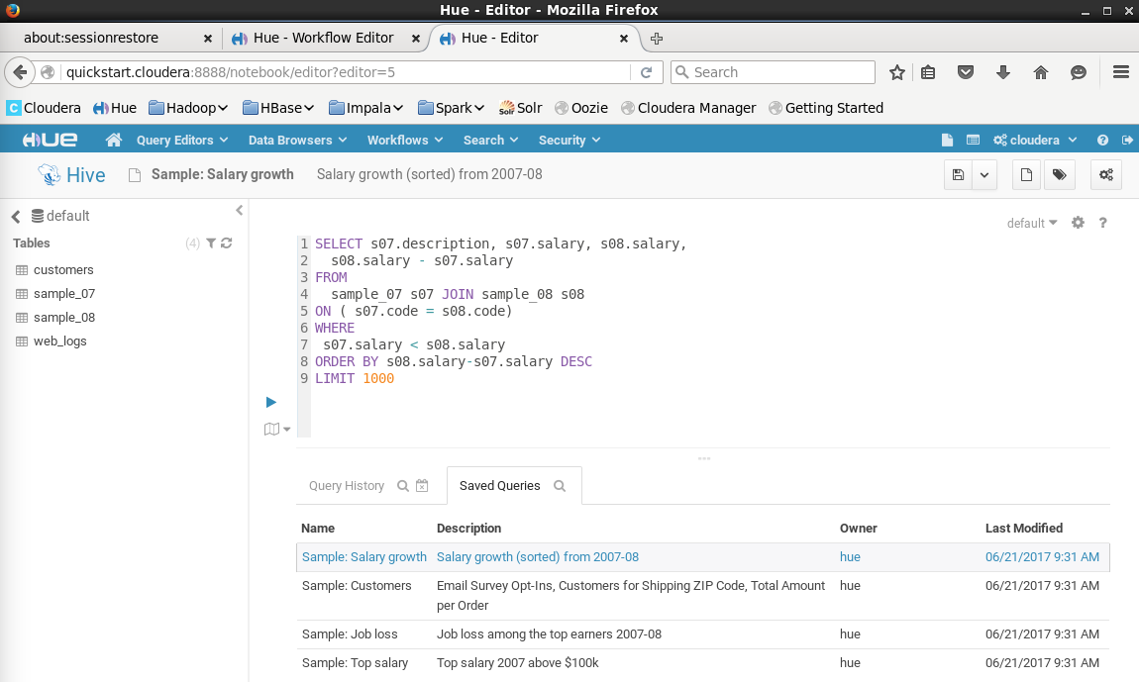
Execute Query

Slide 15
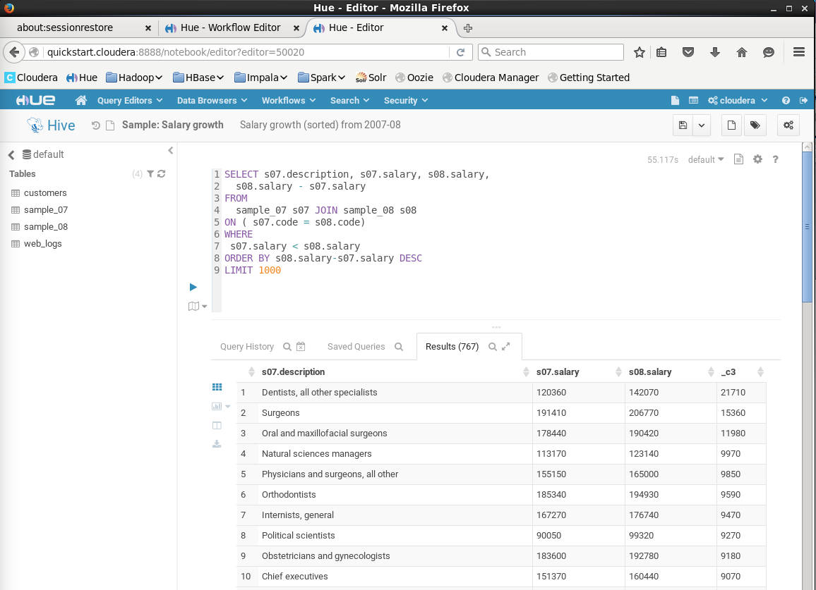

Slide 16
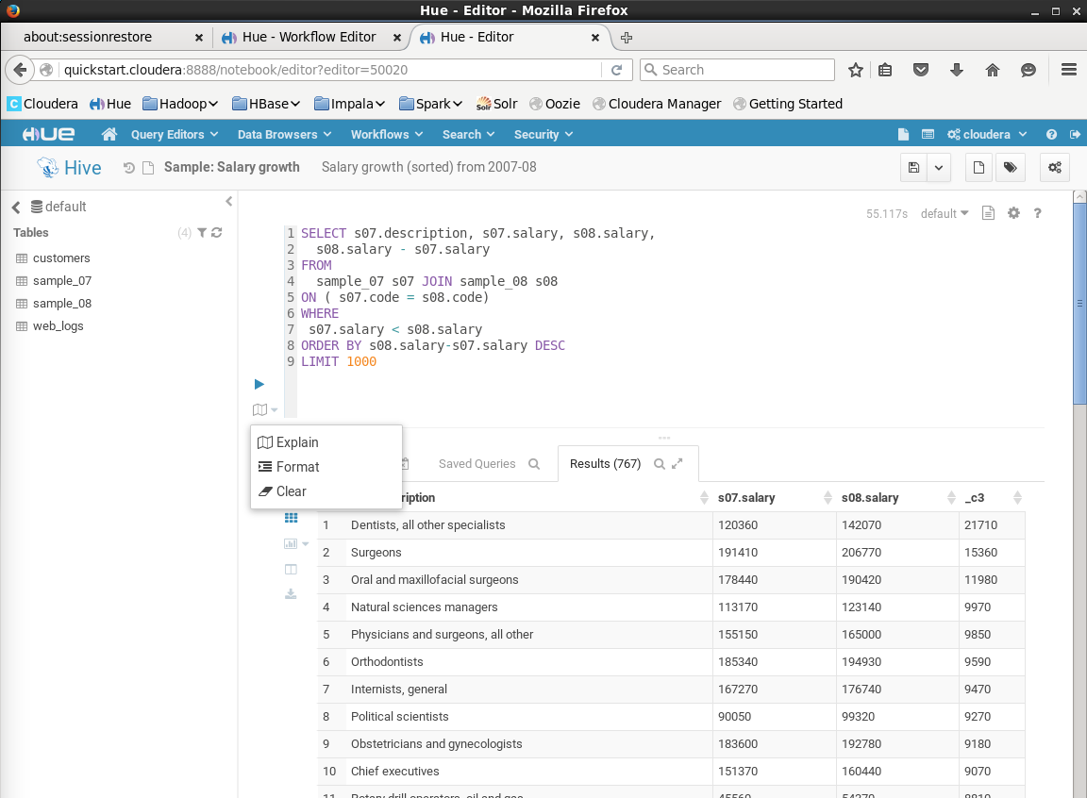
Explain

Slide 17
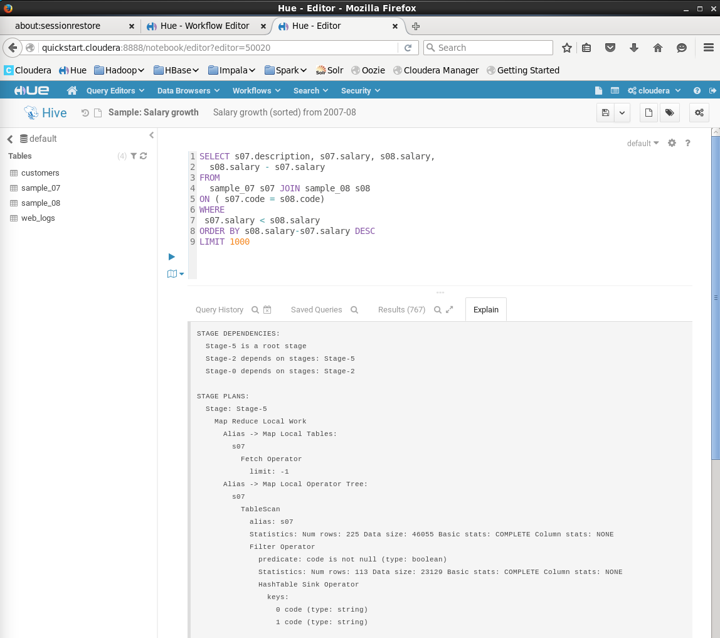

Slide 18
Review
All are true about Hive, except ____
It is SQL-like query
It uses H-SQL
It is used in conjunction with HBase
It is interactive
Which of the following data types was supported in Hive 0.11
Varchar
Binary
Float
Decimal
People who are mostly Analysts who know SQL, and who want to ask analytical questions will most likely use Hive over other methods
False
True
Some of the query optimization for Hive includes which of the following? All of these answers
Partitioning, bucketizing, or sampling
Using column-based statistics
Cost-base optimization
All of the above

