Slide 1

The Google File System (GFS) + HDFS
CS4230 – Distributed and Cloud Computing
Jay Urbain, PhD
"Google's Colossus Makes Search Real-Time by Dumping MapReduce", High Scalability (World Wide Web log), 2010-09-11.
Carr, David F (2006-07-06), "How Google Works.”
Ghemawat, S.; Gobioff, H.; Leung, S. T. (2003). "The Google file system". Proceedings of the nineteenth ACM Symposium on Operating Systems Principles - SOSP '03.

Slide 2
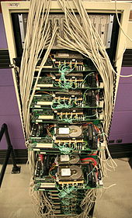
Introduction
Google’s search engine and related applications process a lot of data.
Google's first production server rack, circa 1998

Slide 3
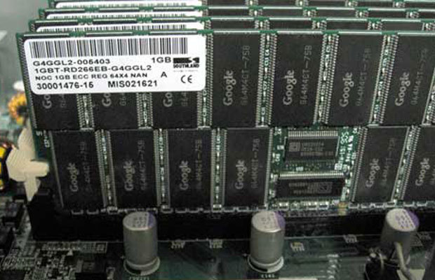
Motivating Facts
Google processes its data in computing clusters
Google makes their own servers – use commodity-class CPUs running customized versions of Linux.
Seek to maximize performance per dollar, not absolute performance.
How this is specifically measured is not public information – includes system running costs and power consumption
Novel switching power supply design to reduce costs and improve power efficiency.

Slide 4
Motivating Facts
Google processes 3.5 billion requests per day (2015)
Stores 10 exabytes of data (10 billion gigabytes!)
Multiples of bytes
SI decimal prefixes |  | Binary usage | IEC binary prefixes
Name (Symbol) | Value |  | Name (Symbol) | Value
kilobyte (kB) | 10³ | 2¹⁰ | kibibyte (KiB) | 2¹⁰
megabyte (MB) | 10⁶ | 2²⁰ | mebibyte (MiB) | 2²⁰
gigabyte (GB) | 10⁹ | 2³⁰ | gibibyte (GiB) | 2³⁰
terabyte (TB) | 10¹² | 2⁴⁰ | tebibyte (TiB) | 2⁴⁰
petabyte (PB) | 10¹⁵ | 2⁵⁰ | pebibyte (PiB) | 2⁵⁰
exabyte (EB) | 10¹⁸ | 2⁶⁰ | exbibyte (EiB) | 2⁶⁰
zettabyte (ZB) | 10²¹ | 2⁷⁰ | zebibyte (ZiB) | 2⁷⁰
yottabyte (YB) | 10²⁴ | 2⁸⁰ | yobibyte (YiB) | 2⁸⁰
See also: Multiples of bits · Orders of magnitude of data

Slide 5
Motivating Facts
Thousands of queries served per second.
One query can read 100's of MB of data.
One query can consume 10's of billions of CPU cycles.
Google stores dozens of copies of their Web index!
Reliability is achieved through software not individual hardware systems – they assume hardware failure.
Conclusion: Need large, distributed, highly fault tolerant file system.

Slide 6
Topic Outline
Design Motivations
Architecture
Read/Write/Record Append
Fault-Tolerance
Performance Results

Slide 7
Design Motivations
Fault-tolerance and auto-recovery needs to be built into the system.
Thousands of commodity components
Standard I/O assumptions (e.g. block size) have to be re-examined.
Files are huge – 100MB typical, multi-GB common.
Record appends are the prevalent form of writing.
Dominant access pattern is streaming read; append, overwrite of existing data supported, but not optimized.
Google applications and GFS should be co-designed.
Relax concurrency model to simplify file system.

Slide 8
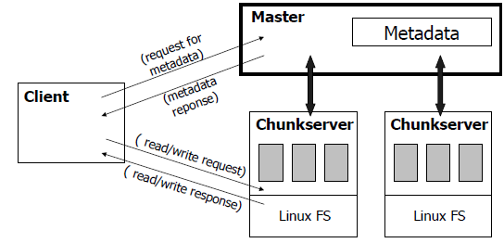
GFS Architecture
Files are divided into fixed-size “chunks”

Slide 9
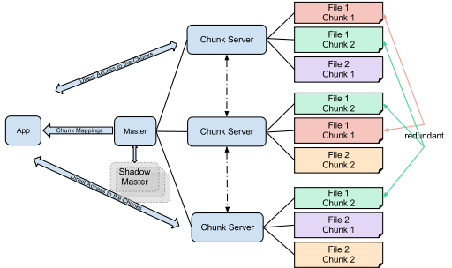
Chunks are stored redundantly across Chunk Servers

Slide 10
GFS Architecture
What is a chunk?
Analogous to a block, except larger.
Size: 64 MB! Note: 4K is typical block size.
Stored on chunkserver as a file.
Chunk handle (~ chunk file name) is used to reference a chunk.
Chunk replicated across multiple chunkservers
Note: There are hundreds of chunkservers in a GFS cluster distributed over multiple racks.

Slide 11
GFS Architecture
What is a master?
A single process running on a separate machine.
Stores all metadata:
File namespace
File to chunk mappings
Chunk location information
Access control information
Chunk version numbers
Etc.

Slide 12
GFS Architecture
Master <-> Chunkserver Communication:
Master and chunkserver communicate regularly (monitor) to obtain chunkserver state:
Ping/keep alive from chunkserver to master: Is chunkserver down?
Are there disk failures on chunkserver?
Are any replicas corrupted?
Which chunk replicas does chunkserver store?
Master sends instructions to chunkserver:
Delete existing chunk.
Create new chunk.

Slide 13
GFS Architecture
Serving Requests:
Client sends the master a request containing the file name and chunk index.
Client retrieves metadata for operation from master.
Read/Write data flows between client and chunkserver.
Single master is not bottleneck, because its involvement with read/write operations is minimized.

Slide 14
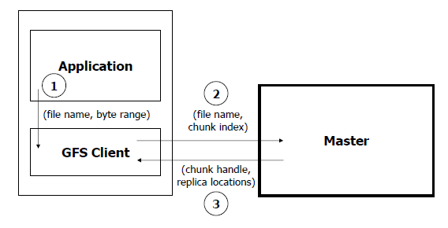
Read Algorithm - 1

Slide 15
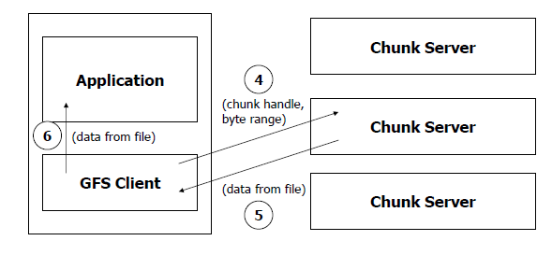
Read Algorithm - 2

Slide 16
Read Algorithm Steps
Application originates the read request.
GFS client translates the request from (filename, byte range) -> (filename, chunk index), and sends it to master.
Master responds with chunk handle and replica locations (i.e. chunkservers where the replicas are stored).
Client picks a location (usually the closest) and sends the (chunk handle, byte range) request to that location.
Chunkserver sends requested data to the client.
Client forwards the data to the application.

Slide 17
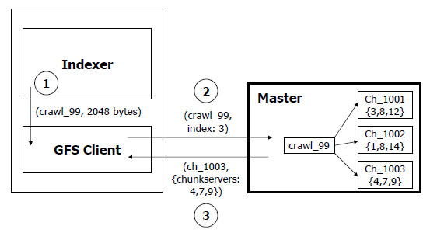
Read Algorithm – Example

Slide 18
Read Algorithm – Chunk Index
Calculating chunk index from byte range:
(Assumption: File position is 201,359,161 bytes)
Chunk size = 64 MB.
64 MB = 1024 *1024 * 64 bytes = 67,108,864 bytes.
201,359,161 bytes = 67,108,864 * 3 + 32,569 bytes.
Chunk index is 3.

Slide 19
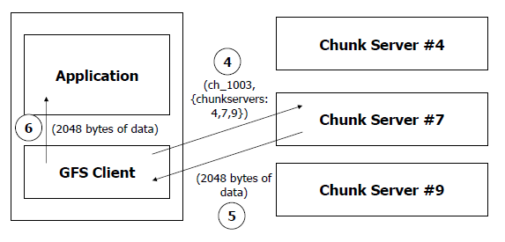
Read Algorithm – Chunk Index

Slide 20
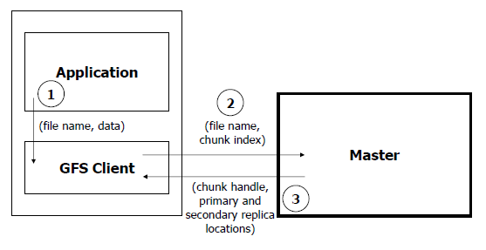
Write Algorithm - 1

Slide 21
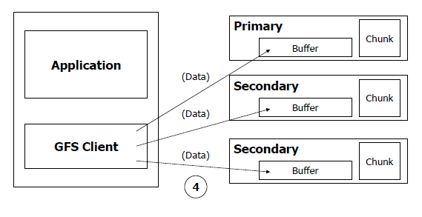
Write Algorithm - 2

Slide 22
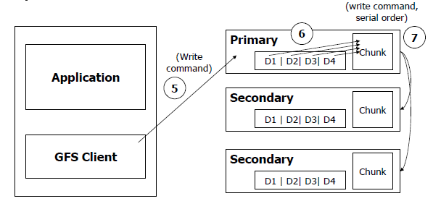
Write Algorithm - 3

Slide 23
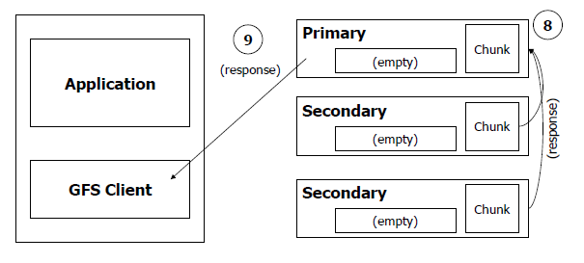
Write Algorithm - Steps

Slide 24
Write Algorithm Steps
Application originates write request.
GFS client translates request from (filename, data) -> (filename, chunk index), and sends it to master.
Master responds with chunk handle and (primary + secondary) replica locations.
Client pushes write data to all locations. Data is stored in chunkservers’ internal buffers.
Client sends write command to primary.

Slide 25
Write Algorithm Steps
Primary determines serial order for data instances stored in its buffer and writes the instances in that order to the chunk.
Primary sends serial order to the secondaries and tells them to perform the write.
Secondaries respond to the primary.
Primary responds back to client.
Note: If write fails at one of chunkservers, client is informed and retries the write.

Slide 26
Record Append Algorithm
Important operation at Google:
Merging results from multiple machines in one file.
Using file as producer-consumer queue.
Application originates record append request.
GFS client translates request and sends it to master.
Master responds with chunk handle and (primary + secondary) replica locations.
Client pushes write data to all locations.

Slide 27
Record Append Algorithm
Primary checks if record fits in specified chunk.
If record does not fit, then the primary:
pads the chunk,
tells secondaries to do the same, and informs the client.
Client then retries the append with the next chunk.
If record fits, then the primary:
appends the record,
tells secondaries to do the same,
receives responses from secondaries, and sends final response to the client.

Slide 28
Observations
Clients can read in parallel.
Clients can write in parallel.
Clients can append records in parallel.

Slide 29
Fault Tolerance
Fast Recovery:
master and chunkservers are designed to restart and restore state in a few seconds.
Chunk Replication:
across multiple machines, across multiple racks.
Master Mechanisms:
Log of all changes made to metadata.
Periodic checkpoints of the log.
Log and checkpoints replicated on multiple machines.
Master state is replicated on multiple machines.
“Shadow” masters for reading data if “real” master is down.
Data integrity:
Each chunk has an associated checksum.

Slide 30
Performance
When used with relatively small number of servers (15), the file system achieves reading performance comparable to that of a single disk (80–100 MB/s), but has a reduced write performance (30 MB/s), and is relatively slow (5 MB/s) in appending data to existing files.
The authors present no results on random seek time.
As the master node is not directly involved in data reading, the read rate increases significantly with the number of chunk servers, achieving 583 MB/s for 342 nodes.
Aggregating a large number of servers also allows big capacity, while it is somewhat reduced by storing data in three independent locations (to provide redundancy).

Slide 31
Hadoop File System (HDFS)
Java-based distributed file system that provides scalable and reliable data storage.
Modeled after GFS.
Open source.
Designed to span large clusters of commodity servers.
HDFS has demonstrated production scalability of up to 200 PB of storage and a single cluster of 4500 servers, supporting close to a billion files and blocks.
HDFS is a scalable, fault-tolerant, distributed storage system that works closely with a wide variety of concurrent data access applications, coordinated by YARN.

Slide 32
How HDFS Works
An HDFS cluster is comprised of a NameNode, which manages the cluster metadata, and DataNodes that store the data.
Files and directories are represented on the NameNode by inodes.
Inodes record attributes like permissions, modification and access times, or namespace and disk space quotas.

Slide 33
How HDFS Works
The file content is split into large blocks (128 Mbytes).
Each block of the file is independently replicated at multiple DataNodes.
The blocks are stored on the local file system on the DataNodes.
The Namenode actively monitors the number of replicas of a block.
When a replica of a block is lost due to a DataNode failure or disk failure, the NameNode creates another replica of the block.

Slide 34
How HDFS Works
The NameNode maintains the namespace tree and the mapping of blocks to DataNodes, holding the entire namespace image in RAM.
The NameNode does not directly send requests to DataNodes. It sends instructions to the DataNodes by replying to heartbeats sent by those DataNodes.
The instructions include commands to:
replicate blocks to other nodes,
remove local block replicas,
re-register and send an immediate block report, or
shut down the node.

Slide 35


