Slide 1
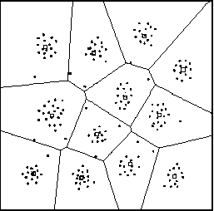
Introduction to Data Clustering
Jay Urbain
Illinois Institute of Technology

Slide 2
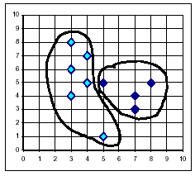
Introduction to Clustering
Objective:
Provide a brief introduction to basic clustering techniques for data mining, and review the results of an algorithm that integrates multiple data types on a demographic data set.

Slide 3
Data Mining
Data Mining
The process of using algorithms to find useful information in data.
Dealing with a geometric increase in information.
Applications:
  Fraud Detection
  Retail Sales
  Stock Market Analysis
  Genetic Research
  Medical
  Web Mining

Slide 4
Data Mining Process
Data Mining – The Basic Process
Preprocessing (most of the work!)
  Data Cleaning
  Data Integration
  Data Normalization
  Data Reduction
Apply Mining Algorithms
  Supervised Learning Algorithms
  Unsupervised Learning Algorithms
Visualization and Analysis of results

Slide 5
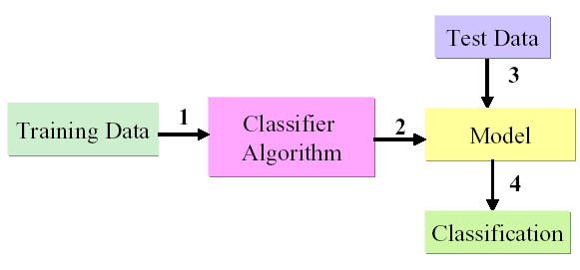
Supervised Learning
Supervised Learning
Learn by example from training data with a class label
Create model by running algorithm on training data
Identify a class label for the incoming new data

Slide 6
Supervised Learning Algorithms
Supervised Learning Algorithms
  Naive Bayes
  Neural Networks
  Decision Trees
  Genetic Algorithms, Fuzzy Sets

Slide 7
Unsupervised Learning Algorithms
There are many machine learning situations in which class labels are not available, so unsupervised methods are needed.
Unsupervised Learning Algorithms
  Association Rules - Apriori
  Clustering

Slide 8
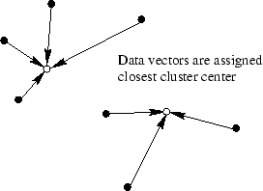
Clustering, a Widespread Approach to
Unsupervised Learning
Clustering is a widespread technique that clusters training data into groups that reflect distinct regions of the decision space.

Slide 9
The First Clustering Application?
During a cholera outbreak in London in 1854, John Snow used a special map to plot the cases of the disease that were reported.
A key observation, after the creation of the map, was the close association between the density of disease cases and a single well located at a central street.
After this, the well pump was removed putting an end to the epidemic.[4,5]

Slide 10
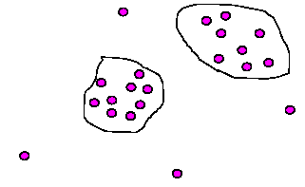
Clustering Applications
Applications:
Market Research
Web logs
Public health
Genomics
Pattern recognition
Spatial data analysis for GIS
Insurance and fraud detection
Preprocessing step for other applications
Stand alone tool for knowledge discovery

Slide 11
High Quality Clusters
Good Clusters:
  High intra-class similarity
  Low inter-class similarity
Dependent on method used, data/domain, and implementation.
Quality measured by its ability to discover some or all of the hidden patterns.

Slide 12
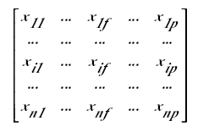
Data Structures
Usually represented as a data matrix:
Array of data vectors
Disimilarity matrix

Slide 13
Data Types
Variables:
  Interval-scaled (numerical or continuous)
  Binary
  Nominal (categorical), Ordinal (rank order), and Ratio (like interval with meaningful ratios)
  Mixed types

Slide 14
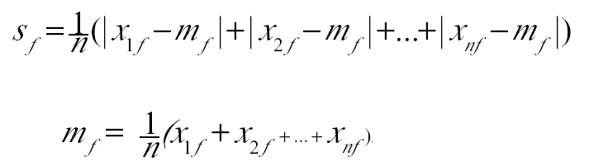
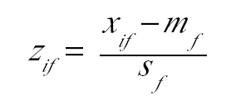
Interval-scaled Data
Normalize Data:
  Mean absoute deviation:
  Calculate standardized measurement (Z-Score):

Slide 15
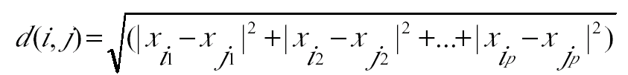
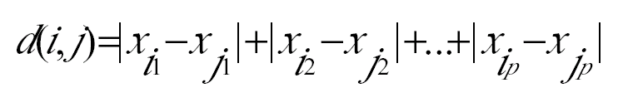
Interval-scaled Data
Measure dissimilarity between data objects:
  Eucledian:
  Manhattan:

Slide 16
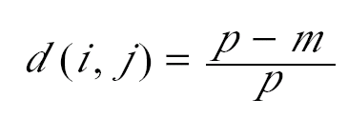
Nominal (Categorical) Data
Generalization of binary data that can have more than two states, e.g., color (red, white, blue), job classification.
  Typically use some form of simple matching:
  where m is the number of matches, p it total number of variables.

Slide 17
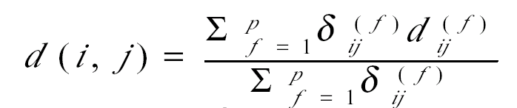

Mixed Data Types
Most databases contain multiple types of data:
Symmetric and asymmetric binary, nominal, interval, and ratio.
Use weighted formula to combine their effects:
  f is binary or nominal: d_{ij}(f) = 0 on match, 0 otherwise.
  f is interval: use normalized distance
  f is ratio ordinal or ratio-scaled:
    compute ranks r_{if} and
    treat z_{if} as interval-scaled
  where m is the number of matches, p it total number of variables.

Slide 18
Sample Clustering Techniques
Clustering Algorithms:
  One-pass
  Hierarchical
  Buckshot
  K-Means

Slide 19
K-Means Clustering
K-Means algorithm for partitioning based on the mean* value of the objects in the cluster
Input: Number of clusters, k, and DB of n objects.
Randomly choose k objects as initial cluster centroids
Repeat
  (re)assign each object to the cluster for which the object is most similar (close) based on mean value of objects in the cluster
  Update cluster means
until (# iterations, no change, or minimum distance)
*Use mode for nominal values

Slide 20
Experimental Data
UCI* adult demographic (16,000+ records):
@RELATION adult
@ATTRIBUTE age REAL
@ATTRIBUTE workclass {Local-gov,Private,Self-emp-not-inc,Federal-gov,...}
@ATTRIBUTE fnlwgt REAL
@ATTRIBUTE education {11th,HS-grad,Assoc-acdm,Some-college,10th,Prof-school,7th-8th,Bachelors,Masters,Doctorate,5th-6th,Assoc-voc,9th,12th,1st-4th,Preschool}
@ATTRIBUTE education-num REAL
@ATTRIBUTE marital-status {Never-married,Married-civ-spouse,Widowed,Divorced,Separated,Married-spouse-absent,Married-AF-spouse}
@ATTRIBUTE occupation {Machine-op-inspct,Farming-fishing,Protective-serv,...}
@ATTRIBUTE relationship {Own-child,Husband,Not-in-family,Unmarried,Wife,Other-relative}
@ATTRIBUTE race {Black,White,Asian-Pac-Islander,Other,Amer-Indian-Eskimo}
@ATTRIBUTE sex {Male,Female}
@ATTRIBUTE capital-gain REAL
@ATTRIBUTE capital-loss REAL
@ATTRIBUTE hours-per-week REAL
@ATTRIBUTE native-country {United-States, ...}
@ATTRIBUTE income {<=50K.,>50K.}

Slide 21
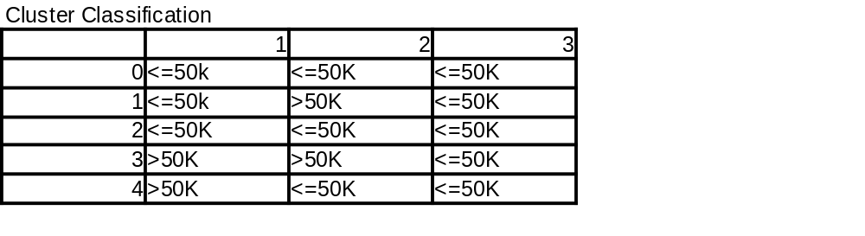
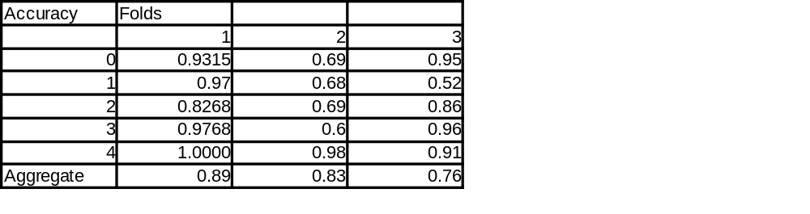
Results: k=5, n=10

Slide 22
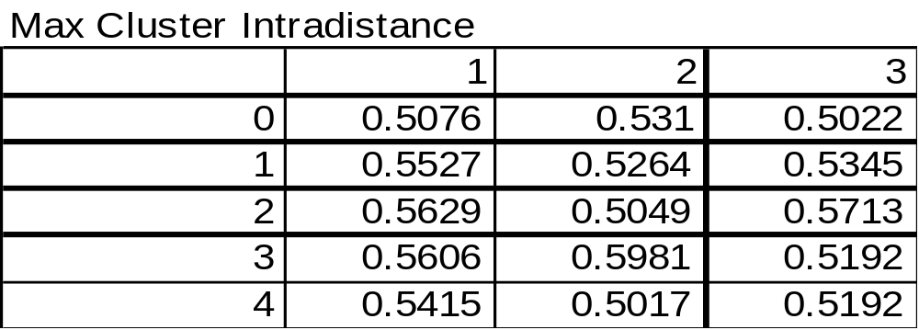
Results: k=5, n=10

Slide 23
Discussion
General Observations:
Results in finding classes of clusters identifed by income were good.
Performance did not increase significantly above ~10 iterations.
Contrary to expectations, short distance vectors within clusters did not seem correlated with accuracy.
Clusters with high entropy, i.e., low class similarity had the lowest accuracy for the income classification.
Number of experimental clusters need to exceed the number of potential classes.

Slide 24
Discussion
Ideas for improvement:
Add iterative optimization procedure to adjust attribute weights such that cluster entropy is reduced.
Consider optimization procedure for selecting initial cluster seed vectors, or use “domain” knowledge to pick seeds that might be useful.
Discard poor performing clusters, and reassign vectors to other clusters. This may/may not decrease performance of existing clusters and may eliminate outliers of interest.
Add ordinal data types.

Slide 25
Resources
1) Jiawei Han, Micheline Kamber. Data Mining, Concepts and Techniques, MK, 2001.
2) Zhexue Huang, Clustering Large Data Sets with Mixed Numeric and Categorical Values
3) Zhexue Huang, A Fast Clustering Algorithm to Cluster Very Large Categorical Data Sets in
4) E.W. Gilbert. Pioneer Maps of Health and Disease in England. Geographical Journal, 124: 172–183, 1958.
5) Periklis Andritsos. Data Clustering Techniques, March 11, 2002
6) Data Mining. Nazli Goharian. Computer Science 422 Data Mining, Illinois Institute of Technology.
UCI Machine Learning Repository Content
http://www.ics.uci.edu/~mlearn/MLSummary.html
The Auton Lab, CMU's School of Computer Science, researches new Statistical Data Mining.
http://www.autonlab.org/autonweb/index.jsp
Glossary of Terms: Issue on Machine Learning and the Knowledge Discovery Process
http://robotics.stanford.edu/~ronnyk/glossary.html
Mathematical Definitions: http://mathworld.wolfram.com

